Slide 1
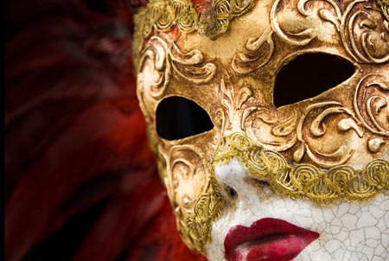
El Carnaval
Carnival

Slide 2
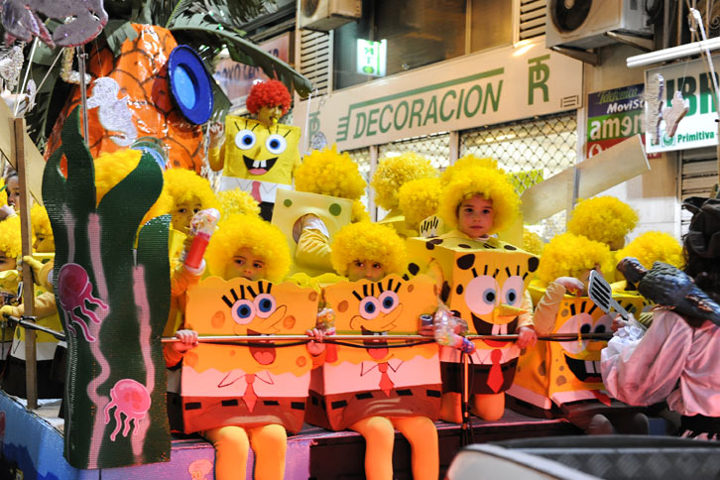
Hundreds of years ago, the followers of the Catholic religion in Italy started the tradition of holding a wild costume festival right before the first day of Lent. Because Catholics are not supposed to eat meat during Lent, they called their festival, carnevale — which means “to put away the meat.” As time passed, carnivals in Italy became quite famous and spread to France, Spain, and many Catholic countries in Europe and America.

Slide 3
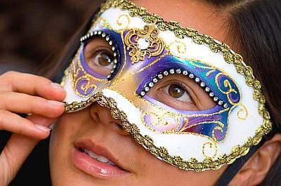
Una máscara
A mask

Slide 4
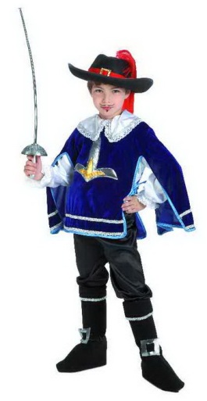
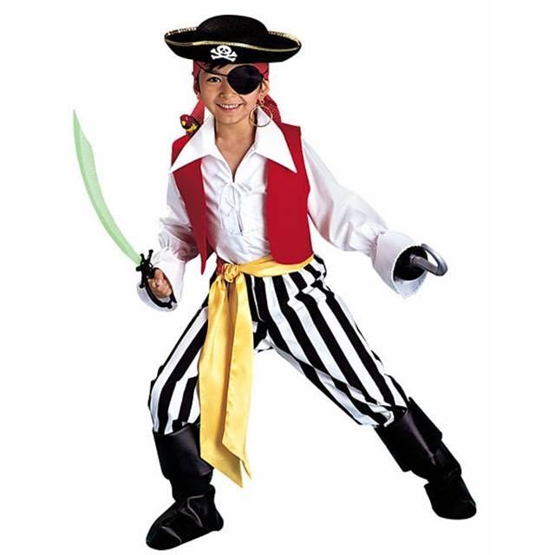
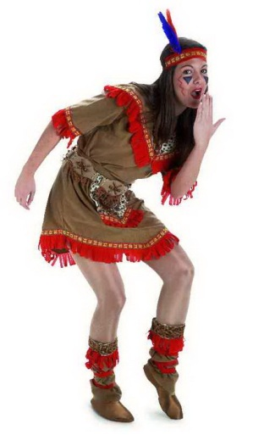
El disfraz
The costume
El disfraz de india
El disfraz de mosquetero
El disfraz de pirata

Slide 5
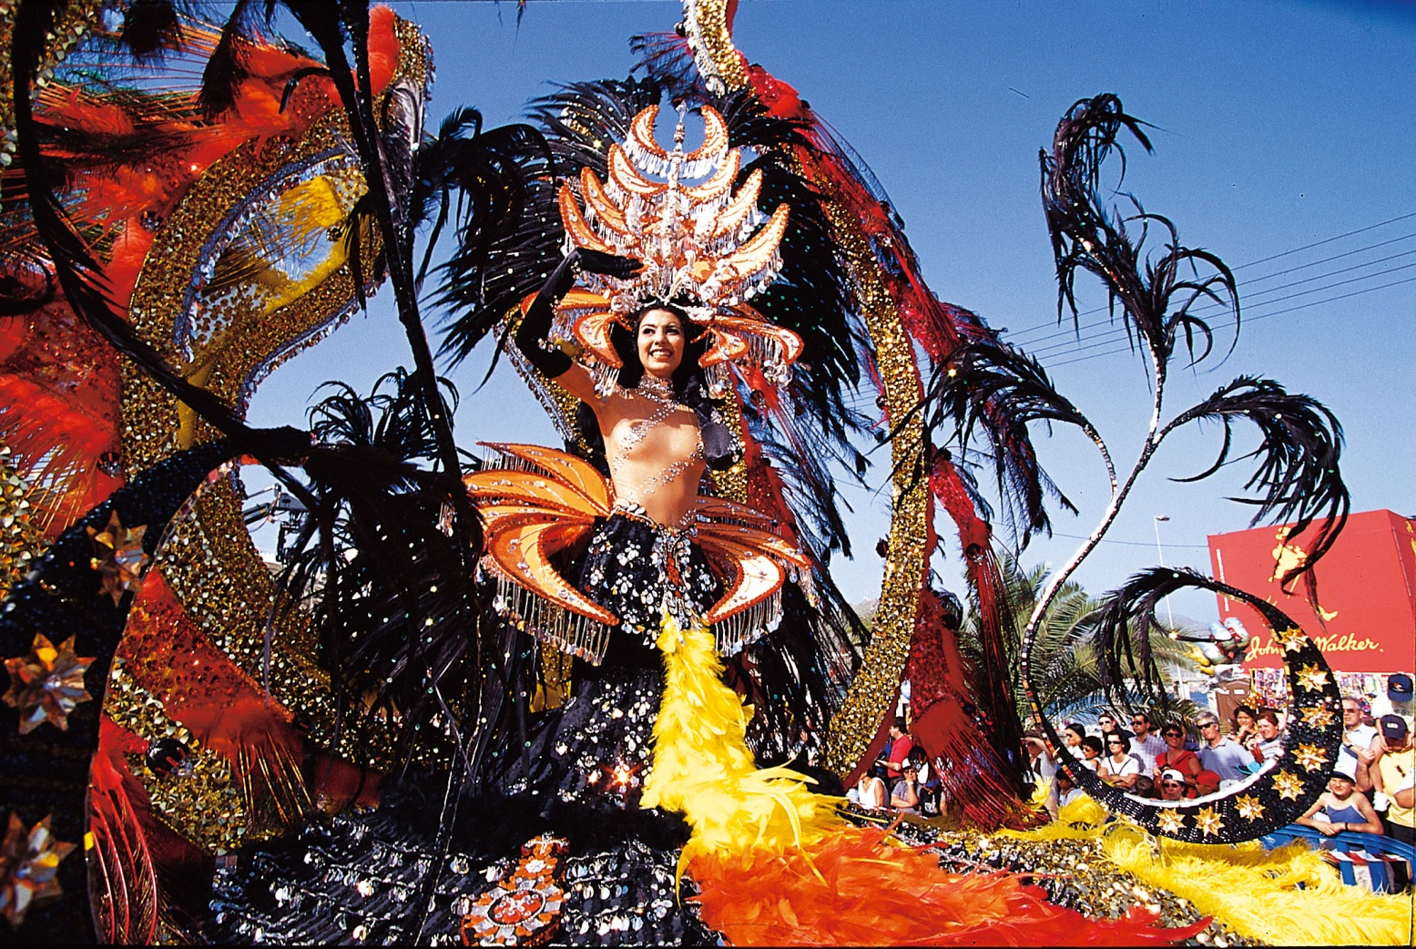
La reina del carnaval
Carnival Queen

Slide 6
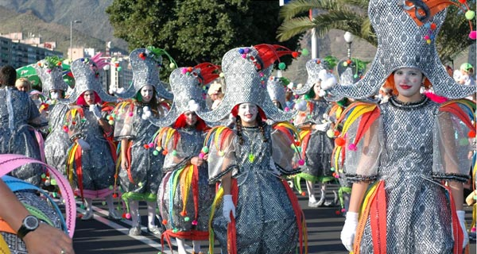
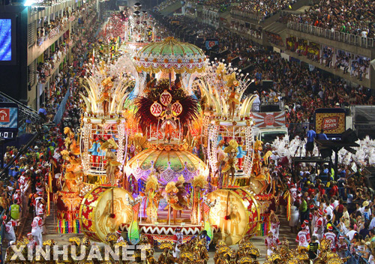
La cabalgata de carnaval
Carnival parade

Slide 7
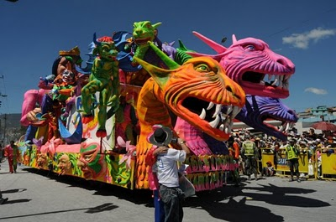
Una carroza de carnaval
A carnival float

Slide 8
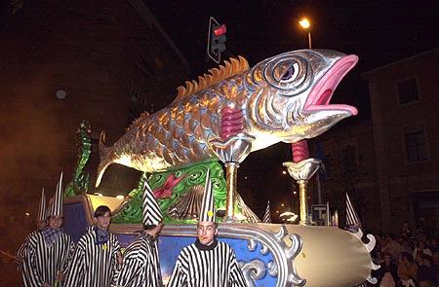
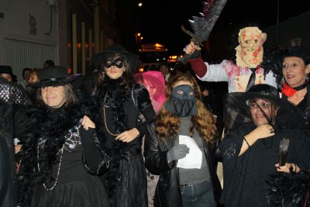
El entierro de la sardina
The burial of the sardine
It marks the end of carnival and the beginning of Lent

Slide 9
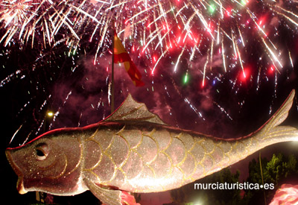
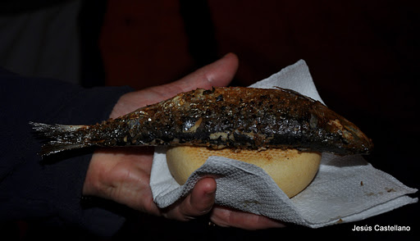
Los fuegos artificiales
Fireworks
Grilled sardines

