Slide 1
American Gothic Unit
Traditional and Southern Gothic Literature styles

Slide 2
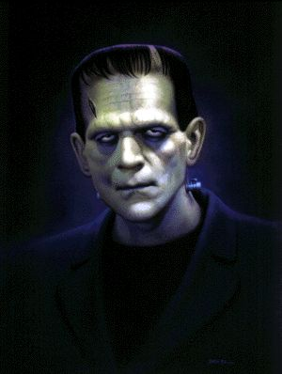
Traditional Gothic Characteristics:

Slide 3
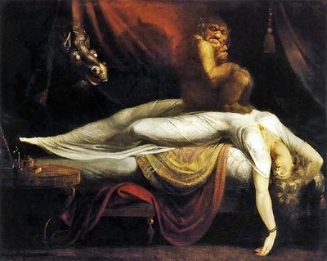
The Nightmare
Wild-eyed horse.
Bad Dreams.
The Nightmare - Henry Fuseli
The painting depicts a female figure lying sprawled across a divan, on her chest sits an incubus, a male demon, while in the background a wild-eyed horse may be seen.
Both creatures are artistically symbolic of the nightmare ('mare' is an Old English word for demon).
Gothic inspired painting.

Slide 4
Gargoyle, Notre Dame
Here is a typical gothic scene: Graveyard, high arched windows and a sense of gloom.
Gothic literature of the time was inspired by Gothic Architecture

Slide 5

The Gothic novel "catered to the perverted taste for excitement among degenerate" and vulgar readers.
The Gothic style originated in Europe centuries before it came to America.
Gothic style refers to more than cathedral structures. The label applies to art, sculpture, glass works, decorative pieces and illuminated manuscripts from the mid 12th through the early 16th century.

Slide 6
Characteristics of Gothic architecture include:
* The pointed arch and vault
* The flying buttress (support)
* Stained glass windows
A gargoyle is a full-relief stone carving with an actual pipe running through it, so that rainwater will flow through it and out of a water-spout in its mouth.
Notes:
The use of gargoyles and grotesques fitted into the nooks and crannies unoccupied by images of saints and biblical figures.
A grotesque refers to a stone carving of a monstrous or mythical creature either in two dimensions or full-relief, but which does not contain a pipe for transferring rainwater.

Slide 7
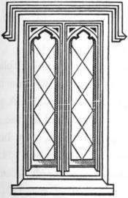
Windows with diamond panes were popular.
One or two bay windows were often used on the main floor, either on the front or side.

Slide 8
Notre Dame
Brooklyn Bridge
Examples of the high Gothic Arch
Inside Notre Dame

Slide 9
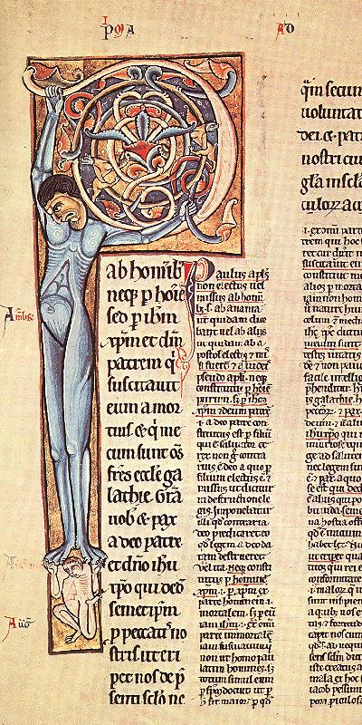
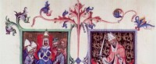
Qualities of the Gothic manuscripts:
Strange monsters and fantastical creatures depicted in the margins of the page.
Elaborate vine-work or leaf-work painted along the borders.
Decorative
boarders

Slide 10
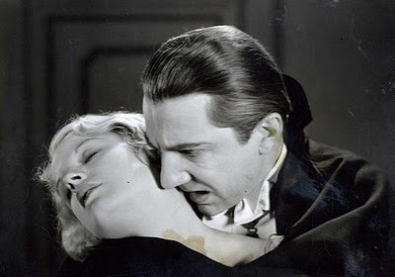
Common Gothic Motifs:
Murder
suicide
torture
vampires
lycanthropy (werewolves)
madness
ghosts
doubles and doppelgangers
poltergeists
Notes:
Also included in many gothic stories: demons, demonic pacts diabolic possession/exorcism, witchcraft, and voodoo. Tell students this info if they are mature enough to handle it. ☺
.

Slide 11
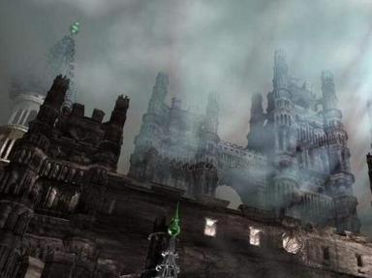
GOTHIC LITERATURE INCLUDES:
Gloomy and disturbing.
Enlightenment
Gothic poetry, short stories, or novels that were designed to thrill readers by providing mystery and blood-curdling accounts of villainy, murder, and the supernatural.
The term has come to be used much more loosely to refer to gloomy or frightening literature. Many scholars believe the rise of the Gothic was a response to the prevailing mode of rational thought and reason.
Eighteenth century thought was dominated by an intellectual movement called the enlightenment by later historians. Enlightenment philosophers and writers valued reason and human understanding above emotions and feelings.
.

Slide 12
The rise of experimental science during this period offered an empirical model for how one could arrive at truth.
Notes:
The Movie The Nightmare Before Christmas provides a great example of this idea.

Slide 13
.
Common Motifs of Gothic Literature
Wild and desolate landscapes
Ancient buildings such as ruined monasteries
Gothic stories have an atmosphere of brooding gloom
cathedrals; castles with dungeons, torture chambers, secret doors, and winding stairways
apparitions, phantoms, demons, and necromancers
scientific tone (fantastic events observed empirically)
Figures with supernatural powers
Youthful, handsome heroes and heroines who face off against corrupt aristocrats, wicked witches, and hideous monsters

Slide 14
Motifs continued
Ancestral curses
remote or exotic locales
dimly lit, gloomy settings
Damsels in distress
crumbling mansions (later cities and houses)
crypts, tombs
dream states or nightmares dream states or nightmares
found manuscripts or artifacts
family secrets
use of traditionally "magical" numbers such as 3, 7, 13
unnatural acts of nature (blood-red moon, sudden fierce wind, etc.)
Specific reference to noon, midnight, twilight (the witching hours)

Slide 15
Gothic Novels
Designed to thrill readers.
Show the dark side of human nature.
A type of romance wildly popular between 1760 up until the 1820s that has influenced the ghost story and horror story of today
They provide mystery and blood-curdling accounts of villainy, murder, and the supernatural.
Although Gothic novels were written mainly to evoke terror in their readers, they also served to show the dark side of human nature.
They describe the "nightmarish terrors that lie beneath the controlled and ordered surface of the conscious mind.”
They show humans in extreme situations and how they react to those situations. Normally humans are kind and generous but under extreme situations, their dark, evil side emerges.

Slide 16
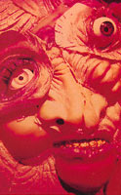
The Gothic movement peaked during the Romantic period with such authors as Mary Shelley, Anne Radcliffe, and Nathaniel Hawthorne.
Dracula
However, it survived well into the nineteenth century (as with Edgar Allan Poe).
And, in spite of some transformations, it survived into the twentieth century with Southern Gothic literature.
Frankenstien

Slide 17
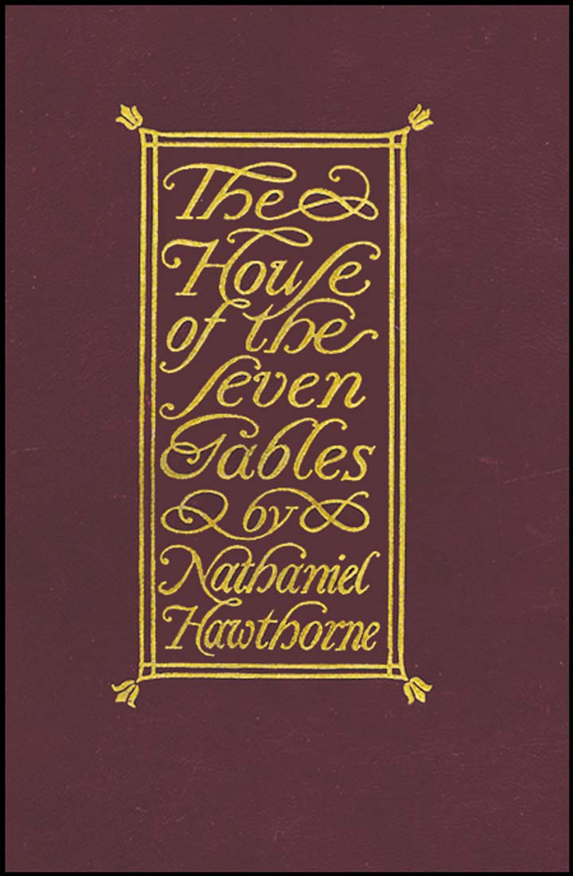
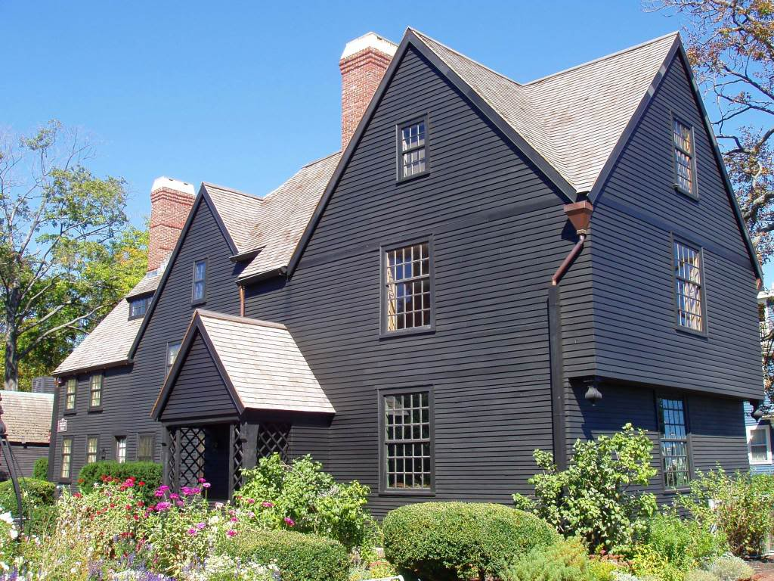
Traditional Gothic Authors

Slide 18
Edgar Allan Poe
Best known for his poems and short fiction, Edgar Allan Poe, born in Boston, Jan. 19, 1809, died Oct. 7, 1849 in Baltimore
Murders in the Rue Morgue
He virtually created the detective story and perfected the psychological thriller.
He deserves more credit than any other writer for the transformation of the short story from anecdote to art.

Slide 19

Poe’s works include:
The Black Cat
Tell Tale Heart
The Raven (poem)
The Pit and the Pendulum
The Bells (poem)
Annabel Lee (poem)

Slide 20
Nathaniel Hawthorne
He was born on July 4, 1804 in Salem, Massachusetts, the descendent of a long line of Puritan ancestors, including John Hathorne, a presiding magistrate in the Salem witch trials.
Gothic Stories
He wrote numerous short stories such as “Young Goodman Brown,” “Rappiccini’s Daughter,”
“Dr. Heidigger’s Experiment,” and
“The Minister’s Black Veil.”

Slide 21
Washington Irving
'The Legend of Sleepy Hollow”
He is best known for “The Legend of Sleepy Hollow,” a Gothic story in which the schoolmaster Ichabold Crane meets with a headless horseman, and 'Rip Van Winkle,' about a man who falls asleep for 20 years.
Irving has been called the father of the American short story.
Notes:
Washington Irving was born in New York City as the youngest of 11 children. His father was a wealthy merchant, and his mother, an English woman, was the granddaughter of a clergyman.
According to a story, George Washington met Irving, named after him, and gave his blessing.
In the years to come Irving would write one of his greatest works, THE LIFE OF GEORGE WASHINGTON.

Slide 22
H(erbert) G(eorge)Wells
English novelist, journalist, sociologist, and historian, whose science fiction stories have been filmed many times.
Wells wrote over a hundred books, about fifty of them novels.
Wells's best known works are THE TIME MACHINE (1895), one of the first modern science fiction stories, THE INVISIBLE MAN (1897), THE MAGIC SHOP and THE WAR OF THE WORLDS (1898).

Slide 23
Stephen King
He is a modern day, prolific American author best known for his horror novels.
King's stories often involve an unremarkable character - middle-class families, children, and often writers - being submerged into increasingly horrifying circumstances.
A clown called It.
King has written numerous works inspired by the Gothic literary movement. He’s written about vampires, zombies, and supernatural creatures.

Slide 24
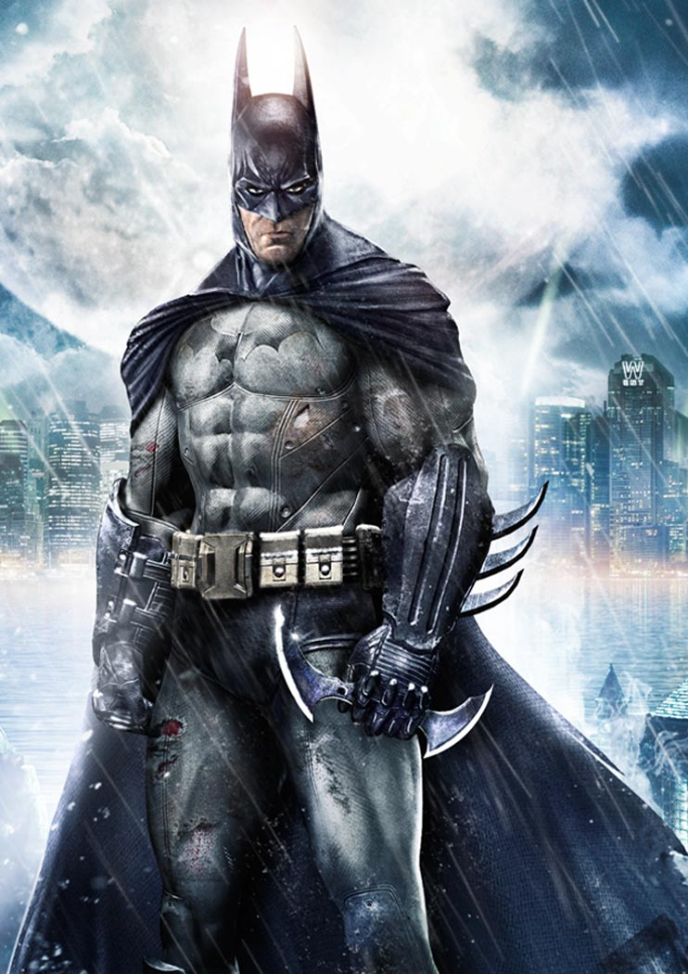

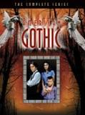
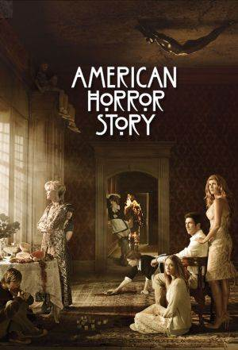
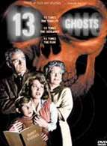
Modern Movies, TV and Books influenced by Gothic tradition.

Slide 25
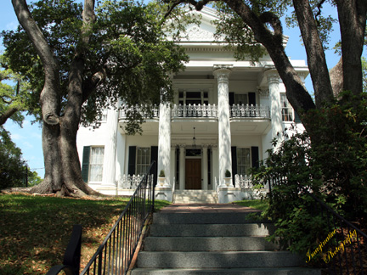
Southern Gothic
&
Modern Gothic

Slide 26
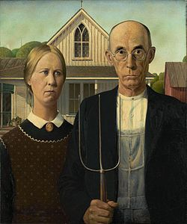
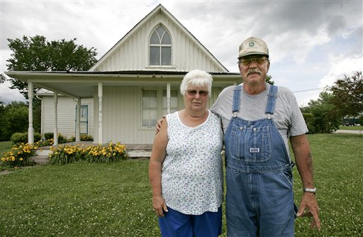
American Gothic
Take a look at the real house that inspired Grant Wood to paint his Gothic and iconic work of art. Take a look at the gothic arch of the window and the pinched anxious expressions of the two people in the painting.

Slide 27
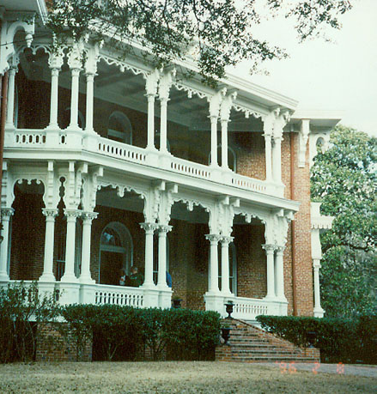
Southern Gothic Literary Style
Small Town Horrors
Grotesque Characters
“A lurid or macabre writing style native to the American South.”
This style provides insight into the horrors in societies and “small town” social conventions. A good example would be “A Rose for Emily” by Faulkner.
Stories are set in Civil War-era mansions and contain characters who are physically or mentally grotesque.
Some gothic authors are: William Faulkner, Flannery O’Connor, Tennessee Williams

Slide 28
Southern Gothic
Racial Tension
Local Color
Centered on a moldering Ante Bellum mansion and featuring the lingering effects of slavery, the Civil War, or racism, actual or suggested incest or insanity.
These stories often contained an elderly Afro-American woman or man who is the embodiment of long-suffering goodness and wisdom.
The also included local color writing, vernacular, and a deep sense of the grotesque.
Many Southern Gothic stories contain magic realism, which thrives on the bizarre, mingling realism and fantasy.

Slide 29
Grotesque
Exaggerated characters
In most southern gothic stories, there is a pivotal character or someone close to them who is set apart from the world by a disability or odd way of seeing the world.
You won't meet very many "normal" characters in the writings of William Faulkner, Flannery O'Connor, Truman Capote or Carson McCullers—and this is by design.
Freakishness

Slide 30

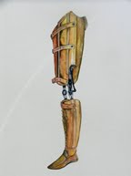
The Outsider
This fascination with the outsider is in many ways used to show readers not only the individuality of the southern culture, but also to connect each reader to their own unique "freakish" nature.

Slide 31
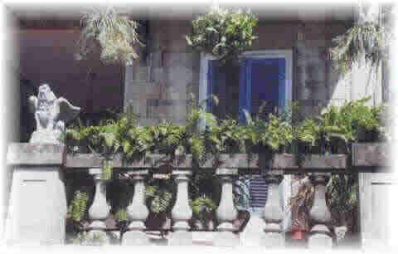
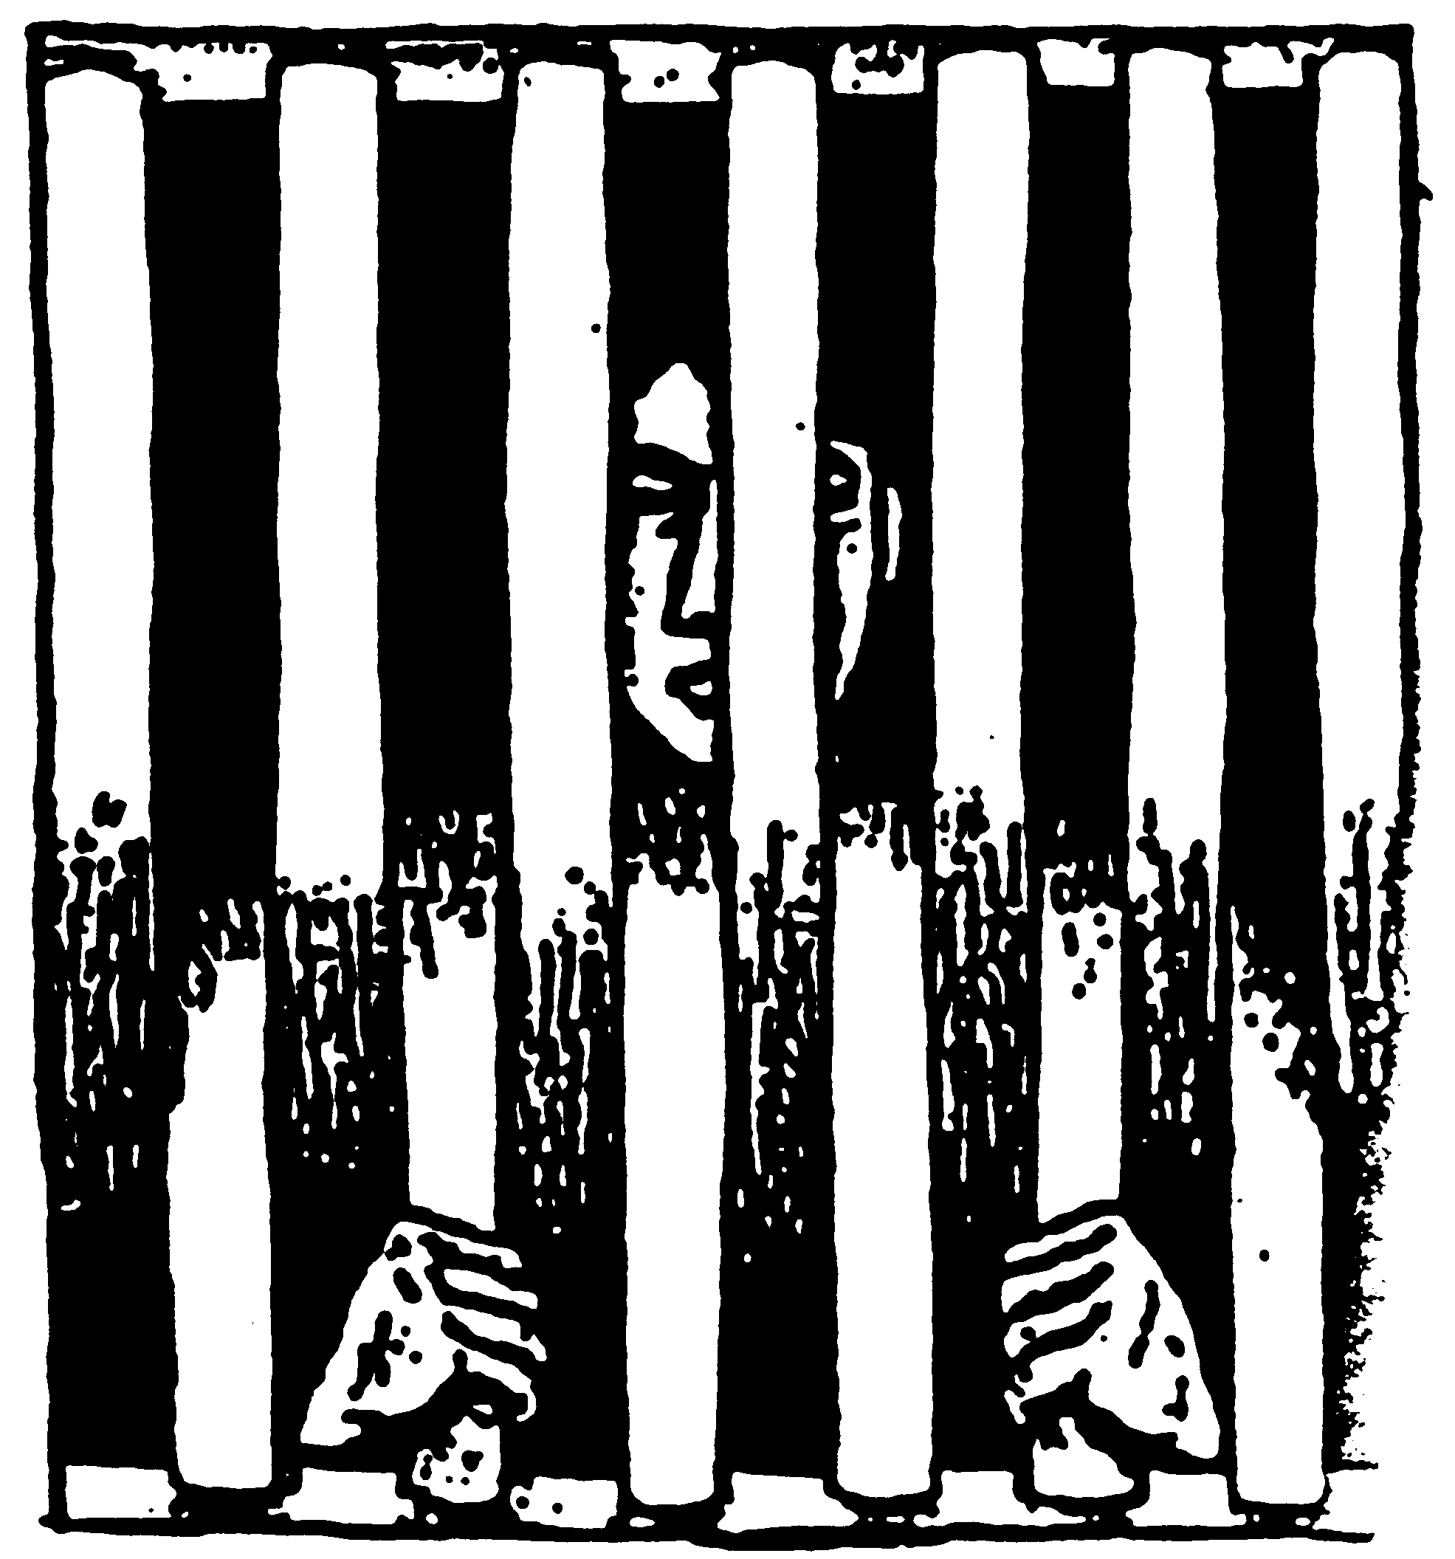
Imprisonment
The idea of being locked up is often both literal and figurative in Southern Gothic works.
While many southern gothic tales include an incident where a character is sent to jail or locked up, there are also several gothic characters that live in fate's prison without hope of parole.

Slide 32
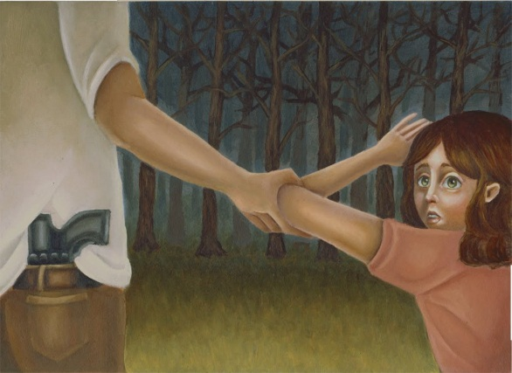
Violence
Southern gothic writers covered a period in the South's history when violence was particularly prevalent.
After the bloodshed of the Civil War, and the period of reconstruction that followed, racial tension and fear ran high in many small southern towns.
This plays its part in many of the stories of this genre.

Slide 33
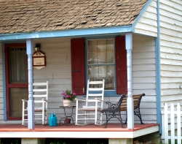
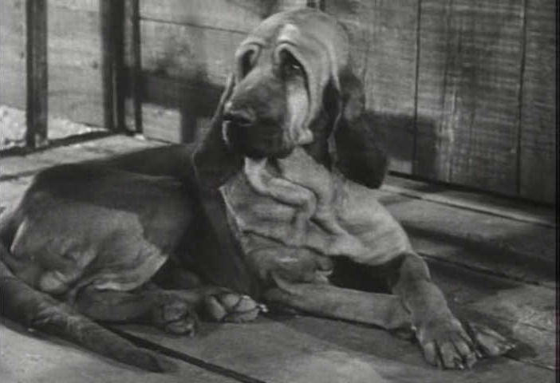
Sense of Place
It wouldn't be southern gothic if you didn't feel like you'd been thrust in the center of a dusty, peach-scented, lonely downtown where porch-bound widows rock gently on creaky rockers, rusty pick-up trucks drive by filled with grimy farmhands, the general store is run by the town drunk, and flies and mosquitoes circle glasses of ice-filled lemonade.
The sense of place is strong—awash in calm, heat, lost dreams and wayward souls.

Slide 34
Southern Gothic Authors

Slide 35
William Faulkner
He came from an old southern family, grew up in Oxford, Mississippi.
The Southern Gothic novel Sanctuary (1931) is about the degeneration of Temple Drake, a young girl from a distinguished southern family.
The Sound and the Fury (1929), the downfall of the Compson family seen through the minds of several characters.

Slide 36
Flannery O’Connor
Although she produced relatively few works in her short lifetime of 39 years, Mary Flannery O'Connor is considered one of the most important short story writers of the twentieth century because of her strange but interesting characters, her violent plot elements, and her religious world view.
She wrote Southern Gothic stories such as “A Good Man is Hard To Find.”
Even though her stories were grim, She sought, however, to present a message of God's grace and presence in everyday life.
O'Connor was born in Savannah, Georgia on March 25, 1925.

Slide 37
Shirley Jackson
Her atmospheric stories explore themes of psychological turmoil, isolation, and the inequity of fate.
Shirley Jackson is the author of the classic short story, "The Lottery," a dark, unforgettable tale of the unthinking and murderous customs of a small New England town.
She was born in San Francisco, California.
She is also the author of several American Gothic novels, such as We Have Always Lived in the Castle and The Haunting of Hill House.

Slide 38
Charlotte Perkins Gilman
American writer, economist, and lecturer, an early theorist of the feminist movement, who wrote over two hundred short stories and some ten novels.
The Yellow Wallpaper
Her famous gothic story, “The Yellow Wallpaper” (1892), depicted a depressed woman who slowly descends into madness in her room while her well-meaning husband is often away due to his work at a hospital.
Notes:
Gilman refused to call herself a "feminist" - her goal as a humanist was to campaign for the cause of women's suffrage.
Gilman saw that the domestic environment has become an institution which oppresses women.

Slide 39
Wrote the Southern Gothic poem: By the Edge of the Swamp
He wrote a wide variety of works, including poetry, plays, histories of the South, novelettes, biographies, magazine essays, medleys, and literary criticism.
Simms chose a range of settings for his romances, including colonial America, revolutionary America, and the American frontier.
William Gilmore Simms

Slide 40
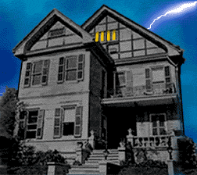
The End

Slide 41
Works Cited
http://www.oprah.com/oprahsbookclub/Southern-Gothic-Distinguising-Features/3
www.dunkirkcsd.org/1138207210582570/lib/.../southern_gothic.doc
http://www.nobelprize.org/nobel_prizes/literature/laureates/1949/faulkner-bio.html

