Slide 1
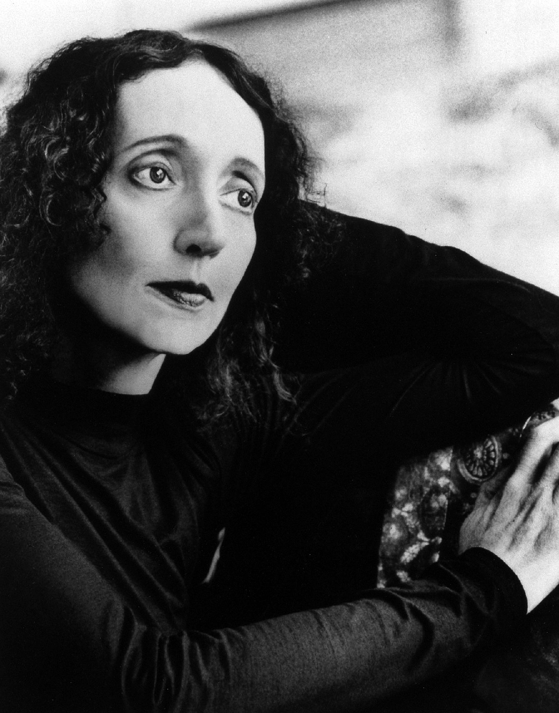
Joyce Carol oates
The Modern Gothic

Slide 2
Joyce Carol Oates: 1938-
Oates writes in the genre of the MODERN GOTHIC: same take on the gothic style of dreary, decayed atmosphere, supernatural…but takes place in the modern day.
Oates explores the inner workings of the human mind. Includes characters who are disturbed or who are looking for their identity. She writes about ordinary people whose lives are upset by some force beyond their control…shows how people are powerless to save their identities from shadowy, perhaps supernatural forces.

Slide 3
Style
Oates explores the inner workings of the human mind.
Includes characters who are disturbed or who are looking for their identity.
She writes about ordinary people whose lives are upset by some force beyond their control…shows how people are powerless to save their identities from shadowy, perhaps supernatural forces.

