Slide 1

Act Tips
Dr. Schmidt
Culleoka High School

Slide 2
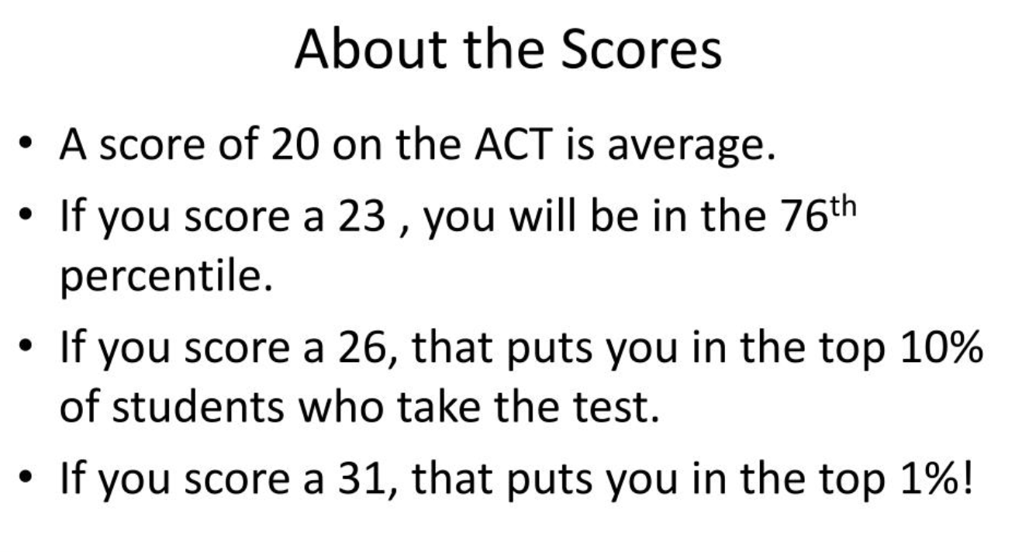

Slide 3
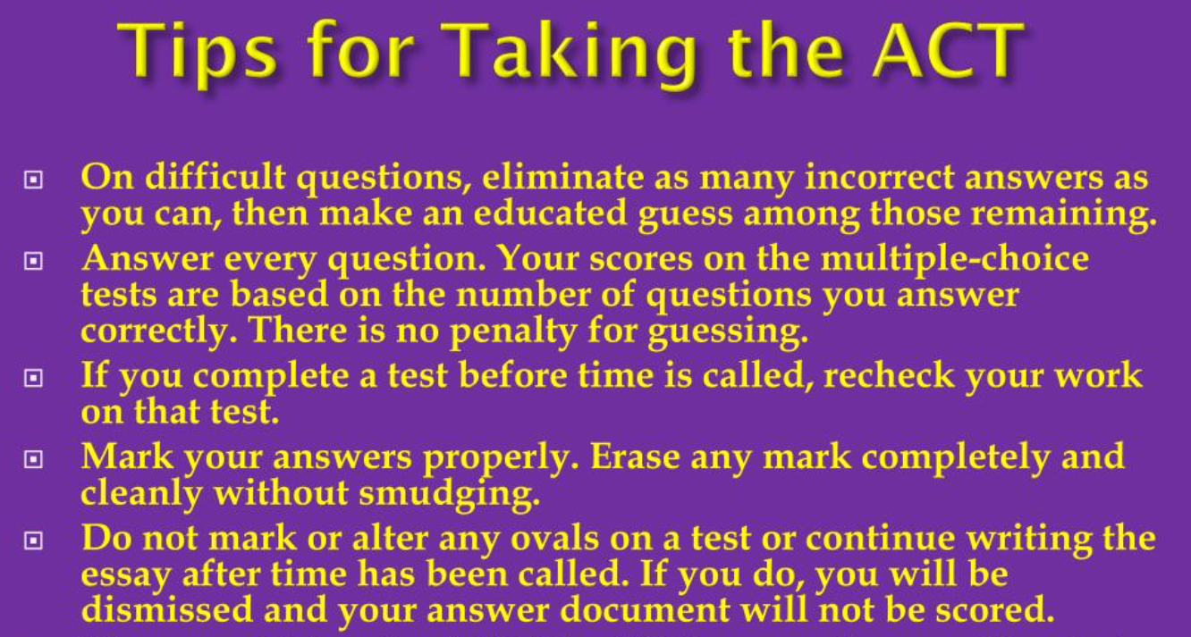

Slide 4
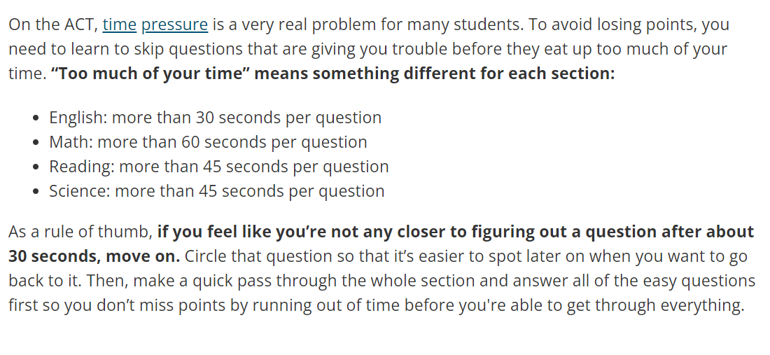
Skip Hard Questions (but return and answer before time even if it is a guess)

Slide 5
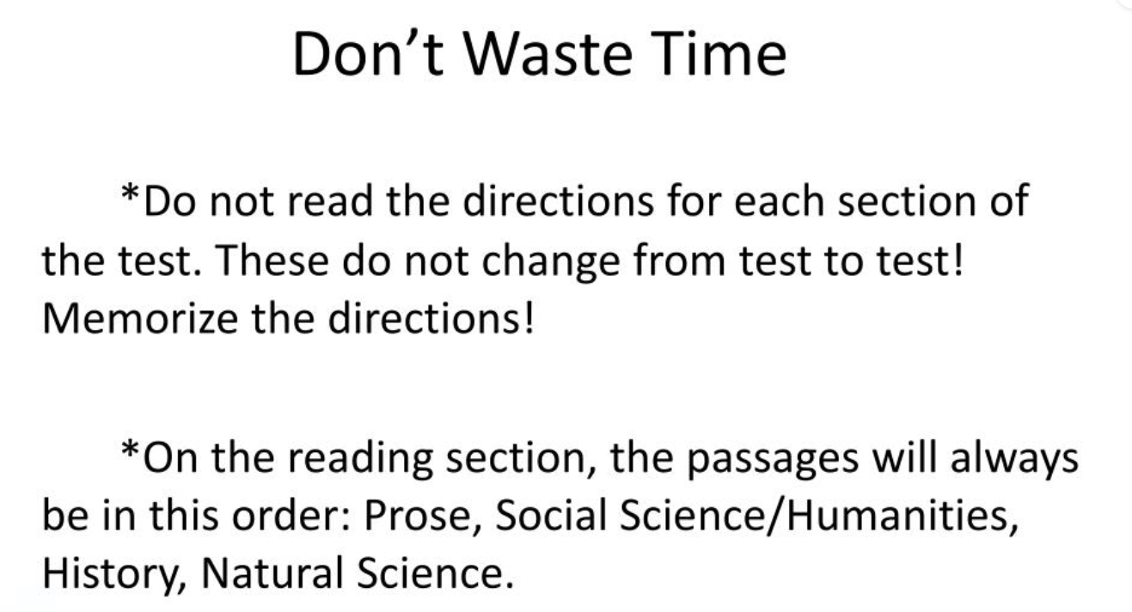

Slide 6
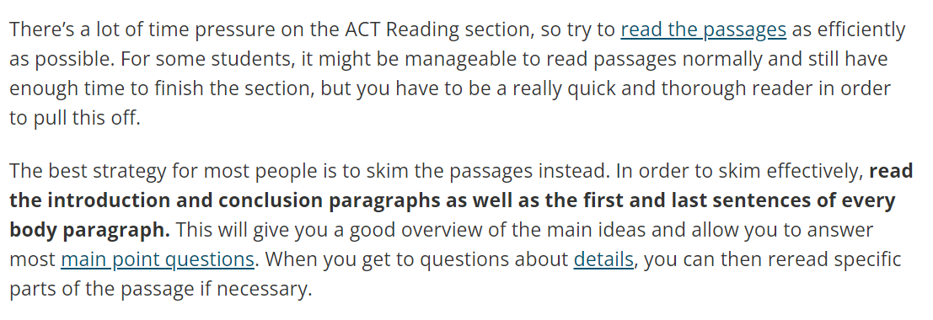
Skimming Passages Can Save Time

Slide 7
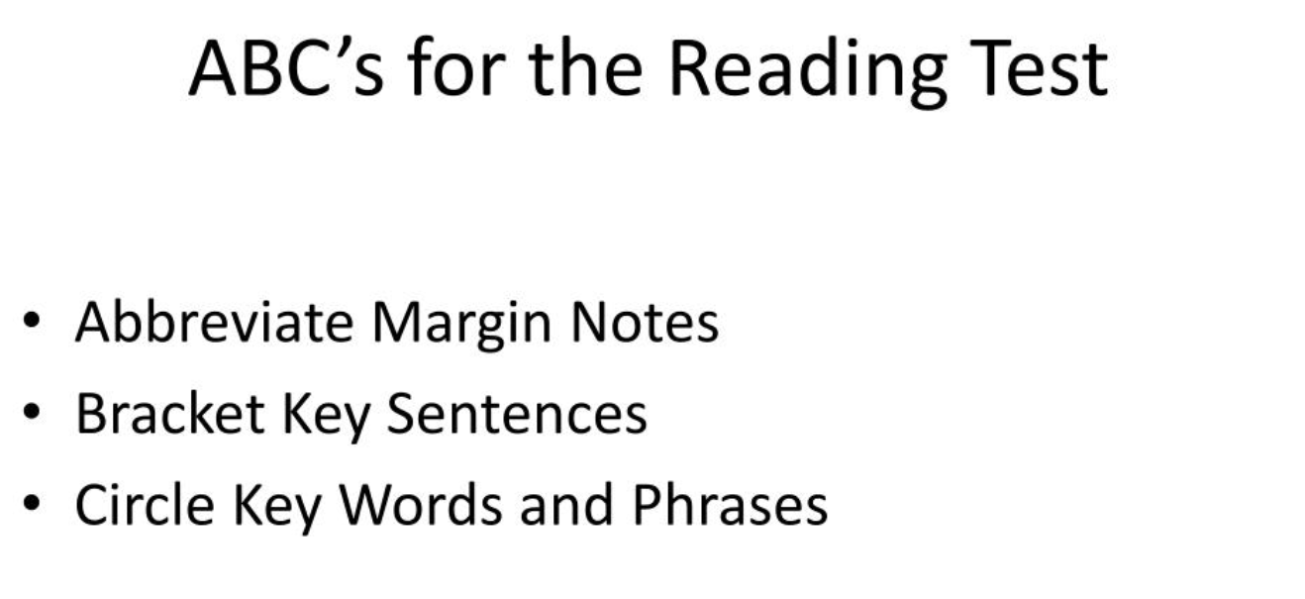

Slide 8
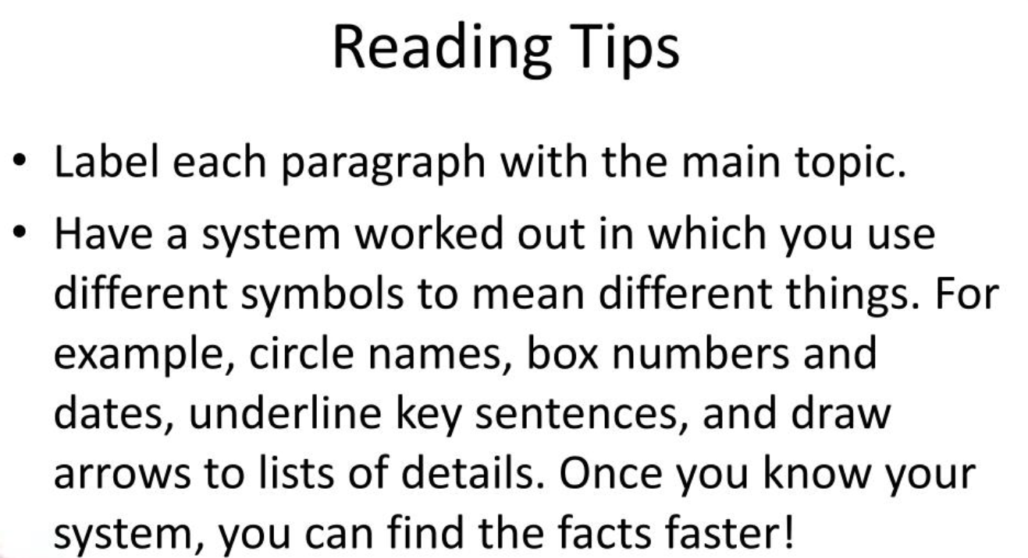

Slide 9
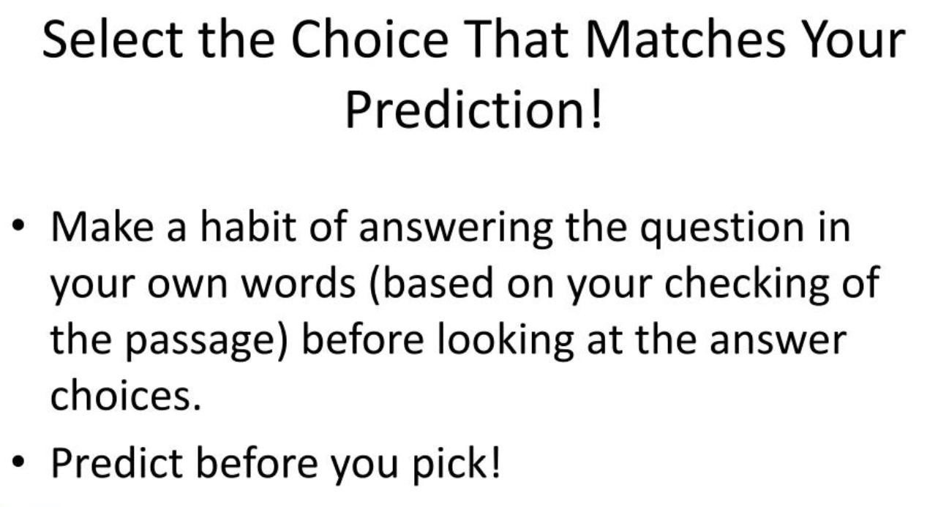

Slide 10
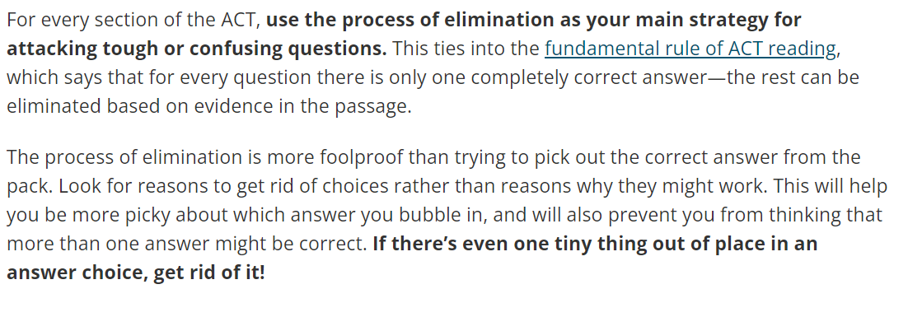
Use the Process of Elimination

Slide 11

Read the Entire Question Before Answering

Slide 12
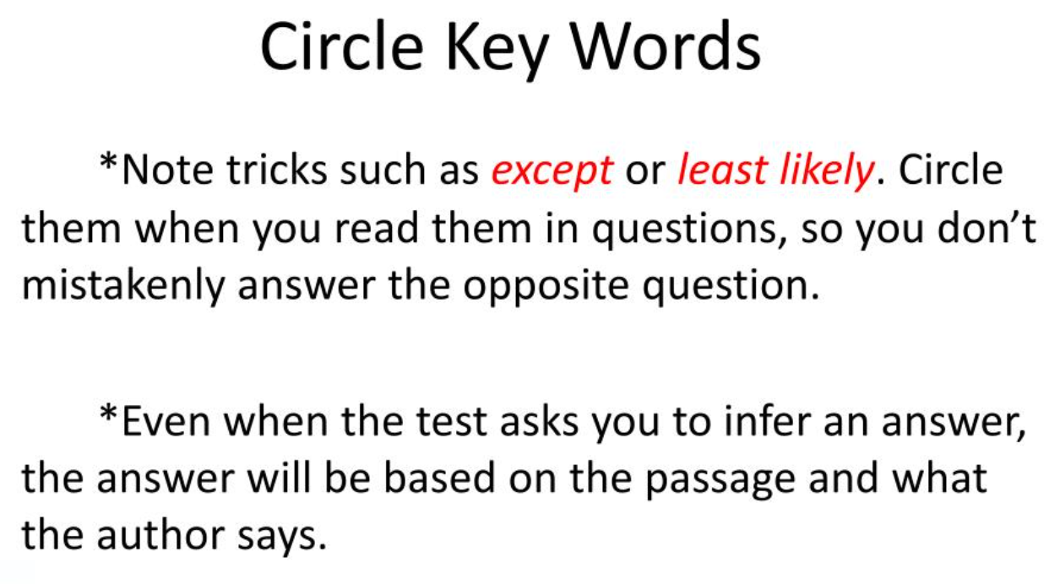

Slide 13
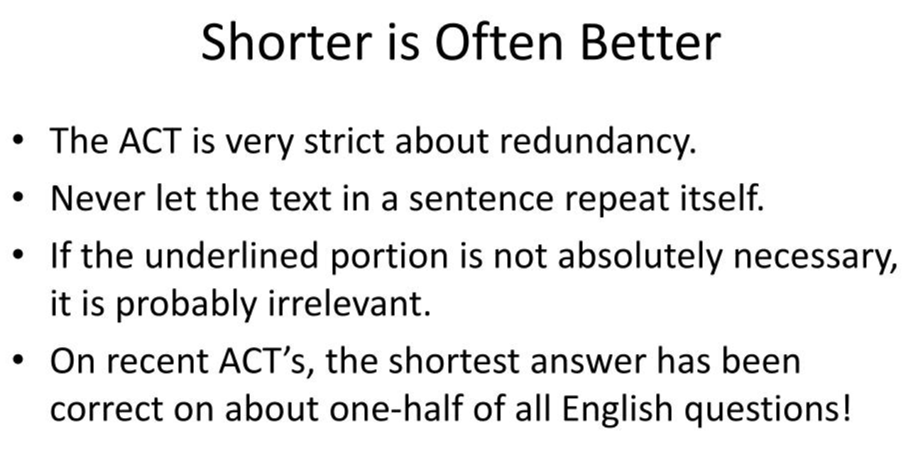

Slide 14
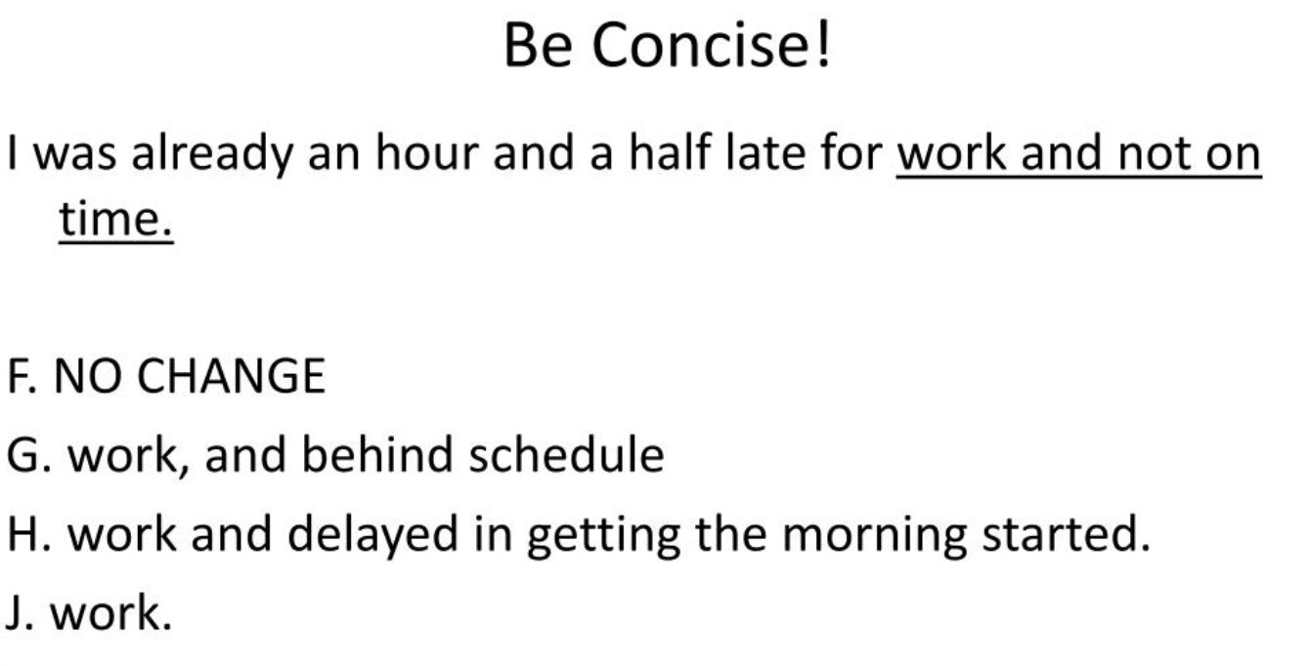

Slide 15
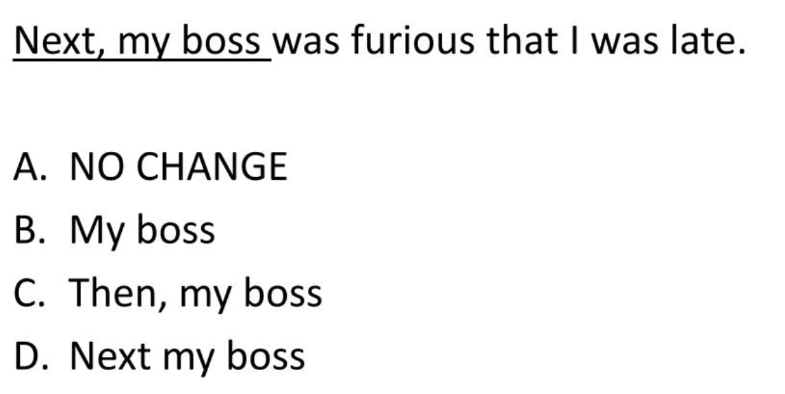

Slide 16
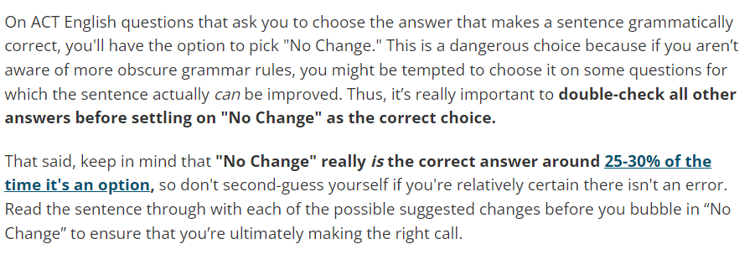
Be Careful with “no change” answers

Slide 17
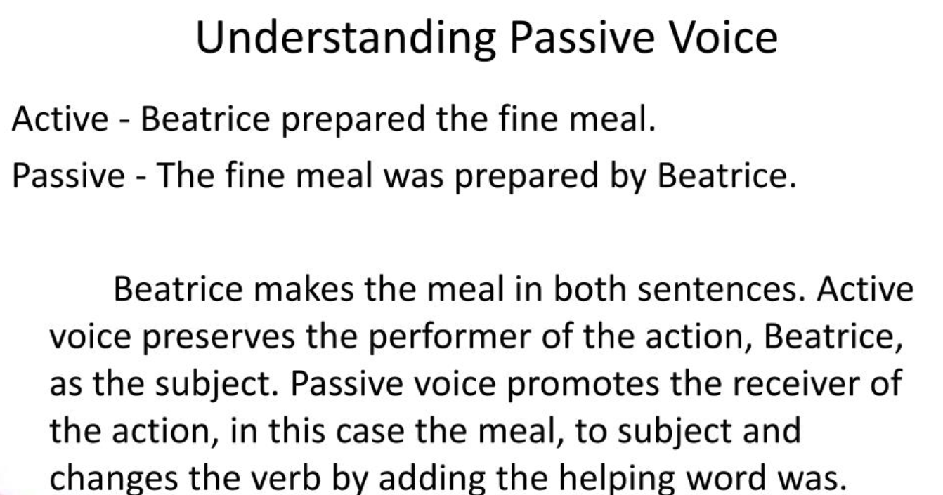

Slide 18
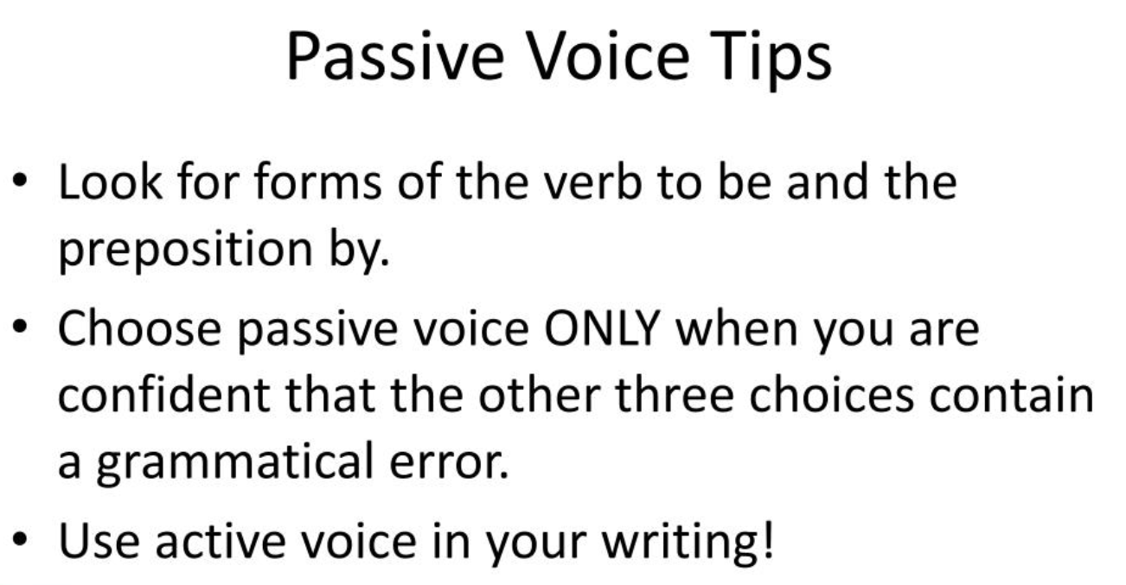

Slide 19
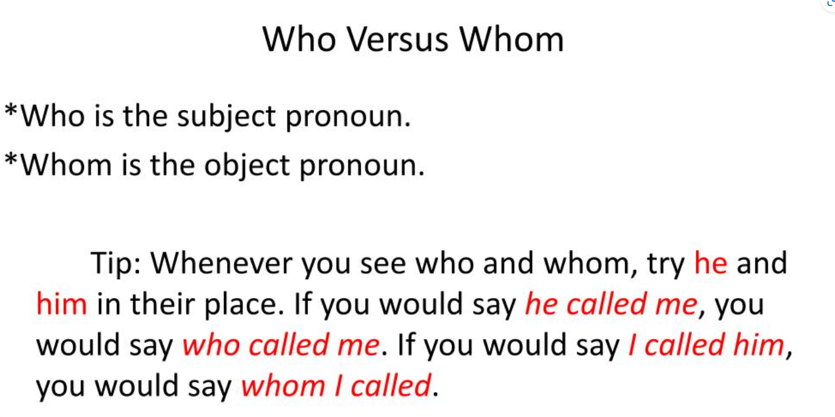

Slide 20

Pay Attention to Diagrams

Slide 21

Do the Conflicting Viewpoints Section Last IN SCience

Slide 22
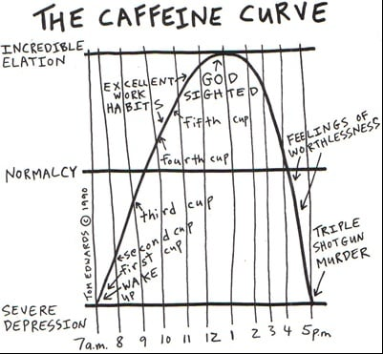

Rely On Visuals

Slide 23
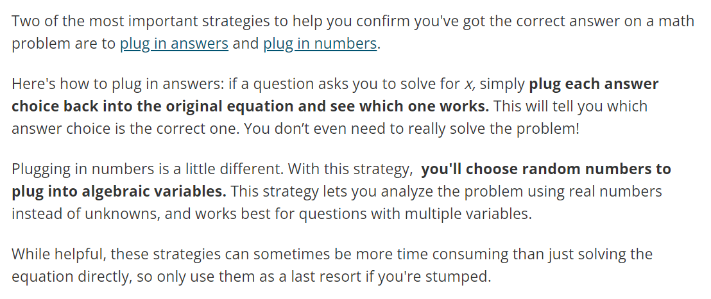
Plug In Answers and Numbers

Slide 24

Don’t change your answers

Slide 25

Answer every question

Slide 26

Have a guessing letter- When in doubt, choose answer B

Slide 27
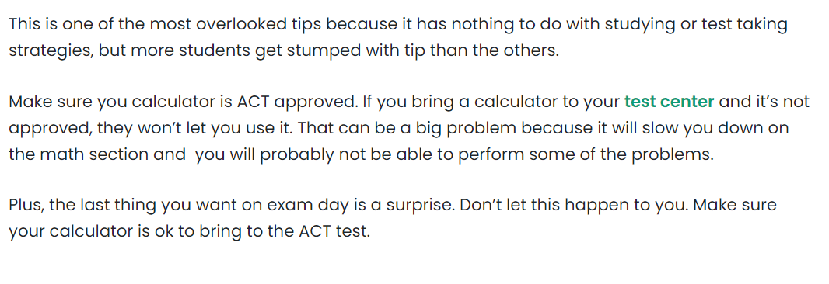
Check Your Calculator

Slide 28

Stay Calm

Slide 29
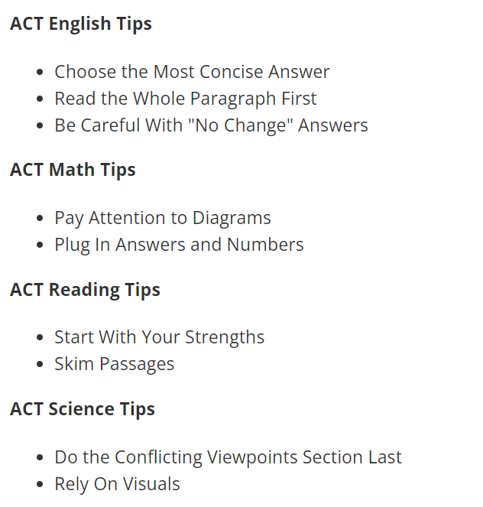
Review

Slide 30

Questions?

