Slide 1
International Trade

Slide 2

Resource Distribution and Trade
Every country has different types and quantities of land, labor and capital
Specialization can help countries use resources more efficiently
Specialization and trade benefit all nations

Slide 3
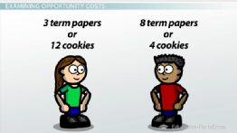
Absolute and Comparative Advantage
An absolute advantage is when a person or country can produce a good cheaper than anybody else
A comparative advantage is when a person or country can produce a good at a lower opportunity cost than anybody else

Slide 4
Absolute and Comparative Advantage
The law of comparative advantage states that nations are better off producing goods and services that they have a comparative advantage in supplying

Slide 5

Imports and Exports of the United States
The United States is the world’s largest importer and exporter
Our main trading partners are Canada, Mexico and China

Slide 6
Trade and Employment
Specialization can have harmful effects
1) Unemployment: people cannot adapt or find new job
2) Relocation: move to where skills meet jobs
3) Retraining: improving human capital to meet demands of specialized labor markets

Slide 7
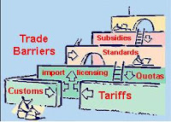
What are Trade Barriers?
A trade barrier is preventing a foreign product from entering a nation’s territory/market
Import quotas are limits on the amount of a good that can be imported.
A tariff is a tax on imported goods, such as customs duty

Slide 8
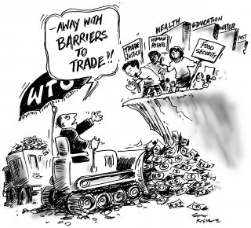
The Effects of Trade Restrictions
Tariffs increase the price of foreign goods making domestic products more competitive
Restricting imports, however, could lead to a countries trading partner imposing its own restrictions

Slide 9
Arguments for Protectionism
Protectionism is the use of trade barriers to protect a nation’s industries from foreign competition. This would:
1) Protect jobs- those who would be hurt by specialization
2) Protect new industries- those who are just starting out
3) National Security- companies/products essential to the defense of National Security

Slide 10

International Cooperation
Has been effort to reduce barriers and increase trade internationally
In 1948, General Agreement on Tariffs and Trade (GATT)–reduced tariffs, expand trade world wide
1995, World Trade Organization (WTO) – Comply with GATT

Slide 11

Exchange Rates and International Markets
Appreciation- Increase in value of currency
Depreciation- Decrease in value of currency
The value of a foreign nation’s currency in relation to your own currency is the exchange rate

Slide 12
Types of Exchange Rate Systems
Fixed Exchange Rate System- governments tries to keep value of currencies constant against one another
Flexible Exchange Rate System- Exchange rate determined by supply and demand

Slide 13
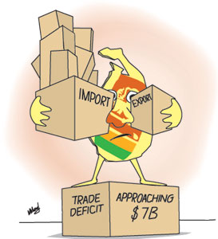
Balance of Trade
Trade Surplus- Nation exports more than it imports
Trade Deficit- Nation imports more than it exports
Balance of Trade- relationship between a nation’s imports and exports

Slide 14
The United States Trade Deficit
The U.S. has been in a trade deficit since the 1970s
Imports of foreign oil as well as Americans enjoyment of imported goods account for America’s trade deficit

