Slide 1
Personal Financial Planning

Slide 2
Objectives
To describe the family life cycle.
To formulate a personal budget.
To describe the various tools available to invest extra funds.
To associate risks involved with various types of investments.
To compare traditional IRAs with Roth IRAs.
To examine how economic conditions affect personal finances.

Slide 3
Main Menu
Family Life Cycle & Budgeting
CDs, IRAs & Other Saving Plans
  Expert Tips & Advice Video Segment

Slide 4
Personal Financial Planning: Family Life Cycle and Budgeting

Slide 5
Goals
Are the focal points of developing a personal financial plan
Can be either:
  short-term
    usually less than one year, such as:
      a vacation or piece of furniture
  long-term
    usually more than one year, such as:
      a house, education or retirement

Slide 6

Goals
Need to have a set of priorities and a target date for achievement
Require constant updating as a result of the changing family life cycle

Slide 7
Family Life Cycle
Explains how a person changes financial position, earnings, consumption and savings throughout the life cycle
Was introduced by marketers to define target markets, for example:
  a single male of 30 will most likely not purchase diapers
  a married male of 30 with an infant will purchase many diapers

Slide 8
Family Life Cycle
Was extended to the realm of personal finance in 2000
Is categorized into eight stages:
  younger single
  younger couple, no children
  couple, dependent children
  single, dependent children
  older couple, independent children
  older single
  couple, retired
  single, retired

Slide 9

Categorization
Provides a framework to examine important issues for a variety of family units
Allows personal finance professionals to argue the first four
stages involve a
greater need for
budgeting

Slide 10
Categorization
Differentiates the various financial planning issues among groups, for example:
  a single person with children is going to have financial needs such as preparing for college and putting food on the table
  a single person who is retired will have financial needs such as traveling and investing in hobbies

Slide 11
Scholars
Recommend the life cycle as the initial tool when evaluating a family unit
Argue financial behavior does conform to the eight stages within the family life cycle
Recognize faults in the family life cycle model, for example:
  goal-planning is not strongly emphasized, focuses more on the “here and now”
  fails to incorporate an empirical way to measure consumption and satisfaction

Slide 12

Personal Financial Process
Begins with budgeting finances
  calculate income sources (fixed and variable)
    salary
    savings account
    benefits (Social Security, alimony)
  calculate expenses
  (fixed and variable)
    rent
    utilities
    insurance
    food

Slide 13
Recording Accurate Financial Information
Is extremely important so individuals can:
  track expenses and income
  apply for additional funds
  save time and accounting costs
  pay taxes on time
  mitigate errors
  correctly budget finances

Slide 14
Budgets
Assist in planning financial situations throughout the year
Identify shortages before they happen
Act as a control mechanism in regard to the way money is spent
Allow the larger picture to be seen
Assist in reorganizing finances to reduce debt or increase savings

Slide 15
What If…
Expenses exceed income
  cut down
    do not eat out as much
    get the best prices possible
  increase income sources
    invest in stacked certificates of deposit (CDs)
    obtain another job
  consolidate debt
    consumer loan
    home equity loan

Slide 16


What If…
Income exceeds expenses
  research investment and savings options
    certificates of deposit
    401K/IRA plans
    mutual funds
    stock market

Slide 17
Personal Financial Planning: CDs, IRAs and Other Savings Plans

Slide 18

Types of Bank Accounts
Include:
  checking
  savings
  certificate of deposit (CD)
  401K plans

Slide 19

Checking Accounts
Allow users to withdraw and deposit money through:
  checks
  ATM
  electronic debits

Slide 20
Checking Account
Disadvantages may include:
  ATM withdraw fees
  withdraw limits
  overdraft fees
Advantages may include:
  no monthly fee to keep account open
    some financial institutions charge a fee if the minimum balance is not maintained
  free online banking
  free bill pay
  free direct deposit

Slide 21

Savings Accounts
Allow users to:
  manage money for long-term financial goals
  have money for emergency use
  have $250,000 worth of funds insured by the Federal Deposit Insurance Corporation (FDIC)

Slide 22
Savings Accounts
Have the disadvantage of a limited number of transfers or transactions
  the Federal Reserve limits number of “convenient” transfers or withdraws to six a month
Have the advantage of earing interest on money in the account as well as keeping it safe

Slide 23
Steps to Open a Banking Account
Choose a financial institution
Visit the bank branch or website
Pick the type of checking account wanted
Provide information to the institution
Agree to terms
Print, sign and mail (if applicable) any documents needed
Some checking and savings accounts require a minimum amount be kept in the account or to open the account. Be sure and read the fine print, in order to not incur extra fees.

Slide 24
Certificate of Deposit (CDs)
Is similar to a savings accounts, with the following exceptions:
  CDs have higher interest rates
  CDs have fixed terms
    must invest an amount of cash for six months, 12 months, 18 months, etc.
  CDs have a fixed interest rate
    interest rates of savings accounts fluctuate depending on the market, while CD interest rates cannot change as a result of poor or strong market performance

Slide 25

Certificate of Deposit (CDs)
Provides periodic income
  at the end of the month
    interest accrued can be mailed in the form of a check or can be transferred to a bank account

Slide 26
CD Rates
Vary according to the:
  size of the bank
  length of maturity
Can secure a new loan with a lower interest rate, for example:
  a car loan may have an interest rate of 9.75 percent; however, if a CD has been pledged as collateral and the CD rate is 5.75 percent, the loan rate will also be 5.75 percent
Collateral: property of value which can be transferred to a creditor in the event a person fails to repay the debt

Slide 27
401K Plans
Are employer-sponsored benefit plans
Provide individuals with the chance to put a portion of their earnings in a financial portfolio
Are exempt from income tax on the portion of earnings placed in a financial portfolio
Can be rolled over into an Individual Retirement Account or to a future employer’s 401K plan, in the event an individual changes employment

Slide 28
Employers
Can contribute a portion of their profit into employees 401K plans based on a formula
  formulas vary based on: position in the company, years of service, age, department, geographic location, etc.
Have the right to enforce a vesting policy, for example:
  employees may accrue profit sharing earnings; however, the employees are not entitled to the earnings until they have provided five years of service

Slide 29

Employers
Have to sponsor a 401K plan
  individuals cannot start 401K plans on their own

Slide 30
Individual Retirement Accounts (IRAs)
Allow individuals to open an account and begin saving funds toward retirement with tax benefits
Come in two different types:
  traditional IRA
  Roth IRA
Restrict the amount of cash which can contributed to the account

Slide 31
Traditional IRAs
Reduces tax liability, in other words, contributions are tax deductible
Require taxes be paid on interest
Includes the option to withdraw the money at the age of 59.5
Require withdrawing the money at the age of 70.5
Apply a 10 percent tax penalty on any withdrawals made before the age of 59.5

Slide 32

Roth IRAs
Do not provide a tax shelter on contributions, in other words, tax liability is not reduced
Do not require taxes paid on the interest
Can be withdrawn at any time

Slide 33

Mutual Funds
Consist of a portfolio of securities, such as:
  common stock
  bonds
  money-market accounts
Are professionally managed

Slide 34
Stocks
Are an investment in publicly traded companies
Provide ownership in a company
Consist of two types:
  common:
    voting rights in a company, last to receive dividends
  preferred:
    no voting rights in a company, first to receive dividends

Slide 35
Emergency Funds
Serve a critical purpose in personal finance
Provide a cushion for unforeseen financial conditions in the event of an emergency
Should be developed through a type of savings, for instance:
  savings account
  money market account
Earn interest
Should be easily accessible

Slide 36
Savings vs. Money Market
Savings | Money Market
Lower return rate | Higher return rate
Lower minimum balance required | Higher minimum balance required
No check writing authority | Check writing authority
Limited withdrawals per month | Limited withdrawals per month

Slide 37
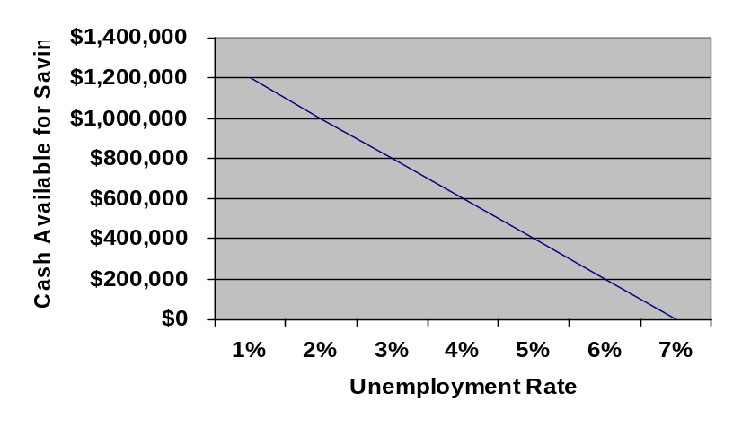
Unemployment Rate
Effects personal financial planning
  for example:
    when the unemployment rate is low, monetary supply is increased, which leads to an increase in savings
Is only one example of
the economic shifts in
a national economy
affecting monetary
supply, thus an
individual’s ability to save

Slide 38
Play iCEV Video
Teacher Instructions:
Show the Expert Tips & Advice video segment

Slide 39
Resources
Brooks, R. (1996). Computing Yields on Enhanced CDs. Financial Services Review, 5(1), 31-42.
Davis, E.P. & Car, R.A. (1992). Budgeting Practices Over the Life Cycle. Financial Counseling and Planning, 3, 12-18.
Robinson Chris (1998). Conceptual Frameworks for Personal Finance. Unpublished Manuscript.

Slide 40
Acknowledgements
Assistant Brand Manager
Caroline Huang-Loggains
Brand Manager
Amy Hogan
Production Coordinator
Erin Metzler
Director of Brand Management
Megan O’Quinn
Videography/Post Production
Holley Baker
Jake Saye
Quality Control Director
Angela Dehls
Collaborator
John Salter, Ph.D., CFP®
Associate Professor
Texas Tech University
V.P. of Brand Management
Clayton Franklin
Executive Producer
Gordon W. Davis, Ph.D.
© MMXIX
CEV Multimedia, Ltd.

