Slide 2
Objectives
To describe the purpose of accounting and financial reporting.
To explain the significance of generally accepted accounting principles (GAAP).
To identify the role which ethical and social responsibility plays in accounting.
To discover accounting certification programs and careers.

Slide 3
Main Menu
What is Accounting?
Accounting Process
Careers

Slide 4


Slide 5

Accounting
Is the process of retrieving, recording, storing and summarizing financial transactions for a business
  accounting information is also used for analysis and decision making
Bookkeeping vs. Accounting: Bookkeeping is the process of recording daily business transactions which is only one part of the accounting process.

Slide 6
Types of Accounting Systems
Include:
  manual
    maintaining accounts by hand
  computer
    maintaining accounts with the help of computer software
      for example:
        QuickBooks®
        Sage 50 Accounting®

Slide 7
Purposes of Accounting
Includes:
  helping management determine the health of a business
    managers use the information to determine if the company is financially stable which helps them make decisions such as borrowing money or expanding the business
  tracking resources
    helps a company keep track of the goods they have on hand as well as the cost of storing and selling these goods

Slide 8
Purposes of Accounting
Includes:
  providing stakeholders with financial information
    creates records which can help stakeholders make decisions about the company
    stakeholder - person who has an interest in a company
      for example:
        investors in companies as well as employees, customers and anyone who has an interest in a company are considered stakeholders

Slide 9

Purposes of Accounting
Includes:
  aiding in maximizing company profits
    accounting helps companies track profits and losses
Profit: amount of money earned is greater than amount of money spent
Loss: amount of money earned is less than the amount of money spent; a loss occurs when there is no profit

Slide 10

Types of Accounting
Include:
  financial accounting
  management accounting
  tax accounting

Slide 11
Financial Accounting
Produces information for external use through financial statements
Ensures external users of company statements receive accurate and useful information to make decisions
  includes investors, creditors and the government
Creditor: person or company which lends money to another person or company

Slide 12

Management Accounting
Produces information mainly for company/management use
Ensures managers are aware of the company’s financial health in order to make decisions such as borrowing money or expanding the business

Slide 13
Tax Accounting
Is the category of accounting which records and files taxes
Ensures the company reports and pays all taxes which are required by the U.S. government
Is also used to comply with state tax laws and regulations

Slide 15
Accounting Cycle
Includes the following steps:
  analyze transactions
  record journal entries
  post ledger account entries
  arrive at unadjusted trial balance
  record and post adjusting entries
  arrive at adjusted trial balance
  prepare financial statements
  close accounts
  arrive at post closing trial balance

Slide 16
Accounting Cycle
Can be summarized by two general elements
  recording business transactions
    analyze transactions
    record journal entries
    post ledger account entries
    arrive at unadjusted trial balance
    record and post adjusting entries
    arrive at adjusted trial balance

Slide 17

Accounting Cycle
Can be summarized by two general elements
  reporting financial information for decision making
    prepare financial statements
    close accounts
    arrive at post closing trial balance

Slide 18
Business Transactions
Is an activity or event which can be measured in terms of money which impacts the financial position or operations of a business
Can be classified as:
  exchange transactions
    involve physical exchanges such as purchasing, selling, collection of receivables and payment of accounts

Slide 19

Business Transactions
Can be classified as:
  non-exchange transactions
    events not involving physical exchanges, but where changes in monetary values are determinable such as wear and tear on equipment and damage to a structure

Slide 20
Financial Reporting
Involves accounting records
  accounting records are the foundation of financial reporting
Is a process of using information gathered from financial transactions and records
  includes information about cash flow and financial health
Helps determine how resources are used

Slide 21

Financial Reporting Objectives
Provide information about company resources
Provide information useful for investors’ and creditors’ decision making
Provide information which clearly shows the health of a company

Slide 22
Generally Accepted Accounting Principles (GAAP)
Are a common set of accounting rules and procedures
Are needed in maintaining accuracy and consistency of financial reports
  completed external financial reports must also follow GAAP
Are issued by the Financial Accounting Standards Board (FASB)

Slide 23

GAAP Examples
Include:
  cost principle
  reliability principle
  disclosure principle
  matching principle
  going concern principle

Slide 24

Cost Principle
States the actual cost of an item needs to be stated, not its current value
  for example:
    a company purchases a printer on sale for $500; the printer initially was priced at $750; when recording the cost of the printer, the company should report $500 not $750

Slide 25
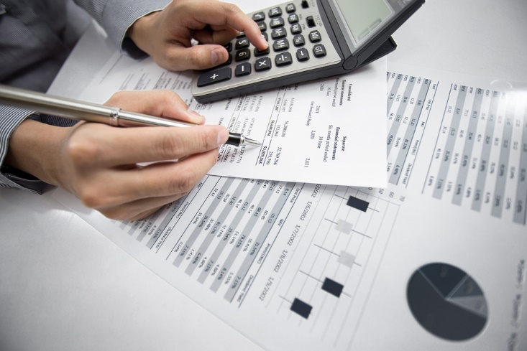
Reliability Principle
States accountants must only record information which can be verified
  for example:
    receipts, bank statements and copies of checks should be kept for accountants to record and verify

Slide 26
Disclosure Principle
States all information which is relevant to financial statement viewers must be included in the financial statement
  for example:
    a food manufacturer must disclose a product recall
    a company must disclose if they are merging with another company

Slide 27

Matching Principle
States expenses must be reported at the same time of the corresponding (matching) revenue
  for example:
    if a store makes $10,000 in revenue in January and employees are paid a total of $10,000 the same month, both must be recorded in January

Slide 28

Going Concern Principle
Is the assumption a company intends to continue operations
  if an accountant believes a company is near closing, this should be fully disclosed

Slide 29
Accountants
Are bound by company rules and professional standards
May face pressure to “break the rules” if a company is in financial trouble
Must have ethical and social responsibilities which they uphold
  actions of an accountant affect both the company and outsiders

Slide 30
Ethical Responsibilities of Accountants
Include:
  upholding laws and regulations
  utilizing moral values to make judgements
  recording only factual business transactions
  keeping client information confidential
  presenting financial statements objectively to share holders
Shareholder: individuals who own part of a company through stock ownership
Many companies use accountants who have no financial ties to the company to help prevent unethical reporting.

Slide 31

Social Responsibilities of Accountants & Businesses
Include:
  taking actions which benefit society as a whole which may result in the company losing money
    additional costs beyond normal business costs due to an activity or policy are known as social costs
  developing social reports along with financial reports

Slide 33
Accountants
Are individuals who record financial transactions and prepare financial reports
Examine statements to ensure accuracy
Suggest ways to improve profits and reduce costs
Compute taxes and prepare tax returns
Ensure statements and records comply with laws and regulations
Maintain financial records

Slide 34
Common Personality Traits & Skills of an Accountant
Include:
  an eye for detail
  ability to analyze data
  willing to travel if needed
  proficiency in math and general computer skills
    extensive knowledge of accounting software
  ability to complete repetitive tasks
  ability to work alone or in a group

Slide 35
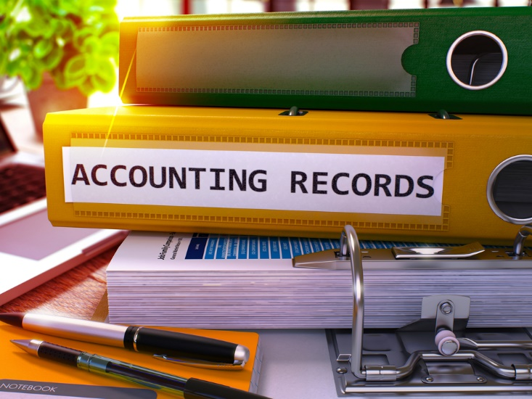
Types of Accountants
Include:
  public accountant
  management accountant
  government accountant
  internal auditor
  general ledger accountant
  forensic accountant
  international accountant

Slide 36
Public Accountants
Are considered an “external” accountant for companies
Have clients such as corporations, governments and individuals
Have duties including recording/filing taxes and preparing financial reports

Slide 37
Public Accountants
Have the opportunity to work with multiple clients in different industries
Must be a good communicators and adaptable to change
Usually requires a Bachelor’s degree in Accounting
  advanced positions require certification (Certified Public Accountant (CPA))

Slide 38

Management Accountants
Are considered “internal” accountants for a company
Work within one specific company
Are also referred to as cost, managerial, corporate or private accountants

Slide 39

Management Accountants
Typically require a Bachelor’s degree in Accounting or Finance
  advanced positions require certification designations such as Certified Public Accountant (CPA) or Certified Management Accountant (CMA)

Slide 40

Government Accountants
Work for federal, state or local government
Maintain and examine records of government agencies
Prepare financial statements and handle payroll duties
Are an integral part of the budget and financial declaration process

Slide 41
Government Accountants
May perform investigations on behalf of the government
Usually requires a Bachelor’s degree in Accounting
  some organizations may accept experience and passing an accounting exam
Government accountants who work for agencies such as the Internal Revenue Service (IRS) audit private businesses and individuals to ensure their compliance with federal income taxation laws and other government regulations at the national, state and local levels.

Slide 42

Internal Auditors
Examine financial records of companies to ensure proper management of funds
Suggest methods of preventing fraud
Report fraud to the federal government
Typically have no connection to a company

Slide 43

Internal Auditors
May have to travel to businesses to complete audits
Should have excellent analysis skills and be very ethical
Requires a Bachelor’s degree in Accounting and a Certified Public Accountant (CPA) license

Slide 44
General Ledger Accountants
Ensure business transactions are properly recorded in the business or organization’s main accounting record, the general ledger
Should be:
  familiar with general accounting and bookkeeping skills
  proficient working in a team or individually
  computer savvy
Require a Bachelor’s or Associate’s degree in business and/or accounting

Slide 45
Forensic Accountants
Specialize in examining accounting transactions for law enforcement to determine if illegal transactions have occurred
Investigate crimes related to:
  fraud
    such as corporate, health care, mass marketing, hedge fund and securities fraud
  money laundering
  contract disputes
  embezzlement
  bankruptcy

Slide 46
Forensic Accountants
Are required to hold a Bachelor’s degree in Accounting or a related field
Take coursework in business administration, finance, marketing, economics and statistics
May also have earned a graduate certificate or Master’s degree in Forensic Accounting
Are generally required to have their Certified Public Accountant (CPA) certification
Can also become a Certified Fraud Examiner or Certified Forensic Accountant

Slide 47
International Accountants
Specialize in recording and analyzing international (non-GAAP) business transactions
Are typically required to have a Bachelor’s degree in a field such as Accounting or Finance and accreditation through certain international agencies

Slide 48

Professional Certifications for Accountants
Show accountants have expertise and experience
Include:
  Certified Public Accountant (CPA)
  Certified Management Accountant (CMA)

Slide 49
Certified Public Accountants (CPA)
May have higher salaries and client trust
Have taken and passed the CPA exam
  a four-part national exam
Are licensed by their state’s board of accountants
  for example:
    state requirements for Texas: https://www.tsbpa.state.tx.us/exam-qualification/certification-requirements.html

Slide 50
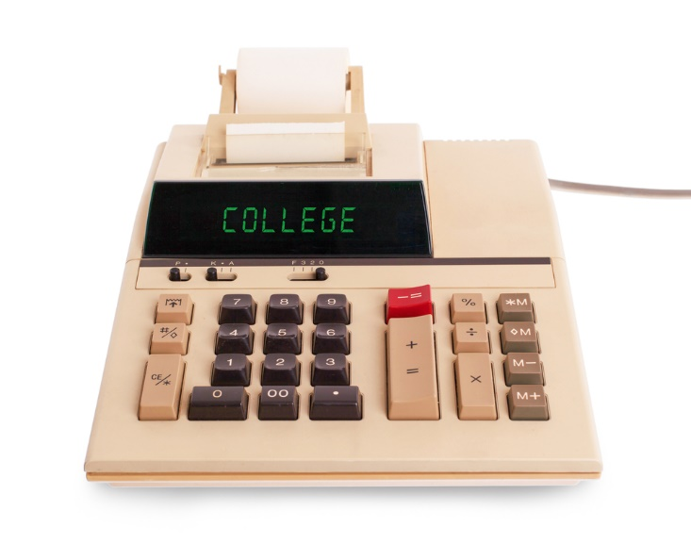
Certified Public Accountants (CPA)
Are required by most states to have continuing education
Requires approximately 1,800 work hours

Slide 51
Certified Management Accountants (CMA)
Specializes more in financial management and performance management than a CPA
Required to take the CMA exam
  exam has two parts and measures knowledge in management accounting
Are required by most states to have continuing education and work experience

Slide 52
Tips for Exploring Accounting Careers in High School
Research colleges which offer accounting degree programs
Interview a local accountant/CPA
Enhance computer skills (typing, Microsoft® Excel)
Increase math skills/study time
Thoroughly research CPA test requirements

Slide 53
Acknowledgements
Accountants and Auditors. (n.d.). Retrieved from http://www.bls.gov/ooh/business-and-financial/accountants-and-auditors.htm
Going Concern Principle - AccountingTools. (n.d.). Retrieved from http://www.accountingtools.com/going-concern-principle
Kieso, D., & Weygandt, J. (2010). Intermediate accounting (13th ed.). Hoboken, NJ: Wiley.
TSBPA - Examination - Certification - Requirements. (n.d.). Retrieved from https://www.tsbpa.state.tx.us/exam-qualification/certification-requirements.html

Slide 54
Acknowledgements
Production Coordinator
Megan O’Quinn
Graphic Designer
Melody Rowell
Assistant Brand Manager
Amy Hogan
Brand Manager
Megan O’Quinn
V.P. of Brand Management
Clayton Franklin
Collaborator
Susan E. Carroll
Business Teacher
(Retired)
Executive Producer
Gordon W. Davis, Ph.D.
© MMXVI
CEV Multimedia, Ltd.

