Slide 1
Workplace Technology

Slide 2
Objectives
To explain the purpose of workplace technology and its impact on business practices.
To discuss benefits and concerns of businesses technology use.
To describe various types of workplace technology.

Slide 3
Main Menu
Purpose & Impact
Types of Technology

Slide 4
Purpose and Impact

Slide 5

Workplace Technology
Plays an essential role in how
businesses function
Is relied upon by businesses to increase efficiency and effectiveness
Enables people in the workplace to work more quickly and
accurately
  in many cases,
  technology allows
  people to work in ways
  previously not possible

Slide 6
Workplace Technology
Can serve many purposes, including:
  facilitating communication
    for example:
      e-mail, messenger systems and
      online cloud sharing services enable communication over long distances
  enhancing organization and productivity
    for example:
      scheduling, filing and procedure systems optimize time management, make resources more accessible and reduce downtime

Slide 7

Workplace Technology
Can serve many purposes, including:
  motivating employees
    for example:
      employee and project management systems allow employees to track their performance and receive ongoing
      feedback

Slide 8
Workplace Technology
Can serve many purposes, including:
  monitoring quantitative business factors
    for example:
      inventory, transaction and accounting systems track information needed for critical management decisions
  analyzing business information
    for example:
      many types of management systems examine operational and performance information to provide statistical insight regarding business methods

Slide 9
Workplace Technology
Can serve many purposes, including:
  expanding product/service options
    for example:
      e-commerce provides an additional channel for purchase and customization systems, allowing customers more control selecting products
  enhancing customer service
    for example:
      social media and e-mail provide customers a direct method for asking questions and commenting at their convenience

Slide 10

Workplace Technology
Can serve many purposes, including:
  improving profitability
    for example:
      tax and invoicing systems can lower costs and budgeting software can indicate how expenses can be reduced

Slide 11
Workplace Technology
Can present risks and ethical concerns for businesses, including:
  invasion of privacy
    organizational practices regarding information collection must be honest, ethical and respectful of individuals’ rights
  data protection
    information stored and communicated using technology should be secured through appropriate tools, policies and procedures

Slide 12
Workplace Technology
Can present risks and ethical concerns for businesses, including:
  technology failure
    organizations should have contingency plans in case of power loss, hardware malfunction, software corruption, etc.
  employee misuse
    policies regarding proper use of workplace technology must be clearly communicated and consistently enforced

Slide 13
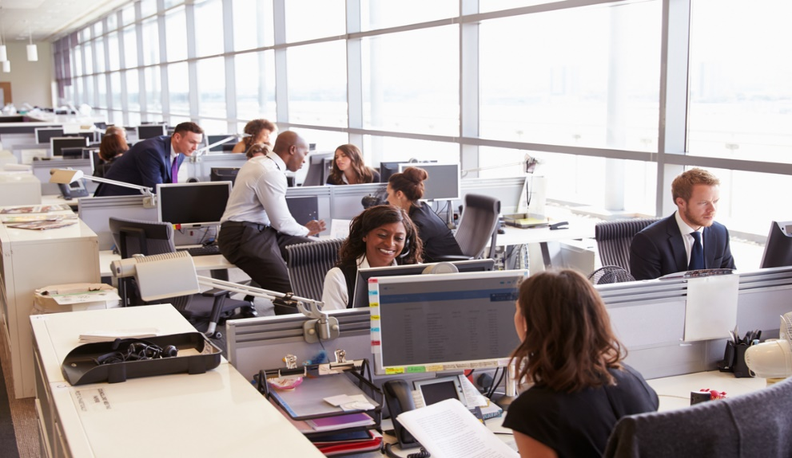
Workplace Technology
Is changing the profile of the workplace
  automation is common, decreasing the need for labor
  many workers are encouraged or required to receive more education and training to keep up with new technologies

Slide 14

Workplace Technology
Is changing the profile of the workplace
  communication and collaboration over distances is easier, so offices and workers may be in multiple and/or shifting locations
  increased access to workplace tools and information means work hours may be more flexible and may not always fit the typical 8 a.m. to 5 p.m. workday

Slide 15
Types of Technology

Slide 16
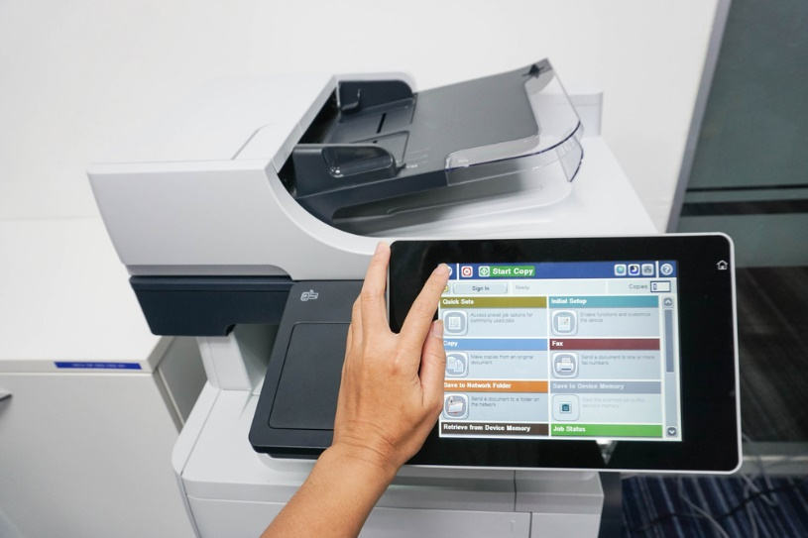
Workplace Technology
Includes:
  copiers and fax machines
  business phone systems
  computers and computer software
  networks and intranet
  the Internet and Internet applications

Slide 17
Copiers & Fax Machines
Are useful when printed documents
are needed
  copiers are machines which make exact duplicates of documents
  fax machines are devices for sending
  and receiving printed documents over telephone lines
May also include features such as the ability to scan and e-mail documents
Technology Tidbit: Copiers were first introduced in 1959 by Xerox®.

Slide 18
Business Phone Systems
Are multiline, interconnected telephone systems which allow for specialized features
  such as call transferring, conference calling, shared voicemail boxes, etc.
May involve Internet connection
  allowing for more advanced features, such as integrated text messenger, voicemail and e-mail systems

Slide 19
Computers
Are programmable machines for storing, processing and retrieving data
  includes a variety of types, such as desktops, laptops, tablets and smartphones
Enhance virtually all workplace tasks
  communication, task management, research and development, marketing, etc.
Technology Tidbit: The first programmable general-purpose electronic digital computer, the Electronic Numerical Integrator and Computer (ENIAC), weighed 30 tons, filled 1,500 square feet and cost $400,000 to build.

Slide 20
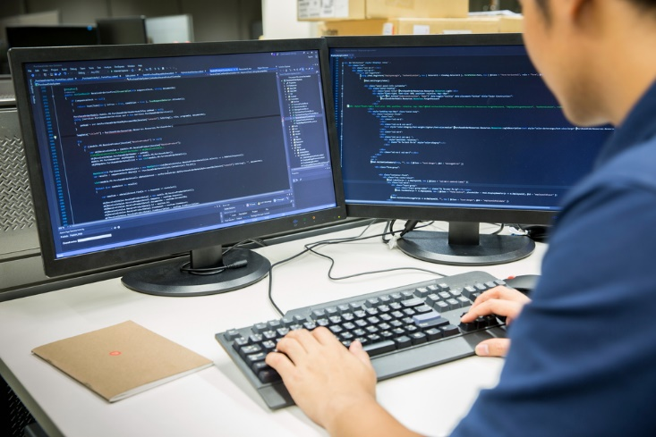
Computers
Require the use of hardware and software
  hardware is physical elements of a computer
    as well as separate elements which support computer functionality
  software is the instructions which guide
  how computer hardware operates, what
  tasks are performed and how those tasks
  are performed

Slide 21
Computer Hardware
Consists of four main types:
  input devices
    keyboard, mouse, touchscreen, microphone, webcam, scanner, etc.
  processing devices
    central processing unit (CPU)
  output devices
    monitors, printers, speakers, etc.
  storage devices
    hard disk drive, optical drives (CDs, DVDs), flash devices (USBs), etc.
Technology Tidbit: The first computer mouse was made of wood.

Slide 22
Printers & Scanners
Are two of the most common, most
useful types of computer hardware
found in the workplace
  printers are output devices which produce physical versions of computer documents and images using paper and ink
  scanners are input devices which transfer information and images from physical documents to computer files

Slide 23
Computer Software
Includes system software
  provides instructions for basic operation of computer hardware
    includes operating systems, device drivers, firmware, programming language translator
    and utilities
  is typically pre-installed by the computer manufacturer before purchase
    because it is required for functionality

Slide 24
Computer Software
Includes application software
  provides platforms and instructions for specific tasks
    includes many types
  may require installation by the user
    some common basic applications are pre-installed
  often available in integrated software packages with multiple related applications
    sales packages, accounting packages, reporting packages, inventory packages, etc.
    integrated software packages are often referred to as application suites

Slide 25
Common Application Software
Includes:
  word processing software
    for creating and editing documents
    example: Microsoft® Word
  database software
    for organizing, storing and managing data
    example: Microsoft® Access®
  spreadsheet software
    for organizing, analyzing and storing data in tables
    example: Microsoft® Excel®
Technology Tidbit: When made for mobile devices, application software is often referred to as an app.

Slide 26
Common Application Software
Includes:
  personal information management software
    for managing tasks, contacts and correspondence
    example: Microsoft® Outlook®
  multimedia software
    for creating and playing audio and video files
    example: Windows® Media Player
  presentation software
    for formatting text, graphics, audio and/or video to accompany a presentation
    example: Microsoft® PowerPoint®

Slide 27
Common Application Software
Includes:
  graphic design software
    for creating and manipulating images
    examples: Adobe® Photoshop® and
    Adobe® Illustrator®
  web development software
    for creating, editing and publishing online content
    example: Adobe® Dreamweaver®
  desktop publishing software
    for creating and editing publications which incorporate images and text
    examples: Microsoft® Publisher and
    Adobe® InDesign®

Slide 28
Common Application Software
Includes:
  content access software
    for accessing and viewing content
    examples: Microsoft® Edge and
    GoogleTM ChromeTM
  virtual meeting software
    for teleconferencing, videoconferencing, etc.
    example: Microsoft® Skype®
  enterprise software
    for tracking and managing business information
    example: Microsoft® Dynamics®

Slide 29
Computer Software
Is either open source or proprietary
  open-source software can be used without paying a license fee and can be modified to add capabilities not realized by its originators
    for example, Linux operating system and Mozilla® Firefox® web browser
  proprietary software has restrictions on its use and its source code is kept secret
    for example, Microsoft® Windows operating system and Edge® web browser
Technology Tidbit: In addition to system and application software, there is programming software, which is used to make all types of software.

Slide 30
Networks
Are connections among computers to facilitate communication and sharing of resources
May be private or public
Include many types which vary by size:
  personal area network (PAN)
  local area network (LAN)
  wide area network (WAN)
  metropolitan area network (MAN)
  global area network (GAN)

Slide 31
Intranets
Are private networks typically used by organizations for the sharing of company news, policies, documents and other information
May incorporate communication and collaboration tools
May be connected to the Internet through one or more gateway computers

Slide 32

The Internet
Is a global system of computer networks
  world’s largest, most popular network
Is a public resource available to everyone
  no one owns the Internet or controls who can connect to it
  used by more than two billion people around the world

Slide 33
The Internet
Requires a hard-wired or Wi-Fi connection
  with a hard-wired connection, a series of cables are used to transport the signal
  between the computer and the Internet service provider
  with Wi-Fi (wireless connectivity), radio waves are used to wirelessly transport the signal between the computer and a wireless access point (usually a router), which is connected via a series of cables to the Internet service provider

Slide 34
The World Wide Web
Is a public information system on the Internet which connects billions of documents known as web pages
  the World Wide Web is a part of the Internet, not a synonym for it
Is accessed through a web browser
  web browsers are web-based content access application software
Technology Tidbit: The World Wide Web was created in 1991 by Timothy Berners-Lee, a computer programmer at the European scientific research organization, CERN.

Slide 35
The Cloud
Describes a global network of remote servers which operate though the Internet
  freeing storage and computing power in local computers and servers
Stores and manages data
  allowing users easy access online
Runs application software
  allowing multiple users to work simultaneously in web-based applications
Technology Tidbit: Using the cloud to store, manage and process data is known as cloud computing.

Slide 36
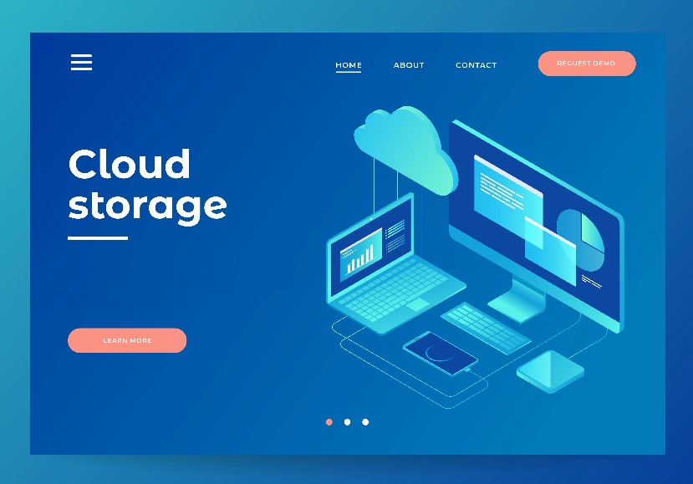
The Cloud
Is owned and operated by multiple entities
  companies such as Amazon® and GoogleTM
Is leased by its owners to individuals and organizations for a fee
  common cloud providers include:
    GoogleTM
    Apple®
    Microsoft® Azure®
    Dropbox®

Slide 37
Web-Based Applications
Are application software which operate and can be accessed through the World Wide Web
  rather than existing within the computer itself
Allow users access from any computer connected to the Internet
  regardless of location or network connection
Allow multiple users to work on a single file simultaneously

Slide 38
Common Web-Based Applications
Include:
  e-mail applications
    for sending and receiving digital mail online
    example: GmailTM
  virtual meeting applications
    for online teleconferencing, videoconferencing, screen sharing, etc.
    example: Microsoft® Skype® For Web
  word processing applications
    for creating and editing documents online
    example: Google DocsTM

Slide 39
Common Web-Based Applications
Include:
  spreadsheet applications
    for organizing, analyzing and storing data in an online table
    example: Google SheetsTM
  presentation applications
    for online formatting of text, graphics, audio and/or video to accompany a presentation
    example: Google SlidesTM
  storage applications
    for storing and sharing files online
    examples: Microsoft® OneDrive® and Dropbox®

Slide 40
Resources
http://smallbusiness.chron.com/importance-technology-workplace-10607.html
http://smallbusiness.chron.com/types-business-technology-167.html
https://www.thebalancesmb.com/how-to-technology-in-small-business-2951633
http://www.promeng.eu/downloads/training-materials/ebooks/business-information-systems.pdf
https://www.business.qld.gov.au/running-business/protecting-business/risk-management/it-risk-management/reducing
https://www.business.com/articles/types-of-phone-systems/
http://cs.sru.edu/~mullins/cpsc100book/module02_introduction/module02-03_introduction.html
https://www.thecomputingteacher.com/csc/index.php/sa-d/hardware/input-output-processing-storage
https://techspirited.com/different-types-of-application-software

Slide 41
Resources
https://www.greennet.org.uk/support/open-source-vs-proprietary-software
http://www.linfo.org/proprietary.html
https://www.vox.com/cards/the-internet/what-is-the-world-wide-web
https://www.forbes.com/2006/09/07/web-based-resources-cx_bn_0907smallbizresource.html#4a0c79345077

Slide 42
Acknowledgements
Brand Manager
Amy Hogan
Director of Brand Management
Megan O’Quinn
Quality Control Director
Angela Dehls
V.P. of Brand Management
Clayton Franklin
Executive Producer
Gordon W. Davis, Ph.D.
© MMXIX
CEV Multimedia, Ltd.

