Slide 1
Window Display
Student Examples of Past Projects

Slide 2
Project Details
Read your directions carefully!
You and your team are creating a miniature version of a window display.
Use a box, any size, as your window.
You can also use a lid as a platform instead.
Feel free to cover the inside of your box in fabric, paint, pictures, sketches, etc. to help create your theme.

Slide 3
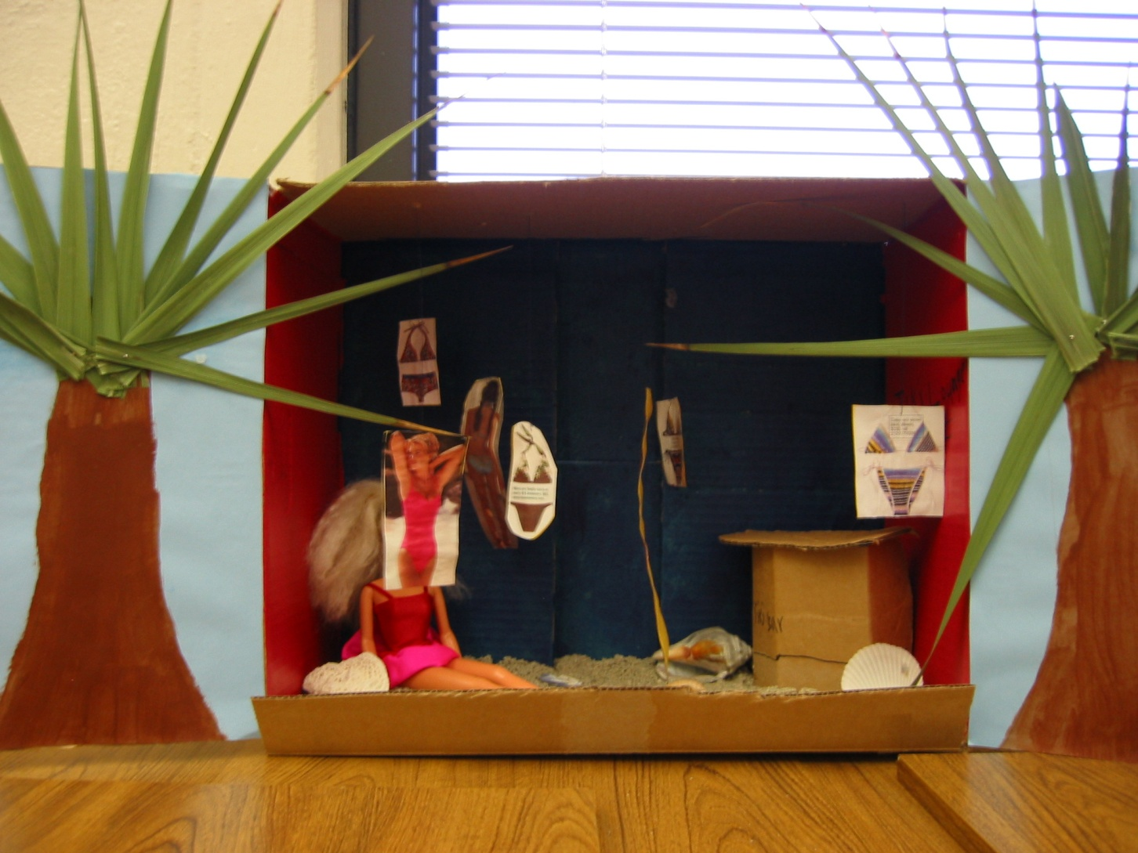
Basic Beach Theme

Slide 4
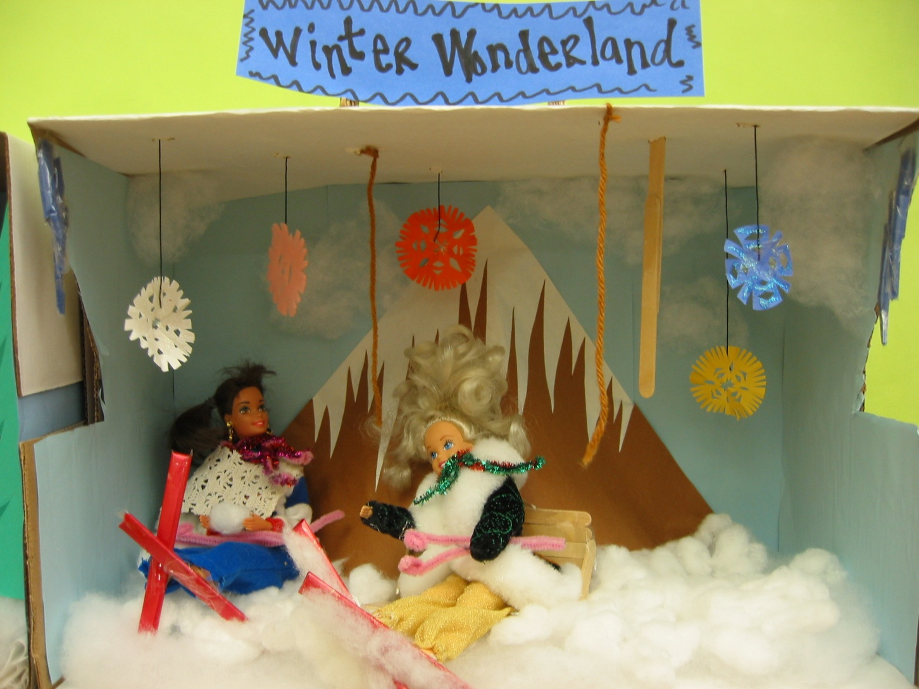
Winter Theme w/ Barbies

Slide 5
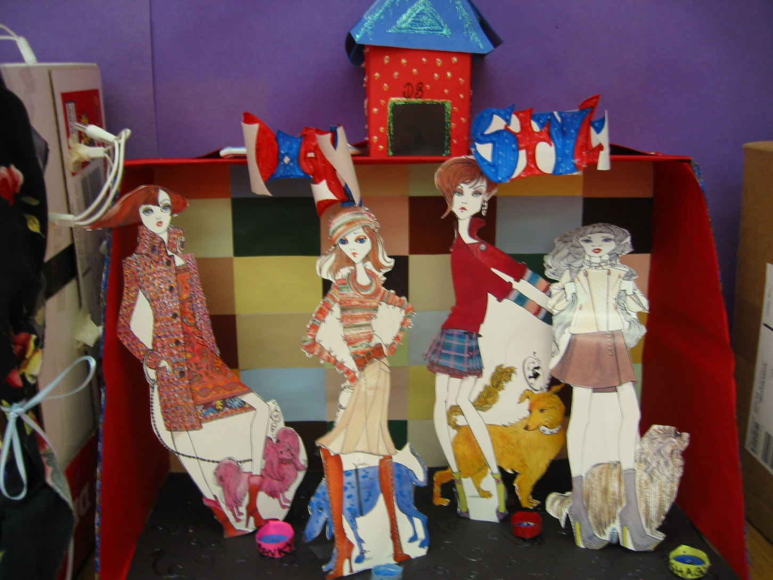
Dog Park – Magazine Cut Outs

Slide 6
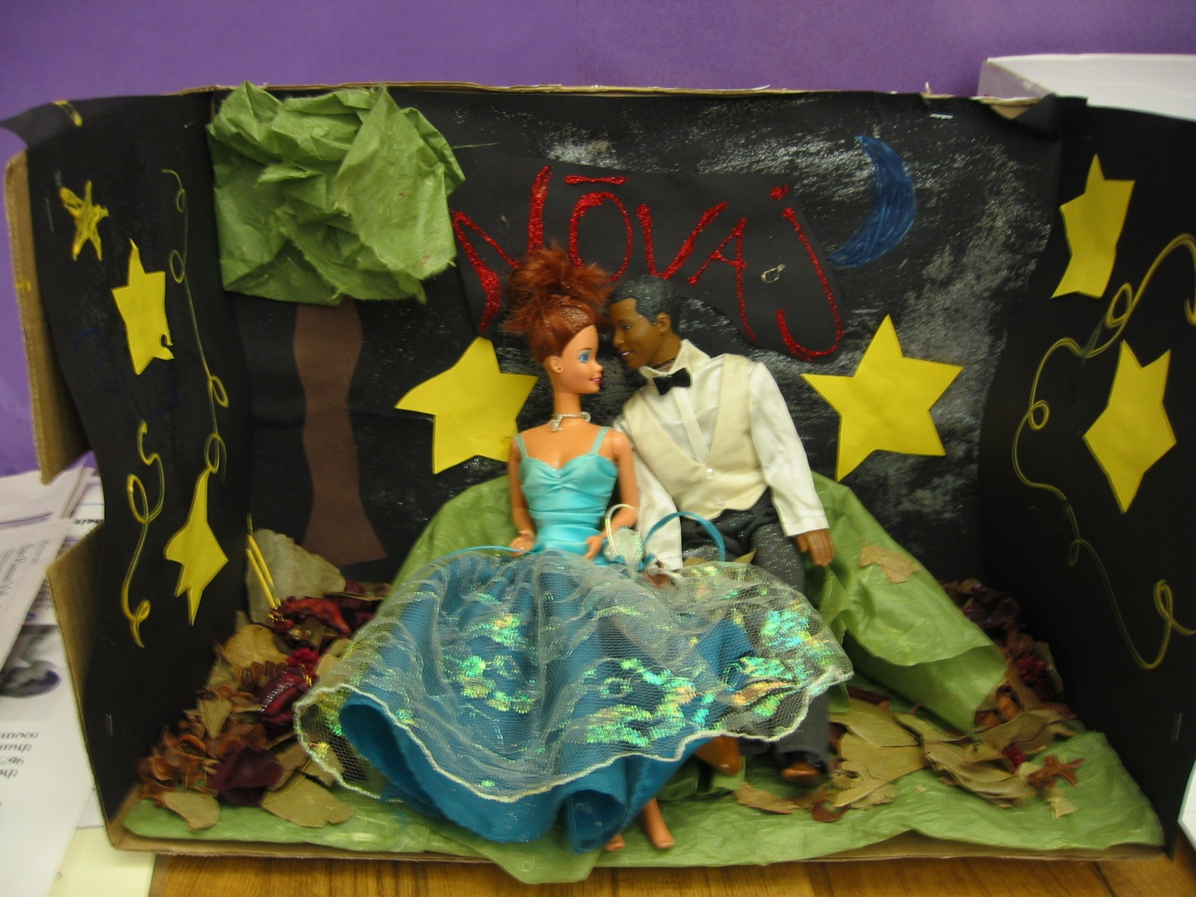
Formal Theme w/ Barbies

Slide 7
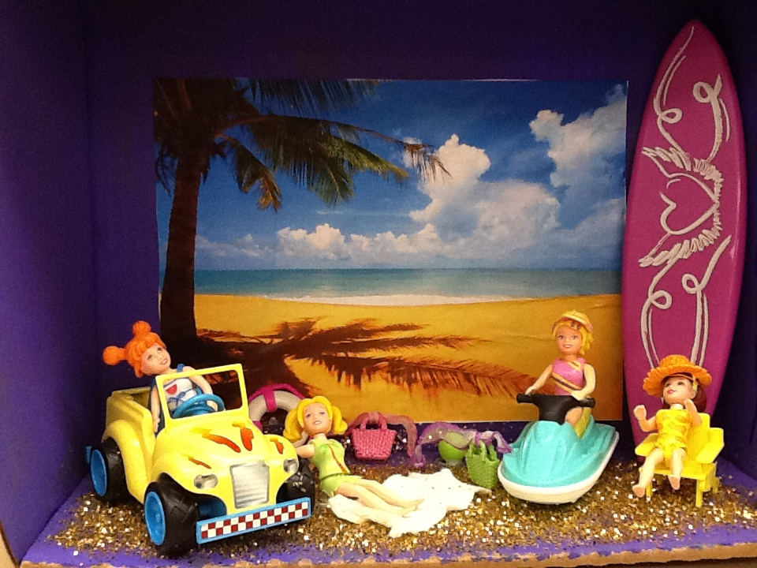
Beach with Polly Pockets

Slide 8
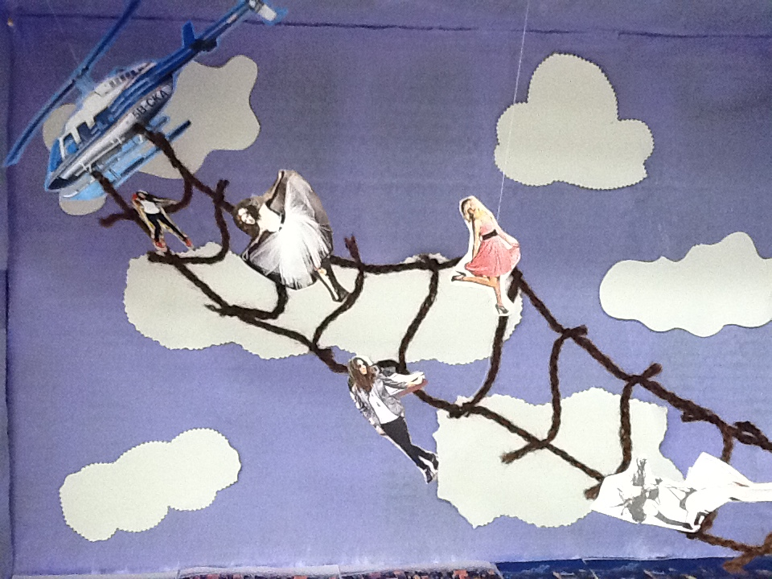
Helicopter from Magazine Pictures

Slide 9
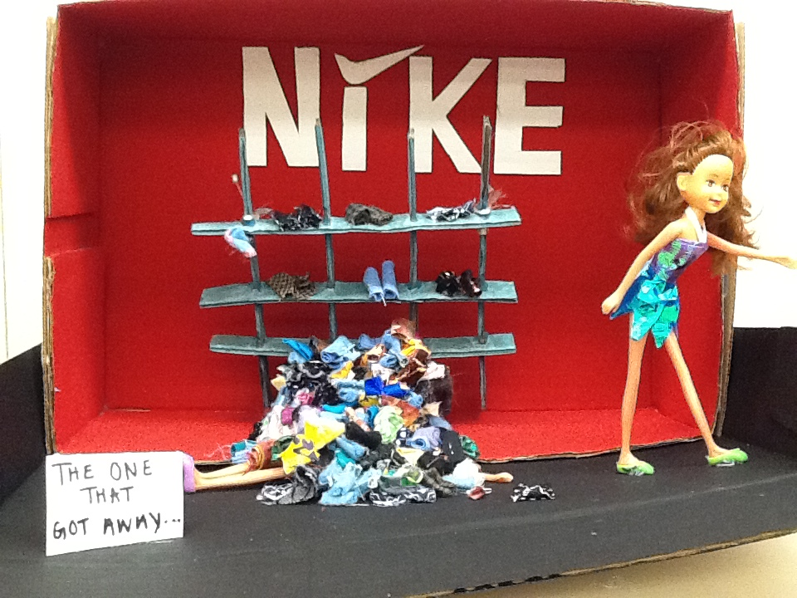
Fabric and Barbies

Slide 10
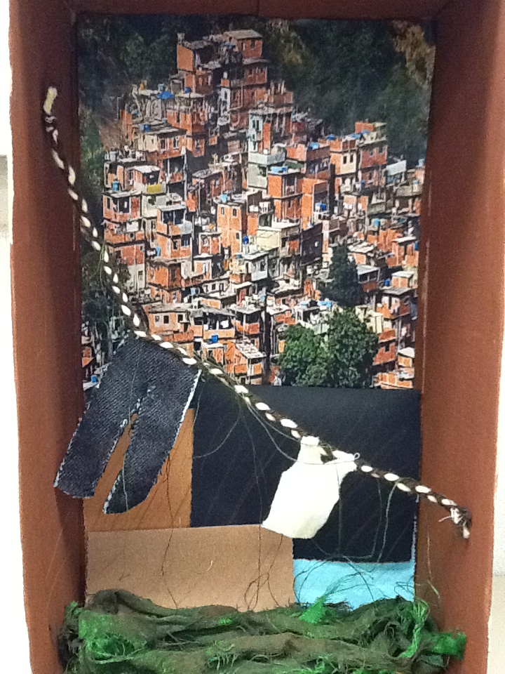
Fabric with Printed Landscape

Slide 11
Possible Props
Polly Pockets
Wooden Mannequins (the kind used for drawing)
Sketches of merchandise (mount on cardboard)
Popsicle Sticks (create furniture)
String for a clothes line or ladder
Clay
Cotton balls
Computer pictures printed for background
You can use almost anything you find in the classroom as long as you can return it after the project

