Slide 1
Window Displays

Slide 2
Vocabulary
Visual Merchandising: It encompasses all of the physical elements that merchandisers use to project an image to customers/clients.
Store Front: This includes the store’s name, logo, banners, windows, and the exterior design.

Slide 3
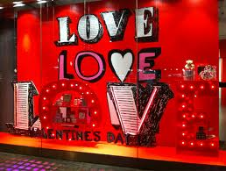

Slide 4
What is the purpose of window displays or
Visual Merchandising?

Slide 5
Displays
Displays are intended to:
  Stimulate product interest
  Provide information
  Suggest merchandise coordination
  Generate traffic flow
  Remind customers of planned purchases
  Create additional sales of impulse items
  Enhance the store’s visual image

Slide 6
Which window displays do you like and why?

Slide 7
Window displays
https://www.google.com/search?q=What+is+the+purpose+of+a+visual+window+display&tbm=isch&tbo=u&source=univ&sa=X&ei=DATnUuimBIjPsASHpIGICg&ved=0CGYQsAQ&biw=1440&bih=743

Slide 8
What are examples of “Bad”
Window displays/why?

Slide 9
What are examples of
Window displays that would attract high school students/why?

Slide 10
Store Front Design
Storefronts must:
  Clearly identify the name and general nature of the display
  Give some hint as to the merchandise inside
  In many cases includes store windows – an advertising medium for the store – window displays should be changed often, be fun/exciting, and reflect merchandise offered inside

Slide 11
Questions?

