Slide 1
Business Documents and Technology

Slide 2
Objectives
To identify the four steps to document creation and to be able to compare positive, negative and persuasive messages.
To understand the formatting procedures for letters, memorandums and business reports.
To understand the technology procedures used in business.

Slide 3
Main Menu
Business Documents
Technology

Slide 4
Business Documents

Slide 5

Steps to Document Creation
Include:
  plan
    gather information
    conduct research
    outline
  write
    create the first draft
    of the document

Slide 6

Steps to Document Creation
Include:
  revise
    check the layout and format
    check for technical errors
    make corrections
  edit
    perform a final spelling/grammar check
    make corrections
    finalize

Slide 7
Tips for Writing
Include:
  knowing the purpose (why) and the subject (who) of the document being created
  always focusing on the receiver and show empathy
  keeping it simple, rather than being wordy or technical
  ensuring the message is understandable and concise

Slide 8
Professional Writing Skills
Are demonstrated by:
  sending messages promptly
  using quality paper
  ensuring accurate formatting of documents
  using high printing quality
  checking for and removing all misspellings and grammatical errors

Slide 9

Types of Messages
Include:
  positive
  negative
  persuasive
Important: Always make sure the type of message matches the response the receiver is looking for.

Slide 10
Positive Messages
Are also known as goodwill messages
Are thoughtful messages intended to generate feelings of support and approval
  usually bearing good or neutral news
Are designed to create a favorable impression of the writer and his/her company
Examples include:
  congratulations, appreciation and acceptance messages, job offers

Slide 11
Positive Messages
Should be written using the direct approach
  straightforward strategy which leads with the main point
Include:
  opening
    announce information
  explanation
    present details and supporting information
  close
    build goodwill by being sincere and friendly

Slide 12
Negative Messages
Are messages bearing bad news
Can create a bad impression of the writer and his/her company
Must be worded sensitively using positive rather than negative words
Examples include:
  order/credit refusal
  employment denials
  poor evaluation/termination messages

Slide 13
Negative Messages
Should be written using the indirect approach
  subtle strategy which leads with explanation and reasoning
Include:
  opening
    use buffer— gentle openings providing a cushion before bad news is presented
  explanation
    provide information and logical reasoning

Slide 14

Negative Messages
Include:
  negative Information
    relate explanation to decision
    provide alternatives if available
  close
    build goodwill by personalizing and staying away from negative subject

Slide 15
Persuasive Messages
Are designed to make the reader want to take action immediately
Must contain interesting and persuasive information
Should be written using an indirect approach
  gain attention in the beginning then proceed with explanation and main point
Examples include:
  sales messages, requests and collection messages, application cover letters

Slide 16
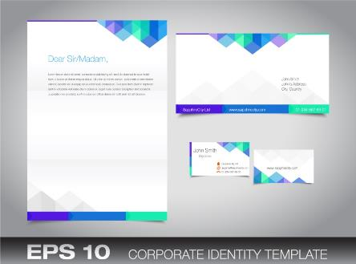
Letter Formatting
Includes:
  equal margins
    usually the default margins set by the word processor
    one-inch side, top and bottom margins, if not set
    side margins can be increased for short letters

Slide 17
Letter Formatting
Includes:
  text alignment options
    all text aligned on the left side with a jagged right side
      preferred by most companies
      gives more personal appearance
    justified with left and right sides being aligned
      gives a computer-generated appearance

Slide 18
Letter Formatting
Includes:
  spacing
    once after a period, question mark, colon or exclamation point
    once after a comma or semicolon
    once after a period following an initial or abbreviation
  mixed punctuation
    colon after salutation
    comma after the complimentary close
    see block letter example

Slide 19
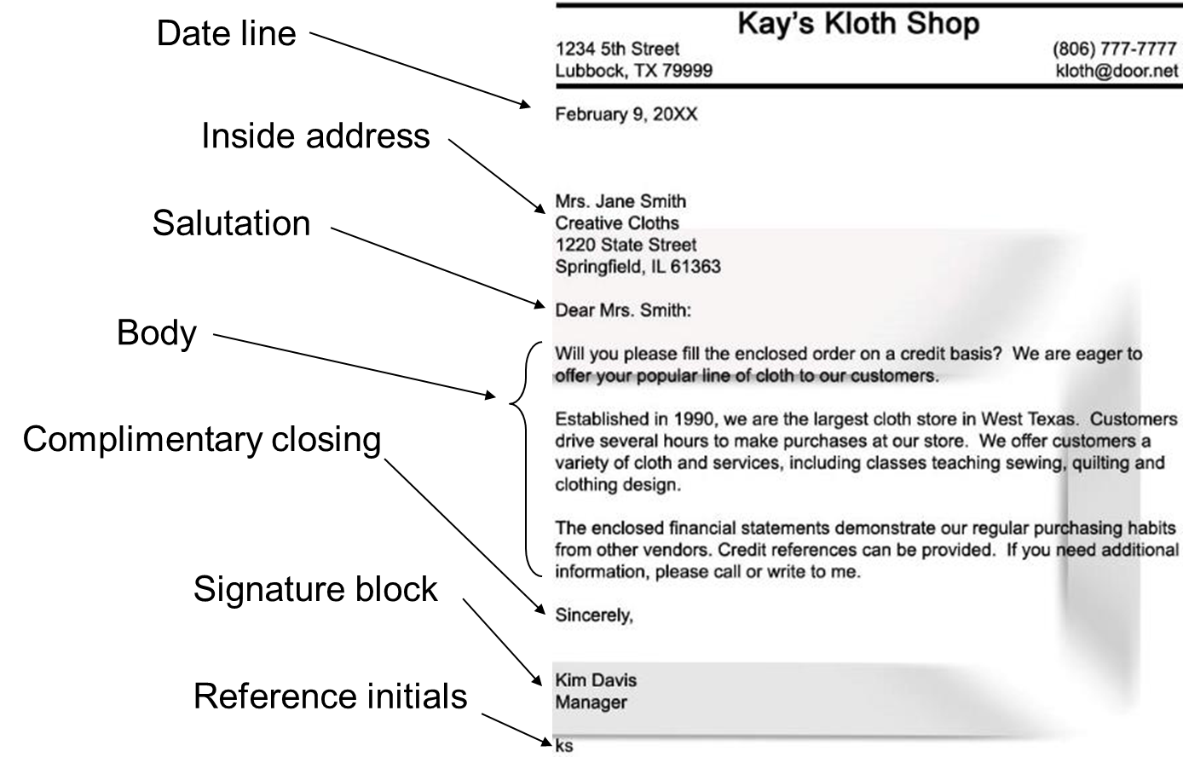
Standard Block Format
Image on the slide of the Standard Block Format of a business letter. Key elements in the Standard Block Format include:
  includes a date line, inside address, salutation, the body, complimentary close, signature block and reference initials
  all elements and paragraphs are left aligned

Slide 20
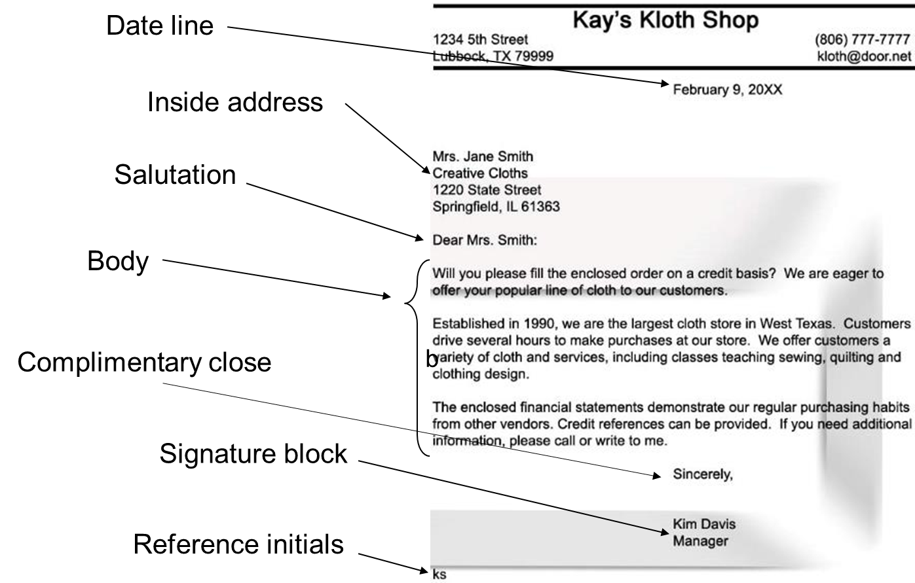
Modified Block Format
Image on the slide of the Modified Block Format of a business letter. Key elements in the Standard Block Format include:
  includes a date line, inside address, salutation, the body, complimentary close, signature block and reference initials
  the date line, complimentary close and signature block are center aligned
  all other elements are left aligned

Slide 21
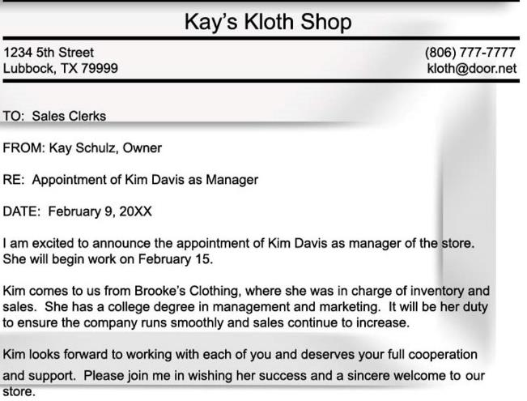
Memorandum Format
Is used for intra-company communication

Slide 22

Parts of a Business Report
Include:
  title page
  letter or memo of transmittal
  table of contents
  table of figures
  executive summary
  report text
    introduction
    body
    conclusion
  citations/bibliography
  appendices

Slide 23
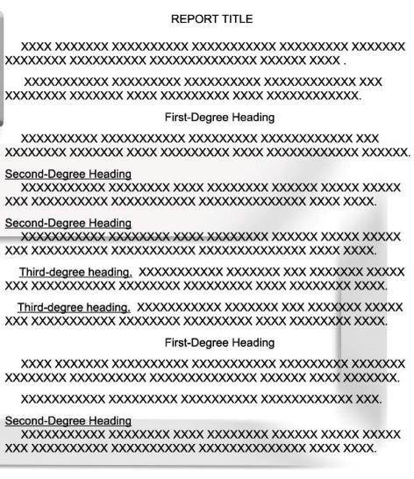
Business Report Heading Formats

Slide 24
Graphics in Written Documents
Allows:
  data to be presented in a simplified way by using graphics
    graphics should only be used to explain and clarify difficult data, not for enhancement purposes
Includes:
  tables
  charts
  maps
  diagrams
  flowcharts

Slide 25

Graphics in Written Documents
Should be inserted into text after their introduction
  there should be written sentences immediately before or after the graphic to summarize its meaning
Do not simply state the figure number and title

Slide 26
Technology

Slide 27

Technology
Is essential for businesses of all types to regulate and optimize business functions and communications
Helps businesses operate more efficiently and effectively

Slide 28
Technology in Business
Includes:
  Internet
  wireless communications
    phone systems, fax machines, e-mail, instant message, videoconferencing, etc.
  computer networking
    local area network (LAN)
      school computer lab or business offices
    wide area network (WAN)
      has two or more interconnected LANs
    metropolitan area network (MAN)
      serves a town or city

Slide 29

Communication Methods
Include:
  calling
  e-mail
  faxing

Slide 30
Communication Procedures
Include:
  prepare
    write down key points
  identify yourself
    first and last name, job title if applicable
  identify purpose
    politely and directly
  take time to listen
    give other party time to ask questions
  review
    make sure both parties agree on what should happen next, if additional communication is needed set up specific day and time

Slide 31

Log-in Procedure
Includes:
  typing in username
  typing in password
  logging out every time

Slide 32
Log-in Tips
For work computers can include:
  always remember username and password
  never give out password
  reset password routinely
Are meant to uphold system security by managing access to files and operations

Slide 33

Troubleshooting
Is the process of solving or determining a problem or an issue, often involves the process of elimination
  identifying the problem by
  first deciding what is not
  wrong in a step-by-step
  manner

Slide 34
Troubleshooting Procedures
Include:
  defining the problem
  eliminating possible causes
  formulating a hypothesis about the cause
  testing hypothesis
  solving the problem

Slide 35

Defining the Problem
Involves determining what is going on
  is there an error message
  is the screen frozen
  has there been a power outage
  is there new hardware or software installed

Slide 36

Eliminate Possible Causes
By using the facts and evidence to progressively exclude possible causes and identify the root of the problem

Slide 37

Formulating & Testing a Hypothesis
Occurs after narrowing down possible problem source
Can be done more than once if changing possible causes is required

Slide 38
Solving the Problem
Is the final step in the process
  make sure to communicate to all parties that the problem has been fixed
Can be done by
  researching error messages
  breaking larger problems into smaller ones and fixing them one by one
  restarting programs or computer

Slide 39

Technology Safety & Security Policies
May concern:
  computer and software use
  e-mail
  Internet
  instant messaging
  blogs and personal
  posting
  cell phone
  portable computing device
  camera phone

Slide 40
Technology Safety & Security Policies
Can protect business by:
  protecting trade secrets
  protecting employer, customer and employee privacy
  managing electronic documents and tools
  limiting liability for employee misconduct
  conserving company resources
  preventing e-harassment

Slide 41
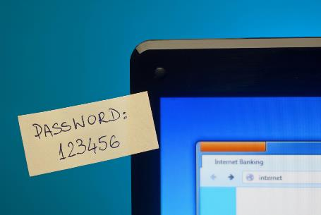
Technology Safety & Security Policies
Usually include information stating:
  do not give out passwords
  always log out
  never visit unprotected web pages
  keep personal information off company computers

Slide 42
Ergonomic Techniques
Deal with designing and arranging equipment so people can use technology easily and safely
Can include guidelines for safe computer use, gaming, smartphones, tablets, etc.

Slide 43
Ergonomic Techniques
Include:
  sit up tall, push hips all the way back in chair, have feet flat on the floor, have chair at 100 to 110 degree angle
  position keyboard directly in front of chair, even with the front edge of the desk and at elbow height so wrist movement is not restricted
  place monitor 18 to 24 inches from eyes, with top edge of display screen at eye level
  take short breaks every hour to relax the neck, shoulders, arms, wrists and fingers

Slide 44
Acknowledgements
Production Coordinator
Krista Scott
Amy Hogan
Graphic Designer
Melody Rowell
Brand Manager
Megan O’Quinn
V.P. of Brand Management
Clayton Franklin
Executive Producer
Gordon W. Davis, Ph.D.
©MMXVI
CEV Multimedia, Ltd.

