Slide 1
Microsoft® PowerPoint® 2019 Basics – Final Review

Slide 2
Objectives
To review concepts covered in the Microsoft® PowerPoint® 2019 Basics units.

Slide 3
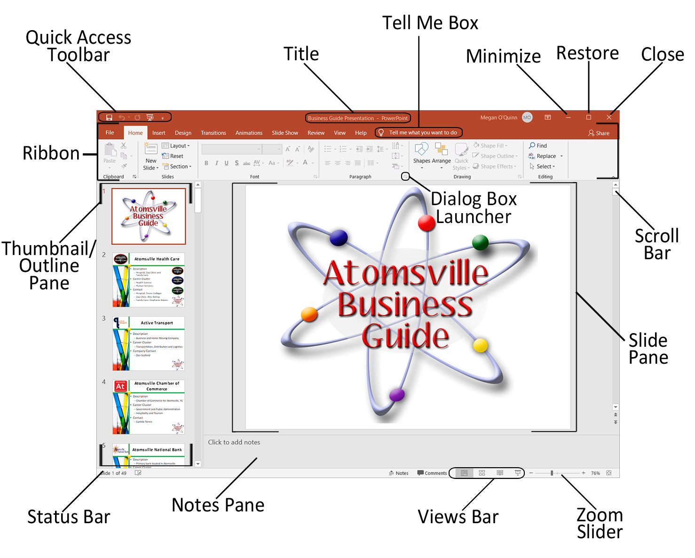
Microsoft® PowerPoint®
Is a presentation software which allows users to create polished, professional slide-based presentations
Presentations can include sets of slides and handouts which contain information a presenter wants to convey to an audience.

Slide 4

Microsoft® PowerPoint®
Can be opened by:
  clicking on the program icon on the Start Menu
  double-clicking on the icon of a previously created PowerPoint® presentation
  double-clicking on a shortcut to the program

Slide 5
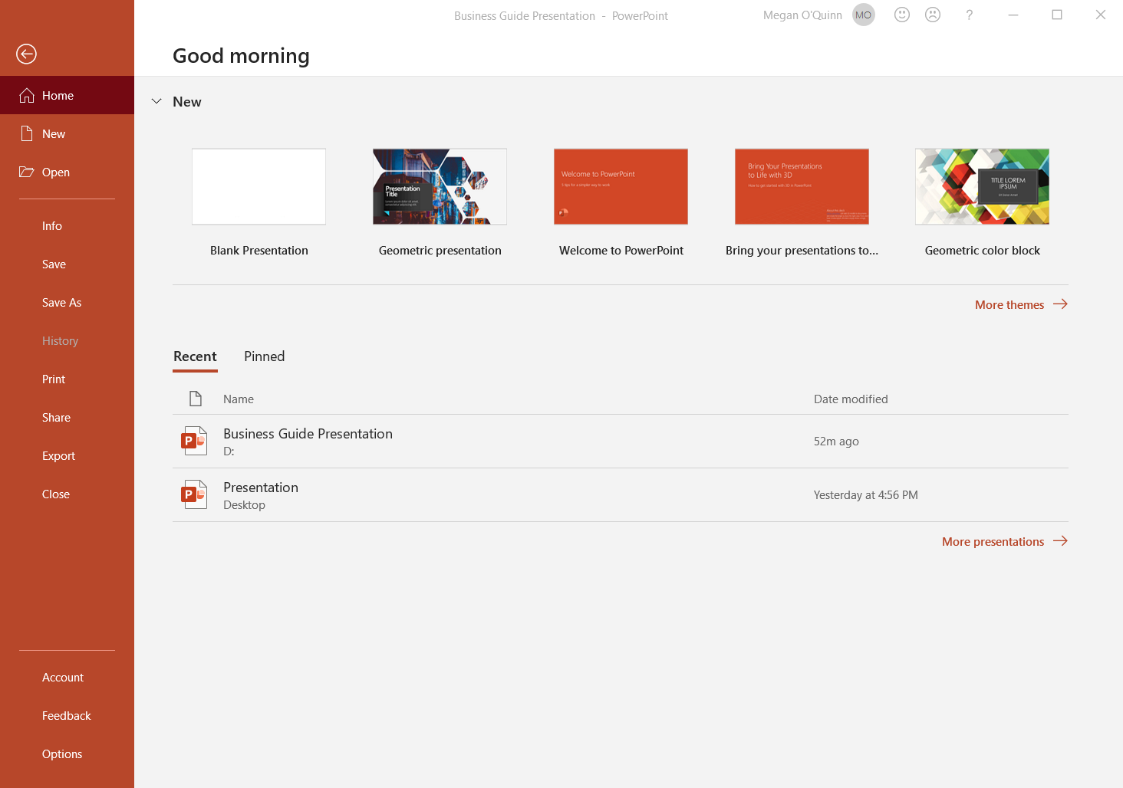
File Tab
When clicked, opens Backstage View
  automatically opens the Info option by default
Holds the following options:
  Home, New, Open, Info, Save, Save As, History, Print,
  Share, Export,
  Close, Account,
  Feedback,
  Options

Slide 6
Home Tab
Contains the following groups:
  Clipboard
    holds commands for cutting, copying, pasting, formatting painter and opening the clipboard
  Slides
    includes commands for adding new slides, changing layout, resetting slide layouts and adding and removing sections
  Font
    contains commands for formatting text such as specifying font type, size, case, color, effects and highlight

Slide 7
Home Tab
Contains the following groups:
  Paragraph
    holds commands for formatting paragraphs such as adding bulleted or numbered lists, alignment, paragraph indent and spacing, paragraph background color and borders and visibility of non-printing characters
  Drawing
    contains commands to add, format and arrange shapes and textboxes
  Editing
    holds commands to find, replace and select text

Slide 8
Insert Tab
Is composed of the following groups:
  Slides
    holds commands to insert new slides
  Tables
    contains commands to insert tables
  Images
    holds commands to insert pictures, screenshots and photo albums
  Illustrations
    consists of the commands to add shapes, SmartArt and charts

Slide 9
Insert Tab
Is composed of the following groups:
  Add-ins
    holds commands for adding commands to simplify tasks
  Links
    contains commands to insert hyperlinks and actions
  Comments
    holds the command for inserting a comment
  Text
    consists of commands to add text boxes, headers and footers, WordArt, date and time, slide numbers and objects

Slide 10
Insert Tab
Is composed of the following groups:
  Symbols
    holds commands to insert equations and symbols
  Media
    contains commands to insert video, audio and screen recording files

Slide 11
Design Tab
Contains the following groups:
  Themes
    consists of themes which can be added to slides
  Variants
    holds commands which are variations of the current theme which uses different color schemes
  Customize
    contains commands which can change the slide size and format the slide background

Slide 12
Transitions Tab
Is composed of the following groups:
  Preview
    contains the command to preview the transitions applied to the slide
  Transition to This Slide
    holds the commands to add transitions and edit effect options
  Timing
    consists of commands which can be used to add sounds, set slide timings and choose how slides advance

Slide 13
Animations Tab
Contains the following groups:
  Preview
    contains the command to preview the animations applied to objects in the slide
  Animation
    holds the animation gallery and effect options
  Advanced Animation
    consists of commands which can be used to format animations
  Timing
    includes commands which can be used to control when animations begin, duration and order

Slide 14
Slide Show Tab
Contains the following groups:
  Start Slide Show
    consists of commands to begin the slide show presentation
  Set Up
    holds commands to set up the slide show, hide slides, rehearse timings, record the slide show, play narration, use timings and show media controls
  Monitors
    contains commands to specify the monitor and view Presenter View

Slide 15
Review Tab
Contains the following groups:
  Proofing
    holds the spelling and grammar check tool and thesaurus
  Accessibility
    contains the command to check the presentation for accessibility issues
  Insights
    consists of the Smart Lookup command
  Language
    holds commands to translate text and set the language

Slide 16
Review Tab
Contains the following groups:
  Comments
    contains commands for adding new comments, navigating through comments and showing comments
  Compare
    holds commands to compare presentations, accept or reject changes, open the Reviewing Pane and end the review
  Ink
    consists of the command to open a pen/highlighter to mark on a presentation

Slide 17
View Tab
Consists of the following groups:
  Presentation Views
    contains different viewing options which can be applied
  Master Views
    contains different viewing options for Masters
  Show
    holds commands to show rulers, gridlines and the Navigation Pane
  Zoom
    contains commands to view the file at different zoom levels

Slide 18
View Tab
Consists of the following groups:
  Color/Grayscale
    contains commands to set which color settings are used for the presentation
  Window
    holds commands for viewing a presentation in the program window
  Macros
    consists of the command to create a macro

Slide 19
Common Keyboard Shortcuts
Shortcut Keys | Command Completed
Control N | Open a new presentation
Control S | Save a presentation
Control W | Close a presentation
Control X | Cut content and place on the clipboard
Control C | Copy content to the clipboard
Control V | Paste content from the clipboard
Control A | Select all content
Control B | Bold selected content
Control I | Italicize selected content
Control U | Underline selected content

Slide 20
Common Keyboard Shortcuts
Shortcut Keys | Command Completed
Control E | Center-align text
Control L | Left-align text
Control R | Right-align text
Control Z | Undo the last action
Control Y | Redo the last undone action
Control K | Insert a hyperlink
Control P | Print
Control D | Duplicate the active slide
Control G | Group selected slide objects
Control Shift G | Ungroup objects

Slide 21
Common Keyboard Shortcuts
Shortcut Keys | Command Completed
Control Shift H | Show/Hide Notes Pane
Control M | Insert new slide
F5 | View slide show from first slide
Shift F5 | View slide show from current slide
Alt F5 | Opens Presenter View
Memorize keyboard shortcuts to increase your speed in completing common actions in Microsoft® Office programs.

Slide 22
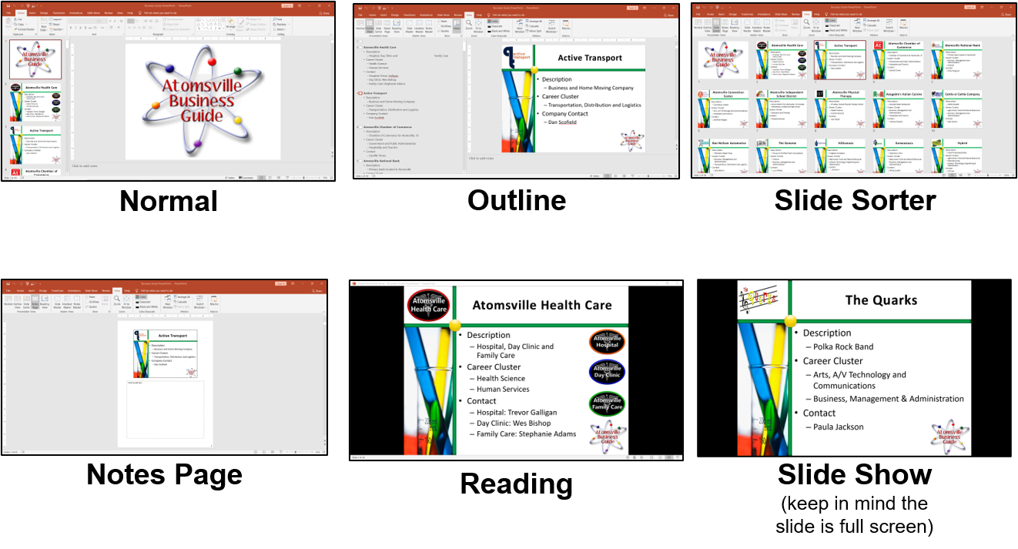
Presentation Views
Control how the presentation is currently shown

Slide 23
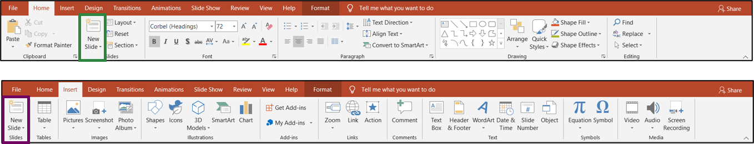
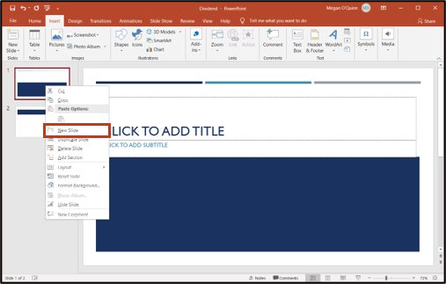
Slides
Can be added after the current slide by:
  clicking New Slide in the Slides group on the Home tab
  clicking New Slide in the Slides group on the Insert tab
Can also be added by right-clicking the slide where a user wants the new slide to be added after and choosing New Slide from the menu

Slide 24
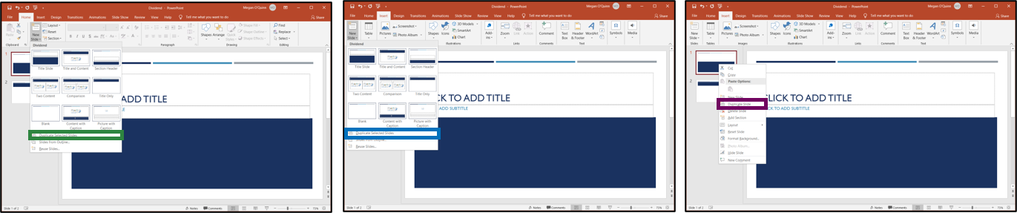
Duplicating Slides
Can be completed by:
  selecting the slide or slides and on the Home tab clicking New Slide in the Slides group and choosing Duplicate Selected Slides
  selecting the slide or slides a user wants to duplicate and on the Insert tab clicking New Slide in the Slides group and choosing Duplicate Selected Slides
  right-clicking on the slide a user wants to duplicate and choosing Duplicate Slide from the menu

Slide 25
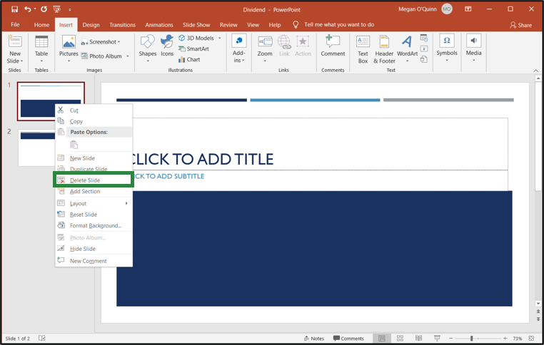
Deleting Slides
Can be accomplished by:
  right-clicking on the slide and choosing Delete Slide from the menu
  selecting the slide and pressing the Delete or Backspace key
Slides should only be removed from presentations if a user does not need the information on them. Users can hide slides in a presentation which do not need to appear in the show but need to stay in the file.

Slide 26
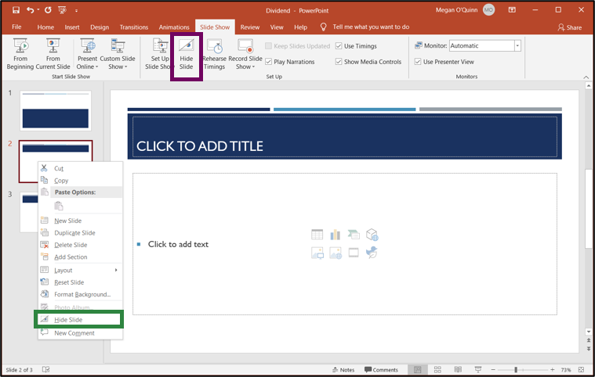
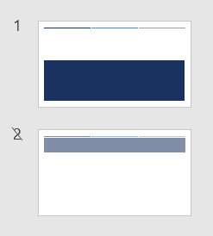
Hiding Slides
Can be done by:
  right-clicking on the slide a user wants to hide and clicking Hide Slide
  selecting the slide and on the Slide Show tab clicking Hide Slide in the Set Up group
Hidden slides appear lighter in the Thumbnail/Outline pane or Slide Sorter and their slide number has a slash through it.

Slide 27
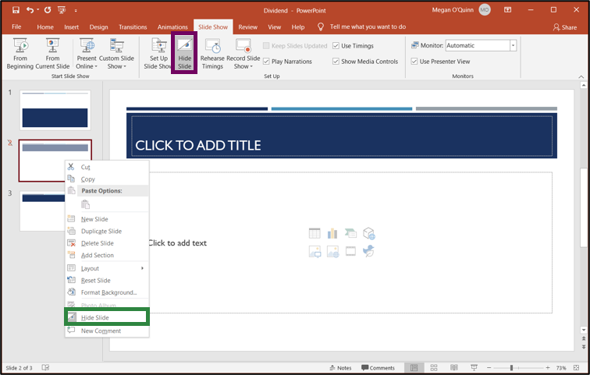
Hidden Slides
Can be unhidden by:
  right-clicking the slide a user wants unhidden and clicking Hide Slide to unselect it
  selecting the slide and clicking Hide Slide in the Set Up group of the Slide Show tab to unselect it

Slide 28
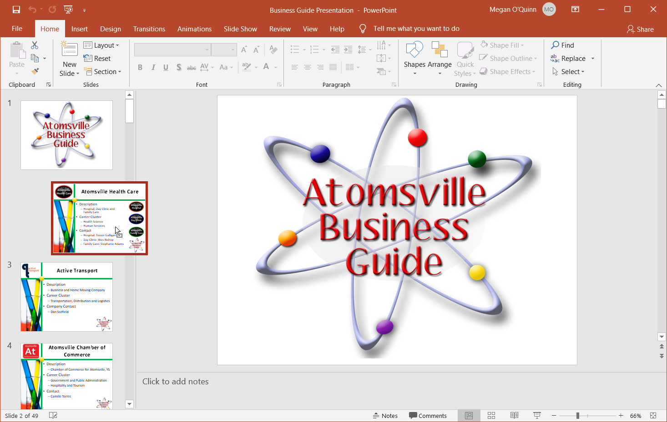
Slide Order
Can be changed in Normal View by:
  selecting the slide a user wants to move
  dragging the slide to a new location
To select more than one slide, press the Control key while clicking on each slide.
To select a series of slides, click the first slide, press Shift and click the last slide in the series.

Slide 29
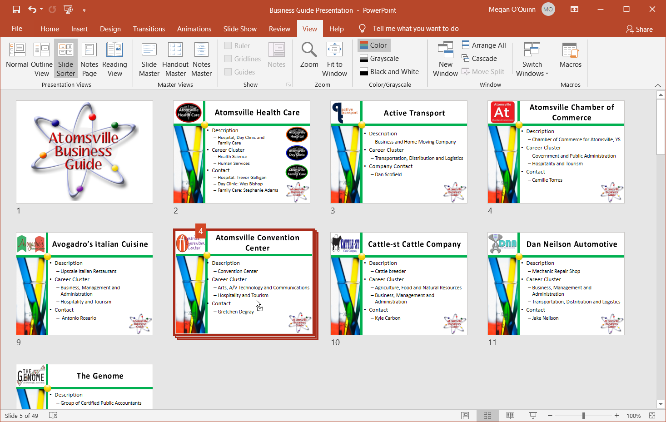
Slide Order
Can be changed in Slide Sorter View by:
  selecting the slides
  dragging them to the desired location
Notice in the image, multiple slides are selected and being moved. A user can tell the number of slides being moved by the number which pops up while dragging the slides.

Slide 30
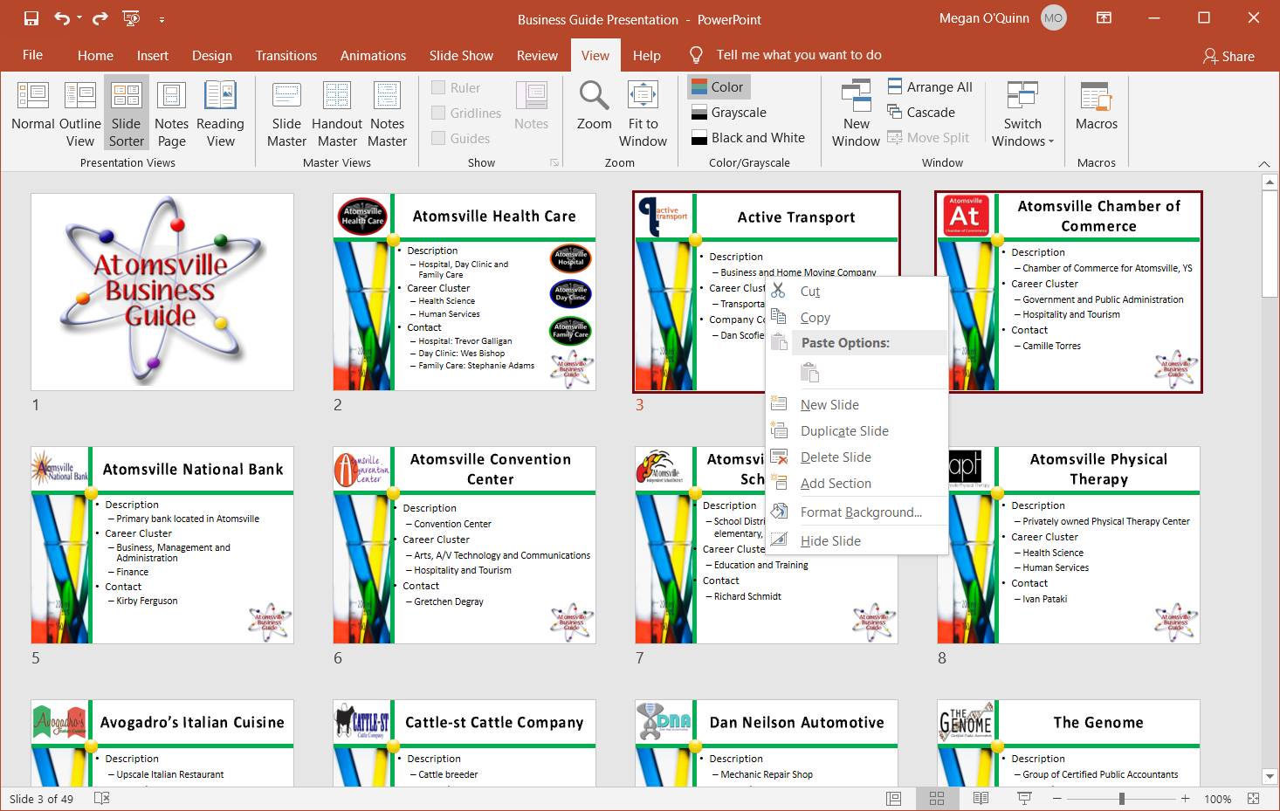
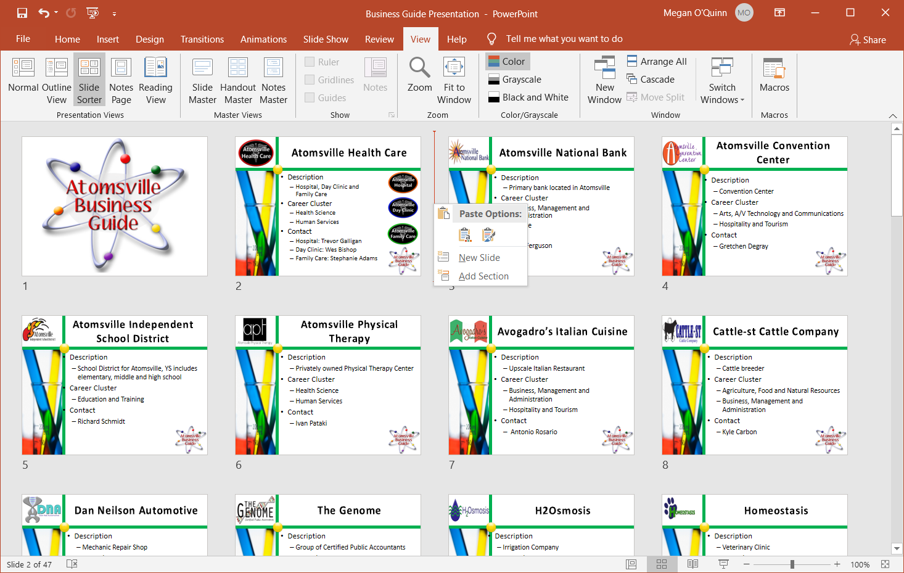
Slide Order
Can also be changed by:
  cutting the slides to the Clipboard
  pasting the slides from the Clipboard to the desired location

Slide 31
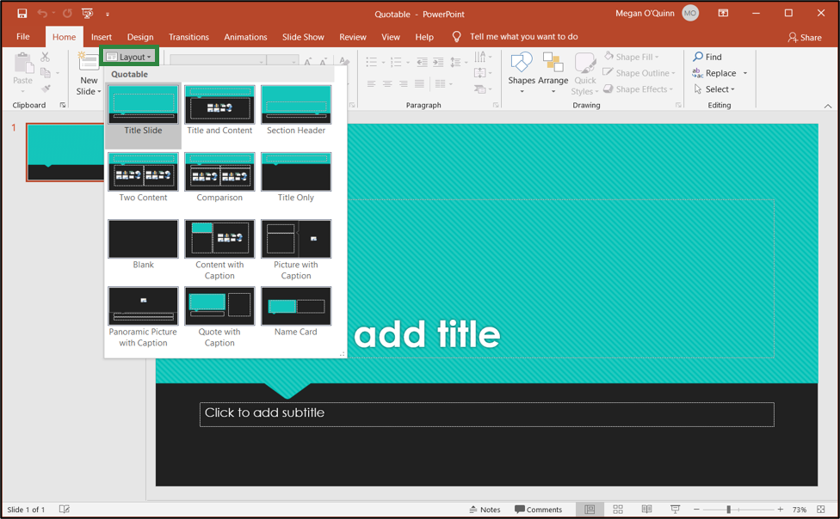
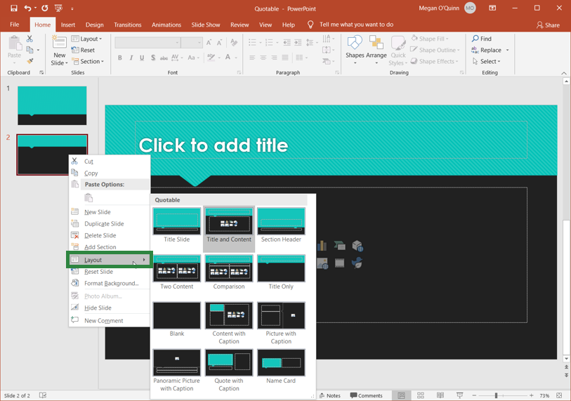
Slide Layouts
Contain formatting, positioning and placeholders for all the content on the slide
Can be found on the Home tab in the Slides group by clicking Layout
Can also be found by right-clicking on a slide in the Thumbnail/Outline pane and choosing Layout from the menu

Slide 32
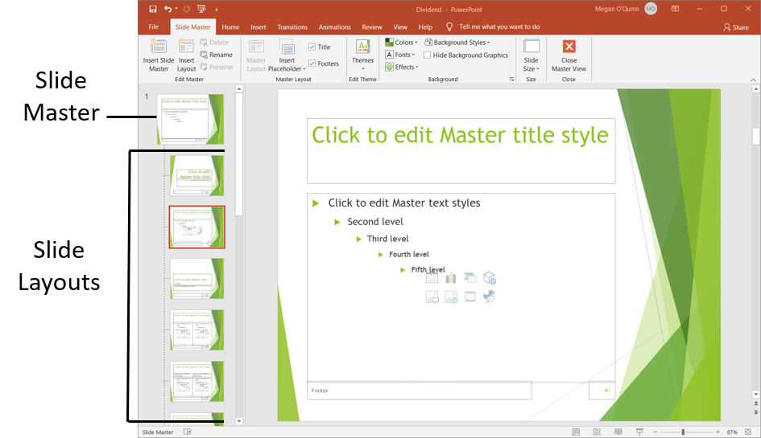
Slide Master
Is the basis of every PowerPoint® slide
Contains all of the design elements for the slides including:
  backgrounds
  font styles
  color schemes
  placeholders
Can be seen by
using Slide Master
View
Can be used to make changes to all slides in a presentation using a particular slide layout

Slide 33
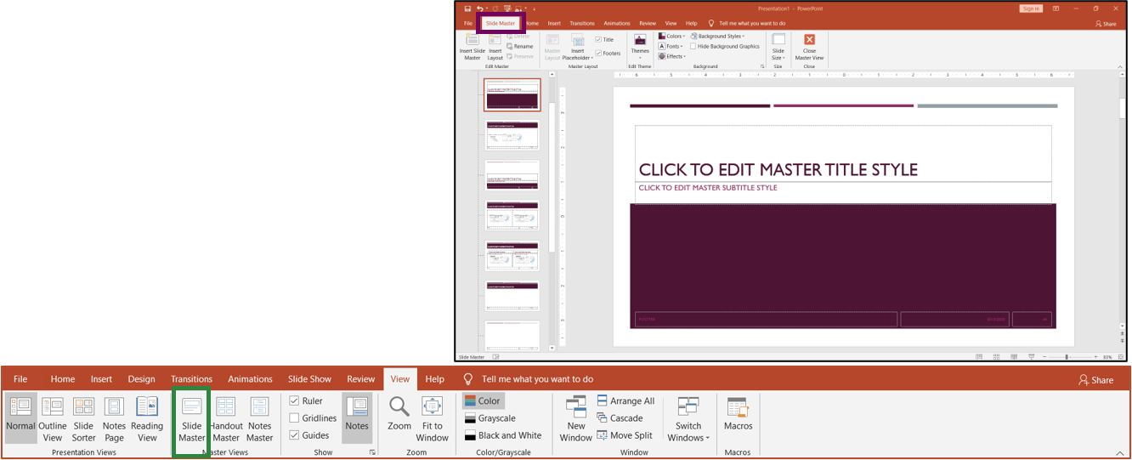
Slide Master View
Can be opened by clicking on the Slide Master icon in the Master Views group of the View tab
Contains the Slide Master tab on the Ribbon before
the Home tab

Slide 34
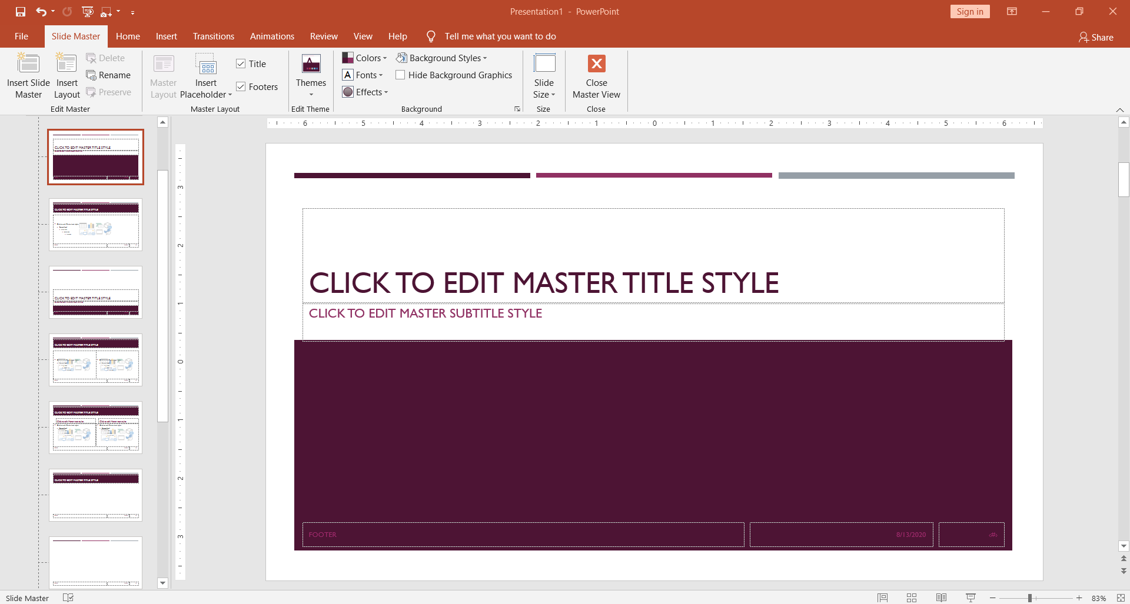
Slide Master View
Contains the tabs normally found on the Ribbon which can be used to make changes to the slide masters and layouts
Keep in mind, changes made to slide masters and slide master layouts will be applied to any and all slides which use the layout in the presentation.

Slide 35
Slide Masters
Should be edited prior to creating individual slides so all slides entered in a presentation are based on the custom edits
  if the slide master or layout is edited after it has been applied to a slide, it will need to be reapplied to the slides

Slide 36
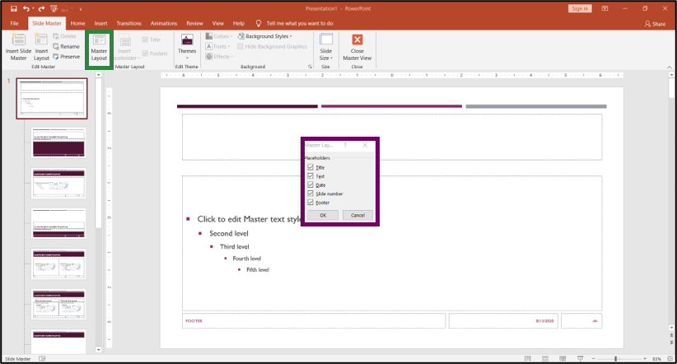
Slide Masters
Can be changed to include different placeholders in Slide Master View by:
  clicking Master Layout in the Master Layout group
  selecting or unselecting the different items a user wants in the Master Layout dialog box

Slide 37
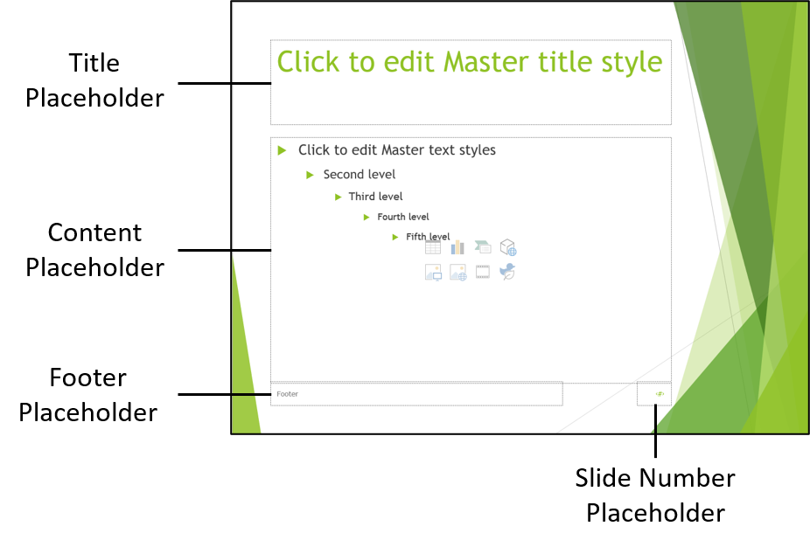
Placeholders
Are boxes with dotted borders which contain content
Are located within slide layouts
Placeholders can ONLY be added to slide layouts, NOT to individual slides in a presentation. This means users must be in Slide Master View in order to add the placeholder.

Slide 38
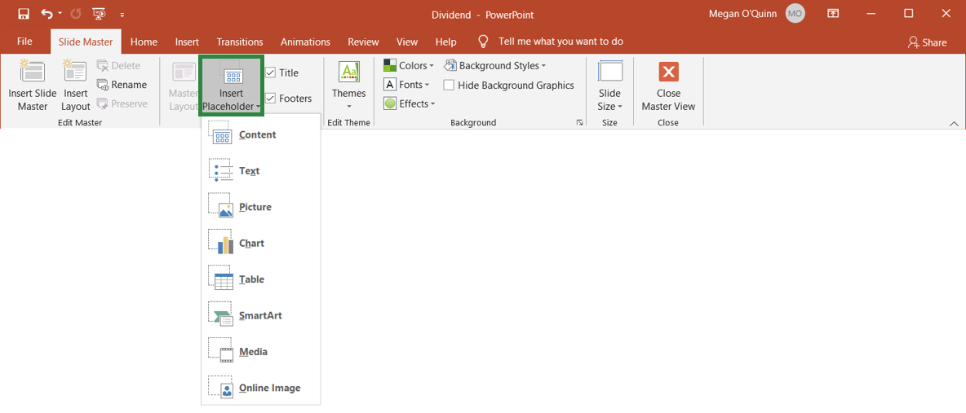
Placeholders
Can be added to slide layouts by clicking Insert Placeholder on the Slide Master tab in the Master Layout group and then clicking the placeholder type and drawing it on the slide
There are many different types of placeholders which can be added depending on what a user would like it to contain.
To close out of Slide Master View, click the Close Master View icon on the Slide Master tab.

Slide 39
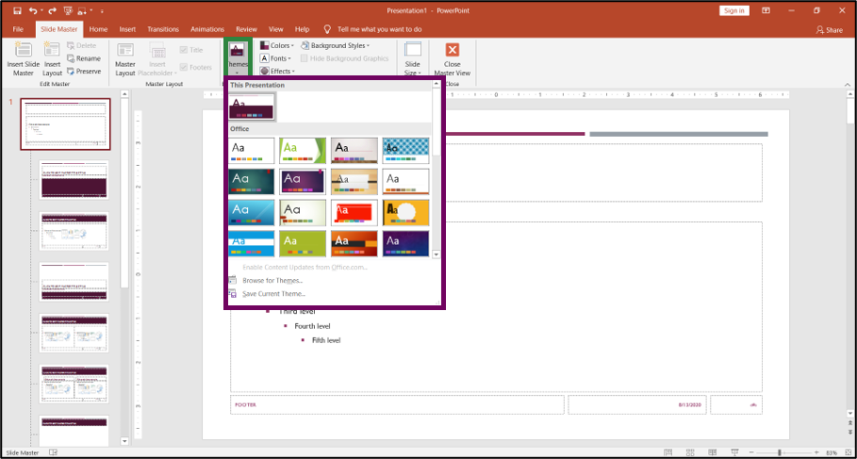
Slide Masters
Can have themes applied by:
  clicking Themes in the Edit Theme group on the Slide Master tab
  choosing a theme from the menu
The theme will contain a slide master and set of slide layouts.
The theme colors, fonts and effects can be edited by using the Background group on the Slide Master tab.

Slide 40
Themes
Are palettes of colors, fonts and special effects which complement one another
Can be located on the Design tab in the Themes group
Include a slide master and a related set of layouts
Can be previewed by hovering over a theme in the Themes group and it will be shown on the slide

Slide 41
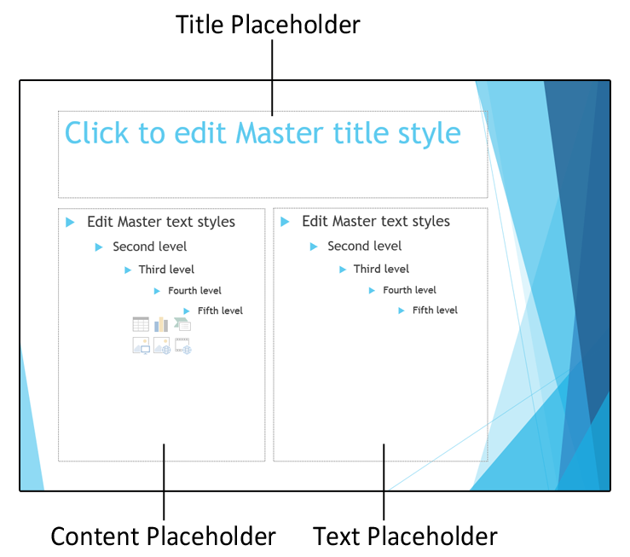
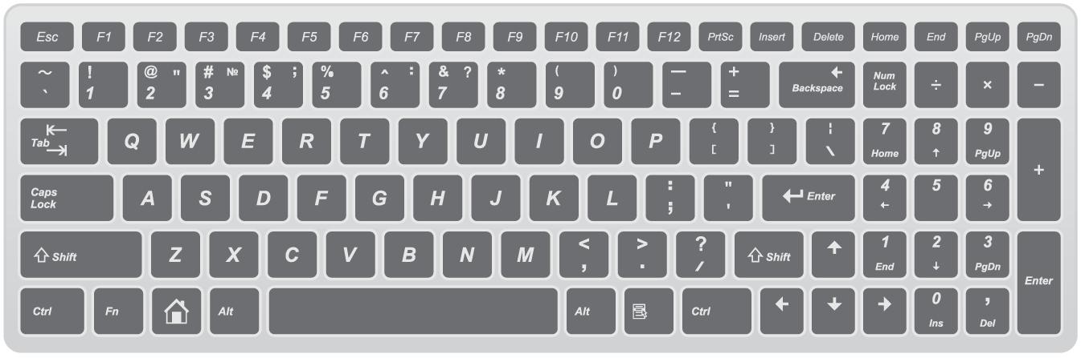
Text
Can be added to slides in:
  title placeholders
  content placeholders
  text placeholders
Can be entered in these
locations by clicking in
the placeholder and
beginning to type on
the keyboard

Slide 42
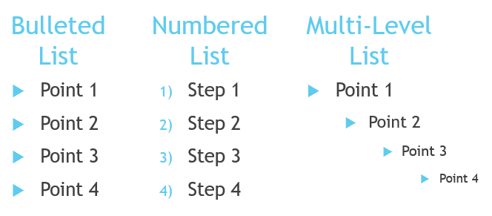
Text
In placeholders, is commonly formatted as one of the following:
  bulleted list
  multi-level list
  numbered list
To change the format of the list, use the commands in the Paragraph group on the Home tab. Multi-level lists can be created by using the Tab key after pressing the Enter key to move to the next point or the Indent icons in the Paragraph group.

Slide 43
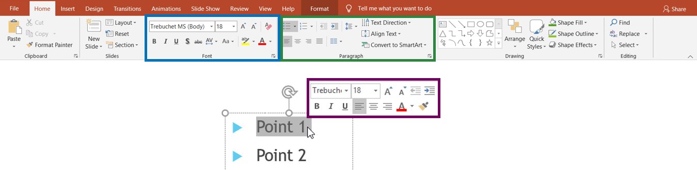
Formatting Text
Can be completed by using the:
  Font group on the Home tab
  Mini toolbar
    contains many of the same commands which are found in the Font group
    appears over selected text
  Paragraph group on the Home tab

Slide 44
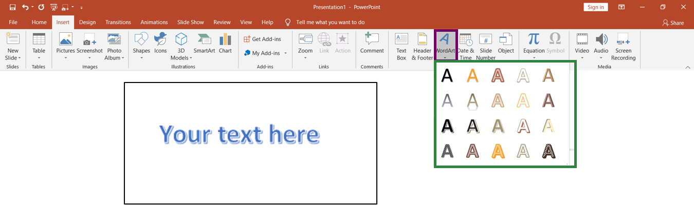
WordArt
Is decorative text which can be added to a document
Can be added by clicking the WordArt icon in the Text group on the Insert tab and choosing an option from the menu

Slide 45
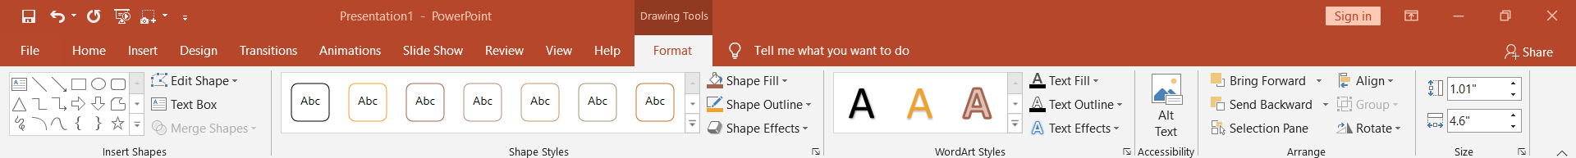
WordArt
When selected, makes the Drawing Tools section appear on the Ribbon and contains the Format tab
  this tab can be used to format WordArt
It is important to note, the text entered in a text box, shape or WordArt can be formatted using the commands on the Home tab related to text or on the shortcut menu.

Slide 46
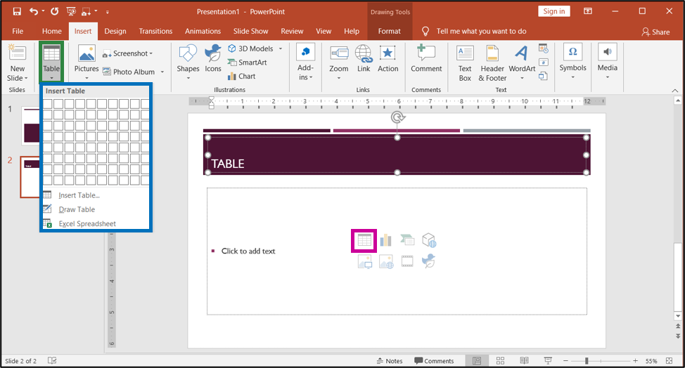
Tables
Can be inserted by:
  clicking the Table icon on the Insert tab and choosing an option from the menu
  clicking the Table icon in the content placeholder

Slide 47
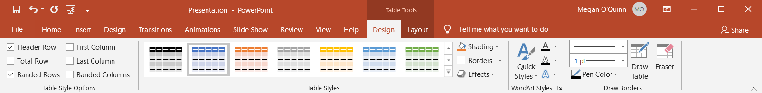
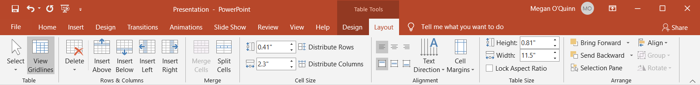
Tables
When selected, makes the Table Tools section appear on the Ribbon and contains the Design and Layout tabs
  these tabs can be used to format the table

Slide 48
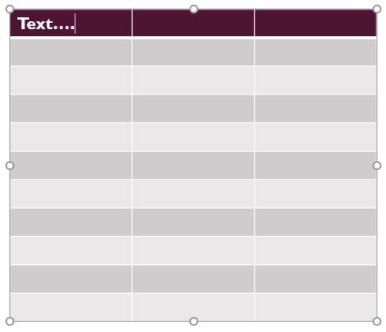
Text
Can be entered in tables by placing the cursor in the cell where a user wants to add text and beginning to type
Row Height: increases automatically to make room for the text
Column Width: does not change to make room for the text; text will wrap at the right border
Formatting Text in a Table: can be completed by using the same commands as formatting text not in a table

Slide 49
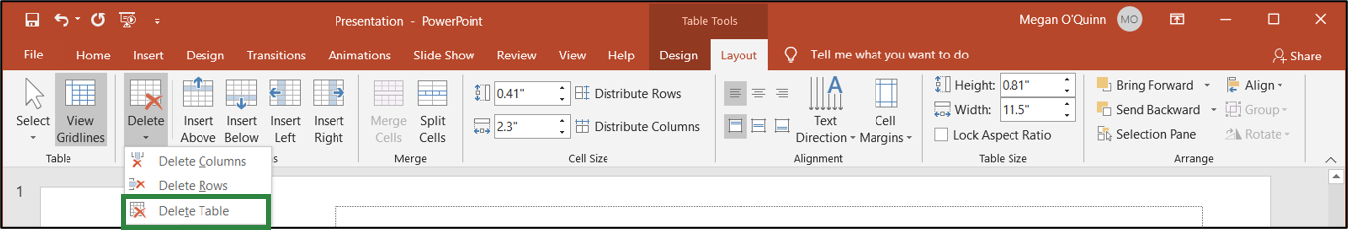
Deleting Tables
Can be completed by:
  selecting the table
  clicking the Delete icon on the Table Tools Layout tab
  choosing Delete Table from the menu
Tables can also be deleted by selecting the table and then pressing the Delete key on the keyboard.

Slide 50
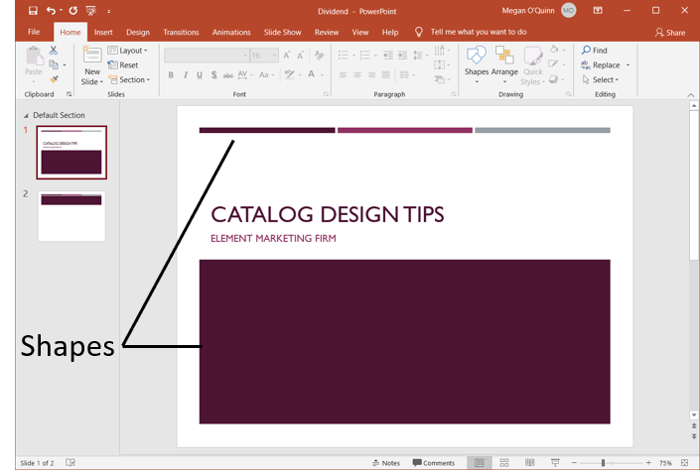
Shapes
Are objects which can be added to presentations such as circles, lines, rectangles, etc.
Can function as a text box or a design element
Shapes are added to presentations as floating objects, meaning they can be positioned anywhere on the page.

Slide 51
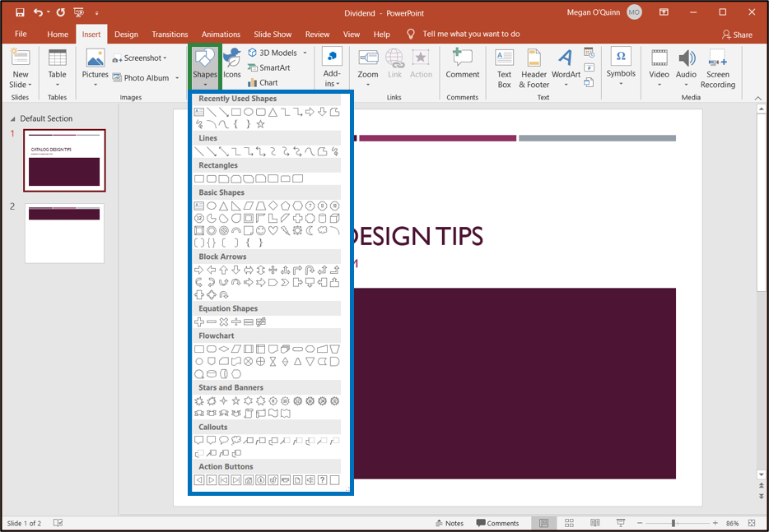
Shapes
Can be added by clicking the Shapes icon in the Illustrations group on the Insert tab and choosing an option from the menu

Slide 52
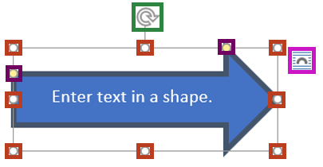
Shapes
Can have text entered into it by selecting it and beginning to type
Can be resized by clicking and dragging on the sizing handles or have the appearance modified by using the yellow circles
Can be rotated using the rotating handle
Can have the layout adjusted by clicking on the Layout Options icon
Can be deleted by selecting the shape and pressing the Delete key

Slide 53
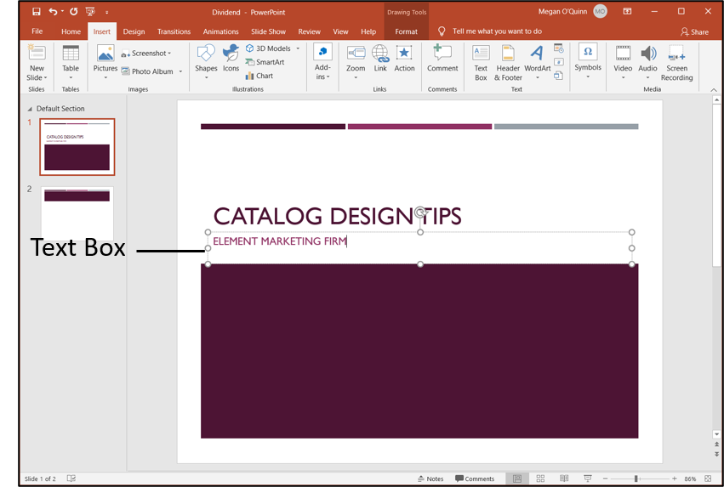
Text Boxes
Are objects in which text can be added and placed anywhere on a slide
Can be used as design elements on a slide by formatting them

Slide 54
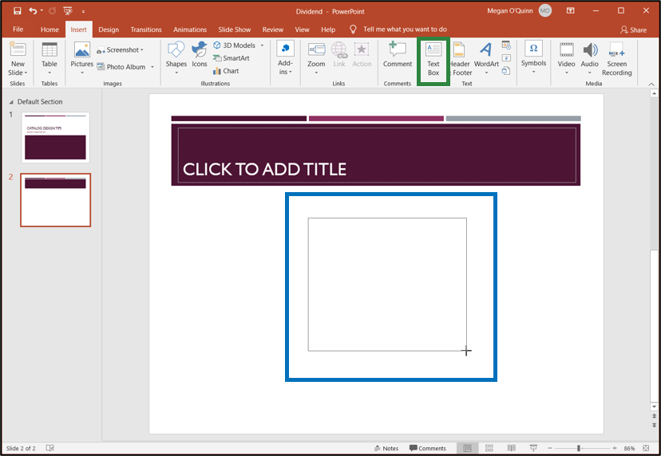
Text Boxes
Can be added by clicking the Text Box icon in the Text group on the Insert tab and then clicking and dragging the mouse where the
text box needs to be placed

Slide 55
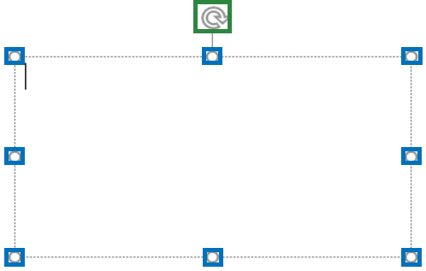
Text Boxes
Can have text entered into them by selecting them and beginning to type
Can be resized by clicking and dragging on the sizing handles
Can be rotated using the rotating handle
Can be deleted by selecting the text box and pressing the Delete key

Slide 56
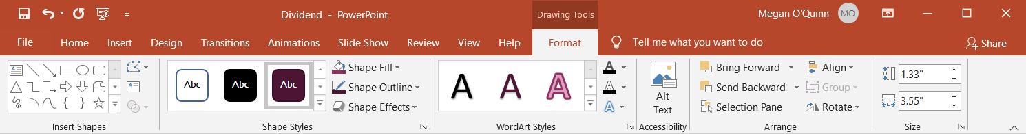
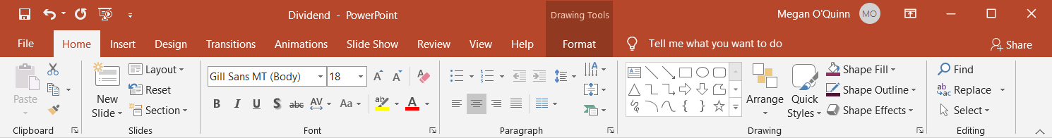
Text Boxes & Shapes
When selected, makes the Drawing Tools section appear on the Ribbon and contains the Format tab
  this tab can be used to format shapes and text boxes
It is important to note, the text entered in a text box, shape or WordArt can be formatted using the commands on the Home tab related to text or on the shortcut menu.

Slide 57
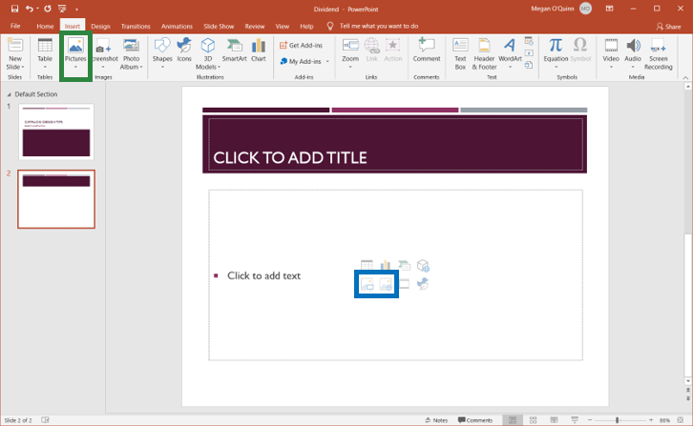
Pictures
Can be added by:
  clicking the Pictures
  icon in the Images
  group on the Insert
  tab and locating the
  file to be added
  clicking the Pictures
  or Online Pictures
  icon in the content placeholder

Slide 58
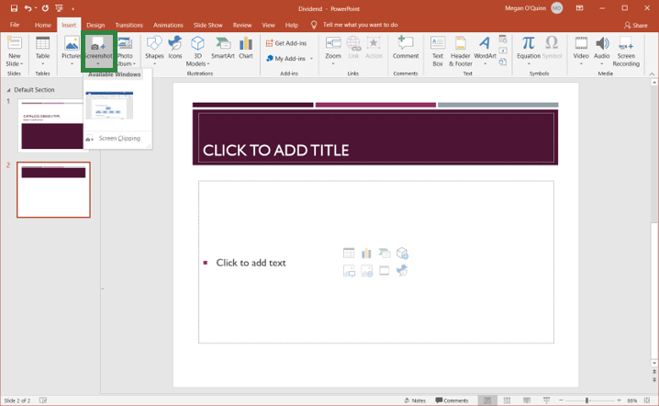
Screenshots
Are images of content currently displayed in a window open on the computer
Can be added by clicking the Screenshot icon in the Images group on the Insert tab and choosing a screenshot from the menu
The Screen Clipping command allows a user to enter a portion of the screen they are using by selecting the image to clip for the screen shot.
Once entered in a slide, a screenshot can be formatted with the same commands as a picture.

Slide 59
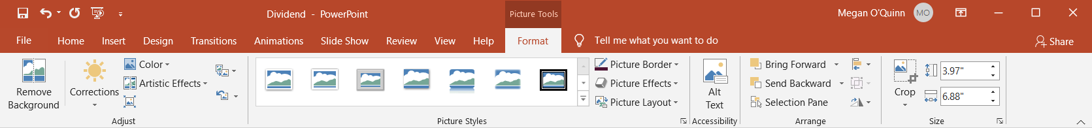
Pictures & Screenshots
When selected, makes the Pictures Tools section appear on the Ribbon and contains the Format tab

Slide 60

Pictures & Screenshots
Can be resized by clicking and dragging on the sizing handles
Can be rotated using the rotating handle
Can have the layout adjusted by clicking on the Layout Options icon
Can be deleted by selecting the image and pressing the Delete key

Slide 61
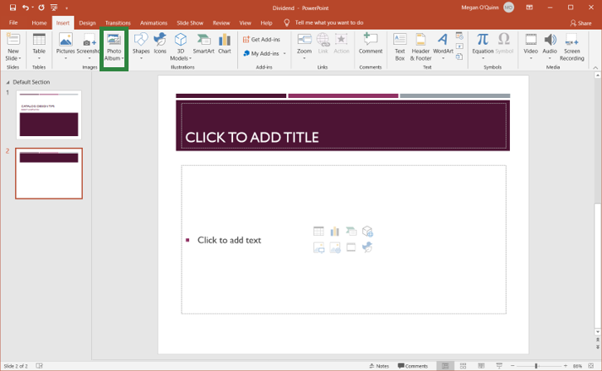
Photo Album
Is a presentation which contains photographs
Can be created by:
  clicking Photo Album on the Insert tab in the Images group
  selecting New Photo
  Album
  locating and selecting
  the images which
  need to be included
  clicking Create to
  make the presentation

Slide 62
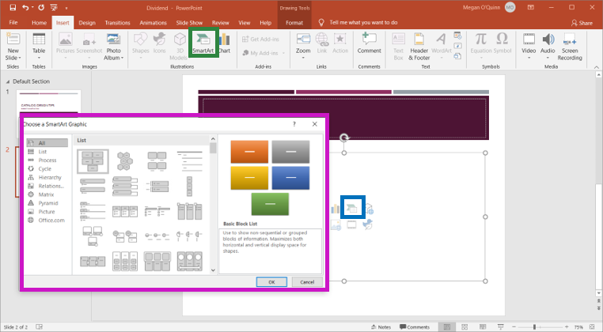
SmartArt
Can be added by:
  clicking the SmartArt icon in the Illustrations group or clicking the SmartArt icon in the content placeholder
  choosing an option from the Choose a
  SmartArt Graphic dialog box
There are many categories of SmartArt which can be added. To preview the SmartArt layout, click on it and a preview with a short description will appear in the dialog box.

Slide 63
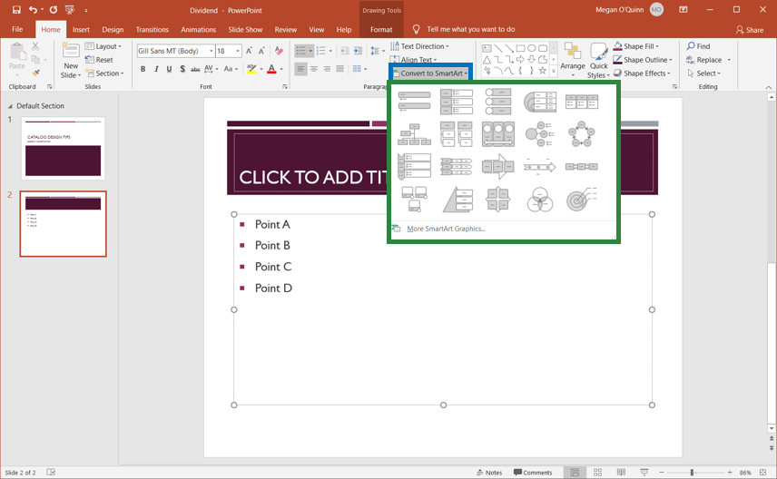
SmartArt
Can also be created from text in a text box
  after text has been added on the Home tab in the Paragraph group, click Convert to SmartArt and choose a SmartArt layout from the menu

Slide 64
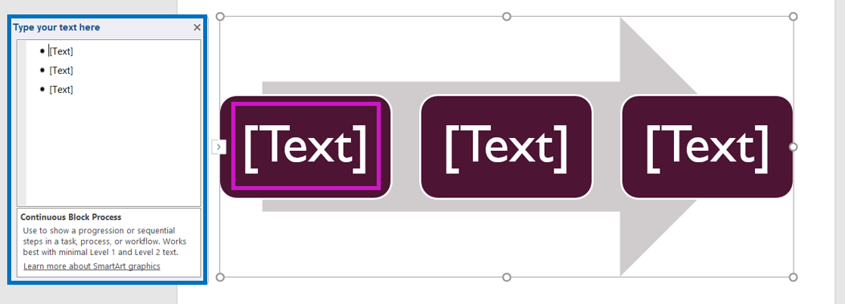
Text
Can be added to the shapes included in the SmartArt graphic by:
  clicking on the shape where text needs to be entered and beginning to type in the text placeholder in the shape
  using the Text Pane and typing in the text which will appear in each shape

Slide 65
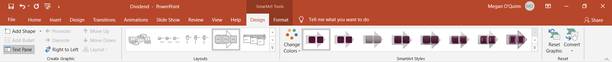

SmartArt
When selected, makes the SmartArt Tools section appear on the Ribbon and contains the Design and Format tabs

Slide 66

Charts
Can be added by:
  clicking the Chart icon in the Illustrations group on the Insert tab or clicking the Chart icon in the content placeholder and then choosing a type of Chart from the Insert Chart
  dialog box

Slide 67

Charts
When added, open an Excel spreadsheet to contain the data a user wants displayed in the chart
  to change the data displayed in the chart, edit the information in the spreadsheet

Slide 68

Charts
Can have Chart Elements (title, legend, labels) removed or changed
Can have Chart Styles or colors applied or changed
Can have Filters applied to chart data
Can be deleted by
selecting the chart
and pressing Delete

Slide 69


Charts
When selected, makes the Chart Tools section appear on the Ribbon and contains the Design and Format tabs

Slide 70

3D Models
Can be added by clicking the 3D Models icon in the Illustrations group on the Insert tab and then selecting either From a File… or From Online Sources…
3D Models can be inserted into a presentation to illustrate a topic or show an audience a more detailed look at an image.

Slide 71

3D Models
When selected, make the 3D Models Tools section appear on the Ribbon and contains the Format tab

Slide 72

Working with Objects
Involves moving objects by:
  selecting the object and dragging it to a new location
    the red lines which appear are guides which can be used to help position the object on the slide
  selecting the object
  and pressing the
  arrow keys in the
  direction wanted
  to move the object

Slide 73

Working with Objects
Involves positioning objects by:
  selecting the object and clicking Arrange on the Home tab and choosing options from the menu to choose where the object appears relative to other objects

Slide 74

Working with Objects
Layering (ordering objects from front to back) involves:
  opening the Selection Pane and dragging the items to be in the order the objects need to appear
  using the Bring Forward or Send Backward
  commands in the
  Arrange group of the
  Design Tools Format
  tab or the same
  commands on the
  menu which appear
  when the object is
  right clicked

Slide 75

Working with Objects
Involves grouping objects by:
  selecting all of the objects to group together
  clicking Group in the Arrange group on the Design Tools Format tab
  right clicking and selecting Group from the menu
Grouping objects will allow users to format or move the “group” as one object rather than having to move or format each object.

Slide 76

Notes
Can be entered by typing in the Notes Pane when in Normal View or Notes Page View

Slide 77

Notes Pages
Are visible in Notes Page View
  this can be opened by clicking Notes Page in the Presentation Views group on the View tab
Consist of:
  slide thumbnail
  notes pane
Each slide has its own notes page, even if there are not any notes associated with the slide.
Changes made in Notes Page View to the notes will be reflected in the Notes Pane in Normal View.

Slide 78

Notes Pages
Can be printed by choosing the Print option in Backstage View, selecting Notes Pages beneath Settings and clicking Print

Slide 79
Slide Transitions
Are animation-like effects which occur when moving from one slide to another during a presentation
Are located on the Transitions tab on the Ribbon
Can be inserted by choosing a transition from the gallery in the Transition to This Slide group
  different variations of the selected transition can be found by clicking Effect Options
Can be previewed by clicking Preview

Slide 80
Slide Transitions
Can be further customized by setting timing and appearance options in the Timing group
  to change how long a transition takes edit the Duration
  to advance slides when the mouse is clicked check On Mouse Click
  to advance slides after a specified time check After and set a time
Can be applied to all slides in a presentation by clicking Apply to All

Slide 81
Slide Transitions
Can be removed by selecting the slides which the user want to remove the transitions and clicking None in the Transitions gallery

Slide 82
Animations
Are movements which can be applied to objects in a presentation
Are located on the Animations tab in the gallery in the Animation group
  different variations of the selected transition can be found by clicking Effect Options
Can be previewed by clicking Preview

Slide 83

Animations
Can be categorized as:
  entrance effects
    dictate how an object
    appears on the slide
  emphasis effects
    occur when the object
    is on the slide
  exit effects
    dictate how and object
    leaves the slide
  motion paths
    move an object along
    a predetermined path

Slide 84

Animations
Can be applied by selecting the object and choosing an effect from the gallery and the effect will be applied

Slide 85

Animations
When applied to an object, will place a small number next to the object
When applied to objects on a slide, will have a star symbol next to the slide in the Thumbnail pane

Slide 86

Effect Options
Allow users to control different properties of the applied effect
Can be found by
clicking Effect
Options in the
Animation group
Not all effects will have options which can be change. Also, the options which can be changed will vary based on the type of effect. For example, the direction, number of spokes or sequence of how an object appears can be changed.

Slide 87
Animations
Can be started by a mouse click or before or after a previous animation
  to set this property, in the Timing group specify the option needed in the Start drop down
Run for a specified amount of time
  to set this property, in the Timing group specify a duration length
Can be run after a set period of time
  to set this property, in the Timing group specify a delay length

Slide 88

Animations
Can be removed by selecting the small number located next to the animated object and pressing the Delete key

Slide 89
Multiple Effects
Can be added to an object by clicking the Add Animation icon in the Advanced Animation group and choosing another effect from the gallery
  if the user selects another effect from the gallery in the Animation group, it will replace the current animation

Slide 90

Objects
Which have multiple effects applied to them will have a different number for each effect
  the numbers indicate the order in which the effects will occur
  to reorder the effects, select the number which needs to be changed and in the Timing group click the Move Earlier or Move Later commands beneath Reorder Animation

Slide 91

Saving Files
For the first time involves:
  naming the file in the File Name Box
  selecting a file type in the File Type drop down
  choosing a storage location

Slide 92

Saving Files
Should be completed after any change is made to the file
  saving changes updates the previously saved version of the file with the most recent changes
Use the Save icon on the Quick Access Toolbar to complete a quick save or the keyboard shortcut Control S.

Slide 93


Saving as a Different File Type
Can be completed by:
  selecting the file type wanted in the Save As window
  utilizing the Export option in Backstage View

Slide 94

Saving as a PowerPoint Show
Can be completed by:
  opening the Export option in Backstage View
  selecting Change File Type
  selecting PowerPoint Show
  clicking Save As
PowerPoint Show: file type which automatically opens the presentation in Slide Show view

Slide 95

Packaging a Presentation for CD
Can be completed by:
  opening the Export option in Backstage View
  selecting Package Presentation for CD
  clicking Package for CD
The Package for CD feature should be used when a user wants to run a slide show on another computer.

Slide 96
Presentations
Can be shown using the following options on the Slide Show tab:
  From Beginning of the presentation
  From Current Slide in the presentation
Using either of these options will open the presentation in Slide Show view which shows each slide covering the entire screen.
The Slide Show icon next to the Zoom Slider can also be used to open the presentation in Slide Show view.

Slide 97

Printing
Can be completed by utilizing the Print option in Backstage View
  contains options for adjusting printing settings
The keyboard shortcut for printing is Control P. Pressing this shortcut will automatically open the Print option in Backstage View.

Slide 98

Print Options Layout
Includes:
  Print Button
    starts the print job
  Number of Copies
    specifies number to
    be printed
  Selected Printer
    shows printer to be
    used
  Printer Properties
    opens printer settings
  Settings
    shows options related to how and what will print on the page
  Print Preview
    shows how the slides or handouts will look when printed

Slide 99

Handouts
Can be printed by choosing one of the handout options beneath the Settings heading
  a preview of the handout will be shown

Slide 100
Acknowledgements
Production Coordinator
Sara Allen
Videography/Post Production
Jake Saye
Video Narrator
Jason Kappus
Graphic Editors
Hilary Jasper, Megan O’Quinn,
Merah Barbee
Director of Brand Management
Megan O’Quinn
Quality Control Director
Angela Dehls
Executive Vice President
Clayton Franklin
Executive Producer
Gordon W. Davis, Ph.D.
© MMXXI
CEV Multimedia, Ltd.

