Slide 1
Avoiding Financial Schemes and Fraud

Slide 2
Objectives
To examine the various types of financial schemes, frauds and scams.
To analyze the methodology behind financial schemes, frauds and scams.
To recommend techniques for avoiding financial schemes, frauds and scams.

Slide 3
Financial Schemes, Frauds & Scams
Are crimes of obtaining money by deliberate deception
Are detrimental to today’s society
Are normally targeted at college students, newlyweds, senior citizens and those unfamiliar with the Internet
Should be avoided in order to preserve safety and security

Slide 4
Main Menu
Schemes
Frauds
Scams

Slide 5
Avoiding Financial Schemes and Fraud - Schemes

Slide 6
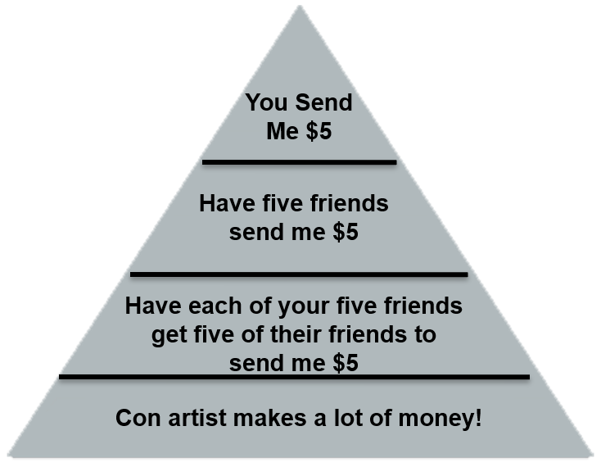
Types of Financial Schemes
Include:
  pyramid schemes
  affinity fraud
  identity theft

Slide 7
Pyramid Schemes
Are non-sustainable business models which involve the exchange of money
Require the recruitment and enrollment of other individuals
Depend on the exponential growth of new participants
Set up a hierarchy for which individuals who join make payments to those above them in the pyramid
Can be called gifting clubs

Slide 8
Pyramid Scheme Structure
Is based on individuals recruiting a specified number of other individuals to invest in a plan
Example:
  if one person recruits ten people, they are paid $10 for each person they recruit
  if each of the ten individuals recruit ten people the first individual gets paid $1,000
  if each of the 100 individuals recruits ten people, the initial recruiter gets paid $10,000

Slide 9
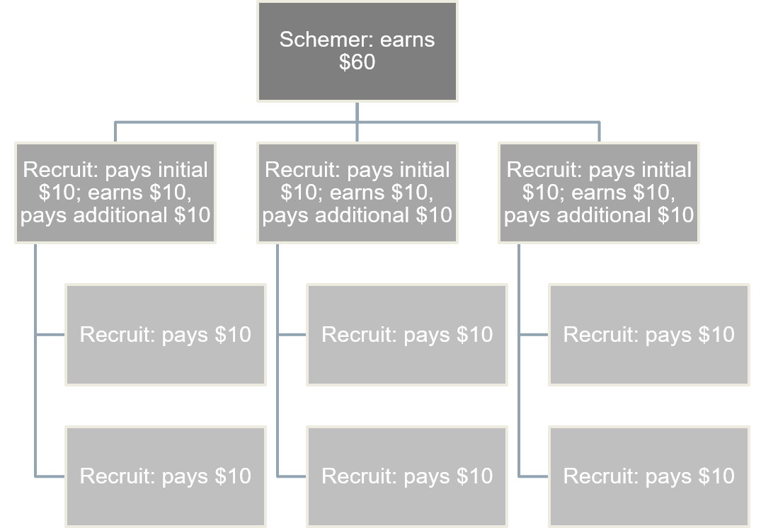
Pyramid Scheme Structure

Slide 10
The Catch of the Pyramid Scheme
There are two points which are inevitable
  there is only a limited number of potential participants
    only so many people can be convinced to join in on the scheme
  only “profit” gained by a participant occurs when money is lost by other participants
    if no one recruits new members of the scheme there is no money to pay anyone involved because there is no real product

Slide 11
Types of Pyramid Schemes
Include:
  Ponzi schemes
  chain letters
  administered pyramid schemes
  elevator schemes

Slide 12
Ponzi Schemes
Are fraudulent investment operations which involve paying abnormally high returns to investors out of the money paid by other investors
Are named for Charles Ponzi, who tricked thousands of Americans into investing in a postage stamp scheme in the 1920s

Slide 13
Characteristics of a Ponzi Scheme
Include:
  an article placed in a newspaper, magazine, etc. promising extraordinary returns on an investment
    example: 25 percent for a one-month contract
  precise system for the return can be attributed to anything, but is not very specific
    example: “hedging futures trading,” “high yield investment programs,” “global currency exchange,” etc. all promising methods for grand returns but not specific

Slide 14
Characteristics of a Ponzi Scheme
Include:
  return to the initial investors is paid out of the new, incoming investment money, not out of profits
    example: Kate puts in money, this money goes to pay the “profit” for Matt, Sally and Joe who invested before her
  early investors get paid large returns, so they frequently reinvest

Slide 15
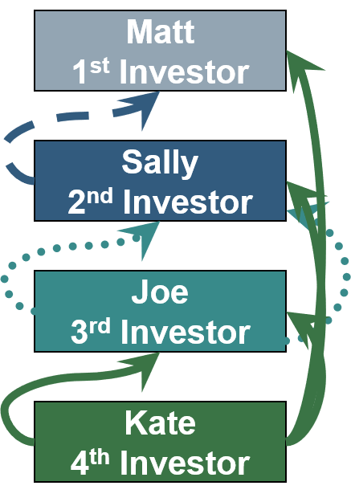
Characteristics of a Ponzi Scheme

Slide 16
The Catch of a Ponzi Scheme
One of three instances will occur:
  promoter of the scam will vanish with all the invested money
  scheme will collapse as investments slow and promoters have problems paying out returns
  scheme is exposed

Slide 17
Chain Letter
Is a letter or e-mail message which asks the recipient to send copies of the letter to several other people
Is a pyramid scheme when it:
  asks recipients to send money to individuals who the letter has passed before
  promises to pay money to the recipient after they send it to other individuals who send in money as well

Slide 18
Administered Pyramid Scheme
Involves a person or company who “administers” the scheme
Allows the “administrator” to take a fee for themselves
Ensures the “administrator” a profit no matter how badly the scheme works out
Collapses much more quickly than regular pyramid schemes due to its dependence on the administrator

Slide 19
Administered Pyramid Scheme
Example:
  Joe sets up a fake company; “Company X,” making him the administrator
  “Company X” is described as a very profitable business
  Individuals are recruited to invest in “Company X” under the assumption they are investing in a profitable business rather than Joe’s pyramid scheme

Slide 20
Elevator Schemes
Can also be called a straight-line matrix
Offer an opportunity to buy a product for a small percentage of the cost based on the pyramid structure
  example: you may purchase this product for 15 percent of the normal cost once you recruit ten people to purchase the item as well
    this means the first person is able to purchase the good when they get five people, the second person can purchase the good once ten people have joined and so on

Slide 21
Tips to Avoid Pyramid Schemes
Includes:
  being aware of any scheme which requires an investment in a franchise in order to be paid for recruiting other investors
  avoiding plans which require you to spend money on high-priced products offered by the company which hires you
  finding out if the plan involves a training program
  researching the company involved before signing a contract
  calling the Better Business Bureau to inquire about the company

Slide 22
Affinity Fraud
Is any type of investment scheme which preys upon members of identifiable groups by using their affiliation with the group
Involves one person gaining the trust of others by having a similarity and then betraying them in a financial transaction
Can be completed by friends, colleagues or anyone you trust

Slide 23
Affinity Fraud
Is committed by individuals using the theory of, “You can trust me because I am like you. We share the same background and interests. I can help you make money.”
Is harder to detect due to the tight-knit structure of many groups
  individuals will try to fix problems within the group rather than reporting the scheme to the authorities

Slide 24

Targeted Groups
Include:
  religious affiliations
  minority groups
  career associations
  community clubs or organizations
    youth groups, garden club, Parent Teacher Association, etc.

Slide 25
Affinity Fraud Example
A man comes to a Garden Club meeting saying he is interested in joining
After a few meetings he tells the club he has used GroBig fertilizer and his garden has grown incredibly
He happens to sell the fertilizer in bulk shipments which cost $2,000, but since he is selling it to his friends, he will only charge them $1,000

Slide 26
Affinity Fraud Example
Many of the other members of the club want their gardens to grow too, so they offer to buy the bulk shipment and split the cost
The man explains he has to have the $1,000 up front before he can place the order, so the members willingly give him the money
The man is never seen again, and neither is the $1,000

Slide 27
Tips to Avoiding Affinity Fraud
Include:
  checking out everything, no matter how trustworthy the person seems who brings the investment opportunity to your attention
  not falling for investments which promise spectacular profits or “guaranteed” returns
  being skeptical of any investment opportunity not in writing
  being wary of investments pitched as “once-in-a-lifetime” opportunities

Slide 28
Identity Theft
Refers to all types of crime in which someone wrongfully obtains and uses another person’s personal information
Is the fastest growing form of fraud in the United States
Can come in many forms

Slide 29
Identity Theft
May have the following impacts on an individual's credit:
  misuse of an existing credit account which causes increased credit balance
  personal information being used to open new accounts which may cause a decrease in credit scores and late payments

Slide 30
Identity Theft
Can be completed by:
  shoulder surfing: watching or listening to you give personal information to a computer or another individual
  dumpster diving: going through your garbage to obtain copies of checks, credit card or bank statements
  spamming: sending bogus e-mails which require you to fill in personal information
  stealing mail: taking “pre-approved” credit card applications or other mail containing private information

Slide 31

Tips to Avoid Identity Theft
Include:
  being careful about giving out your personal information
  checking your financial information regularly
  viewing a copy of your credit report often
  maintaining accurate records of all financial transactions
  never throwing away receipts or statements containing private information
  shredding any document which contains personal information

Slide 32
Avoiding Financial Schemes and Fraud - Frauds

Slide 33
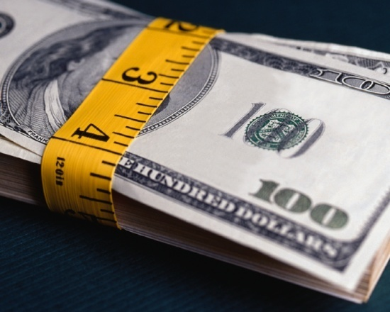
Types of Financial Frauds
Include:
  4-1-9 frauds (Nigerian Letter)
  banking fraud
  utilities fraud
  government documents fraud
  insurance fraud
  telemarketing fraud

Slide 34
4-1-9 Frauds (Nigerian Letter)
Involve an individual receiving a letter or
e-mail from a supposed government official, royal family member, extremely wealthy widow, etc. which promises the recipient a percentage of a large sum of money if they help the official get the money out of the country
Rely on convincing willing victims to freely give personal information
Play on an individual’s wish for wealth

Slide 35

4-1-9 Frauds (Nigerian Letter)
Are named after section 419 of the Nigerian criminal code
Can be from any country, but the first were from Nigeria
Are a form of advanced fee fraud
Are dangerous

Slide 36
Tips to Avoid 4-1-9 Frauds
Include:
  not responding if you receive a letter or e-mail resembling the traits of the 4-1-9 frauds
  being skeptical of individuals representing themselves as wealthy government officials, royalty, widows, etc.
  not believing the promise of large sums of money for your cooperation
  guarding your account information

Slide 37
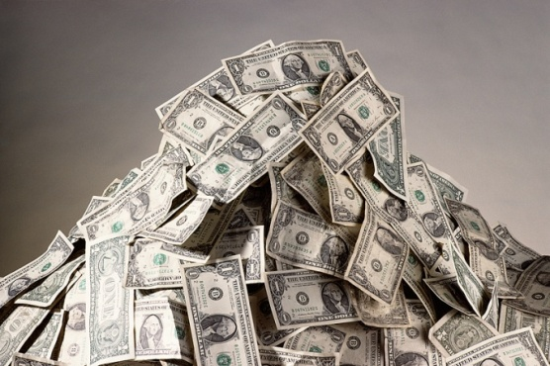
Bank Fraud
Is obtaining property or money which does not belong to you from any federally insured financial institution
Is a federal offense
Can result in up to 30 years in prison and $1,000,000 in fines

Slide 38
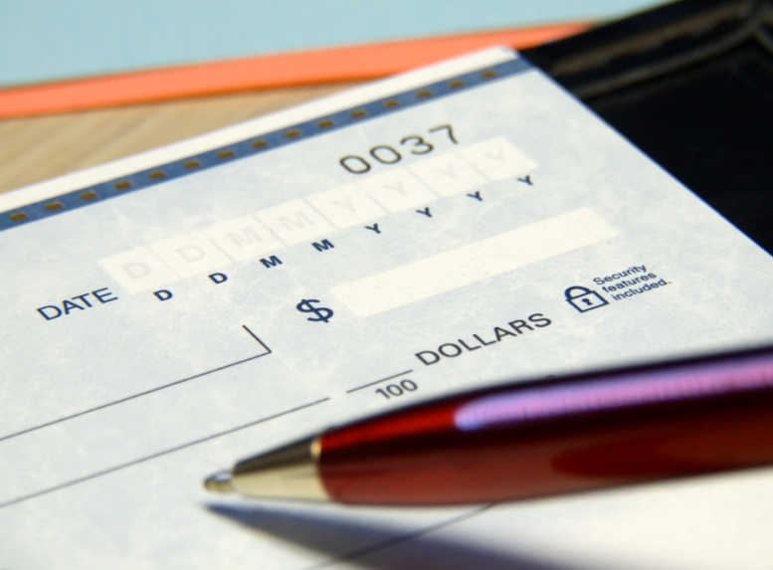
Types of Bank Fraud
Include:
  forgery
  check kiting
  phishing
  check cashing
  credit card fraud

Slide 39
Forgery
Is the act of making or producing an illegal copy of items so they look genuine
Can include:
  check forgery: making a check from a false account, someone’s account or signing a blank check from a real account
  altered checks: changing the amount on the check

Slide 40
Check Kiting
Is when an in-transit or non-existent transaction is recorded in more than one bank account
Is a check written against an account containing insufficient funds and dated to take advantage of the time lag for clearing
Example:
  a fake check from account A is deposited into account B; another check is written against account A is cashed before all of the checks have time to clear

Slide 41
Check Cashing
Involves the scammer sending an individual a false check and then having the victim wire money in return
  usually the victim thinks they are making easy money, however they are the ones being stolen from

Slide 42
How Check Manufacturers Guard Against Fraud
Includes:
  watermarks
    are subtle designs on the front and backs of checks
  copy void pantograph
    are patented designs in the background patterns of checks, when copied the pattern changes to the word “VOID”
  chemical void
    involves treating the paper so when chemicals are applied the word “VOID” appears

Slide 43
How Check Manufacturers Guard Against Fraud
Includes:
  high resolution microprinting
    is very small printing used on the signature line of a check, if copied the print becomes illegible
  three-dimensional reflective holostripe
    is a metallic stripe which contains a hologram
  security inks
    reduce the forger’s ability to modify the printed dollar amount or alter the designated payee due to a chemical reaction with the ink

Slide 44
Phishing
Works by sending forged e-mails impersonating an online bank, auction or payment site
Directs the user to a forged website which looks legitimate and requires the user to update their personal information, thus stealing any information the user provides
Is a precursor to identity theft

Slide 45
Credit Card Fraud
Occurs when a business is tricked into releasing merchandise or rendering services because they believe a credit card account will pay for the goods or services
Causes the credit card of another person to be charged for a purchase
Is the most common type of fraud in society

Slide 46
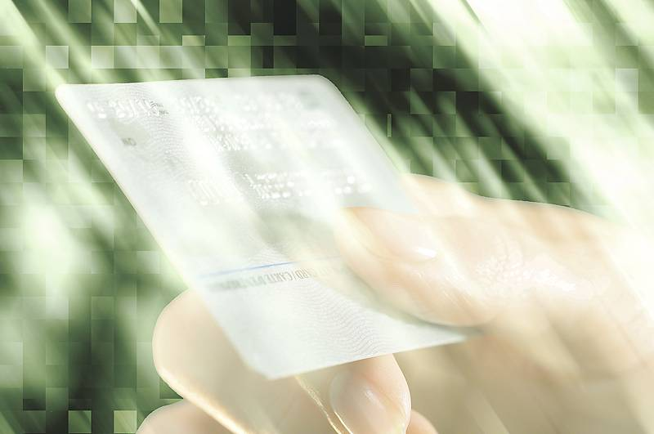
Types of Credit Card Fraud
Includes:
  stolen card fraud
  credit card mail order fraud
  skimming

Slide 47
Stolen Card Fraud
Occurs when a card holder loses or has their card stolen and a thief makes purchases using their card
Can cost victims thousands of dollars
Is extremely easy to do at pay-at-the-pump gas stations
Can be insured by purchasing theft insurance from the credit card company

Slide 48
Credit Card Mail Order Fraud
Is the process of using a stolen credit card number or computer-generated card number to order goods
Is known as “Card Not Present” (CNP) transactions which are made by:
  mail
  telephone
  Internet

Slide 49
Skimming
Is the theft of credit card information by a dishonest employee of a legitimate business manually copying down credit card numbers or using a magnetic stripe reader on a pocket-sized device
Is commonly completed at restaurants where the skimmer has possession of the card out of the cardholder’s view
Can be completed at ATM machines if the thief has installed a camera to read credit card numbers and the pin you enter

Slide 50
Tips to Avoid Credit Card Fraud
Include:
  signing cards as soon as they arrive
  keeping a record of your account numbers, expiration dates and the address and phone number of each company
  keeping an eye on your credit card during the transaction
  saving receipts to compare to billing statement
  not lending your card to anyone
  not signing a blank receipt

Slide 51
Utilities Fraud
Is the practice of a thief using your personal information to obtain utility accounts such as gas, electric, water and sewer, cable, and other services
Can be completed with only your name, address and phone number
Is the second largest fraud committed in society

Slide 52
Government Documents Fraud
Is the process of creating false social security cards, marriage licenses, green cards, birth certificates, etc. in order to obtain money, goods or services from businesses or government programs
Is usually a precursor for identity theft, Medicare or Medicaid fraud and Social Security fraud
Is highly illegal

Slide 53
Insurance Fraud
Occurs when someone intentionally deceives another about an insurance matter to receive money or other benefits not rightfully theirs
Is considered a white-collar crime
Is a popular method for obtaining money

Slide 54
Types of Insurance Fraud
Includes:
  falsifying theft reports
  arson
  staged auto accidents
  slip-and-fall
  workers’ compensation fraud
  insurance agent fraud
  phantom repairs and estimates
  owning multiple policies

Slide 55
Telemarketing Fraud
Is the process of an individual giving their personal information to a telemarketer who they believe is from a legitimate business or organization
Is typically completed by individuals who are calling for “donations” to a cause
Uses lines such as:
  you must act now or the offer will not be good
  you do not need any information about the company
  you cannot miss this once-in-a-lifetime opportunity

Slide 56
Tips for Avoiding Telemarketing Fraud
Includes:
  not buying from an unfamiliar company
  always asking for written material about a company or charity
  checking out the business with the Better Business Bureau
  not paying in advance for services offered over the phone
  not giving out personal information over the phone

Slide 57
Avoiding Financial Schemes and Fraud - Scams

Slide 58
Types of Financial Scams
Include:
  investment
  credit repair
  prizes and lotteries
  e-mail scams
  employment scams
  door-to-door scams

Slide 59
Investment Scamming
Can come via a phone call, e-mail or social media
  but in all cases the money 'invested' goes straight into the scammer's bank account and not towards any real investment

Slide 60
Invest Scamming
Can have three types:
  investment offer does not exist
  investment offer exists but the money given to the scammer is not going towards the investment
  scammer claims to be representing a well-known investment company, but they are lying

Slide 61
Credit Repair Scams
Promise to erase accurate negative information from your credit file
ARE NOT legitimate ways to improve bad credit
Can result in individuals lying about their credit history, Social Security number, getting a false employer identification number from the IRS
  all result in violating federal laws, which is worse than having bad credit

Slide 62
Prizes & Lotteries
Are scams which proclaim you have won a prize or lottery you do not remember entering
Ask either for money to be paid or personal information in order for you to receive your prize
Play off of Publisher’s Clearing House prizes or Internet pop-ups and banners

Slide 63
E-mail Scams
Can be promoted using spam mail
Are fraudulent e-mails sent to mass amounts of individuals
Often transmit computer viruses or worms
Can claim to be your bank or credit card company needing some personal information

Slide 64
Employment Scams
Are based on the “work at home and make millions” belief
Use the Internet, newspaper, seminars, mail and direct approaches to lure individuals into self-employment
Sell information of no value
Provide skills which turn out to be unmarketable
Can be pyramid schemes

Slide 65
Door-to-Door Scams
Involve promoting real or false goods and services
Often offer roof repair, maintenance, telephone services or some type of good such as magazine subscriptions
  example: home renovation scams
Ask for a deposit or full payment in cash or credit card prior to giving the individual the good or completing the service

Slide 66
Tips to Avoid Scams
Include:
  knowing there is no easy way to repair credit damage
  researching companies offering credit repair, prizes, lotteries, employment or services
  filtering all spam e-mails
  not trusting unsolicited mail, e-mail or door-to-door salesmen
  checking the Internet for common scams

Slide 67
General Safety Tips to Follow
Includes:
  keeping all passwords and pins private
  only giving out your credit card number if you are sure you are speaking to a member of the company
  never giving out your Social Security number over the phone
  changing your passwords and pins every six months
  checking Internet sites such as the Better Business Bureau, FBI, FCC and FTC for schemes which have been reported

Slide 68
Financial Schemes, Frauds & Scams
Are different methods to make money by dishonest means
Are crimes of persuasion
Cost thousands of individuals millions of dollars each year
Should be reported to the Better Business Bureau, FBI, Federal Communications Commission and Federal Trade Commission

Slide 69
Consumer Protection Agencies
Can help eliminate schemes, frauds and scams
Check the business’s reputation and credentials
Include:
  Better Business Bureau
  Consumer Financial Protection Board

Slide 70
Better Business Bureau (BBB)
Is a private nonprofit organization which receives consumer complaints and rates the performance and reliability of businesses based on a number of criteria
Promotes ethical business practices, which leads to buyers and sellers operating under a common understanding of trust

Slide 71
Consumer Financial Protection Board
Is a U.S. government agency which supervises and verifies banks, lenders and other financial companies (credit reporting agencies and debt collection companies) treat consumers fairly
  helps consumers by providing educational materials and accepting complaints

Slide 72
Consumer Protection Agencies
Can be found online
  from there consumers can:
    submit a complaint
    report identify theft
    add a number to the “do not call registry”
    read tips and advice on how to stop identity theft
    research questionable services, businesses or people who may have a history with identity theft

Slide 73
Resources
(n.d.). Retrieved October 7, 2008, from Crimes of Persuasion: www.crimes-of-persuasion.com
(1995-2008). Retrieved October 7, 2008, from AARP.Org: www.aarp.org
(2008). Retrieved October 7, 2008, from Investopedia: www.investopedia.com
(2008). Retrieved October 7, 2008, from Social Security Online: www.ssa.gov
(2008). Retrieved October 7, 2008, from U.S. Department of Justice: www.usdoj.gov

Slide 74
Resources
(2008). Retrieved October 7, 2008, from U.S. Securities and Exchange Commission: www.sec.gov
(2008). Retrieved October 7, 2008, from Federal Trade Commisson: www.ftc.gov
Department of Consumer and Employment Protection. (2008, January 25). Retrieved October 7, 2008, from Government of Western Australia: www.docep.wa.gov.au
Office of the Attorney General. (2008). Retrieved October 7, 2008, from The State of New York: www.oag.state.ny.us

Slide 75
Acknowledgements
Production Coordinator
Amy Hogan, Sydney Buckley
Brand Manager
Megan O’Quinn
Project Coordinator
Maggie Bigham
Technical Writer
Jessica Odom
Production Manager
Dusty Moore
V.P. of Brand Management
Clayton Franklin
Executive Producer
Gordon Davis, Ph.D.
©MMXIII
CEV Multimedia, Ltd.

