Slide 1
Microsoft® Access® 2019 Basics – Final Review

Slide 2
Objectives
To review concepts covered in the Microsoft® Access® 2019 Basics units.

Slide 3
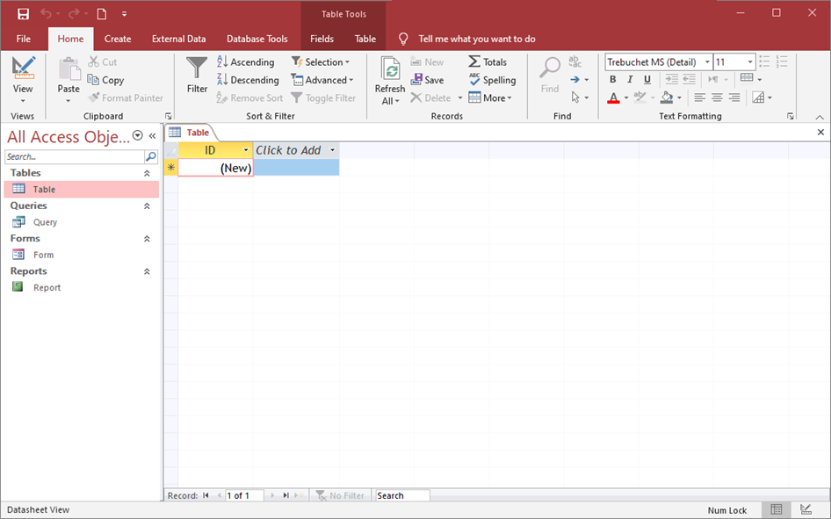
Microsoft® Access®
Is a database management system
Allows users to create and manage various types of databases
  databases are collections of objects which work together to store, retrieve, display and summarize information and automate various tasks

Slide 4
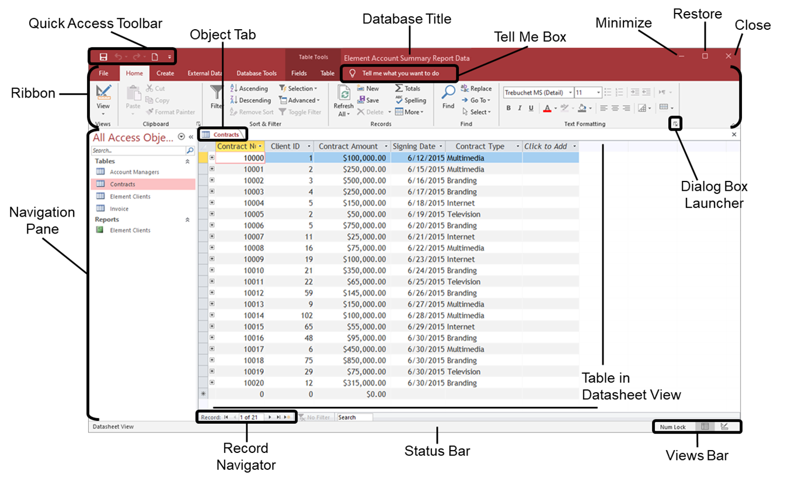
Access® Window Layout

Slide 5
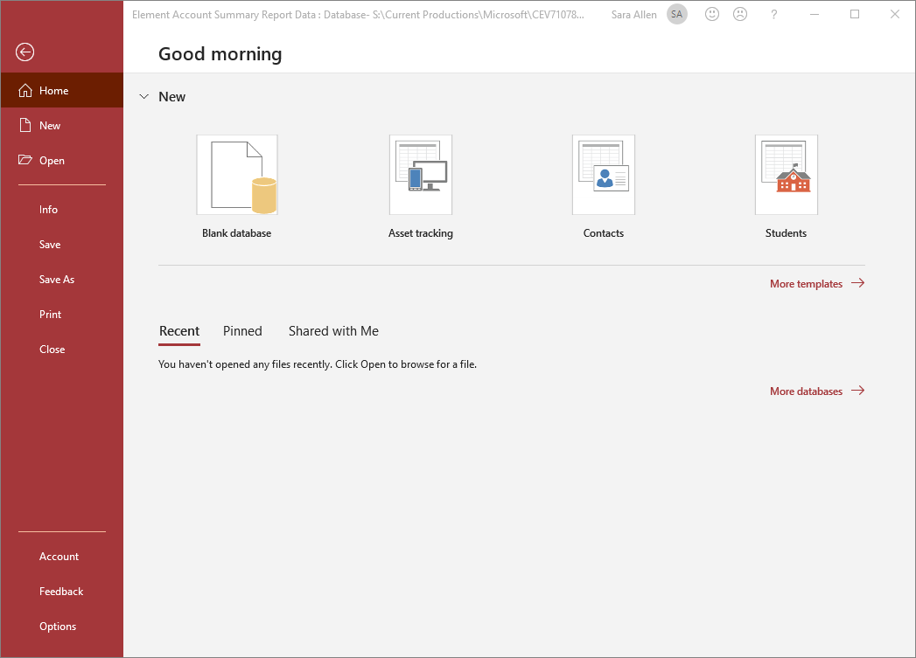
File Tab
When clicked, opens Backstage View
Holds the following options:
  Home
  New
  Open
  Info
  Save
  Save As
  Print
  Close
  Account
  Options

Slide 6
Home Tab
Contains the following groups:
  Views
    contains commands for changing the current view of the object
  Clipboard
    consists of commands for cutting, copying, pasting, formatting painter and opening the clipboard
  Sort & Filter
    holds commands for filtering, sorting and selecting data

Slide 7
Home Tab
Contains the following groups:
  Records
    contains commands for refreshing, inserting, saving and deleting records, adding total rows, checking spelling and working with fields
  Find
    consists of commands for finding, replacing, going to and selecting data

Slide 8
Home Tab
Contains the following groups:
  Text Formatting
    holds commands for changing the font type, size, style and color, adding a fill color, aligning text in fields and adding borders to fields and records

Slide 9
Create Tab
Contains the following groups:
  Templates
    holds commands for inserting premade database parts
  Tables
    contains commands for creating tables
  Queries
    holds commands for creating queries

Slide 10
Create Tab
Contains the following groups:
  Forms
    holds commands for creating forms
  Reports
    contains commands for creating reports
  Macros & Code
    holds commands for opening macros, modules and Visual Basic

Slide 11
External Data Tab
Contains the following groups:
  Import & Link
    holds commands for importing data from various locations
  Exports
    contains commands for exporting data to various locations and file types

Slide 12
Database Tools Tab
Contains the following groups:
  Tools
    holds commands for compacting and repairing databases
  Macro
    contains commands for opening the Visual Basic editor and running macros
  Relationships
    holds commands for viewing relationships and object dependencies

Slide 13
Database Tools Tab
Contains the following groups:
  Analyze
    holds commands for using the Database Documenter, analyzing performance and analyzing a table
  Move Data
    contains commands for moving data in a database or on SharePoint

Slide 14
Database Structure
Is the layout of the tables and relationships between fields
  tables which share a common field are “related”
    for instance, a Product database might include tables about customers, suppliers, orders, etc., with each being stored in its own related table rather than one large table with all of the information
Should be carefully planned and designed prior to creating the database
Relational Database: database which contains or can contain multiple tables with relationships between them

Slide 15
Database Structure Design Steps
Identify the fields needed to produce the required information
Organize each piece of data into its smallest useful part
Group related fields into tables
Determine each table’s primary key
Include a common field in related tables
Avoid data redundancy
Determine the properties of each field

Slide 16
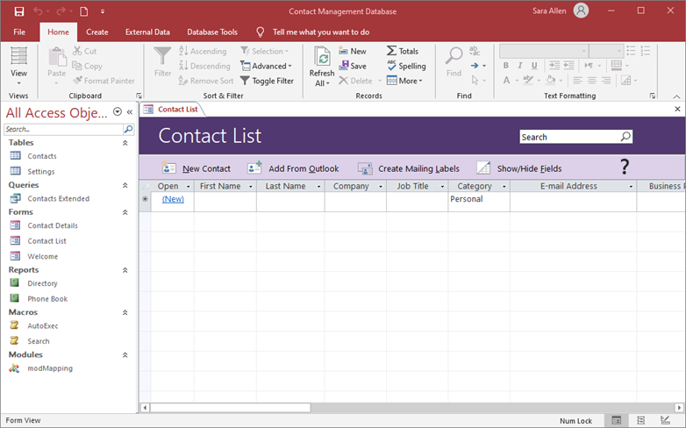
Saving Files
Should be completed after any change is made to the file
  saving changes updates the previously saved version of the file with the most recent changes
Use the Save icon on the Quick Access® Toolbar to complete a quick save or the keyboard shortcut Control S.

Slide 17
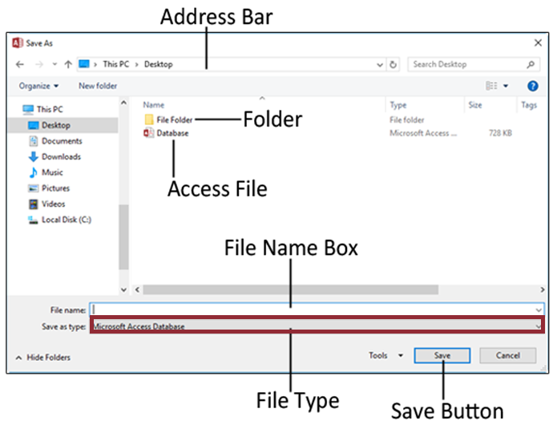
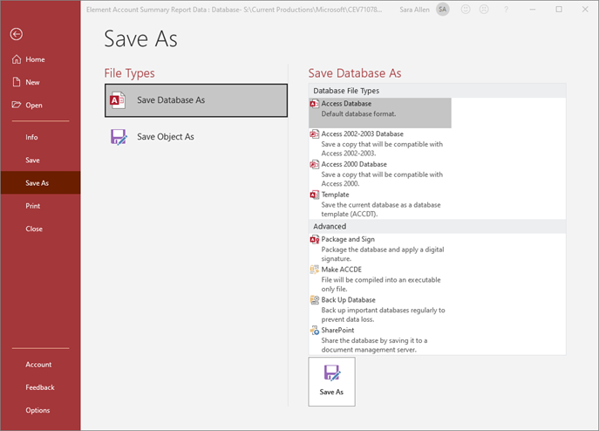
Saving as a Different File Type
Can be completed by:
  selecting the file type wanted in the Save As window
  utilizing the Save As option in Backstage View

Slide 18
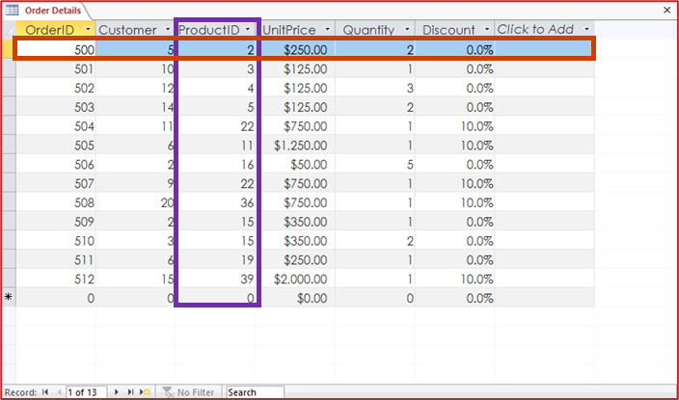
Table
Is a collection of fields and records which store data
  field
    single piece of information related to the person, place, object, event or idea it describes
    categorizes the details of each record
  record
    complete sets of data
    about a specific item
    which is made up of
    fields
Fields are the columns of the table. Records are the rows of the table.

Slide 19
Tables
Can be added to a database
  by clicking the Table icon in the Tables group of the Create tab
    this opens a new table in Datasheet view
  by clicking the Table Design icon in the Tables group of the Create tab
    this opens a new table in Design view

Slide 20
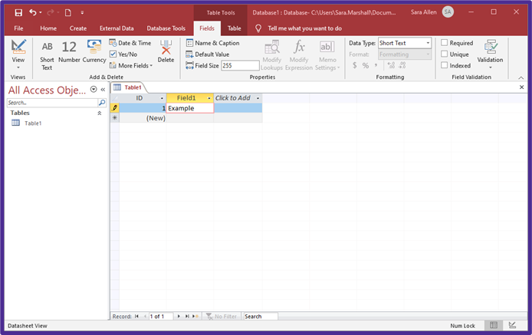
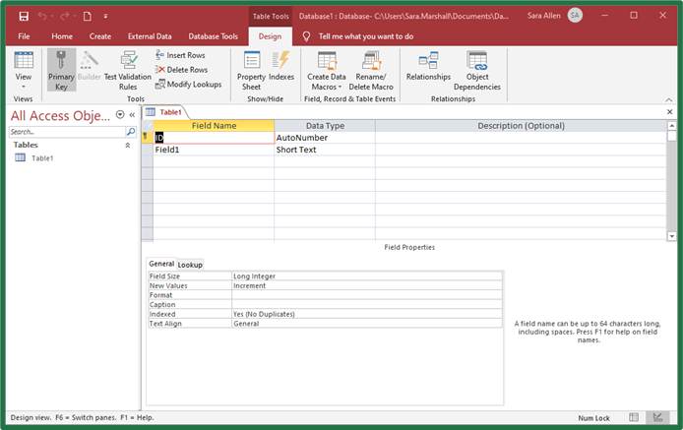
Tables
Can be edited in:
  Datasheet view
  Design view

Slide 21
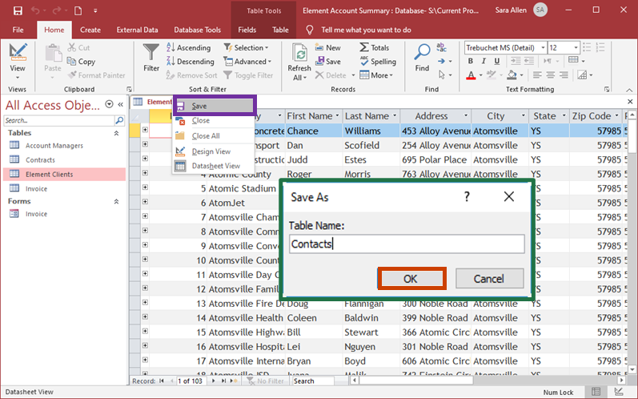
Tables
Can be saved in either Datasheet or Design view by:
  right-clicking on the table object tab and selecting Save from the menu
  entering a name in the Save As dialog box
  clicking OK

Slide 22
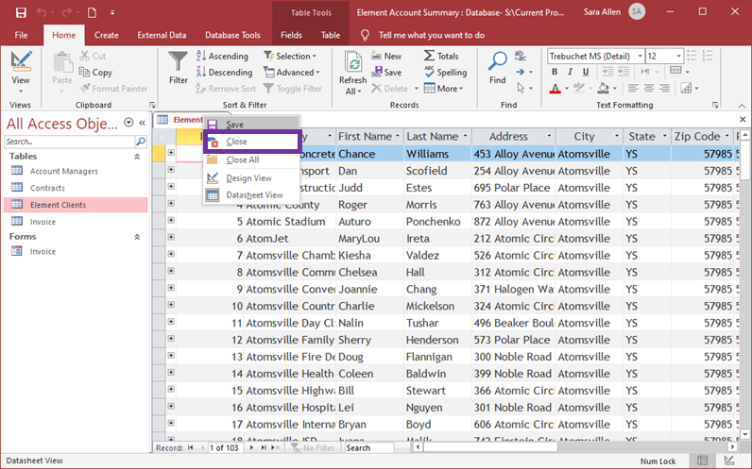
Tables
Can be closed in either Datasheet or Design view by:
  right-clicking on the table object tab and selecting Close from the menu
  clicking the X in the top corner of the object area

Slide 23
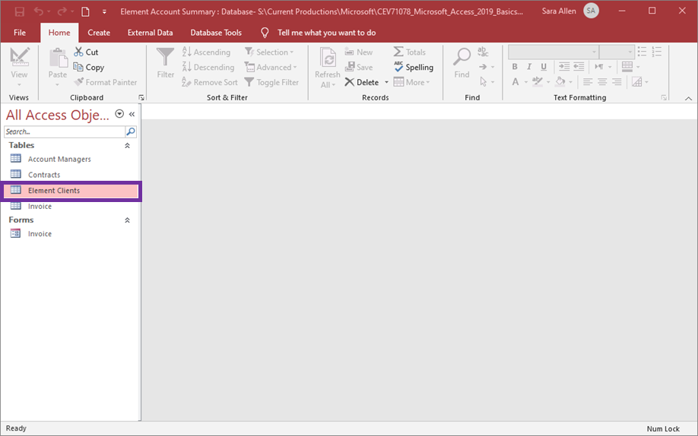
Tables
Can be reopened by:
  double-clicking the table name in the Navigation Pane

Slide 24
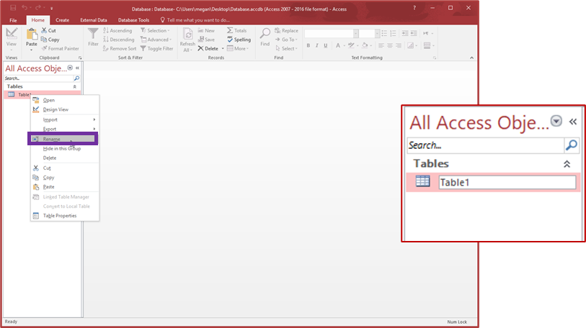
Tables
Can be renamed in either Datasheet or Design view by:
  right-clicking on the table object tab and selecting Rename from the menu
  typing in the name wanted in the editing area
Tables can only be renamed when closed.

Slide 25
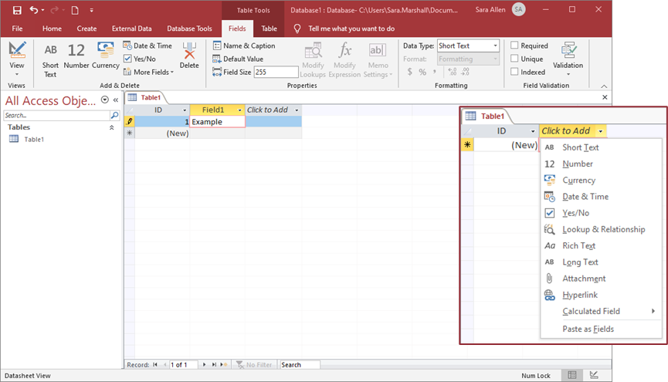
Fields
Are single pieces of information related to the person, place, object, event or idea it describes
Categorize the details of each record
Can be added in Datasheet view by typing into the last column
Access® will automatically assign a data type based on the data entered.
Another method is to click the arrow next to Click to Add and choose a data type and a field with the data type will be entered in the table.

Slide 26
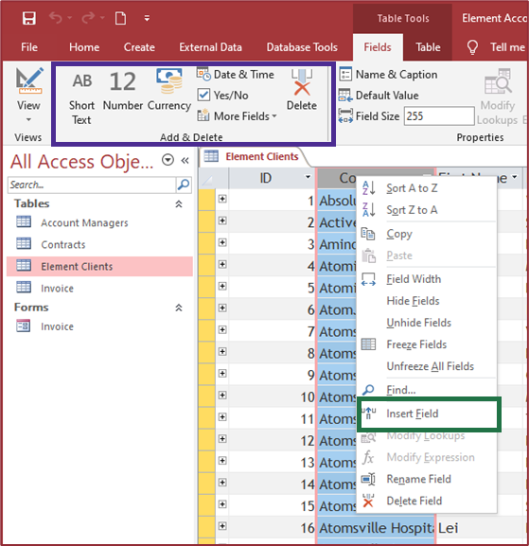
Fields
Can be inserted between fields in Datasheet view by selecting the field in front of where the new field should be added then:
  clicking the field type to
  add in the Add & Delete
  group of the Table Tools
  Fields tab
  right-clicking on the
  selected field and clicking
  Insert Field on the menu

Slide 27
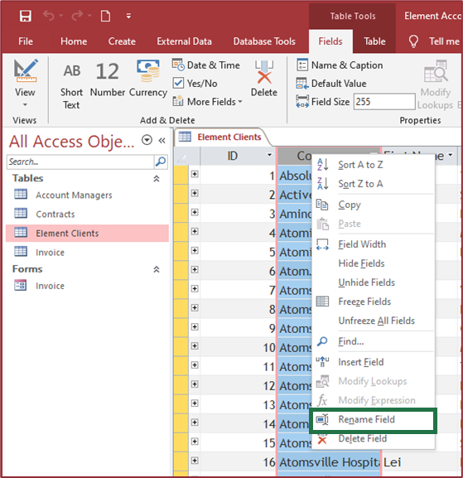
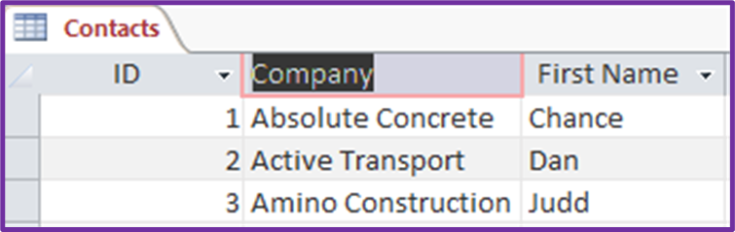
Fields
Can be named or renamed in Datasheet view by double-clicking on the field label and entering the name for the field
Can also be renamed by
right-clicking the field and
choosing Rename Field
from the menu

Slide 28
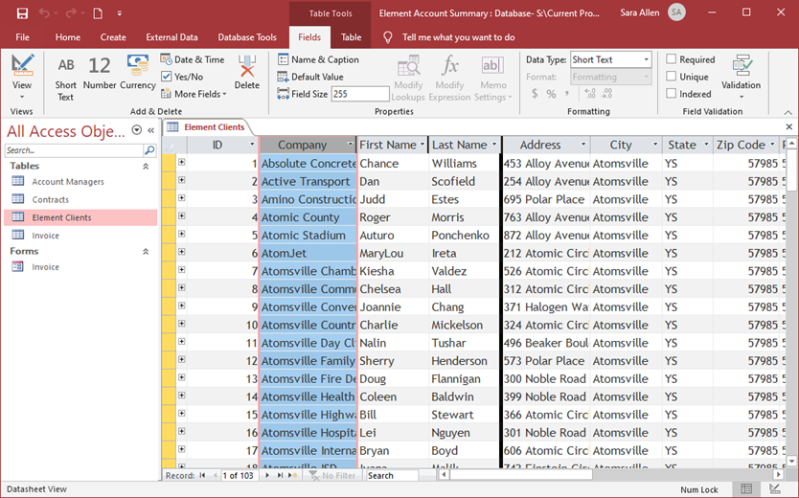
Fields
Can be moved by:
  selecting the field to move
  dragging it to the desired location
    a thick black bar will appear where the field will be placed

Slide 29
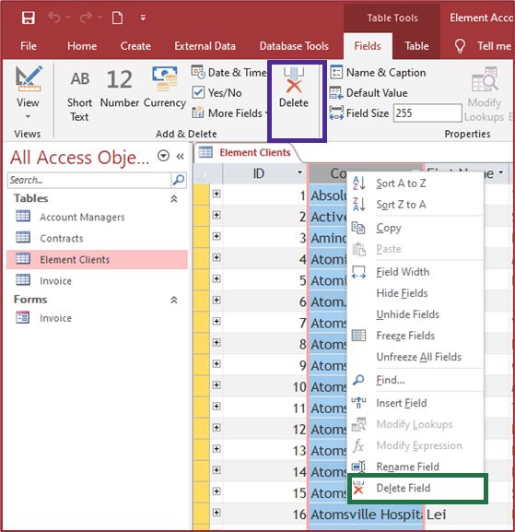
Fields
Can be deleted in Datasheet view by:
  clicking the Delete icon in the Add & Delete group of the Table Tools Fields tab
  right-clicking on the
  selected field and clicking
  Delete Field on the menu

Slide 30
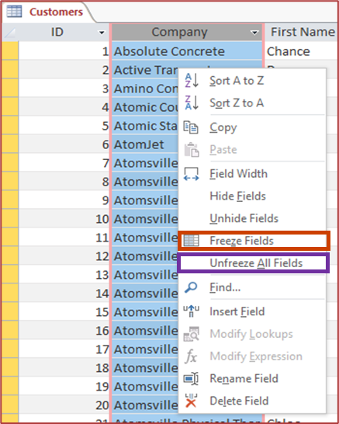
Fields
Can be frozen or made to stay on the screen as a user scrolls from left or right
  this is useful when there are more fields which cannot be seen without scrolling
Can be frozen by:
  selecting the field
  right-clicking and choosing
  Freeze Field from the menu
Can be unfrozen by:
  selecting the field
  right-clicking and choosing
  Unfreeze All Fields from the menu

Slide 31
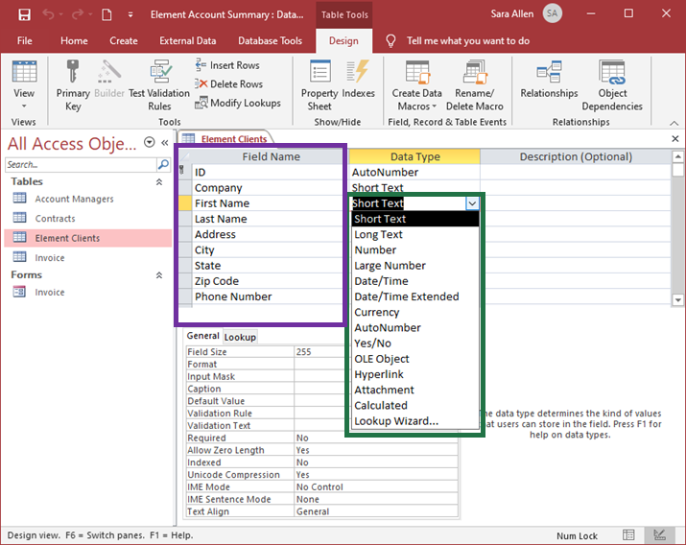
Fields
Can be added to a table in Design view by:
  entering a field name beneath the Field Name heading
  selecting a data type
  for a field from the
  drop-down menu
  in the Data Type area
  for each field
Working in Design view allows users to build the structure of a table without actually having to add data to the table.

Slide 32
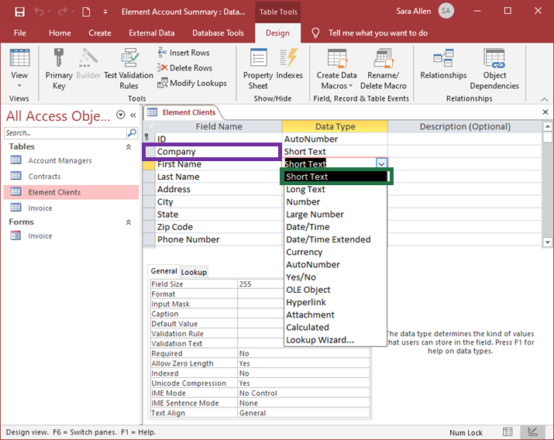
Fields
Can be renamed by selecting the name in the Field Name area and editing the text
Can have their data type changed by
clicking the data type
and choosing another
data type from the
menu

Slide 33
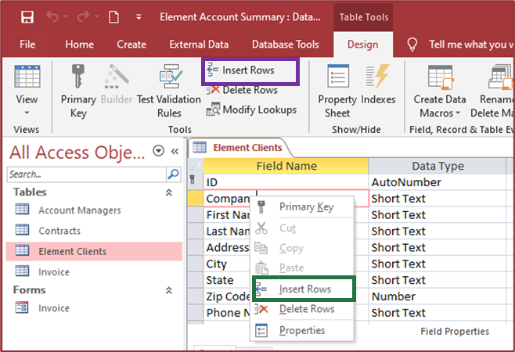
Fields
Can be inserted between fields in Design view by selecting the field behind where the new field should be added then:
  clicking the Insert Rows icon in the Tools group of the Table Tools Design tab
  right-clicking on the selected field and clicking
  Insert Rows on
  the menu

Slide 34
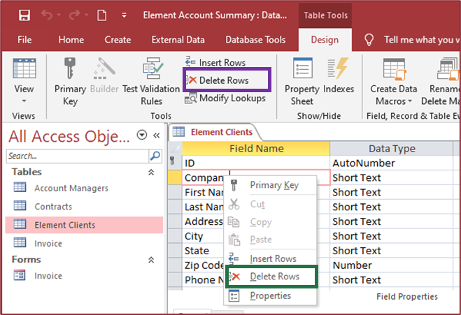
Fields
Can be deleted in Design view by selecting the field to be deleted and:
  clicking the Delete Rows icon in the Tools group of the Table Tools Design tab
  right-clicking on the selected field and clicking
  Delete Rows on the menu

Slide 35
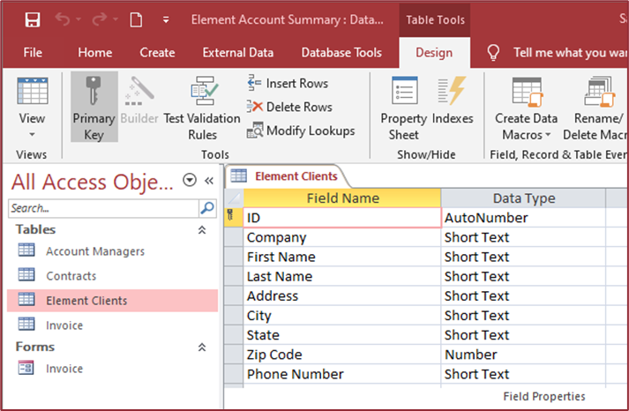
Primary Key
Is a unique field which can be used to identify a record
Helps avoid duplicate records in a table
Keep in mind, primary keys must be unique for each record so choosing a field such as First Name or Last Name which could be duplicated at some point is not a good idea. Choose a field like Social Security Number or create an individual ID number for each record.

Slide 36
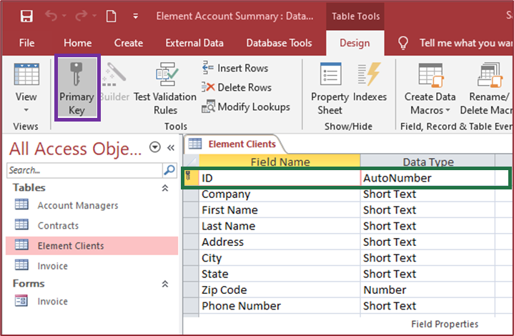
Primary Key
Can be set in Design View by:
  selecting the field which needs to be the primary key
  clicking the Primary Key icon in the Tools group of the Table Tools Design tab
To see if a table contains a primary key, look for the key icon next to the field name in the field selector.
A composite key can be created when two or more fields combine to define the primary key by unique combinations of their values. Keep in mind the combination must be unique.

Slide 37
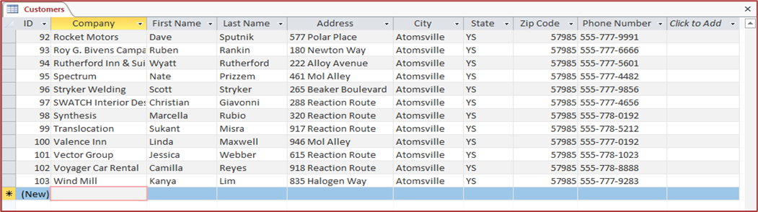
Records
Are complete sets of data about a specific item made up of fields
Are stored in tables
  other objects offer alternative methods of looking at the records, but does not store them
Can be entered by typing the information wanted in a field and moving to the next field
Access® will automatically save the record when a user moves to another record.

Slide 38
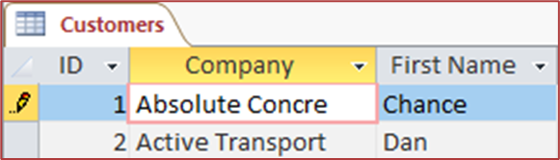
Records
Can be edited by clicking in the field which needs to be edited and then deleting or inserting the text to be added
  when editing, a pencil icon will appear in the record selector to show the changes are not currently saved
    when a user moves to another record, the record will automatically save
Text in records can be changed in much the same way it would in any other program, by positioning the insertion point and using the Backspace or Delete keys to remove text and the other keys on the keyboard to enter text.

Slide 39
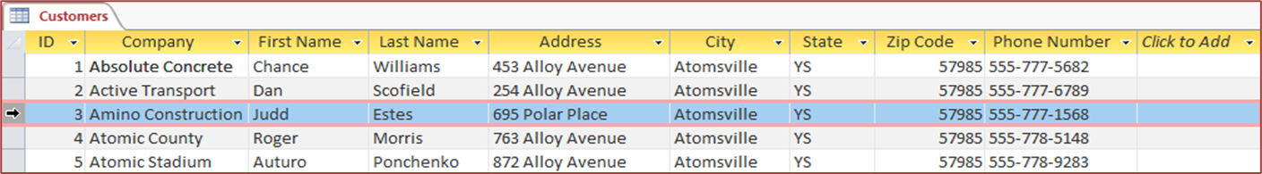
Records
Can be selected individually by clicking the record selector to the left of the record wanted
Can be selected as a contiguous group by clicking the first one and then holding down the shift key and clicking the record selector on the last one
To select all records in a table, press Control A.

Slide 40
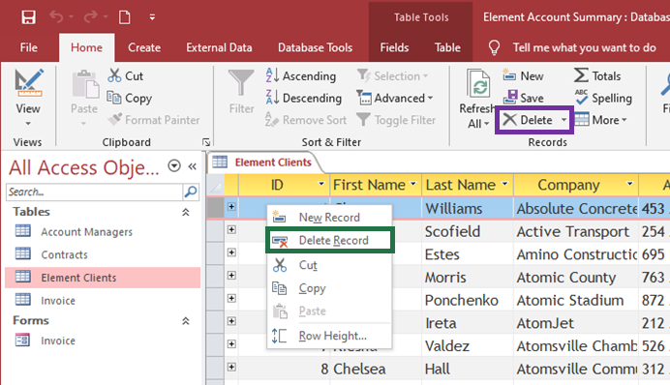
Records
Can be deleted by selecting the record or records and then:
  pressing the Delete key on the keyboard
  clicking the Delete icon in the Records group on the Home tab
  right-clicking and choosing Delete Record from the menu

Slide 41
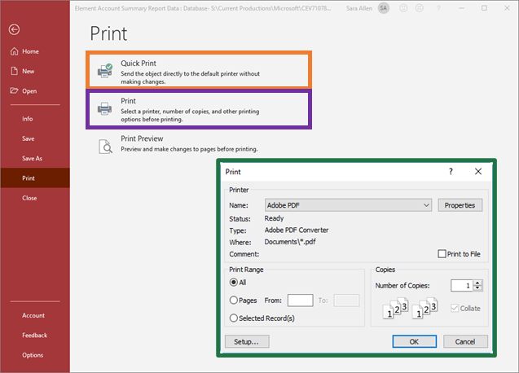
Tables
Can be printed by:
  clicking the File tab then
  selecting the Print option
  selecting:
    Quick Print
      sends the object to
      the default printer
      without making any
      changes
    Print
      allows a user to choose a printer and other printing options before printing in the Print dialog box
      then click OK and the object will be printed

Slide 42
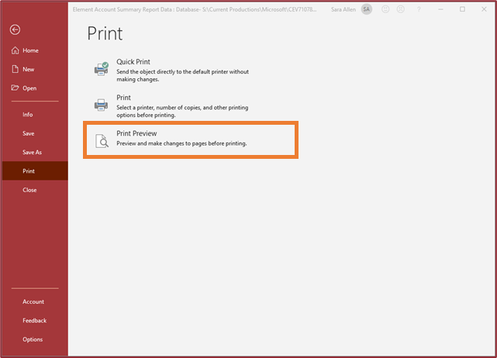
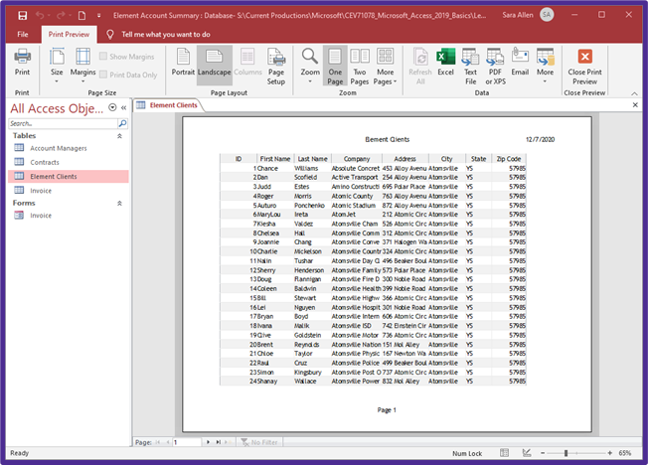
Print Preview
Can be opened by clicking Print Preview
  this view shows how the object will look when printed and contains the Print Preview tab

Slide 43
Data
Can be imported from many different sources such as:
  text files
  Excel® worksheets and workbooks
  other Access® databases
Can be imported by using the Import & Link group on the External Data tab
Regardless of which importing option is chosen, a wizard will walk users through the importing process. A wizard is a sequence of dialog boxes which guides a user through a set of steps in a process.

Slide 44
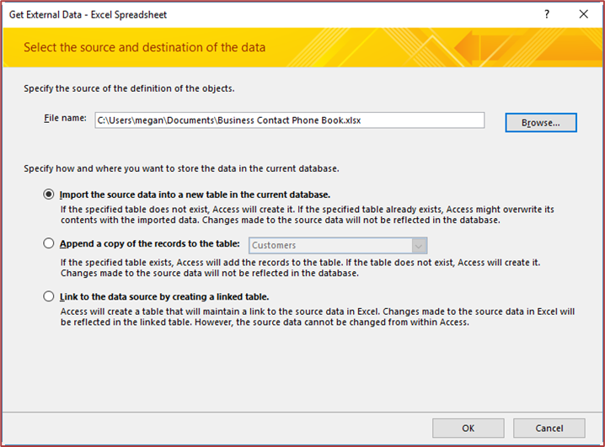
Data
Can be imported by:
  adding it into an existing table in a database
  creating a new table
  creating a link to the original data source
The option to choose where to place the imported data will open in the Get External Data dialog box after a user clicks on one of the options in the Import & Link group.
Based on the option chosen, the data will be brought into Access®.

Slide 45
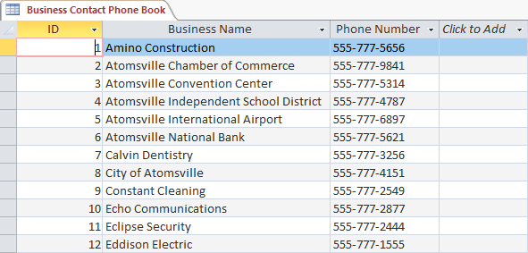
Data
After being imported, can be edited, formatted, queried just as any data which was originally created in the database

Slide 46
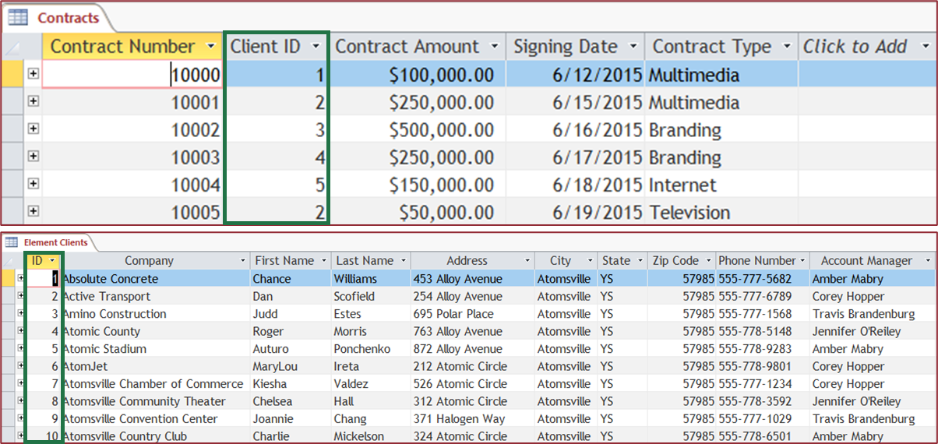
Tables
Can have a relationship created between them if they share a common field
  the field names can be different, but the fields must contain the same data and data type

Slide 47
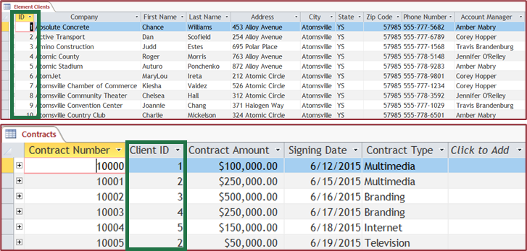
Tables
Are commonly related using the primary keys of one table
  keep in mind, this field is typically unique in one table, but not in the related table
    a one-to-many relationship results in this instance
For example, the ID field in the Element Clients table uniquely identifies each client. In the Contracts table the Client ID field is still used to identify each client however, it can appear more than once in the table based on the number of contracts a client has.

Slide 48
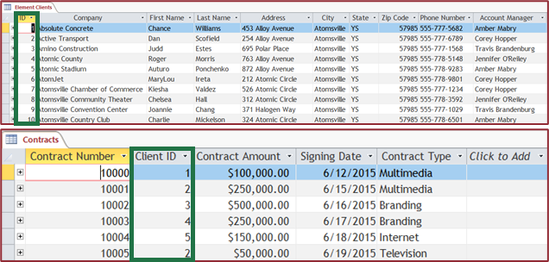
One-To-Many Relationship
Is a relationship between two fields in which the value of the linked field in the parent table is unique for each record, but the value in the linked field in the child table can be the same for multiple records
Parent Table: the main table of the relationship or the “one” side of the relationship; in the example of the Element Clients table
Child Table: the second table of the relationship containing the “many” side of the relationship; in the example of the Contracts table

Slide 49
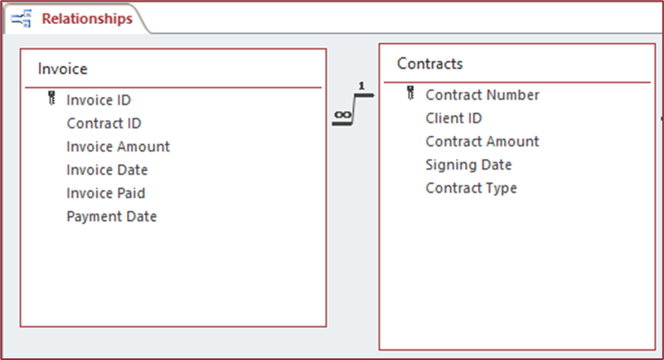
One-to-One Relationship
Is a relationship between information in two tables where each record only appears once
  for instance, the Computer Serial Number field in the Employees table is a lookup field which looks up the value in the Serial Number field in the Technology table since each employee is only issued one computer

Slide 50

Foreign Keys
Are the field in the child table which is related to the primary key in the parent table
Can be thought of as the field containing the “many” side of the relationship
For example, the Client ID field in the Contracts table is the foreign key. Also, the ID field in the Element Clients table can be referred to as the master field as it is the related field from the parent table.

Slide 51
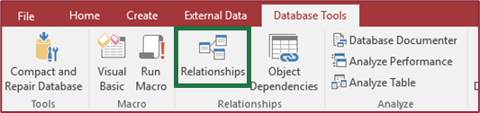
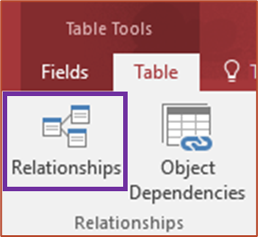
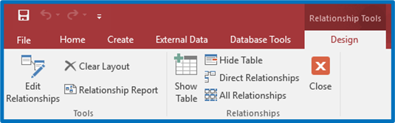
Relationship Window
Can be opened by clicking the Relationships icon in the Relationships group of the Database Tools tab
Can also be opened by clicking the Relationships icon in the Relationships group of the Table Tools Table tab
Contains the Relationship Tools Design tab

Slide 52
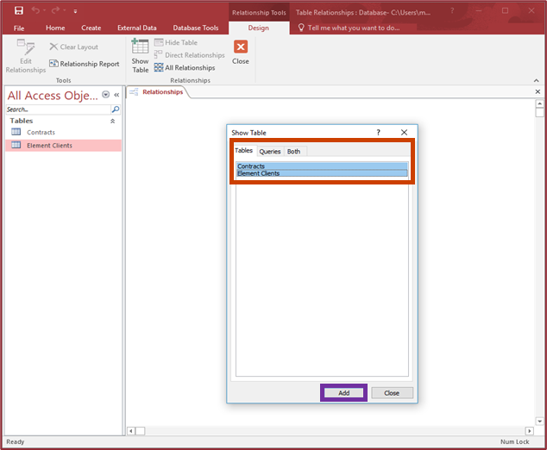
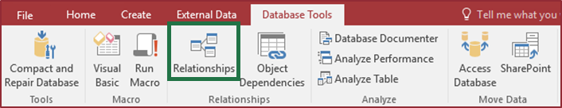
Relationships
Can be created by:
  clicking the Relationships icon in the Relationships group of the Database Tools tab
  adding the tables to the Relationship window by selecting them in the Show Table dialog box
  clicking Add
Tables can also be added to the Relationship window by clicking and dragging the table from the Navigation Pane to the window.

Slide 53
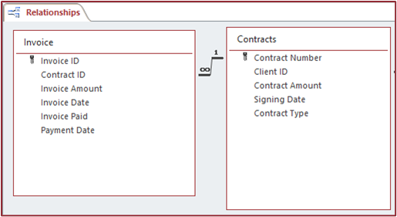
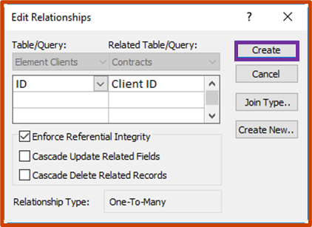
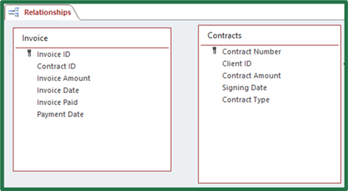
Relationships
Can be created by:
  clicking the field in the parent table and dragging it to the related field in the child table
  clicking Enforce Referential Integrity in the Edit Relationships dialog box
  clicking Create
Once create is clicked, the relationship will appear in the Relationship window as a join line with a “1” on one end and an infinity sign on the other to show it is a one-to-many relationship.

Slide 54
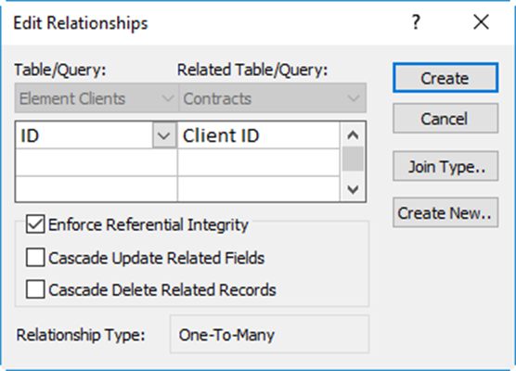
Referential Integrity
Is a set of rules enforced by Access® between related tables
When enforced, specifies each foreign key value in the child table which must have a matching primary key value in the parent table
Cascade Update Related Fields should be selected if a user wants to update the appropriate foreign key values in the child table when a primary key value is changed in the parent table.
Cascade Delete Related Records deletes records related to any deleted records in the parent table.

Slide 55
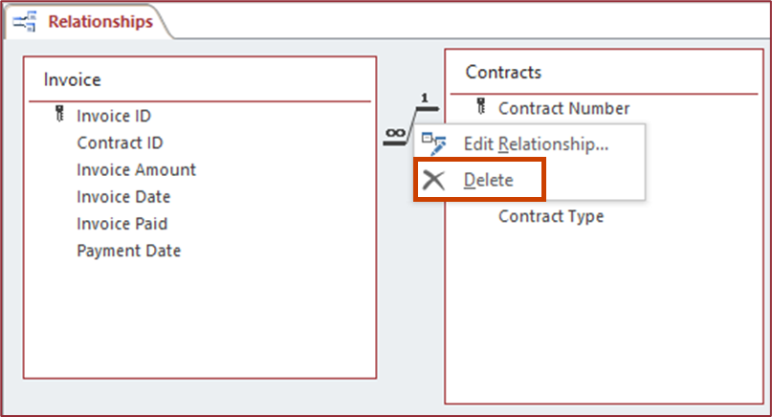
Relationships
Can be deleted by selecting the join line of the relationship:
  pressing the delete key
  right-clicking and choosing Delete from the menu

Slide 56
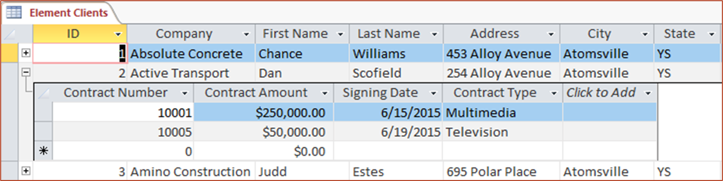
Related Records
Can be shown in Datasheet View by clicking the small plus sign at the edge of the record and the related rows will appear beneath the record
  to hide the related rows, click on the minus sign which appears at the edge of the record

Slide 57


Relationship Reports
Are a copy of the relationships between the tables in a database
Can be printed when the Relationship window is open by:
  clicking the Relationship
  Report icon in the Tools
  group of the Relationship
  Tools Design tab
  clicking Print in Print
  Preview

Slide 58
Queries
Are questions asked about the data stored in a database
Can make viewing, adding, deleting or changing data in a database easier
Can also be used to find specific data, calculate or summarize data or automate data management tasks
Result in a record set
Can be used as the basis for a form or report

Slide 59



Queries
Can be created by using:
  the Simple Query Wizard
  Query Design view

Slide 60



Simple Query Wizard
Can be used to create a select query
Is a sequence of dialog boxes to guide a user through the query design process

Slide 61

Query Design View
Contains:
  the Query Tools Design tab
  table field lists
  Query Design grid
Allows a user to:
  choose the fields
  which appear in a
  query
  select the sort order
  set criteria

Slide 62
Select Queries
Are some of the most common types of queries created
Sort and filter data in a table or other query to develop a record set based on specified criteria
  for example, a select query could be run on a table containing all of an employee’s contact information to create a record set which only includes the employee's name and phone number
Can be created by using:
  the Simple Query Wizard
  Query Design view

Slide 63


Simple Query Wizard
Can be used to create a select query by:
  clicking the Query Wizard icon in the Queries group of the Create tab
  selecting Simple Query Wizard in the New Query dialog box
  clicking OK

Slide 64

Simple Query Wizard
Can be run by:
  selecting the fields wanted in the query from the tables and queries
  clicking Next
  naming the query
  selecting to view the query or modify the design
  clicking Finish

Slide 65


Query Design View
Can be used to create a select query by:
  clicking the Query Design icon in the Queries group of the Create tab
  selecting the tables which contain the fields to add to the Query
  Design grid in the
  Show Table
  dialog box

Slide 66

Query Design View
Can be used to create a select query by:
  selecting the fields wanted in the query and placing them in the Query Design grid
  entering criteria for the
  query to use in the
  Query Design grid
  clicking Run in the
  Results group of the
  Query Tools Design
  tab to run the query
A field can be added to the design grid by double-clicking it in the table’s field list, dragging it to the grid or choosing it from the field drop down menu in the grid. The order in which fields are added is the order they will appear in the query.

Slide 67

Queries
Can be saved after they are run by:
  right-clicking on the object tab when the query is open
  selecting save from the menu
Can also be saved by clicking the Save icon on the Quick Access toolbar

Slide 68

Queries
Can be printed by:
  having the query open
  clicking the file tab and in Backstage view choosing the Print option
  selecting an option based on if the user is ready to print immediately or would like to check settings

Slide 69

Multi-Table Query
Is a query based on more than one table
  meaning, fields from multiple tables are included in the query

Slide 70


Multi-Table Query
Can be created using the Simple Query wizard by:
  clicking the Query Wizard icon in the Queries group of the Create tab
  selecting Simple Query Wizard in the New Query dialog box
  clicking OK

Slide 71

Multi-Table Query
Can be created using the Simple Query wizard by:
  selecting the fields from the tables and/or queries
  clicking Next
  naming the query
  selecting to view the query or modify the design
  clicking Finish

Slide 72

Multi-Table Query
Can be created in Design View by adding fields from multiple table’s fields lists to the Query Design grid
In this example, the query will pull the Company field from the Element Clients table and the Contract Amount and Signing Date fields from the Contracts table.

Slide 73

Multi-Table Query
Can sometimes need a different name for a field than what was in the original table to help it make sense in the query
  for instance, rather than the field name being Company, it should be Client in the example below
    to make this change, type the name required before the current name in the Field row and then enter a colon
      this creates an alias, or an alternate name for the field in the query

Slide 74

Make Table Query
Creates a table containing the fields specified in the query design

Slide 75

Make Table Query
Can be created by:
  clicking Make Table in the Query Type group on the Query Tools Design tab
  naming the table in the Make Table dialog box
  selecting a location for the table to be placed
  clicking OK

Slide 76

Make Table Query
Can be created by:
  specifying the fields and criteria in the Query Design grid
  clicking Run in the Results group
  clicking Yes in the Warning which appears

Slide 77

Append Query
Enables users to select records from one table and add them to another without removing or altering the records in the original table
  it is important to note, the table which is going to have the data appended must contain the necessary fields or the records will not append
The append query in this example, adds the records from the Account Managers- Origin table to the Account Managers table so all are in one location.

Slide 78

Append Query
Can be created by:
  clicking Append in the Query Type group on the Query Tools Design tab
  selecting the table to append the information to in the Append dialog box
  clicking OK

Slide 79

Append Query
Can be created by:
  specifying the fields and criteria in the Query Design grid
  clicking Run in the Results group
  clicking Yes in the Warning which appears

Slide 80

Simple Query Wizard
Can be used to create a query which summarizes numeric data

Slide 81



Simple Query Wizard
Can be used to summarize data by:
  clicking Query Wizard in the Queries group on the Create tab
  selecting Simple Query Wizard in the New Query dialog box and clicking OK
  selecting the fields in the Simple Query Wizard dialog box and clicking Next

Slide 82



Simple Query Wizard
Can be used to summarize data by:
  selecting the summary option button and clicking Summary Options
  selecting summary values to be calculated
  naming the query and clicking Finish

Slide 83


Query Design View
Can also be used to create summary queries by using the Total Row in the Query Design grid and selecting an aggregate function from the menu
To make the Total Row visible on the Query Design grid, make sure the Totals icon is selected in the Show/Hide group of the Query Tools Design tab.
Aggregate Function: is a function which summarizes data

Slide 84

Form
Is a database object which can be used to enter, edit or display data from a table or query
Typically displays all of the information for one record on a single page
Forms are connected to tables and queries; therefore, when information is entered in a form it is automatically added to the connected tables and queries.

Slide 85


Forms
Can quickly be created based on a current table by:
  having the table open in Datasheet view
  clicking the Form icon in the Forms group on the Create tab
    a form will automatically be opened in Layout View

Slide 86




Form Wizard
Is a sequence of dialog boxes to guide a user through the form design process
Once the wizard is finished, if a user chooses to open the form, it will open in Form view and information can begin being added to records.

Slide 87

Forms
Can be saved by:
  right-clicking on the object tab and selecting Save from the menu
  clicking the Save icon on the Quick Access Toolbar
To begin using the form to enter data, switch to Form View by clicking on one of the view icons on the Ribbon and selecting Form View or clicking the Form View icon on the Status Bar.

Slide 88


Forms
Utilize the Record Navigator buttons at the bottom of the form to move from record to record
  as a user moves from record to record the data in the form will change to reflect the selected record

Slide 89


Forms
When in Form view, can be used to add records to the table a form is connected to by:
  clicking the New icon in the Records group of the Home tab
  clicking the New Record icon on the Record Navigator at the bottom of the screen
When the new record is added, simply fill out the information needed in the form and move to the next record.

Slide 90


Forms
Can have records deleted from them in Form View by:
  clicking the Delete icon in the Records group of the Home tab and choosing Delete Record
  clicking the selection bar
  and pressing the Delete
  or Backspace key
A warning will pop up regardless of which method is used to delete the record, making sure a user means to delete the record. If so, click Yes. If not, click No.

Slide 91

Forms
Can be printed by:
  having the form open
  clicking the file tab and in Backstage view choosing the Print option
  selecting an option based on if a user is ready to print immediately or would like to check settings

Slide 92

Forms
Can be renamed by:
  making sure the form is closed
  right-clicking the form name in
  the navigation pane
  selecting Rename from the
  menu and entering a new name
Can be deleted by:
  making sure the form is closed
  right-clicking the form name in
  the navigation pane
  selecting Delete from the menu

Slide 93

Form Design View
Is a view where users can edit the controls on a form
  control is a term for any object on a form
    label is a control which contains descriptive text such as the name of a field
    text box is a control which pulls information from a table or query and displays it on the form

Slide 94


Controls
Can be added to a form in Design view by:
  selecting a control to be added in the Controls group of the Table Design Tools Design tab
  placing it on the design grid
  formatting the control to fit
  what is needed by entering
  text, resizing, moving, etc.
If a user needs to delete a control, select it and press the Delete or Backspace key and it will be removed from the design grid.

Slide 95



Report Types
Include:
  Columnar
    all fields for each record
    appear together followed
    by the next record
  Tabular
    each row is a record and
    each column is a field;
    similar to how datasheet
    printouts appear
  Justified
    field names are located
    above the fields for each
    record in blocks

Slide 96


Reports
Can quickly be created based on a current table by:
  having the table open in Datasheet View
  clicking the Report icon in the Reports group on the Create tab
    a report will open in Layout View

Slide 97




Views for Working with Reports
Include:
  Report
  Print Preview
  Design
  Layout

Slide 98


Report Wizard
Is a sequence of dialog boxes to guide a user through the report design process

Slide 99

Reports
Can be saved by:
  right-clicking on the Object tab and selecting Save from the menu
  clicking the Save icon on the Quick Access Toolbar

Slide 100

Reports
Can be renamed by:
  making sure the report is closed
  right-clicking the report name in
  the navigation pane
  selecting Rename from the
  menu and entering a new name
Can be deleted by:
  making sure the report is closed
  right-clicking the report name in
  the navigation pane
  selecting Delete from the menu

Slide 101



Reports
Can be grouped by a field in the report in Layout view by:
  clicking the Group & Sort icon in the Grouping & Totals group of the Format Layout Tools Design tab
  clicking Add a group in the Group, Sort and Total pane which opens at the bottom of the screen
  selecting a field to group by

Slide 102


Reports
Containing groups, will display all of the records pertaining to the field it was grouped by together
In this example, the report was grouped by Contract ID so each of the Invoices which pertain to a Contract ID are grouped together.
Group or sort can be deleted by clicking the “X” icon next to it.

Slide 103


Reports
Can be sorted based on a specific field by:
  clicking Add a sort in the Group, Sort and Total pane which opens at the bottom of the screen
  selecting a field to group by
Sorting allows a user to order records from smallest to largest, oldest to newest or alphabetically. It is important to note, data can be sorted without grouping it.

Slide 104

Reports
Can be filtered in Layout view by:
  right-clicking a field
  selecting a filter command from the menu

Slide 105

Reports
Can be printed by:
  having the report open
  clicking the file tab and in Backstage view choosing the Print option
  selecting an option based on if a user is ready to print immediately or would like to check settings

Slide 106
Filtering Data
Displays only records matching certain criteria
  the filter is applied and only a subset of records are shown in the datasheet; the other data is not deleted, just hidden from view
Can be completed by:
  filtering by selection
    filter based on data selected in a record or field
  filtering for multiple values
    filter based on multiple values in a record or field
  filtering by form
    filter based on a form which allows a user to enter criteria for the filter

Slide 107

Filtering by Selection
Can be completed by:
  selecting the data to filter in one of the fields
  clicking the Selection icon in the Sort & Filter group
  choosing the type of filter to
  apply from the menu
The option chosen in the menu is the filter which will be applied to the data. In the example, if we want to see addresses containing Alloy Avenue at any point in the address, we should choose “Contains Alloy Avenue”.

Slide 108

Filtering by Multiple Values
Can be accomplished by:
  clicking the arrow on the field name header
  selecting the checkboxes for the values which need to appear in the filter
  clicking OK
For this example, we want the records which contain Amber Mabry or Jennifer O’Reiley to appear, so both checkboxes should be checked.

Slide 109


Filtering by Form
Provides options to filter on multiple fields
Can be completed by:
  clicking the Advanced icon in the Sort & Filter group of the Home tab
  selecting Filter by
  Form from the menu
  filling out the Filter by
  Form screen
Filtering by form allows a user to filter multiple fields using a variety of data. In the example, the filter will show records containing Contract ID 1000, with an Invoice Amount greater than $500 which have been paid.

Slide 110


Filters
Can be cleared by:
  using the Clear All Filters command
    click Advanced in the Sort & Filter group
    select Clear All Filters from menu
  using the Clear Filter command on the field
    click the arrow on the field containing the filter
    select Clear Filter from… on the menu

Slide 111

Filters
Can have their results saved as a query by:
  clicking Advanced in the Sort & Filter group and choosing Filter by Form from the menu
  setting the filter criteria
  clicking Advanced in the Sort & Filter group and choosing Save As Query
  naming the query and clicking OK

Slide 112
Sorting
Arranges the records in order by one or more fields
Can be done in ascending or descending order
Can be completed on fields which have the following data types:
  short text
  number
  currency
  date/time
  Yes/No

Slide 113


Sorting
Can be accomplished by:
  selecting the field to be sorted and:
    clicking the Ascending or Descending icon in the Sort & Filter group
    clicking the arrow in the field header and choosing Sort A to Z or Sort Z to A
To remove a sort, click on the Remove Sort icon in the Sort & Filter group after a sort has been applied.

Slide 114

Data
Can be located and replaced using the Find and Replace tools in the Find group of the Home tab
  clicking either icon will open the Find and Replace dialog box

Slide 115
Wildcards
Can be used to search for data in the Find What area of the Find and Replace dialog box
  the asterisk wildcard can be used to replace one or more characters
    for instance, Mitch*m will find Mitchum, Mitchem and Mitcham or J*n* will fine Jan, Jinny and Janis
  the question mark wildcard can be used as a substitute for a single unknown character
    for example, ?an would locate Tan and Man but not Stan

Slide 116


Database Properties
Can be edited by:
  clicking the File tab and in Backstage View clicking View and edit database properties on the Info option
  changing or entering properties in the Properties dialog box which opens

Slide 117


Backing Up Databases
Can be accomplished by:
  clicking the File tab and in Backstage View choosing the Save As option
  beneath File Types click Save Database As
  under Advanced, click Back Up Database and then Save As
  in the Save As dialog
  box, name the database

Slide 118

Compacting & Repairing a Database
Can be completed by:
  clicking the File tab and in Backstage View choosing the Info option
  clicking the Compact & Repair Database button

Slide 119
Acknowledgements
Production Coordinator
Sara Allen
Videography/Post Production
Jake Saye
Video Narrator
Jason Kappus
Graphic Editors
Hilary Jasper, Megan O’Quinn,
Tasman Keel
Director of Brand Management
Megan O’Quinn
Quality Control Director
Angela Dehls
Executive Vice President
Clayton Franklin
Executive Producer
Gordon W. Davis, Ph.D.
© MMXXI
CEV Multimedia, Ltd.

