Slide 1
Basic Accounting Principles

Slide 2

Objectives
To become acquainted with generally accepted accounting principles.
To learn the basic terminology and concepts concerning accounting.
To gain an understanding of how accounting fits into the business cycle.

Slide 3
Main Menu
Basic Accounting Concepts
Equations, Debits & Credits
Accounting Systems & The Business Operating Cycle

Slide 4
Basic Accounting Concepts

Slide 5

Accounting
Is the recording, reporting and analysis of financial transactions according to accepted principles in order to provide meaningful financial information

Slide 6
Accounting
Is not just a process to figure out how much money a business made last year
Also helps a business identify trends in sales and expenditures
Allows a business to track and identify trends and make decisions which can quickly boost profitability or avoid cash shortages

Slide 7
Businesses Need Accounting
In order to provide accurate financial information for:
  owners and potential investors or creditors
    to help them understand the business’s financial situation
  management
    to help them make sensible business decisions

Slide 8
Revenue
Is one of the most important accounting terms to know
Represents the amount of money a business receives over a period of time
  calculated by the number of goods sold by the number of units sold
Can be divided into two types:
  operating revenue
  non-operating revenue

Slide 9

Operating Revenue
Is income from sales or services based on the goal of the business
  for example:
    if you own a t-shirt business the operating revenue would be the amount of revenue you receive from selling and producing shirts

Slide 10
Non-Operating Revenue
Is income which does not come from the primary goal of the business, but instead comes from:
  rent on owned buildings
  interest on investments
  dividends from stocks
  royalties
Dividends: money paid by a company to its shareholders
Royalties: money paid to an owner of a product when another entity uses the product for financial gain

Slide 11
Basic Terms & Concepts
Include:
  sales figures
    represent the amount of revenue generated by the business
    represent the total sales, less any product returns or sales discounts
  cost of goods sold
    costs directly associated with making or acquiring products, such as materials purchased from outside suppliers used in the manufacturing of the product

Slide 12
Basic Terms & Concepts
Include:
  gross profit
    derived by subtracting the cost of goods sold from net sales figures
    does not include any operating expenses or income taxes
  income tax
    required contribution for the support of a national, state or local government calculated based on income

Slide 13
Basic Terms & Concepts
Include:
  operating expenses
    are the daily expenses incurred in the operation of a business
    are divided into two categories either: selling or administrative expenses
  fixed expenses
    are expenses which are necessary, stable and occur regularly
    examples include:
      rent
      employee salaries

Slide 14
Basic Terms & Concepts
Include:
  flexible or variable expenses
    expenses which are still necessary but do not have a fixed amount
    examples include:
      hourly wages or travel costs
  discretionary expenses
    are expenses which are not necessary to daily operation of the business
    costs are entirely up to the discretion of the company
    examples include:
      employee entertainment or building renovations

Slide 15
Basic Terms & Concepts
Include:
  total expenses
    is a tabulation of all expenses incurred in running a business, exclusive of taxes or interest expense on interest income
  net income before taxes
    represents the amount of income earned by a business prior to paying income taxes
    is arrived at by subtracting total operating expenses from gross profit
  net income
    is the amount of money the business has earned after paying income taxes

Slide 16
Basic Terms & Concepts
Include:
  fixed assets
    property which a firm owns long-term, will not be converted to cash for at least a year
      include building, real estate, equipment
  inventory goods on hand
    act of assessing the amount of goods which are in the possession of the business
    used in merchandising businesses
    may be done on a periodic basis (often at the end of a quarter) or on a perpetual basis (monitored continuously)

Slide 17
Basic Terms & Concepts
Include:
  illiquid assets
    are not able to be sold quickly; carry higher risk of losing money
      include assets which have unstable value such as houses, cars, interest in private companies
  liquid assets
    can be easily converted into cash; have very low risk because prices are stable
    include government bonds and most stocks

Slide 18
Basic Calculation
Revenue, sometimes called income, is the money a business takes in
Expenses are the costs of running the business or the money going out
Profit, also known as net income, is what the business has left over or what is gained
Revenue – Expenses = Profit

Slide 19

Revenue Accounts
Help identify the source of revenue
Typically include:
  sales revenue
  interest revenue
  revenue from sale of assets

Slide 20
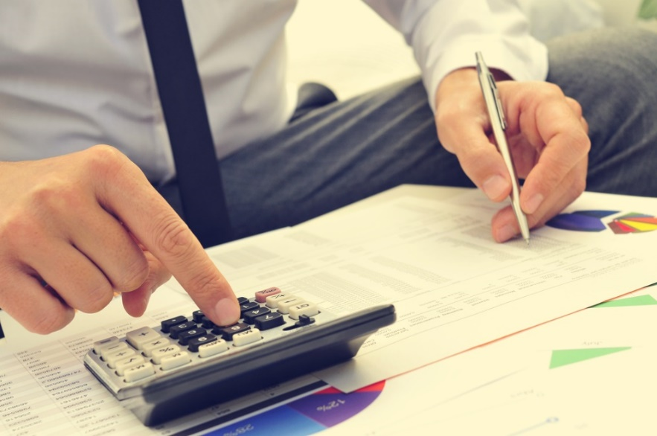
Expense Accounts
Are specific for the expense they incur
Usually incur the same expenses from month to month
Typically include:
  salaries and wages
  telephone
  utilities
  repairs
  maintenance
  depreciation
  interest
  rent

Slide 21
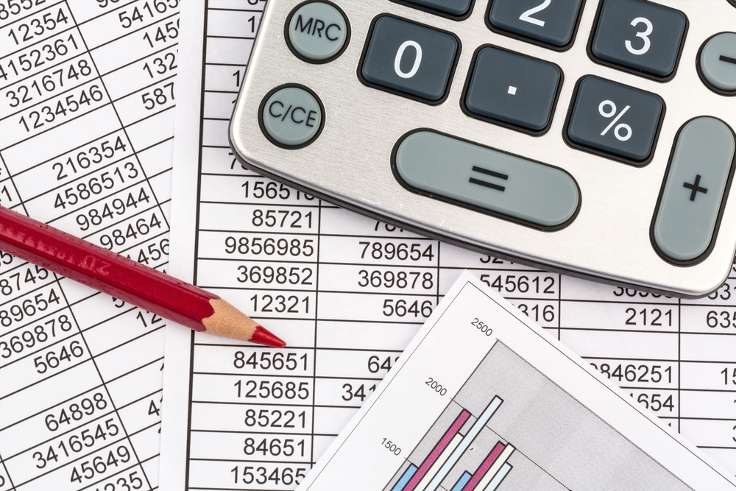
Depreciation
Measures the loss in value of an asset
Can occur with equipment such as:
  automobiles
  computers
  fax machines

Slide 22
Depreciation Example
A business purchases a truck which loses value the minute it is driven out of the dealership. The truck is considered an operational asset in running the business, but each year the truck is used, it loses some value. Eventually, the truck stops running and has no value to the business.

Slide 23
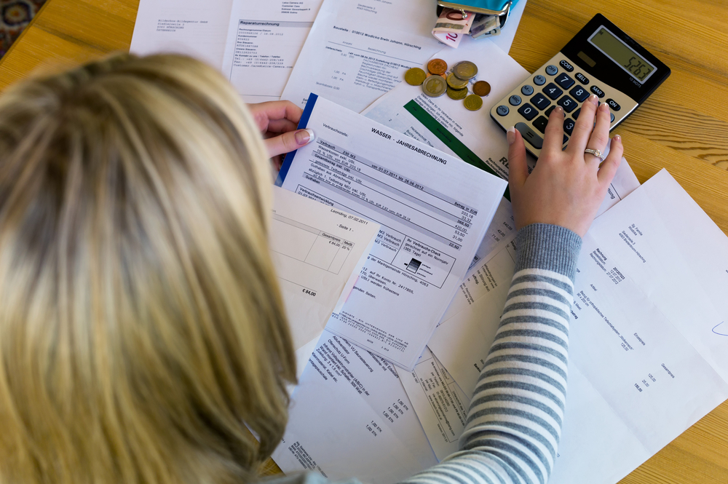
Depreciation
Is an annual expense and is listed in an income statement under expenses
  however it may decrease other expenses such as taxes and insurance

Slide 24
Depreciation Example
In 2000, Jacob purchased a parcel of land in Tennessee for $200,000, with taxes of five percent. The wind erosion over the past few years has cause a lot of damage to the land and it depreciated to a value of $165,000. Because the value is now lower, Jacob pays less in taxes on the land.
2000: $200,000 x .05 = $10,000 in taxes
Current: $165,000 x .05 = $8,250 in taxes

Slide 25
Calculating Depreciation
Is most commonly figured by using the straight-line method:
  (Purchase Price – Salvage Value) / Life expectancy
    salvage value is the value used in accounting to determine depreciation amounts
    salvage value can be a best guess of the end worth or can be determined by a governing body such as the IRS

Slide 26
Depreciation Example
Mark purchased a trailer for $12,500. The salvage value of the trailer is $3,000 with a life of eight years
Purchase price $12,500.00
Salvage value $3,000.00
Depreciable value $9,500.00
Life (in years) 8
Depreciation expense $1,187.50 (per year)

Slide 27
Overhead Costs
Are expense items which cannot be clearly associated with a particular product or function
Are the costs of resources used to maintain a business’s existence
May include:
  insurance
  office supplies
  cleaning services

Slide 28
Generally Accepted Accounting Principles (GAAP)
Are detailed accounting principles, guidelines and rules used to prepare, present and report financial statements
Are not written in law, although the U.S. Securities and Exchange Commission (SEC) requires they be followed in financial reporting

Slide 29
GAAP
Differ somewhat from International Financial Reporting Standards
Are issued by the Financial Accounting Standards Board (FASB) and its predecessor, the Accounting Principles
Board (APB)
Are generally accepted industry practices

Slide 30
Financial Accounting Standards Board (FASB)
Is a non-government group of seven members
  supported by a staff of more than 60
Sets GAAP
Works to reconcile differences between international standards and GAAP so reports created under international standards will be acceptable for companies in U.S. markets

Slide 31
GAAP
Has been recognized as authoritative by the Securities and Exchange Commission (SEC) and the American Institute of Certified Public Accountants
Must be followed by:
  any company which distributes its financial statements to the public
  any company whose stock is publicly traded
  certified public accountants
  anyone who handles a company’s financial accounts

Slide 32

GAAP
Attempts to standardize and regulate accounting definitions, assumptions and methods
Allows the assumption there is consistency from year to year in the methods used to prepare a company's financial statements
Permits reasonably confident conclusions when comparing one company to another, or comparing one company's financial statistics to the statistics for its industry

Slide 33
Equations, Debits & Credits

Slide 34
The Basic Accounting Equation
Assets = Liabilities + Owner’s Equity

Slide 35
Assets
Are items of value which a company owns
  examples include:
    cash in the bank
    company car
    rights and claims having value for the firm
    accounts receivable
    machinery
    real estate
    patents

Slide 36
Assets
Are subdivided into current and long-term assets to reflect the ease of liquidating each asset
  the most liquid asset is cash
  long-term assets are less likely to sell overnight or have the capability of being quickly converted into a current asset such as cash
    for example:
      real estate and machinery

Slide 37
Current Assets
Are any assets which can be easily converted into cash within one calendar year, such as:
  checking or money market accounts
    money available immediately
  accounts receivable
    money owed to the business for purchases made by customers, suppliers and other vendors

Slide 38

Fixed Assets
Include:
  land
  buildings
  machinery
  vehicles used in connection with the business

Slide 39
Liabilities
Are the opposite of assets
Are also known as obligations of one company to another
Include:
  accounts payable
  loans (notes payable)
  accrued payroll and withholding
Are separated into short-term or long-term based on the scheduled payment time

Slide 40
Total Current Liabilities
Are all those which must be paid within one year
Include:
  accounts payable
    comprised of all short-term obligations owed to creditors, suppliers and other vendors, including materials acquired on credit
  notes payable
    represent money owed on a collection cycle of one year or less, including bank notes and mortgage obligations

Slide 41
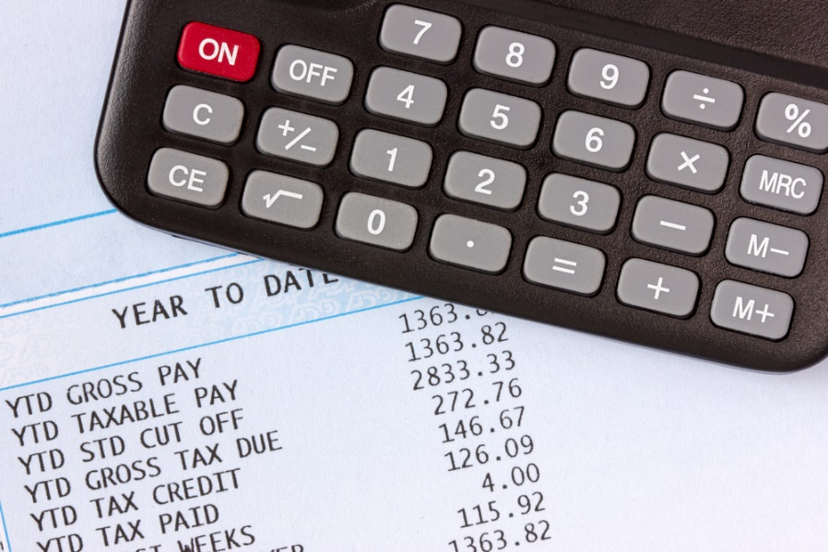
Total Current Liabilities
Include:
  accrued payroll and withholding
    includes any earned wages or withholdings owed to or for employees but have not yet been paid

Slide 42
Long-Term Liabilities
Are any debts or obligations owed by the business which are due more than one year out from the current date
Can include accounts payable, notes payable or accrued payroll and withholding, but are most commonly notes payable
  suppliers, vendors and employees typically require payment within a year

Slide 43
Owner’s Equity
Consists of the initial investment in the business as well as any retained earnings which are reinvested in the business
Is the difference between assets and liabilities
Is ideally a positive number
Is referred to as stockholders’ equity

Slide 44
Liabilities & Owner’s Equity
Comprise all debts and monies which are owed to outside creditors, vendors or banks and the remaining monies owed to shareholders, including retained earnings reinvested in the business
Added together equal total assets

Slide 45
Net Worth
Is the total value of a company or an individual
Can be found using the equation:
net worth = assets – liabilities
Example: An individual has a house which is worth $100,000, a car worth $10,000 and other assets valued at $80,000. However, the individual also has a mortgage of $50,000 and school loans for $6,000. Calculating for net worth will be done as follows:
Net Worth = ($100,000 + $10,000 + $80,000) – ($50,000 + $6000)
Net worth = $134,000

Slide 46
Debits & Credits
Are the backbone of any accounting system
Are contained in every entry in a ledger
  out-of-balance entries throw the balance sheet off
  most accounting systems have a mechanism to ensure all entries balance
Either increase or decrease the account balance

Slide 47
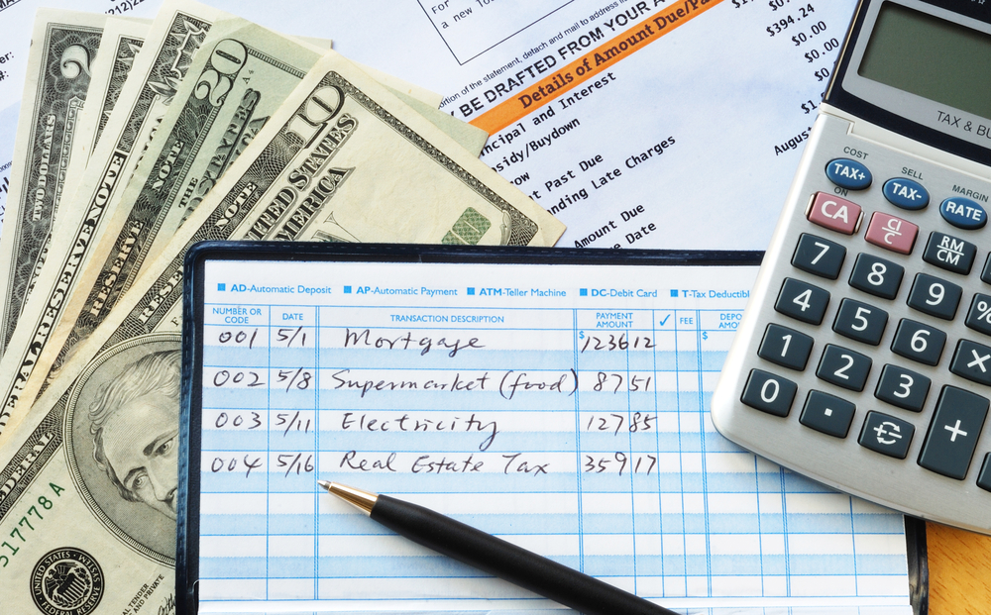
Double Entry Accounting
Recognizes every financial transaction affects at least two accounts
States for every increase in one account there is an opposite and equal decrease in another

Slide 48
Debits & Credits
Are posted or entered into accounting ledgers on opposite sides
  debits always go on the left and credits always go on the right
Have opposite effects on accounts
  for example:
    debits increase assets, while credits decrease assets

Slide 49
Debits & Credits
Increase or decrease each type of account, illustrated in this table:
Account Type | Debit | Credit
Assets | Increases | Decreases
Liabilities | Decreases | Increases
Income | Decreases | Increases
Expenses | Increases | Decreases
REMEMBER: For every credit, there is an equal debit and vice versa

Slide 50
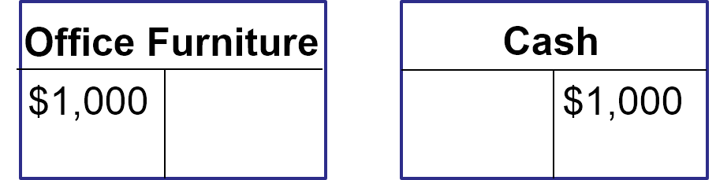
Debits & Credits Example
A business paid cash for a new office desk which cost $1,000; the two affected accounts are cash and office furniture– both assets
Debits increase assets– the business now has more office furniture
Credits decrease assets– the business now has less cash

Slide 51
Accounting Systems & The Business Operating Cycle

Slide 52

Accounting Systems
Communicate information which gives specific details about a company
Place the information needed to run a company in easy reach
Use financial terms to convey all of the information

Slide 53
Accounting Systems
Need to provide a business with feedback which must:
  be accurate
  fulfill management's requirements
Need to be simple
  system should be easy to understand and use
Are made up of many parts, called ledgers

Slide 54
The General Ledger
Is an accounting system’s main ledger
  compiles information from subledgers to create an overview of a business’s financial standing
Is the core of a company’s financial records
Constitutes the central “books” of the accounting system
Remains as a permanent track of the history of all financial transactions since the inception of the company

Slide 55
Balance Sheet
Is a primary document of the general ledger
Shows the numerical balances determined by the chart of accounts

Slide 56
Profit & Loss Statement
Is a primary document of the general ledger
Shows any changes which have occurred in the numerical balances of the company

Slide 57
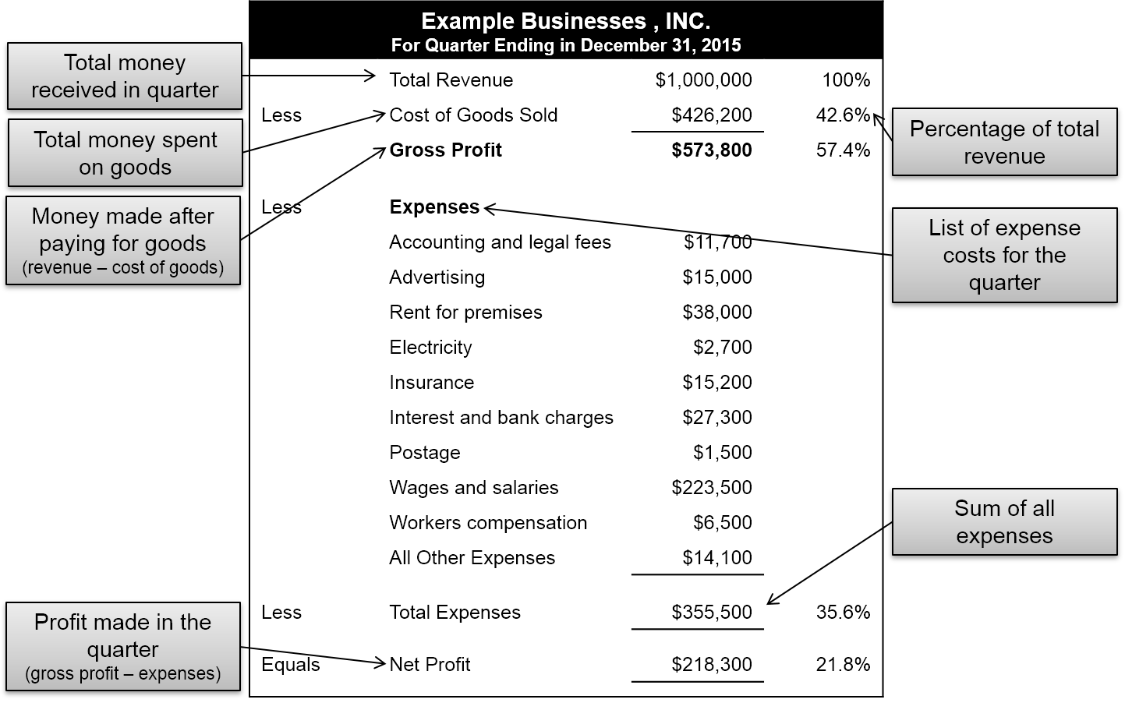
Profit & Loss Statement Example
Image on slide contains a profit and loss statement example including:
  total money received in the quarter, which is the total revenue of $1,000,000 or 100 percent
  total money spent on goods, which is costs of goods sold of $426,000 or 42.6 percent of total revenue
  money made after paying for goods (revenue minus cost of goods), which is the gross profit of $573,000 or 57.4 percent of total revenue
  list of expense costs for the quarter and total sum of all expenses of $355,500 or 35.6 percent
  profit made in the quarter (gross profit minus expenses), which is the net profit of $218,300 or 21.8 percent of the total revenue

Slide 58
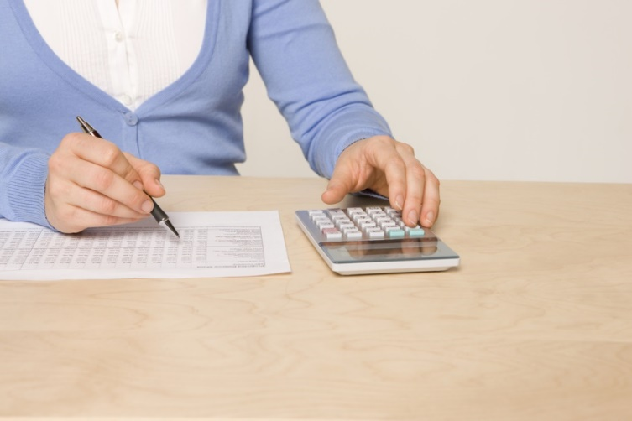
The General Ledger
Accrues the balances which make up the line items on reports
Accrues changes reflected in the profit and loss statement
Opening balance is not always zero
Shows assets and liabilities

Slide 59
The General Ledger
Creates an audit trail
Documents an internal trail of transactions so any discrepancy can be traced
  for example:
    double billing or unrecorded payments
Helps find the origin of any transaction in order to verify its accuracy

Slide 60
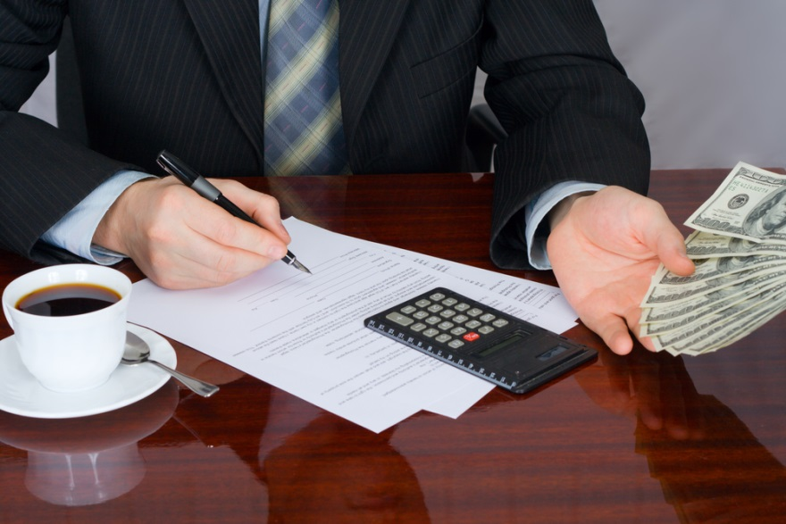
Subledgers
Are divisions of the general ledger
Typically include items such as:
  cash
  accounts receivable
  accounts payable
Contain all transactions

Slide 61
Income Statements
Are also known as profit and loss statements
Are a summary of a company’s profit or loss during any given period of time such as:
  one month, three months or one year
Record all revenues and operating expenses
Are used to track revenues and expenses to determine the operating performance of a business
Can be used to figure tax income liability

Slide 62
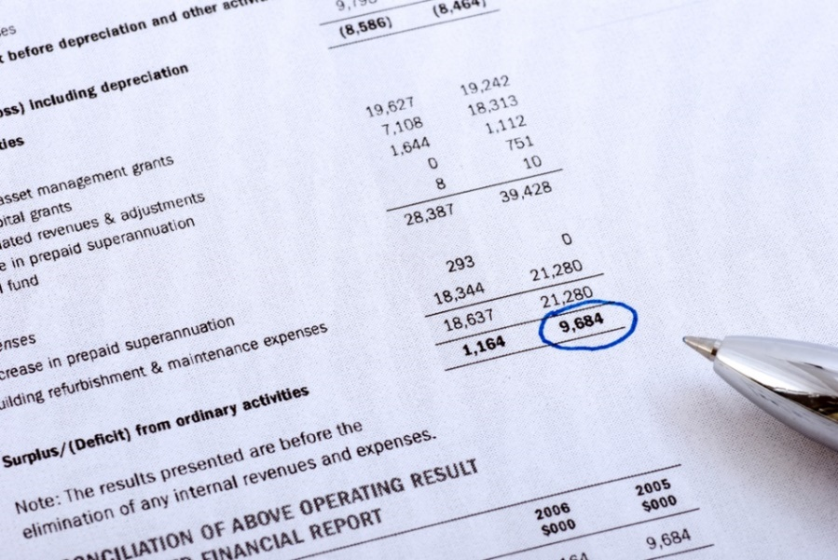
Income Statements
Are required to be given to potential lenders such as:
  banks
  investors
  vendors
Are used to help determine credit limits

Slide 63

The Business Operating Cycle
Is the flow of transactions needed in business to complete a sale and collect the proceeds
Is important to consider when setting up an accounting system

Slide 64
The Business Operating Cycle
Often progresses similar to the following:
  purchase raw materials
  enter goods into raw materials inventory
  begin the manufacturing or assembly process
  enter goods into work in process inventory
  pay suppliers or pay employees (at service companies)
  complete the manufacturing or assembly process
  enter goods into finished goods inventory
  sell the inventory
  collect payment for credit sales

Slide 65
The Business Operating Cycle
Uses the accounting system for steps 1 and 2, requiring these accounting entries in the ledger:
  step 1: purchase of raw materials
    decrease cash if balance paid on the spot (credit) or increase accounts payable if balance will be paid later (credit)
  step 2: entering goods into raw materials inventory
    increase raw materials inventory (debit)
Requires goods created in step 3 to be accounted for in the accounting system in step 4

Slide 66
The Business Operating Cycle
Uses the accounting system in step 4, requiring this accounting entry in the ledger:
  step 4: enter goods into work in process inventory
    transfer of inventory from raw material to an intermediate stage, called work in progress (WIP)
    decreases raw material inventory (credit)
    increases work in progress inventory (debit)

Slide 67

The Business Operating Cycle
Uses the accounting system in step 5, requiring these accounting entries in the ledger:
  step 5: pay suppliers
    decreases accounts payable (debit)
    decreases cash (credit)

Slide 68
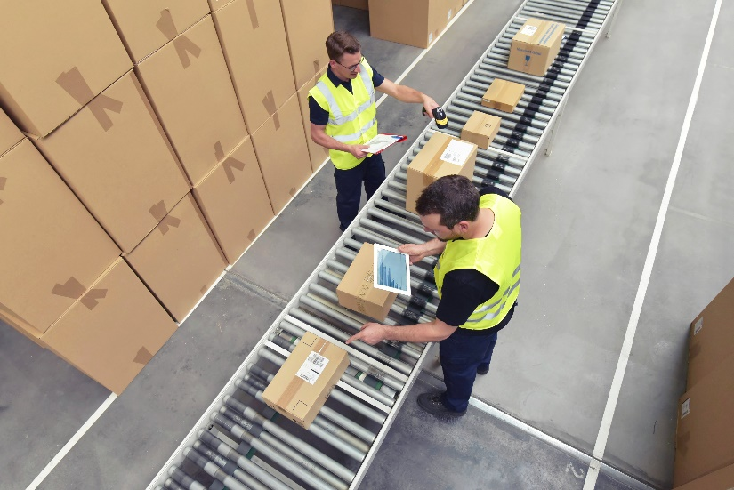
The Business Operating Cycle
Uses the accounting system in step 6, requiring these accounting entries in the ledger:
  step 6: complete the manufacturing or assembly process
    monitor work in progress inventory

Slide 69
The Business Operating Cycle
Uses the accounting system in step 7, requiring these accounting entries in the ledger:
  step 7: enter goods into finished goods inventory
    transfer inventory from work in progress to finished goods
    decreases work in process inventory (credit)
    increases finished goods inventory (debit)

Slide 70
The Business Operating Cycle
Uses the accounting system in step 8, requiring these accounting entries in the ledger:
  step 8: sell the product
    if it is a credit sale
      decrease finished goods inventory (credit)
      increase in accounts receivable (debit)
    if it is a cash sale
      decrease finished good inventory (credit)
      increase in cash (debit)

Slide 71
The Business Operating Cycle
Uses the accounting system in step 9, requiring these accounting entries in the ledger:
  step 9: collect the receivable payment
    decrease in accounts receivable (credit)
    increase in cash (debit)

Slide 72
Cash Flow
Is the amount of money which comes in and goes out of a business
Is an indicator of financial health
  more cash going in than out is a positive cash flow
    strengthens a company, allows for spending money strategically and proactively
  more cash going out than in is a negative cash flow
    indicates a problem in the growth of the company
    can be solved by taking out a loan, but this limits cash flow later when repaying the loan

Slide 73

Alternative Accounting Methods
Allow some variety within the bounds of the GAAP
Cannot be changed without good justification to the IRS

Slide 74
Alternative Accounting Methods
Include
  cost of goods sold expense methods: determine how to calculate the cost of producing goods
    FIFO (first in, first out): cost of goods is based on the initial cost
    LIFO (last in, first out): cost of goods is based on the final cost
    Average: cost of goods averaged between the initial and last cost

Slide 75
Alternative Accounting Methods
Include
  depreciation methods: calculate the value of a fixed asset
    straight-line method: value of asset spread evenly over the entire lifespan of the asset
    declining-balance method: diminishing value of asset accelerates

Slide 76
Alternative Accounting Methods
Include
  depreciation methods: calculate the value of a fixed asset
    sum-of-the-years’ digits method: value is determined based on the ratio of how many years the asset has been utilized to estimated total years the asset will be used
    units-of-production method: value is determined based on ratio of units produced so far by the asset to units asset is expected to produce

Slide 77
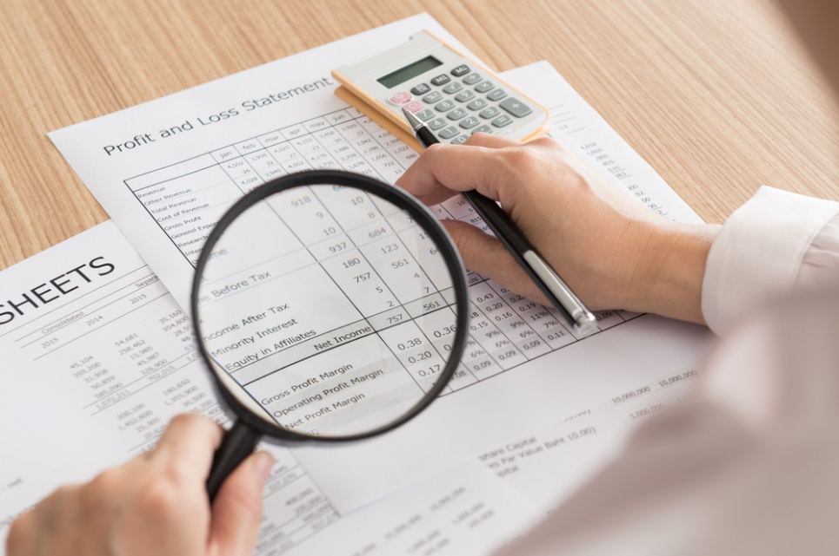
Internal Accounting Controls
Are strategies used to monitor a business’s resources
  to prevent fraud
  assess efficiency of business operating cycle
  ensure compliance with laws

Slide 78
Internal Accounting Controls
Include:
  separating accounting duties
  controlling who has access to accounting system
  physical audits to check for discrepancies
  documentation to maintain consistency in record keeping

Slide 79
Internal Accounting Controls
Include:
  trial balances to ensure ledgers are always balanced
  reconciliation to ensure balances in accounting systems match with balances in actual accounts
  approval authority to limit certain kinds of transactions

Slide 80
Basic Accounting
For a business should be kept separate from personal accounting
  no matter the size of the business, personal bank accounts and business accounts should be kept separate and should not be used interchangeably
    business revenue and expenses should involve a business bank account or credit card
    personal income and purchases should involve a personal bank account or credit card

Slide 81
Basic Accounting
Should be done monthly
  calculate the profitability of the business by putting together an income statement
  look at the financial statements each month to quickly adjust expenditures and sales efforts to keep the business within budget

Slide 82
Basic Accounting
Requires thorough records be kept
  no matter how strong or weak an individuals understanding of accounting is, very careful, well-organized records must be kept
    if ever audited (officially inspected), tax agents are going to want to see receipts, not just cancelled checks and if the receipts requested cannot be produced, the IRS will not be understanding about it
IRS: Internal Revenue Service; the government agency responsible for the collection of taxes

Slide 83
Basic Accounting
Must be organized to be efficient and effective
  it is not uncommon for companies to pay the same bill twice— sometimes overpaying by thousands of dollars
  it is not uncommon for vendors to claim a particular bill has not been paid, even when it has

Slide 84
Basic Accounting
Can be made easier with the use of computer software or a certified public accountant
  many types of accounting software exist, some of which give step-by-step instructions on financial bookkeeping and tax procedures
  hiring a certified public accountant (CPA) who has received years of education and training on accounting procedures may be the best option for some businesses

Slide 85
Alternative Accounting Methods
Are being explored to account for “soft” assets such as:
  brand image
  business reputation
  customer loyalty
  human capital
Include new methods to measure employee and customer satisfaction, environmental impact and safety
Include looking for ways to globalize accounting practices

Slide 86
Resources
http://www.accountingcoach.com
http://www.businesstown.com

Slide 87
Acknowledgements
Production Coordinators
Megan O’Quinn
Amy Hogan
Stevi Huffaker
Brand Manager
Megan O’Quinn
Graphic Designer
Melody Rowell
V.P. of Brand Management
Clayton Franklin
Executive Producer
Gordon W. Davis, Ph.D.
CEV Multimedia, Ltd.
© MMXVI

