Slide 1

Adjusting Entries and the Worksheet
Chapter 5

Slide 2
Learning Objective 1
Prepare end-of-period adjustments

Slide 3
End-of-Period Adjustments
Changes occur that affect the business’s financial condition:
  Equipment wearing out
  Prepaid insurance and supplies being used up
  Employees earning wages that have not yet been paid
Since these events have not been entered into the accounting system, adjusting entries must be made
Adjustments are guided by three important principles:
  Revenue recognition principle
  Expense recognition principle
  Matching principle

Slide 4
Revenue Recognition Principle
States that revenues should be recognized when earned, regardless of when cash is received from the customer
Revenues are considered earned when a service is provided or a product is sold

Slide 5
Expense Recognition Principle
States that expenses should be recognized when incurred, regardless of when cash is paid
Expenses are generally considered incurred when goods and services are received or assets are consumed

Slide 6
Matching Principle
Requires the matching of revenues earned during an accounting period with the expenses incurred to produce the revenues
Provides the best measure of net income
To follow all three principles necessitates that accounts be brought up to date before financial statements are prepared

Slide 7
Fiscal Year
A twelve-month period of time used as an accounting period
Does not need to be the same as a calendar year
Many businesses schedule their fiscal year to end when business is slow
Generally adjustments are made and financial statements are prepared at the end of a fiscal year

Slide 8
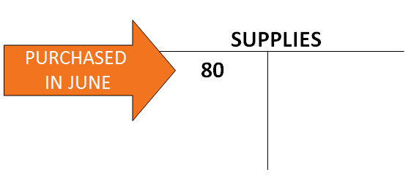
Adjustment For Supplies (1 of 3)
During June, Mitch purchased supplies for $80
These were debited to the supplies account
According to an inventory of supplies, there are only $20 of supplies on hand at the end of June

Slide 9
Adjustment For Supplies (2 of 3)
Unless there is an adjusting entry made, $80 of supplies will be shown on the balance sheet
  Assets would be overstated
  Supplies Expense would be understated
$80 purchased during month, less $20 supplies remaining = $60 supplies used
Adjusting entry needed:
  Supplies Expense – Debit $60
  Supplies – Credit $60

Slide 10
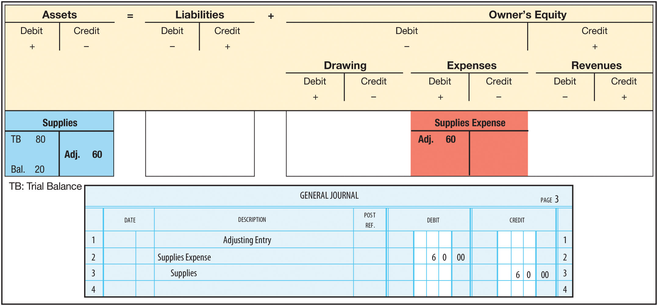
Adjustment For Supplies (3 of 3)
FIGURE 5-3 Adjustment for Supplies

Slide 11
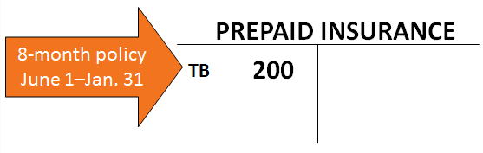
Adjustment for Expired Insurance (1 of 3)
During June, Mitch paid $700 for a ten-month liability insurance policy with coverage beginning on June 1
Prepaid insurance (asset) was debited
Insurance policy expires with passage of time incurring an expense

Slide 12
Adjustment for Expired Insurance (2 of 3)
Now that June is over, we need to remove the cost of one month’s insurance from Prepaid Insurance
$700 ÷ 10 = $70 per month
Adjusting entry needed:
  Insurance Expense – Debit $70
  Prepaid Insurance – Credit $70

Slide 13
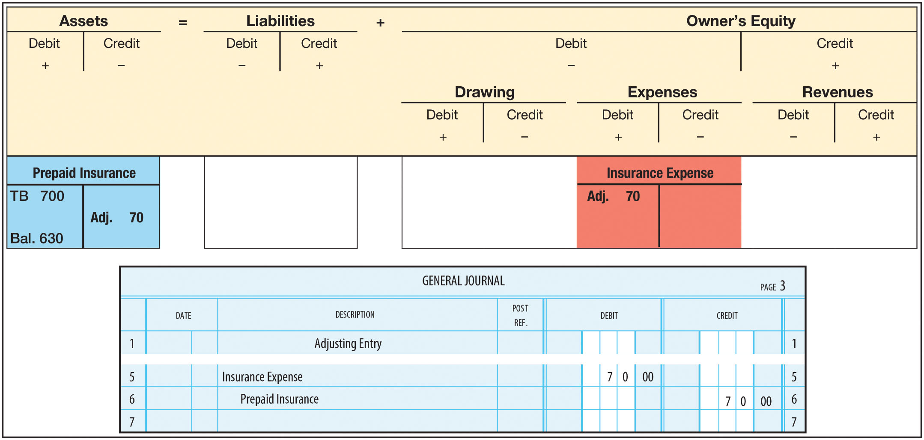
Adjustment for Expired Insurance (3 of 3)
FIGURE 5-5 Adjustment for Expired Insurance

Slide 14
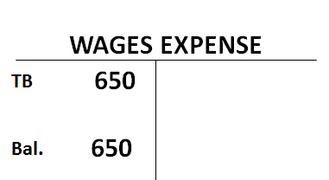
Unpaid Wages Adjustment (1 of 3)
Rohan paid his part-time employees $1,650 on June 27
Since then, they have earned an additional $400, but have not yet been paid
The additional wage expense must be reflected in the accounts

Slide 15
Unpaid Wages Adjustment (2 of 3)
Wages have been earned, but not paid
Rohan owes the employees for the additional wages
  This liability is recorded in the Wages Payable account
Adjusting entry needed:
  Wages Expense – Debit $400
  Wages Payable – Credit $400

Slide 16
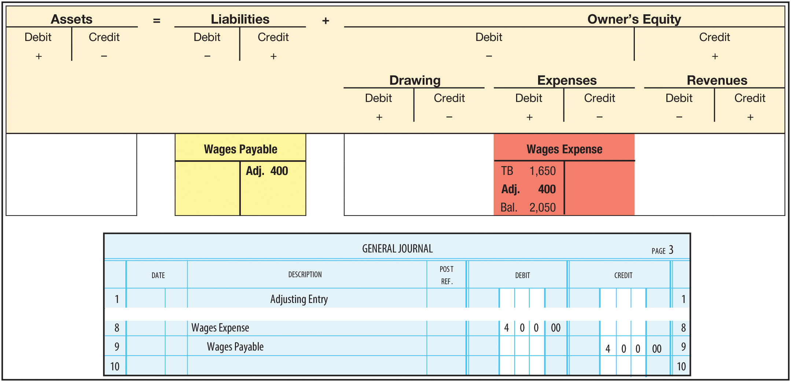
Unpaid Wages Adjustment (3 of 3)
FIGURE 5-7 Adjustment for Unpaid Wages

Slide 17
Historical Cost Principle
Assets are recorded at their actual cost
The cost remains on the books as long as the business owns the asset
No adjustments are made for changes in the market value of the asset

Slide 18
Useful Life
The period of time that an asset is expected to help produce revenues
An asset’s useful life expires
  As a result of wear and tear
  If it no longer satisfies the needs of the business
Expense should be recognized and the value of the asset should be reduced over the useful life

Slide 19
Depreciation
A method of matching an asset’s original cost against the revenues produced over its useful life
There are many depreciation methods
  Example uses the straight-line method
Depreciation expense is based on estimates of useful lives and salvage values

Slide 20
Salvage Value
The expected market value or selling price of an asset at the end of its useful life
Also called:
  Scrap value
  Residual value
Depreciable cost is the original cost of an asset, less salvage value

Slide 21
Straight-Line Depreciation Calculation (1 of 2)
Mitch has motor scooters with estimated useful lives of 5 years, no salvage value, and an original cost of $4,800.
Because salvage value is zero, the whole $4,800 cost needs to be spread over the next 5 years
Assume that a full month’s depreciation is recognized in the month in which an asset is purchased
The depreciable cost is spread over 60 months (5 years x 12 months)

Slide 22
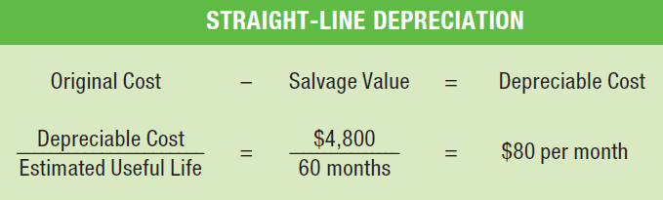
Straight-Line Depreciation Calculation (2 of 2)
Straight-line depreciation expense for the month of June is $80 ($4,800 / 60 months)

Slide 23
Book Value
The value carried on the books or in the accounting records
Book Value = Original Cost of Plant Assets – Accumulated Depreciation
Also called undepreciated cost
Does not represent the market value, or selling price, of the asset

Slide 24
Accumulated Depreciation
Is a contra-asset account
  “Contra” means opposite
Has a credit balance (the opposite of an asset)
Is deducted from the related asset account on the balance sheet
The appropriate adjusting entry consists of
  Debit to Depreciation Expense—Delivery Equipment
  Credit to Accumulated Depreciation—Delivery Equipment

Slide 25
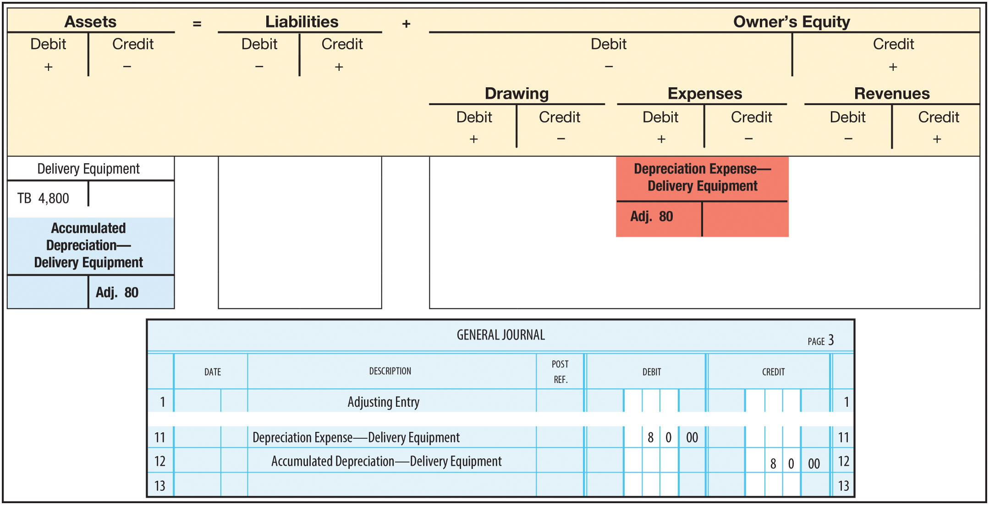
Straight-Line Depreciation Adjustment
FIGURE 5-9 Adjustment for Depreciation of Delivery Equipment

Slide 26
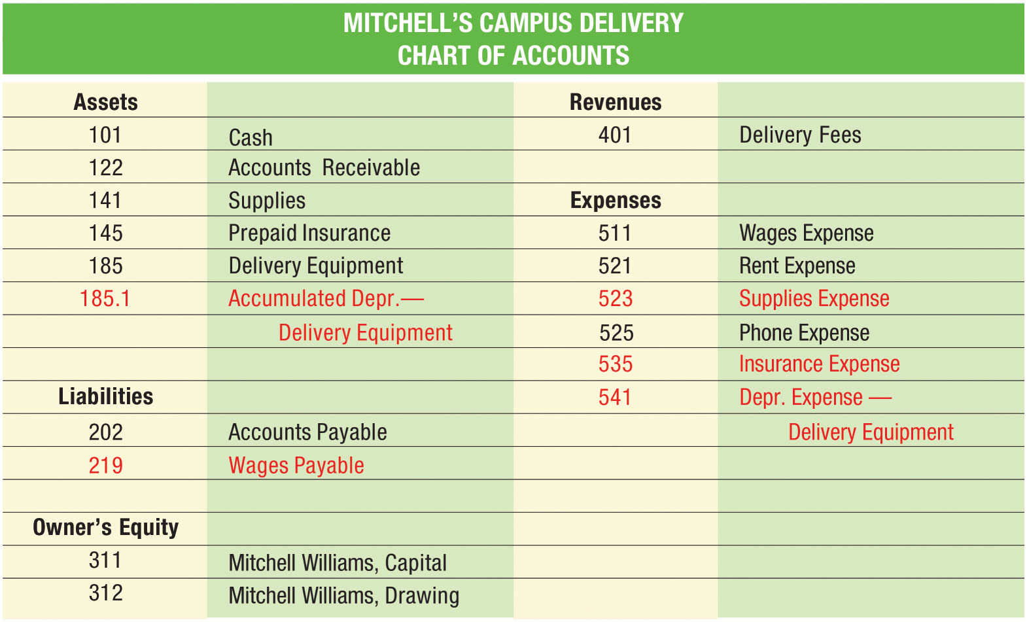
Expanded Chart of Accounts
FIGURE 5-13 Expanded Chart of Accounts

Slide 27
Learning Objective 2
Post adjusting entries to the general ledger

Slide 28
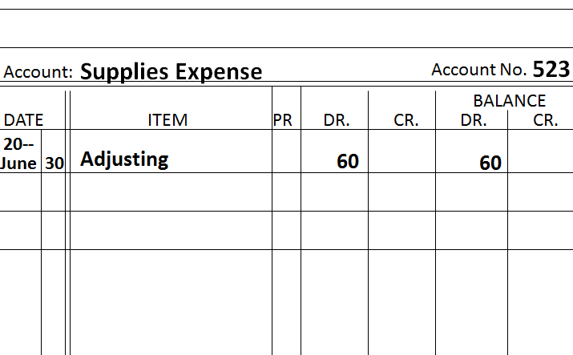
Posting Adjusting Entries (1 of 3)
Posting adjusting entries is the same as posting other entries except “Adjusting” is written in the Item column

Slide 29
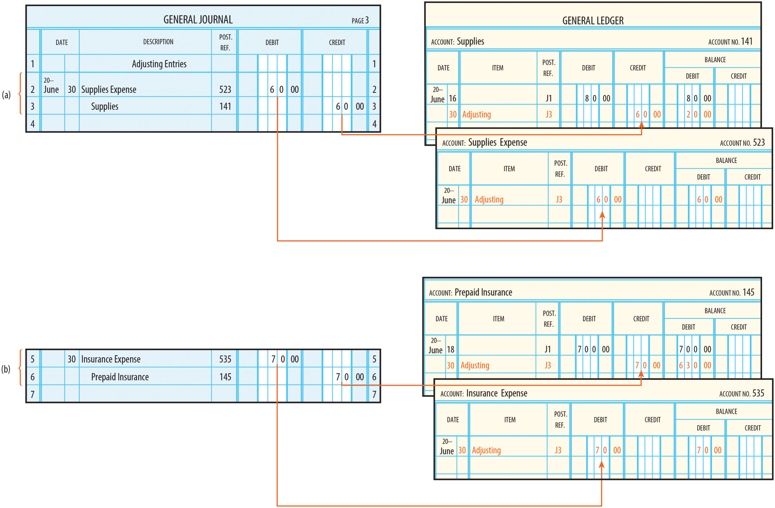
Posting Adjusting Entries (2 of 3)
FIGURE 5-14 Posting the Adjusting Entries

Slide 30
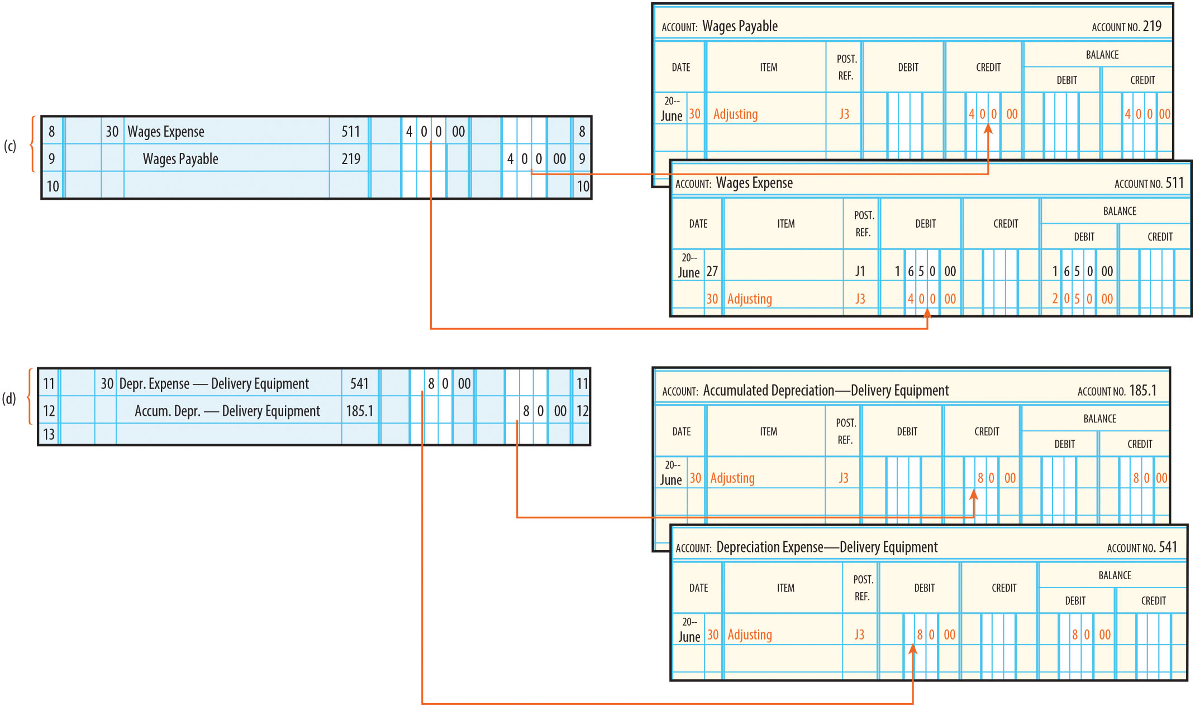
Posting Adjusting Entries (3 of 3)
FIGURE 5-14 Posting the Adjusting Entries (concluded)

Slide 31
Learning Objective 3
Prepare a work sheet

Slide 32
The Work Sheet
Pulls together all of the information needed to:
  Enter adjusting entries
  Prepare financial statements
Is not a financial statement
Usually prepared as an Excel spreadsheet
Is not a formal part of the accounting system
Ordinarily, only the accountant uses a work sheet
Commonly in a ten-column format

Slide 33
Preparing the Work Sheet
5 Steps
  Prepare the Trial Balance
  Prepare the Adjustments
  Prepare the Adjusted Trial Balance
  Extend Adjusted Balances to the
  Income Statement and Balance Sheet Columns
  Complete the Work Sheet

Slide 34
Worksheet Preparation Step-by-Step (1 of 9)
Heading includes:
  Name of the company
  Name of the working paper
  Date of the accounting period just ended
Step 1: Prepare the trial balance (before any adjustments) in the first pair of amount columns
  This is the same trial balance from Chapter 3, now being shown on a ten- column work sheet

Slide 35
Worksheet Preparation Step-by-Step (2 of 9)
Step 1: Prepare the Trial Balance
  Write the heading, account titles, and the debit and credit amounts from the general ledger
  Place a single rule across the Trial Balance columns and total the debit and credit amounts
  Place a double rule under the totals for each column
  Total debits must equal total credits

Slide 36
Worksheet Preparation Step-by-Step (3 of 9)
Step 2: Prepare the Adjustments
  Record the adjustments.
    Make certain that each adjustment is on the same line as the account name and in the appropriate column
    Identify each adjusting entry by a letter in parentheses
  Rule the Adjustments columns
  Total the Debit and Credit columns and double rule the columns
  Total debits must equal total credits

Slide 37
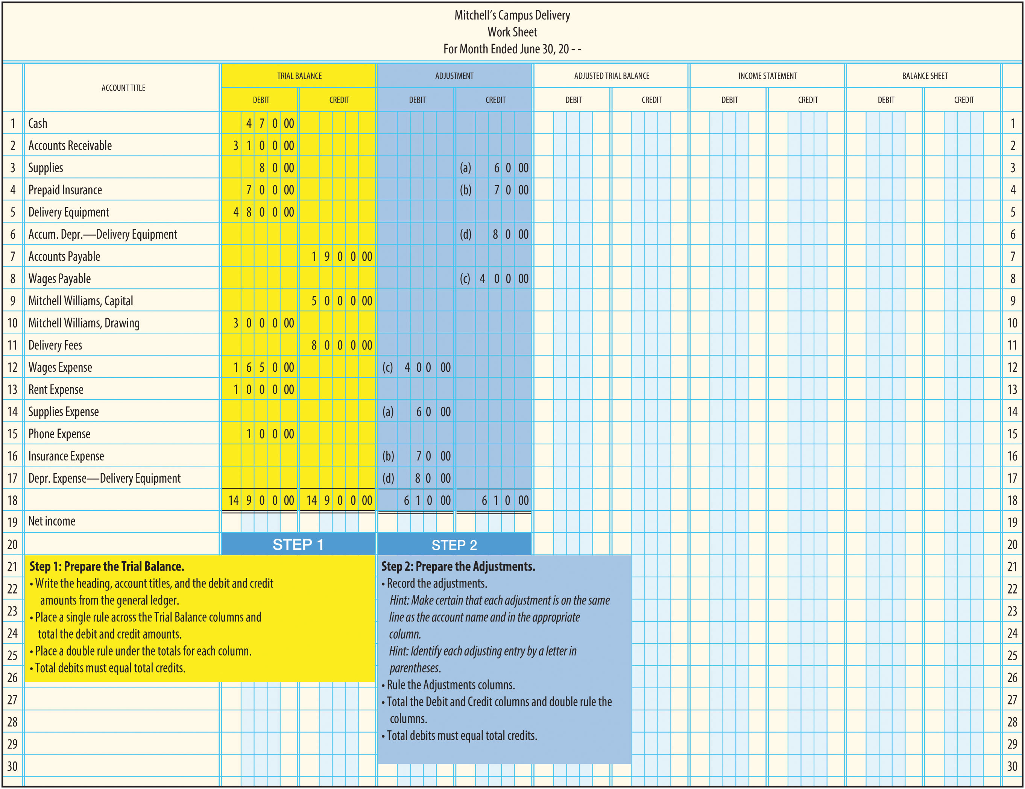
Worksheet Preparation Step-by-Step (4 of 9)
FIGURE 5-16 Step 1: Prepare the Trial Balance; Step 2: Prepare the Adjustments

Slide 38
Worksheet Preparation Step-by-Step (5 of 9)
Step 3: Prepare the Adjusted Trial Balance
  Extend those debits and credits that are not adjusted directly to the appropriate Adjusted Trial Balance column
  Enter the adjusted balances in the appropriate Adjusted Trial Balance column
    If an account has a debit and a credit, subtract the adjustment
    If an account has two debits or two credits, add the adjustment
  Single rule the Adjusted Trial Balance columns
  Total and double rule the Debit and Credit columns
  Total debits must equal total credits

Slide 39
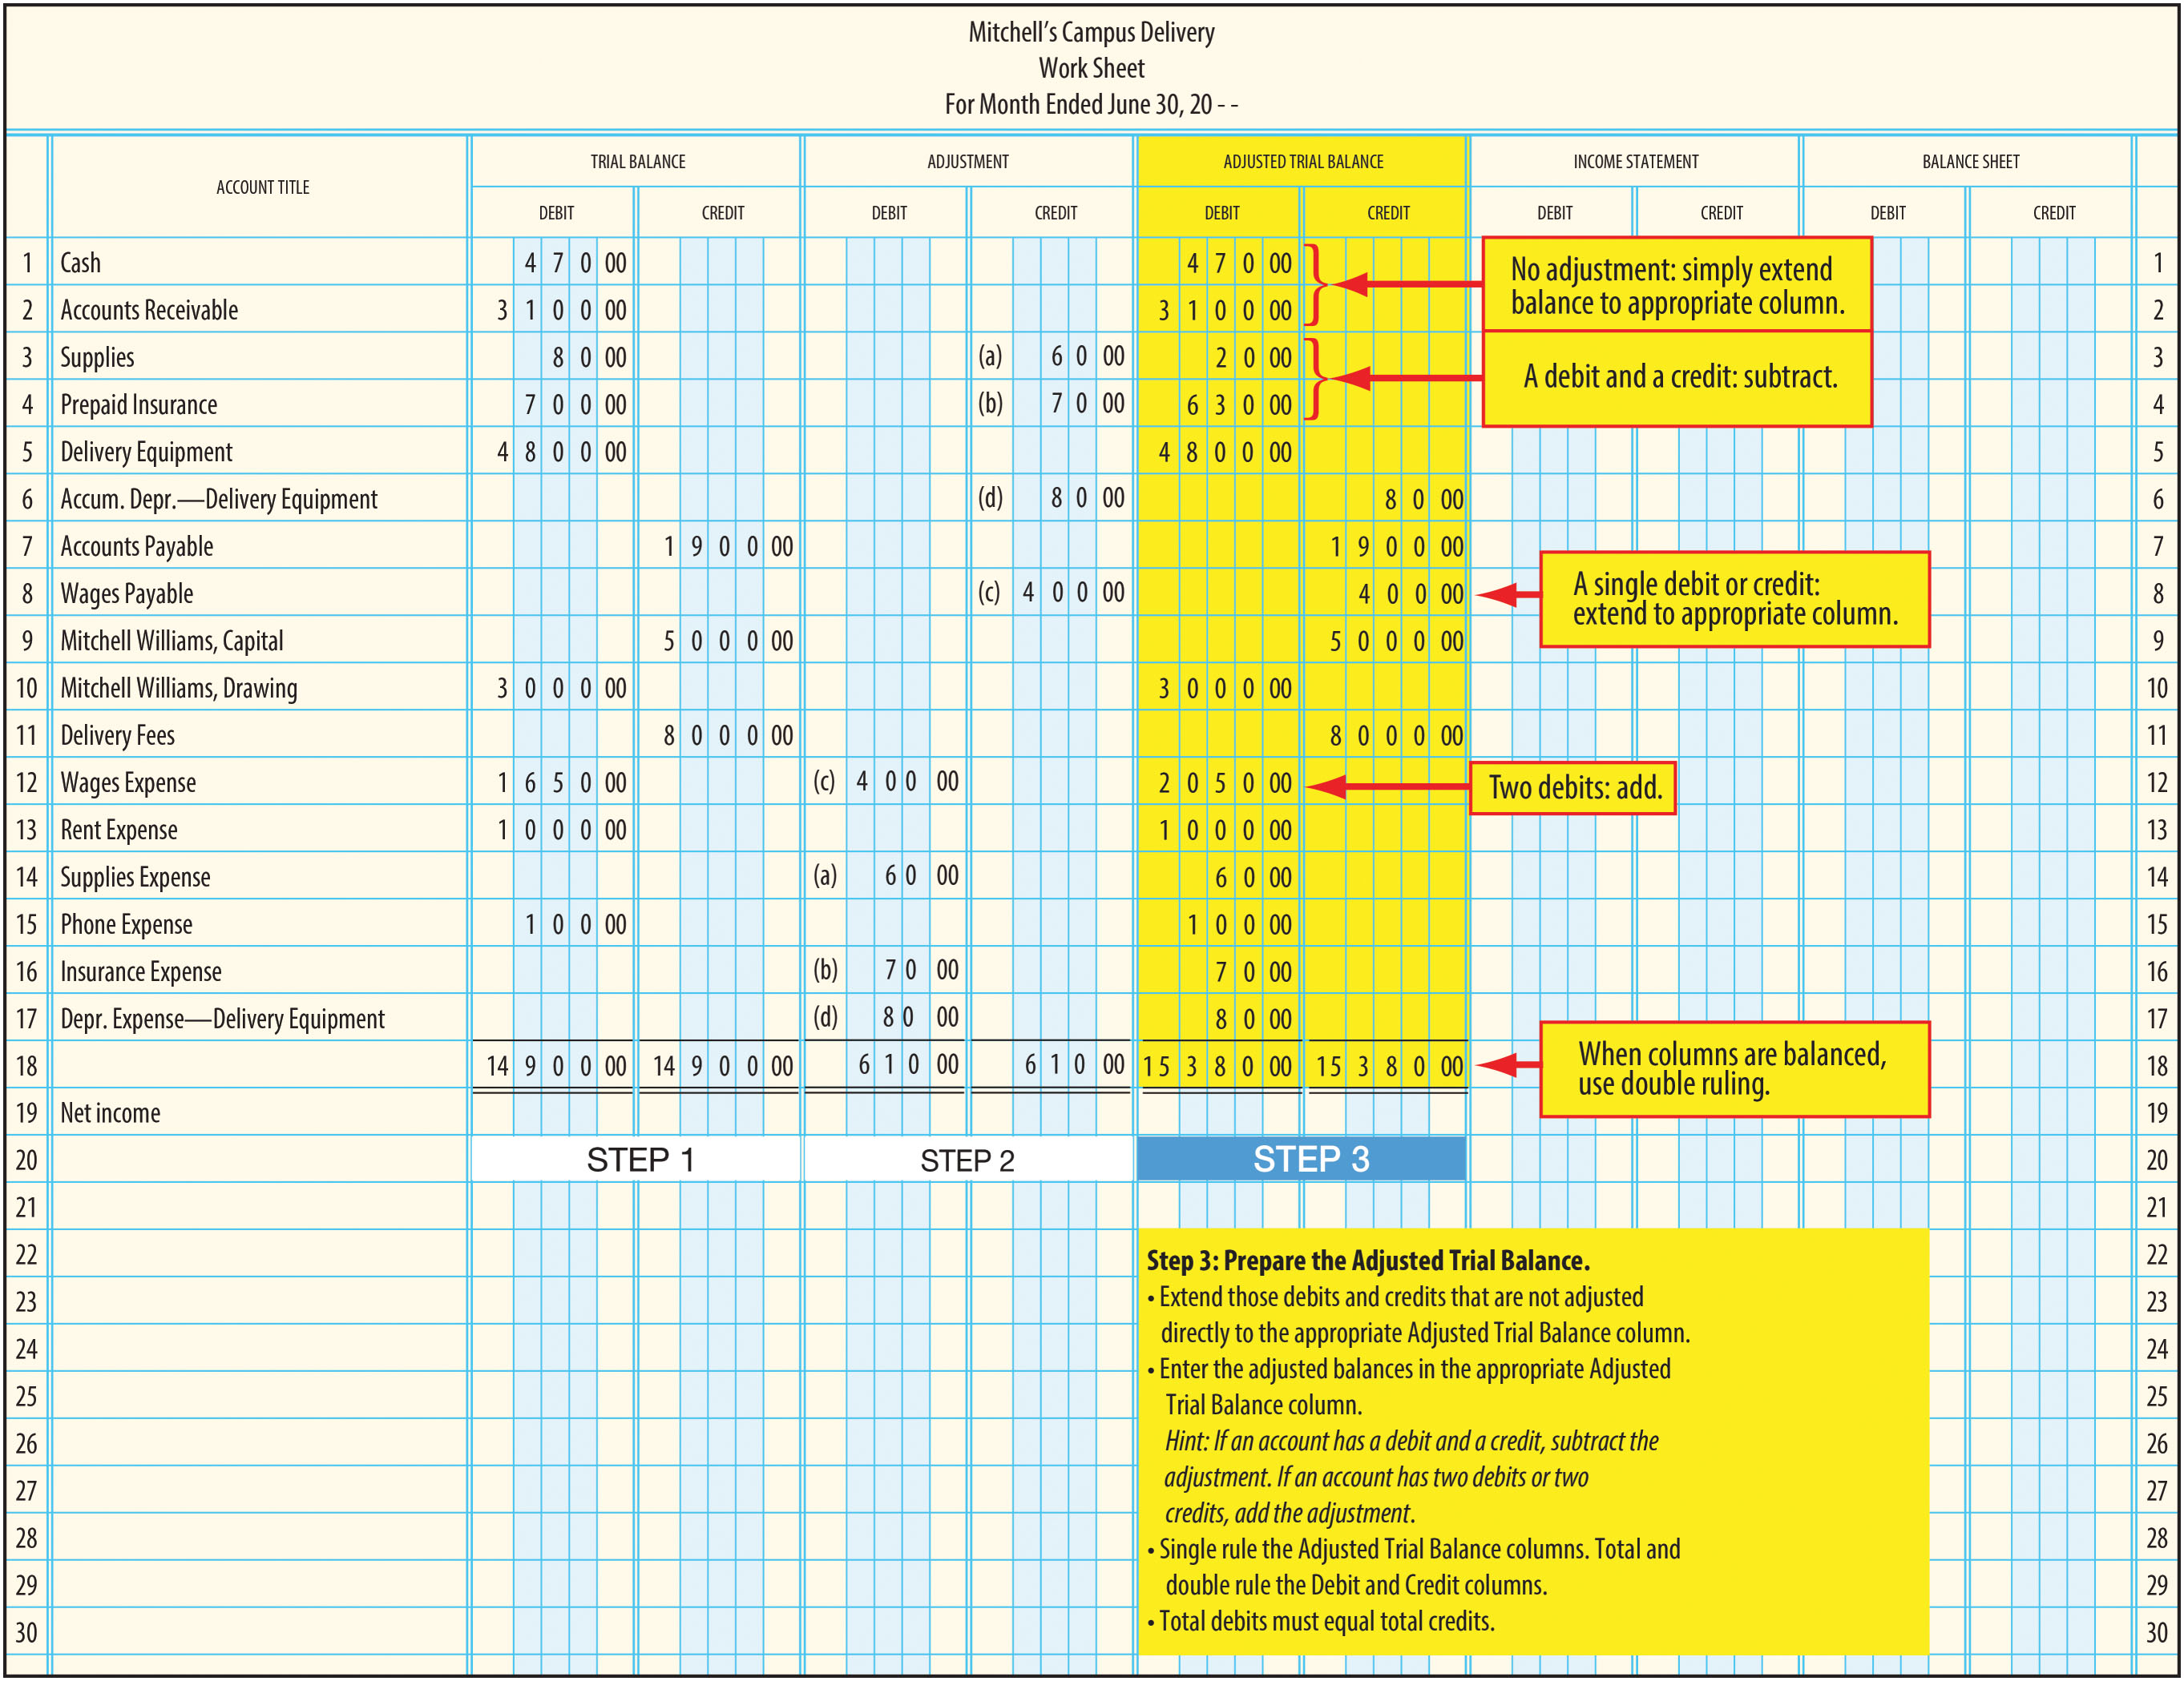
Worksheet Preparation Step-by-Step (6 of 9)
FIGURE 5-17 Step 3: Prepare the Adjusted Trial Balance

Slide 40
Worksheet Preparation Step-by-Step (7 of 9)
Step 4: Extend Adjusted Balances to the Income Statement and Balance Sheet Columns
  Extend all revenue accounts to the Income Statement Credit column
  Extend all expense accounts to the Income Statement Debit column
  Extend the asset and drawing accounts to the Balance Sheet Debit column
  Extend the liability and owner’s capital accounts to the Balance Sheet Credit columns

Slide 41
Worksheet Preparation Step-by-Step (8 of 9)
Step 5: Complete the Work Sheet
  Rule and total the Income Statement and Balance Sheet columns
  Calculate the difference between the Income Statement Debit and Credit columns
  Calculate the difference between the Balance Sheet Debit and Credit columns
    Difference between the Balance Sheet columns should be the same as the difference between the Income Statement columns
  Add the net income to the Income Statement Debit column or add the net loss to the Income Statement Credit column
  Add the net income to the Balance Sheet credit column or the net loss to the Balance Sheet Debit column
  Write "Net income" or “Net Loss” in the Account Title column.
  Total and double rule the columns.

Slide 42
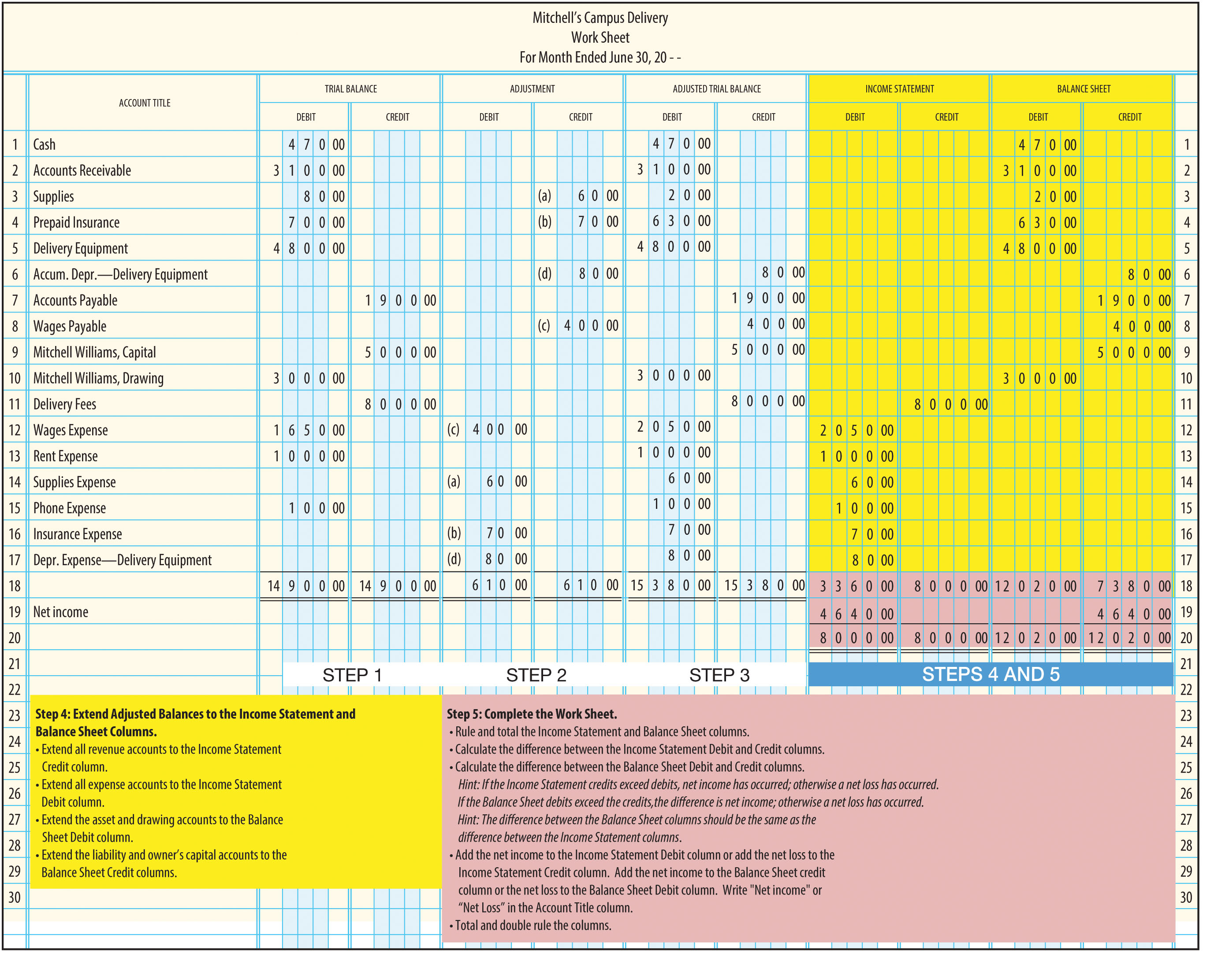
Worksheet Preparation Step-by-Step (9 of 9)
FIGURE 5-18 Step 4: Extend Adjusted Balances to the Income Statement & Balance Sheet Columns; Step 5: Complete the Work Sheet

Slide 43
Learning Objective 4
Describe methods for finding errors on the work sheet

Slide 44
Finding Errors on the Work Sheet
If any of the columns on the work sheet do not balance, you must find the error before you continue
Tips for finding errors:
  Check the addition of all columns
  Check the addition and subtraction required when extending to the Adjusted Trial Balance columns
  Make sure the adjusted account balances have been extended to the appropriate columns
  Make sure that the net income or net loss has been added to the appropriate columns

Slide 45
Learning Objective 5
Journalize adjusting entries from the work sheet

Slide 46
Journalizing Adjusting Entries
The work sheet helps the accountant organize the end-of-period financial information, including adjusting entries
The accounts are not adjusted until a general journal entry is made and posted to the general ledger accounts

Slide 47
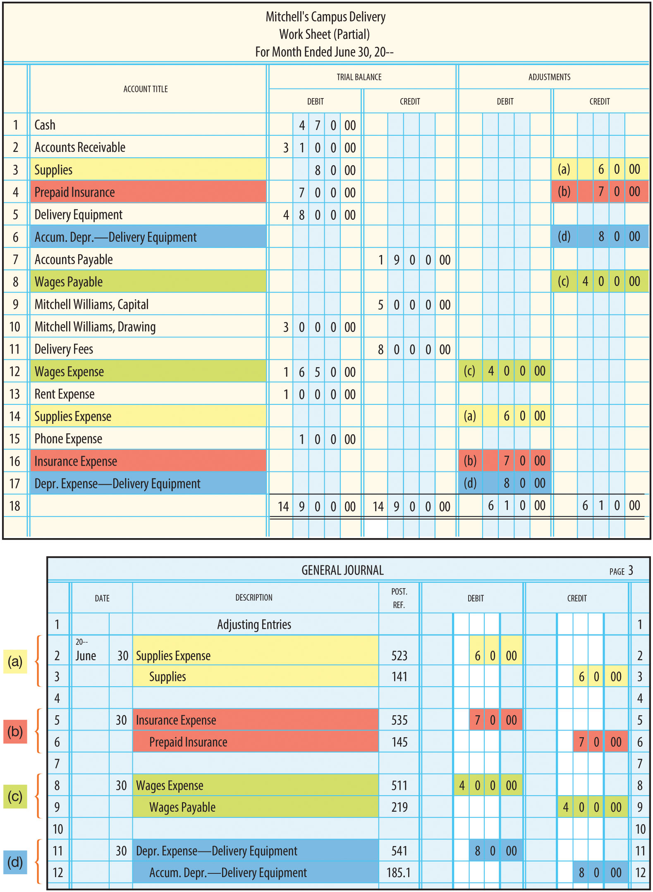
Journalizing Adjusting Entries from the Work Sheet
FIGURE 5-21 Journalizing Adjusting Entries from the Work Sheet

Slide 48
Learning Objective 6
Explain the cash, modified cash, and accrual bases of accounting

Slide 49
Accrual Basis of Accounting
Revenues are recorded when earned
Expenses are recorded when incurred
Recognizes receivables and payables
Offers the best matching of revenues and expenses
  The best method of measuring income for most businesses
  Smaller service organizations often use the cash or modified cash basis

Slide 50
Cash Basis of Accounting
Revenues are recorded when cash is received
Expenses are recorded when cash is paid
Similar to the accrual basis if there are few receivables, payables, and assets
Can vary significantly if a business has many receivables, payables, and assets

Slide 51
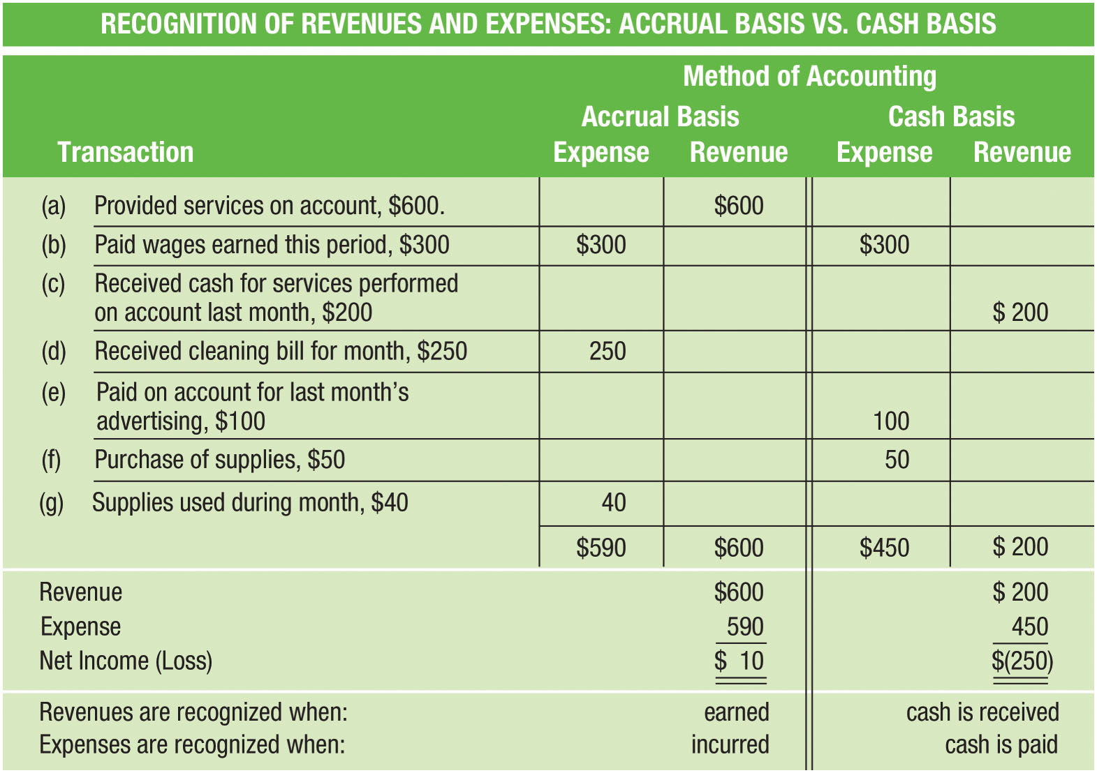
Cash vs. Accrual Accounting
FIGURE 5-22 Cash vs. Accrual Accounting

Slide 52
Modified Cash Basis
Combines aspects of the cash and accrual methods
A business uses the cash basis for recording revenues and most expenses
Exceptions are made when cash is paid for assets with useful lives greater than one accounting period
  If cash is paid for equipment, buildings, supplies, or insurance, these are recorded as assets, and adjustments are made each period as under the accrual basis
Liabilities associated with the acquisition of these assets are also recognized
Does not account for receivables or for payables for services received

Slide 53
Comparison of Cash, Modified Cash, and Accrual Methods (1 of 2)
Entries Made Under Each Accounting Method: Event | Entries Made Under Each Accounting Method: Cash | Entries Made Under Each Accounting Method: Modified Cash | Entries Made Under Each Accounting Method: Accrual
Revenues: Perform services for cash | Cash Professional Fees | Cash Professional Fees | Cash Professional Fees
Perform services on account | No entry | No entry | Accounts Receivable Professional Fees
Expenses: Pay cash for operating expenses i.e. wages, advertising, rent, phone, etc. | Expense Cash | Expense Cash | Expense Cash
Pay cash for prepaid items: insurance, supplies, etc. | Expense Cash | Prepaid Asset Cash | Prepaid Asset Cash

Slide 54
Comparison of Cash, Modified Cash, and Accrual Methods (2 of 2)
Entries Made Under Each Accounting Method: Event | Entries Made Under Each Accounting Method: Cash | Entries Made Under Each Accounting Method: Modified Cash | Entries Made Under Each Accounting Method: Accrual
Pay cash for property, plant, and equipment (PP&E) | Expense Cash | PP&E Asset Cash | PP&E Asset Cash
Receive bill for services received | No entry | No entry | Expense Accounts Payable
End-of-period adjustments: Wages earned by employees but not paid | No entry | No entry | Wages Expense Wages Payable
Prepaid items used | No entry | Expense Prepaid Asset | Expense Prepaid Asset
Depreciation on property, plant, and equipment | No entry | Depreciation Expense Accumulated Depreciation | Depreciation Expense Accumulated Depreciation
Other: Purchase of assets on account | No entry | Asset Accounts Payable | Asset Accounts Payable
Payments for assets purchased on account | Expense Cash | Accounts Payable Cash | Accounts Payable Cash

Slide 55
Depreciation Methods
Chapter 5 Appendix

Slide 56
Appendix Learning Objective 1
Prepare a depreciation schedule using the straight-line method

Slide 57
Four Depreciation Methods
Straight-line
Sum-of-the-years’-digits
Double declining balance
Modified Accelerated Cost Recovery System

Slide 58
Conditions
For all illustrations in this appendix, we will assume that a delivery van was purchased for $40,000
  Five-year useful life
  Salvage value of $4,000

Slide 59
Straight-Line Method (1 of 3)
Under this method, an equal amount of depreciation will be taken each period
Step 1: Compute the depreciable cost
  COST less SALVAGE VALUE = DEPRECIABLE COST
  $40,000 - $4,000 = $36,000

Slide 60
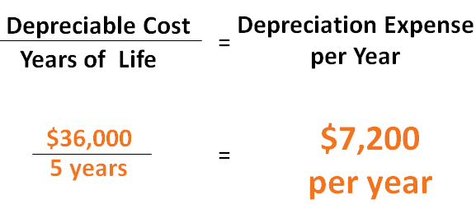
Straight-Line Method (2 of 3)
Step #2: Divide the depreciable cost by the expected life of the asset

Slide 61
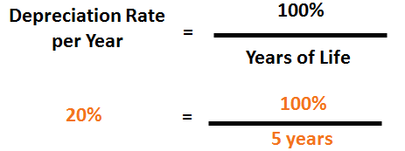
Straight-Line Method (3 of 3)
It is often convenient to use a depreciation rate per year
20% of the asset’s depreciable cost will be recognized as depreciation expense each year

Slide 62
Straight-Line Depreciation Schedule
Year | Depreciable Cost | × | Rate | = | Depreciation Expense | Accumulated Depreciation (End of Year) | Book Value (End of Year)
1 | $36,000 |  | 20% |  | $7,200 | $7,200 | $32,800
2 | $36,000 |  | 20% |  | $7,200 | $14,400 | $25,600
3 | $36,000 |  | 20% |  | $7,200 | $21,600 | $18,400
4 | $36,000 |  | 20% |  | $7,200 | $28,800 | $11,200
5 | $36,000 |  | 20% |  | $7,200 | $36,000 | $4,000

Slide 63
Appendix Learning Objective 2
Prepare a depreciation schedule using the sum-of-the-years’-digits method

Slide 64
Sum-of-the-Years’-Digits Method
Depreciation is determined by multiplying the depreciable cost by a schedule of fractions
The numerator (top) of the fraction for a specific year is the number of years of remaining useful life
The denominator (bottom) of the fraction is determined by adding the digits of the years of the estimated life of the asset
  For an asset with a five-year useful life:
    Sum-of-the-Years’-Digits = 5 + 4 + 3 + 2 + 1 = 15
Depreciation for the first year is 5/15 of depreciable cost

Slide 65
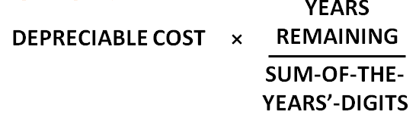
Sum-of-the-Years’-Digits Formula
Sum-of-the-Years’-Digits = 5 + 4 + 3 + 2 + 1 = 15
Depreciation for the first year is 5/15 of depreciable cost

Slide 66
Sum-of-the-Years’-Digits Depreciation Schedule
Year | Depreciable Cost | × | Rate | = | Depreciation Expense | Accumulated Depreciation (End of Year) | Book Value (End of Year)
1 | $36,000 |  | 5/15 |  | $12,000 | $12,000 | $28,000
2 | $36,000 |  | 4/15 |  | $9,600 | $21,600 | $18,400
3 | $36,000 |  | 3/15 |  | $7,200 | $28,800 | $11,200
4 | $36,000 |  | 2/15 |  | $4,800 | $33,600 | $6,400
5 | $36,000 |  | 1/15 |  | $2,400 | $36,000 | $4,000

Slide 67
Appendix Learning Objective 3
Prepare a depreciation schedule using the double declining balance method

Slide 68
Double Declining Balance Method (1 of 3)
The book value is multiplied by a fixed rate, often double the straight-line rate
  The van has a five-year life, so the straight-line rate is 1/5, or 20%
  Double the straight-line rate is 2 x 20%, or 40%
Once the book value is reduced to the expected salvage value, no more depreciation may be recognized
As with the sum-of-the-years’-digits depreciation method, larger amounts of depreciation are taken in the early years of the asset’s life

Slide 69
Double Declining Balance Depreciation Schedule
Year | Book Value (Beginning of Year) | × | Rate | = | Depreciation Expense | Accumulated Depreciation (End of Year) | Book Value (End of Year)
1 | $40,000 |  | 40% |  | $16,000 | $16,000 | $24,000
2 | $24,000 |  | 40% |  | $9,600 | $25,600 | $14,400
3 | $14,400 |  | 40% |  | $5,760 | $31,360 | $8,640
4 | $8,640 |  | 40% |  | $3,456 | $34,816 | $5,184
5 | $5,184 |  |  |  | $1,184 | $36,000 | $4,000

Slide 70
Appendix Learning Objective 4
Prepare a depreciation schedule for tax purposes using the Modified Accelerated Cost Recovery System

Slide 71
Modified Accelerated Cost Recovery System (MACRS)
Used for tax purposes
The Internal Revenue Service (IRS) classifies various assets according to useful life and sets depreciation rates for each year of the asset’s life
  The IRS would give our van a six-year life and no salvage value
  Rates for a van are as follows:
    Year 1 – 20%
    Year 2 – 32%
    Year 3 – 19.2%
    Year 4 – 11.52%
    Year 5 – 11.52%
    Year 6 – 5.76%
The rates are then multiplied by the cost of the asset

Slide 72
MACRS Depreciation Schedule
Year | Cost | × | Rate | = | Depreciation Expense | Accumulated Depreciation (End of Year) | Book Value (End of Year)
1 | $40,000 |  | 20% |  | $8,000 | $8,000 | $32,000
2 | $40,000 |  | 32% |  | $12,800 | $20,800 | $19,200
3 | $40,000 |  | 19.20% |  | $7,680 | $28,480 | $11,520
4 | $40,000 |  | 11.52% |  | $4,608 | $33,088 | $6,912
5 | $40,000 |  | 11.52% |  | $4,608 | $37,696 | $2,304
6 | $40,000 |  | 5.76% |  | $2,304 | $40,000 | $0
 |  |  | 100% |  | $40,000

