Slide 1

Financial Statements and the Closing Process
Chapter 6

Slide 2
The Work Sheet
Used for three major end-of-period activities:
  Journalizing adjusting entries (covered in Chapter 5)
  Preparing financial statements
  Journalizing closing entries

Slide 3
Learning Objective 1
Prepare financial statements with the aid of a work sheet

Slide 4
Order of Preparing Financial Statements
Income statement
Statement of Owner’s Equity
Balance Sheet

Slide 5
Income Statement Preparation (1 of 2)
Heading should contain 3 lines:
  Company name
  Statement title
  Period ended or last date in the period
Dollar signs used at top of columns
Revenues are shown first
  When there is only one revenue account, “Total Revenues” is not computed or shown

Slide 6
Income Statement Preparation (2 of 2)
Expenses are shown next
Expenses are listed in either:
  Account number order
  Descending order by dollar amount
Single rulings indicate addition or subtraction
Expenses are totaled
Net income is computed last

Slide 7
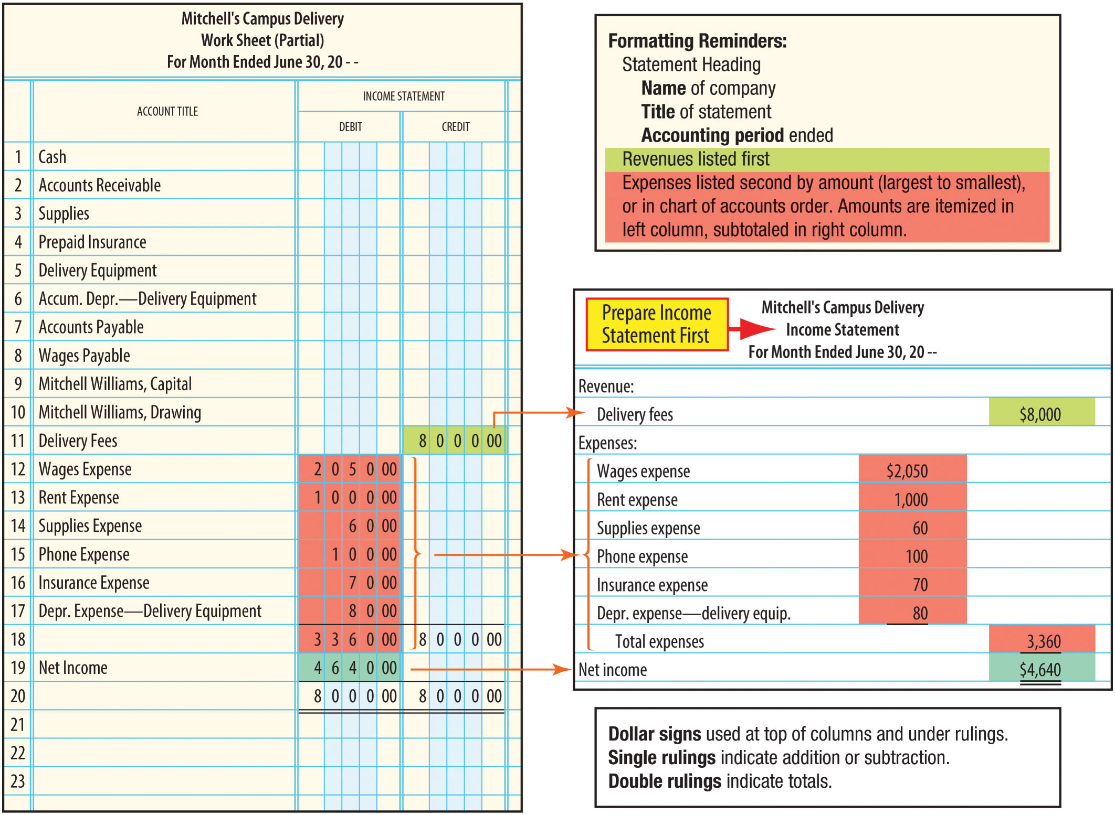
Worksheet and Income Statement
FIGURE 6-1 Linkages Between the Work Sheet and Income Statement

Slide 8
Statement of Owner’s Equity Preparation
The statement starts with the capital account balance as of the beginning of the accounting period
  Note: Capital from the work sheet may not be the beginning capital account balance. It is the beginning balance plus any additional investments
  Since Mitch made no additional investments this period, we can use the capital account balance from the work sheet
Instead of showing revenue increasing and expenses decreasing the owner’s equity, this statement uses the net effect (net income/loss) from the income statement
The drawing account tells us the amount of assets Mitch has withdrawn from the business for personal use

Slide 9
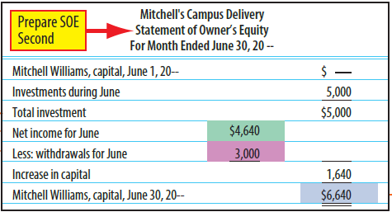
Statement of Owner’s Equity

Slide 10
Forms of Balance Sheets
Report Form
  Liabilities and owner’s equity sections are shown BELOW the assets section
  This is the form you will see from now on in this text
Account Form
  Assets section is on the LEFT, and liabilities and owner’s equity sections are on the RIGHT
  This is the form you saw in Chapters 2 through 5

Slide 11
Classified Balance Sheet
Similar items are grouped together
Assets are classified as:
  Current Assets
  Property, Plant, and Equipment
Liabilities are classified as:
  Current Liabilities
  Long-Term Liabilities

Slide 12
Current Assets
Assets (including cash) that will be converted into cash or consumed within one year or the normal operating cycle, whichever is longer
  Cash
  Accounts receivable
  Supplies
  Prepaid insurance

Slide 13
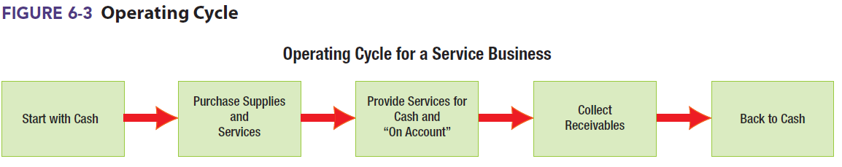
Operating Cycle
The period of time required to purchase supplies and services and convert them back into cash

Slide 14
Property, Plant, and Equipment
Assets that are expected to serve the business for many years
Also called plant assets or long-term assets
Examples:
  Land
  Buildings
  Equipment

Slide 15
Current Liabilities
Liabilities that are due within one year or the normal operating cycle of the business, whichever is longer
They will be paid with current assets
Examples:
  Accounts payable
  Wages payable

Slide 16
Long-Term Liabilities
Obligations that are not expected to be paid within a year and do not require the use of current assets
Also called long-term debt
  Example: A mortgage on an office building
Mitch does not have any long-term liabilities

Slide 17
Balance Sheet Preparation
Current assets are listed first
Property, plant, and equipment includes the long-term assets AND their related accumulated depreciation accounts
Current (or short-term) liabilities are shown first
  Mitch has only two liabilities, and they are both current: Accounts payable and wages payable
The capital amount does not show net income or drawing
  Use the ending capital amount from the statement of owner’s equity
Balance sheet MUST balance

Slide 18
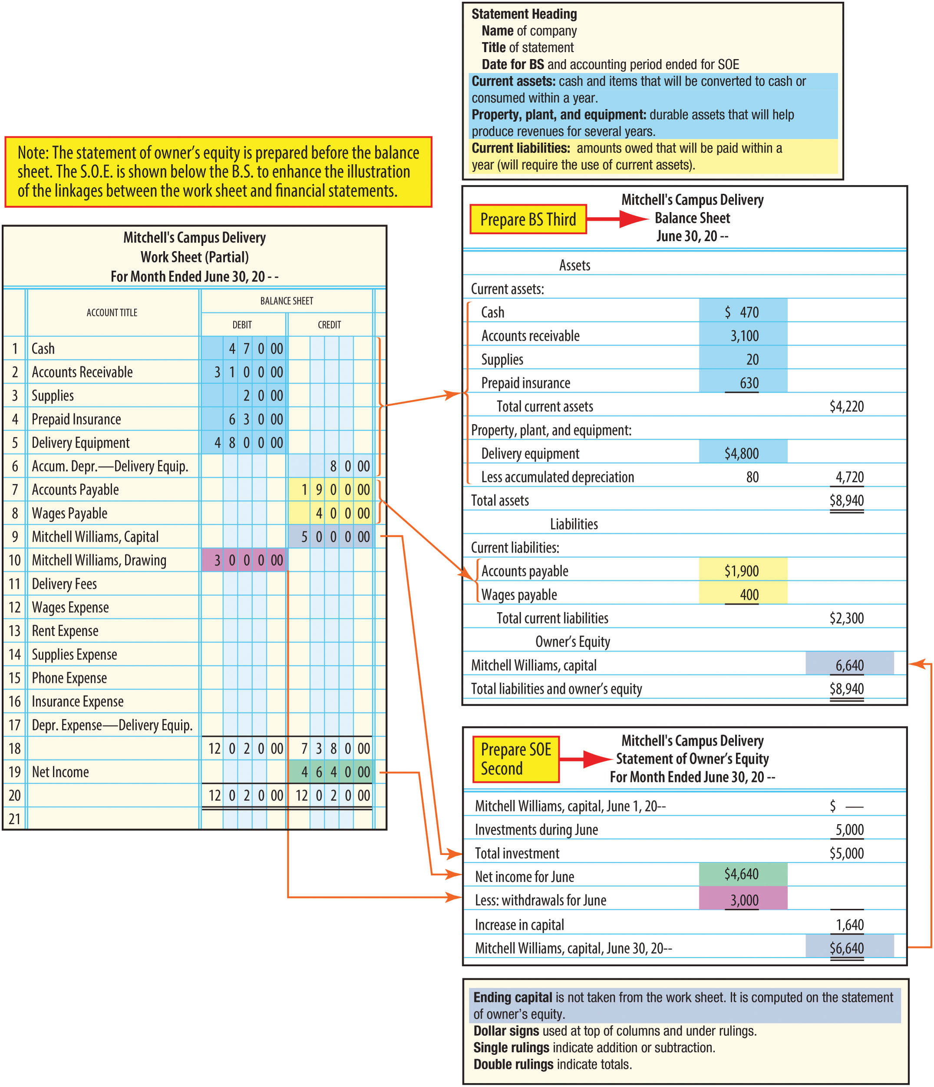
Balance Sheet Relationship to Worksheet
FIGURE 6-2 Linkages Between the Work Sheet, Statement of Owner’s Equity, and Balance Sheet

Slide 19
Additional Investments by Owner (1 of 2)
Additional investments by the owner during the accounting period:
  Appear in the general ledger capital account
  Are part of the amount reported in the unadjusted trial balance on the work sheet
  Must be shown separately in the statement of owner’s equity

Slide 20
Additional Investments by Owner (2 of 2)
We will illustrate additional investments using another business, Ramon’s Shopping Service
Ramon Balboa’s capital account had a beginning balance of $5,000
During the month, he invested an additional $3,000 into his business
The $8,000 balance in the capital account appears in the unadjusted trial balance on the work sheet and as Total Investment on the Statement of Owner’s Equity

Slide 21
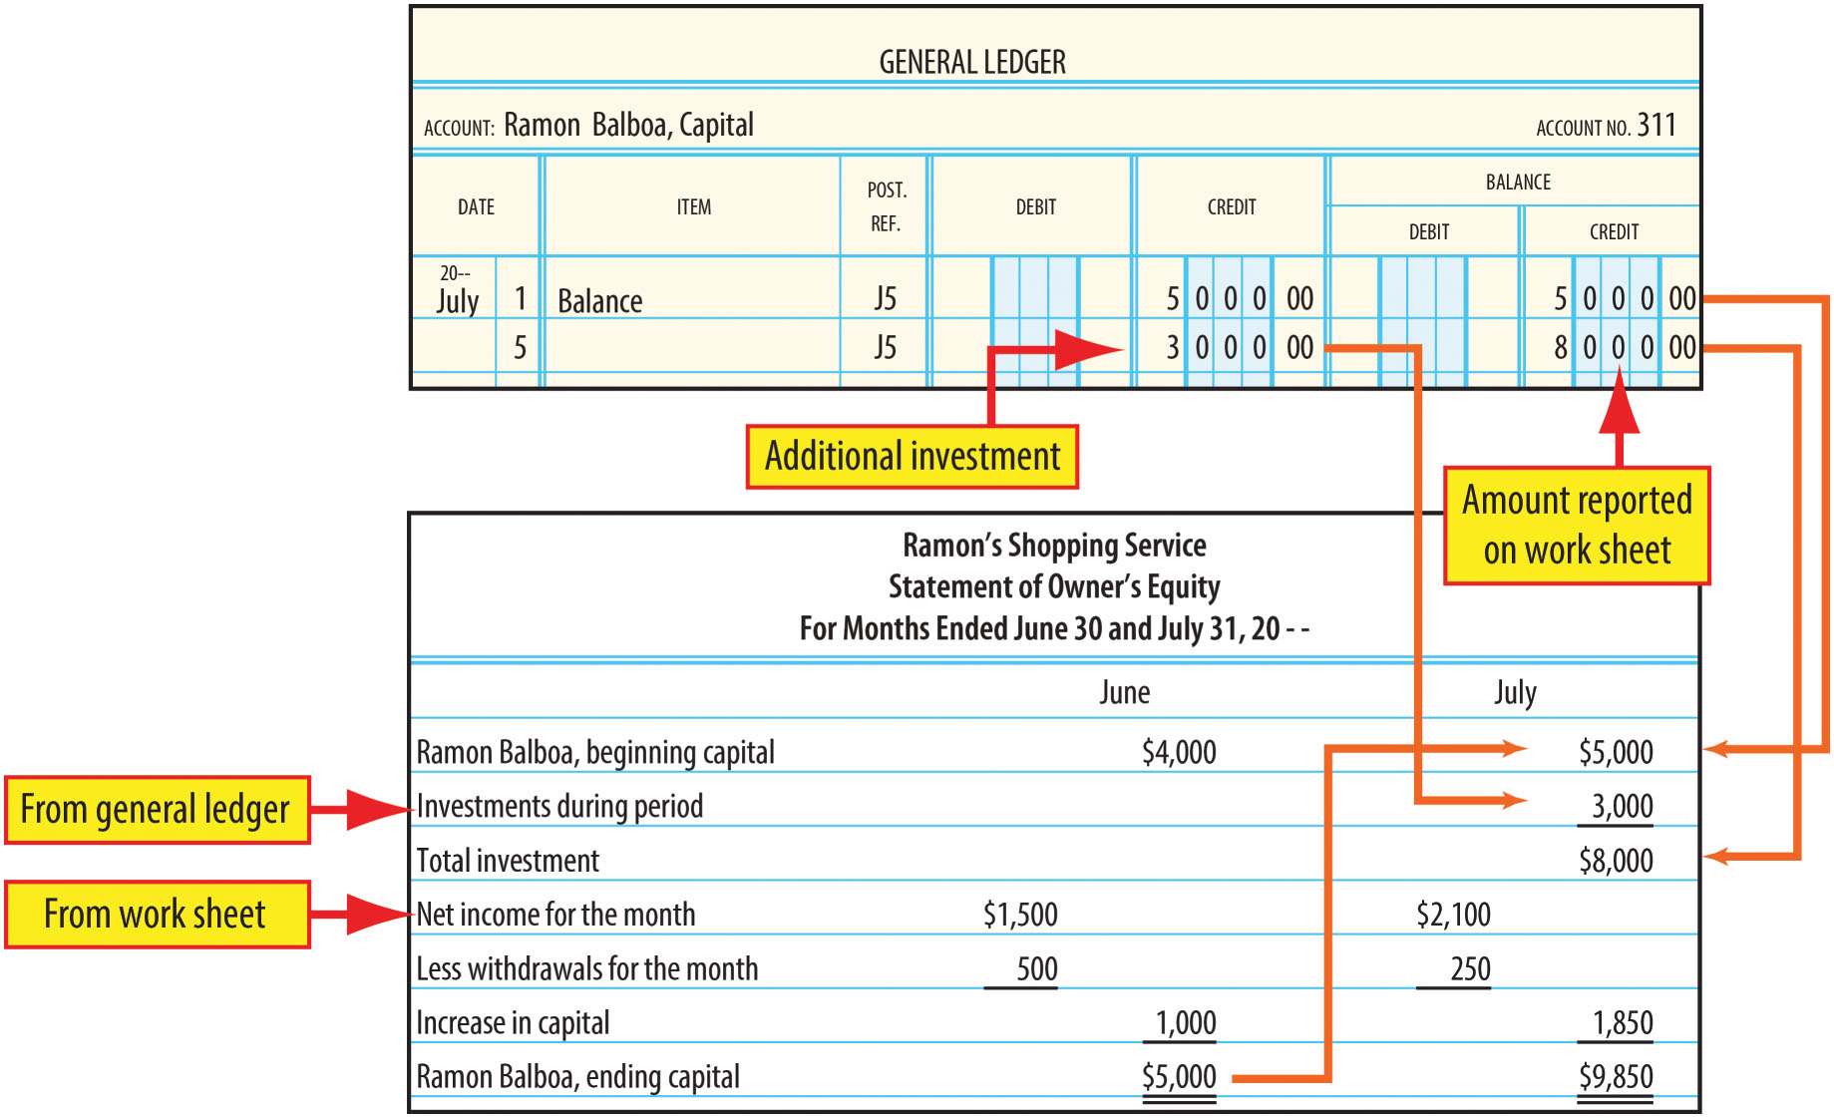
Statement of Owner’s Equity with Additional Investment
FIGURE 6-4 Statement of Owner’s Equity with Additional Investment

Slide 22
Learning Objective 2
Journalize and post closing entries

Slide 23
Permanent Accounts
All accounts reported on the balance sheet:
  Assets (including contra-assets)
  Liabilities
  Capital accounts
Contain the results of all transactions since the business started
These accounts are NOT CLOSED

Slide 24
Temporary Accounts
Accumulate information for a specific accounting period
All accounts not on the balance sheet:
  Revenues
  Expenses
  Drawing
These accounts are CLOSED

Slide 25
The Closing Process
Gives temporary accounts zero balances so they are prepared to accumulate new information for the next accounting period
The Income Summary account is used to aid in the closing process
There are four basic steps in the closing process

Slide 26
Closing Process Steps (1 of 2)
Step 1: Close Revenue Accounts to Income Summary
  Revenues have credit balances and increase owner’s equity
  Revenue accounts are debited to create zero balances
  Income Summary is credited for the total revenues
Step 2: Close Expense Accounts to Income Summary
  Expenses have debit balances and reduce owner’s equity
  Expense accounts are credited to create zero balances
  Income Summary is debited for the total of the expenses

Slide 27
Closing Process Steps (2 of 2)
Step 3: Close Income Summary to the Owner’s Capital Account
  Balance in Income Summary represents the net income (credit balance) or net loss (debit balance)
  Net income – debit Income Summary, credit owner’s capital
  Net loss – debit owner’s capital, credit Income Summary
Step 4: Close Drawing to the Owner’s Capital Account
  Drawing has a debit balance and reduces owner’s equity
  Drawing is credited to zero it out
  Owner’s capital account is debited

Slide 28
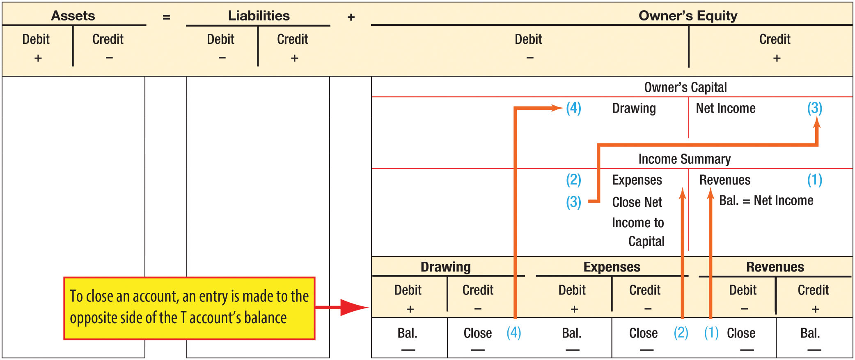
Illustration of Closing Process
FIGURE 6-5 The Closing Process

Slide 29
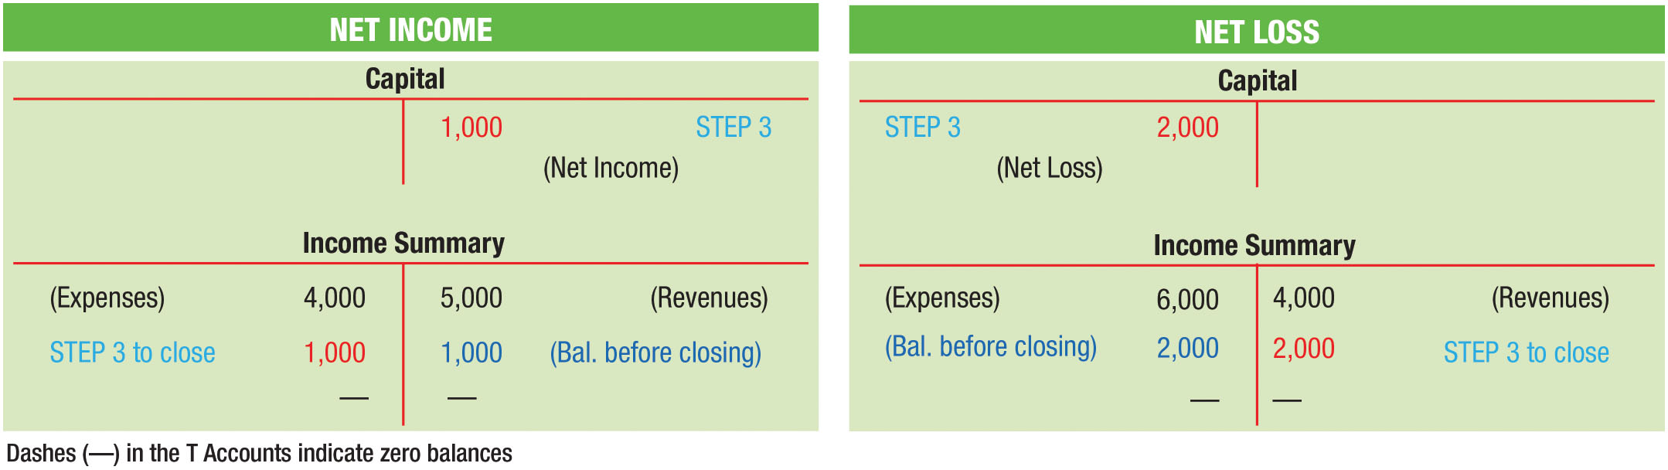
Closing Net Income vs. Net Loss
FIGURE 6-6 Step 3: Closing Net Income and Closing Net Loss

Slide 30
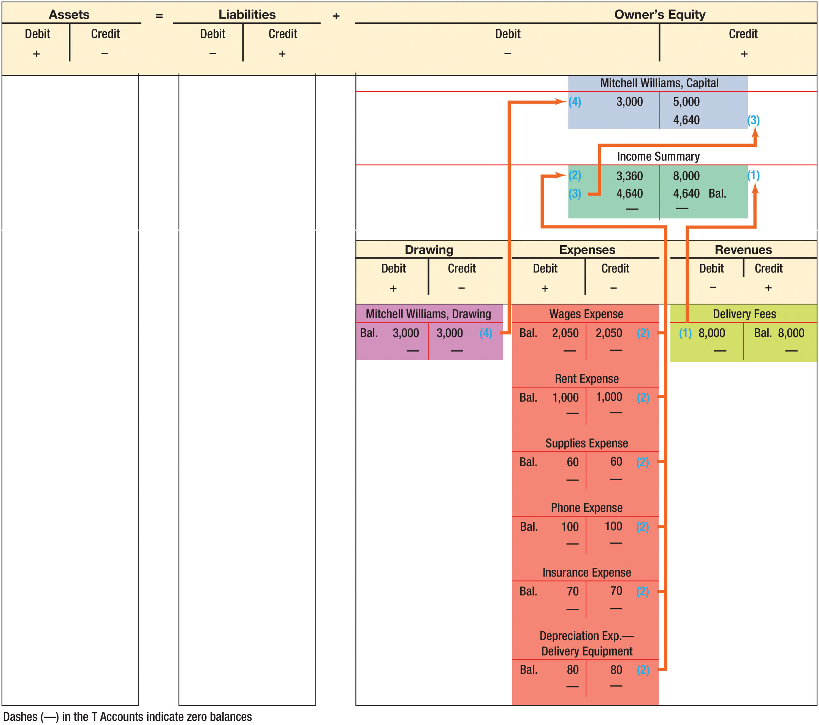
Closing Entries in T Account Form
FIGURE 6-7 Closing Entries in T Account Form

Slide 31
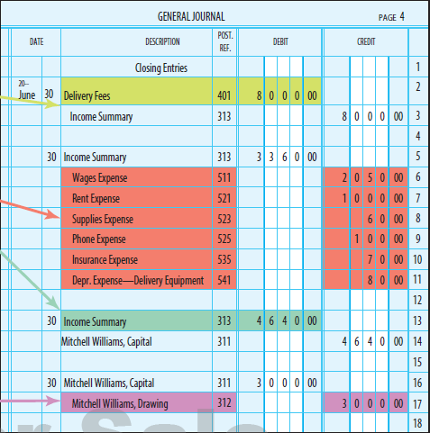
Journalize Closing Entries
To actually change the ledger accounts, the closing entries must be journalized and posted to the general ledger
FIGURE 6-8 Closing Entries in Journal Form

Slide 32
Learning Objective 3
Prepare a post-closing trial balance

Slide 33
Post-Closing Trial Balance
Prepared after posting closing entries
To prove the equality of the debit and credit balances in the general ledger accounts
Only accounts that remain open (permanent accounts) are listed

Slide 34
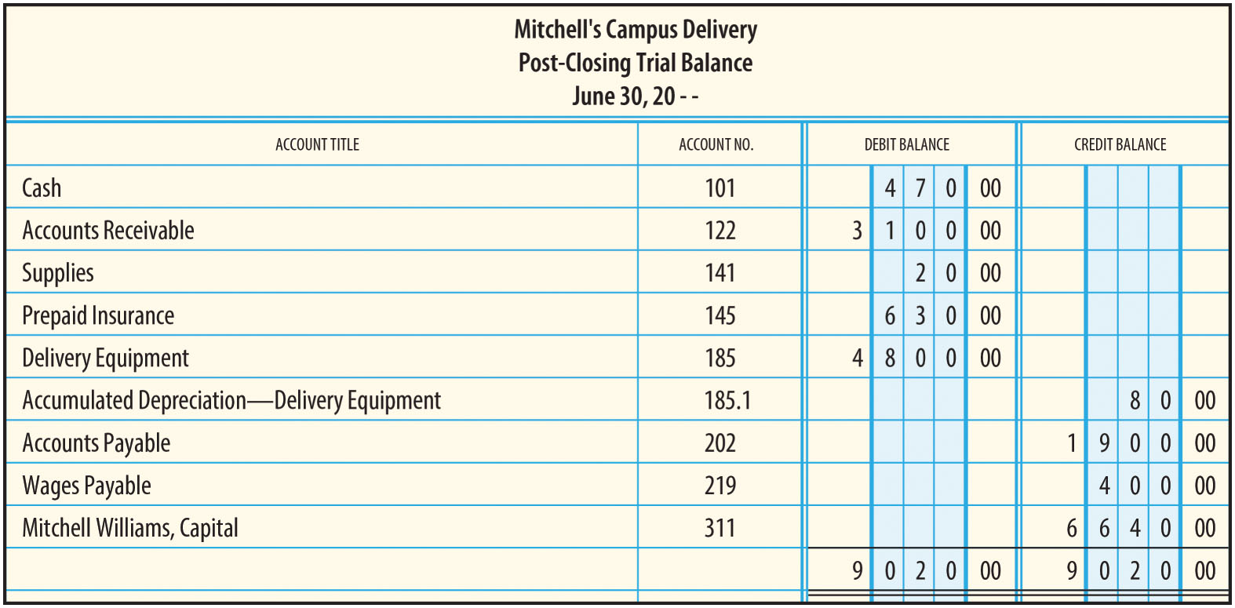
Post-Closing Trial Balance - FIGURE 6-10

Slide 35
Learning Objective 4
List and describe the steps in the accounting cycle

Slide 36
Steps in the Accounting Cycle
During Accounting Period
  STEP 1: Analyze source documents
  STEP 2: Journalize the transactions
  STEP 3: Post to the general ledger accounts
End of Accounting Period
  STEP 4: Prepare a trial balance
  STEP 5: Determine and prepare needed adjustments on the work sheet
  STEP 6: Complete end-of-period work sheet
  STEP 7: Journalize and post adjusting entries
  STEP 8: Prepare income statement, statement of owner’s equity, and balance sheet
  STEP 9: Journalize and post closing entries
  STEP 10: Prepare post-closing trial balance

Slide 37
Statement of Cash Flows
Chapter 6 Appendix

Slide 38
Appendix Learning Objective 1
Classify business transactions as operating, investing, or financing

Slide 39
Types of Business Activities (1 of 2)
Operating Activities: Related to the revenues and expenses reported on the income statement
  Cash received from customers
  Cash paid for wages
  Cash paid for rent
  Cash paid for insurance

Slide 40
Types of Business Activities (2 of 2)
Investing Activities: Transactions involving purchase and sale of long-term assets, lending money, and collecting principal on loans
  Cash paid to purchase equipment
  Cash received from the sale of old equipment
Financing Activities: Transactions dealing involving exchange of cash between the business and its owners and creditors
  Investment of cash by the owner
  Owner’s withdrawals
  Borrowing cash
  Cash paid to repay the principal on a loan

Slide 41
Summary of Transactions for Mitchell’s Campus Delivery (1 of 4)
Description of Transaction | Type of Transaction | Explanation
(a) Mitchell Williams invested cash in his business, $5,000. | Financing | Cash received from the owner is an inflow from financing activities. Don’t be fooled by the word “invested.” From the company’s point of view, this is a way to finance the business.
(b) Purchased delivery equipment for cash, $2,000. | Investing | Purchases of long-term assets are investments.
(c) Purchased delivery equipment on account from Big Red Scooters, $1,800. (Note: Big Red has loaned Mitch $1,800.) | No cash involved | This transaction will not affect the main sections of the statement of cash flows. (This is a noncash investing and financing activity.)
(d) Paid first installment to Big Red Scooters, $600. [See transaction (c).] | Financing | Repayments of loans are financing activities.

Slide 42
Summary of Transactions for Mitchell’s Campus Delivery (2 of 4)
Description of Transaction | Type of Transaction | Explanation
(e) Received cash for delivery services rendered, $2,100. | Operating | Cash received as a result of providing services is classified as an operating activity.
(f) Paid cash for June office rent, $1,000. | Operating | Cash payments for expenses are classified as operating activities.
(g) Paid phone bill, $100. | Operating | Cash payments for expenses are classified as operating activities.
(h) Made deliveries on account for a total of $2,400. | No cash involved | This transaction will not affect the statement of cash flows.
(i) Purchased supplies for cash, $80. | Operating | Cash payments for expenses are classified as operating activities. Most of these supplies were used up. Those that remain will be used in the near future. These are not long-term assets and, thus, do not qualify as investments.

Slide 43
Summary of Transactions for Mitchell’s Campus Delivery (3 of 4)
Description of Transaction | Type of Transaction | Explanation
(j) Received $1,900 in cash for services performed in transaction (h). | Operating | Cash received as a result of providing services is classified as an operating activity.
(k) Purchased a third scooter from Big Red Scooters, $1,000. A down payment of $300 was made with the remaining payments expected over the next four months. | Investing | Purchases of long-term assets are investments. Only the $300 cash paid will be reported on the statement of cash flows.
(l) Paid cash for a seven-month liability insurance policy, $700. Coverage began on June 1. | Operating | Cash payments for expenses are classified as operating activities. Prepaid Insurance is not considered a long-term asset and, thus, does not qualify as an investment.

Slide 44
Summary of Transactions for Mitchell’s Campus Delivery (4 of 4)
Description of Transaction | Type of Transaction | Explanation
(m) Paid wages of part-time employees, $1,650. | Operating | Cash payments for expenses are classified as operating activities.
(n) Earned delivery fees for the remainder of the month amounting to $3,500. $900 in cash and $2,600 on account. | Operating | Cash received ($900) as a result of providing services is classified as an operating activity.
(o) Mitch withdrew cash for personal use, $3,000. | Financing | Cash payments to owners are classified as a financing activity.

Slide 45
Appendix Learning Objective 2
Prepare a statement of cash flows by analyzing and categorizing a series of business transactions

Slide 46
Statement of Cash Flows
The fourth financial statement
Explains:
  What the business did to generate cash
  How the cash was used
Categorizes all cash transactions into three types:
  Operating
  Investing
  Financing
Since operating activities are the main purpose of the business, it is important to be able to generate positive cash flows from operating activities

Slide 47
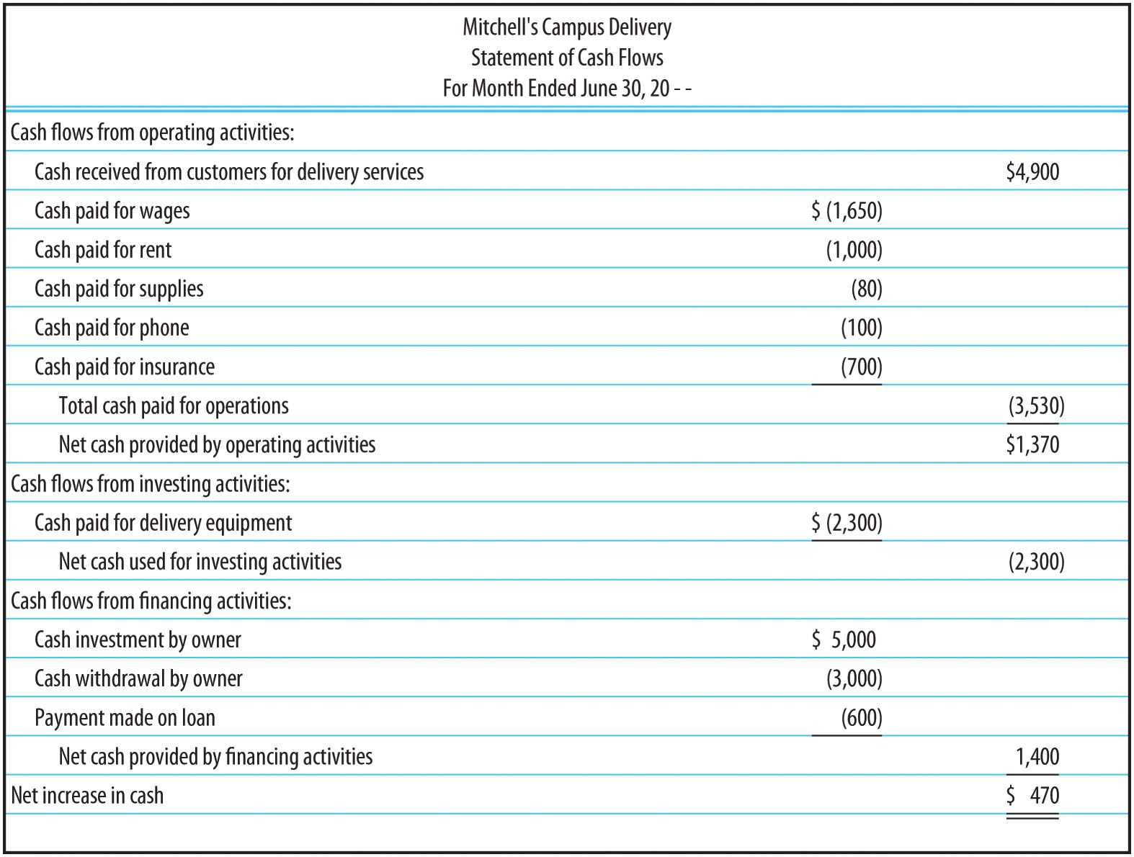
Statement of Cash Flows (FIGURE 6A-3)

