Slide 1

Accounting For Cash
Chapter 7

Slide 2
Cash
Includes:
  Currency and coins
  Checking accounts
  Checks received from customers
  Money orders and bank cashier’s checks
Because cash plays such a central role in operating a business, it must be carefully managed and controlled

Slide 3
What Is Internal Control?
A system of policies and procedures designed to ensure proper accounting for transactions
Good internal control for cash transactions includes:
  All cash received should be deposited DAILY in a bank
  All disbursements, except for payments from petty cash, should be made by CHECK

Slide 4
Learning Objective 1
Describe how to open and use a checking account

Slide 5
USA Patriot Act
Passed in 2001
Primary purpose of this act was to help detect and prevent terrorism
As a result, banks must have a Customer Identification Program (CIP) that provides clear identification of every account holder of the bank

Slide 6
Opening a Checking Account
Each person authorized to sign checks must complete and sign a signature card
  This card is used to verify the depositor’s signature on any banking transactions
Card also includes Taxpayer Identification Number (TIN)
  Social security number (for individuals)
  Employer Identification Number (EIN) – businesses, trusts, estates

Slide 7
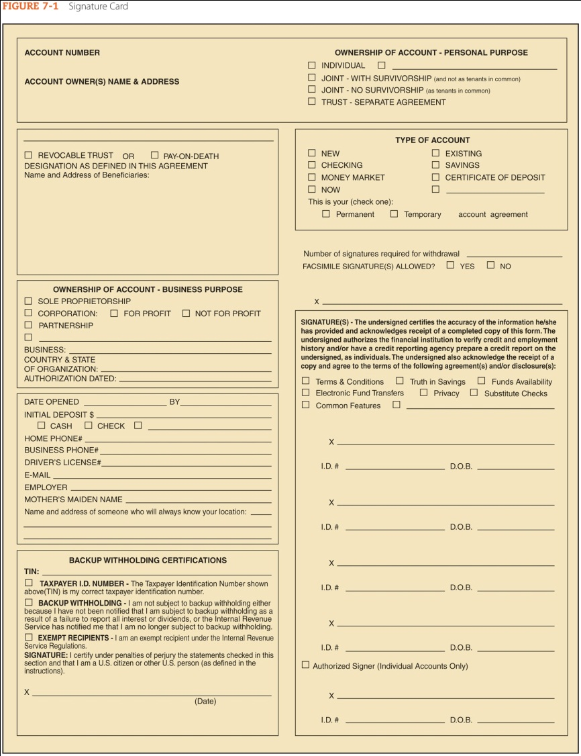
Signature Card Example

Slide 8
Making Deposits
A deposit ticket is a form showing a detailed listing of items being deposited
  Currency, coins, and checks are listed separately
  Each check can be identified by its ABA (American Bankers Association) number
    Found in upper right-hand corner of each check
    Also appears in Magnetic Ink Character Recognition (MICR) code on the lower left side of the front of each check
    The code is used to sort and route checks through the U.S. banking system

Slide 9
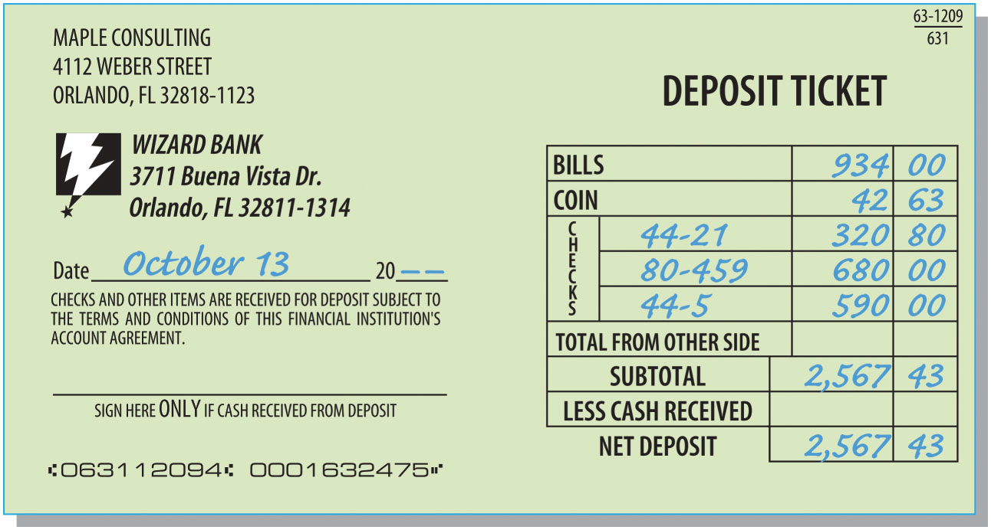
Deposit Ticket
FIGURE 7-2 Deposit Ticket

Slide 10
Endorsements
Each check being deposited must be endorsed by the payee, the party to whom the check is payable
The endorsement consists of stamping or writing the payee’s name and sometimes other information on the back of the check
Businesses commonly use a rubber stamp to endorse checks for deposit

Slide 11
Types of Endorsements
Blank endorsement
  The payee simply signs the back of the check
    This makes the check payable to any bearer
Restrictive endorsement
  The payee adds words such as:
    “For deposit only”
    “Pay to the order of (specific) bank”
    “Pay to Daryl Beck”
  This restricts payment to a specific party or purpose

Slide 12
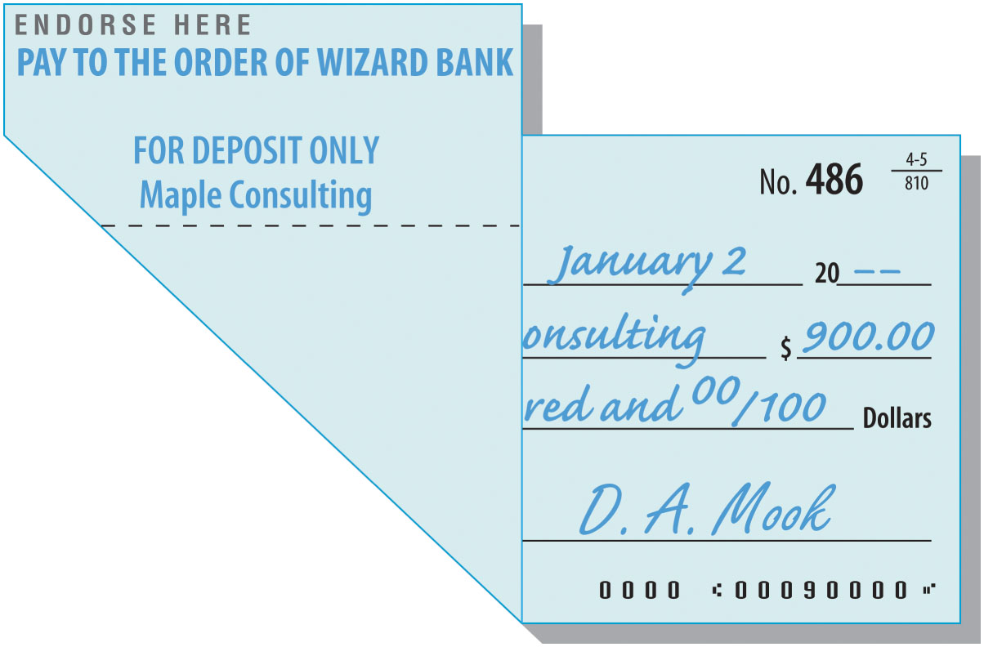
Restrictive Endorsement
FIGURE 7-3 Restrictive Endorsement

Slide 13
Automated Teller Machines (ATMs)
Each depositor has a plastic card and a personal identification number (PIN)
Most automated teller machines (ATMs) are on a system that allows noncustomers to use their ATMs
It is important for the depositor to keep an accounting record of ATM withdrawals and deposits

Slide 14
Writing Checks
A check is a document ordering a bank to pay cash from a depositor’s account
There are three parties to every check:
  Drawer – the depositor who orders the bank to pay the cash
  Drawee – the bank on which the check is drawn
  Payee – the person being paid the cash
Business checks often have a check stub; otherwise, a check register is used

Slide 15
Steps in Preparing a Check
Complete the check stub or register
  Provides a record of the transaction to prepare journal entry
Enter the date, payee name, and amount on the check
Authorized signer signs the check
  The check should not be signed until the check signer has verified that all aspects of the check are correct

Slide 16
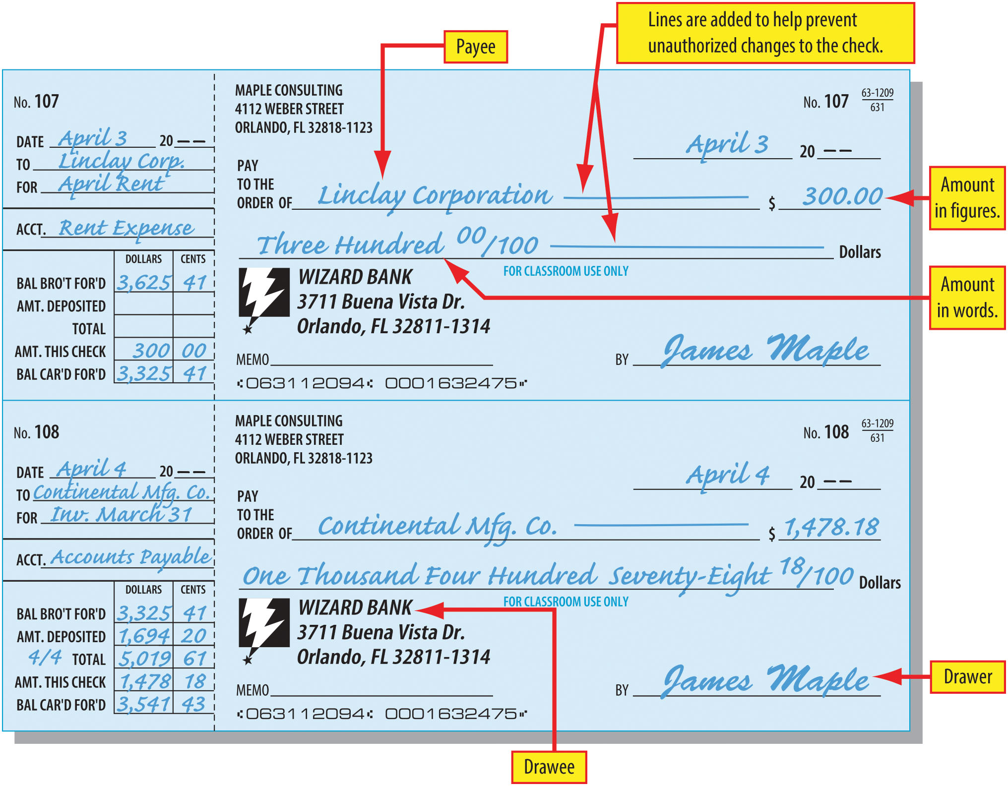
Checks and Check Stubs (Figure 7-4)

Slide 17
Bank Statement
A statement of account issued by a bank to each depositor once a month
The statement shows:
  The balance at the BEGINNING of the period
  Deposits and other amounts ADDED during the period
  Checks and other amounts SUBTRACTED during the period
  The balance at the END of the period
Sent with the bank statement:
  Canceled checks, “imaged” sheets of check faces, or a listing of checks
  Any other forms representing items added to or subtracted from the account

Slide 18
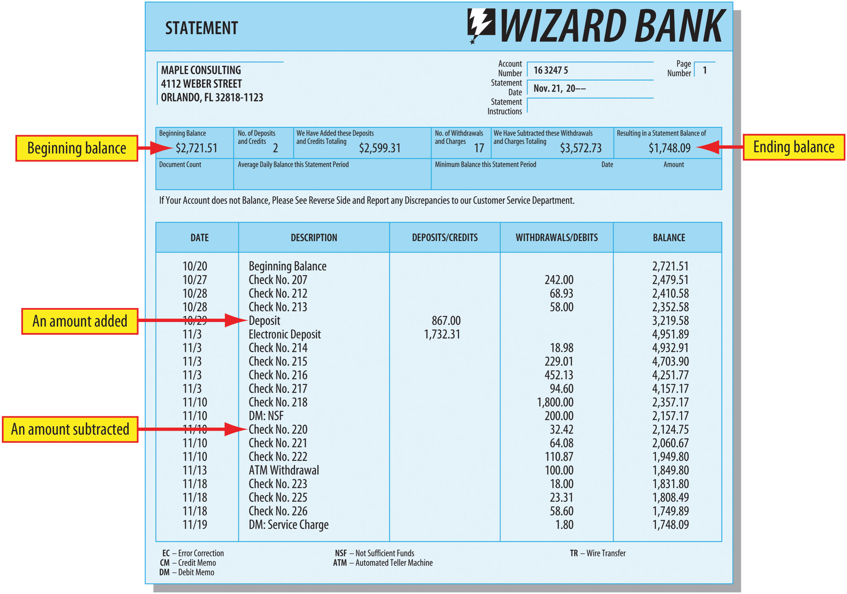
Bank Statement (Figure 7-5)

Slide 19
Learning Objective 2
Prepare a bank reconciliation and related journal entries

Slide 20
Book vs. Bank Balances
On any given day, the balance in the cash account (the book balance) is unlikely to be the same as that on the bank’s books (the bank balance)
  This difference can be due to errors, but it usually is caused by timing
  Transactions generally are recorded by the business at a time that is different from when the bank records them
We need to prepare a bank reconciliation

Slide 21
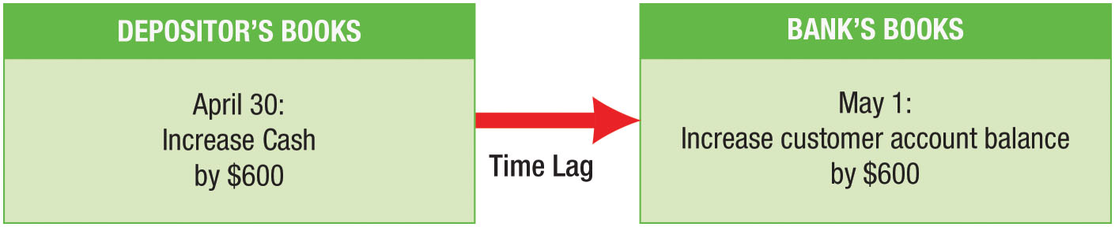
Deposit Timing Differences (Figure 7-6)
On April 30, the balances in the depositor’s books and in the bank’s books would be different
The depositor’s book balance would be $600 more than the bank’s book balance

Slide 22
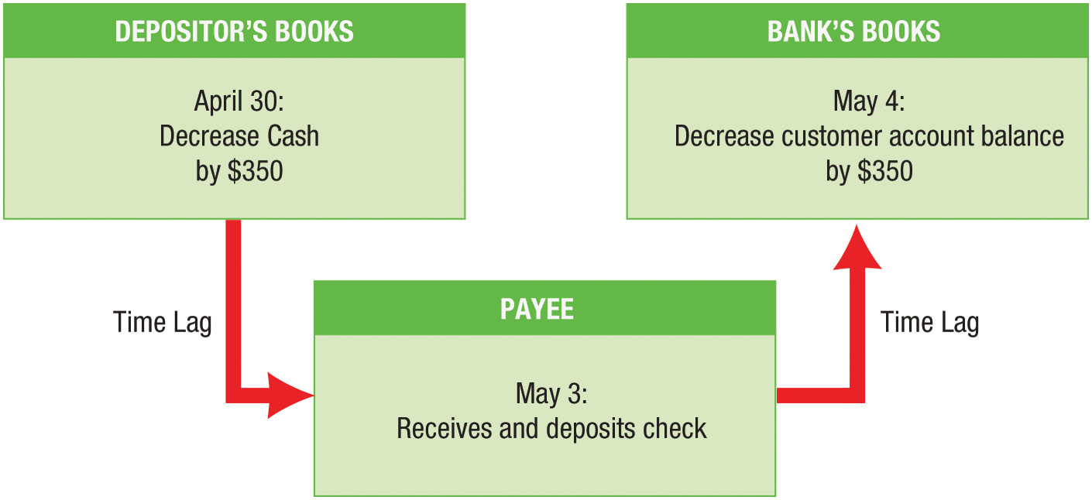
Cash Payment Timing Differences (Figure 7-7)
The depositor’s book balance would be $350 less than the bank’s book balance

Slide 23
Differences Between Bank and Book
Balances (1 of 2)
Deposits in transit
  Deposits that have not reached the bank or been recorded by the bank before the statement is prepared
Outstanding checks
  Checks that have been issued but have not been presented to the bank for payment before the statement is prepared
Service charges
  Bank charges for services such as check printing and processing

Slide 24
Differences Between Bank and Book
Balances (2 of 2)
Collections
  Collections of promissory notes or charge accounts made by the bank on behalf of the depositor
Not sufficient funds (NSF) checks
  Checks deposited but not paid because the drawer did not have sufficient funds
Errors
  Errors made by the bank or by the depositor in recording cash transactions

Slide 25
Steps in Preparing Bank Reconciliation
STEP 1: Identify deposits in transit and any related errors
STEP 2: Identify outstanding checks and any related errors
STEP 3: Identify additional reconciling items

Slide 26
Step 1: Identify deposits in transit and related errors
Compare the bank statement with:
  Last month’s deposits in transit
    Should all be on the bank statement
  Deposits listed in the accounting records
    If not on bank statement, is considered a deposit in transit
  Individual deposit amounts in the accounting records
    If they differ, the error needs to be corrected

Slide 27
Step 2: Identify outstanding checks and related errors
Compare canceled checks with bank statement and accounting records
  If they differ, the error needs to be corrected
Check mark the stub or accounting record to indicate that the check has cleared
Checks written but not cleared are outstanding checks
  Subtracted from the bank balance on the reconciliation

Slide 28
Step 3: Identify additional reconciling items
Compare any additions and deductions on the bank statement that are not deposits or checks with the accounting records
  Items added to the account by the bank are credit memos
    Interest paid on an account is treated like a credit memo
  Items deducted from the account by the bank are debit memos

Slide 29
Bank Reconciliation Example – Maple Consulting
(1) Deposit of $637.02 recorded on November 21 had not been received by the bank
  This deposit in transit is added to the bank statement balance
(2) Check numbers 219, 224, and 227 are outstanding
  Amount of these outstanding checks is subtracted from the bank statement balance
(3) Check number 214 was written for $18.98 but was entered on the check stub and on the books as $19.88
  $0.90 error is added to the book balance
(4) Maple made an ATM withdrawal of $100 on November 13 for personal use but did not record the withdrawal on the books
  Amount is deducted from the book balance
(5) The bank returned an NSF check (received from a customer by Maple) of $200
  This amount is deducted from the book balance
(6) The bank service charge was $1.80
  Amount is deducted from the book balance

Slide 30
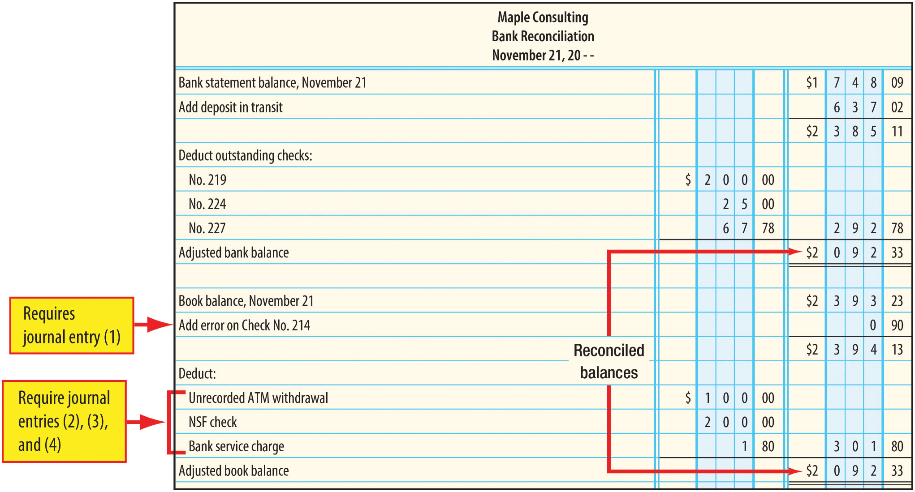
Bank Reconciliation (Figure 7-10)

Slide 31
Bank Reconciliation Journal Entries
Only two kinds of items appearing on a bank reconciliation require journal entries:
  Errors in the depositor’s books
  Bank additions and deductions that do not already appear in the books
ALL items in the book balance section of the reconciliation require a journal entry

Slide 32

Bank Reconciliation General Journal Entry #1
The $0.90 item is an error in the accounting records that occurred when the check amount was incorrectly entered
Assume that $18.98 was in payment of an account payable which had been incorrectly debited for $19.88

Slide 33

Bank Reconciliation General Journal Entry #2
The $100 ATM withdrawal has been deducted from Maple’s account by the bank
Maple has not yet recorded the withdrawal
Maple withdrew the funds for personal use

Slide 34

Bank Reconciliation General Journal Entry #3
The $200 NSF check was deducted by the bank for a check deposited by Maple that proved to be worthless
This amount must be deducted from the book balance
Assume that the check was received from a customer on account

Slide 35

Bank Reconciliation General Journal Entry #4
The $1.80 bank service charge is a fee for bank services received by Maple
Bank deducted this amount from Maple’s account
Bank service charges are usually small and are charged to Miscellaneous Expense

Slide 36
Electronic Banking
Both deposits and payments can be made with electronic funds transfer (EFT), using a computer rather than paper checks
Businesses are making increasing use of EFT:
  Employee wages can be paid using EFT
  Bills from suppliers can be paid by EFT
  Payments from customers frequently are in electronic form
  Funds can be transferred electronically among multiple accounts at different banks
When EFT is used, accounting records must be correctly updated

Slide 37
Learning Objective 3
Establish and use a petty cash fund

Slide 38
The Petty Cash Fund
A fund set up to pay for small (petty) items with cash
  Checks for very small amounts are inconvenient and inefficient
To establish the fund:
  A check is written to the petty cash custodian for the amount to be set aside in the fund
  The custodian cashes the check and places the money in a petty cash box
The custodian should be the only person authorized to make payments from the fund

Slide 39

Petty Cash Fund Example
Maple wants to establish a $100 petty cash fund to be used to make small purchases
$100 is withdrawn (by check) from the cash account
Petty Cash is an ASSET account

Slide 40
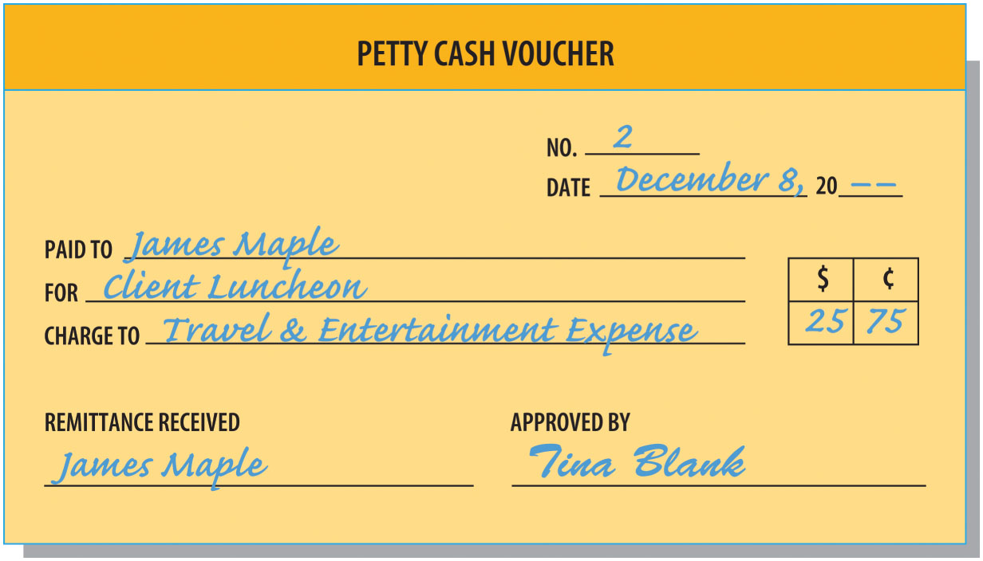
Petty Cash Voucher (Figure 7-12)
A receipt prepared for every payment from the petty cash fund
Voucher shows:
  Name of payee
  Purpose of payment
  Account to be charged (e.g., Postage Expense)
  Signatures of the custodian and payee

Slide 41
Petty Cash Payment Records
A special multi-column record that supplements the regular accounting records
Provides a record of each petty cash payment
  Broken down by account
    Travel/Entertainment Expense, Postage Expense, etc.
  Used to prepare the replenishment journal entry

Slide 42
Replenishing the Petty Cash Fund
Replenish Petty Cash
  Whenever the fund runs low
  At end of accounting period
To replenish the fund, debits are made to appropriate expense accounts and Cash is credited
  Only if the amount of the fund itself is being changed would there be a debit or credit to Petty Cash
Because the petty cash payments record is not a journal, no posting is done from this record
  A separate entry must be made in the journal to replenish the fund

Slide 43
Petty Cash Replenishment Example
At the end of the month, the petty cash fund contains eight vouchers and only $11.20 in cash
  The fund needs to be replenished
To replenish the fund:
  A check is written for $188.80, which is the total of the eight vouchers
  A journal entry is made to recognize:
    The expenses shown on the vouchers
    The outflow of cash via the check

Slide 44
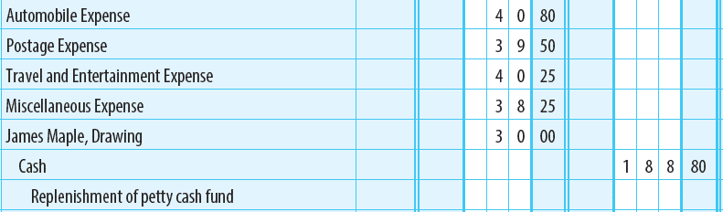
Petty Cash Replenishment Journal Entry

Slide 45
Learning Objective 4
Establish a change fund and use the Cash Short/Over account

Slide 46
Change Fund
A supply of currency and coins kept in the cash register or cash drawer
  Allows businesses to make change when customers pay in cash
At the end of the day, cash received during the day is deposited
  Change fund is held back for use the next day

Slide 47

Journal Entry – Establish Change Fund

Slide 48
Change Fund Example
At the close of its first day of business there is $1,450.00 in the cash register
The cash from sales should agree with the sales recorded on the cash register tape
  CASH IN DRAWER $1,450.00
  Less: CHANGE FUND − 200.00
  CASH FROM SALES $1,250.00

Slide 49

Journal Entry To Deposit Daily Cash Receipts

Slide 50
Cash Short and Over
Mistakes making change lead to errors
Actual cash is compared to the daily sales total
  Too much cash – Cash Over
  Too little cash – Cash Short
Cash Short/Over account used for recording differences
  Debit balance – Expense
  Credit balance - Revenue

Slide 51
Cash Shortage Example
There is $1,161.00 in the cash register
Cash register tape shows sales of $963.00
  CASH IN DRAWER $1,161.00
  Less: CHANGE FUND - 200.00
  CASH FROM SALES $ 961.00
  CASH REGISTER TAPE $ 963.00
  SHORTAGE $ 2.00
Cash debited for the amount deposited
Cash Short and Over debited for shortages
Service Fees is credited for the amount on the cash register tape even though this was not the amount collected

Slide 52
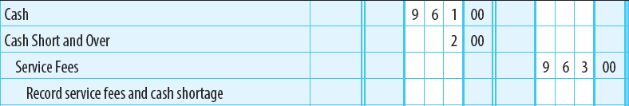
Cash Shortage Journal Entry

Slide 53
Cash Overage Example
There is $1,015 in the cash register
Cash register tape shows sales of $814.00
  CASH IN DRAWER $1,015.00
  Less: CHANGE FUND - 200.00
  CASH FROM SALES $ 815.00
  CASH REGISTER TAPE $ 814.00
  OVERAGE $ 1.00
Cash debited for the amount deposited
Cash Short and Over credited for overages
Service Fees is credited for the amount on the cash register tape even though this was not the amount collected

Slide 54
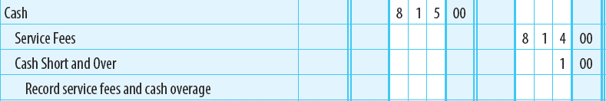
Cash Overage Journal Entry

Slide 55
Internal Controls
Chapter 7 Appendix

Slide 56
Appendix Learning Objective 1
Explain the importance of internal control

Slide 57
Importance of Internal Control
Good internal control helps ensure:
  Reliable and timely records
  Asset management and protection
  Rules and procedures followed by employees
  Accurate reporting of information

Slide 58
Sarbanes-Oxley Act (SOX)
Applies to all publicly held companies
Requires annual reporting on the effectiveness of internal control over financial reporting
Has resulted in many non-publicly held companies evaluating their internal control quality

Slide 59
Appendix Learning Objective 2
Define internal control and describe its key components

Slide 60
Internal Control
A system developed by a company to provide reasonable assurance of achieving:
  Effective and efficient operations
  Reliable financial reporting
  Compliance with laws and regulations

Slide 61
Key Components of Internal Control
The most widely accepted framework in the U.S. contains five components:
  Control environment
  Risk assessment
  Control activities
  Information and communication system
  Monitoring processes

Slide 62
Control Environment
The policies, procedures, and attitudes of the top management and owners of the business
Includes:
  The organization structure
  Management’s philosophy and operating style
  Integrity and ethical values
  Commitment to competent, trustworthy employees

Slide 63
Risk Assessment
The process for identifying, analyzing, and responding to business risks
Examples of internal business risks:
  Errors
  Fraud
  Obsolete inventory
  High employee turnover

Slide 64
Control Activities
Policies and procedures established to help management meet its control objectives
Four types of control activities:
  Segregation of duties
  Authorization procedures and related responsibilities
  Adequate documents and records
  Protection of assets and records

Slide 65
Segregation of Duties
Different employees should be responsible for different parts of a transaction
  Provides a built-in check by one employee on another
Employees who account for transactions should not also have custody of the assets
  One employee cannot obtain goods for personal use without being caught by another employee

Slide 66
Authorization Procedures and Related Responsibilities
Every business activity should be properly authorized
It should be possible to identify who is responsible for every activity that has occurred

Slide 67
Adequate Documents and Records
Business transactions should be supported by a document that is:
  Prenumbered
  Used in sequence
  Subsequently accounted for
Business can ensure that it made a record of each transaction

Slide 68
Protection of Assets and Records
Assets generally need physical protection
  Examples:
    Vaults for cash, securities, etc.
    Secure storage rooms for inventory
Records need both physical and logical protection
  Examples:
    Secure storage of journals, ledgers, and key documents (including electronic backups)
    Password protection of data files and processing programs

Slide 69
Information and Communication System
Set of procedures, processes, and records used to initiate, process, record, and report business transactions
Accounts for the related assets and liabilities
Includes journals and ledgers

Slide 70
Monitoring Processes
Methods used by management to determine:
  Controls are operating properly
  Controls are modified in response to changes in assessed risks
Example of ongoing process:
  Comparisons of financial reports with expectations
Example of separate process:
  Tests of internal controls by internal auditors

Slide 71
Appendix Learning Objective 3
Describe selected internal controls over cash receipts

Slide 72
Internal Controls Over Cash Receipts (1 of 3)
Controls over cash receipts ensure:
  All cash received by the business is recorded in the accounts
  The cash is promptly deposited (physical control)
Protecting cash received directly from customers:
  Cash register or terminal with a printed receipt
  Only authorized employees operate registers
  Registers generate internal records of all transactions
  Cash and register records are reconciled, and differences are investigated
  Cash receipts deposited daily

Slide 73
Internal Controls Over Cash Receipts (2 of 3)
To protect cash/checks received as collections on account:
  Mail room should be supervised
  Employees handling the cash/checks should have no access to the accounting records
  A remittance list should be prepared when mail is opened
    The list shows all amounts received and from whom
    The list is sent to the accounting department for use in recording the collections
  Checks immediately endorsed “For deposit” to business bank account
  Cash/checks sent to cash receipts department for deposit
  Remittance list and bank deposit amounts should be independently verified and any differences investigated

Slide 74
Internal Controls Over Cash Receipts (3 of 3)
Independent bank reconciliation prepared monthly
  Cash receipts, cash payments, and beginning and ending balances per bank and per books must be reconciled
  Reconciliation prepared by employees who have no access to cash
  Any differences should be investigated

Slide 75
Internal Controls Over Cash
Internal controls over cash help businesses manage their cash resources by:
  Maintaining enough cash to meet current obligations
  Ensuring that too much cash does not lie idle

Slide 76
Appendix Learning Objective 4
Describe selected internal controls over cash payments and the use of a voucher system

Slide 77
Controls Over Cash Payments
Main purposes of internal controls over cash payments
  Ensure cash is paid only for goods and services received by the business
  Payments are consistent with business’s best interests
Voucher System – Control technique that requires every acquisition and subsequent payment to be supported by an approved voucher
  A voucher is a document that shows that an acquisition is proper and that payment is authorized

Slide 78
The Purchasing Process (1 of 3)
Authorized person prepares requisition
The purchasing department:
  Reviews and approves the purchase requisition
  Prepares a purchase order to send to the supplier
When goods are received, receiving report is prepared
Copy of the purchase requisition, purchase order, and receiving report is sent to the vouchers payable section in the accounting department

Slide 79
The Purchasing Process (2 of 3)
Supplier sends the purchase invoice
  Received by the mailroom
  Sent to the accounting department
Accounting department reviews the purchase invoice to determine if it is:
  For the goods ordered
  At the correct price
  For the correct quantity
    If any aspect of the purchase is improper, it will be caught when the voucher is prepared

Slide 80
The Purchasing Process (3 of 3)
Accounting department prepares a voucher
  Basis for paying the invoice on the due date
NO payment may be made without an approved voucher
Voucher is entered into voucher register (a special journal)
Voucher and supporting documents are stapled together and filed by due date

Slide 81
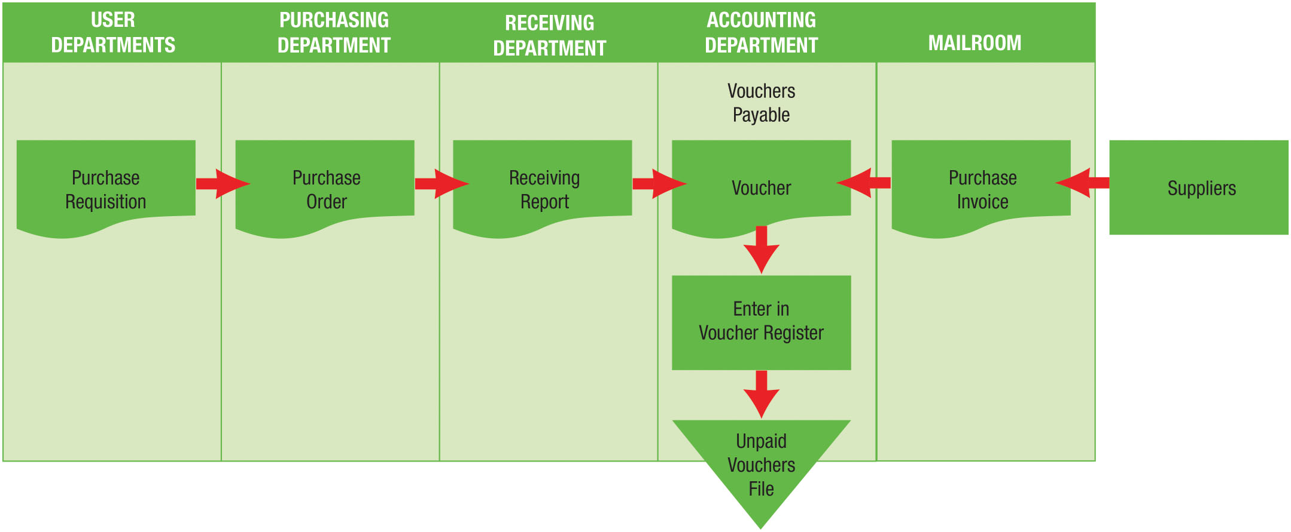
The Purchasing Process (Figure 7A-4)

Slide 82
Voucher System Control
Incorporates three of the four elements of internal control:
  Duties are segregated
    Different employees order, receive, and record purchases
  Authorization
    Required to order goods and prepare voucher
  Documents and Records
    Purchase is supported by voucher, purchase invoice, receiving report, purchase order, and purchase requisition

Slide 83
Voucher System Payment Process
Pull Voucher and Supporting Documents; Send to Cashier
Review Voucher and Documents; Prepare and Sign Check
Send Check to Supplier
Cancel Voucher and Documents
Return Voucher and Documents to Vouchers Payable; Record Payment in Voucher Register
File Voucher and Documents in Paid Vouchers File
Record Payment in Check Register

Slide 84
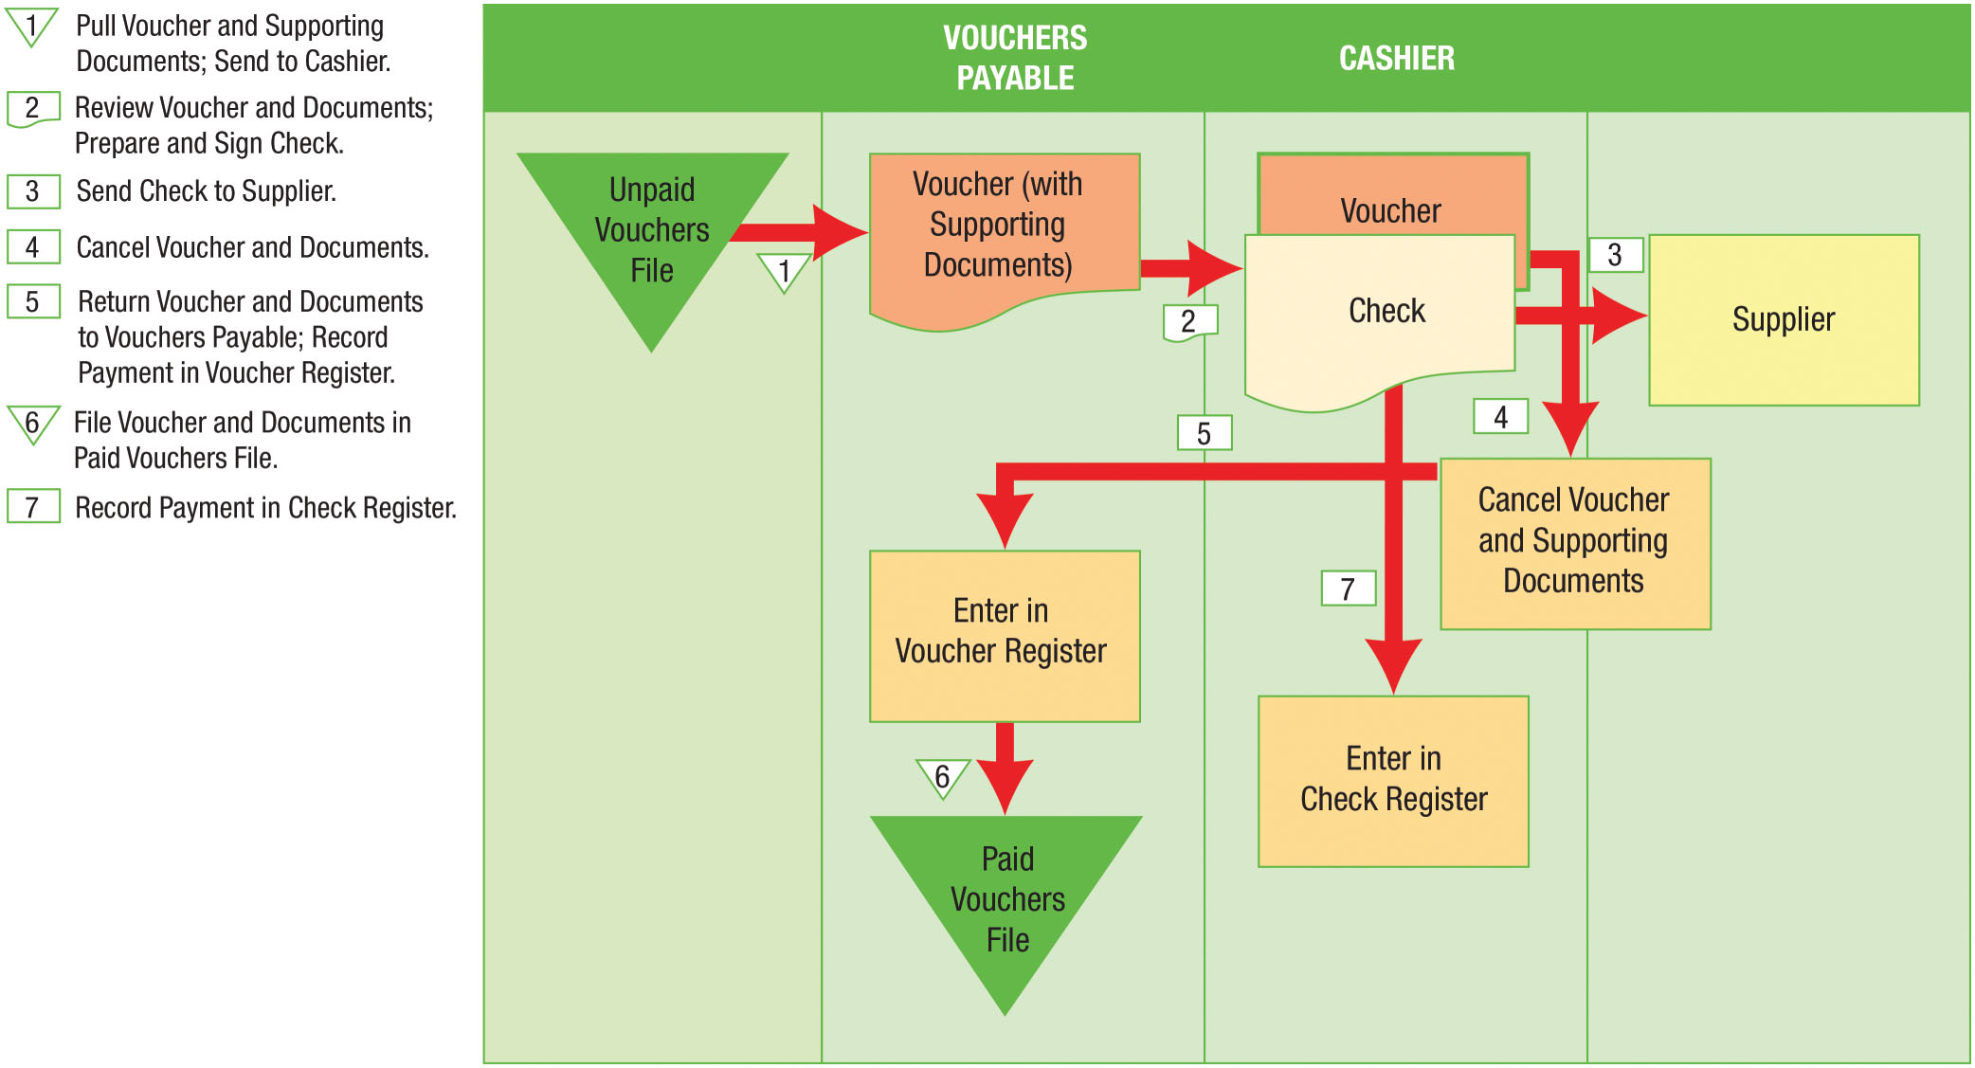
Voucher System Payment Process (Figure 7A-6)

