Slide 1
Franchising

Slide 2
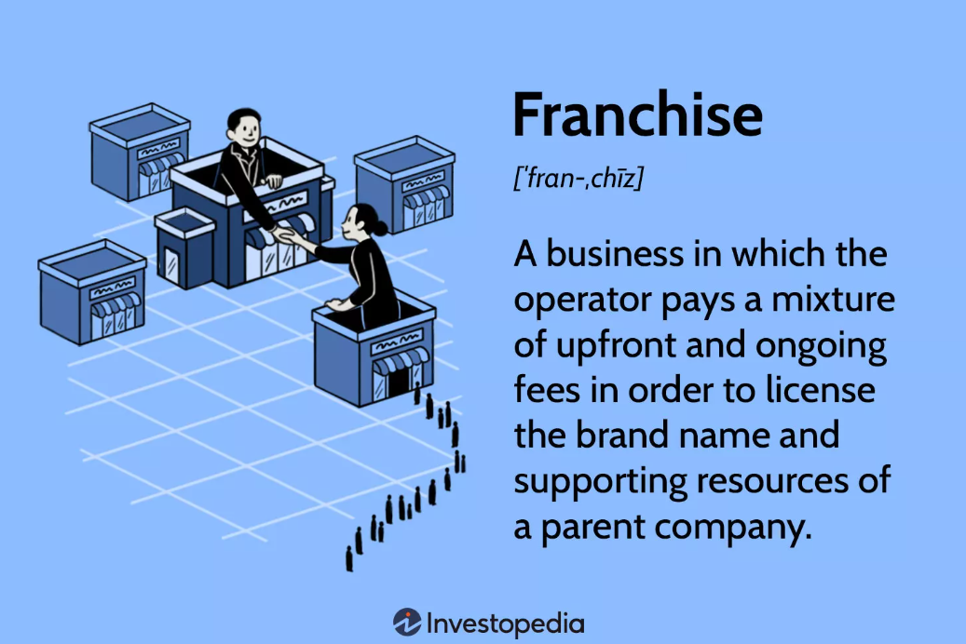

Slide 3
What Is a Franchise, and How Does It Work?
A franchise is a type of license that grants a franchisee access to a franchisor's proprietary business knowledge, processes, and trademarks, thus allowing the franchisee to sell a product or service under the franchisor's business name. In exchange for acquiring a franchise, the franchisee usually pays the franchisor an initial start-up fee and annual licensing fees.

Slide 4
Key Takeaways
A franchise is a business whereby the owner licenses its operations—along with its products, branding, and knowledge—in exchange for a franchise fee.
The franchisor is the business that grants licenses to franchisees.
The Franchise Rule requires franchisors to disclose key operating information to prospective franchisees.
Ongoing royalties paid to franchisors vary by industry and can range between 4.6% and 12.5%.

Slide 5
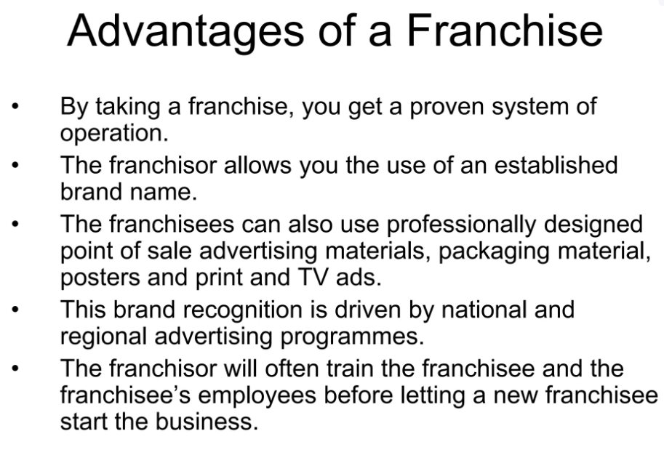

Slide 6
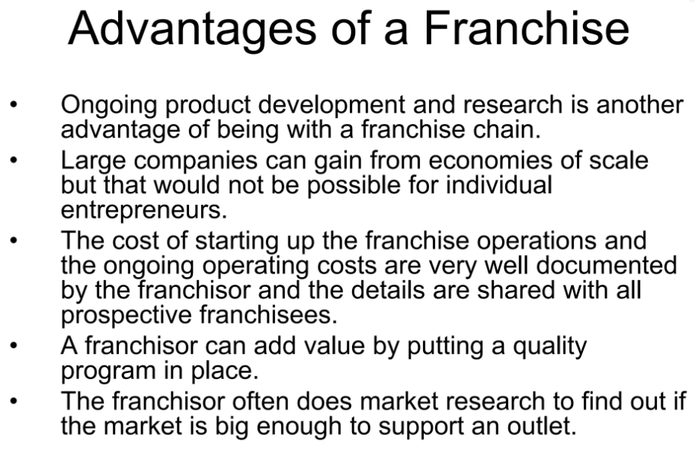

Slide 7
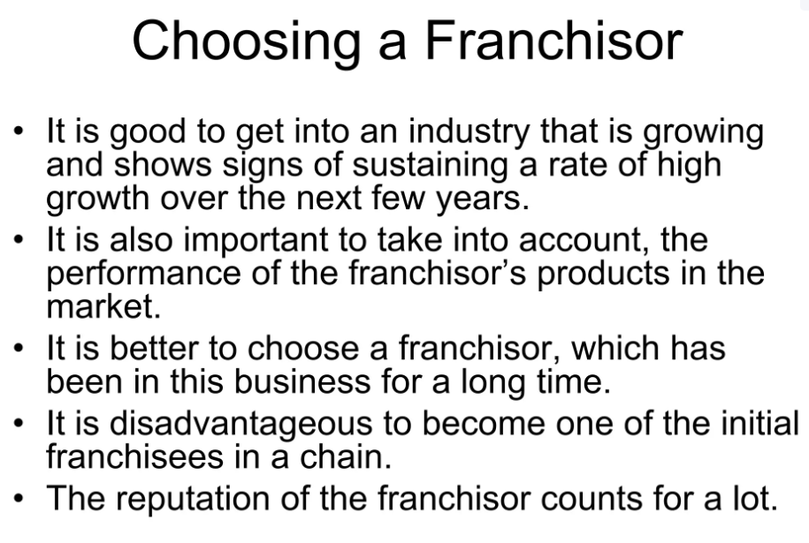

Slide 8
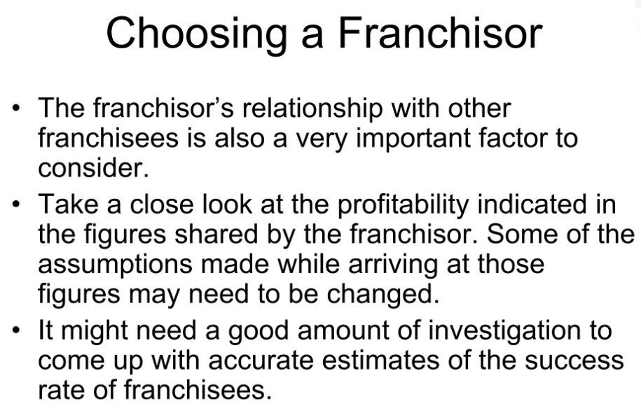

Slide 9
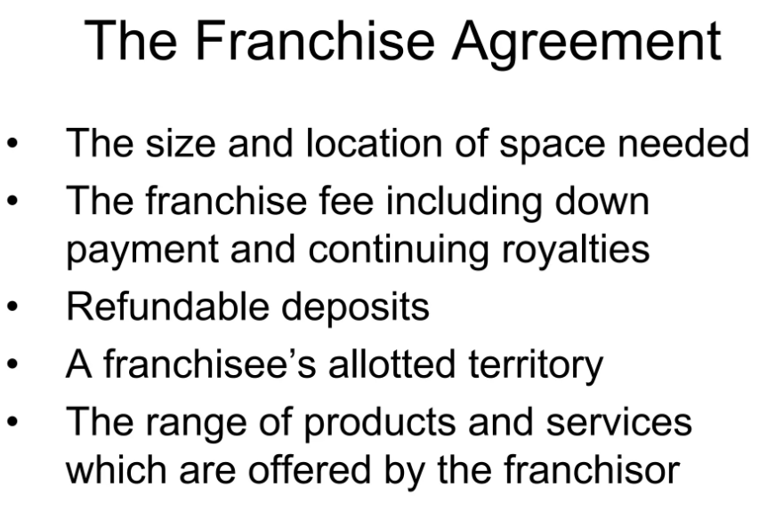

Slide 10
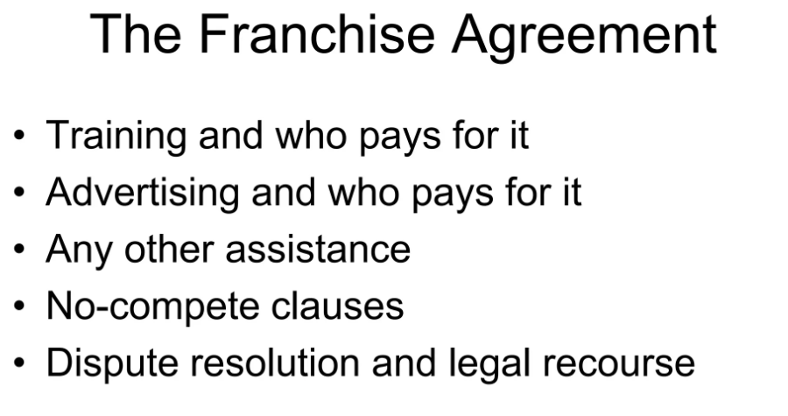

Slide 11
Some of the famous franchises are:
McDonald's, the world's largest fast-food chain with over 38,000 locations in 119 countries.
7-Eleven, the largest convenience store chain with over 71,000 stores in 17 countries.
Dunkin', the leading coffee and baked goods chain with over 12,000 locations in 45 countries.
The UPS Store, the largest network of retail shipping, postal, printing and business service centers with over 5,000 locations in the US and Canada.
Popeyes, the second-largest quick-service chicken restaurant chain with over 3,000 locations in 25 countries.

Slide 12


