Slide 1

Source Documents

Slide 2
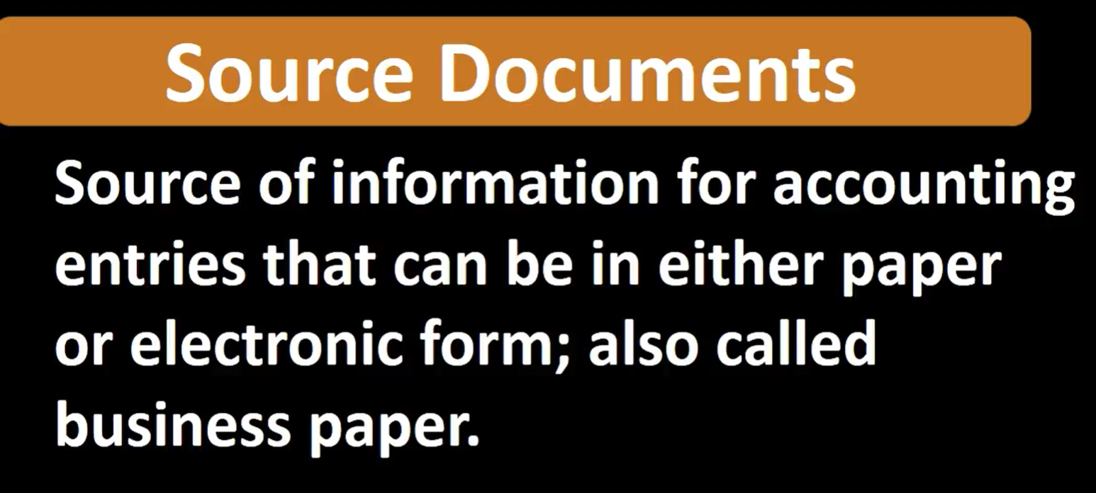

Slide 3


Slide 4
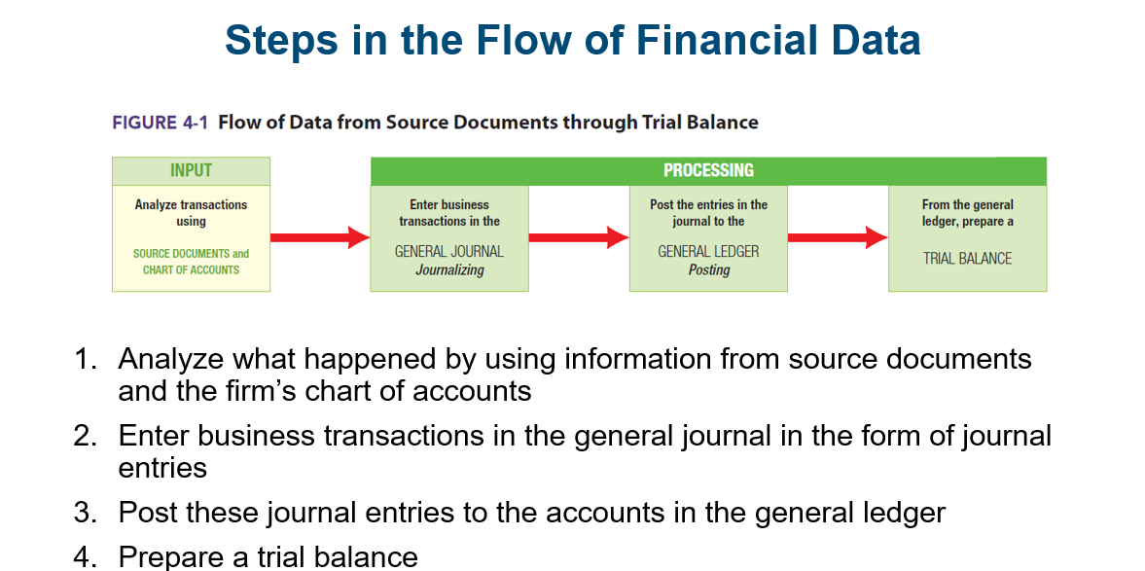

Slide 5
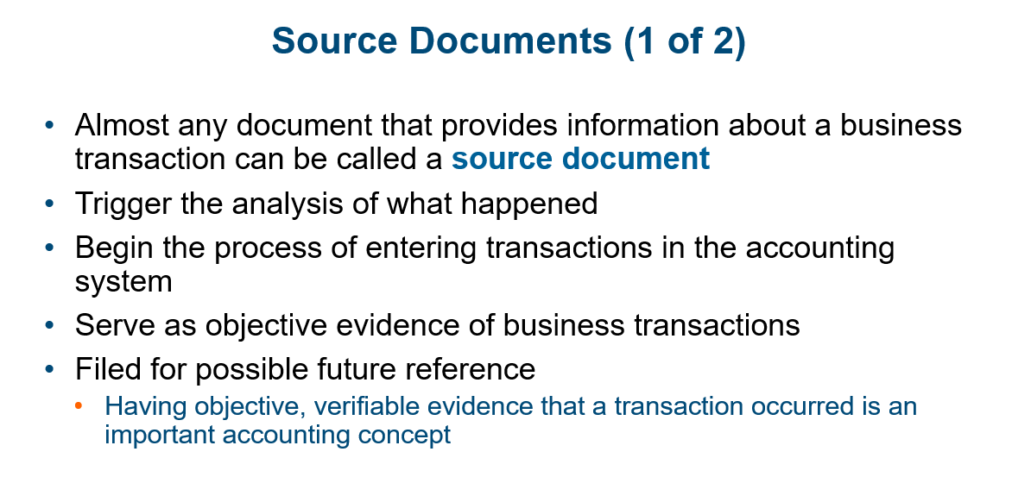


Slide 6
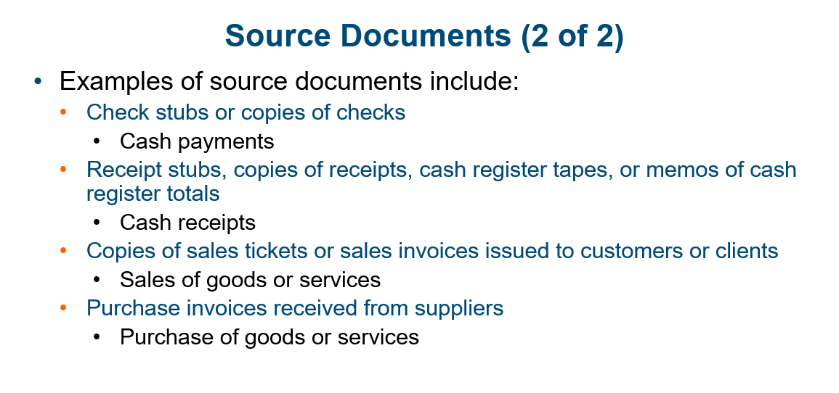


Slide 7

Questions?

Slide 8
Speaking engagement metrics
Impact factor | Measurement | Target | Achieved
Audience interaction | Percentage (%) | 85 | 88
Knowledge retention | Percentage (%) | 75 | 80
Post-presentation surveys | Average rating | 4.2 | 4.5
Referral rate | Percentage (%) | 10 | 12
Collaboration opportunities | # of opportunities | 8 | 10

Slide 9
Thank you
Brita Tamm
502-555-0152
brita@firstupconsultants.com
www.firstupconsultants.com

