Slide 1


What is a Balance Sheet

Slide 2
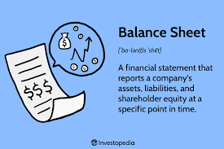
The Balance Sheet

Slide 3
What Is a Balance Sheet?
The balance sheet is one of your company’s most important financial statements. It provides a snapshot of the company’s financial position at a specific point in time. Managerial accountants, business managers and investors use balance sheets as a key source of information to better understand the company’s financial health.

Slide 4
Key Takeaways
A company’s balance sheet is a snapshot of its financial position at a specific point in time.
The balance sheet lists everything that the company owns (its assets), everything that it owes (its liabilities), and shareholder equity.
The difference between assets and liabilities is the equity in the company, which belongs to the owners. In a healthy company, this equity is a significant positive balance; if it’s negative, the company is technically insolvent.

Slide 5
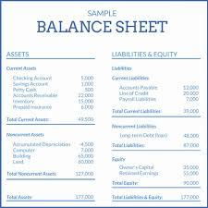
Key Takeaways Cont’d
The balance sheet doesn’t provide information about the company’s revenue or cash flow, so it needs to be analyzed together with other financial data to gain a full picture of the company’s financial health.
The information in the balance sheet can be used to help assess the company’s liquidity, operating efficiency and potential return on investment.

Slide 6
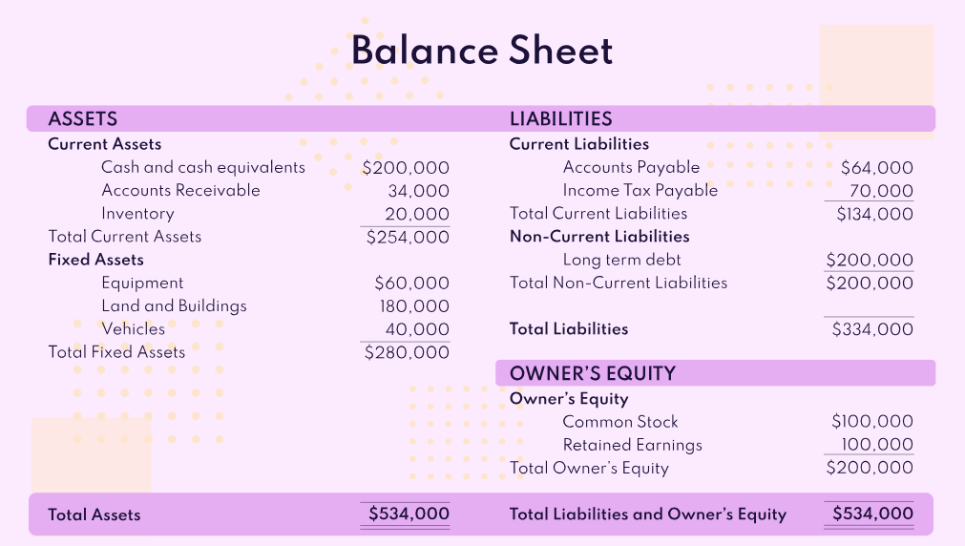

Slide 7
What Is Included on a Balance Sheet?
A company’s balance sheet includes everything that the company owns and everything that it owes—all of its assets and liabilities, in other words. It also shows the owners’ or shareholders’ equity in the company, which is equal to the difference between its assets and liabilities.
For a privately-held company, the shareholders typically include the founders and any investors. For a public company, they include anyone who owns the company’s stock.

Slide 8
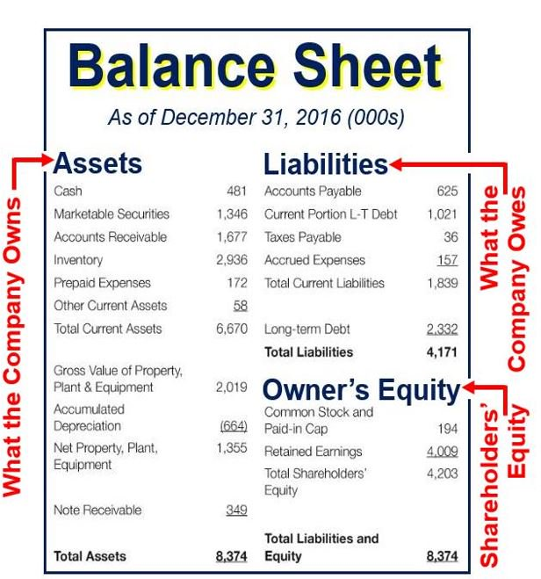
Snapshot
The balance sheet provides a snapshot of the company’s assets and liabilities on a specific date, such as the end of a fiscal quarter. Companies generally produce balance sheets at least once a year, and often quarterly and/or monthly as well.

Slide 9
Cumulative Effect
The balance sheet reflects the cumulative effect of all the company’s transactions since the day the business started. For this reason, it is sometimes called the statement of financial position. It provides insights into the business’s overall financial health, including:
Whether the company’s assets exceed its liabilities.
How much money is currently invested in the business.
Any profits retained in the business.
How much debt the company carries, and how much of that debt is due in the short term.
Whether the company is likely to be able to easily borrow money if it needs to.

Slide 10
What It Doesn’t Show
Although the balance sheet contains a lot of useful financial information, it doesn’t show the company’s income, expenses or cash flow. To analyze those, you need to look at the company’s other two financial statements. Income and expenses can be found on the income statement, and changes to available cash are shown on the cash flow statement.
However, the company’s net profits in any specific reporting period are reflected in the balance sheet at the end of that period, where they appear as increases in shareholders’ equity.

Slide 11
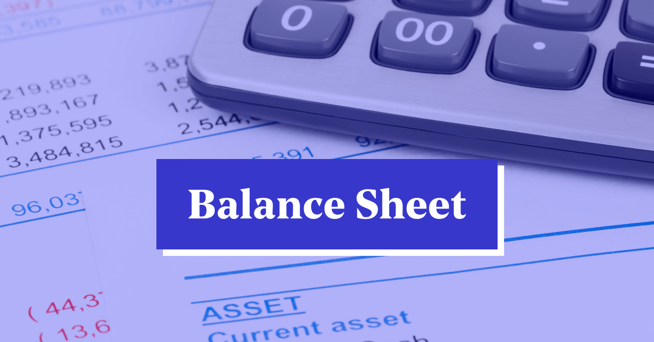
Video
Watch Balance Sheet Definition and How to Use It

