Slide 1

Payroll Accounting: Employee
Earnings and Deductions
Chapter 8

Slide 2
Payroll Record Keeping
Payroll costs are major expenditures for most businesses
  Payroll records provide data for analyzing and controlling these expenditures
Laws require employers to keep payroll records
  For the business as a whole
  For each employee

Slide 3
Learning Objective 1
Distinguish between employees and independent contractors

Slide 4
Employees vs. Independent Contractors (1 of 2)
Work under the control and direction of an employer
  Secretaries
  Salesclerks
  Plant Supervisors
  Maintenance Workers
Perform services for a fee and do not work under the control and direction of the company paying for the services
  Lawyers
  Public Accountants
  Real Estate Agents
  Consultants

Slide 5
Employees vs. Independent Contractors (2 of 2)
Government laws and regulations for employees are much more complex:
  Taxes must be deducted
  Payroll records must be maintained
  Numerous reports must be filed
Only one form must be filed for independent contractors – Form 1099

Slide 6
Learning Objective 2
Calculate employee earnings and deductions

Slide 7
Employee Earnings and Deductions
Three steps to determine how much to pay an employee for a pay period:
  Calculate total earnings
  Determine the amount of deductions
  Subtract deductions from total earnings to compute net pay

Slide 8
Salaries and Wages
Salaries
  Compensation for managerial or administrative services
  Normally expressed in bi-weekly, monthly, or annual terms
Wages
  Compensation for skilled or unskilled labor
  Expressed in terms of hours, weeks, or units produced

Slide 9
Overtime
Fair Labor Standards Act (FLSA) requires employers to pay overtime (1½ times the regular rate) to any hourly employee who works over 40 hours in a week
Some salaried employees are exempt from the FLSA rules and are not paid overtime

Slide 10
Computing Total Earnings
When compensation is based on time, a record must be kept of the time worked by each employee
  Time cards, plastic cards, or badges with special magnetic strips or bar codes
The hours worked are multiplied by the rate of pay to determine total earnings

Slide 11
Computing Total Earnings – Hourly Worker Example (1 of 2)
Helen Kuzmik worked 54 hours this week
Kuzmik’s regular rate of pay is $14 per hour
Helen worked 4 hours on Sunday.
She is paid 1½ times the regular rate for hours in excess of 8 on Monday through Friday and any hours worked on Saturday, and twice the regular rate for hours on Sunday
  $14 × 1½ = $21 (overtime rate)
  $14 x 2 = $28 (double-time rate for Sunday work)

Slide 12
Computing Total Earnings—Hourly Worker Example (2 of 2)
Calculations | Pay
40 hours × $14 per hour = | $560
10 hours × $21 per hour = | 210
4 hours (Sunday) × $28 per hour = | 112
Total earnings (gross pay) for the week = | $882

Slide 13
Computing Total Earnings – Salaried Employee Example (1 of 3)
Linda Swaney has a salary of $2,600 a month plus 1½ times the regular hourly rate for hours in excess of 40 per week
In order to compute her overtime rate, we must determine her regular hourly rate
Step 1 – Determine her annual salary
  $2,600 per month × 12 months = $31,200 annual pay
Step 2 – Determine her weekly salary
  $31,200 annual salary ÷ 52 weeks = $600 pay per week

Slide 14
Computing Total Earnings – Salaried Employee Example (2 of 3)
Step 3 – Compute regular hourly pay
  $600 per week ÷ 40 hours per week = $15 pay per regular hour
Step 4 – Compute overtime rate
  $15 per hour × 1½ = $22.50 overtime pay per hour

Slide 15
Computing Total Earnings – Salaried Employee Example (3 of 3)
Swaney worked 50 hours during the week
Her total earnings for the week are:
Calculations | Pay
40 hours × $15 per hour = | $600.00
10 hours × $22.50 per hour = | 225.00
Total earnings (gross pay) for the week = | $825.00

Slide 16
Deductions from Total Earnings
Three categories:
  Federal (and possibly state and city) income tax withholding
  Employee FICA tax withholding
  Voluntary deductions
Gross pay less Deductions = Net pay
  Also called take-home pay

Slide 17
Federal Income Tax Withholding
Required by federal law
Applied toward the payment of the employee’s federal income tax
Amount withheld determined by:
  Total earnings
  Marital status
  Number of withholding allowances claimed
  Length of the pay period

Slide 18
Withholding Allowances
Exempt a specific dollar amount of an employee’s gross pay from federal income tax withholding
Computed on Form W-4 (Employee’s Withholding Allowance Certificate)
  Based on the marital status and the number of allowances claimed
    In general, each employee is permitted one personal withholding allowance, one for a spouse who does not also claim an allowance, and one for each dependent

Slide 19
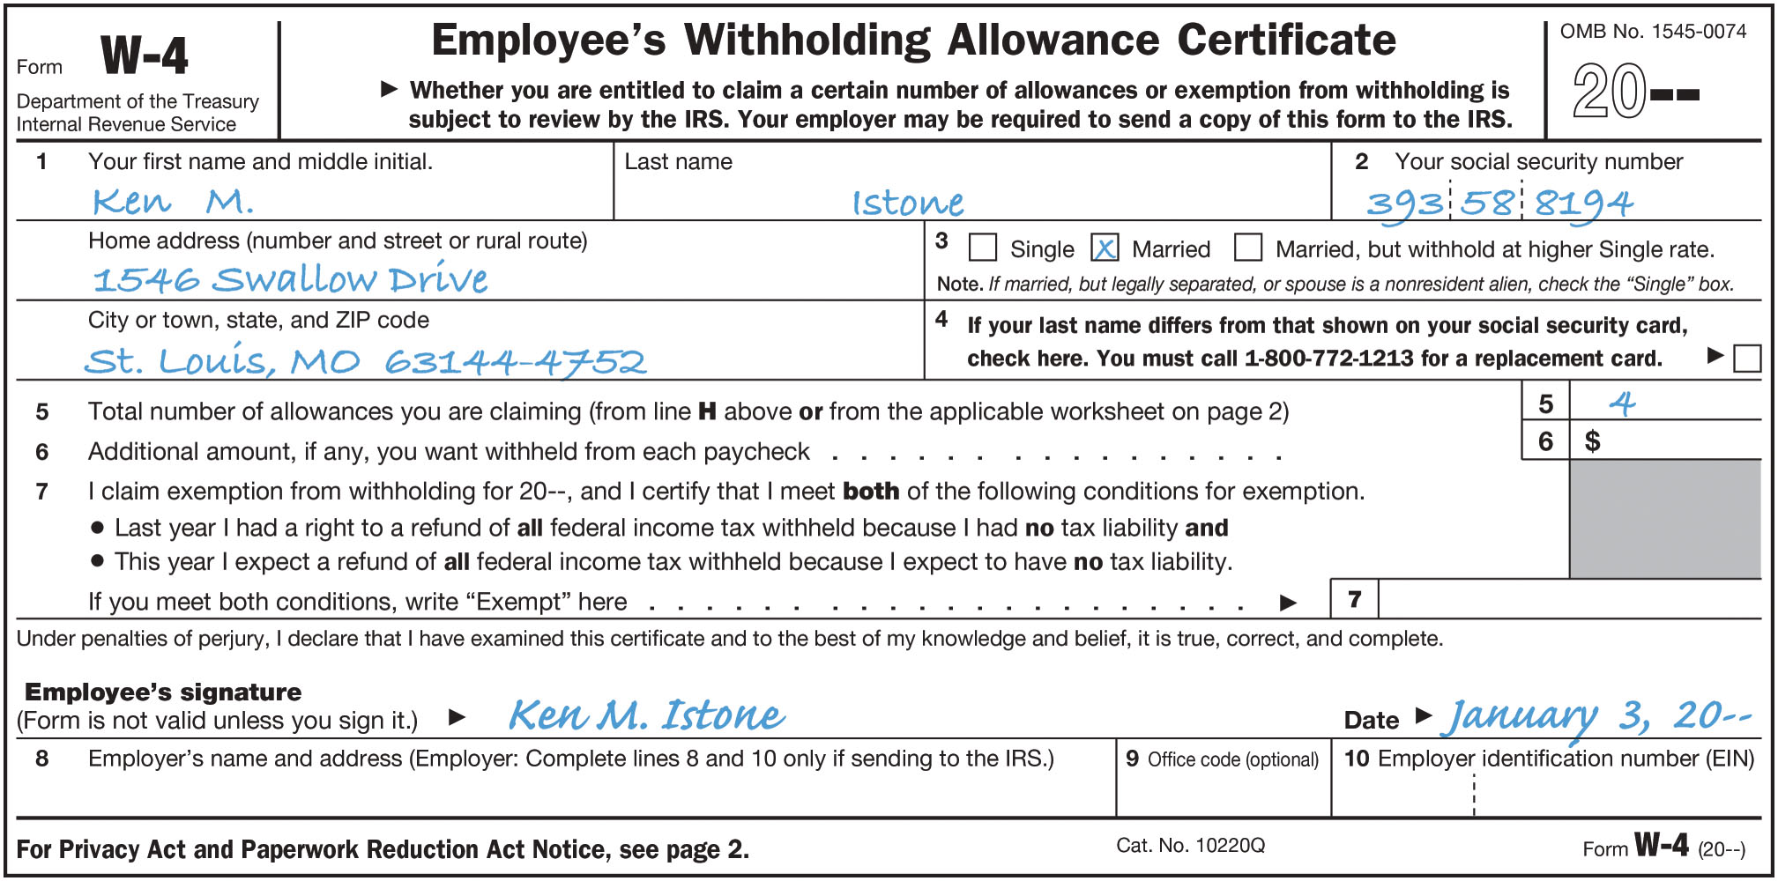
Form W-4 (Figure 8-3)

Slide 20
Wage-Bracket Method Example
Ken Istone is married and claims 4 allowances
He has gross earnings of $640 for the week
Wage-bracket method
  Step 1 – Find the row for wages of “at least $635, but less than $645.”
  Step 2 – Find the column headed “4 withholding allowances.”
  Step #3 – Find the amount where they cross
    This is the amount to be withheld

Slide 21
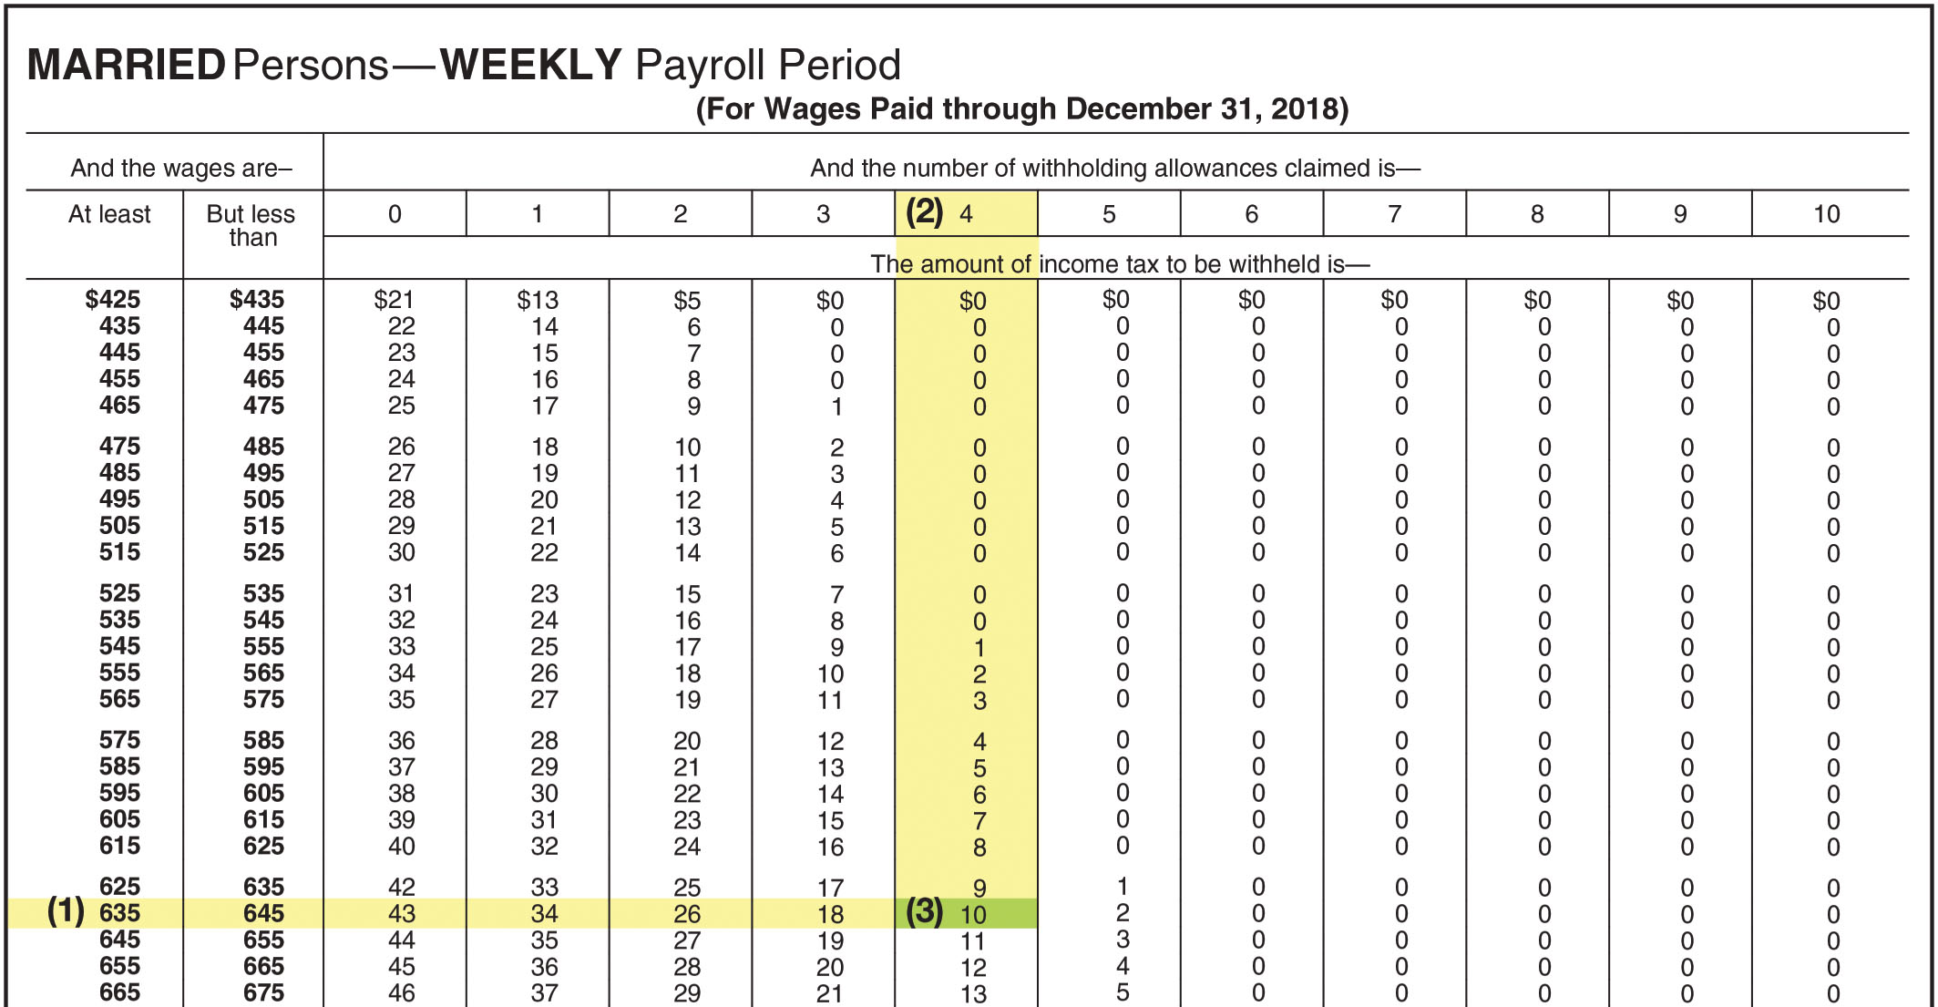
FIGURE 8-4 Federal Withholding Tax Table: (concluded) Married Persons

Slide 22
Employee FICA Tax Withholding (1 of 2)
Includes amounts for:
  Social Security
    Provides pension and disability benefits
  Medicare
    Provides health insurance
Required by the Federal Insurance Contributions Act (FICA)

Slide 23
Employee FICA Tax Withholding (2 of 2)
Tax rates are set by Congress
  Social Security
    6.2% on maximum annual earnings of $128,400
  Medicare
    1.45% on ALL earnings – no maximum
Rates and maximum amounts subject to FICA taxes can be changed annually by Congress

Slide 24
Employee FICA Tax Withholding Example
Sarah Cadrain had earnings of $2,000 for the December 6–12 pay period, bringing her earnings year-to-date to $127,340
Sarah’s earnings have not yet reached the maximum of $128,400
  ALL of her earnings for this week are subject to Social Security and Medicare tax
Gross Pay x | Tax Rate = | Tax
$2,000 | Social Security 6.2% | $124.00
$2,000 | Medicare 1.45% | 29.00
 |  | $153.00

Slide 25
Voluntary Deductions
Deductions that are optional and depend on specific agreements between the employee and employer
  U.S. savings bond purchases
  Health insurance premiums
  Credit union deposits
  401(K) Plan contributions
  Charitable contributions

Slide 26
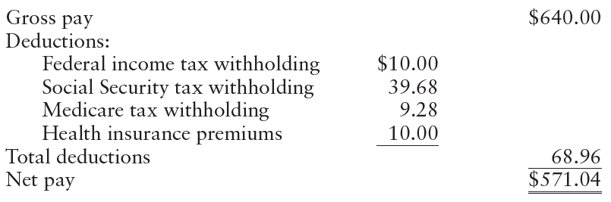
Computing Net Pay

Slide 27
Learning Objective 3
Describe and prepare payroll records

Slide 28
Payroll Records
Should provide the following information on each employee:
  Name, address, occupation, social security number, marital status, and number of withholding allowances
  Gross amount of earnings, date of payment, period covered by each payroll
  Gross amount of earnings accumulated for the year
  Amounts of taxes and other items withheld
Three types of payroll records are used:
  Payroll register
  Payroll check (or record of direct deposit) with earnings statement attached
  Employee earning record

Slide 29
Payroll Register
A payroll register is a form used to assemble the data required at the end of each payroll period
Since marital status and number of allowances are used to compute withholding taxes, they are recorded on the payroll register
Earnings for this period are shown, categorized by regular and overtime earnings

Slide 30
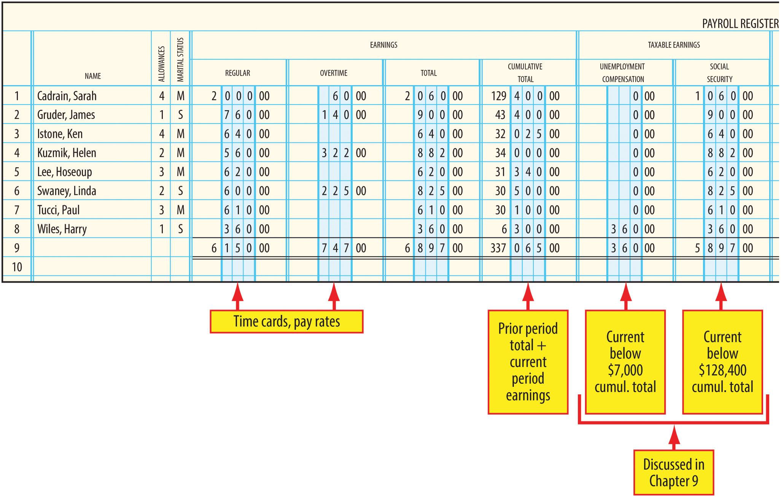
Payroll Register (Left Side) – Figure 8-5

Slide 31
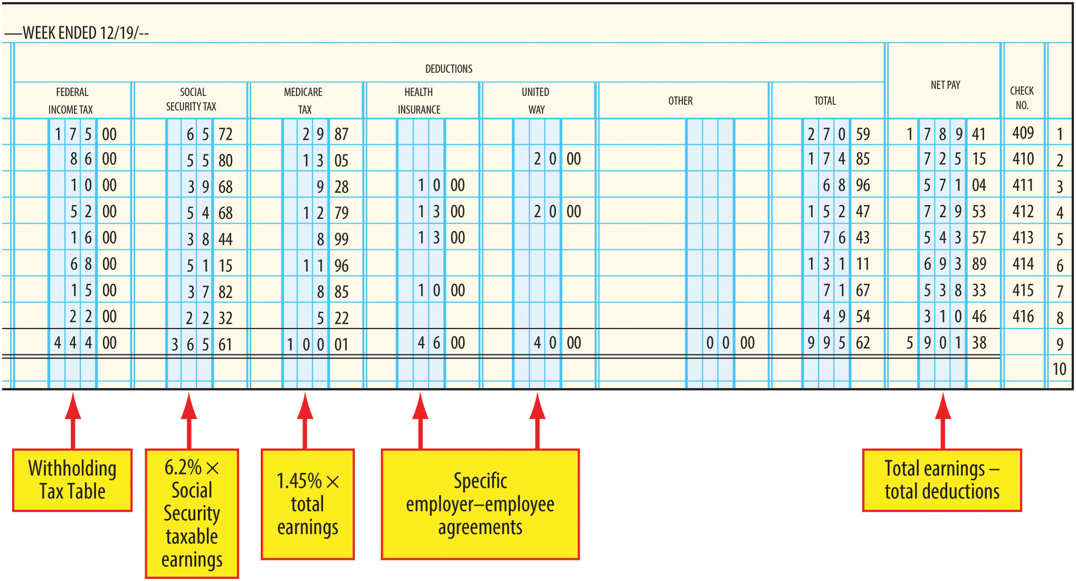
Payroll Register (Right Side) – Figure 8-5

Slide 32
Paying Employees
Employees should be paid by check or by direct deposit
  These methods provide better internal accounting control than payment by cash
  When direct deposit is used, payment is deposited directly by the employer into the employee’s bank account using electronic funds transfer (EFT)
The employer furnishes an earnings statement to each employee along with his or her paycheck or after a direct deposit has been made

Slide 33
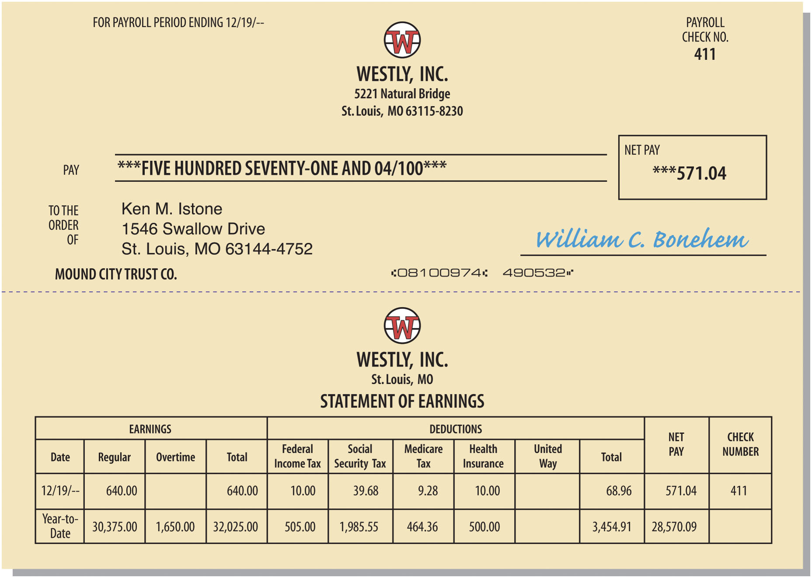
Paycheck and Earnings Statement (Figure 8-6)

Slide 34
Employee Earnings Record
A separate earnings record is maintained for each employee
Information comes from the payroll register
  These records are automatically generated and updated in computerized systems
Employer needs this information to prepare several reports (discussed in Chapter 9)

Slide 35
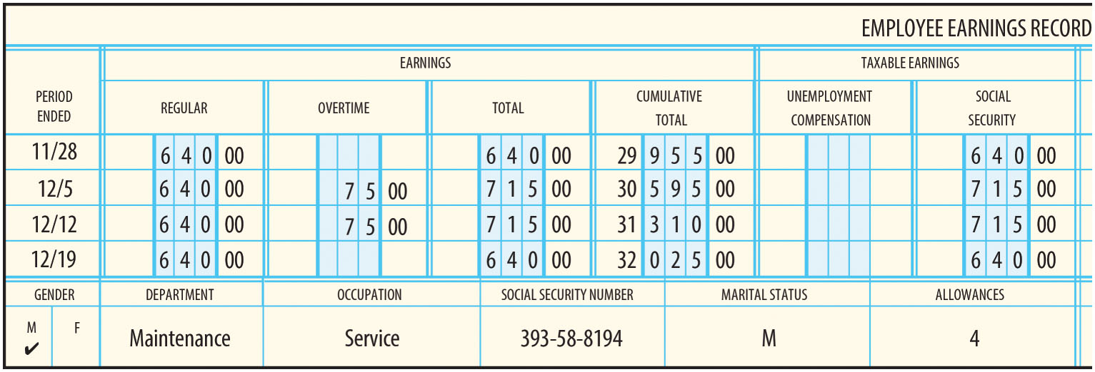
Employee Earnings Record (Left Side) – Figure 8-7

Slide 36
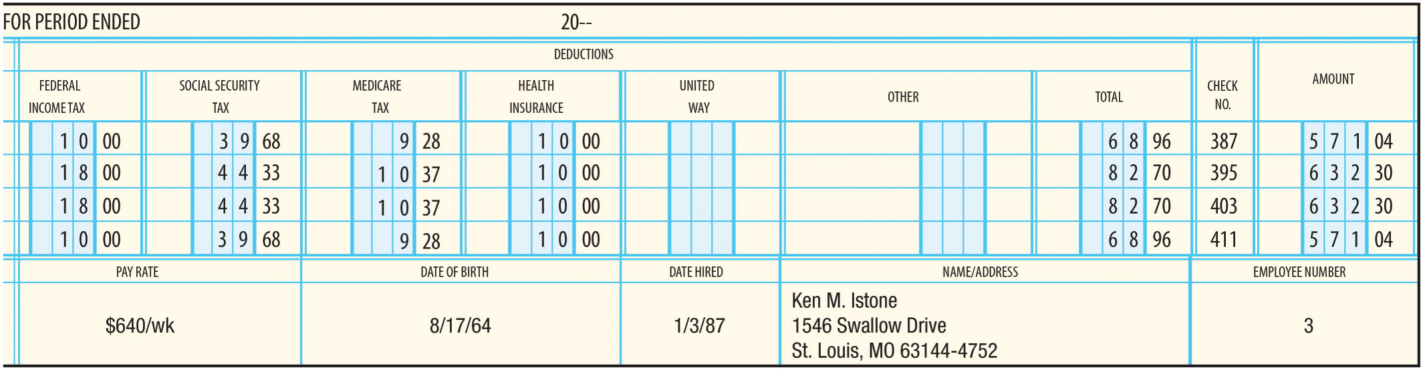
Employee Earnings Record (Right Side) – Figure 8-7

Slide 37
Learning Objective 4
Account for employee earnings and deductions

Slide 38
Journalizing Payroll
Journal entries must be made to record the payroll expenses and liabilities
The payroll register is the source for the journal entries
  Gross pay is debited to Wage Expense
  Each deduction is recorded in a separate liability account
  Net pay is credited to cash

Slide 39
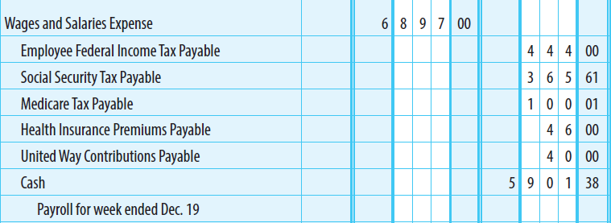
Payroll Journal Entry

Slide 40
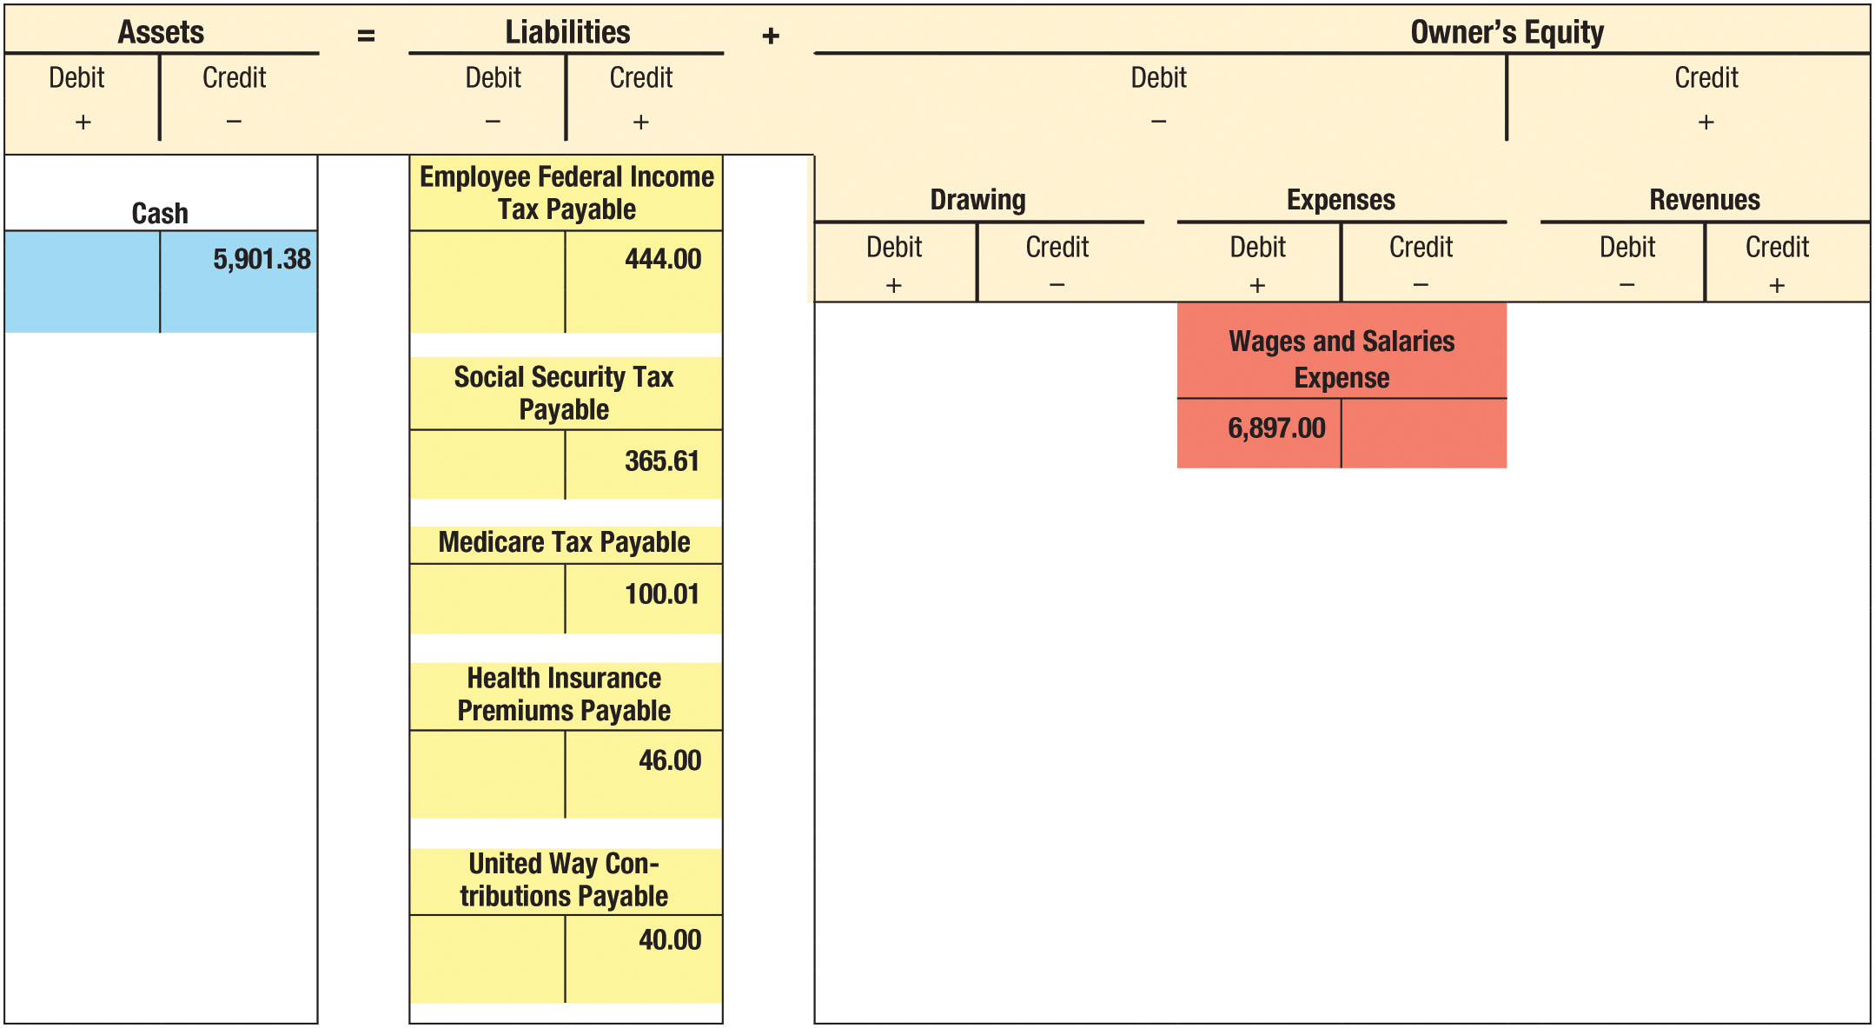
Effect of Payroll Entry on Accounting Equation (Figure 8-8)

Slide 41
Accounts Involved in Payroll Accounting (1 of 2)
Wages and Salaries Expense – Debited for Gross Pay
  Separate accounts used for different departments
Employee Federal Tax Payable
  Credited – Federal income tax withheld from employees’ earnings
  Debited – Payment of federal income tax previously withheld
Social Security and Medicare Taxes Payable
  Credited when Social Security taxes
    (1) withheld from employees’ earnings
    (2) imposed on the employer
  Debited – Taxes previously withheld or imposed are remitted to Federal Government

Slide 42
Accounts Involved in Payroll Accounting (2 of 2)
Other Deductions
  Health Insurance Premiums Payable
    Credited for health insurance contributions deducted from an employee’s pay
    Debited for the subsequent payment of these amounts to the health insurer
  United Way Contributions Payable is handled in a similar manner

Slide 43
Learning Objective 5
Describe various payroll record-keeping methods

Slide 44
Payroll Record-Keeping Methods
Manual system
  The same information is recorded several times
  Can be very inefficient
Payroll processing center
  A business that sells payroll record-keeping services
  Their fees can be much less than the cost to an employer of handling payroll internally
Electronic system
  A computer system that performs all payroll record-keeping and prepares payroll checks or EFT records

Slide 45
Electronic Payroll Systems
Only the employee’s number and hours worked are input each pay period
The computer uses the employee number and hours worked to determine the gross pay, deductions, and net pay
The payroll register, paychecks (or EFTs), and employee earnings records are provided as outputs

Slide 46
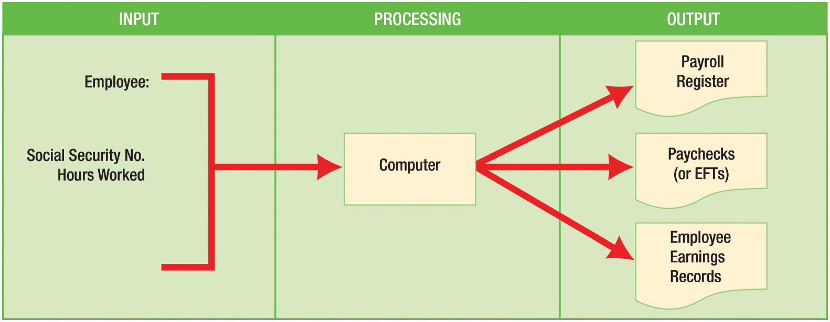
Electronic Payroll System (Figure 8-9)

