Slide 1


Mastering the Art of the Entrepreneurial Pitch
Notes:
Created from: https://biz.libretexts.org/Bookshelves/Business/Entrepreneurship/Entrepreneurship_(OpenStax)/07%3A_Telling_Your_Entrepreneurial_Story_and_Pitching_the_Idea/7.03%3A_Developing_Pitches_for_Various_Audiences_and_Goals

Slide 2

What is a Pitch?
A pitch is a brief presentation about your business idea
Usually given to potential investors or partners
Designed to be clear, concise, and compelling
Covers key areas like the problem, solution, market, and funding needs
What's the most important thing you would want to communicate in a pitch?

Slide 3
Different Pitch Audiences
Investors (angel investors, venture capitalists)
Friends and family
Potential employees
Grant-making agencies
Trade groups/associations
How might you adjust your pitch for different audiences?

Slide 4
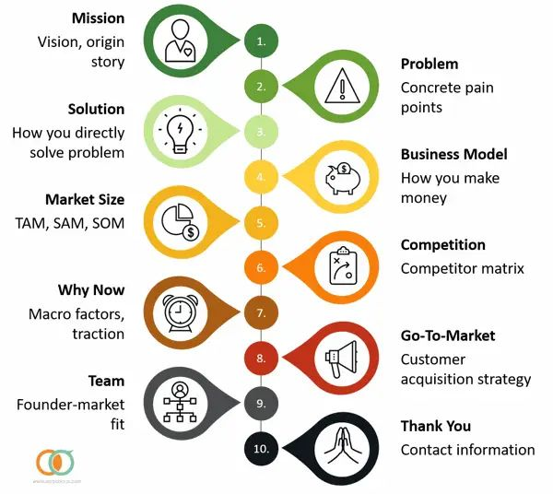
Key Elements of a Pitch
Brand identity and tagline
Problem-solution narrative
Key features and value proposition
Product-market fit description
Competitive analysis
Financial projections
Which of these elements do you think is most critical to include?

Slide 5
The Pitch Deck
Usually 10-20 slides explaining your company and goals
Visual and engaging presentation
Easy to edit and rearrange
Communicates inspiration, capabilities, and team strengths
Why do you think visuals are important in a pitch deck?

Slide 6

Example: Airbnb's Pitch Deck
Simple 10-slide deck from 2008-2009
Established brand identity
Clearly stated problem and solution
Showed market size and potential
Demonstrated competitive advantage
What do you think made this pitch deck successful?

Slide 7
Elevator Pitch
Brief 1-2 minute version of your pitch
Memorized and ready to deliver anytime
Covers key elements: problem-solution, value, market fit, team
Used to get a foot in the door for a full pitch
When might you need to give an elevator pitch?

Slide 8
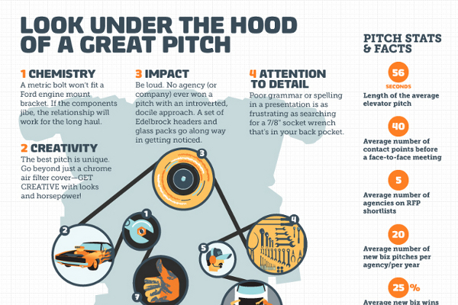
Elements of a Good Elevator Pitch
Targeted to specific audience
Written down and edited
Focused on the company/investor's needs
Clear of buzzwords and jargon
Practiced out loud
Which of these elements do you think is most challenging?

Slide 9
Pitching to Friends and Family
Often the first source of funding for startups
More informal tone
Focus on value proposition and immediate outcomes
Explain tangible deliverables or milestones
Draw clear path from contribution to likely revenues
How might pitching to friends and family be different from pitching to investors?

Slide 10
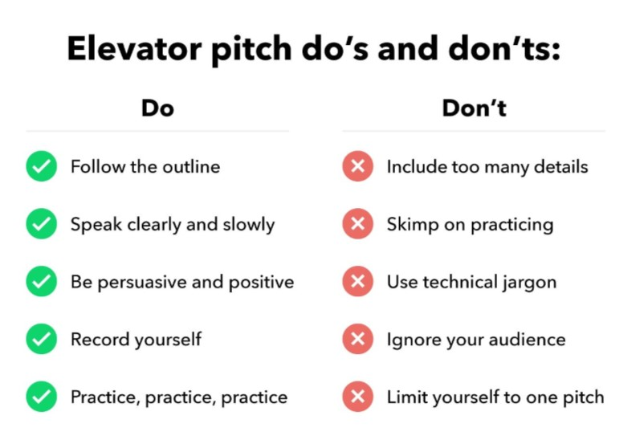
Tailoring Your Pitch
Research your audience and their interests
Adjust content based on investor/firm preferences
Highlight relevant experience and team strengths
Focus on market potential and your unique solution
Be prepared to answer specific questions
Why is it important to tailor your pitch to different audiences?

Slide 11
Practice Makes Perfect
Write out your pitch and practice delivering it
Get feedback from others and refine
Be ready to give your pitch anytime, anywhere
Keep your pitch updated as your business evolves
Remember: your pitch represents you and your idea
What steps will you take to practice and improve your pitch?

