Slide 1
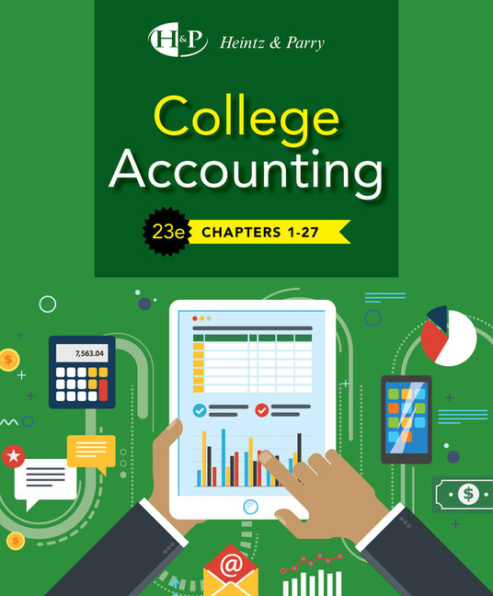
Accounting For Purchases and Cash Payments
Chapter 11

Slide 2
Learning Objective 1
Define merchandise purchases transactions

Slide 3
Purchases
In a merchandising business, “purchases” refers to merchandise acquired for resale
  Must be items for RESALE (inventory)
Procedures and documents vary, depending on the nature and size of the business
Can be made “on account” or for cash

Slide 4
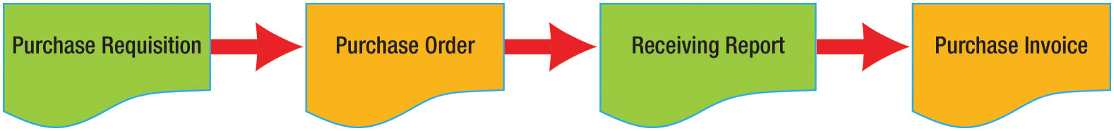
Purchasing Process Documents (Figure 11-1)

Slide 5
Purchase Requisition
A form used to request the purchase of merchandise or other property
Can be prepared by any authorized person
Three-part form
  Copy 1 to purchasing department
  Copy 2 to accounting department
  Copy 3 kept by the department that prepared the requisition

Slide 6
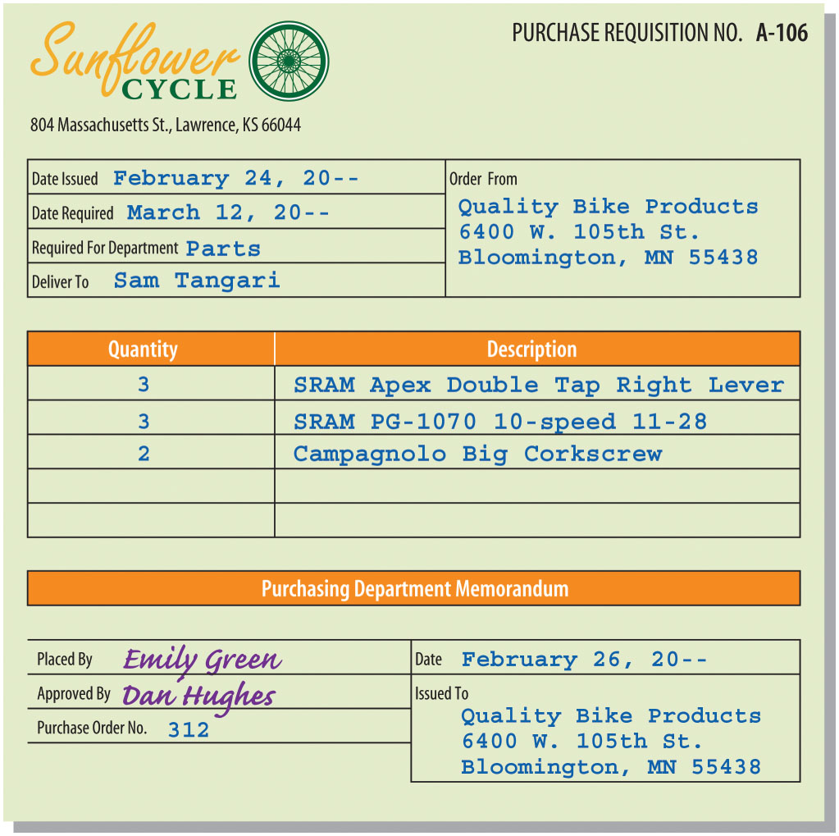
Purchase Requisition (Figure 11-2)

Slide 7
Purchase Order
A written order to buy goods from a specific vendor (supplier)
The purchasing department reviews and approves the purchase requisition and prepares a purchase order
  One copy is sent to the vendor to order the goods
  One copy is sent to the accounting department
  One copy is kept in the purchasing department
  Copies may also be sent to the receiving area and to the department initiating the purchase requisition

Slide 8
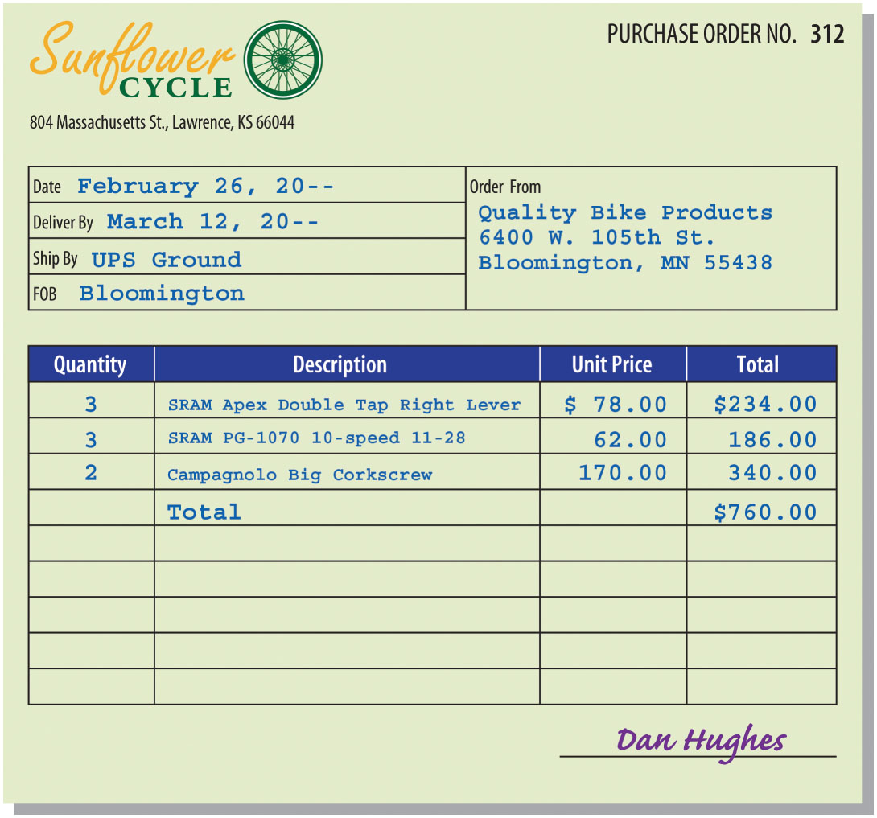
Purchase Order (Figure 11-3)

Slide 9
Receiving Report
Prepared by the receiver (in receiving department)
Indicates what has been received
Can be a separate form or can be created from the vendor’s purchase invoice

Slide 10
Purchase Invoice
Prepared by the seller as a bill for the merchandise shipped
  Seller calls it a sales invoice
  Buyer calls it a purchase invoice
Before payment is made, the accounting department compares the purchase invoice with the:
  Purchase requisition
  Purchase order
  Receiving report
Checking all documents is an example of exercising proper internal control

Slide 11
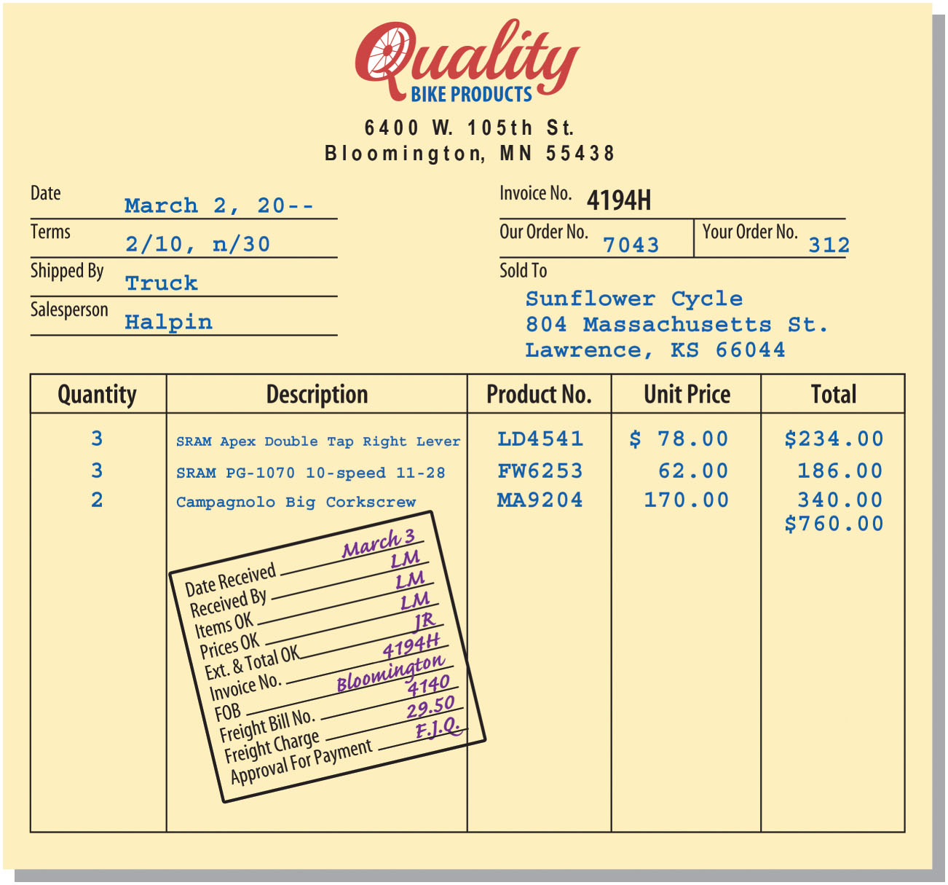
Purchase Invoice (Figure 11-4)

Slide 12
Cash Discounts
Available if the bill is paid within the discount period
  The buyer calls it a purchase discount
  The seller calls it a sales discount

Slide 13
Trade Discounts
Offered by manufacturers and wholesalers
A reduction from the list or catalog price offered to different classes of customers
Trade discounts represent a reduction in the price of the merchandise
  Should not be entered in the accounts of either the seller or the buyer
The buyer and seller both record the transaction at the NET amount (after the trade discount)
  If there is both a cash and a trade discount, the cash discount applies to the net amount after deducting the trade discount

Slide 14
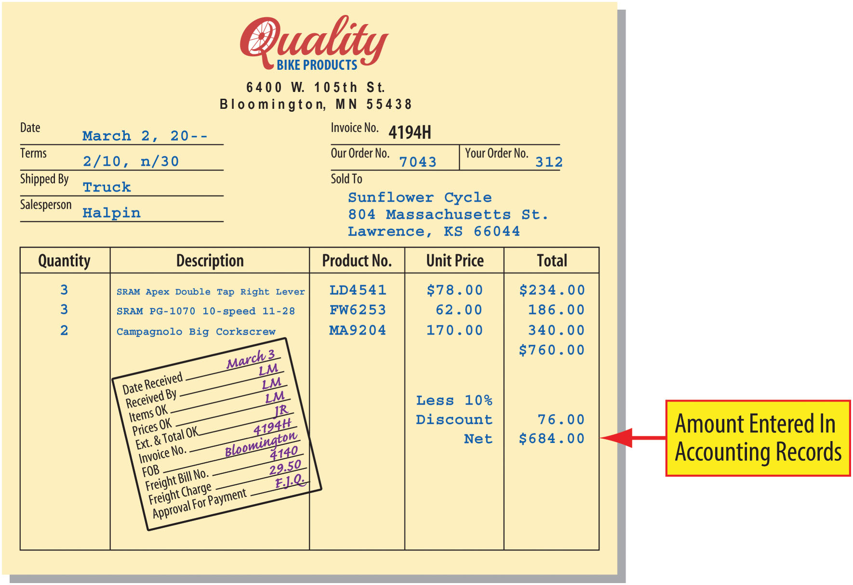
Purchase Invoice With Trade Discount (Figure 11-6)

Slide 15
Learning Objective 2
Describe and use merchandise purchases accounts and compute gross profit

Slide 16
Merchandise Purchase Accounts
Purchases
Purchases Returns and Allowances
Purchases Discounts
Freight-In

Slide 17
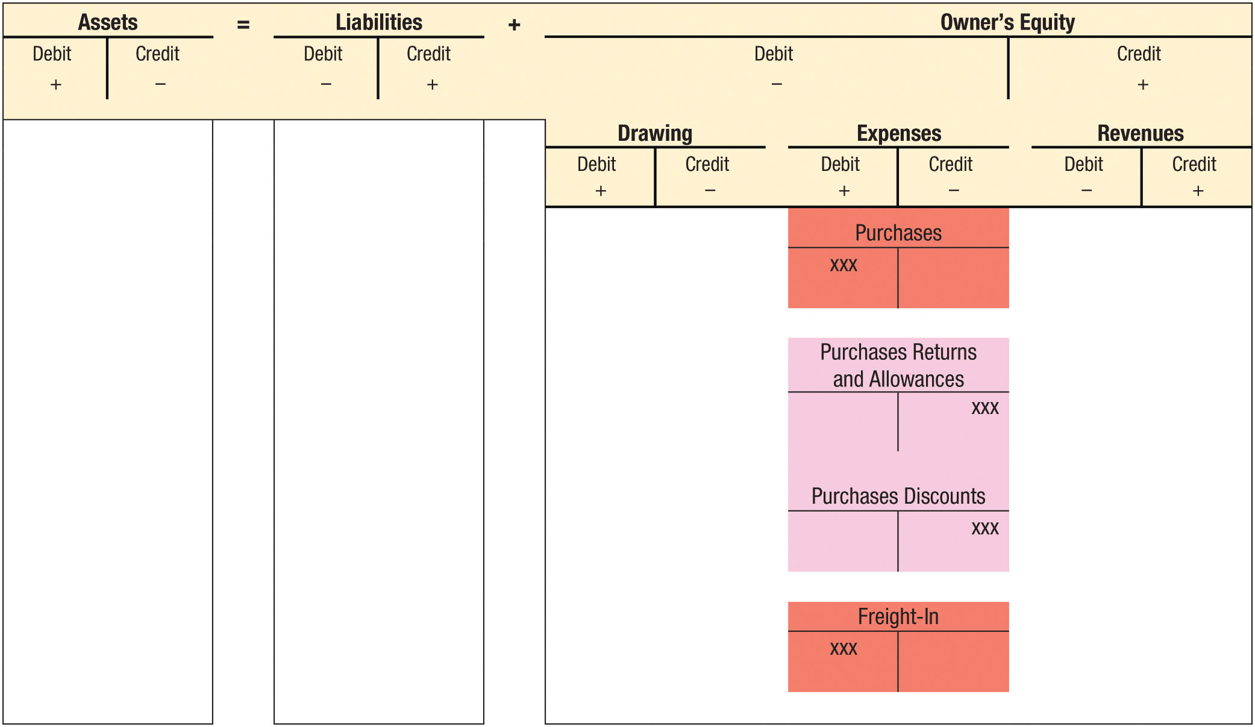
Accounting For Merchandise Purchase Transactions (Figure 11-7)

Slide 18
Purchases Account
Used to record the cost of merchandise purchased
The account is debited when merchandise is purchased
The account is credited only during the closing process

Slide 19
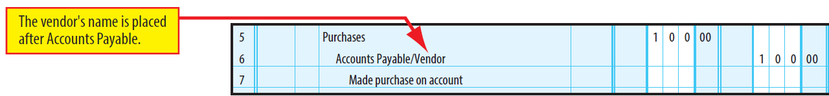
Purchase Example
Made $100 purchase for cash
  Debit Purchases
  Credit Cash
If purchase was made on account:
  Debit Purchases
  Credit Accounts Payable/Vendor

Slide 20
Purchases Returns and Allowances Account
A contra-purchases (or contra-cost) account used to record purchases returns and purchases allowances
  Normal balance is a credit balance
Credited for the amount of returns and allowances
  The account is debited only during the closing process

Slide 21
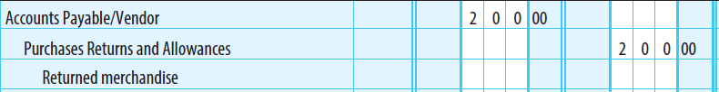
Purchases Returns and Allowances Example (1 of 2)
Merchandise purchased on account for $200 is defective and is returned to the supplier
Accounts Payable is debited – Specific vendor is identified
Purchases Returns and Allowances is credited
  Account shown as a deduction from the Purchases account on the income statement

Slide 22

Purchases Returns and Allowances Example (2 of 2)
Assume that the same merchandise is retained, but the supplier grants a price reduction of $45 because of the defects
Accounts Payable is debited to reflect the price reduction
Purchases Returns and Allowances is credited

Slide 23
Purchases Discounts Account
A contra-purchases account used to record cash discounts allowed on purchases
The account is credited for the discount granted by the vendor for prompt payment
The account is debited during the closing process

Slide 24
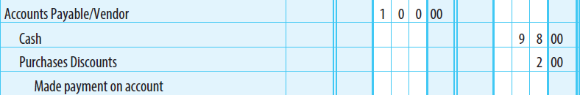
Purchase Discount Example
Merchandise is purchased for $100 on account with credit terms 2/10, net/30, and payment is made within the discount period
Accounts Payable is debited for the entire amount of the purchase
Cash is credited for the actual amount paid, $98 ($100 - $2 discount)
Purchase Discounts is credited for the discount amount, $2 ($100 × 2%)

Slide 25
Freight-In Account
An adjunct-purchases account used to record transportation charges on merchandise purchases
Account is debited for transportation charges
Account is credited during the closing process

Slide 26
Transportation Charges
Expressed in FOB (free on board) terms
FOB shipping point
  Buyer pays for transportation charges; buyer owns item as soon as it is shipped
  Freight charges are either listed separately on purchase invoice or sent as a separate freight bill
FOB destination
  Seller pays for transportation charges; seller owns item until it is delivered
  Freight charges do not appear on purchase invoice

Slide 27
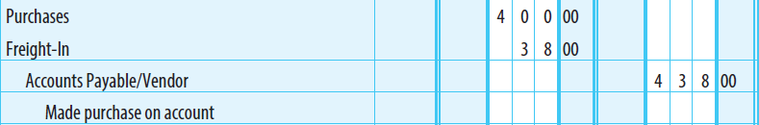
Freight Example (1 of 2)
Merchandise was purchased on account for $400 plus freight charges of $38
Purchases is debited only for the cost of the merchandise
Freight-In is debited for the transportation costs
Accounts Payable is credited for the entire purchase price (merchandise + freight)

Slide 28
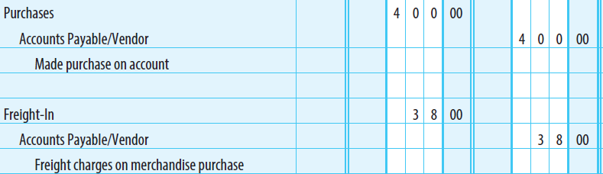
Freight Example (2 of 2)
If the freight charges were on a separate bill from the transportation company
Purchases is debited for the cost of the merchandise
Accounts Payable is credited for the amount due to the supplier
A separate journal entry is made to record the freight charges
Accounts Payable is credited, but the vendor is the transportation company

Slide 29
Computation of Gross Profit
Gross profit (also called gross margin)
  Difference between net sales and cost of goods sold
Cost of goods sold (also called cost of merchandise sold)
  Difference between the goods available for sale and the ending inventory
  Indicates the cost of the goods sold during the period

Slide 30
Computation of Gross Profit (1 of 3)
Assume the following for the year ended December 31:
  Sales $201,500
  Sales returns and allowances $1,200
  Sales discounts $1,000
  Purchases $105,000
  Purchases returns and allowances $800
  Purchases discounts $1,000
  Freight-in $300
  Merchandise inventory, Jan 1 - $26,000
  Merchandise inventory, Dec 31 - $18,000

Slide 31
Computation of Gross Profit (2 of 3)
STEP 1: Compute net sales
  NET SALES = SALES - SALES RETURNS AND ALLOWANCES - SALES DISCOUNTS
  This is the price charged to customers for the merchandise
STEP 2: Compute goods available for sale
  GOODS AVAILABLE FOR SALE = BEGINNING INVENTORY + COST OF GOODS PURCHASED
  This is the cost of ALL the goods that were offered for sale

Slide 32
Computation of Gross Profit (3 of 3)
STEP 3: Compute cost of goods sold (COGS)
  COGS = GOODS AVAILABLE FOR SALE - ENDING INVENTORY
    Out of the $129,500 of merchandise available to sell, $18,000 was not sold (ending inventory)
    $111,500 of merchandise was sold
STEP 4: Compute gross profit
  GROSS PROFIT = NET SALES - COST OF GOODS SOLD
    Merchandise was sold for $87,800 more than its cost

Slide 33
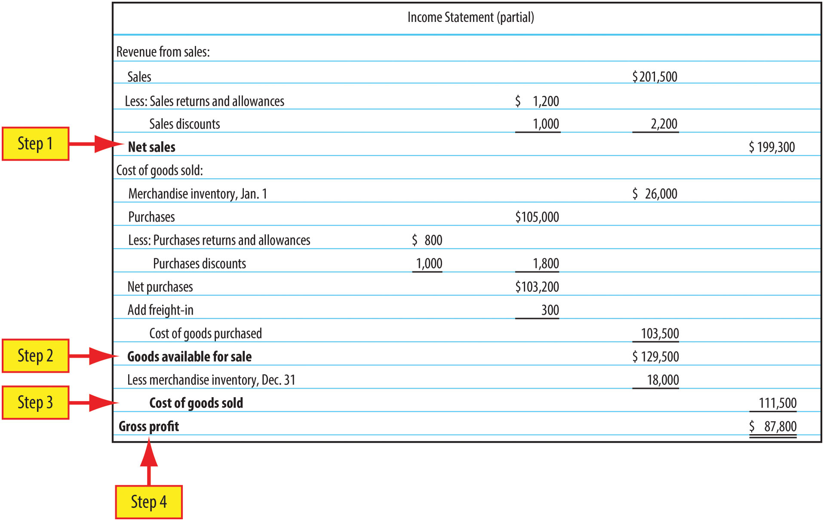
Computation of Gross Profit (Figure 11-8)

Slide 34
Learning Objective 3
Describe and use the accounts payable ledger

Slide 35
Accounts Payable Ledger
A separate subsidiary ledger
Contains an individual account payable for each supplier
Often numbered
Filed either alphabetically or numerically
Summary accounts payable account maintained in the general ledger is the controlling account

Slide 36
Purchases Example Data
Assume the following purchases on account occurred during the month of April:
  April 4 Purchased merchandise from Bilenky Cycle Works, $3,300, Invoice No. 631, dated April 2, terms, net/30
  April 8 Purchased merchandise from Ellsworth, $2,500, Invoice No. 927D, dated April 6, terms, net/30
  April 11 Purchased merchandise from Gunnar Cycles, $8,700, Invoice No. 804, dated April 9, terms, 1/15, net/30
  April 17 Purchased merchandise from Milwaukee Cycle Co., $800, Invoice No. 611, dated April 16, terms, net/30
  April 23 Purchased merchandise from Rans Designs, Inc., $5,300, Invoice No. 1465, dated April 22, terms, 1/10, net/30

Slide 37
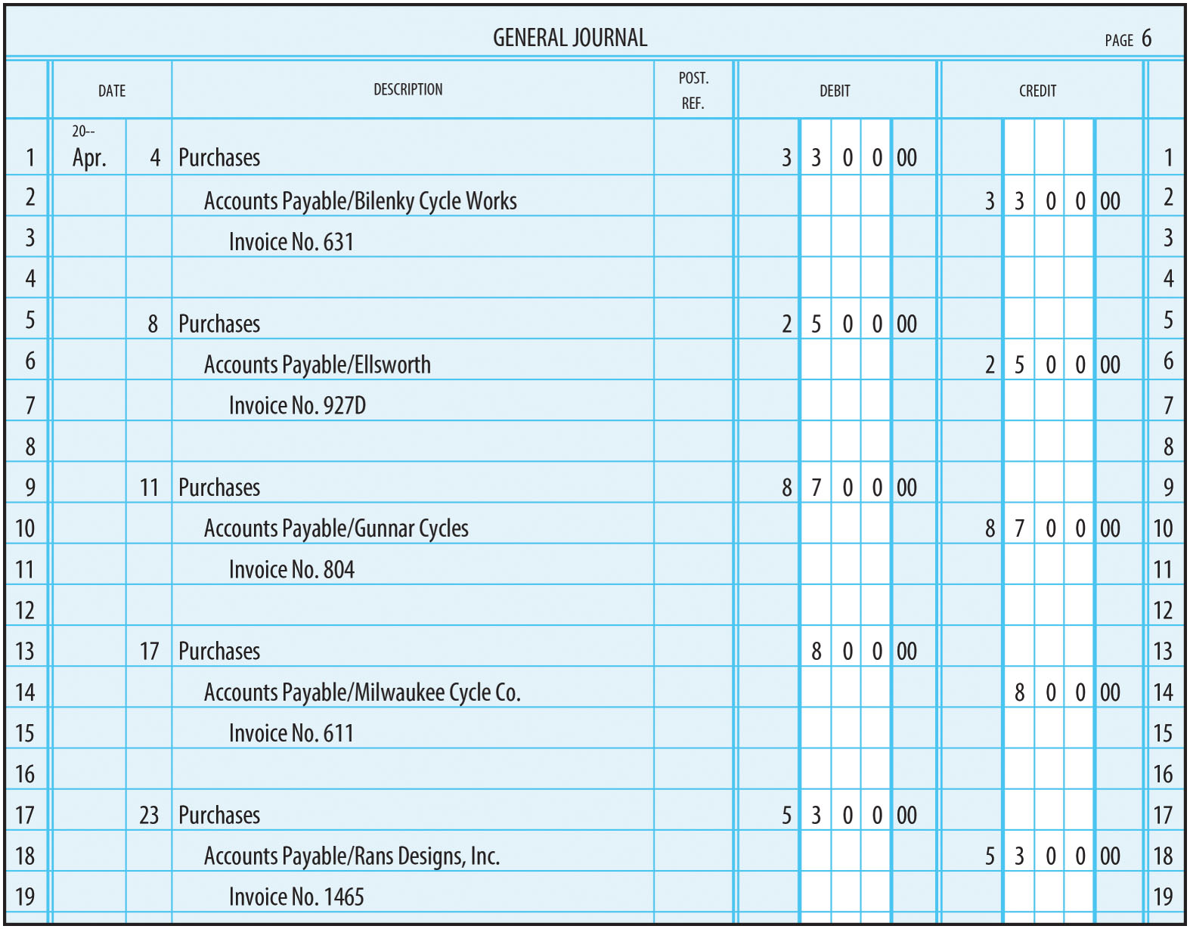
Purchases Entered in General Journal (Figure 11-9)

Slide 38
Posting Purchases to the General Ledger
In the ledger account:
  Step 1: Enter the date of the transaction
  Step 2: Enter the amount of the transaction
  Step 3: Enter the new balance
  Step 4: Enter the journal page number
In the journal:
  Step 5: Enter the ledger account number in the PR column

Slide 39
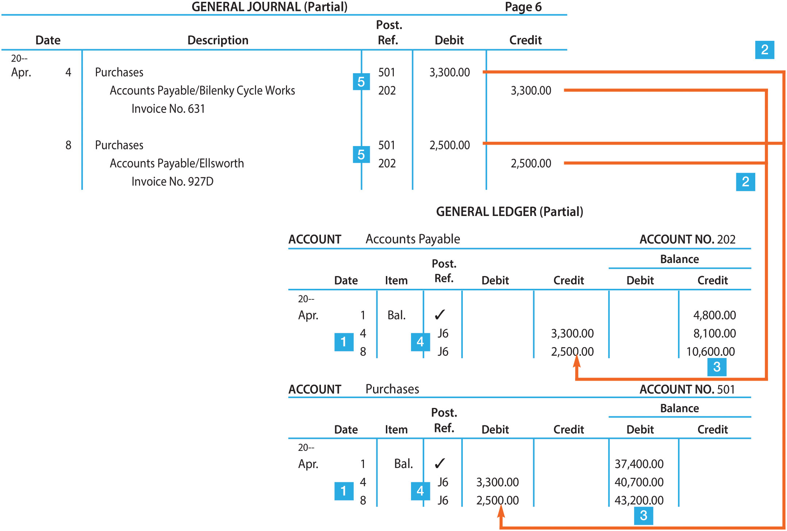
Posting Purchases to the General Ledger (Figure 11-10)

Slide 40
Posting to the Accounts Payable Ledger
In the accounts payable ledger account:
  Step 1: Enter the date of the transaction
  Step 2: Enter the amount of the transaction
  Step 3: Enter the new balance
  Step 4: Enter the journal page number
In the journal:
  Step 5: Enter a slash (/) followed by a check mark () in the PR column.

Slide 41
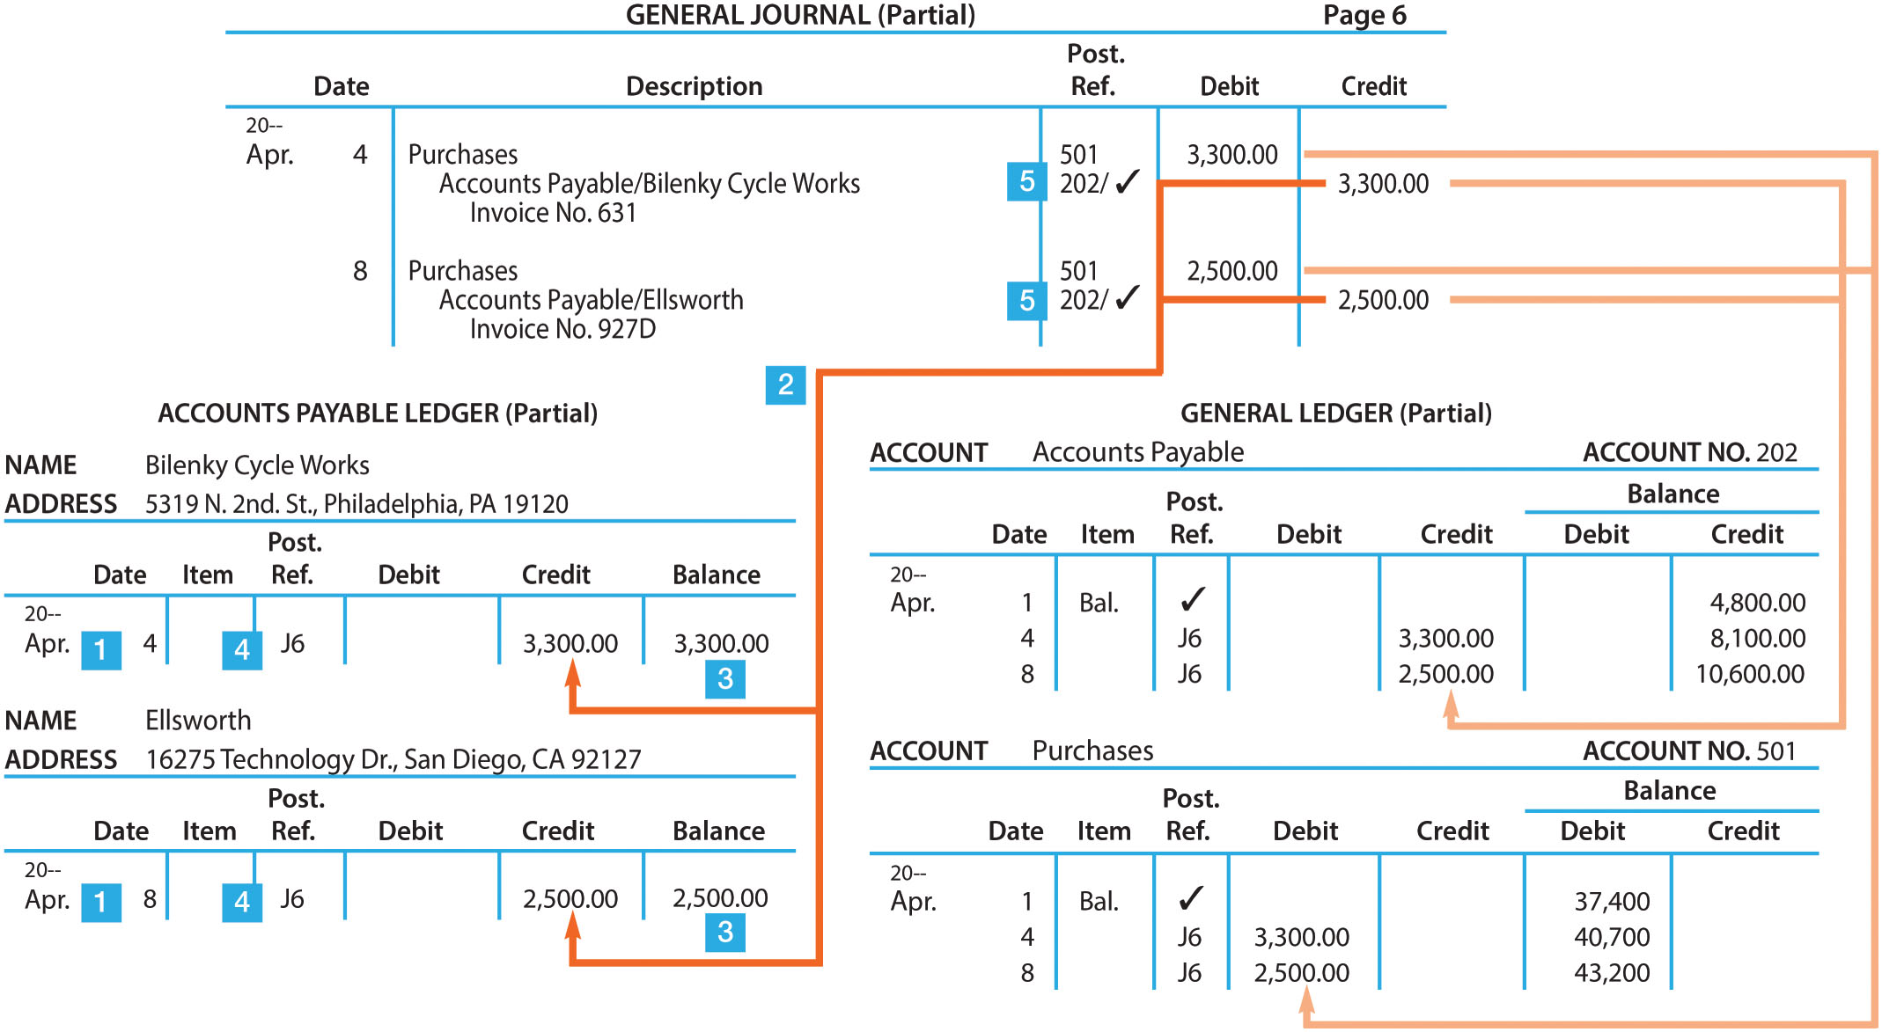
Posting to the Accounts Payable Ledger (Figure 11-11)

Slide 42
Posting Purchase Returns
Assume that on May 4, Sunflower Cycle returns $200 of merchandise to Rans Designs, Inc.
  These goods were part of a purchase made on April 23
The $200 debit is posted to the accounts payable controlling account and to the subsidiary ledger account for Rans Designs
Purchases Returns and Allowances is posted in the normal manner

Slide 43
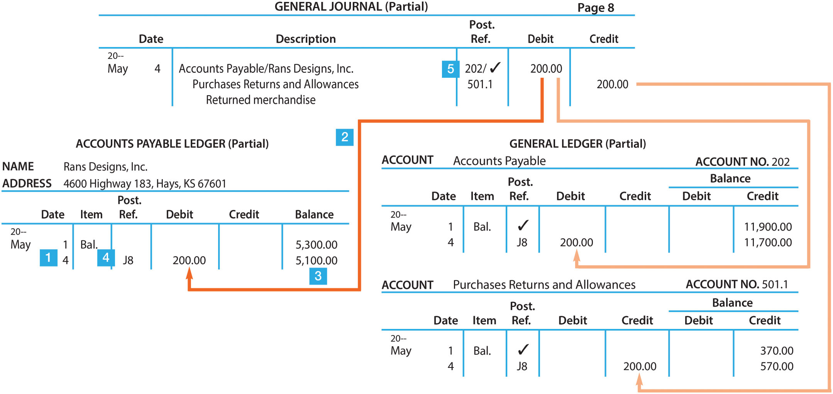
Posting Purchase Returns (Figure 11-12)

Slide 44
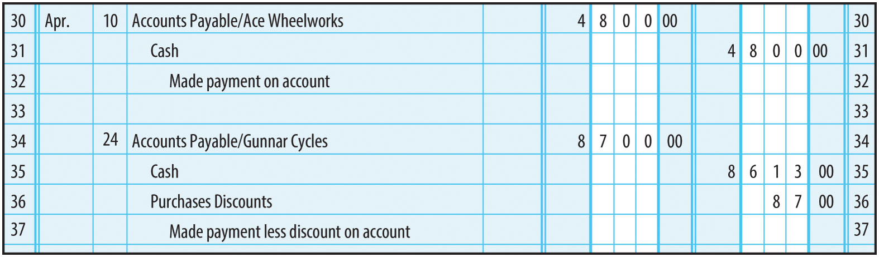
Posting Cash Payments (1 of 2)
Assume Sunflower Cycle made the following two payments on account during the month of April:
  April 10 Paid Ace Wheelworks $4,800 for purchases made on account
  April 24 Paid Gunnar Cycles $8,700 less discount of 1% for purchases made on account
FIGURE 11-13 Cash Payments Entered in a General Journal

Slide 45
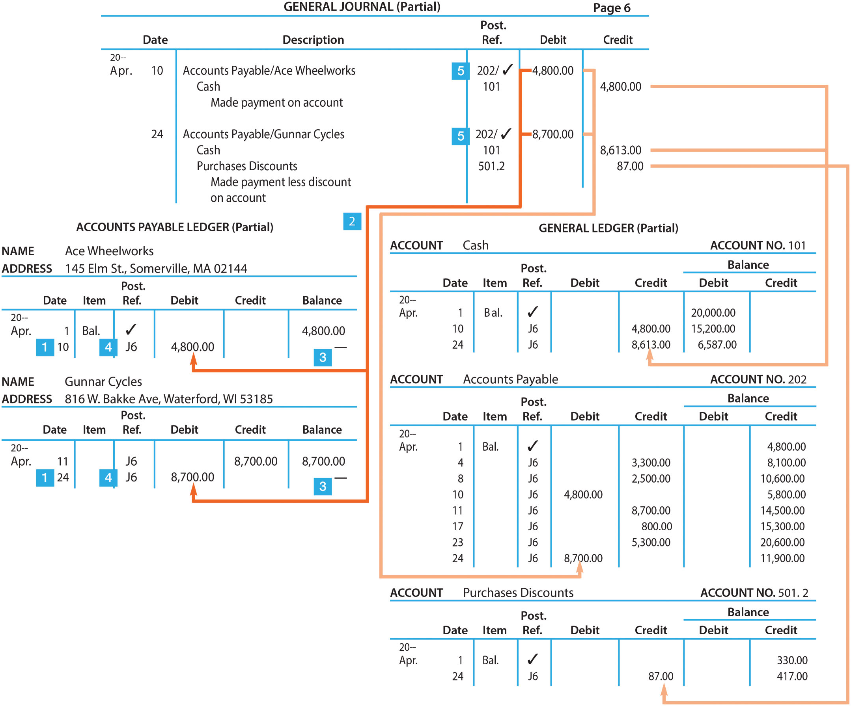
Posting Cash Payments (2 of 2)
FIGURE 11-14 Posting Cash Payments to the General Ledger and Accounts Payable Ledger

Slide 46
Learning Objective 4
Prepare a schedule of accounts payable

Slide 47
Schedule of Accounts Payable
Prepared to verify that the sum of the accounts payable ledger balances equals the Accounts Payable balance
An alphabetical or numerical listing of supplier accounts and their balances
Usually prepared at the end of the month
The total calculated in the schedule is compared with the balance in Accounts Payable in the general ledger

Slide 48
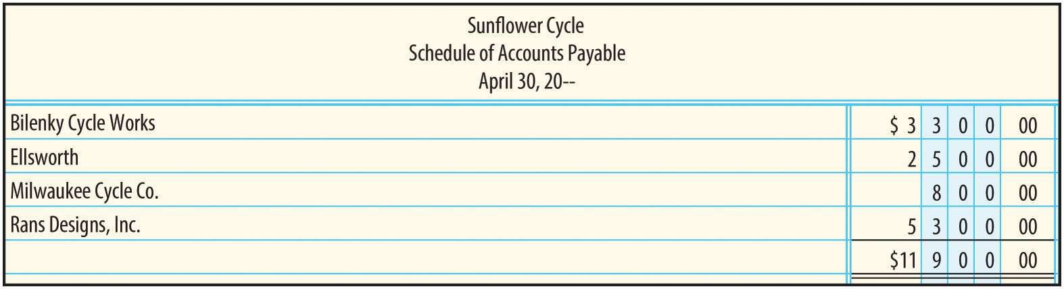
Schedule of Accounts Payable (Figure 11-16)

Slide 49
Finding Accounts Payable Errors
If the total on the schedule of accounts payable and the Accounts Payable balance do not agree:
  Step 1: Verify the total of the schedule
  Step 2: Verify the postings to the accounts payable ledger
  Step 3: Verify the postings to Accounts Payable in the general ledger

Slide 50
The Net-Price Method of Recording Purchases
Chapter 11 Appendix

Slide 51
Appendix Learning Objective 1
Describe the net-price method of recording purchases

Slide 52
Methods of Recording Purchases
Gross-Price Method
  Purchases are recorded at the gross amount, regardless of available cash discounts
  Method used previously in this chapter
Net-Price Method
  Purchases are recorded at the net amount, assuming that all available cash discounts will be taken

Slide 53
Appendix Learning Objective 2
Record purchases and cash payments using the net-price method

Slide 54
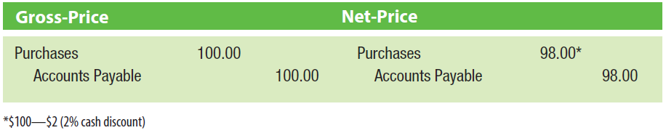
Comparing Methods of Recording Purchases
Purchased $100 of merchandise on account, with credit terms of 2/10, net/30
Gross-price method records the purchase as $100
  Discount, if taken, will be recorded at the time of payment
Net-price method records the purchase at the net amount of $98
  Assumption is made that ALL discounts will be taken

Slide 55
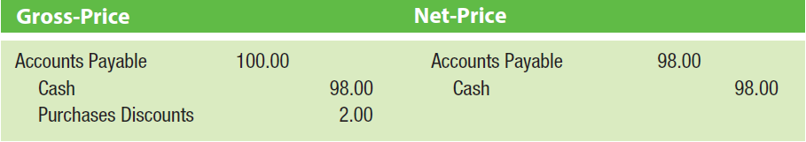
Comparing Methods of Recording Payments (1 of 2)
Payment is made within the discount period
Gross-price method – $2 discount credited to Purchases Discounts
Net-price method – $2 discount is not recorded

Slide 56
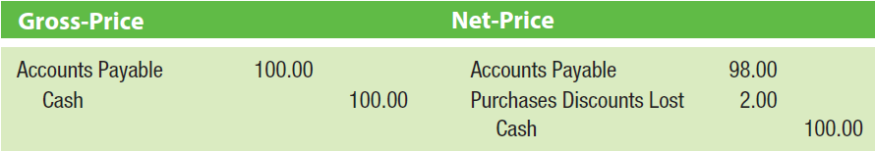
Comparing Methods of Recording Payments (2 of 2)
Payment is made after the discount period
Gross-price method – Discount period is missed, no record is made of the discount
Net-price method: Discount period is missed, $2 discount is recorded as “lost”

Slide 57
Purchases Discounts Lost Account
A temporary owner’s equity account used to record cash discounts lost on purchases
Reported as an expense on the income statement
A balance represents a finance charge for postponing the payment for merchandise

