Slide 1

Accounting for Merchandise Inventory
Chapter 13

Slide 2
Learning Objective 1
Explain the impact of merchandise inventory on financial statements

Slide 3
Impact of Merchandise Inventory on Financial Statements
Errors in inventory will cause errors on the:
  Income statement
  Statement of owner’s equity
  Balance sheet
    Since this year’s ending inventory becomes next year’s beginning inventory, financial statements for the following year will also contain errors

Slide 4
Effect of Inventory Errors
Understating the ending inventory has the following effects:
  Cost of goods sold overstated
  Net income understated
  Capital understated
  Assets understated
Overstating the ending inventory has the following effects:
  Cost of goods sold understated
  Net income overstated
  Capital overstated
  Assets overstated

Slide 5
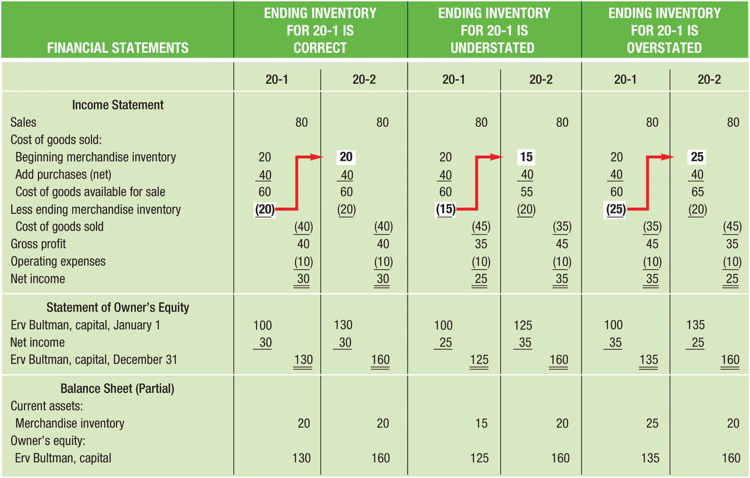
Effect of Inventory Errors on Net Income (Figure 13-1)

Slide 6
Learning Objective 2
Describe the two principal systems of accounting for merchandise inventory – the periodic system and the perpetual system

Slide 7
Types of Inventory Systems
Periodic Inventory System
  Merchandise inventory account balance = most recent physical inventory
  Purchases account used for all merchandise purchases
  Merchandise inventory and cost of goods sold are only computed at the end of the accounting period (adjusting entry required)
Perpetual Inventory System
  Merchandise inventory account reflects current inventory
  Purchases are debited to Merchandise Inventory, and cost of goods sold are credited to Merchandise Inventory
  No need for end-of-year adjustments
    If physical inventory agrees with the amount reported in Merchandise Inventory

Slide 8
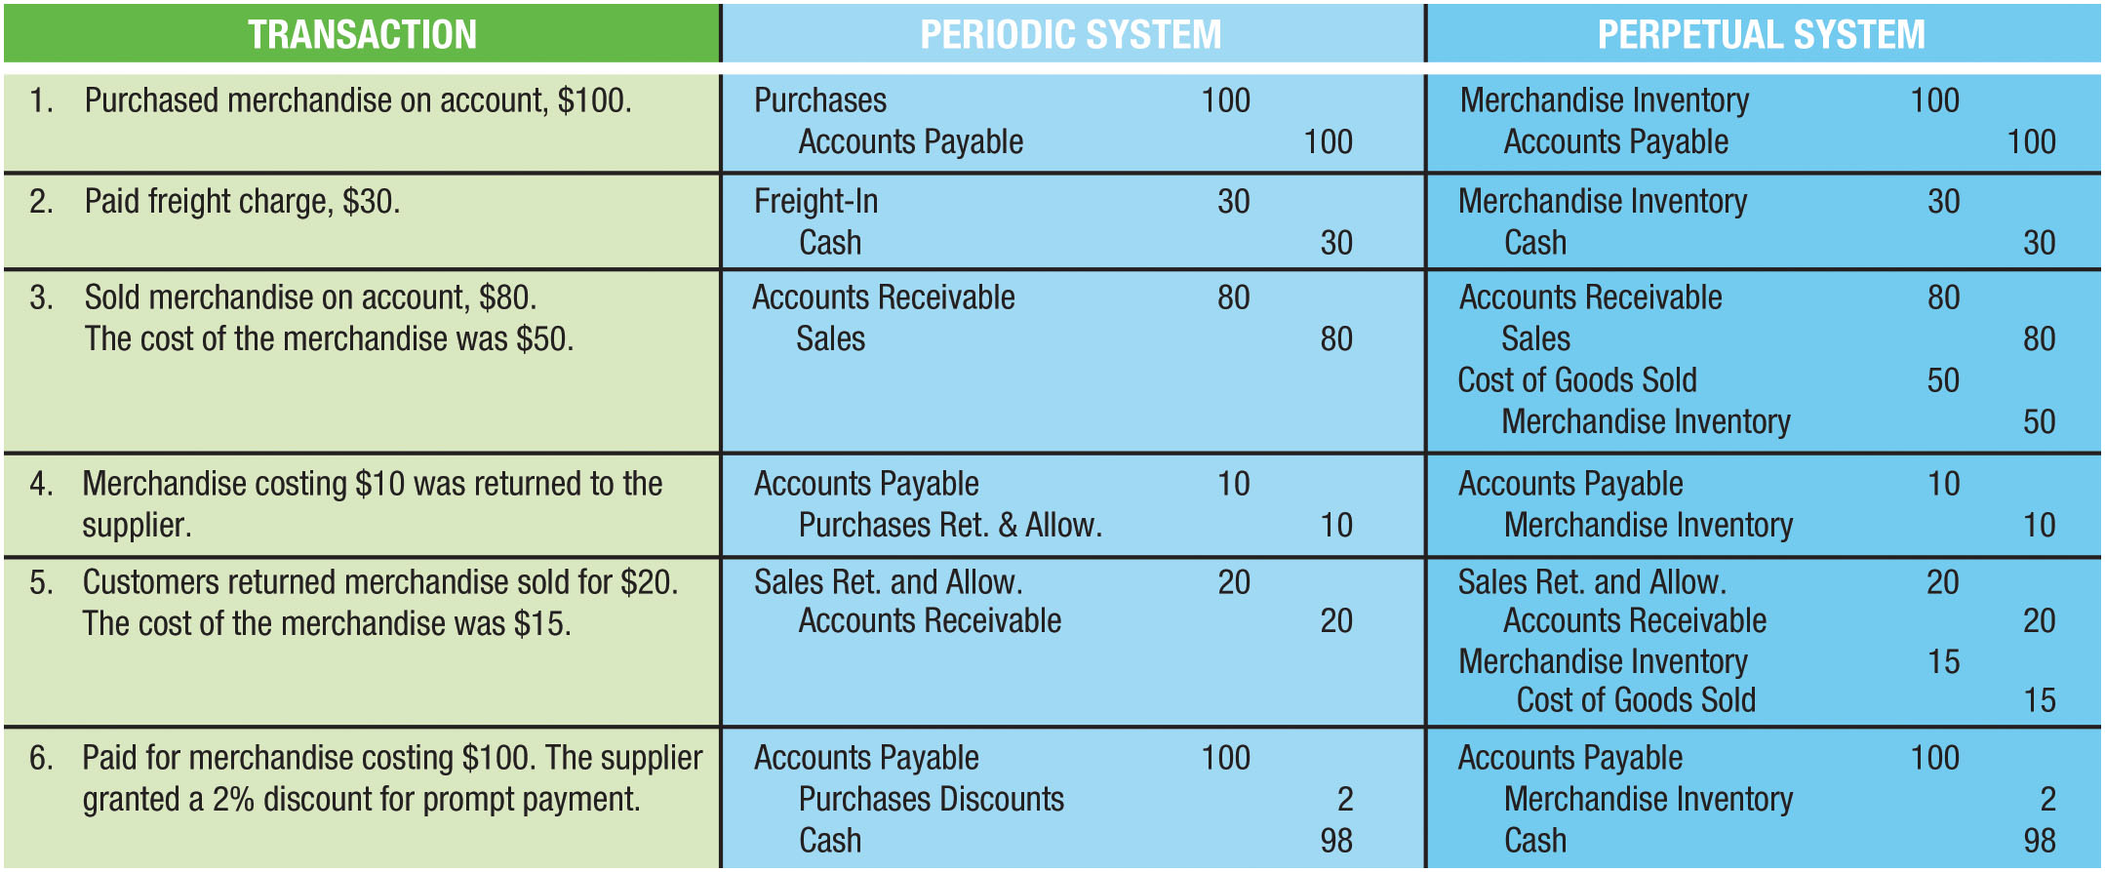
Inventory System Journal Entries (Figure 13-2)

Slide 9
Learning Objective 3
Compute the costs allocated to the ending inventory and cost of goods sold using different inventory methods

Slide 10
Key Concepts
To determine the cost of goods sold and ending inventory, it is important to understand:
  Purpose of a physical inventory
  Specific calculations used under the periodic and perpetual systems
  Role of the lower-of-cost-or-market rule

Slide 11
Taking a Physical Inventory
Counting the goods on hand at the end of the period
  Periodic system
    Used to allocate merchandise costs between sold and unsold goods
  Perpetual system
    Compared to the accounting records to determine if the amount of merchandise actually held agrees with what is reported in the accounting records
Frequently done after regular business hours
  Some companies even close for a few days to take inventory
The ideal time to count the goods is when the quantity on hand is at its lowest level
  A fiscal year that starts and ends when inventory is normally at its lowest level is known as a natural business year

Slide 12
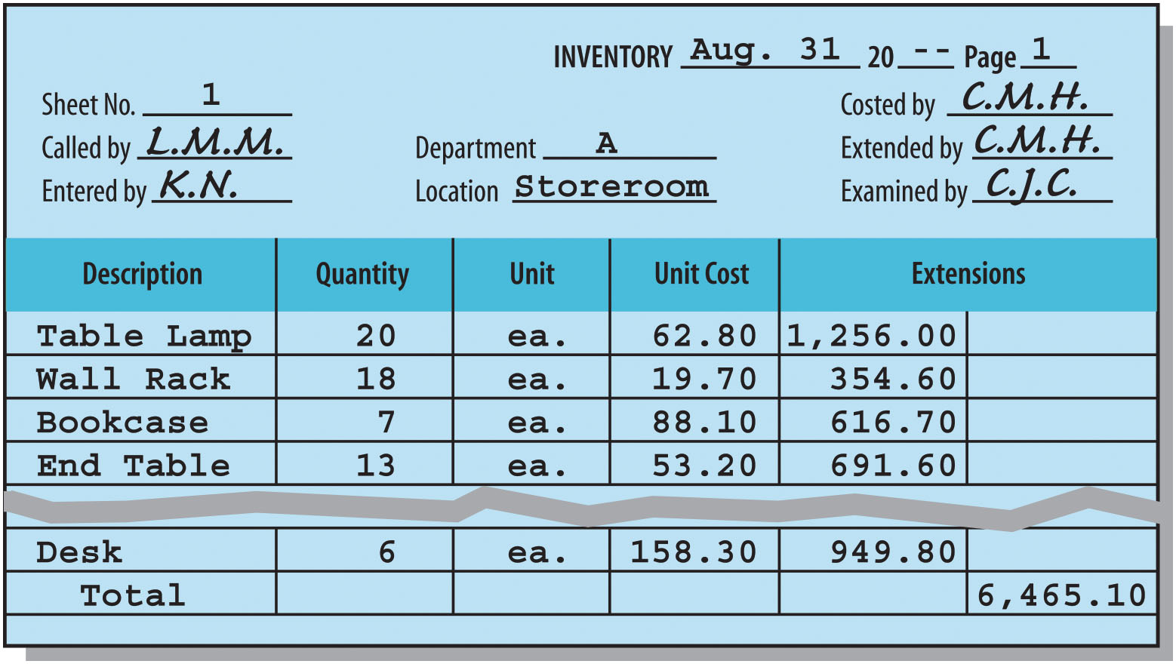
Inventory Sheet (Figure 13-3)

Slide 13
Physical Inventory Special Considerations
Goods held for sale on consignment
  Consigned good remain property of shipper (consignor)
  Should NOT be included in inventory of company holding goods (consignee)
Goods in transit
  Shipped FOB shipping point
    BUYER pays for shipping
    Goods belong to buyer when shipped
  Shipped FOB destination
    SELLER pays for shipping
    Goods belong to seller until received by buyer

Slide 14
Inventory Cost Components
Proper cost must be assigned to the inventory (after counting)
Cost means ALL necessary and reasonable costs incurred to get the goods to the buyer’s place of business
Cost components of inventory can include:
  Purchase price
  Delivery costs (freight-in)
  Insurance
  Storage fees

Slide 15
Computing Cost of Inventory
Identical items are purchased at different times and at different costs per unit
Of the goods available for sale, how do we decide which units were sold and which units remain on the shelf?
Four inventory methods generally accepted:
  Specific identification
  First-in, first-out (FIFO)
  Weighted-average
  Last-in, first-out (LIFO)
Methods can be applied under periodic or perpetual inventory systems

Slide 16
Specific Identification
To use specific identification, inventory items must
  Be physically different from each other (i.e. works of art) or
  Have serial numbers (cars, computers)
Cost is determined from supplier’s invoice
Usually practical only for businesses in which sales volume is relatively low and inventory unit value is relatively high

Slide 17
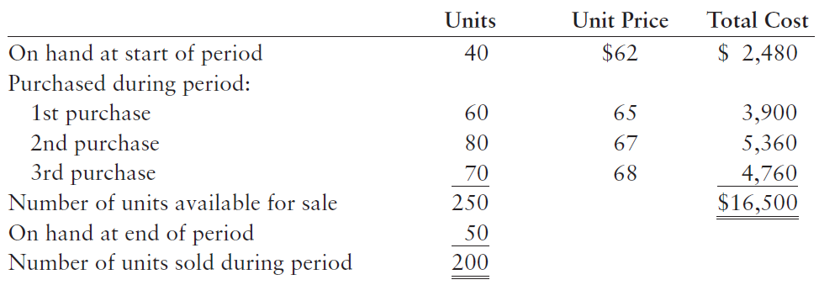
Inventory Costing Example Data (Color Printers)

Slide 18
Computing Cost of Goods Sold Using the Specific Identification Method
The identity of the 200 printers sold is as follows:
  30 of the beginning inventory were sold
  50 from the 1st purchase were sold
  60 from the 2nd purchase were sold
  60 from the 3rd purchase were sold
Cost of goods sold = Total cost of 200 printers sold

Slide 19
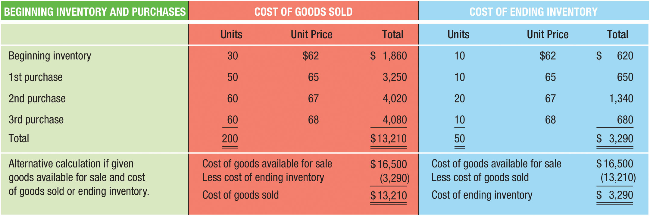
Computing Cost of Goods Sold Using the Specific Identification Method (Figure 13-5)

Slide 20
Periodic Inventory System – First-In, First-Out (FIFO)
Assumes that the first goods purchased were the first goods sold
  Therefore, the latest goods purchased remain in inventory
Whenever possible, a business will attempt to sell the older goods first (before they become obsolete)
  Example: Grocery stores, bakeries, computer dealers
FIFO often follows the movement of goods

Slide 21
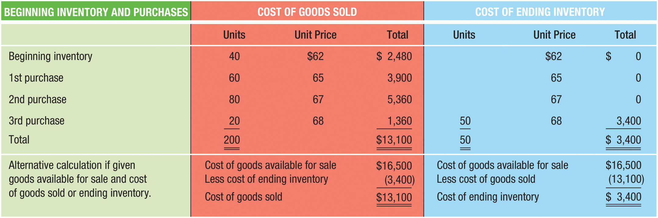
FIFO Inventory Method (Figure 13-6)

Slide 22
Periodic Inventory System – Weighted-Average Method
Computes an average cost per unit using the following formula:
  Total cost of units available for sale divided by the total number of units available for sale

Slide 23
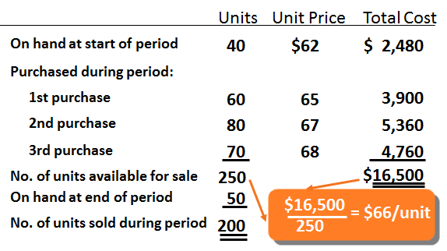
Computing Cost of Goods Sold Using the Weighted-Average Method (1 of 2)
Calculate the average cost
Cost of units available for sale divided by number of units

Slide 24
Computing Cost of Goods Sold Using the Weighted-Average Method (2 of 2)
Cost of goods sold 200 units @ $66 = $13,200
Ending inventory 50 units @ $66 = 3,300
One of the advantages of the weighted-average method is its simplicity

Slide 25
Periodic Inventory System – Last-In, First-Out (LIFO) Method
Assumes that the sales in the period were made from the most recently purchased goods
  Earliest goods purchased remain in inventory
Justifications for this method include:
  Physical movement of goods in some businesses is actually last-in, first-out
  Matches the most current cost of items purchased against the current sales revenue
  Results in lower net income, and therefore lower income tax, when prices are rising

Slide 26

LIFO Inventory Method (Figure 13-7)
FIGURE 13-7 LIFO Inventory Method

Slide 27
Physical Flows and Cost Flows
Only the specific identification method will necessarily reflect cost flows that match physical flows of goods
Assumed cost flows (FIFO, weighted-average, and LIFO) methods do not have to reflect actual physical movement of goods
Any one of these methods could be used under any set of physical flow conditions

Slide 28
Comparison of Inventory Methods (1 of 2)
Goods available for sale is the same for all four methods
Ending inventory and cost of goods sold differ with each method
Gross profit differs with each method
When prices are rising (as with the printers), FIFO results in the largest gross profit
LIFO results in the smallest gross profit, therefore creating the smallest tax liability

Slide 29
Comparison of Inventory Methods (2 of 2)
When selecting the inventory method to be used by a business, keep in mind:
  The Internal Revenue Service requires the use of the same inventory method for tax and financial reporting purposes
  The physical flow of the inventory does not need to match the flow assumed by the inventory method
  The consistency principle requires that the same accounting methods be followed from period to period

Slide 30
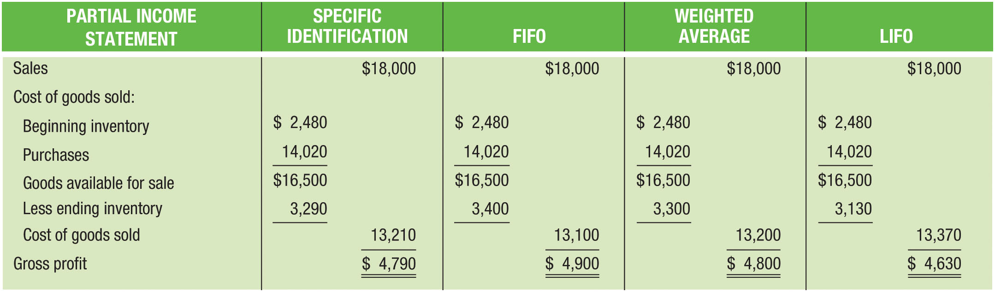
Comparison of Inventory Methods (Figure 13-8)

Slide 31
Perpetual Inventory System
A continuous record is maintained for the quantities and costs of goods on hand at all times
  Much easier to handle with computerized systems
The balance of the Merchandise Inventory account at any time shows the cost of goods that should be on hand
  Merchandise Inventory is usually a controlling account
  A subsidiary ledger is maintained with an account for each type of merchandise
Goods sold usually are assigned cost on either a FIFO, moving-average, or LIFO basis

Slide 32
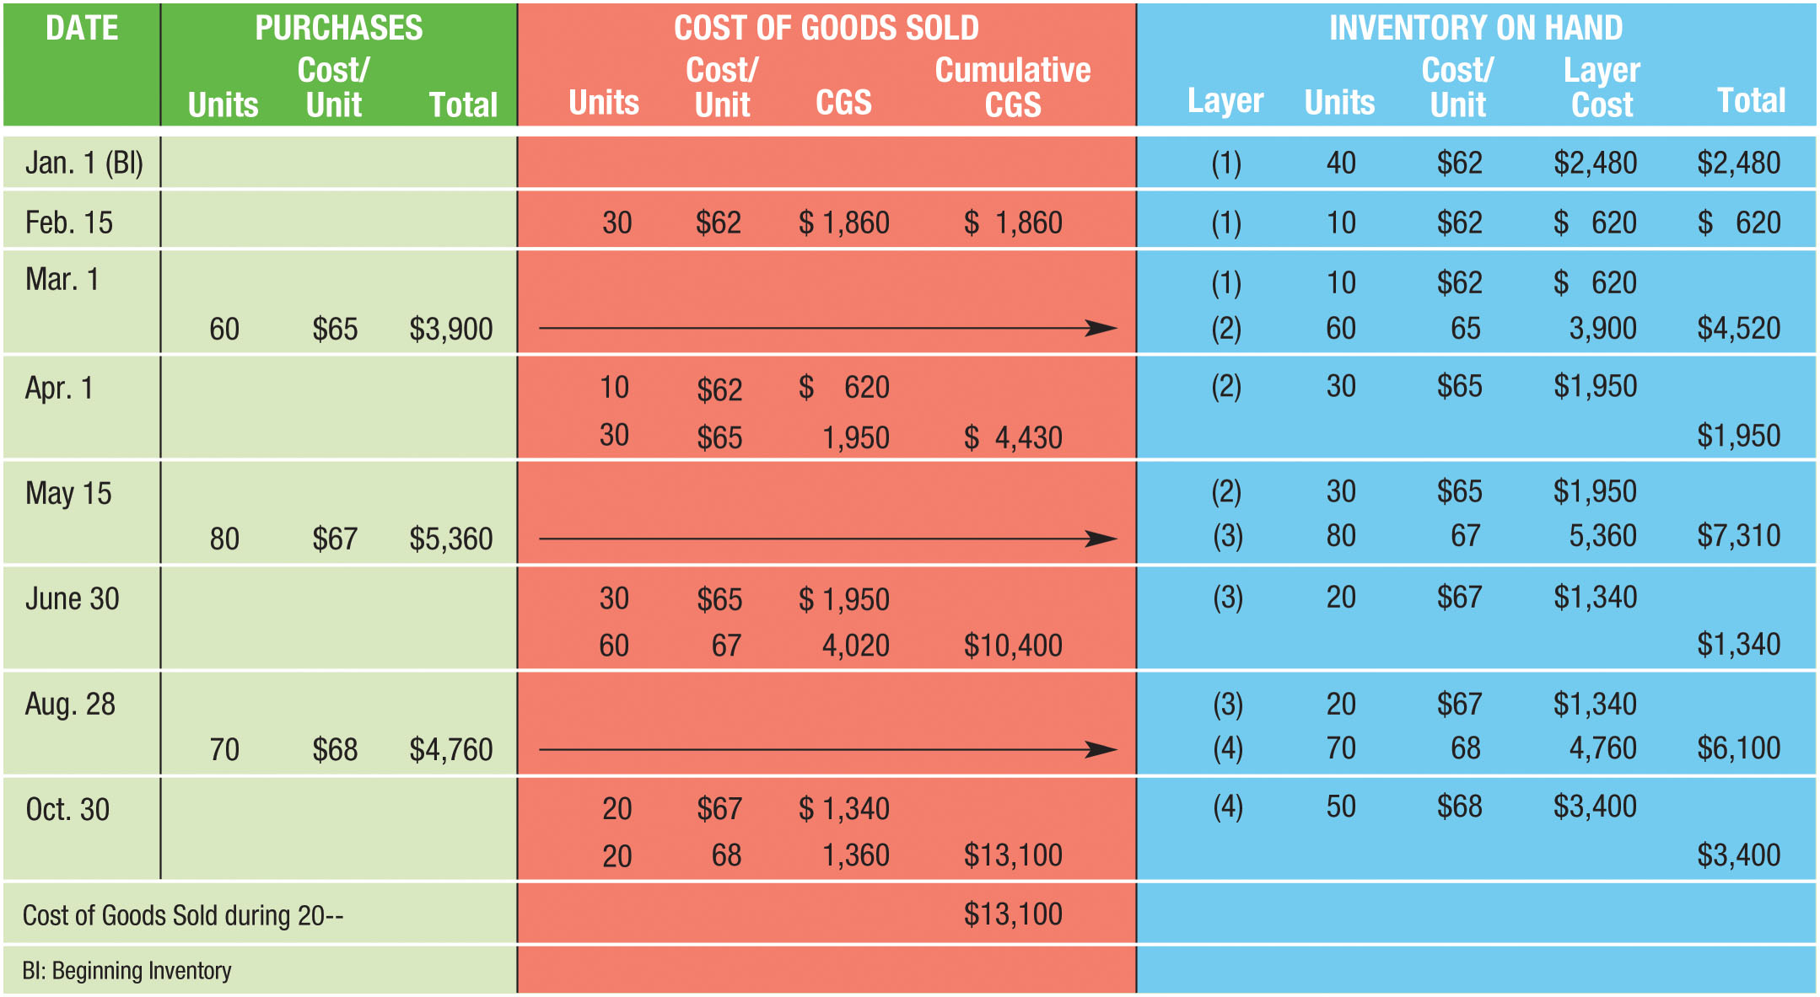
Perpetual Inventory Record: FIFO Method (Figure 13-9)

Slide 33
Conservatism Principle
When in doubt, a lower asset value and net income measure should be used
If an asset increases in value while being held, no formal entry of the gain is made on the books until the asset is sold
If an asset decreases in value while being held, an entry is made to recognize the loss
We should never anticipate gains, but we should always anticipate and account for losses

Slide 34
Lower-of-Cost-or-Market Method (1 of 5)
If the value of inventory declines while it is being held, the loss should be recognized in the period of the decline
Purpose of the lower-of-cost-or-market method is to:
  Recognize such losses on the income statement
  Report the lower inventory valuation on the balance sheet

Slide 35
Lower-of-Cost-or-Market Method (2 of 5)
Cost means dollar amount calculated using one of the four inventory costing methods
Market mean current cost to replace the inventory
  Price in the market in which goods are purchased by the business
  NOT the price in the market in which goods are normally sold by the business
Method assumes that a decline in the purchase (replacement) price is accompanied by a decline in the selling price and thus signals a decline in the value of the inventory

Slide 36
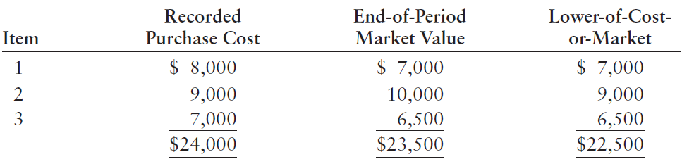
Lower-of-Cost-or-Market Method (3 of 5)

Slide 37
Lower-of-Cost-or-Market Method (4 of 5)
Two ways to calculate the lower-of-cost-or-market:
  Applied to Total Inventory
    The lower of all items at their cost OR all items at their market value
  Applied to Each Item
    Each item is evaluated individually
    Lower amount (cost or market) is determined for each item
Assume we use the total inventory method
  Journal entry needed to reduce Merchandise Inventory to $23,500
Reduction in value is an expense

Slide 38
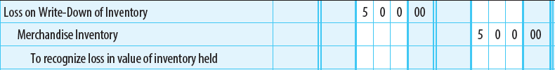
Lower-of-Cost-or-Market Method (5 of 5)

Slide 39
Learning Objective 4
Estimate the ending inventory and cost of goods sold by using the gross profit and retail inventory methods

Slide 40
Estimating Inventory
Estimating inventory is not a problem for businesses using the perpetual inventory method
  Unverified amounts are generally reliable estimates and can be used for interim monthly or quarterly financial statements
Businesses using the periodic inventory method must use other methods to estimate ending inventory and cost of goods sold
  Two generally accepted methods:
    Gross profit method
    Retail inventory method

Slide 41
Gross Profit Method of Estimating Inventory
A business’s normal gross profit (net sales - cost of goods sold) is used to estimate the cost of goods sold and ending inventory
  Calculation is appropriate only if the firm’s normal gross profit as a percentage of net sales has been relatively stable over time
Example data:
  Inventory, start of period – $80,000
  Net purchases, first month – $70,000
  Net sales, first month – $110,000
  Normal gross profit as a percentage of sales – 40%

Slide 42
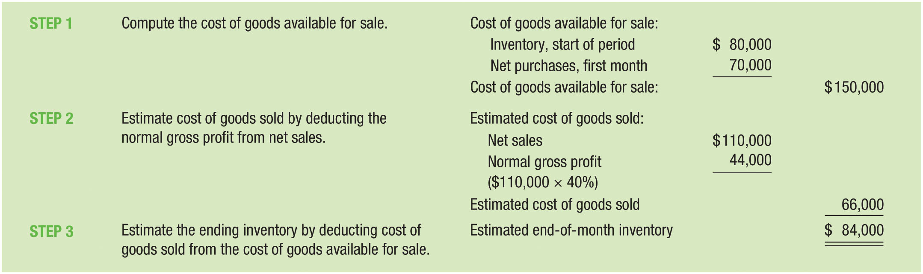
Steps for the Gross Profit Method (Figure 13-10)

Slide 43
Retail Method of Estimating Inventory (1 of 2)
Used by many retail businesses
Requires keeping records of both the cost and selling (retail) prices of all goods purchased

Slide 44
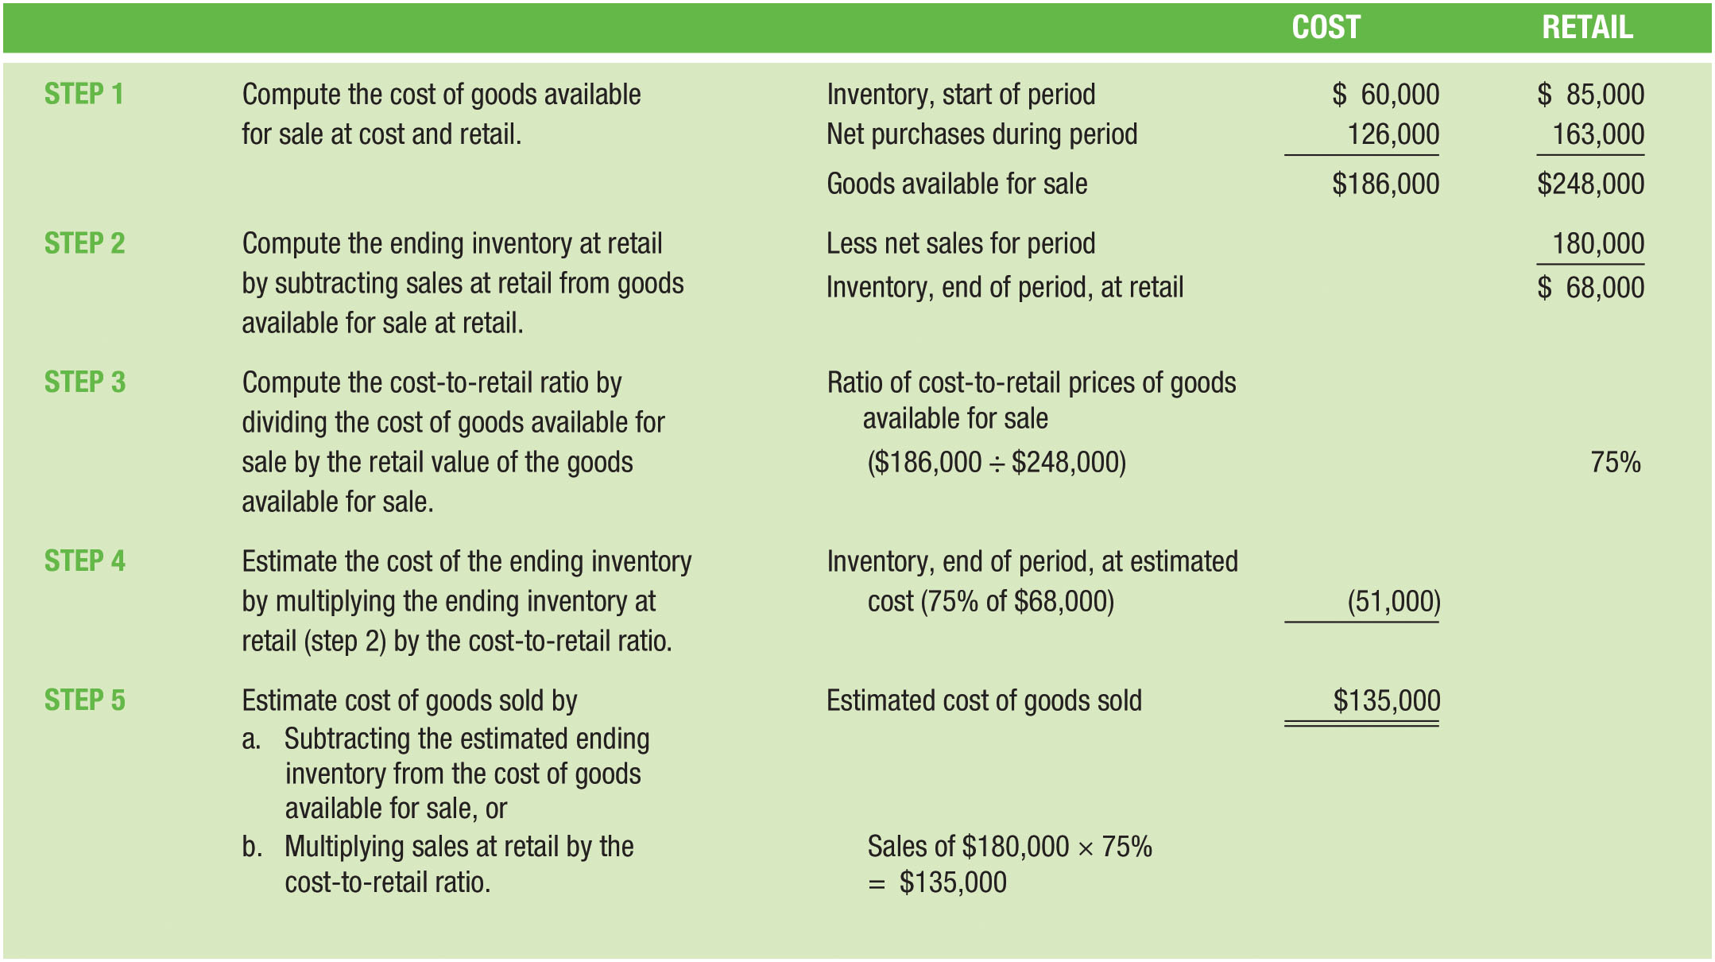
Steps in the Retail Inventory Method (Figure 13-11)

Slide 45
Appendix:
Perpetual Inventory Method:
LIFO and Moving Average Methods
Chapter 13

Slide 46
Appendix Learning Objective 1
Compute the costs allocated to the ending inventory and cost of goods sold using the perpetual LIFO inventory method

Slide 47
Perpetual LIFO Inventory Method (1 of 4)
When using this method, every time inventory is purchased, a new layer is formed
When inventory is sold, we assume that the most recently purchased layer is sold first
As those units are used up, units are taken from the next most recently purchased layer

Slide 48
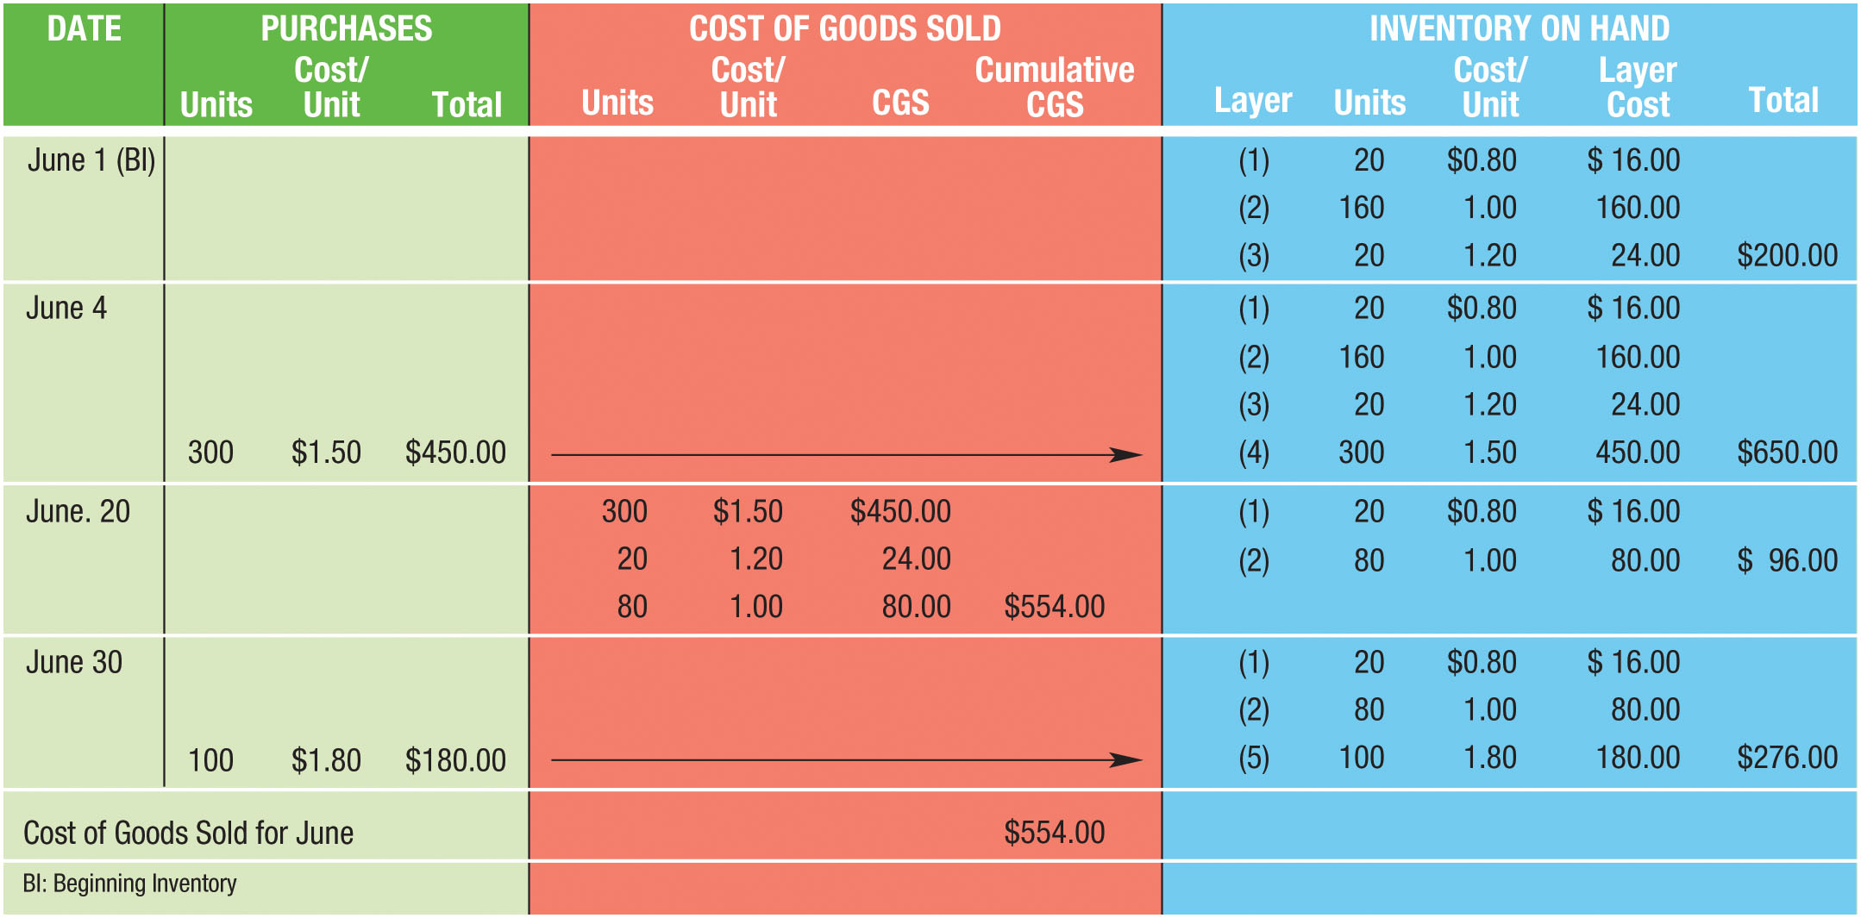
Perpetual LIFO Inventory Method (2 of 4)
FIGURE 13A-1 Perpetual LIFO Inventory System

Slide 49
Perpetual LIFO Inventory Method (3 of 4)
Beginning inventory of 200 units forms first three layers of inventory
Purchase on June 4 forms a fourth layer (300 units @ $1.50, $450)
Company has a total of 500 units at a total cost of $650
June 20, company sells 400 units
  300 units purchased on June 4 are sold first, followed by 20 that cost $1.20 each and 80 units that cost $1.00 each from the beginning inventory
  Cost of goods sold on June 20 is $554
  Cost of the inventory on hand is $96
  Company has 100 units remaining from the beginning inventory (2 layers)

Slide 50
Perpetual LIFO Inventory Method (4 of 4)
100 units are purchased on June 30 @ $1.80/unit
Forms a new fifth layer of inventory (100 @ $1.80 = $180)
This layer is added to the two layers remaining from the beginning inventory for a total of 200 units at a total cost of $276 of inventory on hand on June 30
Note that the third ($1.20 layer) and fourth ($1.50 layer) layers of inventory are gone; they will never reappear

Slide 51
Appendix Learning Objective 2
Compute the costs allocated to the ending inventory and cost of goods sold using the perpetual moving-average inventory method

Slide 52
Perpetual Moving-Average Inventory Method (1 of 3)
Every time inventory is purchased, a new average cost per unit is calculated
When inventory is sold, the most recent average cost is used to measure:
  Cost of goods sold
  Remaining inventory on hand

Slide 53
Perpetual Moving-Average Inventory Method (2 of 3)
There are 200 units in inventory at the beginning of June
  Cost ÷ Number of units ($200 ÷ 200) = $1 per unit
300 units are purchased on June 4 @ $1.50/unit.
  $200.00 in inventory + $450 just purchased = $650
  200 units in inventory + 300 just purchased = 500
  $650 ÷ 500 units = $1.30 per unit (new average cost)
400 units are sold on June 20
  Cost of the units sold is $1.30 per unit
  After the sale, cost per unit is still $1.30

Slide 54
Perpetual Moving-Average Inventory Method (3 of 3)
100 units are purchased on June 30 @$1.80/unit
  $310 ÷ 200 units = $1.55 per unit (new average cost)
  Use $1.55 to compute June 30 ending inventory
Selling inventory does not change the moving-average cost
  Units are being removed at the most recent average cost

Slide 55
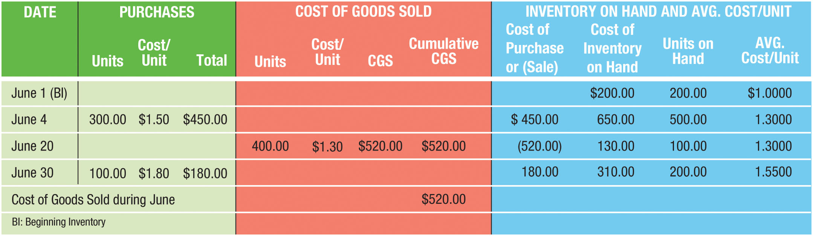
Perpetual Moving-Average Inventory System (Figure 13A-2)

