Slide 1

Adjustments for a Merchandising Business
Chapter 14

Slide 2
Learning Objective 1
Prepare an adjustment for merchandise inventory using the periodic inventory system

Slide 3
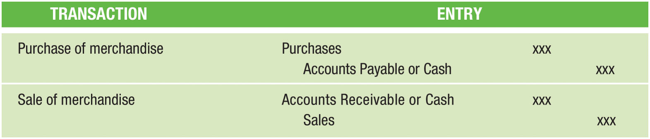
Review of Entries for Purchase and Sale of Merchandise (Figure 14-1)

Slide 4
Work Sheet for a Merchandising Business
Is similar to a service business work sheet
Used to prepare year-end adjustments
Also includes an adjustment to properly report the amount of merchandise inventory held at the end of the accounting period
Used to prepare financial statements

Slide 5
Adjustment for Merchandise Inventory: Periodic Inventory System (1 of 7)
Andy’s Auto Parts had a beginning merchandise inventory of $25,000
At the end of the accounting period, a physical inventory of the merchandise determined that merchandise costing $27,000 was still on hand
Why is there more inventory at the END than at the BEGINNING of the year?
  When purchases EXCEED sales, the inventory balance is HIGHER at the end of the year

Slide 6
Adjustment for Merchandise Inventory: Periodic Inventory System (2 of 7)
Merchandise Inventory account is NOT changed during the accounting period
  Merchandise bought during the year is debited to Purchases instead of Merchandise Inventory
The COST of merchandise sold is NOT recorded
  The selling price is credited to the Sales account.
After a year of purchasing and selling merchandise, the merchandise inventory balance is no longer accurate
  A two-step adjustment is needed to update the balance of the Merchandise Inventory account

Slide 7
Adjustment for Merchandise Inventory: Periodic Inventory System (3 of 7)
Step 1 – The beginning inventory ($23,000) is removed by crediting Merchandise Inventory
  Income Summary is debited because this amount is used in the calculation of cost of goods sold and net income
Step 2 – The ending inventory ($27,000) is entered by debiting Merchandise Inventory
  Income Summary is credited because this amount is also used in the calculation of cost of goods sold and net income
Note that the debit and credit adjustments made to Income Summary are extended into the Adjusted Trial Balance columns. This is done because the individual amounts are needed for the calculation of cost of goods sold on the income statement (beginning inventory + purchases - ending inventory = cost of goods sold)

Slide 8
Adjustment for Merchandise Inventory: Periodic Inventory System (4 of 7)
Steps 3-5 in the inventory adjustment process address issues related to customers returning inventory
In a merchandising business, it is likely that customers will return some of the merchandise that was purchased
The entry made when merchandise is returned during the current period is as follows:
  Debit – Sales Returns and Allowances
  Credit – Accounts Receivable (or Cash)
Returned inventory is not debited to the merchandise inventory account
  Will be captured in the physical count of the ending inventory, if not sold by the end of the year
Some of the inventory sold this year is likely to be returned next year

Slide 9
Adjustment for Merchandise Inventory: Periodic Inventory System (5 of 7)
Andy’s estimates that customers will be granted $4,000 in refunds of this year’s sales next year
Merchandise expected to be returned will have a cost of $3,000
Customer Refunds Payable must be adjusted to equal the estimated $4,000 liability
  Has a balance of $2,600 before adjustment
Step 3 – Make the following adjustment:

Slide 10
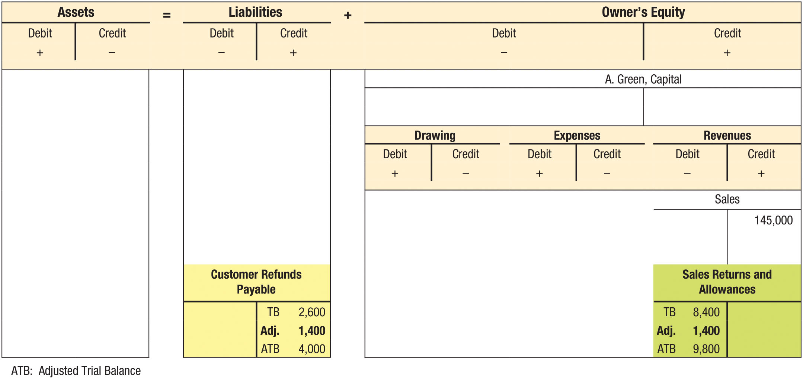
Adjustments for Sales Returns and Allowances (Figure 14-3)

Slide 11
Adjustment for Merchandise Inventory: Periodic Inventory System (6 of 7)
In Steps 4 and 5, we adjust for the estimated inventory to be returned next year
Estimated Returns Inventory is an asset account that represents the estimated cost of merchandise inventory sold this year, but expected to be returned next year
  Is reported as a current asset on the Balance Sheet and is often combined with Merchandise Inventory
  Will be adjusted at the end of each period to properly reflect the cost of merchandise sold this period, but expected to be returned next period

Slide 12
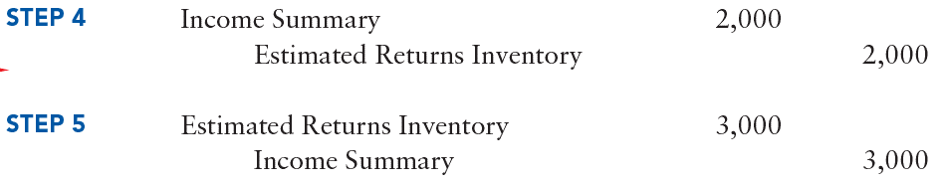
Adjustment for Merchandise Inventory: Periodic Inventory System (7 of 7)
Estimated Returns Inventory has a balance of $2,000 before adjustment
Account must reflect the required $3,000 balance, the cost of the expected returns
Following entries are made:

Slide 13
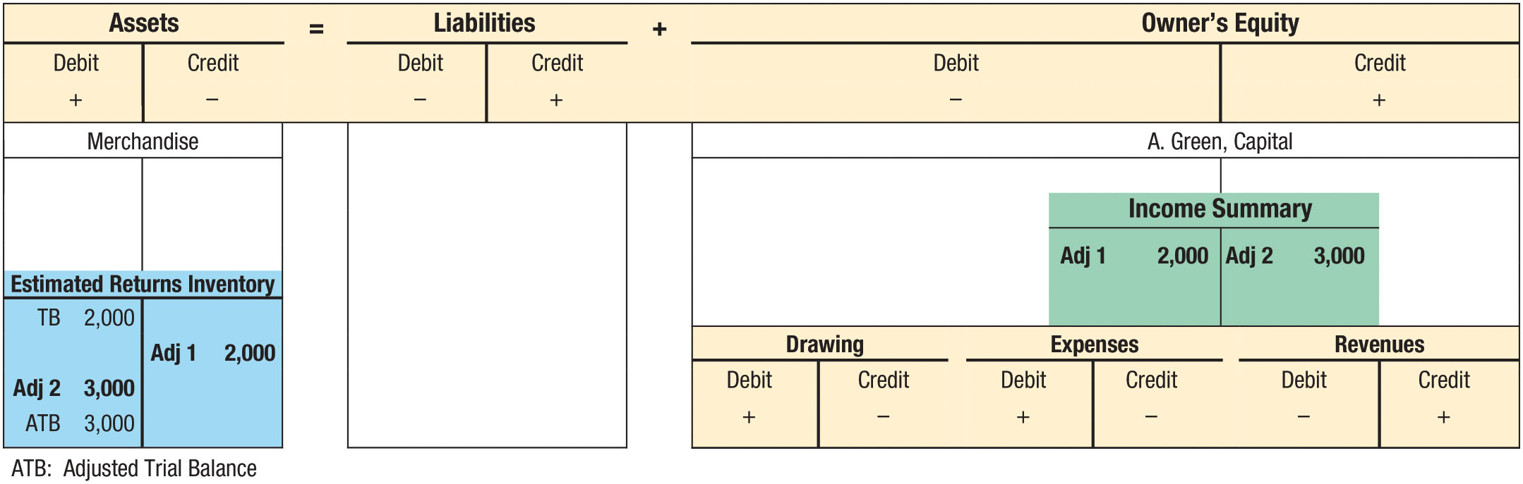
Adjustments for Estimated Returns Inventory (Figure 14-4)

Slide 14
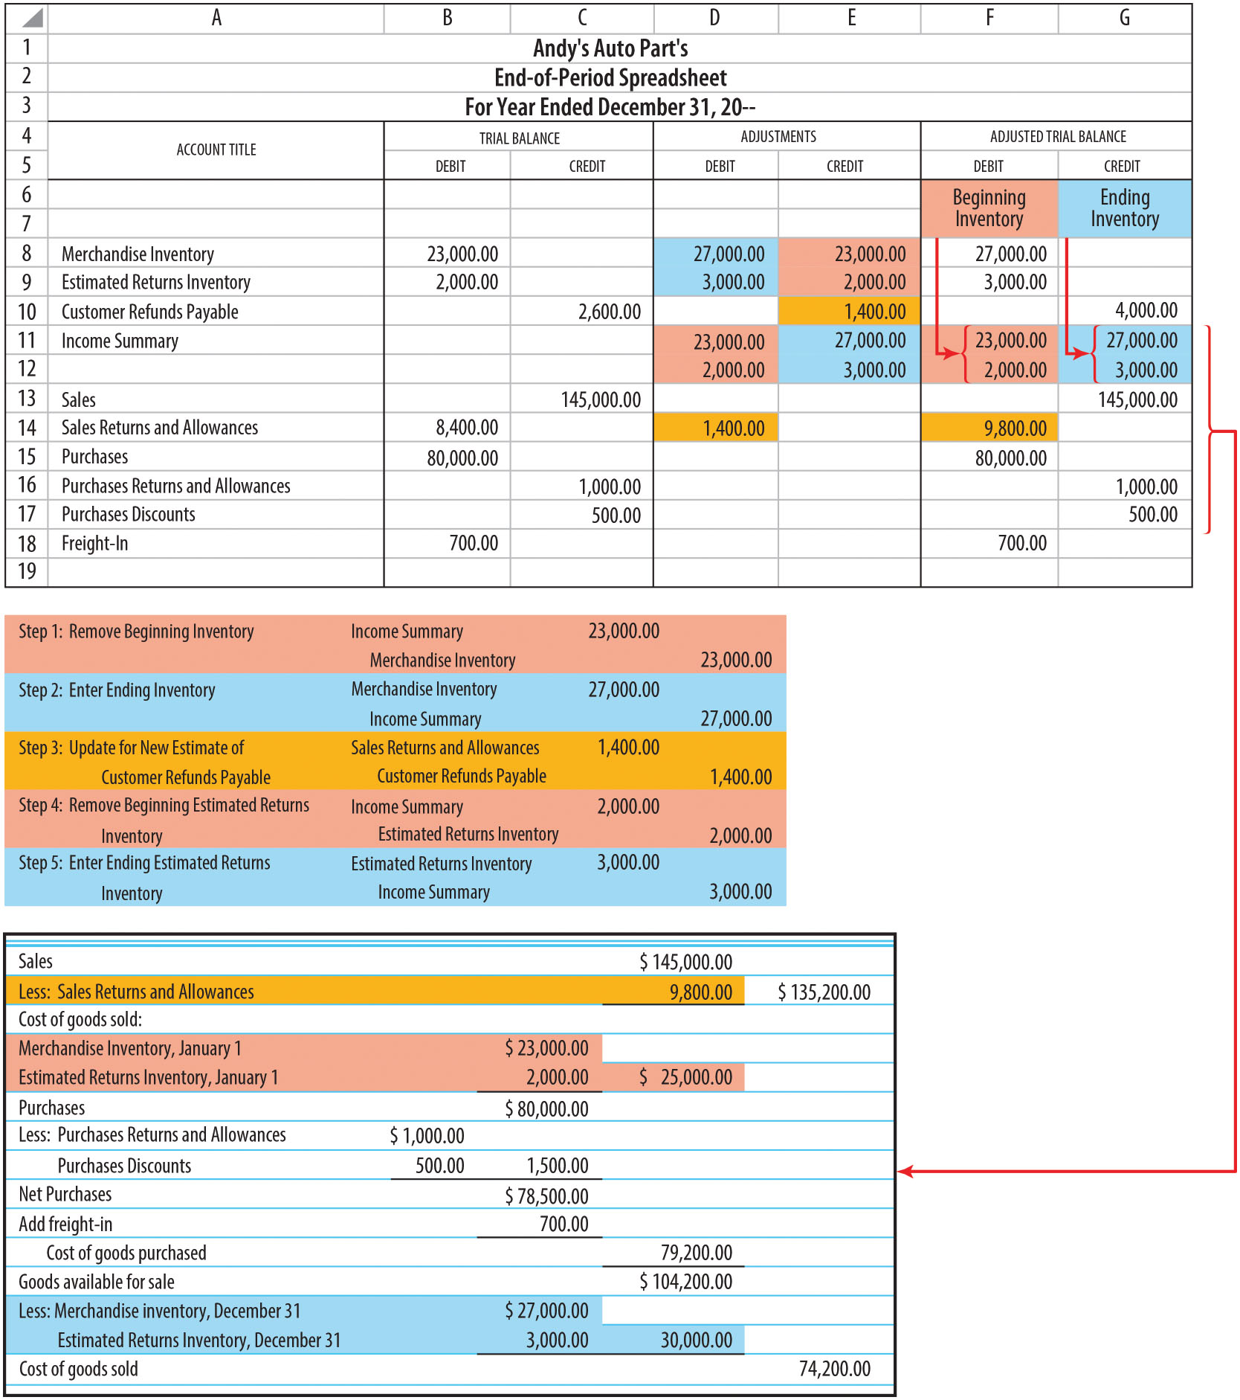
Calculation of Cost of Goods Sold
(Figure 14-2)

Slide 15
Learning Objective 2
Prepare an adjustment for unearned revenue

Slide 16
Unearned Revenue
Cash received in advance before delivering a product or performing a service
Reported as a liability on the balance sheet because the company owes the customer the product or service

Slide 17
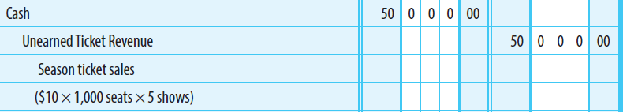
Adjustment for Unearned Revenue (1 of 2)
Brown County Playhouse sells season tickets
  Tickets sell for $10 for each play (5 plays per season)
A maximum of 1,000 seats can be sold for each play
Assume that all shows sell out during the first week
When season tickets are sold, Cash is debited and Unearned Ticket Revenue is credited

Slide 18

Adjustment for Unearned Revenue (2 of 2)
Following production of the third show, financial statements are to be prepared.
An adjusting entry is needed to recognize the ticket revenue earned for the three shows
  3 shows × 1,000 tickets for each show = 3,000 tickets
  3,000 tickets × $10 per ticket = $30,000
  $30,000 in earned revenue is removed from the unearned account and put into the revenue account
Remaining balance of $20,000 in Unearned Ticket Revenue is reported as a current liability on the balance sheet

Slide 19
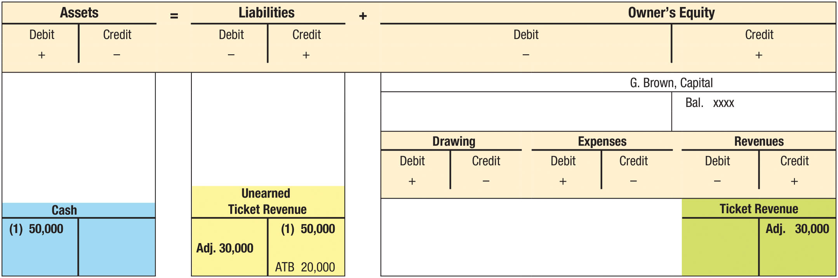
Entries for Unearned Revenue (Figure 14-5)

Slide 20
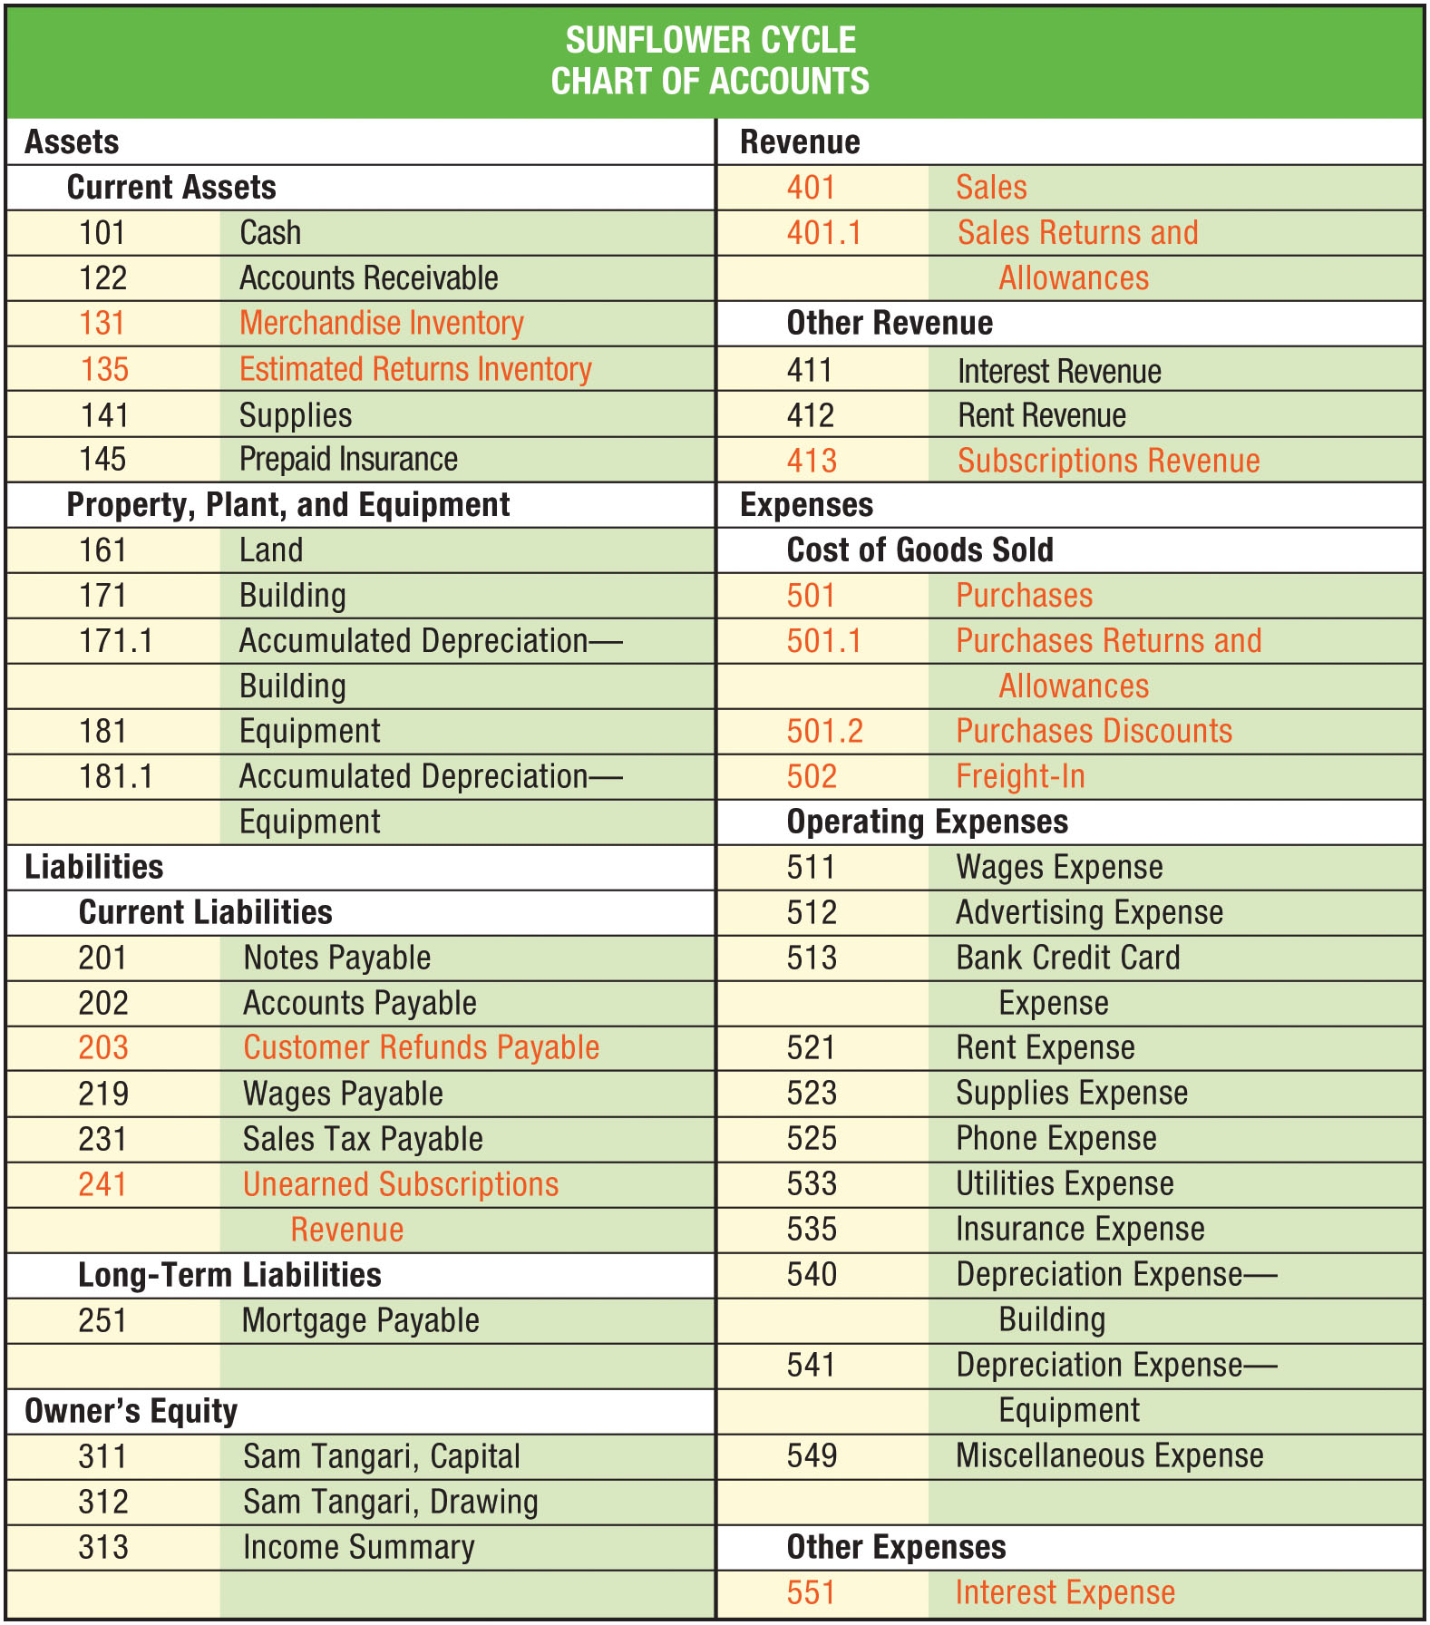
Chart of Accounts for Sunflower Cycle (Figure 14-6)

Slide 21
Learning Objective 3
Prepare a work sheet for a merchandising business

Slide 22
Preparing a Work Sheet for a Merchandising Business
Prepare the trial balance
Prepare the adjustments
Prepare the adjusted trial balance
Extend the adjusted trial balance amounts to the Income Statement and Balance Sheet columns
Total the Income Statement and Balance Sheet columns to compute the net income or net loss

Slide 23
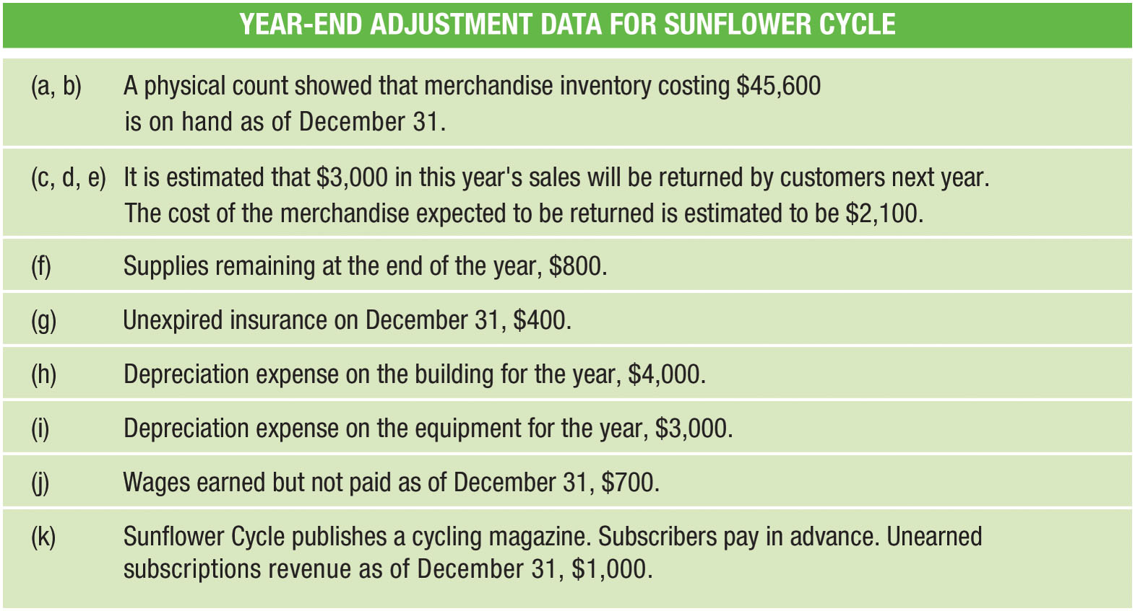
Year-End Adjustment Data for Sunflower Cycle (FIGURE 14-7)

Slide 24
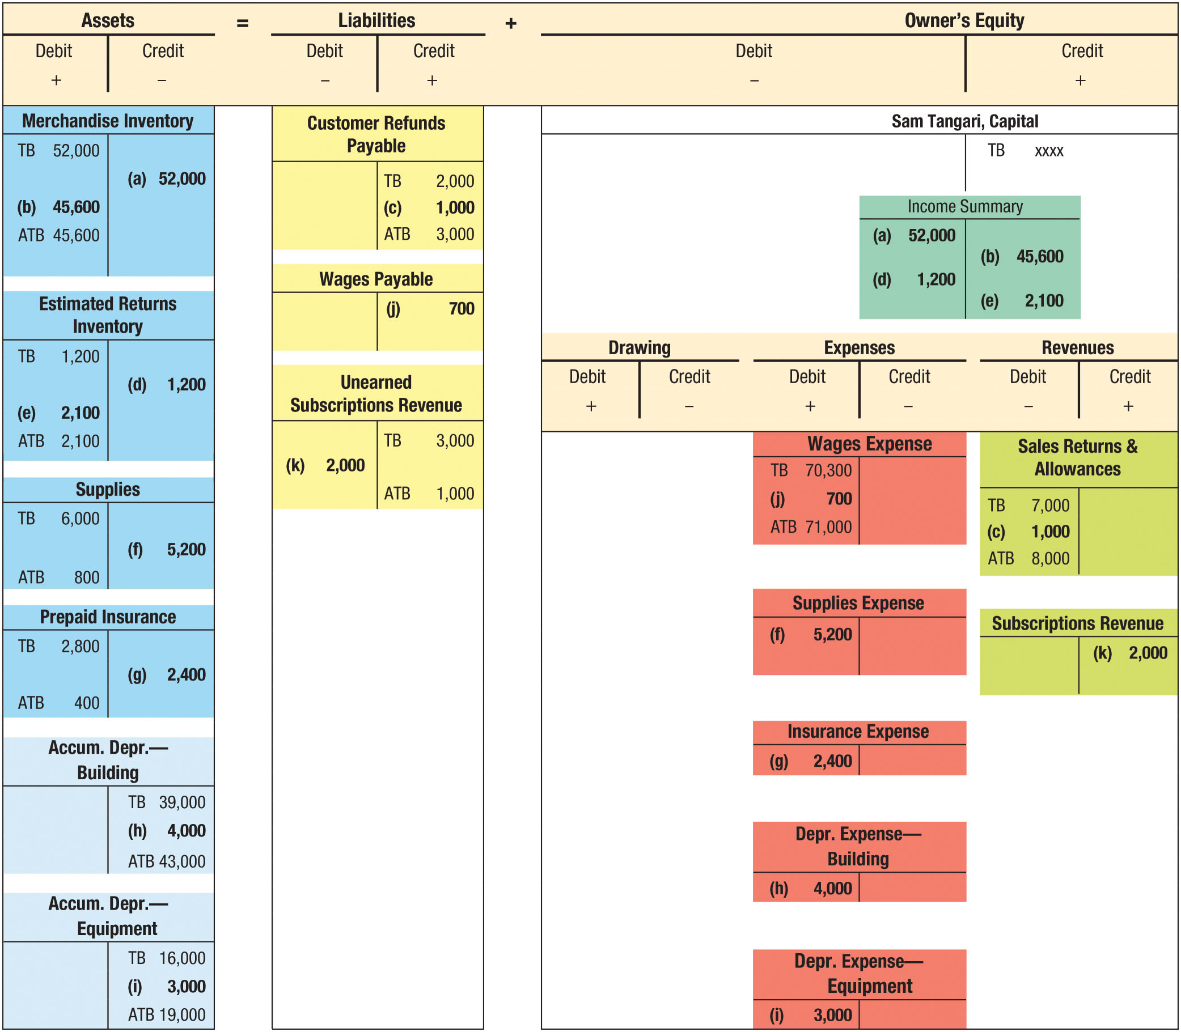
Adjusting Entries for Sunflower Cycle (FIGURE 14-8)

Slide 25
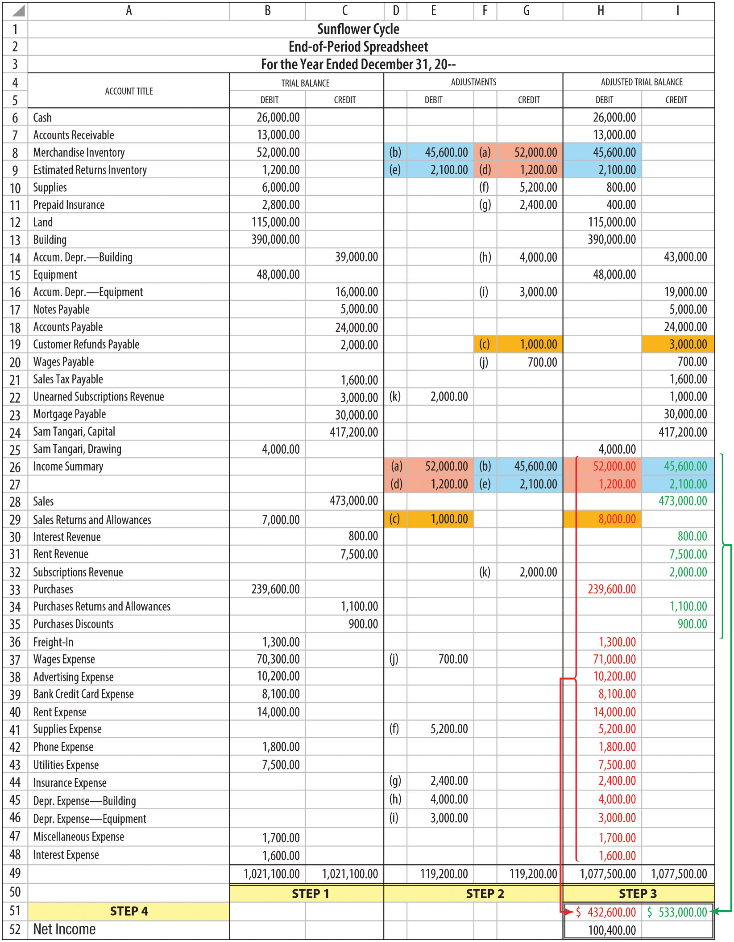
Year-End Spreadsheet for Sunflower Cycle (FIGURE 14-9)

Slide 26
Learning Objective 4
Journalize adjusting entries for a merchandising business

Slide 27
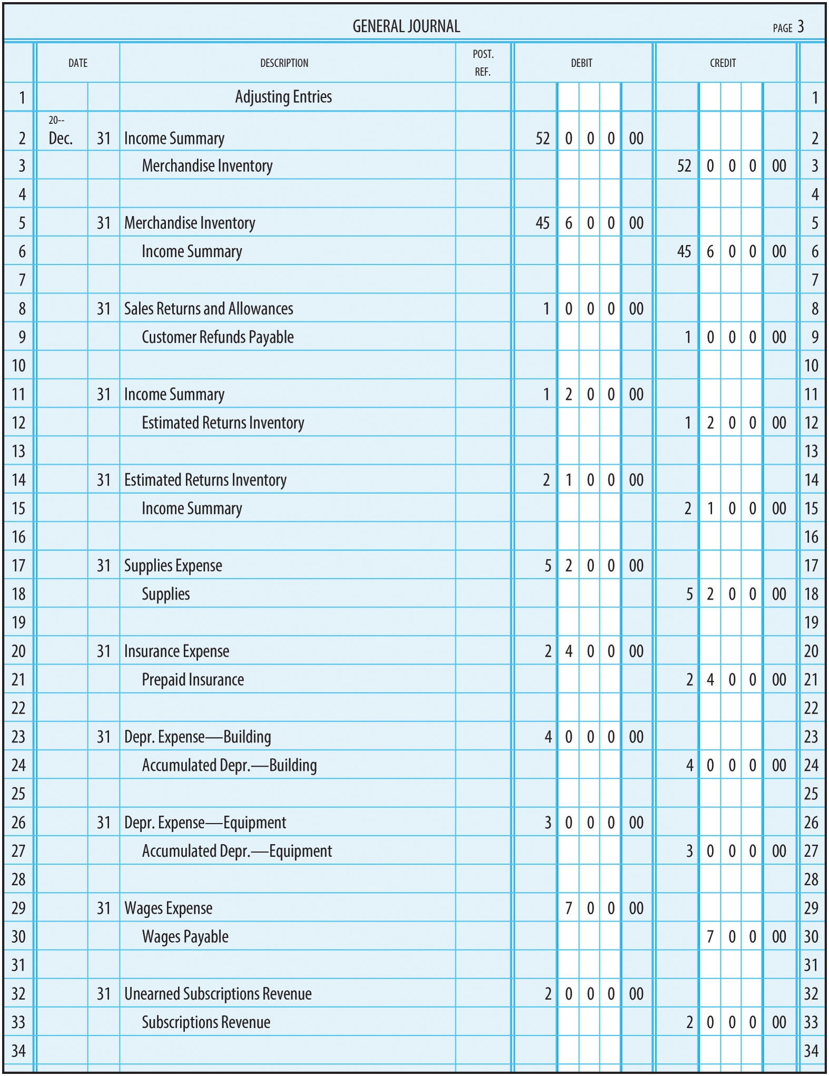
Adjusting Entries for Sunflower Cycle (FIGURE 14-10)

Slide 28
Learning Objective 5
Prepare adjusting journal entries under the perpetual inventory system

Slide 29
Entries Under the Perpetual Inventory System
Under the perpetual inventory system, the merchandise inventory, estimated returns inventory, cost of goods sold, and customer refunds payable accounts are continually updated throughout the year to reflect:
  Inventory purchases
  Sales
  Returns by customers
  Returns to suppliers

Slide 30
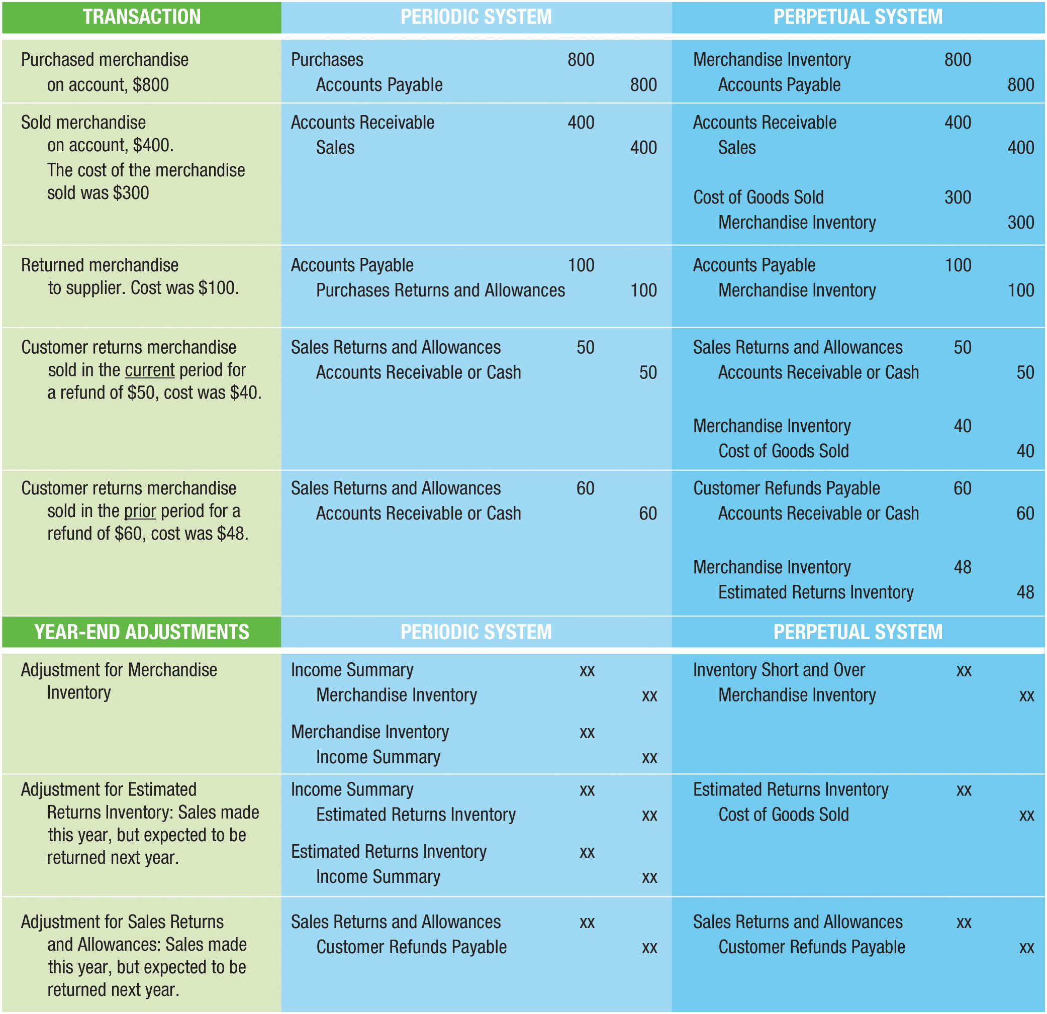
Entries for Periodic and Perpetual Inventory Systems (FIGURE 14-11)

Slide 31
Adjustments for Expected Sales Returns and Allowances
Under a perpetual inventory system, business has the ability to track the details of inventory transactions since they are updated during the year:
  Merchandise Inventory
  Estimated Returns Inventory
  Cost of Goods Sold
  Customer Refunds Payable
Must be adjusted at year end for next year’s estimates
  If last year’s estimates for refunds and returns inventory were accurate, the ending balances of Estimated Returns Inventory and Customer Refunds payable should approach zero

Slide 32
Adjustments for Inventory Shrinkage (1 of 2)
Perpetual inventory system does not eliminate the need for taking physical inventories
Perpetual records must be compared with the physical inventory to discover and correct any errors or losses of merchandise from theft, breakage, or spoilage
  This is known as inventory shrinkage
Differences found between physical count and amount in the perpetual inventory
Records must be corrected by an adjusting entry

Slide 33

Adjustments for Inventory Shrinkage (2 of 2)
Differences are recorded in an account called Inventory Short and Over
  Debit balance – Listed with other expenses on the income statement
  Credit balance – Listed with other revenues on the income statement
EXAMPLE: A physical inventory shows $3,710 worth of merchandise, but the inventory account has a balance of $3,840
  $130 short

Slide 34
Expense Method of Accounting for Prepaid Expenses
Chapter 14 Appendix

Slide 35
Appendix Learning Objective 1
Use the expense method of accounting for prepaid expenses

Slide 36

The Expense Method
Prepaid expenses, supplies, and other prepaid items are expensed when purchased
An adjustment must be made at the end of each accounting period
  Adjustment records the unused portion of the expense as an asset
Office supplies are purchased for $425

Slide 37
Appendix Learning Objective 2
Make the appropriate adjusting entries when the expense method is used for prepaid expenses

Slide 38
Adjusting Entries—Example A (1 of 2)
Office supplies were purchased for $425 earlier in the accounting period and expensed when purchased
At end of period, $150 of supplies were unused
Following adjustment is needed:

Slide 39
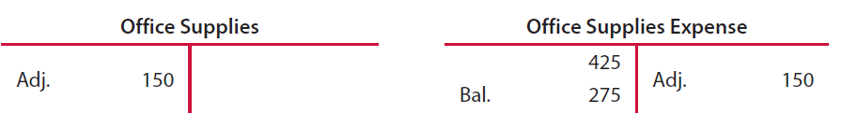
Adjusting Entries—Example A (2 of 2)

Slide 40
Adjusting Entries—Example B (1 of 2)
Three-year insurance policy purchased for $6,000
  Expensed when purchased (debit expense, credit cash)
End of first year, one-third ($2,000) has expired
Following adjustment is needed:

Slide 41
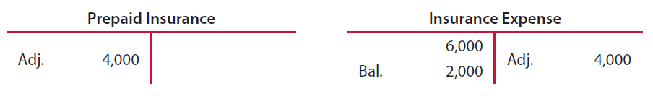
Adjusting Entries—Example B (2 of 2)

