Slide 1
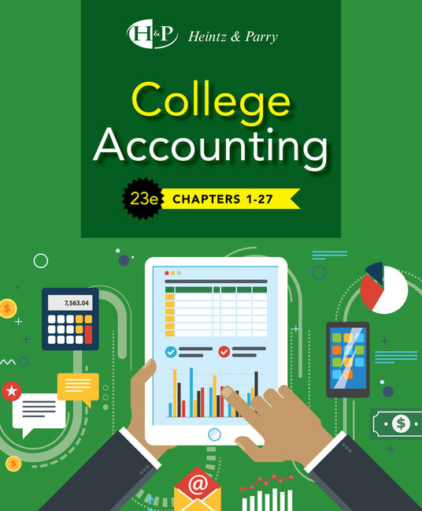
Financial Statements and Year-End Accounting for a Merchandising Business
Chapter 15

Slide 2
Learning Objective 1
Prepare a single-step and multiple-step income statement for a merchandising business

Slide 3
Income Statement
Purpose: To summarize the results of operations during an accounting period
Shows:
  The sources of revenue
  Types of expenses
  The amount of net income or net loss for the period
Two forms:
  Single-step
  Multiple-step

Slide 4
Single-Step Income Statement
All the revenue sources are listed and totaled
Cost of goods sold is listed with all the other expenses
Expenses are totaled and subtracted from revenues to determine net income or loss
Called a single-step income statement because expenses (including cost of goods sold) are subtracted from revenues in ONE step to determine net income or loss

Slide 5
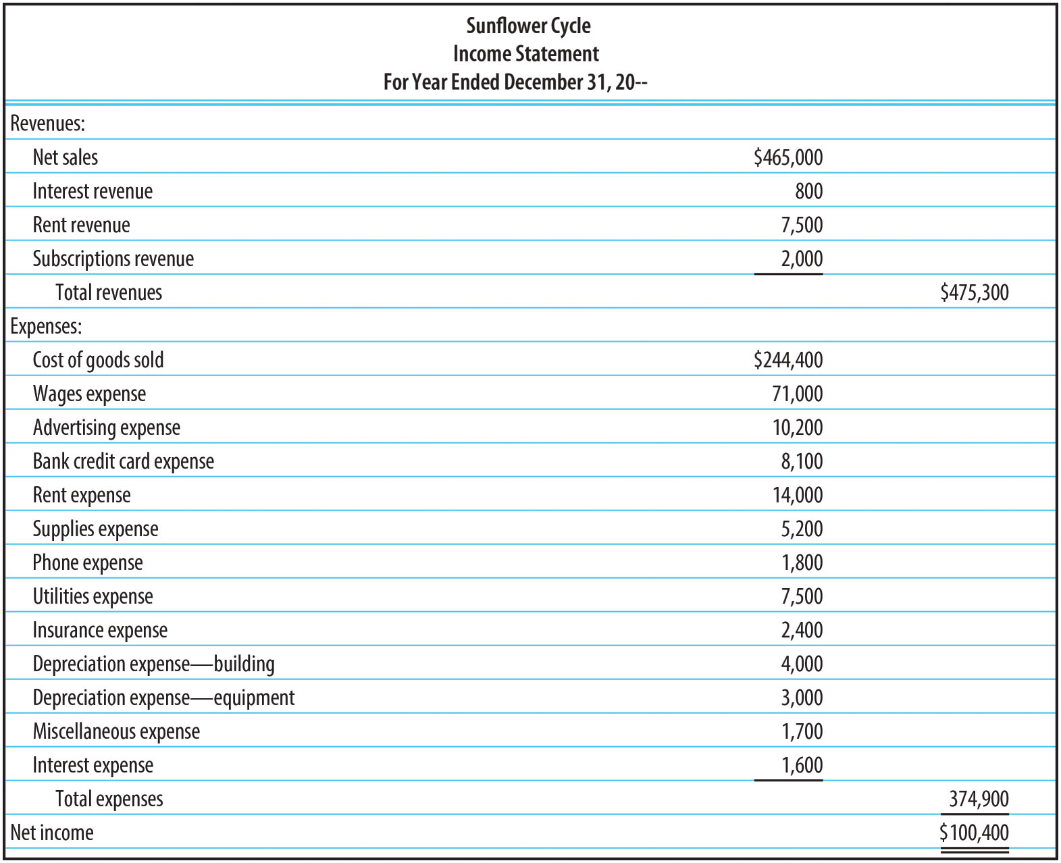
Single-Step Income Statement (FIGURE 15-2)

Slide 6
Multiple-Step Income Statement
Gross sales is shown first, less any returns, allowances, or discounts
  Difference is called net sales
  Other revenues are listed at the end of the statement
Cost of goods sold is computed and subtracted from net sales to arrive at gross profit (or gross margin)
Operating expenses are listed, totaled, and subtracted from gross profit to compute income from operations (sometimes called operating income).
  Operating expenses are directly associated with providing the primary goods and services of the business
  Operating expenses can be divided into subcategories of selling expenses and general expenses

Slide 7
Selling Expenses
Expenses directly associated with selling activities
Examples:
  Sales Salaries Expense
  Sales Commissions Expense
  Advertising Expense
  Bank Credit Card Expense
  Delivery Expense
  Depreciation Expense – Store Equipment and Fixtures

Slide 8
General Expenses
Expenses associated with administrative, office, or general operating activities
Examples:
  Rent Expense
  Office Salaries Expense
  Office Supplies Expense
  Phone Expense
  Utilities Expense
  Insurance Expense
  Depreciation Expense – Office Equipment

Slide 9
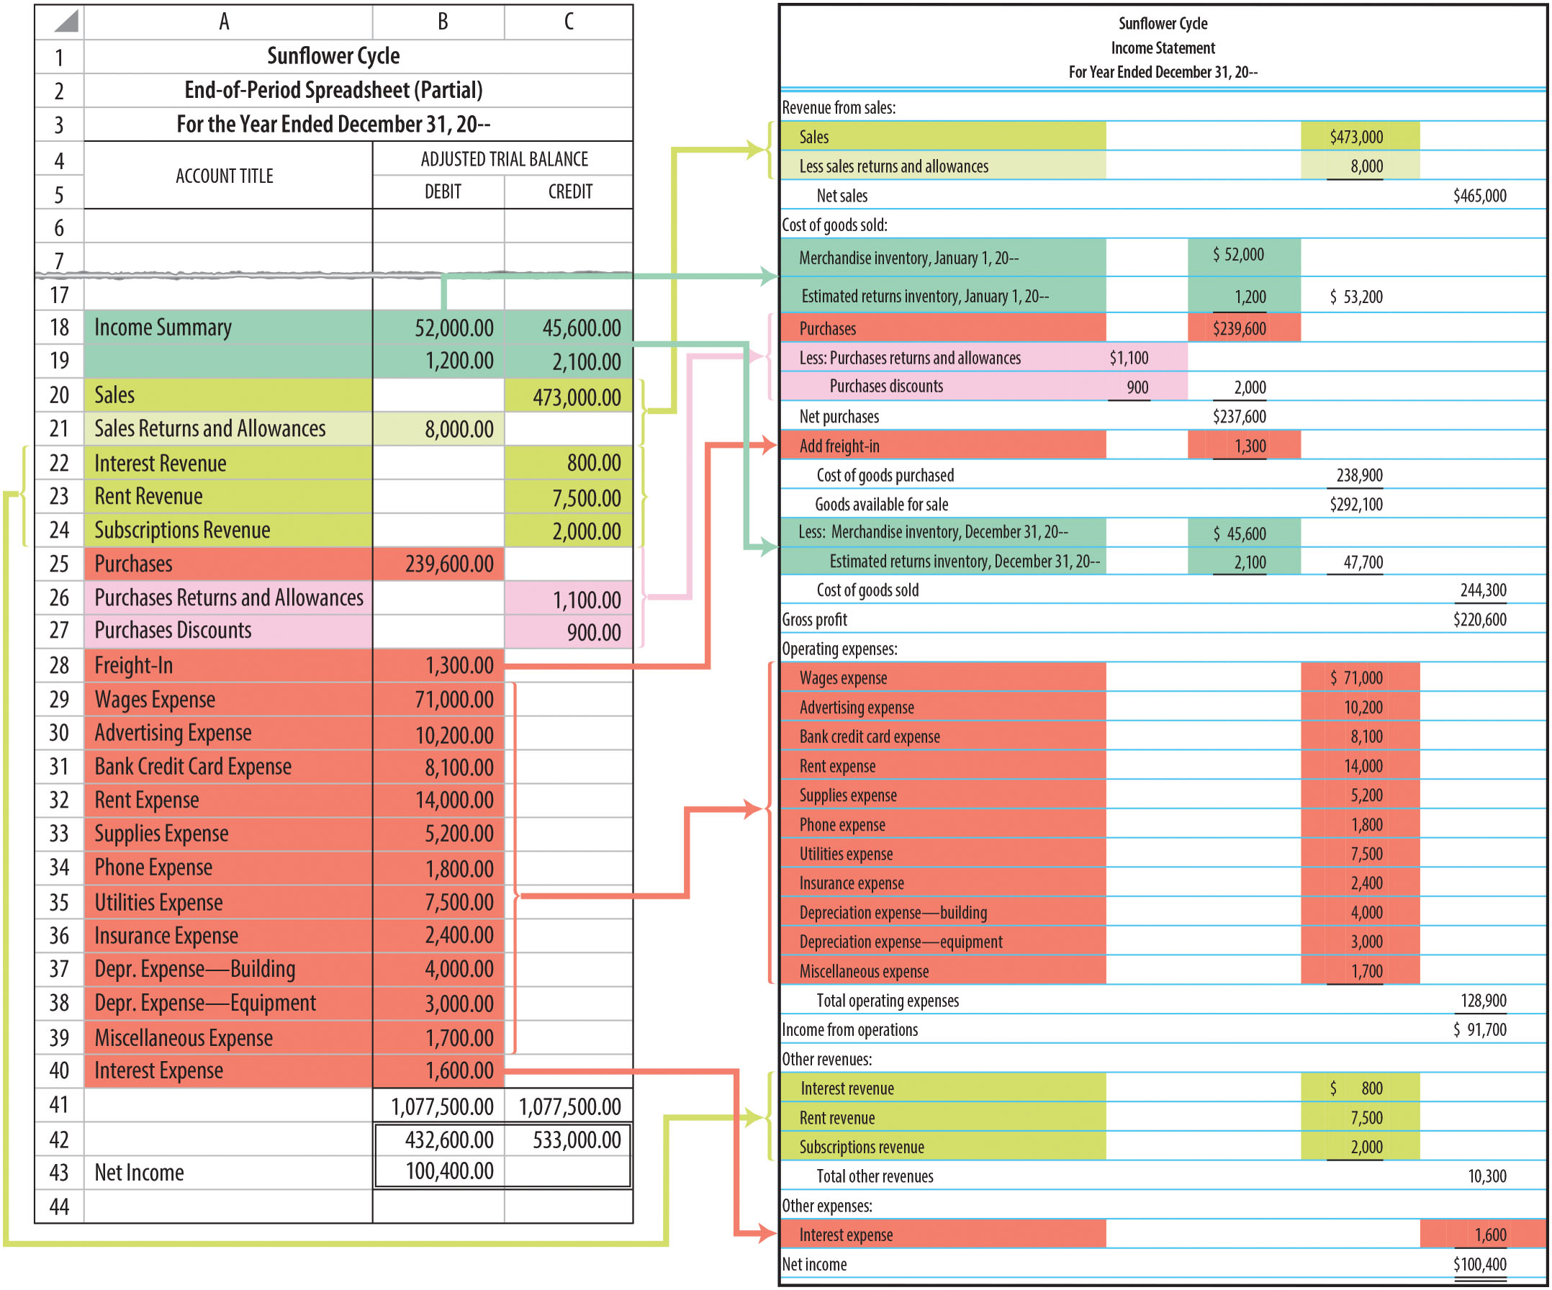
Using a Spreadsheet to Prepare a Multiple-Step Income Statement (FIGURE 15-3)

Slide 10
Learning Objective 2
Prepare a statement of owner’s equity

Slide 11
The Statement of Owner’s Equity
Summarizes all changes in the owner’s equity during the period
Sources needed to prepare this statement:
  Work sheet
  General ledger capital account
Includes:
  Investments and withdrawals by the owner
    Found on worksheet
  Net income or loss
    Found on income statement
  Beginning and ending capital balances
    Found in general ledger

Slide 12
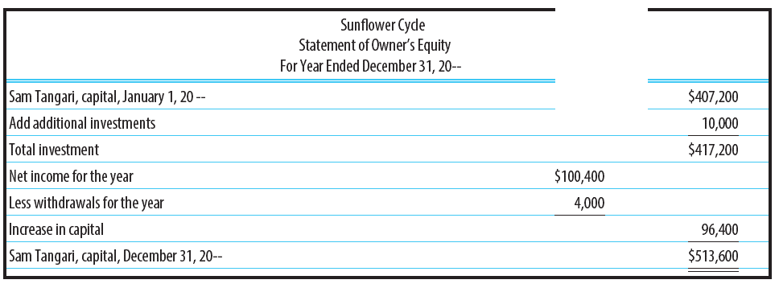
Statement of Owner’s Equity (FIGURE 15-5)

Slide 13
Learning Objective 3
Prepare a classified balance sheet

Slide 14
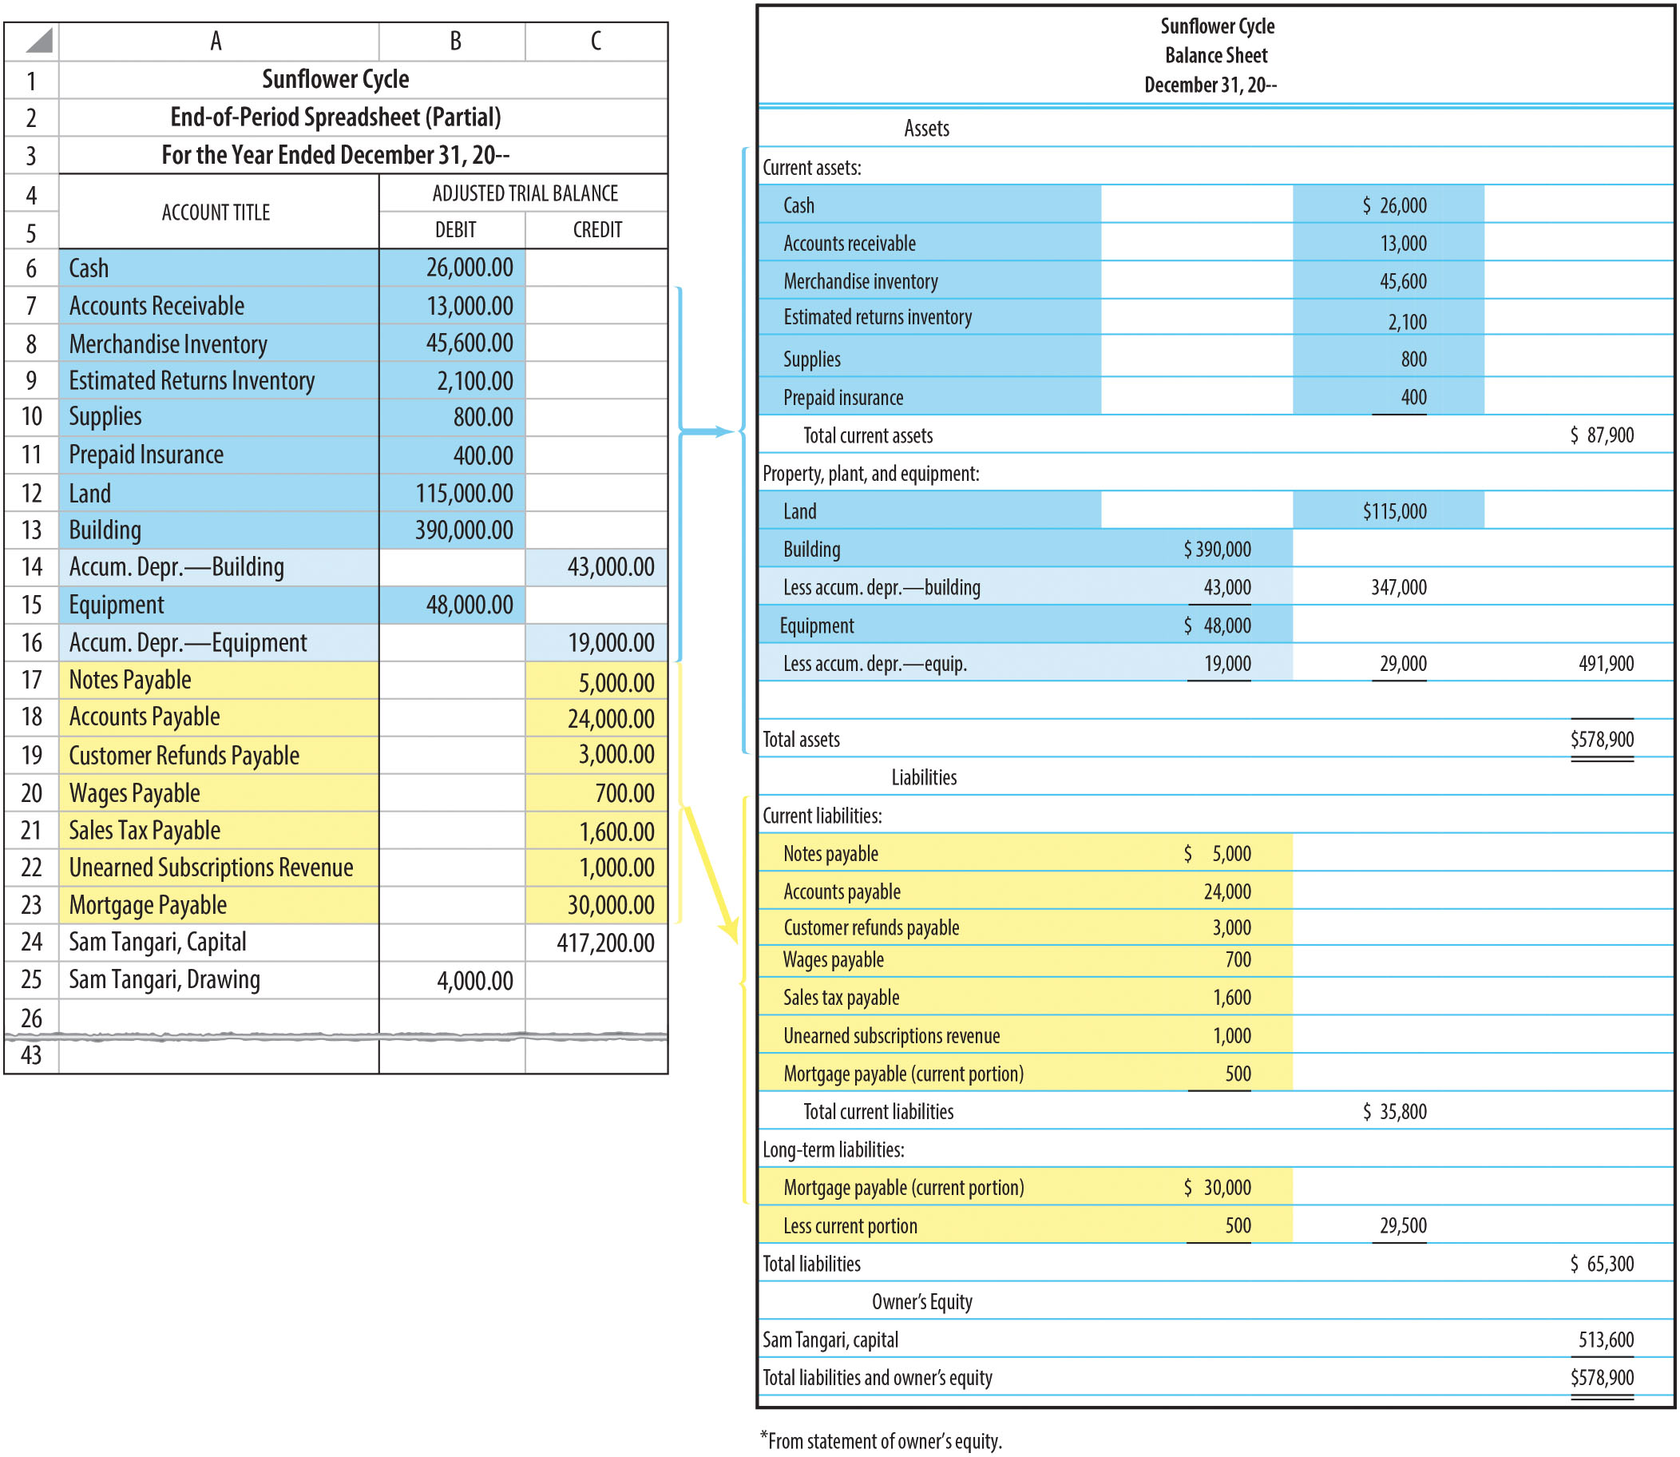
Using a Spreadsheet to Prepare a Report- Form Classified Balance Sheet (FIGURE 15-6)

Slide 15
Current Assets
Include cash and other assets which are:
  Expected to be converted into cash, OR
  Consumed within one year or the normal operating cycle of the business, whichever is longer
    Operating Cycle – Length of time generally required for a business to:
      Buy inventory
      Sell it
      Collect cash
Examples: Cash, receivables, merchandise inventory, prepaid expenses
Listed in order of liquidity – the speed with which the company can convert the asset to cash
  From most liquid to least liquid
  Cash is the most liquid – always listed first

Slide 16
Property, Plant, and Equipment
Assets that are expected to be used:
  For more than one year in the operation of a business
Examples: Land, buildings, office equipment, store equipment, delivery equipment
Assets with longer useful lives are listed first

Slide 17
Current Liabilities
Obligations that are due within one year or the normal operating cycle, whichever is longer
  Will require the use of current assets
Examples:
  Notes Payable
  Accounts Payable
  Wages Payable
  Sales Tax Payable
  Unearned Subscriptions Revenue
  Mortgage Payable (portion due within the next year)

Slide 18
Long-Term Liabilities
Obligations that will extend beyond one year or the normal operating cycle, whichever is longer
Mortgage payable is a common long-term liability
  Used to reflect an obligation that is secured by a mortgage
    Mortgage – written agreement that lender has right to take over specific property to satisfy a debt if borrower does not repay it

Slide 19
Owner’s Equity
Accounts are determined by the type of organization:
  Sole proprietorship
  Partnership
  Corporation
A sole proprietorship reports one owner’s equity account

Slide 20
Learning Objective 4
Compute standard financial ratios

Slide 21
Financial Statement Analysis
Used to evaluate the financial condition and profitability of a business
Used by management and creditors
Two types:
  Balance sheet analysis
  Interstatement analysis

Slide 22
Balance Sheet Analysis
Uses only the information on the balance sheet
Includes:
  Working capital
  Current ratio
  Quick ratio

Slide 23
Working Capital
The amount of capital the business has available for current operations
FORMULA: CURRENT ASSETS minus CURRENT LIABILITIES
Sunflower Cycle has current assets of $127,900 and current liabilities of $34,800
  Working Capital = $127,900-$34,800 = $93,100

Slide 24
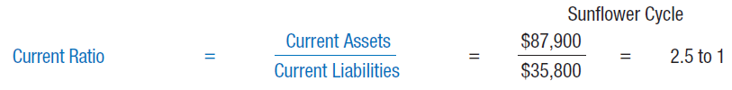
Current Ratio
Measures a firm’s ability to pay its current liabilities
  “Rule of thumb” = 2 to 1
  Many businesses operate successfully with a current ratio of 1.5 to 1
  It is better to compare an individual company to industry averages

Slide 25
Quick Assets
Cash and all other current assets that can be converted into cash quickly
Examples:
  Cash
  Accounts receivable
  Temporary investments

Slide 26
Quick Ratio
Gives a more defined picture of a firm’s ability to pay its current liabilities
  “Rule of thumb” = 1 to 1
  Many businesses operate successfully with a quick ratio of 0.6 to 1

Slide 27
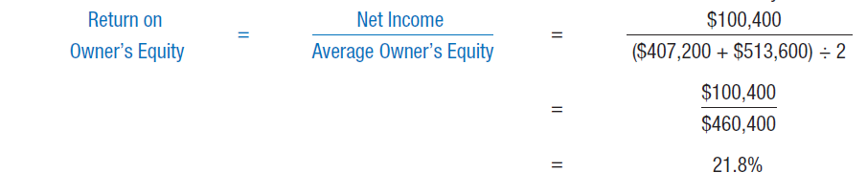
Return on Owner's Equity

Slide 28
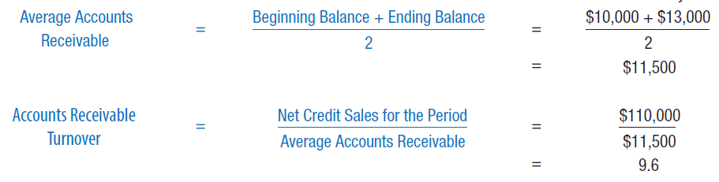
Accounts Receivable Turnover
Measure of time required to collect cash from credit customers
  Indicates number of times accounts receivable “turned over,” or were collected, in the accounting period
Higher numbers indicate cash collected more quickly

Slide 29

Average Collection Period
Number of days credit customers are taking to pay for their purchases
Comparing average collection period with business’s credit terms offers an indication of whether customers are paying within terms
Calculated by dividing the number of days in the year (365) by the rate of turnover

Slide 30
Inventory Turnover (1 of 2)
Represents the number of times merchandise inventory turned over (was sold) during the accounting period
Higher rate of inventory turnover – smaller profit required on each dollar of sales to produce a satisfactory gross profit
  Grocery stores have high inventory turnover and a low profit per item
  Jewelry stores need a higher profit per item to offset their low inventory turnover
Compare Inventory Turnover rate with:
  Prior years
  Other companies
  Industry average

Slide 31
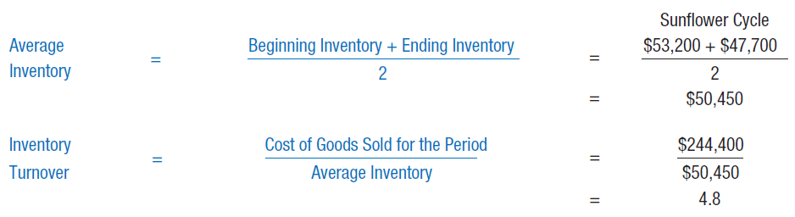
Inventory Turnover (2 of 2)

Slide 32

Average Days to Sell Inventory
Computed by dividing number of days in a year (365) by inventory turnover
Requires comparison with prior years, other companies, or industry averages

Slide 33
Learning Objective 5
Prepare closing entries for a merchandising business

Slide 34
Closing Entries
Similar to closing entries for a service business
Additional merchandising accounts also must be closed
Easiest way to complete closing process – Use a work sheet to prepare closing entries

Slide 35
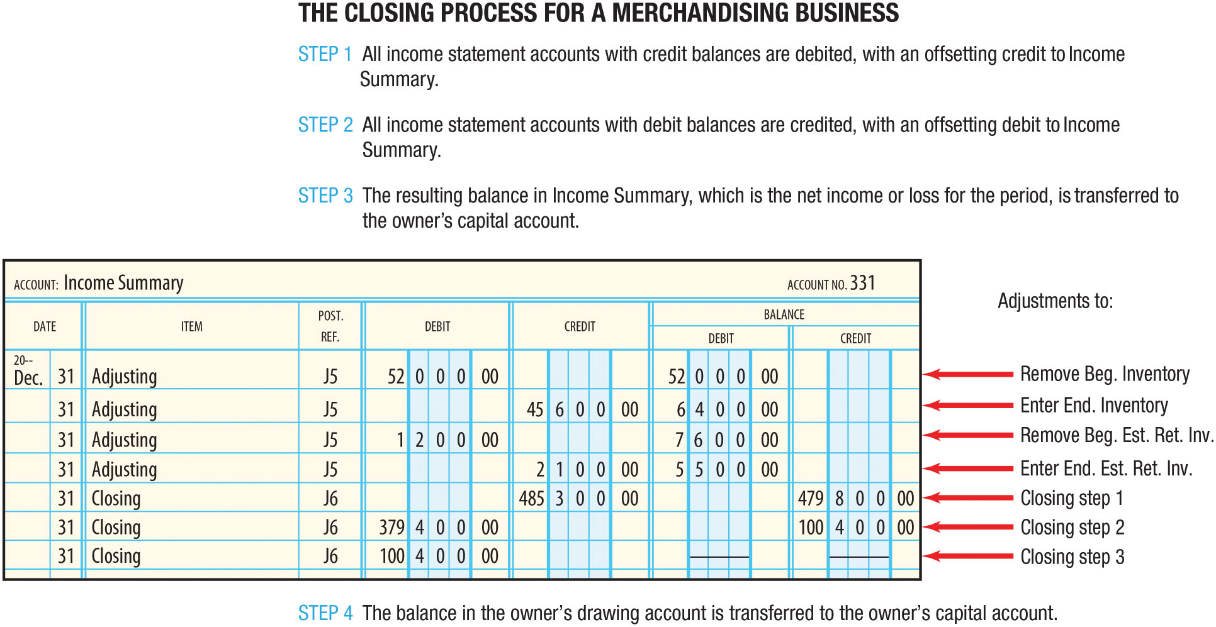
The Closing Process (Figure 15-7)

Slide 36
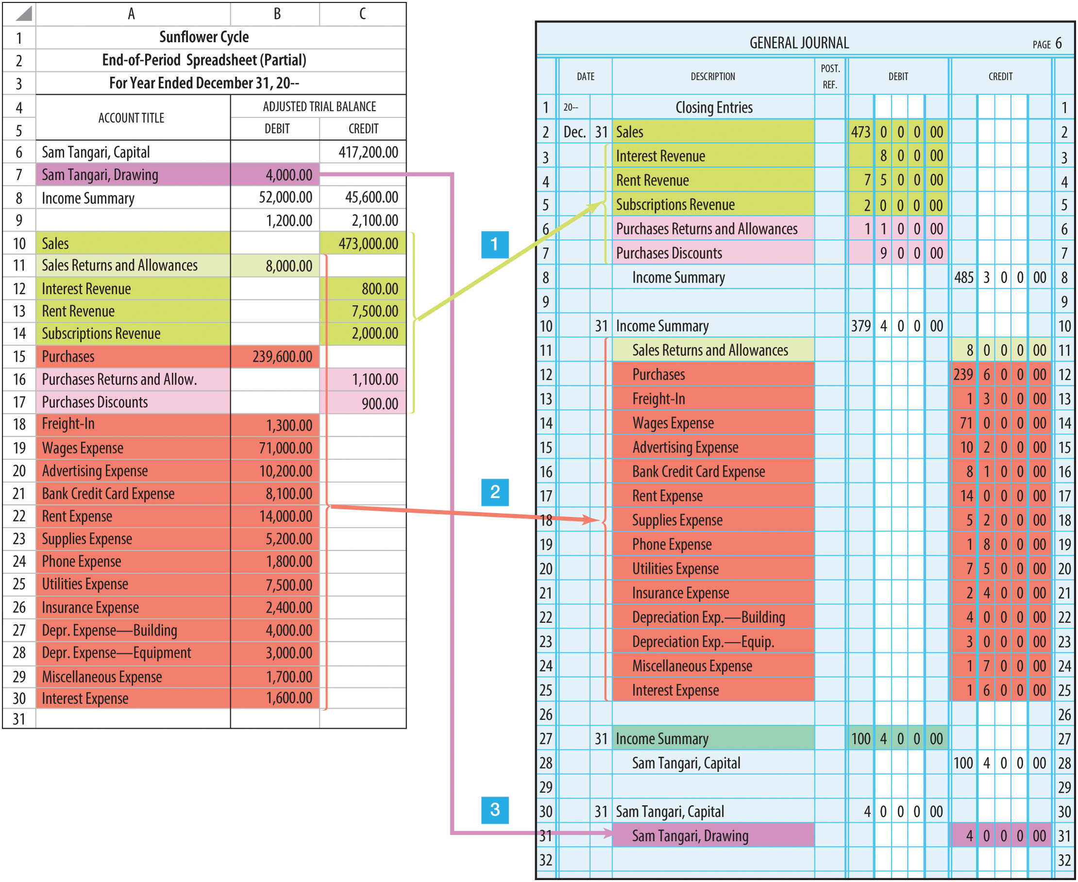
Closing Entries for a Merchandising Business
(Figure 15-8)

Slide 37
Post-Closing Trial Balance
Prepared by taking the balances from the general ledger accounts
  Should not be prepared from the balances on the spreadsheet
  Using general ledger accounts helps ensure that all temporary accounts have been closed properly
  Proves general ledger is in balance at beginning of new accounting period

Slide 38
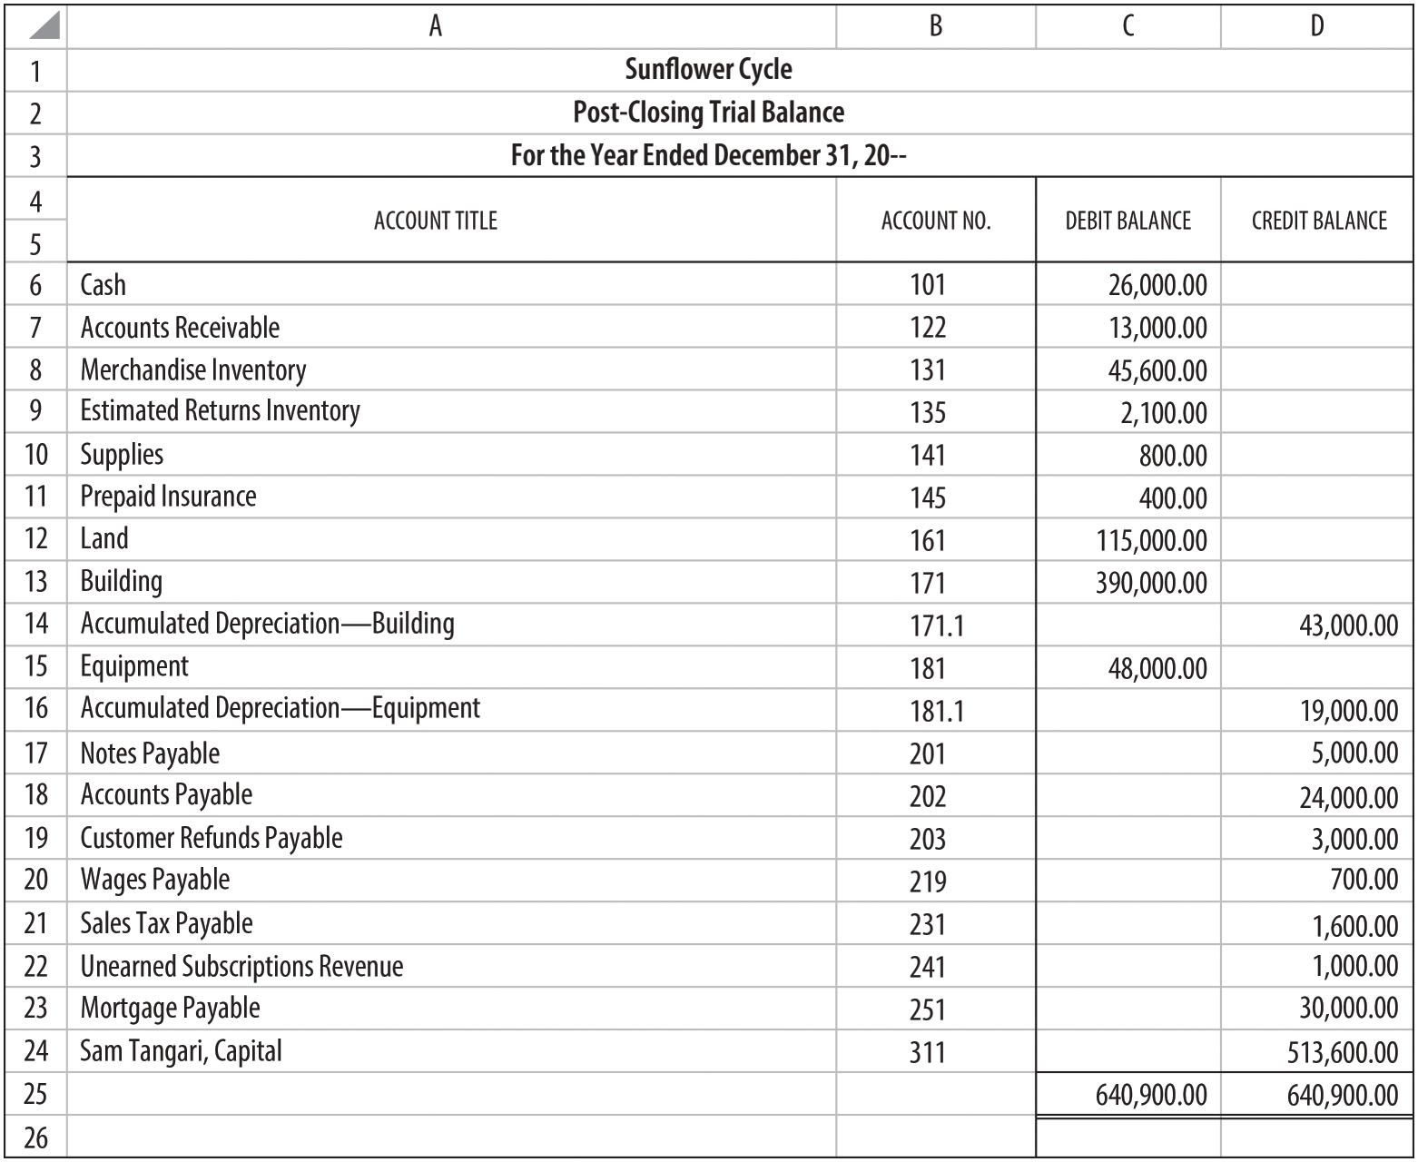
Post-Closing Trial Balance (FIGURE 15-9)

Slide 39
Learning Objective 6
Prepare reversing entries

Slide 40
Reversing Entries
Reverse (or opposite) of an adjusting entry
  Done to simplify recording of transactions in new accounting period
Prepared at the beginning of the next accounting period
What to reverse: Except for the first year of operations, reverse all adjusting entries that increase an asset or liability account from a zero balance

Slide 41
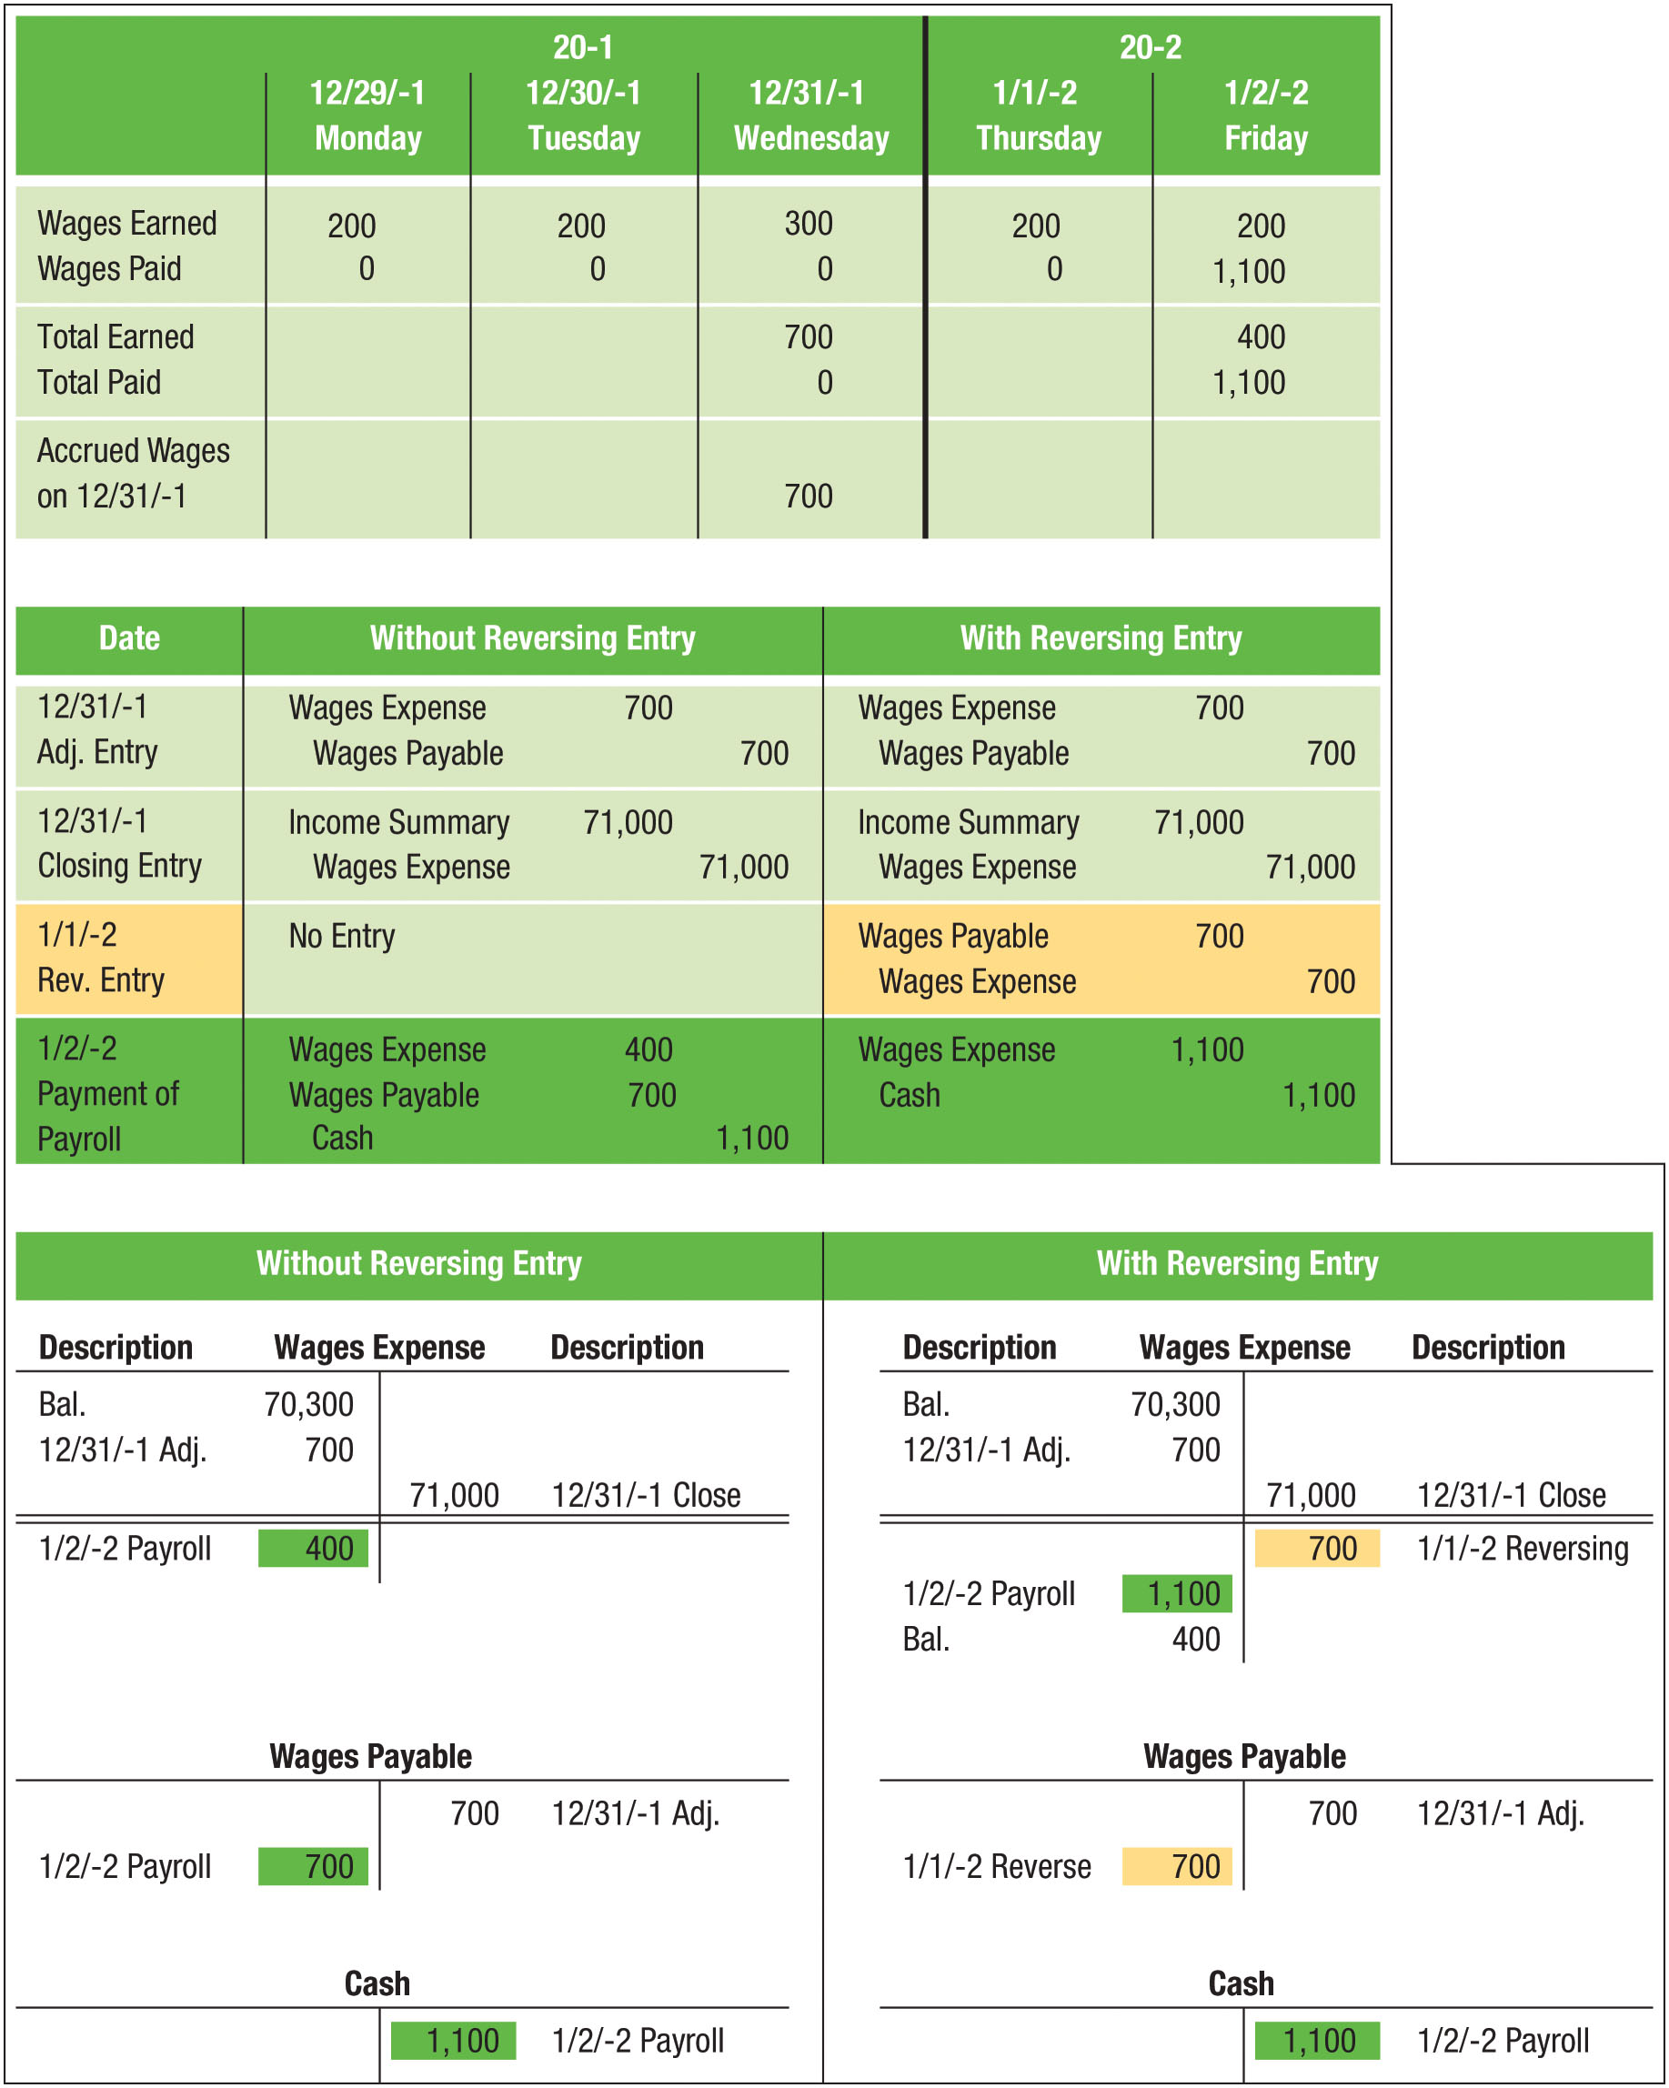
Adjusting, Closing, and Reversing Entries for Wages (FIGURE 15-10)

Slide 42
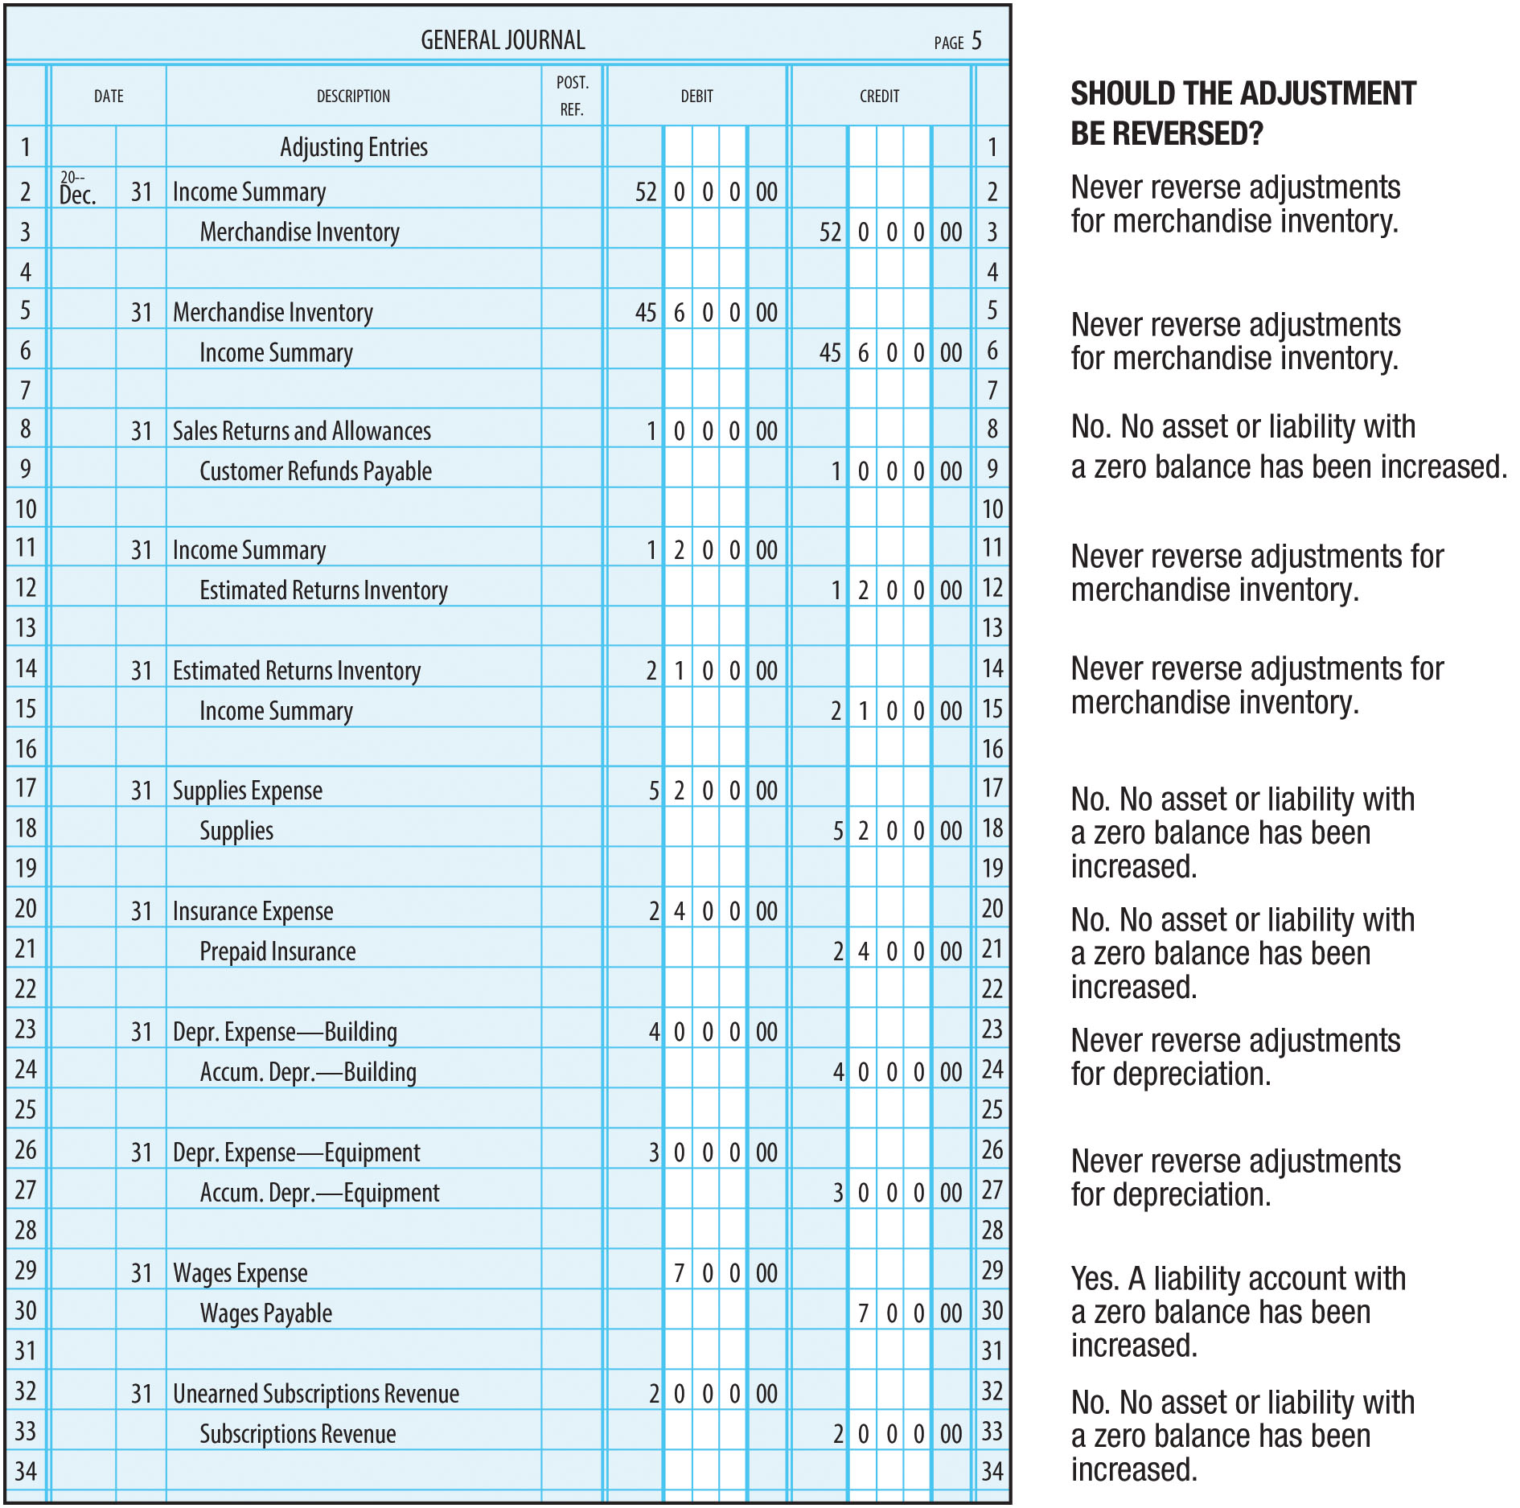
Which Adjusting Entries to Reverse? (FIGURE 15-11)

Slide 43
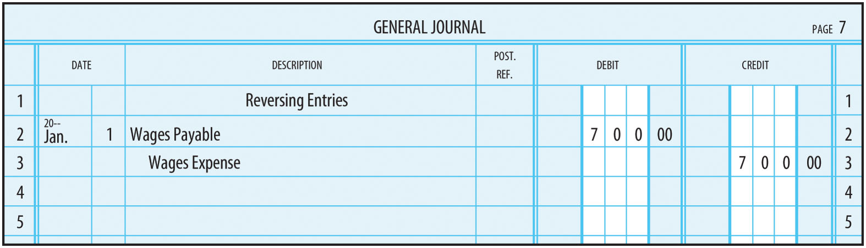
Reversing Entry for Sunflower Cycle (Figure 15-12)

