Slide 1
Communication Styles

Slide 2
Objectives
To describe the communication and listening processes.
To analyze different communication models.
To interpret the effects of nonverbal communication.
To apply communication to professional situations.
To examine the impact of communication on society.

Slide 3
Main Menu
Communication Process & Models
Styles Overview
Listening Process
Nonverbal Communication
Professional Communication
Communication & Society

Slide 4
Communication Process and Models

Slide 5

Communication
Is the exchange of thoughts, opinions or information by speech, writing or behavior
Is vital to the success of any relationship, both personally and professionally
Assists in breaking
down barriers
between opposing
sides to reach a
common goal
By first grade, a child can understand about 10,000 words; by fifth grade, they can understand about 40,000 words.

Slide 6
Communication
Is defined as a process in which one creates and conveys a message to develop a shared understanding
Occurs when there is a message to be shared, person or persons to share it and a medium which can be used to make the sharing possible
  this can be as simple as two people talking or as complex as the planning and thought which occurs when developing a television ad

Slide 7
Basic Elements of Communication
Include:
  sender
    individual or group who sends the message
  message
    thought, idea or opinion, which the sender has encoded and wants conveyed
  channel
    portion of the communication process which carries the message to its desired location
  receiver
    target of the message
  feedback
    receiver’s response to the message

Slide 8
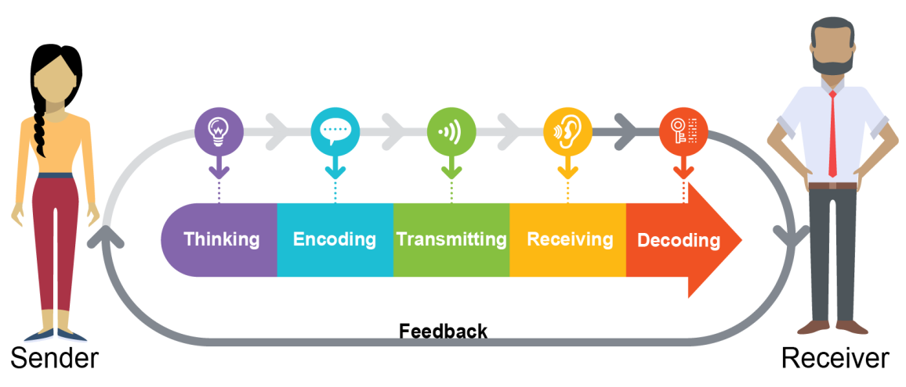
The Communication Process
Refers to the steps taken in order to successfully send and receive a message
  thinking
  encoding
  transmitting
  receiving
  decoding
  feedback

Slide 9
The Communication Process
In this depiction, the channel used to convey the message is simply verbal communication between the sender and the receiver.

Slide 10
Thinking
Is the initial step in the communication process
Involves the source or sender generating information intended to be shared with others
  information can be primary or secondary
    primary information is an original, fundamental and authoritative statement pertaining to an event or subject of inquiry; a first-hand or eyewitness account of an event

Slide 11

Encoding
Is the process of transforming a message into a transferrable form
  communicator translates
  thoughts into a series
  of verbal and nonverbal
  actions, which will
  communicate the
  message to the
  intended receiver

Slide 12

Transmitting
Involves selecting the appropriate channel of communication for message delivery
  a message channel refers to the medium which carries the message from the sender to the receiver
    such as speaking, writing, video or audio

Slide 13

Receiving
Is the stage which involves the reception of the sender's message by the intended individual or audience
  messages may be received in the form of hearing, seeing or feeling

Slide 14

Decoding
Is the process a receiver uses to mentally process a message
  in order to understand the sender’s message
Effective communication can only occur when both the sender and the receiver assigns the same or similar meanings to the message.

Slide 15
Feedback
Is the final step of the communication process
Refers to any response the receiver offers to the message
  this could be communication or behavior
    a person or group of people conversing back to the sender of the message
    facial expressions or body movement
Increases effective communication
  ensuring the receiver has correctly understood the message

Slide 16
Models of Communication
Refers to conceptual models used to explain the communication process
Examples include:
  Linear Model
  Interactive Model
  Transactional Model

Slide 17
Linear Model of Communication
Is considered a one-way process where the sender is the only one sending a message and the receiver does not offer feedback
  sender is more prominent in linear models of communication
Examples include:
  Aristotle’s Model
  Shannon-Weaver Model
  Berlo’s SMCR Model

Slide 18
Aristotle’s Model of Communication
Is the model used in public speaking, persuasion and propaganda
Focuses on the speaker and the message or speech
  is a speaker-centered model, as the speaker has the most important role and is the only one who is active while the audience is passive and influenced by the speech

Slide 19
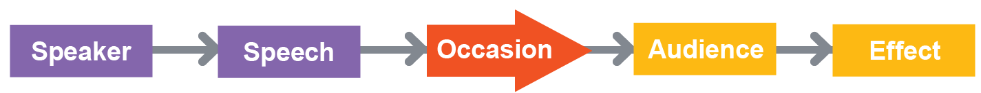
Aristotle’s Model of Communication
Is broadly composed of five elements:
  speaker
    creates speech beforehand based on the audience and occasion
  speech
    prepared so the audience is persuaded or influenced
  occasion
    situation in which the speech is given

Slide 20
Aristotle’s Model of Communication
Is broadly composed of five elements:
  audience
    those listening to the speech
  effect
    action taken by the audience

Slide 21
Shannon-Weaver Model of Communication
Was designed to mirror the function of telephones or radio
  primarily designed to improve technical communication
Is considered a linear model, even though it contains feedback, because the primary focus is on the sender and the message being sent to the receiver

Slide 22
Shannon-Weaver Model of Communication
Is based on the following elements:
  information source
    sender which produces the message
  transmitter
    encodes messages into signals
  channel
    method of getting the message to the receiver
  noise
    physical noise, such as loud noises

Slide 23
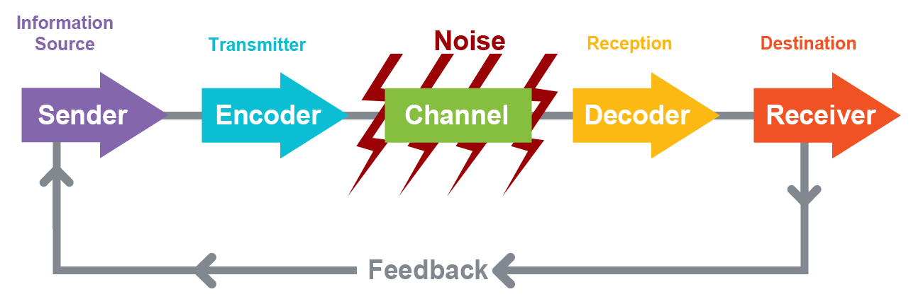
Shannon-Weaver Model of Communication
Is based on the following elements:
  reception
    reception of the message to be decoded
  destination
    location or person where the signal arrives
  feedback
    response of the receiver

Slide 24
Berlo’s SMCR Model of
Communication
Was developed from the Shannon-Weaver Model
Follows the process of a source encoding a message for a channel to a receiver who decodes the message
Describes factors impacting the individual components in communication, as well as encoding and decoding
Does not account for noise or barriers within communication or feedback

Slide 25
Berlo’s SMCR Model of Communication
Has four main components:
  sender - S
    source of the message
  message - M
    substance or information being sent by sender
  channel - C
    medium used to send the message
  receiver - R
    person or group who receives the message
Depicts how each component is affected by different factors

Slide 26
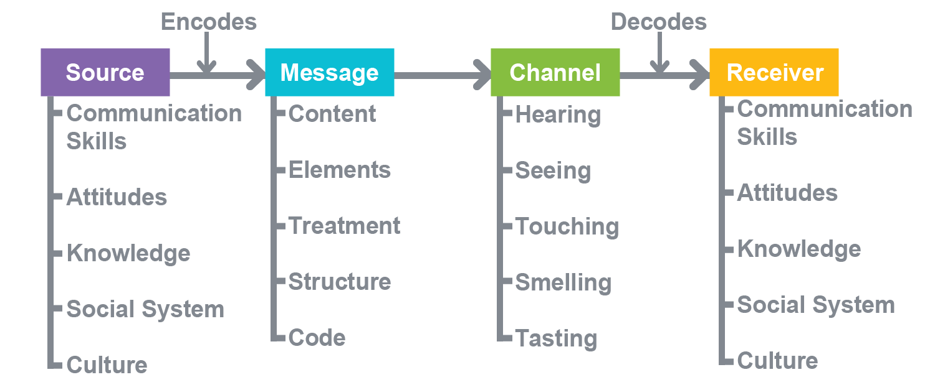
Berlo’s SMCR Model of Communication

Slide 27
Interactive Model of
Communication
Is also known as the Convergence Model of Communication
Depicts the exchange of ideas and messages taking place both from the sender to the receiver, and vice versa, but not as a simultaneous process
Can be applied to the communication process which takes place between humans and machines
  for example, this model can be applied to technologies such as the internet

Slide 28
Interactive Model of
Communication
Includes the following components:
  encoder-source-decoder
    person who originates the message is the source and will also have the role of encoder and decoder; second source will also have the role of encoder and decoder
      first source acts as an encoder while sending the message and as a decoder when receiving a message
      second source acts as a decoder when receiving the message and an encoder when sending feedback

Slide 29
Interactive Model of
Communication
Includes the following components:
  message
    information sent
  feedback
    response to the information sent
  field of experience
    experience and knowledge a source possesses can impact the message formation and interpretation
      can include culture, social behavior and education level

Slide 30
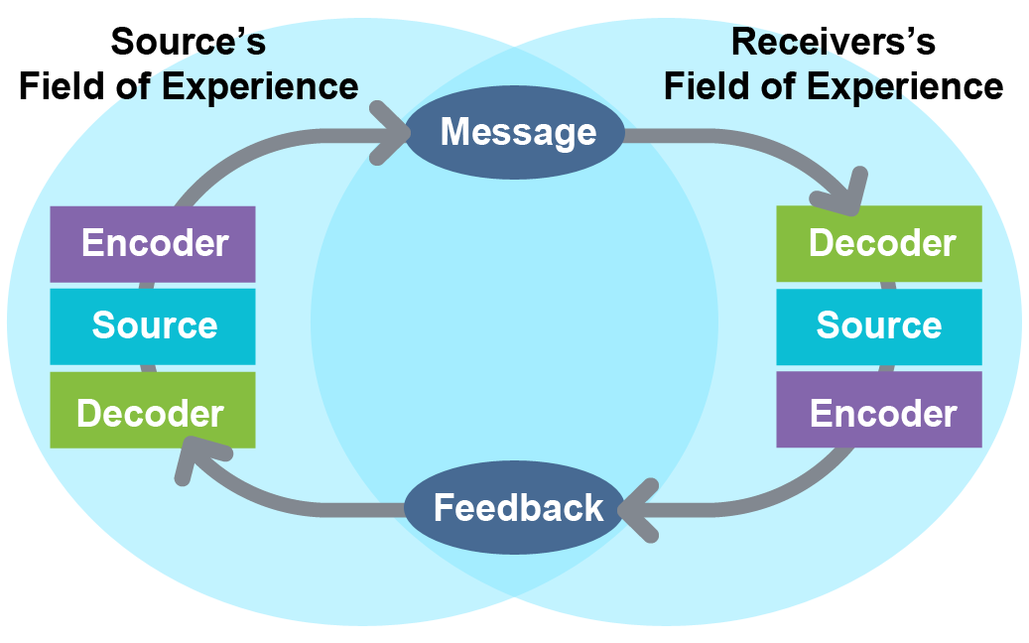
Interactive Model of
Communication

Slide 31
Transactional Model of Communication
Is the exchange of messages between the sender and receiver where each takes turns to send or receive messages
  in this model, communication is a simultaneous process where both the sender and receiver are communicators, and the roles reverse continuously in the communication process
  is most common in interpersonal communication

Slide 32
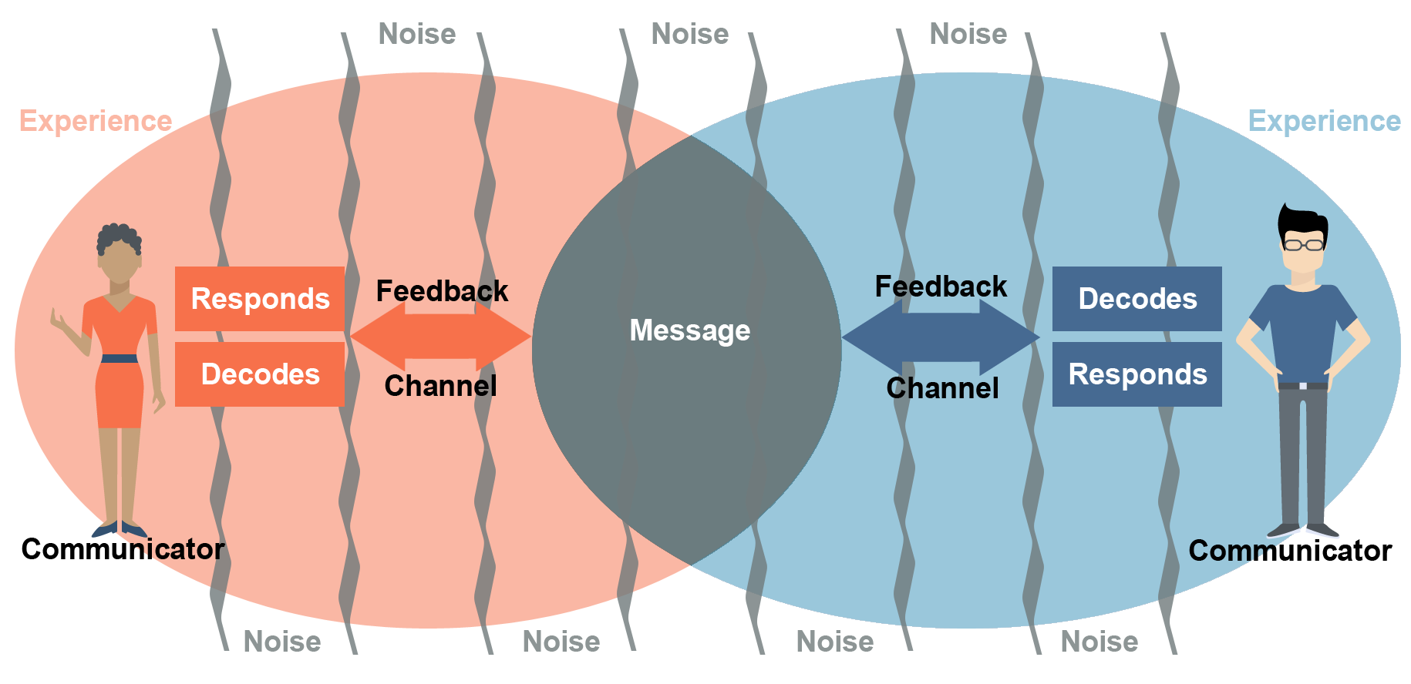
Transactional Model of Communication

Slide 33
Transactional Model of Communication
Accounts for a communicator’s environment
  physical location, personal experiences and cultural backgrounds of the communicator
Examines how the chosen channel can impact the meaning of a message
Includes any noise which can interfere with communication

Slide 34
Transactional Model of Communication
Contains an overlap between each communicator
  this is representative of similarities in the communicators and can show how communication can be more difficult when communicators have less in common

Slide 35
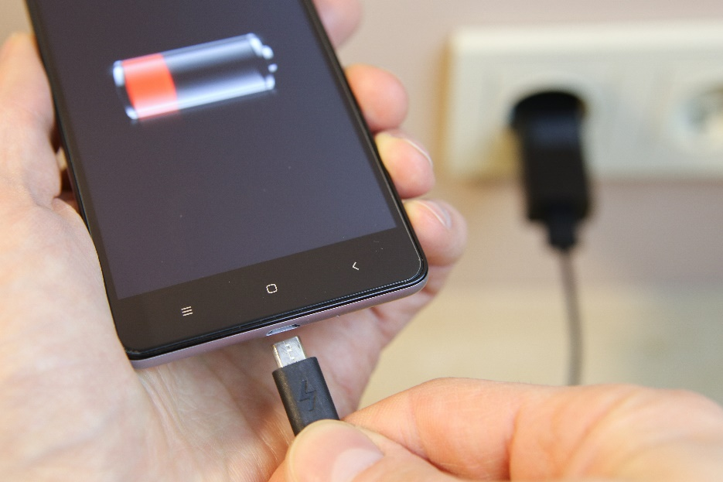
Noise
Is the term given to anything which disrupts the communication process
  preventing an individual or audience from receiving the message the way the sender intended
  disruptions do not
  necessarily involve
  audible distractions

Slide 36

Noise
Can be:
  external noise
    physical noises or barriers, such as loud sounds
  physiological noise
    biological noise factors, such as illness or fatigue
  psychological noise
    internal forces which interfere, such as personal feelings or unwillingness to listen

Slide 37
Styles Overview

Slide 38
Communication Styles
Refer to the way a message is conveyed
  whether communicating through speech or another method, the style impacts how the message will be understood and accepted
Include the following:
  assertive
  aggressive
  passive
  passive-aggressive

Slide 39
Assertive Communication
Is characterized by trying to reach a mutually agreed-upon solution
Usually involves a familiar way of expression and communication
  this is typically described as how people normally communicate
Provides the healthiest and most effective style of communication
  by creating an inclusive atmosphere of self-expression to reach a common solution

Slide 40
Assertive Communication Example
Salesman: I would like to show you some of our products.
Person: No thank you, I'm not interested.
Salesman: We really have a great range to offer you.
Person: That may be true, but I'm not interested at the moment.
Salesman: Is there someone else here who would be interested?
Person: I don't want any of these products.
Salesman: Okay, would you take this brochure and think about it?
Person: Yes, I will take a brochure.
Salesman: Thank you.
Person: You're welcome.

Slide 41
Assertive Communication
Can also be referred to as a “broken record” since the salesman in the example continued to ask the same question repeatedly
  two parties communicated desires and, in the end, achieved the salesman’s goal by having the person take a brochure

Slide 42
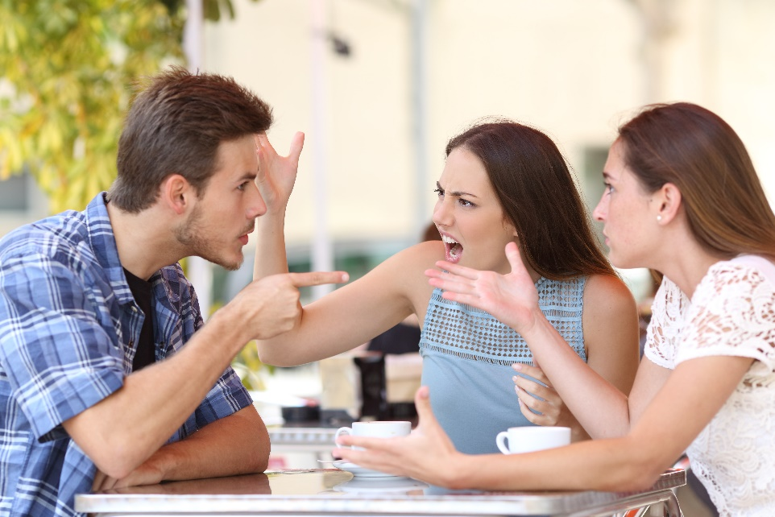
Aggressive Communication
May involve manipulation in order to achieve an end goal
Uses guilt or intimidation
Does not include any compromise
Allows for people
to know how the
speaker truly
feels

Slide 43
Aggressive Communication Example
I feel frustrated when you are late to meetings, I don’t like having to repeat the information
  this example provides feedback and allows the other person to know when they arrive late, they are interrupting the meeting
    allows for the receiver to know how the speaker is feeling
  the person being told the information knows exactly what needs to be done in order to fix the problem without being able to compromise on the solution

Slide 44

Passive Communication
Is based on avoiding confrontation
Is characterized by not reacting, standing up or being noticed
Usually has a person remaining quiet,
not sharing
feelings or not
making a point to
voice an opinion

Slide 45

Passive Communication Example
I wish our house was tidier for our guests this evening
  this example does not provide an assertive opinion
  can be taken as a statement or suggestion

Slide 46
Passive-Aggressive Communication
Is a combination of passive communication and aggressive communication
Includes the desire to avoid conflict but manipulates the situation so the outcome is in the communicator’s favor
Is the most common style

Slide 47
Passive-Aggressive Communication Example
Samantha and her friend planned to watch a movie together, but the friend cancels to hang out with her boyfriend; Samantha remains quiet, so the friend asks Samantha if cancelling would be an issue and she replies, “No. I guess I'll just watch it by myself.“
  Samantha does not communicate her desire to watch the movie with her friend but, instead, hints she will be lonely to make her friend feel guilty and reconsider

Slide 48
Listening Process

Slide 49
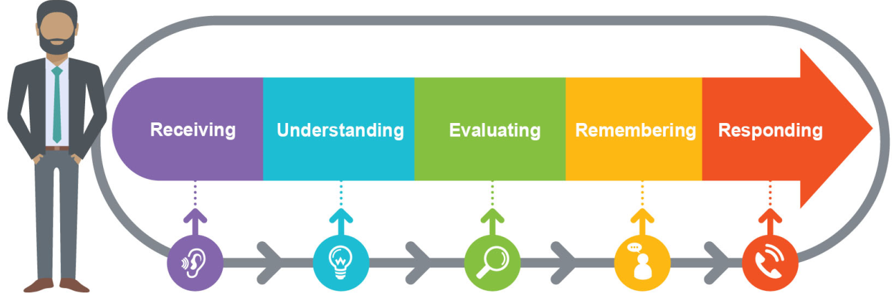
The Listening Process
Refers to the steps taken to fully understand and retain a message
  receiving
  understanding
  evaluating
  remembering
  responding

Slide 50
Receiving
Involves hearing and attending
  hearing is the ability to register sound waves which hit the eardrum
  attending is the process of identifying and interpreting sounds as words
The sounds which are heard have no meaning until placed in the proper context.

Slide 51

Understanding
Is the process through which the listener determines the context and meanings of the words
  understanding is essential to comprehending a speaker’s message

Slide 52
Evaluating
Is the process of the listener assessing information received from the speaker
  this stage is only effective once the listener fully understands the speaker’s message
Allows a listener to form an opinion on received information
  evaluating is important for a listener’s ability to form personal ideas, decisions, actions and beliefs

Slide 53
Remembering
Occurs as the listener categorizes and retains the information gathered from the speaker
Allows individuals to record information about individuals, objects and events for later recall
  this occurs during and after a speaker’s delivery

Slide 54
Responding
Is the stage when the listener provides verbal or nonverbal reactions to a message
  nonverbal reactions include nodding, making eye contact, smiling and other body language cues
  verbal reactions include asking a question, requesting additional information and repeating the speaker’s message

Slide 55

Types of Listening
Include:
  active listening
  passive listening

Slide 56
Active Listening
Requires retaining and applying information
Typically occurs in more formal settings
  such as an office or school
Involves the listener providing feedback to the speaker according to the information received
  restating or paraphrasing heard information

Slide 57

Active Listening
Has the ability to improve personal relationships, reduce misunderstandings, strengthen cooperation and foster understanding

Slide 58

Passive Listening
Involves absorbing information with little or no outward reaction
Typically occurs in informal settings
  such as a conversation between friends
Involves showing
engagement in
listening through
facial expressions
and body language

Slide 59
Nonverbal Communication

Slide 60

Nonverbal Communication
Is messages sent through body language and facial expressions
Helps establish credibility with the audience
Has the potential
to send a message
opposite to the
intended message

Slide 61

Nonverbal Communication
Includes the following:
  eye contact
  facial expressions
  gestures
  posture and body
  orientation
  proxemics
  paralanguage
  humor

Slide 62

Eye Contact
Establishes credibility with the audience by allowing the people to know the speaker is sincere
Helps spark an interest with the topic
Creates an inviting atmosphere for the audience

Slide 63
Facial Expressions
Set the tone for the conversation
  a simple smile can convey friendliness to the audience, making the environment more inviting
Can provide feedback on the information being communicated
  a look of confusion during a speech can help the speaker realize the information needs re-explaining or clarification

Slide 64

Gestures
Are required in communication, otherwise the speaker is seen as unanimated and boring
Should be used appropriately to emphasize certain words or phrases
Create a more interesting appearance

Slide 65
Posture & Body Orientation
Can communicate countless messages by simply walking, talking, standing or sitting
Should be presented where the speaker appears approachable and friendly, rather than distant or rude
Can be distracting if the speaker sways back and forth or is constantly pacing the stage
Using open body language, such as uncrossed arms and legs, sends the message of being more positive and open to the message.

Slide 66
Proxemics
Is the distance between the speaker and the audience
Should be close enough for the audience to maintain attention, but far enough away to not invade the audience’s space

Slide 67

Proxemics Example
Usually, a conversation between two individuals who are familiar with each other is conducted with
a distance of one to two feet
An “indoor voice” is used when standing 12 to 36 inches from the other person.

Slide 68
Paralanguage
Consists of tone, pitch, rhythm, loudness and inflection of voice
Requires practice to reach the correct volume, tone or pitch for a presentation
  each presentation style will vary
  finding the appropriate tone, pitch, rhythm, volume and inflection is key
  can be used to convey emotion
The most common mistake is being monotone.

Slide 69

Humor
Is discouraged in certain settings
Can be used as a simple way of breaking through the stress in a room
Allows for a more friendly approach

Slide 70
Professional Communication

Slide 71
Professional Communication
Refers to the methods used to convey information in the workplace
  effective professional communication is critical in the workplace to ensure the flow of ideas, facts, decisions and advice
Involves:
  communication between coworkers, colleagues, clients and professional contacts
  professional speeches or presentations

Slide 72
Tips for Communication in the Workplace
Include:
  listening
    actively listen to those who are speaking
  paying attention to body language
    notice and respond to nonverbal cues
  considering communication preference
    email may be a great way to communicate with one coworker, but another may prefer face-to-face communication
  keeping tone in mind
    make sure language is clear and cannot be misconstrued
    do not let anger show in communication

Slide 73
Tips for Communication in the Workplace
Include:
  not being too casual
    keep communication professional; being too casual can make others uncomfortable
  checking grammar, spelling and punctuation
    proofread everything written
  keeping criticism constructive and positive
    make sure comments are not emotional; provide positive reinforcement

Slide 74

Tips for Communication in the Workplace
Include:
  restating the message for clarity
    rephrase to show attentiveness and understanding
  practicing
    effective communication is a skill and can constantly be
    improved

Slide 75
Professional Speeches & Presentations
Are another type of professional communication
Can be developed by following these steps:
  preparation
  speaking or presenting

Slide 76

Preparation
Is considered the most important aspect of effective communication
Includes:
  identifying the audience
  selecting the topic
  writing the speech

Slide 77

Identifying the Audience
Is crucial for the preparation process
Allows individuals to know who the message will reach, including the:
  age
  number of people
  education and experience
  occasion

Slide 78

Selecting the Topic
Can be easy; however, developing the topic into a message can be difficult
Should be based on the demographics of the audience and the occasion in which one will be speaking

Slide 79

Topics
Can be categorized into three categories:
  informative
  motivational
  entertaining

Slide 80

Writing Speeches
Allows individuals to organize
and develop points to
communicate
Should follow this format:
  introduction
    creates a first impression
    introduces yourself
    shows courteousness

Slide 81
Writing Speeches
Should follow this format:
  body
    largest portion of the speech
    provides main points
    includes supportive evidence
  conclusion
    review of main points
    instructs audience the speech is ending

Slide 82
Organizing Information
Provides a reasonable thought process of how and when information should be communicated
  allows for the information to be easily understood
  can be done utilizing various techniques, such as:
    outlines
    diagrams
    flow charts

Slide 83
Organizing Information
Is important because it allows for:
  recognizing and retaining information more effectively
  communicating information efficiently
  disregarding useless and unimportant information
  identifying patterns and relating information into knowledge

Slide 84
Organizing Information
Helps in establishing the goal for the communication
  whether it requires persuading or informing another
Assists in ordering thoughts logically into sentences

Slide 85
Tips for Speeches & Presentations
Include:
  making sure the content matches the audience
  practicing and rehearsing
    self-record the presentation to analyze techniques
  speaking with conviction
  maintaining sincere eye contact
  using effective body language
  utilizing pauses to emphasize points
  relaxing

Slide 86
Communication and Society

Slide 87
Impact of Communication on Society
Includes:
  bridges a gap between cultures and communities
  creates and shares meanings through words, customs or dress
  is the common denominator which can bring people together

Slide 88

Communication of Society
Includes information which can be presented in a way to persuade people to think or feel a certain way about a subject
  which is known as propaganda

Slide 89
Propaganda
Is information which has been presented in a way to persuade people to think or feel a certain way about a subject
Can be used to damage the opposing cause
Can be used to influence attitudes toward a product, idea or issue
Encourages people to think or act in some way because other people are doing so

Slide 90
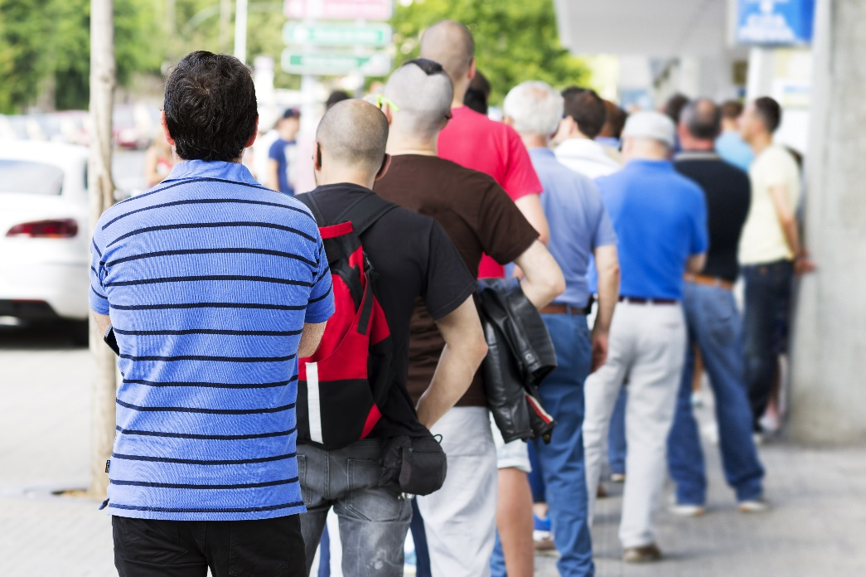
Propaganda
Includes the following techniques:
  bandwagon
  glittering generalities
  “either/or” fallacy

Slide 91
Bandwagon
Is the approach encouraging someone to believe because everyone else is doing something, so they should too; not participating will lead to feelings of exclusion
Is the most common technique
Usually referred to as “Keeping up with the Joneses”
“Keeping up with the Joneses” was created by Arthur “Pop” Momand in 1913 as a comic strip for U.S. Newspapers.

Slide 92
Glittering Generalities
Are characterized by using important- sounding words in a general statement, which have no true meaning and cannot be proved or disproved
Common words used are “good,” “fair” and “best”

Slide 93
Glittering Generalities
Include the use of assumptions
  information which is accepted as truth without having proof
  for example:
    if a doctor is giving a speech about health, it can be assumed the doctor is the most informed person in the room on the subject
Are based on misinformation, obsolete data or misbeliefs

Slide 94

Glittering Generalities Example
Pure, fresh mountain spring water; bottled just for you from our purest Colorado springs

Slide 95
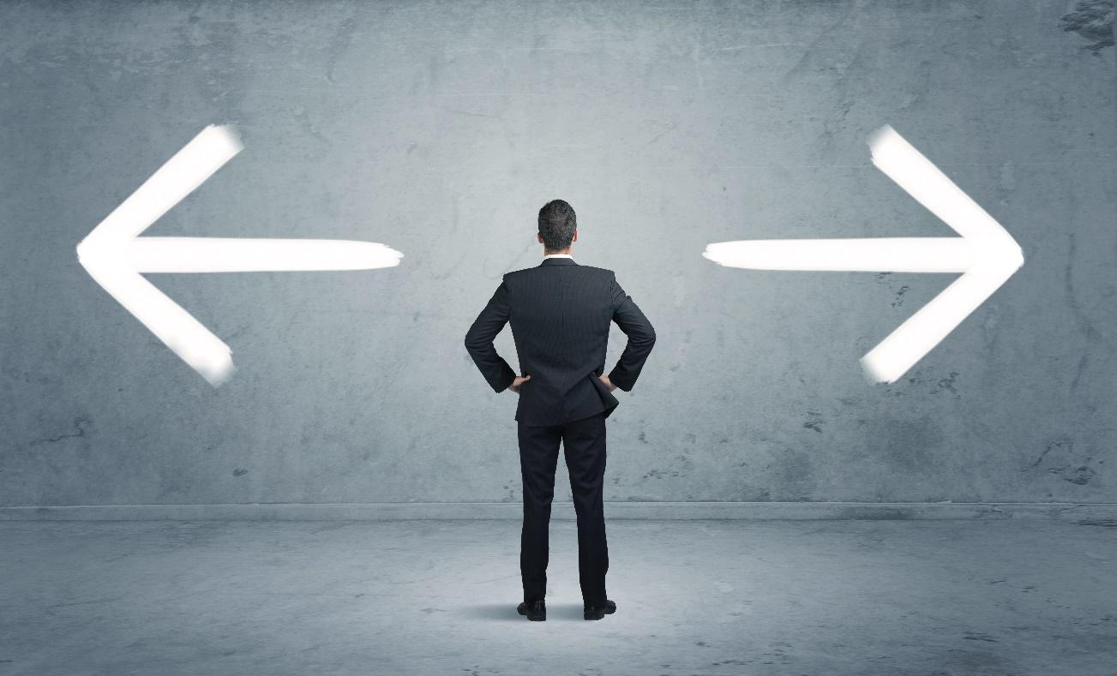
Either/Or Fallacy
Is also known as “black-and-white thinking”
Involves only two choices: for or against
Leaves no room for compromise or ambiguity

Slide 96

Either/Or Fallacy Example
Either you are part of the problem, or you are a part of the solution
Either you are with us, or you are against us

Slide 97
Identifying Propaganda
Can be accomplished by recognizing biased, literal, inferential or factual statements
  bias
    the inclination, feeling, opinion or disproportionate weight in favor of or against and idea or thing
  literal
    the use of words solely by the defined or primary meaning

Slide 98
Identifying Propaganda
Can be accomplished by recognizing biased, literal, inferential or factual statements
  inferential
    a conclusion reached based on evidence and reasoning
  factual
    a piece of information known or proved to be true, rather than interpretations of information

Slide 99
Identifying the Purpose
In communication is important to decide which approach and structure are appropriate to use
  the purpose of a message is for the sender to express knowledge or feelings
  requires the speaker to:
    know the audience
    understand the topic
    realize the goal of the communication

Slide 100
Communication Mistakes
Are very common
Include:
  being poorly prepared
  speaking in a manner which is not easily understood
    talking too fast or soft
    using too many fillers, such as um, eh or well
  avoiding eye contact

Slide 101

Communication Solutions
Can be improved by practicing the following methods:
  practice speaking and be prepared
  take deep breaths and focus on pronunciation
  focus on the audience

Slide 102
Outcomes
Are the observable results
Are based on communication goals
Can be measured by:
  testing audience understanding
    question and answer
    quality measures
      focus groups, interviews, open-ended survey questions
Can be unanticipated
  based on the audience’s reaction

Slide 103
Key Economic Factors Influencing the Communication Industry
Include:
  stage of economic development
  standard of living
  per capita income
  distribution of wealth
  currency stability
  exchange rates

