Slide 1
Preparing for an Entrepreneurial Career: Communication

Slide 2
Objectives
To demonstrate professional business communication skills.
To model business norms for professional interactions.
To display professional communication standards in face-to-face, virtual and phone settings.
To practice professional writing.

Slide 3
Main Menu
Professional Business Communication
Professional Business Norms
Professional Written Communication

Slide 4
Preparing for an Entrepreneurial Career: Communication− Professional Business Communication (Segment 1)

Slide 5
Professional Business Communication
Is the process of sharing information with individuals within and outside of a business
  external communications convey messages about the business to others
  internal communication informs and engages employees
Includes:
−verbal
− nonverbal
− written communication

Slide 6

Verbal Communication
Occurs when words are used to communicate information with others
Is an important part of business interactions
  with customers, stakeholders and coworkers
  face-to-face, over the phone or online
Involves elements of:
  speaking rate
  speaking volume
  tone of voice
  enunciation

Slide 7

Professional Verbal Communication
Involves speaking to others with respect
May include asking and answering questions to gain insight and direction
Usually avoids the use of slang
Requires:
  clear enunciation of words
    avoid mumbling
  speaking at an appropriate volume and tone

Slide 8
Nonverbal Communication
Uses body language and facial cues to convey information without the use of words
Enhances the clarity, impact and understanding of verbal messages
  for example, open posture demonstrates being approachable
Helps build rapport, establish trust and strengthen communication

Slide 9
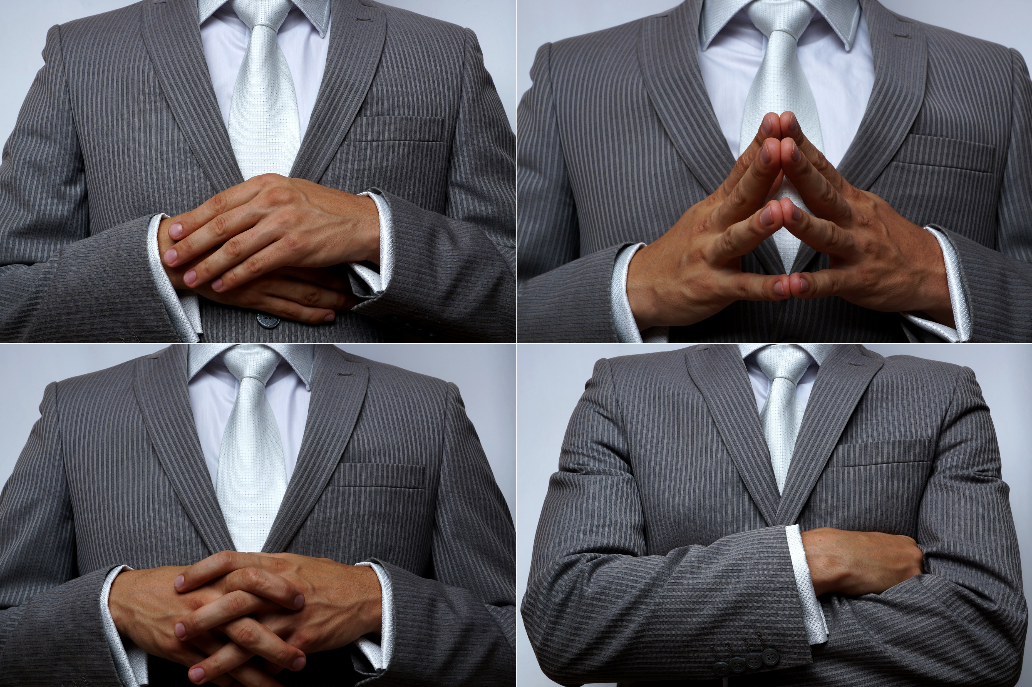
Body Language
Involves posture and the use of gestures or movements
Should communicate openness and interest when communicating with others professionally

Slide 10

Body Language Discussion
Consider what the following body language is communicating. Be prepared to share with the class.

Slide 11

Professional Nonverbal Communication
Shows respect for cultural differences in personal space
Involves eye contact between the speaker and listener
Can be used to express emotions or attitudes, such as:
  smiling
  frowning
  raising eyebrows
Requires active listening

Slide 12

Active Listening
Is a communication technique where the listener focuses on understanding and responding to what is communicated
  requires full attention to the speaker
Provides feedback to the speaker

Slide 13

Active Listening
Is effective when the listener:
  makes eye contact
  asks questions
  avoids interruptions
  nods
  paraphrases information
  asks clarifying questions
  defers judgment

Slide 14
Verbal vs. Nonverbal Communication Discussion
With a partner, take turns to discuss the following question.
  What are the similarities and differences between verbal and nonverbal communication?
Main Menu

Slide 15
Preparing for an Entrepreneurial Career: Communication− Professional Business Norms (Segment 2)

Slide 16
Professional Business Norms
Refer to the accepted and expected behaviors and conduct in a professional setting
Support:
  a productive workforce
  positive workplace culture
  effective communication
  successful business
Include standards of attire, face-to-face interaction, virtual interaction and phone communication

Slide 17

Professional Attire
Involves dressing in a manner which shows seriousness and respect for a job
  attire varies to fit the rules and culture of various businesses
    for example, an ice cream show employee has different professional attire than a lawyer

Slide 18
Professional Attire
Generally includes the following, regardless of the workplace:
  clean and well-groomed appearance
  well-maintained clothing
    wrinkle-free
    no holes or tears
  appropriate fitting clothing
    generally avoid overly tight or loose garments
    appropriate lengths and cuts

Slide 19



Appropriate Professional Attire Discussion
With a partner discuss whether each image below would be considered professional attire and why.

Slide 20

Professional Face-to-Face Interactions
Facilitate communication, relationship building and collaboration
Occur regularly in any business, such as:
  meetings
  customer interactions
  trainings
  networking
  negotiations
  community outreach

Slide 21

Professional Face-to-Face Interactions
Should utilize respectful verbal and nonverbal communication, such as:
  professional greetings
  introductions
  eye contact
  positive body language
  active listening

Slide 22

Professional Face-to-Face Interactions
May require participants to:
  arrive on time
  be adaptable
  be empathetic
  respect cultural differences
  limit distractions
    cell phones, side conversations or email
  follow up on action items

Slide 23
Professional Virtual Interactions
Are common in businesses with remote employees or working with others far away
Usually occur through:
  video meetings
  virtual presentations
  webinars
  online training
  collaboration on online documents
Require effective communication, digital etiquette and appropriate use of online tools

Slide 24

Professional Virtual Interactions
Should be conducted in quiet, distraction-free environments
  participants should avoid multitasking
Require stable internet connection to prevent disruptions
May involve recordings
  allows those who cannot attend live to view

Slide 25
Professional Virtual Interactions
Commonly involves participants:
  speaking clearly and concisely
  enabling cameras to promote personal connection
    choose a professional background
  dressing professionally
  muting microphones when not speaking
  arriving on time
  contributing to discussions
    ask questions and actively engage
  using written communication in the chat

Slide 26
Virtual vs. Face-To-Face Interaction Discussion
Consider your response to the following question and be prepared to share it with the class.
  In what situations might virtual communication be more efficient or effective than face-to-face interactions, and vice versa?

Slide 27

Professional Phone Calls
Are commonly used in businesses to facilitate communication, coordination and relationship-building
May occur for:
  job interviews
  client consultations
  sales calls
  customer support
  meetings
Require listening to voicemails and returning calls

Slide 28
Professional Phone Calls
Usually follow these norms:
  answering the call by the third ring
  opening with a courteous greeting
  identifying themselves at the beginning of the call
    for example, hello, thank you for calling, my name is…
  practicing active listening
  only using speakerphone when necessary
  enunciating words
  using respectful verbal communication
  ending the call with a professional goodbye

Slide 29
Professional Phone Calls
May require the caller to be placed on hold
  common hold time practices include:
    limit the number of times the caller is placed on hold
    before placing them on hold, ask the caller, “May I place you on a brief hold”
    provide an estimate of the expected wait time
    place the caller on hold for two minutes or less

Slide 30
Professional Phone Calls
Can be transferred to another person if the caller reaches the wrong department or person
  following these steps:
    inform the caller
    give the caller the transfer information
    thank the caller
    place the caller on a brief hold
    transfer the caller to their new destination
    ensure the call goes through

Slide 31
Professional Phone Call Practice
Practice a professional phone call with a partner while taking turns as the caller.
  Answer the call by the third ring, open with a courteous greeting, identify yourself at the beginning of the call, practice active listening, place the caller on hold and transfer the call.
Main Menu

Slide 32
Preparing for an Entrepreneurial Career: Communication− Professional Written Communication (Segment 3)

Slide 33
Professional Writing Skills
Help businesses communicate effectively and clearly
Can be used to:
  create memos or proposals
  generate reports
  correspond with others
    emails and letters
  develop policies and procedures
  write technical documents
  take meeting minutes
  make social media posts

Slide 34
Professional Writing
Should:
  demonstrate accurate grammar, spelling and punctuation
    use spellcheck and have others proofread to avoid errors
  present information in a logical manner
    seek feedback from others
  use an active voice
  avoid slang or overly casual language
  have content and style tailored to the audience
    avoid jargon unfamiliar to the audience

Slide 35
Professional Email
Is a message shared electronically from a sender to one or more recipients
Usually follows these professional norms:
  maintains a professional and respectful tone throughout the message
  avoids the use of casual language and emojis
  is proofread before sending for any spelling or grammatical errors
  mentions attachments and files when necessary
  uses an email address which reflects the name or initials of the sender

Slide 36

Professional Email
Usually follows the same format of:
  subject line
  formal salutation
  body
  formal closing
  signature line

Slide 37
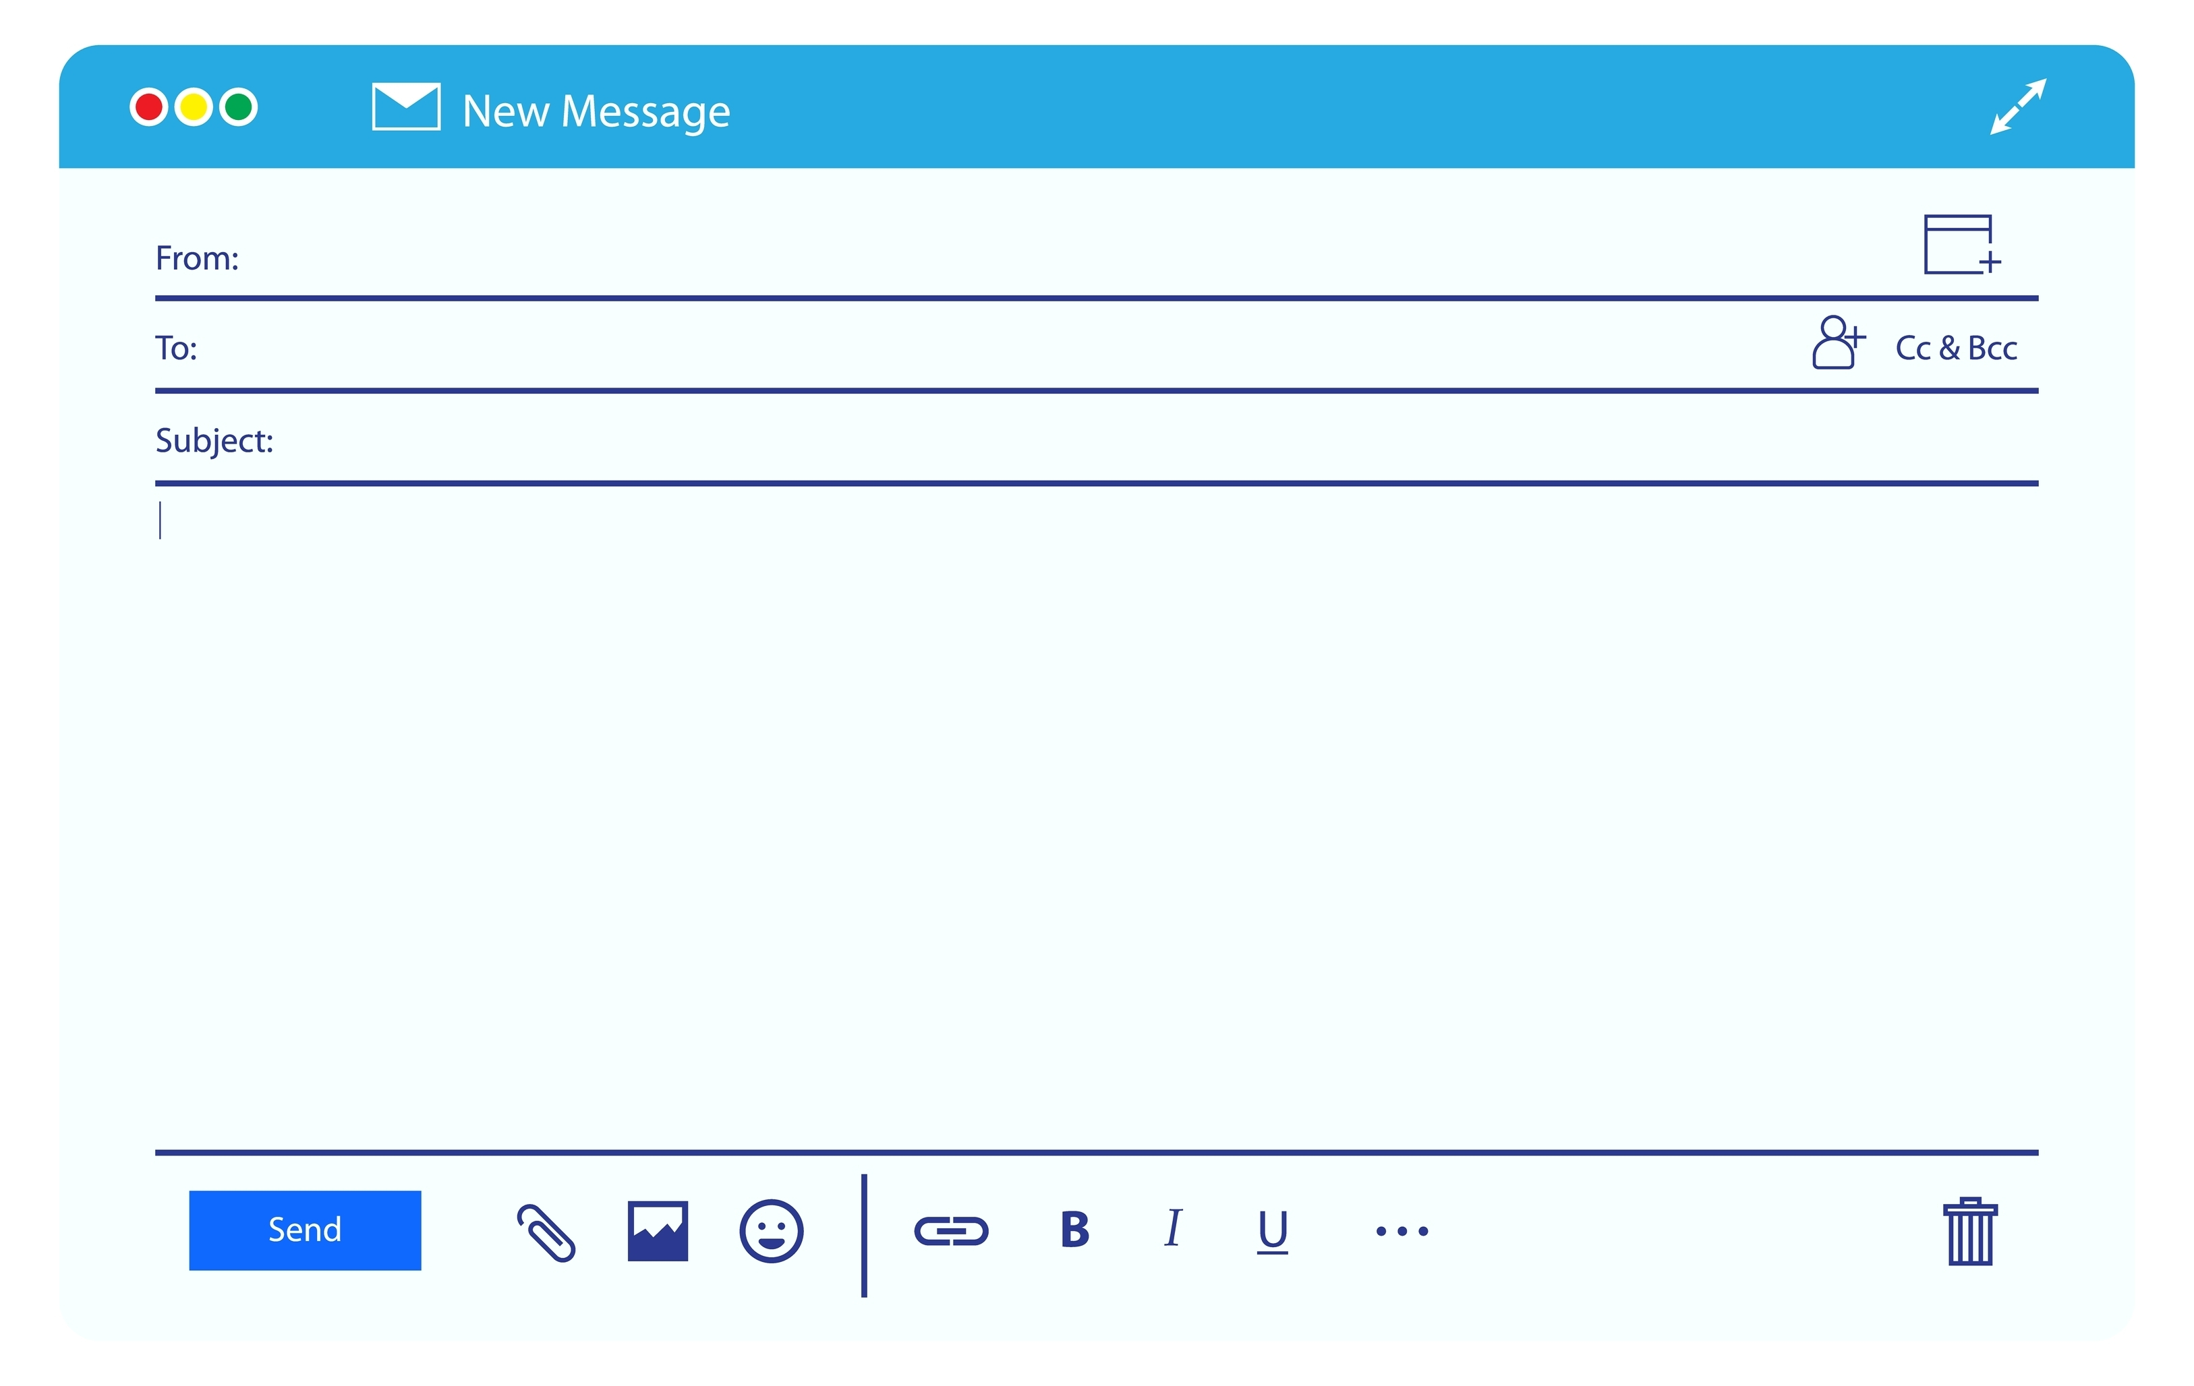
Email Subject Line
Is a brief phrase or sentence to summarize the purpose of the message
  provides the reader with a preview of what to expect
Helps the reader organize and prioritize messages

Slide 38
Email Salutation
Is used at the beginning of an email to greet the reader
Sets a professional tone for the message
Is usually followed by the reader’s name
Commonly includes:
  dear
  hello
  hi
  good morning or evening

Slide 39
Email Body
Is the main content of the email with the information communicated to the recipient
  keep it concise
Usually starts with a brief introduction stating the reason for the email
Includes space between paragraphs to make it easier to read
Should be well organized and easy to read

Slide 40
Email Formal Closing
Is the concluding part of an email
Comes after the main body of the email
Serves to end the message
Commonly includes:
  sincerely
  best regards
  kind regards
  yours truly
  best
  thank you
  best wishes
Ends with the sender’s name

Slide 41
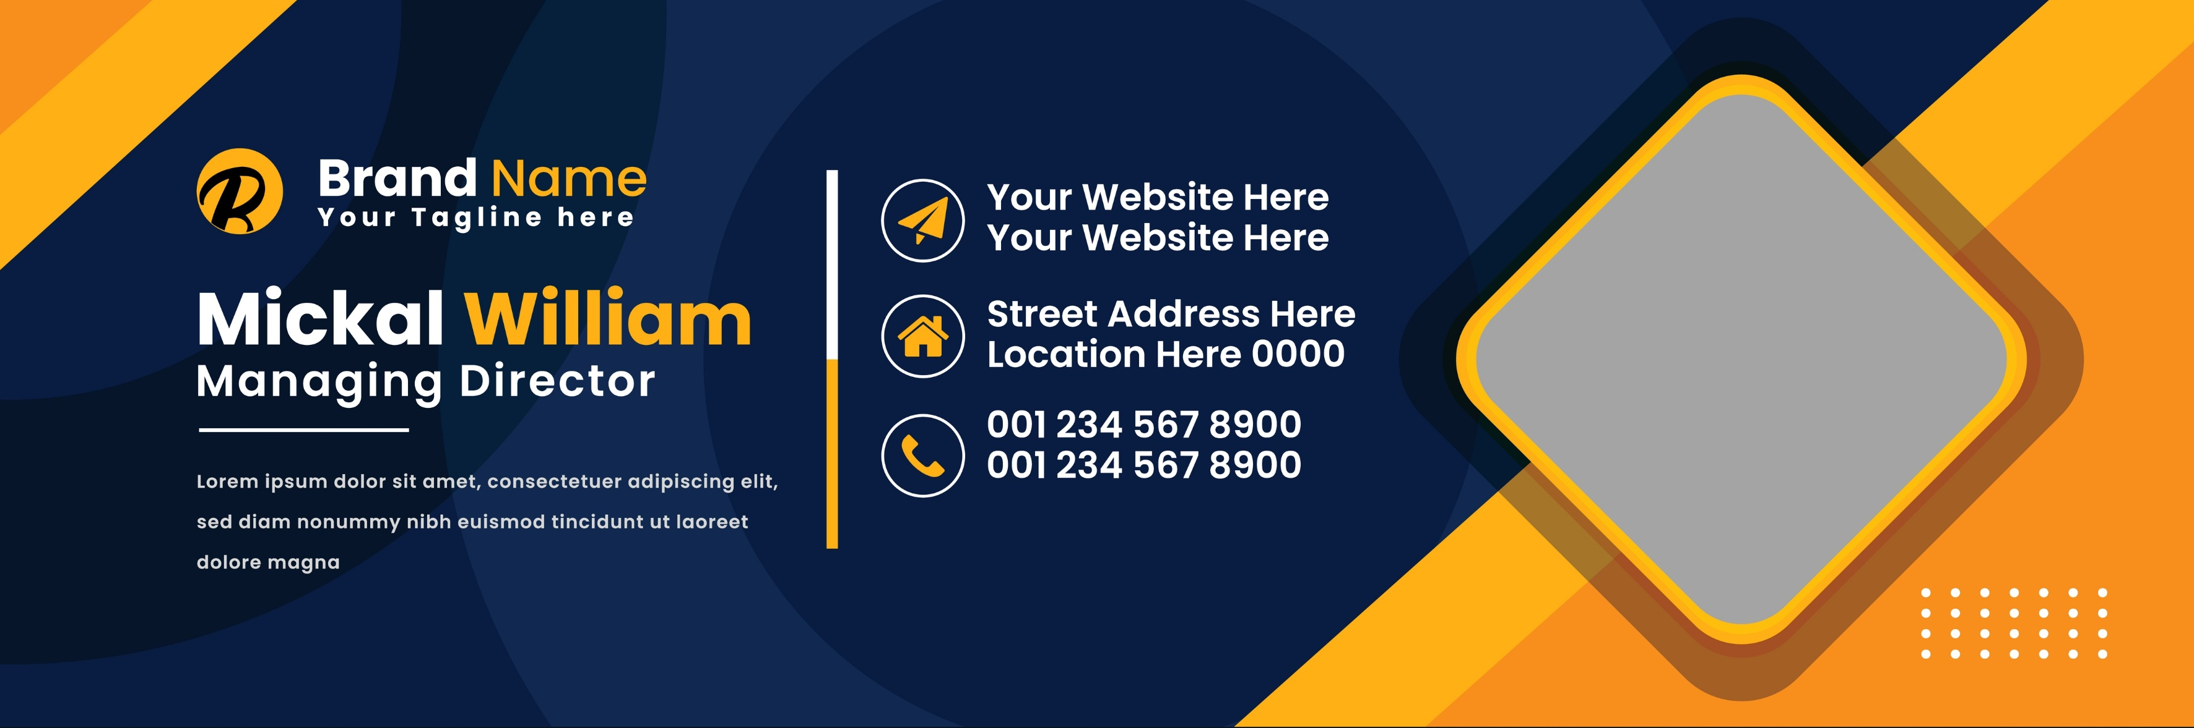
Email Signature Line
Includes details about the sender
  name, position or title, business name and contact information
Is a way to provide contact details and other information

Slide 42
Email Analysis Practice
Work with a partner to identify each part of the email below and identify two ways to improve the email.
To: andybob@icev.com
Subject: Thank You
Andy-
We hope this email finds you well. Thank you for choosing Beauty Foils for your recent purchase. We appreciate your business and are committed to ensuring your satisfaction.
We noticed that your order #12345 was successfully delivered to the address provided. We sincerely hope that you are pleased with your purchase. At Beauty Foils customer feedback is crucial to our continuous improvement, and we would love to hear about your experience.

Slide 43
Email Analysis Practice Continued
Work with a partner to identify each part of the email below and identify two ways to improve the email.
If you have a moment, could you kindly share your thoughts on the product and the overall shopping experience? Your insights are invaluable and will help us enhance our services. You can leave a review on our website or reply to this email with your feedback.
Thank you again for choosing Beauty Foils. We look forward to hearing from you and appreciate the opportunity to serve you.
Best regards,
Heather
C.E.O., Beauty Foils
555-555-555

