Slide 1
Evaluating Applications and Résumés

Slide 2
Objectives
To examine the hiring process.
To identify tips for hiring new employees.
To discover what to search for on applicants' résumés.

Slide 3
Main Menu
Hiring
Applications
Résumés & Tips

Slide 4
Hiring

Slide 5
Hiring
Can be a difficult process
Includes finding the right person for the right job, making your organizations more productive and profitable

Slide 6
The Hiring Process
Includes:
  identify a new position need within the company
  announce the need to job applicants
  accept résumés
  interview applicants
  hire new employee

Slide 7
New Position Need
Must be identified by:
  asking other employees if they feel the need for additional help
  observing the workload of others
Can be due to the need to refill a position left by an employee who left the company
Can be due to the need to form a new position to start a new division or business venture

Slide 8
Job Analysis
Is required to determine job duties and requirements for a given position
Is used to determine the following:
  training needs
  compensation
    rewarding someone for service or by making up for someone’s loss, damage or injury; usually in the form of money
  duties and tasks
  skill level

Slide 9
Job Analysis
Is conducted to analyze the job not the person applying for the job
Data from the analysis can be used to screen applicants' applications, résumés and during interviews

Slide 10
Announce the Need to Job Applicants
By allowing job seekers to recognize the organization has a position opening
By advertising on the Internet, television, radio or newspaper
By informing employees of job openings
  they may refer employees or apply for the position themselves

Slide 11
Accept New Résumés
By utilizing phone, fax or e-mail
By informing job seekers of the individual responsible for reading the résumés
  allows job seekers to direct their job hunt toward specific individuals
  handled most often by the human resource department of a company

Slide 12
Interview Applicants
By viewing candidates face-to-face
By identifying applicants qualified for the position
By comparing candidates
Interview: a face-to-face meeting between the employer and the applicant

Slide 13
Pre-Employment Tests
Are used to identify candidates most likely to perform well on the job
Are necessary because they can be used to:
  cut cost in the selection process
  decrease turnover
  improve attitude

Slide 14
Pre-Employment Test
Can include:
  personality test
    determines certain traits
  talent assessment
    career test
    help employers determine if an applicant will be a good fit for a specific job

Slide 15
Pre-Employment Test
Can include:
  physical exams
    important for jobs which require physical activity
  drug test
    urine or hair
    important for all jobs, especially those which require the operation of heaving equipment and machinery

Slide 16
Federal Laws
Regarding interviewing states the employer can not ask certain types of questions:
  whether of not the applicant has or plans to have children
  marital status
  race
  religion
  sex or sexual preference
  age
  height or weight
  question concerning drugs or alcohol used

Slide 17

Hire New Employee
By offering the chosen candidate the job
By scheduling a time the candidate will start
By negotiating salary and benefits, if necessary

Slide 18
Applications

Slide 19
Applications
Are written requests for employment
Are a record of candidates’ personal and employment history
Should be verified and signed by the job candidate

Slide 20
Applications
Supply employers with information about qualifications, skills and experience
Should be reviewed regularly by organizations to ensure questions
  are job-related
  are up to date
  avoid intrusion into personal life

Slide 21
Job Analysis
Is determining the particulate job duties in detail for a given job
Data is used to:
  know the requirements of the job
  identify the job-relatedness of the skills needed to perform the job

Slide 22
Job Description
Is a list of responsibilities affiliated with a certain career
May include:
  who the employee reports to
  working conditions of the job
  qualifications or skills needed
  salary range

Slide 23
Match Your Résumé
To a job description by:
  adding a value statement
    summarizing what values you can bring
  list relevant courses and projects
    two or three key projects
    elaborate in bulleted list
    do not include this such as GPA
  cut out everything irrelevant
    only included activities which are relevant to the job
    do not include hobbies which are random

Slide 24
Common Misrepresentations
Include:
  dates
    adjusting dates to hide unemployment gaps
  employment history
    creating phony companies
  education
    falsifying information about schools attended and completed degrees

Slide 25
Common Misrepresentations
Include:
  compensation
    increased previous compensation or high salary
  reason for leaving
    withhold reason for leaving
    the application states they were laid off but they were actually fired

Slide 26
Applications
Should include questions about the applicant’s:
  name
  contact information
  employment history to present day
  contact information for previous employers
  work availability
  criminal convictions and/or offenses
  health issues
Should include the signature of the job candidate

Slide 27
Applications
Should:
  be filled in using blue or black ink
  be legible
  include correct spelling and grammar
  can be filled out at the business or taken home and returned

Slide 28
Applications
Should NOT include questions about:
  race or national origin
  religion
  age
    unless to verify legal working age
  family or personal background
  marital status
  height and weight
    unless job related

Slide 29
Applications
Should NOT include questions about:
  residence
    rent or own
  political affiliation
  military service discharge information

Slide 30
Résumés and Tips

Slide 31
Résumé
Is a document explaining an applicant’s education, experience and qualifications for a job
Regarded as the one sheet of paper hiring managers see
Represents a person, but cannot accurately portray the following:
  appearance
  attitude
  social skills
Errors are highly frowned upon

Slide 32
Résumé Falsification
Is lying or misrepresenting information on your résumé
May result in termination from your job
Has negative career consequences

Slide 33
Résumés
Should include the following:
  education
  employment
  recent employment
  skills and qualifications
  contact information
  references
Need an overall easy-to-read format

Slide 34
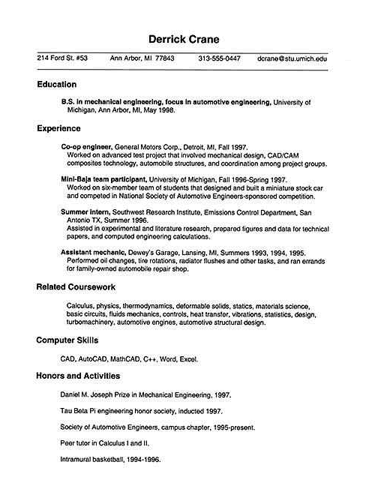
Sample Résumé

Slide 35
Education Section
Shows applicants educational accomplishments
Should include the necessary education requirements for the job
Separates applicant’s résumé from others if education is extensive

Slide 36
Employment Section
Shows previous employers of the candidate
Includes dates of time spent with each company
Highlights the duties the applicant performed
Should minimize or not contain employment gaps
Employment gap: extended period of time when applicant was unemployed

Slide 37
Employment Section
Is especially important in evaluating if a candidate has performed similar duties in the past
  duties at last job should match well with the job duties of the job of application
Shows if the candidate is currently employed

Slide 38
Skills & Qualifications Section
Matches skills and qualifications with job requirements
Draws attention to quality performance in the past
Makes the candidate stand out from other applicants

Slide 39
Contact Information
Includes address, phone number, e-mail, etc.
Must be absolutely clear
Should be up-to-date

Slide 40
References
Are contacts provided by the applicant
Should be used by employers to gather insight concerning the applicant’s job performance, attendance, attitude, etc.
Help employers verify an applicant’s character
Are optional and can only be contacted with an applicant’s consent

Slide 41
Overall Format
Should show professionalism and clarity
Must be error free
Should be easy to read and easy to skim
  hiring managers will view many résumés in a short time period

Slide 42
Interviewers
Should understand the purpose of the interview is to retrieve information about the candidate
Are typically looking for personal qualities and job fit
  information and qualities not found on a résumé include:
    appearance
    attitude
    social skills

Slide 43
Interviewers
Ask questions to provide insight into how a candidate will perform on the job
Should interview multiple candidates

Slide 44
Interviewers
Must be mindful of laws regarding the interview process
Cannot ask questions in reference to the following:
  whether or not the applicant has or plans to have children
  marital status
  race
  religion
  sex or sexual preference
  age
  height or weight
  question concerning drugs or alcohol use

Slide 45
Employers
Use background checks to verify or discover education, criminal records, driving records and credit reports
Call references
  most people can find something positive to say about an applicant
  pay more attention to the negatives
Search for new talent continuously
  excellent organizations never stop the search for new, outstanding employees

Slide 46
Resources
How Is a Background Check Different from Checking References? (2004, December 5). Retrieved October 9, 2008, from AllBusiness:
Interviewing for Employers. (1999-2004). Retrieved October 9, 2008, from Peak Search Company: http://www.peaksearch.net/hiringtips.htm
Job-Seeker's Glossary of Key Job-Hunting, Career, Job-Search, and Employment Terms. (1996-2008). Retrieved October 9, 2008, from QuintCareers.Com: http://www.quintcareers.com/jobseeker_glossary.html
Ten Tips on Hiring Your First Employee. (1999-2008). Retrieved October 9, 2008, from AllBusiness: http://www.allbusiness.com/human-resources/workforce-management-hiring/3934-1.html
Ten Tips to Hiring and Keeping Top Employees. (2003). Retrieved October 9, 2008, from Stengel Solutions: http://www.stengelsolutions.com/tips18.htm
Your Career: How Others Read Resumes. (2001, May 28). Retrieved October 9, 2008

Slide 47
Acknowledgements
Production Coordinator
Liz Weber
Project Coordinator
Maggie Bigham
Technical Writer
Jessica Odom
Production Manager
Dusty Moore
V.P. of Brand Management
Clayton Franklin
Executive Producer
Gordon Davis, Ph.D.
© MMIX
CEV Multimedia, Ltd.

