Slide 1
Managing People

Slide 2
Objectives
To gain an insight into human resource management.
To learn the traits of a good manager.
To obtain knowledge concerning various management strategies and theories.

Slide 3
Main Menu
Management Overview
Employee Management
Management Theories

Slide 4
Managing People – Management Overview

Slide 5
Human Resource Management
Is a strategic approach to the management of an organization’s most valued assets — the people
Is synonymous with personal management, personnel administration, industrial relations and employee relations

Slide 6
Human Resource Management
Is based on the assumption employees are individuals with varying goals and needs
Focuses on the belief employees should not be thought of as basic business resources such as a desk or computer
Takes a positive view of workers

Slide 7
Management
Comprises the directing and controlling of a group of people for the purpose of coordinating and harmonizing the group toward accomplishing a goal

Slide 8
Traits of a Good Manager
Character
Vision
Motivational skills
Knowledge
Communication skills
Personal drive
Interpersonal skills
Planning and organizational skills

Slide 9
Character
Includes displaying honesty, sincerity and candor in all situations
Is always ethical and moral
Inspires employees to trust the manager or leader
Allows managers to lead by example

Slide 10
Vision
Involves looking at the small and big picture
Allows for priorities to be established
Consists of not only organizational skills, but also creativity and thinking “outside of the box”
Plays a large role in the inspiration of employees

Slide 11
Motivational Skills
Allow managers to inspire their employees by:
  gaining respect
  setting an example
  conveying ideas
Involve displaying confidence and excitement
Are conveyed through the charisma of an individual

Slide 12
Knowledge
Encourages managers and other employees to become life-long learners through the use of:
  professional associations, trade journals, workshops and training seminars
Allows leaders to study, prepare and seek challenging assignments
Facilitates quick thinking and problem solving
Enables individuals to be able to logically create ideas and methods to reach other individuals

Slide 13
Communication Skills
Allow managers to accurately convey thoughts, feelings, goals and objectives to employees
Facilitate good company morale with clear communication
Involve communicating verbally and non-verbally with others as well as listening
Ensure easy coordination with other departments and employees

Slide 14
Communication Skills
Include being able to assume the communication roles of:
  mentor: gives advice and support to employees
  trainer: explains facets of a job or task
  presenter: enlightens employees with information on projects, office policies and other organizational presentations
  counselor: serves as an advisor on interoffice problems

Slide 15
Personal Drive
Allows a leader to stay energized
Inspires employees to follow example
Encompasses the idea of being goal oriented
Includes being intrinsically motivated

Slide 16
Interpersonal Skills
Are used in working with others
Are the measures of a person's ability to operate within business organizations through social communication and interactions
Involve the relationships which are established from manager to employee, manager to team and manager to department

Slide 17
Planning & Organizational Skills
Involve the ability to effectively and efficiently:
  create and manage teams
  coordinate with other departments
  control quality of goods and services
  strategize
  set deadlines
  save time and money

Slide 18
Activity
What are some additional traits you think are valuable for a manager to possess

Slide 19
The Roles of Managers
Can be divided into three main categories:
  interpersonal roles
  informational roles
  decisional roles

Slide 20
Interpersonal Roles
Are concerned with the relationships between individuals
Link all managerial work together
Include these general roles:
  figurehead: represents the organization
  director: defines the relationships between the manager and employees
  liaison: serves as a contact for the organization to the public as well as from department to department

Slide 21
Informational Roles
Are concerned with the information aspects of managerial work
Ensure information is provided to all employees
Include these general roles:
  monitor: supervises the quality of the work being completed
  distributor: spreads the information to all employees
  spokesperson: presents information to higher management or to the public

Slide 22
Decisional Roles
Place the manager at the center of the decision-making process
Include these general roles:
  entrepreneur: initiates change in the organization
  disturbance handler: deals with threats to the organization
  resource distributor: chooses where the organization should place its efforts
  negotiator: discusses topics on behalf of various departments and individuals in the organization

Slide 23
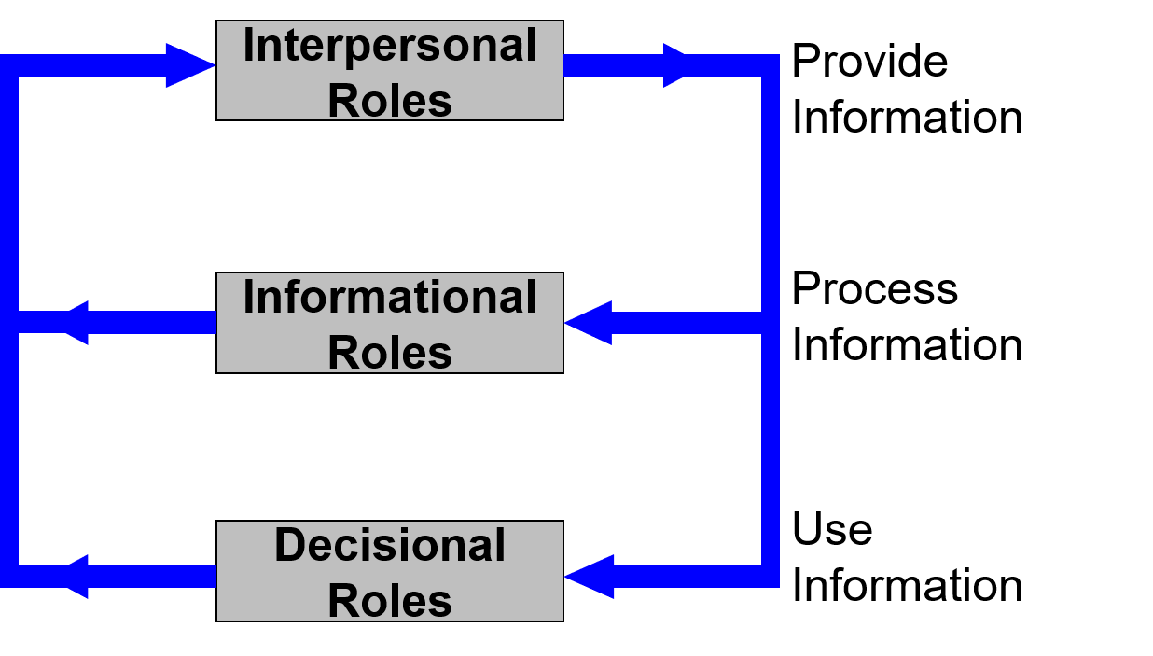
How the Managerial Roles Work Together

Slide 24
Management Styles
Are methods of leadership which are practiced to some degree by most individuals
Include the:
  autocratic style
  democratic style
  laissez-faire style

Slide 25
Autocratic Leaders
Hold all the authority and responsibility
Are normally found in organizations where communication moves from the top to the bottom
Assign employees specific tasks and expect orderly results
Are very directive and military in nature
Exemplify the statement, “my way or the highway”

Slide 26
Democratic Leaders
Hold the final responsibility, but delegate authority to others
Require active communication throughout the organizational structure
Require employee commitment due to high employee participation in the decision-making process
Exemplify the statement “let’s work together”

Slide 27

Laissez-Faire Leaders
Give authority to employees
Allow employees to work with minimum interference from management
Occur in organizations where communication flows horizontally among group members and leaders
Grant as much freedom to employees as possible
Exemplify the statement “do it your way”

Slide 28
Managing People – Employee Management

Slide 29
Managing Departments & Teams
Is vital to the productivity of an organization
Includes these techniques:
  matching the personalities of team members
  focusing on personal strengths and weaknesses
  creating a productive and functional work environment
  understanding employee needs
  establishing a chain of command
  maintaining departmental or team motivation

Slide 30
Managing Employees
Is a difficult but doable task
Involves dealing with multiple personality types
Is essential for the successful running of a business
Is a key element of management

Slide 31
Tips for Successful Employee Management
Understand employees’ motivations
Define roles and responsibilities
Set measurable team objectives
Provide a forum for regular feedback
Set and enforce consequences
Show appreciation and recognition

Slide 32
Understanding Employees’ Motivations
Is a simple strategy which needs to be completed by every manager
Allows managers who frequently write off troublesome employees as "difficult people" to realize no worker is “unmanageable”
Enables managers to view a person who seems problematic as someone they have not taken the time and effort to understand

Slide 33
Goals
Can have a great affect on motivating employees
  give direction
  energize employees
  set challenges
Should be SMART
  specific
  measurable
  aggressive
  realistic
  time-bound

Slide 34
Employee Perception
Is how one views the company for which they work
  includes individual job tasks
Has been shown to have an impact on the performance of a company
  employees with a favorable attitude toward their job will result in
    greater worker retention
    loyal customers
    better financial performance

Slide 35
Defining Roles & Responsibilities
Ensures everyone knows his or her role and responsibilities
Prevents confusion over responsibilities, which can lead to employee “turf wars” or unfinished tasks
Establishes clear lines of communication
Identifies a chain of command

Slide 36
Line Authority
Gives the right to make decisions and give orders to subordinates regarding production, sales and finance
Pertains to matters directly involving management
  production and sales managers exercise this authority

Slide 37
Staff Authority
Consists of the right to advise and assist those who possess line authority
  services include budgeting, controlling, pricing and special decisions
Can help improve effectiveness of line personnel
  purchasing and finance exercise this authority

Slide 38
Span of Control
Determines the number of subordinates a manager can supervise at one time
  set by the type of work involved
    for example, mass production needs less supervision than craftsmen

Slide 39
Line Organization
Is the most simple and oldest method
Has a superior-subordinate relationship
Use a scalar chain of demand
  ranges from top authority to the lowest

Slide 40
Line Organization
Advantages include:
  simplicity
  fixed responsibilities
  unified control
Disadvantages include:
  overloading
  lack of specialization
  limited communication

Slide 41
Line-and-Staff Organization
Is a compromise of line organization
Divide the organization into areas to which staff specialists are attached
Has both line and staff authority

Slide 42
Line-and-Staff Organization
Advantages include:
  improved oversight
  relieving management
  focus decisions in specific areas
Disadvantages include:
  overlapping authority
  line and staff conflicts
  interdependence issues

Slide 43
Matrix Organization
Is an organizational structure where people report to multiple managers who have different roles
Can be used when:
  a company has multiple products
  a company operates internationally
  a company works in a changing environment

Slide 44
Matrix Organization
Advantages include:
  flexible
  more efficient
  increased motivation
Disadvantages include:
  ambiguity
  conflicting instructions
  costly for double management

Slide 45
Total Quality Management
Is a management system focused on customers
  customer determines quality
Involves all employees working toward similar goals
Pushes continual improvement throughout the organization

Slide 46
Total Quality Management
Advantages include:
  improves reputation
  higher employee morale
  higher quality products
Disadvantages include:
  benefits may not be seen quickly
  workers may resist change
  high introduction costs

Slide 47
Setting Measurable Team Objectives
Creates quantifiable objectives and milestones everyone will understand and want to accomplish
Allows your team to work toward a well-defined collective goal
Decreases the likelihood of individuals sinking into spitefulness
Enhances the feeling of accomplishment when goals are met

Slide 48
Providing a Forum for Regular Feedback
Allows managers to detect brewing conflicts
Enables leaders to make changes to policies or practices which are hindering or helping an organization
Can be structured as department meetings, team meetings, individual meetings, comment cards, etc.
Gives “problem team members” a chance to explain or talk about their actions and feelings

Slide 49
Setting & Enforcing Consequences
Enables managers to have a functional set of rules at their disposal
Creates the limits employees should abide by
Decreases the likelihood for team resentment as everyone will be held to the same limitations

Slide 50
Showing Appreciation & Recognition
Demonstrates to employees the manager cares about them
Can prevent group animosity toward the manager
Examples include:
  coming in on Friday with a cup of coffee
  taking the team out to lunch
  sending an appreciation e-mail to members of the team

Slide 51
Employee Personality Types
Vary from individual to individual
Play a vital role in inter-office relationships
Are a key component to managing people
  each personality type should be
    considered when placing employees into teams, departments and management positions
    dealt with individually
Can be determined by personality tests

Slide 52
Understanding Employee Personality Types
Allows for higher-performing and more satisfied employees if their personality type is compatible with their job
Enables a manager to recognize the strengths and weaknesses of each individual in order to compile functional teams and departments

Slide 53
Employee Personality Measures
Are the general characteristics which contribute to employee performance
Include:
  locus of control
  Machiavellianism
  self-monitoring

Slide 54
Locus of Control
Is the source of control over an individual’s behavior
Is either:
  internal - possessed by individuals who believe they control their own fate
  external - possessed by individuals who believe their lives are controlled by outside forces

Slide 55
Internal Individuals
Are driven and likely to work for achievement
Plan for long-term goals and rewards
Are less likely to take risks
Are extremely hard on themselves
Re-evaluate for future performance and are likely to lower their goals after failing an assignment

Slide 56
Internal Individuals
Are happiest in jobs where:
  goals can be set
  risks are small or can be avoided
  achievement can be reached
  others can praise their work
  they have control over personal space and work
Need:
  democratic or laissez-faire leadership
  personal space
  tasks which require thinking, reasoning and creativity

Slide 57
External Individuals
Are often less satisfied with their jobs
Place the blame on others rather than themselves
Are very focused on how they are viewed by others
Are normally outgoing
Are more likely to take risks
Do not deal well with vague situations
Re-evaluate the situation and normally raise standards after failing an assignment

Slide 58
External Individuals
Are happiest in jobs where:
  goals are short-term
  achievement can be reached in short periods of time
  they are surrounded by other individuals
  risks can be taken
  the job is very planned and not ambiguous
Need:
  autocratic or democratic leadership
  group involvement
  an open communication channel with all employees and supervisors

Slide 59
Machiavellianism Tendencies
Are manipulative behavioral traits based on the belief the ends can justify the means
  individuals who possess these traits can be viewed as ruthless, cutthroat, unfeeling or uncaring
  individuals are:
    motivated on jobs which require bargaining or where there are substantial rewards for winning
    frustrated on jobs where specific rules must be followed or where rewards are based more on using the proper means than on the achievement of the outcome

Slide 60
Self-Monitoring
Is the ability to adjust behavior to external situational factors
  if the ability is high, they can easily behave according to the situation, but their true feelings are not always known
    these individuals can play multiple roles in office work groups
  if the ability is low, they do not disguise their feelings or beliefs and very rarely conform to their surroundings
    these individuals can be viewed as abrasive, but it will always be clear as to where they stand

Slide 61
Difficult Workplace Personalities
May include:
  the aggressive employee
  the “talker”
  the overwhelmed/stressed employee
  the lazy employee
  the “gossip”

Slide 62
Activity
What are some valuable strategies for managing employees with difficult personality traits

Slide 63
Tips for Employee Management
Handle discipline matters privately
Schedule break times to prevent constant employee chatting
Give detailed deadlines to all employees
Hold individual meetings with employees to discuss quality of work, work habits, suggestions and concerns

Slide 64
Tips for Employee Management
Schedule company social activities during “off hours” to encourage networking outside the office
Establish positive work environments
Lead by example

Slide 65
Managing People – Management Theories

Slide 66
Management Theories
Are ideas associated with successful management techniques
Give managers prospective ideas on how to complete tasks
Vary by organization and business structure

Slide 67
Management Theories
Include
  Theory X-Theory Y
  Motivation-Hygiene Theory
  Maslow’s Hierarchy of Needs

Slide 68
Theory X-Theory Y
Is an idea created by Douglas McGregor
Are two contrasting theories
Explain a supervisor’s view of human nature is based on certain groupings of assumptions

Slide 69
Theory X
States the four assumptions which are held by supervisors:
  employees inherently dislike work and when possible will try to avoid it
  since employees dislike work, they must be coerced, controlled or threatened with punishment to achieve the desired goals
  employees will shrink responsibilities and seek formal direction whenever possible
  most workers place security above all other factors associated with work and will display little ambition

Slide 70
Theory Y
Contrasts the negative views of Theory X:
  employees view work as being as natural as play
  a person will exercise self-direction and self-control if he or she is committed to the objectives
  the average person can learn to accept, even seek, responsibility
  the ability to make good decisions is widely dispersed throughout the population and is not necessarily the sole responsibility of supervisors

Slide 71
Theory X-Theory Y
Is suggested as a theory of employee management, but is not confirmed by any evidence for either to be solely correct
Can both be considered correct assumptions to make regarding various employees’ motivation

Slide 72
Motivation-Hygiene Theory
Is an idea created by Frederick Herzberg
States the opposite of satisfaction is not dissatisfaction but no satisfaction, and the opposite of dissatisfaction is not satisfaction but no dissatisfaction

Slide 73
Motivation-Hygiene Theory
Suggests the factors leading to job satisfaction are separate from those which lead to job dissatisfaction
States supervisors who remove factors which causes dissatisfaction may create peace, but do not necessarily motivate employees or increase worker satisfaction
Introduces hygiene factors

Slide 74
Hygiene Factors
Are factors which when adequate may eliminate job dissatisfaction, but do not increase job satisfaction
  examples include:
    salary
    company policies
    administration
    interpersonal relations
    working conditions

Slide 75
Motivation-Hygiene Theory
Suggests emphasizing achievement, recognition, work, responsibilities and growth
  these factors are commonly associated with being rewarding to individuals and thus serve as a strong personal motivator

Slide 76
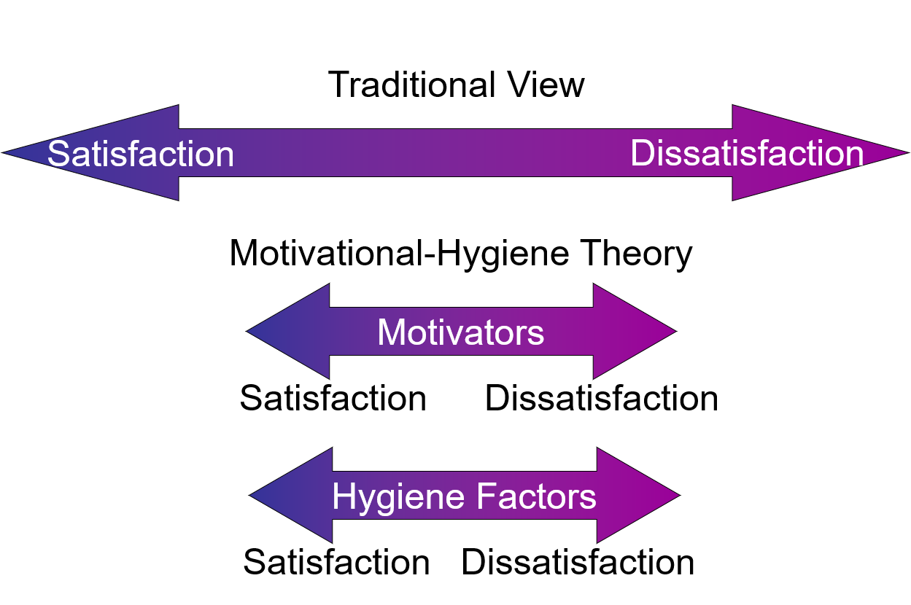
Motivation-Hygiene Theory Graphic

Slide 77
Maslow’s Hierarchy of Needs Theory
Was developed by Abraham Maslow
Identifies the five basic needs of individuals which are:
  physiological
  safety
  social
  esteem
  self-actualization
States once a need is satisfied it no longer creates tension and therefore does not motivate the individual

Slide 78
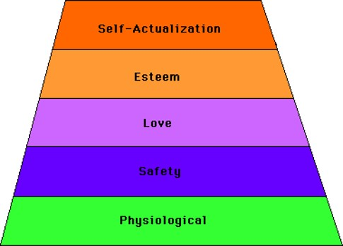
Maslow’s Hierarchy of Needs Theory
Once a need becomes satisfied, the next need becomes dominant and the individual moves up the steps

Slide 79
Maslow’s Hierarchy of Needs Theory
Is not the same for every person
Understands each need is never fully gratified, but a need which is considerably satisfied no longer causes motivation
Is not the best guide for motivating employees due to the variation of need priority from person to person

Slide 80
Which Theory is Best?
No one style is better than the others
It is recommended management should be situational, meaning the management style, methods and theories should all relate to the specific task or environment

Slide 81
Managing People
Is a vital function of human resource management
Enables managers to create conditions in the workplace which will allow employees to work effectively and efficiently
Helps an organization to run smoothly

Slide 82
Managing People
It is important to remember a business is not made by the product it produces, but the people producing the product

Slide 83
Resources
www.businessknowhow.com
www.techtarget.com/tip
www.businessballs.com
www.ifma.com/daily_articles
www.industrialrelations.nsw.gov.au
abcnews.go.com/Business/SmallBiz
www.work911.com

Slide 84
Acknowledgements
Production Coordinators
Amy Hogan
Brand Manager
Megan O’Quinn
Technical Writer
Jessica Odom
V.P. of Brand Management
Clayton Franklin
Executive Producer
Gordon W. Davis, Ph.D.
© MMXIV
CEV Multimedia, Ltd.

