Slide 1
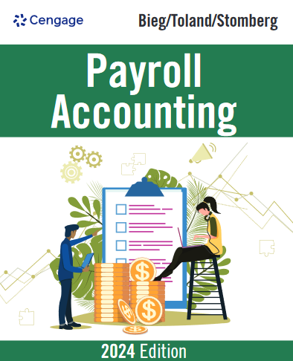
Payroll Accounting, 34e
Chapter 1: The Need for Payroll and Personnel Records
Bieg/Toland/Stomberg, Payroll Accounting 2024, 34th Edition. © 2024 Cengage. All Rights Reserved. May not be scanned, copied or duplicated, or posted to a publicly accessible website, in whole or in part.

Slide 2
Chapter Objectives
By the end of this chapter, you should be able to:
01.01 Identify the various laws that affect employers in their payroll operations. (slides 06-14)
01.02 Examine the recordkeeping requirements of these laws. (slides 15-35)
01.03 Describe the employment procedures generally followed in a Human Resources Department. (slides 36-39)
01.04 Identify the various personnel records used by businesses and the type of information shown on each form. (slides 40-46)
01.05 Identify the payroll register and the employee’s earnings record. (slides 47-52)

Slide 3
The Payroll Profession
Payroll professionals are required to comply with numerous regulations and have advanced knowledge in the area of payroll
Positions within payroll profession range from payroll clerk to senior payroll manager
  As per 2023 payroll survey conducted by Robert Half Associates:
    Average salary for payroll managers is $83,500
    Average salary for payroll clerks is $52,750
  Membership in American Payroll Association (APA) helps in keeping professionals updated with the current changes
  “Code of Ethics” sets direction for profession (Figure 1.1)

Slide 4
Figure 1.1 APA Code of Ethics (1 of 2)
To be mindful of the personal aspect of the payroll relationship between employer and employee, and to ensure that harmony is maintained through constant concern for the Payroll Professional’s fellow employees.
To strive for perfect compliance, accuracy, and timeliness of all payroll activities.
To keep abreast of the state of the payroll art with regard to developments in payroll technologies.
To be current with legislative developments and actions on the part of regulatory bodies, insofar as they affect payroll.

Slide 5
Figure 1.1 APA Code of Ethics (2 of 2)
To maintain the absolute confidentiality of the payroll within the procedures of the employer.
To refrain from using Association activities for one’s personal self-interest or financial gain.
To take as one’s commitment the enhancement of one’s professional abilities through the resources of the American Payroll Association.
To support one’s fellow Payroll Professionals, both within and outside one’s organization.

Slide 6
Many Laws Affect Payroll (1 of 2)
Fair Labor Standards Act (FLSA)
  States’ Minimum Wage and Maximum Hour Laws
Federal Insurance Contributions Act (FICA)
Income tax Withholding Laws
  Federal, State, and Local
Unemployment Tax Acts

Slide 7
Many Laws Affect Payroll (2 of 2)
Fair Employment Laws
  Civil Rights Act of 1964
  Age Discrimination in Employment Act
  Americans with Disabilities Act
Other Federal Laws
Other State Laws

Slide 8
Fair Labor Standards Act (FLSA)
Federal Wage and Hour Law of 1938
Minimum wage is $7.25 per hour and overtime pay requirements
Equal pay for equal work provisions
Sets law for employers involved
  In interstate commerce or
  In production of goods/services for interstate commerce
Establishes minimum wage rates for covered employees
Covered in greater detail in Chapter 2

Slide 9
Federal Insurance Contributions Act (FICA)
Comprised of two taxes
  OASDI (Federal Old-Age and Survivors’ Trust Fund and the Federal Disability Insurance Trust Fund)
  HI (Health Insurance Plan - Medicare)
Both taxes paid by employer and employee
Imposes tax on net earnings of the self-employed individuals
Covered in greater detail in Chapter 3

Slide 10
Income Tax Withholding Laws
Federal income tax
  Levied on earnings of employees
  Is withheld from paychecks
  Percentage formula or wage bracket chart used to withhold tax
State and local income tax
  Is withheld from paychecks
  Different in each state
  Not all states have state income tax
  Covered in greater detail in Chapter 4

Slide 11
Unemployment Tax Acts (1 of 2)
FUTA (Federal Unemployment Tax Act)
  Employer tax
  Taxes used to pay state and federal administrative expenses of the unemployment program
  Credit is granted against most of the FUTA tax if the employer pays a state unemployment tax
  Not used to pay unemployment benefits

Slide 12
Unemployment Tax Acts (2 of 2)
SUTA (State Unemployment Tax Act)
  Mandatory unemployment insurance – for each state it is different
  Social Security Act outlines standards that each state’s unemployment compensation law must follow
  Used to pay unemployment benefits
Covered in greater detail in Chapter 5

Slide 13
Knowledge Check Activity 1
According to the Fair Labor Standards Act (FLSA), what is the minimum wage rate per hour?
$6.75
$7.25
$8.00
$8.25
Notes:
Present slide information with possible answers and have students select an answer.

Slide 14
Knowledge Check Activity 1: Answer
According to the Fair Labor Standards Act (FLSA), what is the minimum wage rate per hour?
Answer: b. $7.25
According to the Fair Labor Standards Act (FLSA), referred to as the Federal Wage and Hour Law, the minimum wage is $7.25 per hour.
The act also deals with overtime pay requirements, equal pay for equal work, employment of child labor, public service contracts, and wage garnishment.

Slide 15
Fair Employment Laws (1 of 2)
Title VII of the Civil Rights Act of 1964, entitled “EEO (Equal Employment Opportunity)”
  Prohibits discrimination in hiring, firing, promoting, or compensating based on color, race, religion, national origin, or gender
    Unions may not exclude/segregate members on above bases
  Sexual harassment is also prohibited
  Applies to all employers who engage in an industry “affecting commerce” and employ 15 or more workers in each of 20 or more weeks in the current or preceding calendar year

Slide 16
Fair Employment Laws (2 of 2)
Civil Rights Act of 1991 – compensatory and punitive damages in cases where discrimination is intentional
See U.S. Equal Employment Opportunity Commission for more information

Slide 17
Age Discrimination in Employment Act (ADEA) (1 of 2)
Age Discrimination in Employment Act of 1967 states that employers, employment agencies, and labor unions cannot use age to discriminate in hiring, firing, or promoting
  Applies to employers engaged in interstate commerce with 20 or more workers

Slide 18
Age Discrimination in Employment Act (ADEA) (2 of 2)
  Provides protection to workers over 40 years old, with a few key exceptions
  Exception is executives 65 years or older who have held high policy making positions during two-year period prior to retirement and are entitled to an annual retirement benefit of at least $44,000
    Such employees can be forcibly retired
Places onus on employer to keep accurate personnel and payroll records

Slide 19
Americans with Disabilities Act (ADA)
ADA of 1990 prohibits employers with 15 or more employees, employment agencies, labor organization, or joint labor management committees from discriminating against qualified (defined as persons who can perform essential functions of the job with or without reasonable accommodation) persons based upon disability
The prohibition of disability-based discrimination applies to job application procedure, hiring, advancement, termination, compensation, job training, and other conditions of employment
Reasonable accommodations, such as wheelchair-accessible restrooms and ramps for qualified disabled job applicants and workers, must be provided

Slide 20
Federal Personal Responsibility and Work Opportunity Reconciliation Act of 1996
Requires employers to report information on all new hires within 20 days of hire to state agency
  Includes name, address and social security number (submitting copy of W-4 suffices in many states)
  Records are coordinated through federal Office of Child Support Enforcement (OCSE)
  Fines up to $25/new hire levied for failure to report
  A few states now require same information for independent contractors
Used to help enforce child support obligations

Slide 21
Immigration Reform and Control Act of 1986 (IRCA) (1 of 2)
Law that bars hiring and retaining aliens unauthorized to work in U.S.
Employees have to complete Form I-9 (Employment Eligibility Verification)
  Employers can photocopy I-9 documents; however, if done, photocopying should apply to all new employees
  Section 1 of the form should be signed by the employee no later than first day of employment
  Section 2 must be signed by the employer within three business days of the employee’s first day of employment

Slide 22
Immigration Reform and Control Act of 1986 (IRCA) (2 of 2)
U.S. Citizenship and Immigration Services may audit and levy civil penalties for hiring, recruiting, or referring violations
E-Verify is a government-run system that allows employers to check employment eligibility of new hires by crossmatching Form I-9 information with databases of the Social Security Administration and Department of Homeland Security
  It is a voluntary program
    Federal contracts contain E-Verify clause for all new employees
    Mandatory in 20 states for some or all employees

Slide 23
Family and Medical Leave Act (FMLA) of 1993 (1 of 2)
Covers employers with 50 or more employees within 75-mile radius for at least 20 weeks in the current or preceding calendar year
Employee guaranteed 12 weeks of unpaid leave for childbirth; adoption; or serious illness of the employee or the employee’s child, spouse, or parent
  Leave may be used all at once or at separate times—within 12 months of qualifying event
  Employer must continue health-care coverage and guarantee right to return to same job or comparable position

Slide 24
Family and Medical Leave Act (FMLA) of 1993 (2 of 2)
Federal tax credits now available for employers that provide paid family/medical leave to their employees (up to 12 weeks)
FMLA expanded to include up to 12 weeks when family member is on active duty or up to 26 weeks for line of duty injury/illness
Employers can exempt employees in specific situations
Some states have implemented paid family leave plans

Slide 25
Uniformed Services Employment and Reemployment Rights Act (USERRA) of 1994
Right to military personnel to take leaves of absences from their civilian jobs for active military service and to return with accrued seniority
  Reinstatement must be to the employee’s original position or its equivalent, except for the dishonorably discharged
  Return must be granted within two weeks of the job request, and health benefits must be started without any waiting period

Slide 26
Employee Retirement Income Security Act (ERISA) of 1974 (1 of 2)
Legislation that safeguards pension funds and ensures workers covered by private pension plans receive benefits in accordance with their credited years of service
  Zero vesting for the first five years of service, with 100% vesting at the end of the fifth year
  Three-to-seven-year vesting provides for 20% vesting after three years of service and 20% annual increase until 100% vesting is reached after seven years
Stringent recordkeeping required

Slide 27
Employee Retirement Income Security Act (ERISA) of 1974 (2 of 2)
Employee is eligible after reaching age 21 or completing one year of service, whichever is later
  Year of service is a 12-month period during which the employee works at least 1,000 hours
Plan administrator must file Form 5500 annually
Provides for Pension Benefit Guaranty Corporation
  Guarantees benefits to employee that could not be met with funds from the plan

Slide 28
Affordable Care Act (ACA) of 2010 (1 of 2)
ACA consists of two pieces of legislation (Note: In 2017 legislation requiring coverage for individuals and dependents was repealed. As a result, the ACA faces an uncertain future.)
  Health Care and Education Reconciliation Act (HCERA)
  Patient Protection and Affordable Care Act
Designed to expand health insurance coverage while increasing benefits and lowering costs

Slide 29
Affordable Care Act (ACA) of 2010 (2 of 2)
State-based health insurance exchanges established for those who do not have employer-provided coverage or are ineligible for public programs like Medicaid
Applicable large employers (ALEs) with 50+ full-time employees are required to report (on Form 1095-C) a return with IRS and an information statement to each full-time employee
Small employers (less than 50 employees) can purchase affordable insurance through Small Business Health Options Program and may also receive a tax credit (if pay is at least 50% of cost for premiums for single coverage)

Slide 30
Other State Laws (1 of 2)
Workers’ Compensation Laws
  The Law protects employees and their dependents against losses due to work-related injury, illness, or death
  Most states require employers to pay employees’ premiums
    Contribution to a state compensation insurance fund
    Can self insure if state approved
      The company bears all risk itself
    Purchase of workers’ compensation insurance from a private insurance company authorized by the state

Slide 31
Other State Laws (2 of 2)
State Disability Benefit Laws
  Five states have established laws requiring employers to provide disability benefits
  This applies even if the disability, illness, or disease did not arise due to employment

Slide 32
Human Resource and Payroll Accounting Systems
Critical that a business keeps human resources and payroll records that meet federal and state law requirements
The Payroll Department performs accounting functions and can be under direct control of chief financial officer, although trend is to place it under direction of Human Resources Department

Slide 33
Discussion Activity 1
Cascade International, a chemical manufacturing company, has recently started its business in San Francisco. The company has plans of expanding its business to other cities in California. As per the company’s business plan, it will be recruiting 50 employees in the current quarter. The payroll clerk of the company has advised that all the employees joining the company should complete Form I-9 before accepting the job offer. You are a payroll manager at Cascade International and the company’s executives are seeking your advice on the procedure involved in the filing of Form I-9.
Discuss if the payroll clerk’s advice is valid and discuss in detail the procedure involved in completing Form I-9.
Notes:
Instructions:
Gather into small groups of three to five.
Read through the slide information.
Collectively decide on your small group’s answer to the questions.
Share your findings with the larger group.

Slide 34
Discussion Activity Debrief 1 (1 of 2)
Discuss if the payroll clerk’s advice is valid and discuss in detail the procedure involved in completing Form I-9.
Answer:
The Immigration Reform and Control Act of 1986 (IRCA) bars employers from hiring and retaining persons unauthorized to work in the United States
It requires all employers to verify employment eligibility for all individuals by examining the employee’s verification documents and having the employee complete Form I-9, Employment Eligibility Verification
The employer cannot ask an applicant about his or her immigration status before a conditional job offer
Notes:
Conduct a debriefing session with the class.

Slide 35
Discussion Activity Debrief 1 (2 of 2)
Discuss if the payroll clerk’s advice is valid and discuss in detail the procedure involved in completing Form I-9.
Answer:
Section 1 of the form must be signed by the employee no later than the first day of employment, but not before accepting a job offer
Section 2 must be signed by the employer or authorized representative within three business days of the employee’s first day of employment
The process of collecting, filing, and retaining I-9 forms and supporting documentation should be a centralized function so that inconsistencies are eliminated
Notes:
Conduct a debriefing session with the class.

Slide 36
Human Resources System
In many mid- and large-sized companies, the human resources (HR) system sets procedures for recruiting, selecting, orienting, training, and terminating personnel
Before the Payroll Department can pay newly hired employees, the Human Resources Department must process those employees (Figure 1.4, on page 1-16, charts the procedure that the Human Resources Department follows in this hiring process)
Job descriptions must be accurate and must have been prepared before the job was advertised or the interviewing began
Requisition for personnel form notifies the Human Resources Department of the need for additional or replacement employees
  The process can also be completed electronically, through the use of a company’s e-mail system

Slide 37
Discussion Activity 2
Your friend owns a startup and he is of the opinion that the Payroll Department can handle all the steps involved in the hiring of employees and there is no need for a separate Human Resources Department.
Explain to your friend the need for a separate Human Resource Department. Discuss the role that the Human Resources Department plays in the hiring process.
Notes:
Instructions:
Gather into small groups of three to five.
Read through the slide information.
Collectively decide on your small group’s answer to the questions.
Share your findings with the larger group.

Slide 38
Discussion Activity Debrief 2 (1 of 2)
Explain to your friend the need for a separate Human Resource Department. Discuss the role that the Human Resources Department plays in the hiring process.
Answer:
The human resources system embodies all the procedures and methods related to recruiting, selecting, orienting, training, and terminating personnel
Before the Payroll Department can pay newly hired employees, the Human Resources Department must process those employees
  Receive request for new employee
  Examine applications
  Interview applicants
Notes:
Conduct a debriefing session with the class.

Slide 39
Discussion Activity Debrief 2 (2 of 2)
Explain to your friend the need for a separate Human Resource Department. Discuss the role that the Human Resources Department plays in the hiring process.
Answer:
Before the Payroll Department can pay newly hired employees, the Human Resources Department must process those employees
  Administer tests
  Check references
  Select and notify successful applicant
  Send information to Payroll Department and prepare personnel file
Notes:
Conduct a debriefing session with the class.

Slide 40
Application for Employment (1 of 4)
Application for Employment (similar to Figure 1.5, on pages 1-18 and 1-19) should be completed by person seeking employment
Pre-hire inquiries can include questions on gender, national origin, criminal background, etc. only if there is a bona fide occupational reason
Background checks must be in compliance with Fair Credit Reporting Act (FCRA)
Aptitude and psychological testing are only lawful if results can be related to job performance
Employers should consult state law regarding drug testing

Slide 41
Application for Employment (2 of 4)
Safeguards to prevent lawsuits include:
  Accepting applications only online
  Have person not involved in interviews process review applications
  Use applicant screening software
Some states now require a formal job offer to be extended before probing salary or benefits histories of applicants (in an effort to ensure pay equality)
Applications must be kept for one year

Slide 42
Application for Employment (3 of 4)
Reference inquiry conducted before employment
  Due to amount of litigation in this area, respondents should only verify facts and not offer subjective information
  Diminishes credibility of reference inquiries
    Prospective employer may require applicant to sign Employment Reference Release
    Some states have passed laws providing protection from liability to employers who want to provide references

Slide 43
Application for Employment (4 of 4)
Hiring notice alerts payroll department to add new employee
Employee history record contains performance evaluations, compensation adjustments, disciplinary issues, performance appraisals, etc.
  Employee must have access to the HR file
Termination of employee may be “at-will” or “for good cause only,” depending on situation
Change in payroll rate form notifies the proper department of a change in the employee’s rate of remuneration
Various other forms also exist to document internal transaction

Slide 44
Recordkeeping System
Whether the system is paper- or computer-based or records in the cloud, it is advantageous to have four separate sets of records for each employee:
  Personnel file – basic information (e.g., name, address, etc.)
  Payroll file – salary and benefits.
  Medical file – insurance and private medical data
  I-9 file – copies of the forms and the appropriate documents
Personnel files are the property of the employer, employees may have the right to view and receive a copy of their own files
  Some documents are considered confidential, and employers should not allow employees to view anything that would be considered an invasion of privacy

Slide 45
Knowledge Check Activity 2
Every business, regardless of size, should have an application form to be filled out by a person seeking employment. Which of the following steps is legal in the process of collecting information on employment application forms?
Lie detector tests should be conducted to verify the criminal background of the applicant.
Give the applicant a notice and a copy of the investigative consumer report within two days of making an adverse employment decision.
Notify the applicant in writing that the information obtained will be used in the employment decision.
Persons involved in the reviewing of application forms should be involved in the interview process as well.
Notes:
Present slide information with possible answers and have students select an answer.

Slide 46
Knowledge Check Activity 2: Answer
Every business, regardless of size, should have an application form to be filled out by a person seeking employment. Which of the following steps is legal in the process of collecting information on employment application forms?
Answer: c. Notify the applicant in writing that the information obtained will be used in the employment decision.
Lie detector tests are strictly illegal. The EEOC has stated that criminal background checks can only be used if there is a solid business reason for them. Asking for arrest records is illegal.
Give the applicant a notice and a copy of the report at least five days before making an adverse employment decision. Some of the safeguards to prevent lawsuits would be to have someone not involved in the interview process review applications.

Slide 47
Payroll Accounting System (1 of 2)
This system encompasses procedures and methods related to disbursement of pay to employees
  Two basic records are inherent in this system (see following two slides)

Slide 48
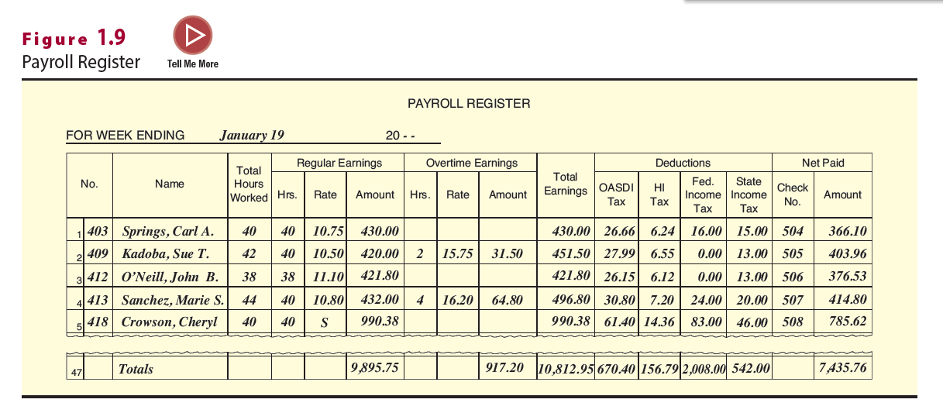
Payroll Register
Compiles data per payroll period
It provides information for recording payroll entries and for preparing reports required by other federal, state, and local laws
Used to compute gross pay, deductions and net pay

Slide 49
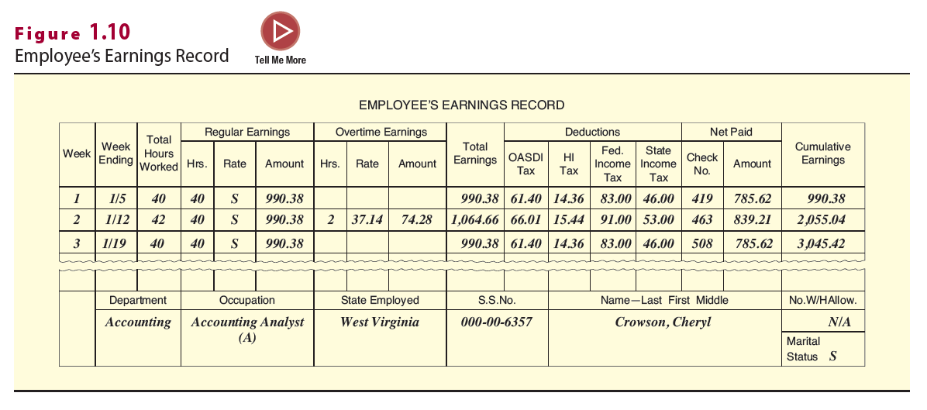
Employee’s Earnings Record
Updated after completion of payroll register
Outlines earnings per period, as well as cumulative earnings for each employee
Used to compile data for a multitude of reports

Slide 50
Payroll Accounting System (2 of 2)
Outsourcing Payroll
  Many small- to mid-sized businesses hire a payroll company to do their processing
    This is an independent company responsible for compliance
  Reduces risk of unpaid payroll taxes by
    Hiring only bonded providers
    Disallowing provider the ability to sign tax returns
    Disallowing tax correspondence to be sent to provider
    Requesting regular IRS transcripts of company accounts

Slide 51
Discussion Activity 3
Your friend, an executive at a small-sized company, is planning to outsource the payroll operations of her company. However, she is skeptical about the quality and cost involved in the outsourcing of the payroll services. You work at an outsourcing company, and she is seeking your advice on her plan before making any decision on payroll outsourcing. Explain to your friend the process and benefits of outsourcing the payroll operations.
Notes:
Instructions:
Gather into small groups of three to five.
Read through the slide information.
Collectively decide on your small group’s answer to the questions.
Share your findings with the larger group.

Slide 52
Discussion Activity Debrief 3
Answer:
Processing payroll by using an outside payroll company is more cost effective than doing the processing in-house. Other benefits realized from outsourcing is increased quality, improved efficiency, and a quicker release time, all of which enable the company to concentrate on its other operations.
The payroll operations at the company’s site need to deal only with the entry of new employee information and number of hours worked by each employee. This information is sent to the payroll processing company electronically. The input is then processed by the outside firm. Once the processing is completed, the output package is returned to the company.
These third-party payroll arrangements can range from just the cutting of paychecks and filing of tax returns to handling all aspects of employment from the hiring through the firing process. The payroll operations can be customized to meet the needs of each individual business at a cost that many businesses find affordable.
Notes:
Conduct a debriefing session with the class.

Slide 53
Self-Assessment
What is the relationship between the Human Resources Department and the Payroll Department? How are the roles and responsibilities of the two departments different?
What are the federal laws affecting the need for payroll and personnel records? What are the major provisions of these laws?
What are the steps involved in a payroll accounting system?

Slide 54
Summary
Now that the lesson has ended, you should have learned how to:
Identify the various laws that affect employers in their payroll operations (slides 06-14).
Examine the recordkeeping requirements of these laws (slides 15-35).
Describe the employment procedures generally followed in a Human Resources Department (slides 36-39).
Identify the various personnel records used by businesses and the type of information shown on each form (slides 40-46).
Identify the payroll register and the employee’s earnings record (slides 47-52).

