Slide 1

Payroll Accounting, 34e
Chapter 3: Social Security Taxes
Bieg/Toland/Stomberg, Payroll Accounting 2024, 34th Edition. © 2024 Cengage. All Rights Reserved. May not be scanned, copied or duplicated, or posted to a publicly accessible website, in whole or in part.

Slide 2
Chapter Objectives
By the end of this chapter, you should be able to:
03.01 Identify, for social security purposes, those persons covered under the law and those services that make up employment. (slides 03-09)
03.02 Identify the types of compensation that are defined as wages. (slides 10-14)
03.03 Apply the current tax rates and wage base for FICA and SECA purposes. (slides 15-27)
03.04 Describe the different requirements and procedures for depositing FICA taxes and income taxes withheld from employees’ wages. (slides 28-34)
03.05 Complete Form 941, Employer’s QUARTERLY Federal Tax Return. (slides 35-55)

Slide 3
Coverage under FICA
Before an individual is considered to be “covered’’ for social security purposes, the following must be determined:
  If the individual is an “employee,” as defined by the common-law relationship of employer and employee
  If the service the individual renders is “employment,” as defined by FICA tax law
  If the compensation the individual receives is “taxable wages,” as defined by FICA tax law

Slide 4
Independent Contractor (SECA) Versus Employee (FICA)
Every person is an employer if the person employs one or more individuals for the performance of services in the United States
  “Person” refers to an individual, a trust or estate, a partnership, or a corporation
  Employment applies to any service performed by employees for their employer, regardless of the citizenship or residence of either
Certain occupations specifically covered by FICA
  Full-time life insurance salespersons
  Agent- and commission-drivers of food and beverages or handling laundry or dry cleaning
  Full-time traveling or city salespersons for one firm or person
  Individuals working at home on products that the employer supplies and are returned to furnished specifications

Slide 5
More Specific Situations
Government employees: Certain exemptions in Medicare (HI) depending upon the date of hire
Inpatriates: May be exempt from FICA (over 20 countries)
Expatriates: Subject to foreign social security taxes
Family employees: In certain situations, children under the age of 18 may be exempt from FICA
Household employees
  If they make cash wages of $2,600 or more per year
  Must pay if a domestic employee, such as a nanny or cook, is under your control
Additional exemptions: Inmates, medical interns, student nurses, and workers serving temporarily in case of emergency

Slide 6
Independent Contractor
Persons may be classified as independent contractors if they conduct an independent trade or business
Employers do not pay or withhold FICA on worker classified as independent contractor
If employer misclassifies employees, there is a penalty
  Generally equal to employer’s share of FICA taxes plus income and FICA taxes that were not withheld from employee’s earnings
  However, if employee reported earnings on Form 1040 (federal income tax return), penalty is voided
  Penalty may be reduced if employer filed a Form 1099 (covered in Chapter 4)
Notes:
See Figure 3.2 on page 3-5 for the characteristics of independent contractors.
Independent contractors are liable for social security taxes on the net earnings of their businesses.

Slide 7
Knowledge Check Activity 1
Which of the following employment types is fully exempt from FICA coverage?
Services performed by student nurses such that the pay received by them equals the regular wages
Services performed by students for a private college while being enrolled and attending classes in another college
Delivery of newspapers or shopping news, including delivery to a point for subsequent delivery by individuals above the age of 18
Services performed by civilians for the U.S. government if such services are covered by a retirement system established by law

Slide 8
Knowledge Check Activity 1: Answer
(1 of 2)
Which of the following employment types is fully exempt from FICA coverage?
Answer: d. Services performed by civilians for the U.S. government and the services are covered by a retirement system established by law.
Exemption is applicable if the student nurses are in the employ of a hospital or a nurses’ training school chartered or approved under state law, and the nurses are enrolled and regularly attending classes in that school. FICA exempts only the pay received by student nurses if the pay is nominal and their work is part time and an integral part of the curriculum.
Students are exempt if they are working as “noncareer” employees while enrolled academically at least half time (for undergraduates, at least six credit hours). This student FICA exception does not apply to an employee who regularly works 40 or more hours a week.

Slide 9
Knowledge Check Activity 1: Answer
(2 of 2)
Which of the following employment types is fully exempt from FICA coverage?
Answer: d. Services performed by civilians for the U.S. government and the services are covered by a retirement system established by law
Services performed by an individual under the age of 18, as a newspaper distributor, excluding delivery or distribution to a point for subsequent delivery or distribution are fully exempt.
Services performed by civilians for the U.S. government, or its agencies are exempt from FICA coverage if such agencies are specifically exempt from the employer portion of the FICA tax, or if such services are covered by a retirement system established by law.

Slide 10
What are Taxable Wages? (1 of 2)
Cash
  Wages and salaries
  Bonuses and commissions
  Cash value of meals and lodging provided for employee’s convenience or not provided on the employer’s business premises
Fair market value of noncash compensation, examples include:
  Gifts (over certain amounts)
  Stock payments
  Fringe benefits (personal use of corporate car or flights on employer-owned plane)
Notes:
Fair market value of noncash compensation, examples include:
Bonuses
Premiums on group term life insurance > $50,000
Vacation pay
Other types of taxable wages found in Figure 3.3 on page 3-6

Slide 11
What are Taxable Wages? (2 of 2)
Tips greater than $20 or more in a calendar month
  Employees can report tips to employer using Form 4070 or
  Attributed Tip Income Program (ATIP) – a formula based on employer’s credit card sales
  Employer calculates FICA on tips and withholds from regular paycheck on these reported tips
    Must withhold on first paycheck after tips are reported; employer pays FICA on reported tips

Slide 12
Specifically Exempt Wages
Meals and lodging on the business property for employer’s convenience
Sick pay
Pay for difference between employees’ salary and military pay for soldiers and reservists activated for more than 30 days
Employer contribution to retirement plan
Employer-provided education assistance
  Job-related educational expenses not subject to FICA
  Payments for non-job-related expenses up to $5,250 are exempt from FICA taxes
Notes:
Sick pay
Only after 6 consecutive months off (personal injury)
FICA defines sick pay as ‘any payment made to individuals due to personal injury or sickness that does not constitute wages.’

Slide 13
Discussion Activity 1
You work as a tax consultant at a consultancy firm. One of your new clients has a food and beverage establishment. The establishment has increased its scale of operations recently and the number of employees of the establishment has been increased to 20. Tipping the employees is customary in the establishment. Currently, the establishment does not report any tip income in its employees’ Form W-2 and it wants to continue the same tradition.
Help the owner of the establishment to understand the need to report the tip income and the applicability of FICA taxes on the tip income.
Notes:
Instructions:
Gather into small groups of 3 – 5.
Read through the slide information.
Collectively decide on your small group’s answer to the questions.
Share your findings with the larger group.

Slide 14
Discussion Activity Debrief 1
Help the owner of the establishment to understand the need to report the tip income and FICA taxes on the tip income.
Answer:
Large food and beverage establishments (11 or more employees where tipping is customary) are required to allocate to their tipped employees the excess of 8% of the establishment’s gross receipts over the tips actually reported by their employees.
Employers withhold FICA taxes only on the tips reported by employees, not from tips that are allocated.
The amount of allocated tip income is shown separately on the employee’s Wage and Tax Statement (Form W-2).
Notes:
Conduct a debriefing session with the class.
Every large food or beverage establishment must report the amount of its receipts from food and beverage operations annually to the IRS and the amount of tips reported by its employees.

Slide 15
FICA Taxable Wage Base
For 2023 old-age, survivors, and disability insurance (OASDI) estimated taxable wage base, see “As We Go To Press”
OASDI for 2023
  Tax rate is 6.20%
  Wage base is $160,200
  Maximum tax is $9,932.40
Hospital insurance (HI)
  Tax rate is 1.45%
  There is no wage base and maximum tax
Notes:
Hospital insurance (HI)
Additional 0.9% Medicare tax on wages in excess of $200,000 (employer does not “match”)
Although it may be rescinded (see “As We Go To Press”)
Interesting note: In 1950, there were 16 workers paying into Social Security for every one person collecting benefits. By 2042, that ratio is projected to be 2 to 1.

Slide 16
Calculating FICA: Example 1 (1 of 2)
Facts: Tamara earns $165,000 per year and is paid semimonthly on the 15th and 30th; determine FICA for the December 30 payroll
First, find prior payroll year-to-date gross: $165,000 ÷ 24 = $6,875.00 semimonthly pay
Hint: How many payrolls were run before the December 30 payroll? Multiply that by the gross per payroll:
  $6,875.00 × 23 payrolls (before today) = $158,125.00

Slide 17
Calculating FICA: Example 1 (2 of 2)
How much will be taxed for OASDI?
  $160,200.00 − $158,125.00 = $2,075.00
  Tamara’s OASDI tax is $2,075.00 × 6.2% = $128.65
  Employer’s OASDI tax is $2,075.00 × 6.2% = $128.65
How much will be taxed for HI?
  Both Tamara’s and the employer’s HI tax is $6,875.00 × 1.45% = $99.69
How much is the total FICA?
  Total FICA for Tamara is $128.65 + $99.69 = $228.34
  Total FICA for employer is $128.65 + $99.69 = $228.34

Slide 18
Calculating FICA: Example 2 (1 of 2)
Facts: Sambit earns $225,000 per year and is paid monthly; determine FICA for the November 30 payroll
First, find the prior payroll year-to-date gross: $225,000 ÷ 12 = $18,750 monthly pay
Hint: How many payrolls were run before the November 30 payroll? Multiply that by the gross pay per payroll
  $18,750 × 10 (before today) = $187,500
How much will be taxed for OASDI?
  $160,200.00 − $187,500.00 = $0 taxable wages; employee and employer OASDI = $0

Slide 19
Calculating FICA: Example 2 (2 of 2)
Facts: Sambit earns $225,000 per year and is paid monthly: determine FICA for November 30 payroll.
How much will be taxed for HI?
  Sambit’s HI tax will be $328.13
  $18,750 × 1.45% = $271.88
  Plus 0.9% additional HI for wages > $200,000
  [$206,250 (prior wages + this month’s pay) – $200,000] × 0.9% additional HI = $56.25
Employer’s HI will be $271.88; Employer does not pay 0.9%

Slide 20
SECA and Independent Contractors
The self-employed tax is paid if net earnings exceed $400
  Net earnings = net income + distributive share of partnership income
If you own more than one business, offset losses and income and calculate self-employed tax based on combined net income
SECA tax = 15.3% (12.4% OASDI + 2.9% HI)
  Plus 0.9% additional HI if self-employment (SE) income or SE alone exceeds $200,000
Can have wages from a job and self-employment income
  Count both toward calculating the cap of $160,200 for OASDI
Notes:
Report on Schedule C (Form 1040), “Profit or Loss from Business”
Also, file Schedule SE (Form 1040), “Self-Employment Tax”
Must include SECA taxes in quarterly estimated payments

Slide 21
Calculating FICA with Employment Earnings and
Self-Employed Earnings: Example 1
Facts: Celia’s wages from her job are $170,000, and her self-employment income is $15,000; how much is her FICA on $15,000?
No OASDI is due because Celia is capped on wages
HI = $15,000 × 2.9% = $435.00
Total FICA is therefore $435.00

Slide 22
Calculating FICA with Employment Earnings and
Self-Employed Earnings: Example 2
Facts: Preben’s wages from his job are $68,250, and his self-employment income is $94,500; how much is his FICA on $94,500?
OASDI is due on the amount between his wages from the job and the taxable wage base
  $160,200.00 − $68,250.00 = $91,950.00
  $91,950.00 × 12.4% = $11,401.80 OASDI
    Preben pays both employee’s and employer’s share
  HI = $94,500 × 2.9% = $2,740.50 HI
Total FICA is therefore $14,142.30

Slide 23
SS-4 and SS-5
File SS-4 with IRS to get Employer Identification Number (EIN)
  EIN is used on all returns, forms, and correspondence with IRS
File SS-5 (Application for a Social Security Card) to receive a social security number
Employers can verify up to 10 names and SSNs per screen or upload files of up to 250,000 names and SSNs with verification results the next day
The Social Security Number Verification Service

Slide 24
Returns Required for Social Security Purposes
File Form 941, Employer’s Quarterly Federal Tax Return
  Download at the IRS Forms, Instructions & Publications page
  Due on last day of month following close of quarter
    January 31, April 30, July 31, October 31
    If that falls on weekend or legal holiday, file the return on the next business day

Slide 25
Major Forms for Preparing FICA Tax Returns and Deposits
Employers who owe $1,000 or less in employment tax per year may file Form 944
Form 945, Annual Return of Withheld Federal Income Tax, should be filed for nonpayroll items (pensions, IRAs, etc.)
See Figure 3.6 on page 3-17 for complete list

Slide 26
Discussion Activity 2
Joseph is a self-employed person and is a citizen of the United States. Joseph’s wife Stella, a U.S. resident alien, recently started work as a scientist in a private company. Stella does not have a social security number (SSN) and she will be filing U.S. tax returns for the first time. Stella’s friend has suggested she fill Form SS-4 and submit it in the IRS office to get the SSN.
Stella wants to know the accuracy of the information provided by her friend. Help her understand the rules and regulations involved in applying for a SSN.
Notes:
Instructions:
Gather into small groups of 3 – 5.
Read through the slide information.
Collectively decide on your small group’s answer to the questions.
Share your findings with the larger group.

Slide 27
Discussion Activity Debrief 2
Stella wants to know the accuracy of the information provided by her friend. Help her understand the rules and regulations involved in applying for a SSN.
Answer:
Under the Social Security Act, every employee and every self-employed person must have a social security number (SSN). The application for a SSN is available at any social security or IRS office. The Application for a Social Security Card (Form SS-5) can be filed with any field office of the SSA.
The Social Security Act requires applicants for a social security card to furnish evidence of their age, identity, and U.S. citizenship or lawful alien status.
Applicants may either apply by mailing the required documents and forms to their nearest social security office or apply in person.
Notes:
Conduct a debriefing session with the class.
For aliens Taxpayer Identification Number (ITIN). An ITIN (begins with the number 9) is intended for tax purposes only.

Slide 28
Depositing Income Taxes and FICA taxes
(1 of 2)
FICA taxes and income taxes are always deposited together
Each November, IRS notifies employer whether it will be a monthly or semiweekly depositor for next calendar year (“lookback period”)
  Monthly: Pay FICA taxes and income taxes by 15th of following month
  Semiweekly: If payday is Wednesday, Thursday, and Friday, then due following Wednesday. If payday is Saturday, Sunday, Monday, or Tuesday, then due following Friday.
However, one-day rule states that if $100,000 or more of federal payroll tax liability is due, taxpayer has until close of next banking day

Slide 29
Depositing Income Taxes and FICA taxes
(2 of 2)
No deposit is required if accumulated employment taxes are less than $2,500 for whole quarter
New employers are monthly depositors unless $100,000+ of liability triggers one-day rule and converts them to semiweekly
Deposit-making rules that apply to employers of agricultural laborers resemble those for employers of nonagricultural workers
Household or domestic employees are usually not subject to federal income tax withholding
Each state and local government employer must file its return on Form 941 with the IRS and deposit its FICA taxes through the federal deposit system

Slide 30
How to Deposit FIT and FICA Electronically (1 of 2)
The original paper-based system has been replaced by an electronic depositing system
Most employers are now on EFTPS (Electronic Federal Tax Payment System)
  Only exception is for businesses owing $2,500 or less in quarterly tax liabilities
  Enroll in EFTPS by completing Form 9779, EFTPS Business Enrollment Form
Employers who want to use online option must enroll at EFTPS Online

Slide 31
How to Deposit FIT and FICA Electronically (2 of 2)
Two electronic methods of deposit:
  EFTPS (direct) – withdraw funds from employer’s bank account and route to Treasury’s account
  EFTPS (through financial institution) – employer instructs bank to send payment directly to Treasury’s account at Federal Reserve Bank

Slide 32
Knowledge Check Activity 2
Most employers must now make their deposits via the Electronic Federal Tax Payment System (EFTPS). Which of the following is a feature of the EFTPS?
Once enrolled in the EFTPS program, an employer cannot switch between computer software or online methods anytime.
To enroll in the EFTPS program, an employer must complete Form 941, Employer’s Business Enrollment Form.
The exception to the EFTPS program is available for businesses with $1,000 or less in quarterly tax liabilities that pay when they file their returns.
In EFTPS through a financial institution method, the employer could instruct the bank to send each payment directly to the Treasury’s account at the Federal Reserve Bank.

Slide 33
Knowledge Check Activity 2: Answer
(1 of 2)
Most employers must now make their deposits via the Electronic Federal Tax Payment System (EFTPS). Which of the following is a feature of the EFTPS?
Answer: d. In EFTPS through a financial institution method, the employer could instruct the bank to send each payment directly to the Treasury’s account at the Federal Reserve Bank.
Most employers must now make their deposits via the Electronic Federal Tax Payment System (EFTPS). The major exception will be for businesses with $2,500 or less in quarterly tax liabilities that pay when they file their returns (see Form 941).

Slide 34
Knowledge Check Activity 2: Answer
(2 of 2)
Most employers must now make their deposits via the Electronic Federal Tax Payment System (EFTPS). Which of the following is a feature of the EFTPS?
Answer: d. In EFTPS through a financial institution method, the employer could instruct the bank to send each payment directly to the Treasury’s account at the Federal Reserve Bank.
There are two electronic methods of deposit:
1. EFTPS (direct)—the employer can instruct the Treasury Financial Agent for the area to withdraw funds from the employer’s bank account and route them to the Treasury’s account at the Federal Reserve Bank (ACH debit method).
2. EFTPS (through a financial institution)—the employer could also instruct the bank to send each payment directly to the Treasury’s account at the Federal Reserve Bank (ACH credit method).

Slide 35
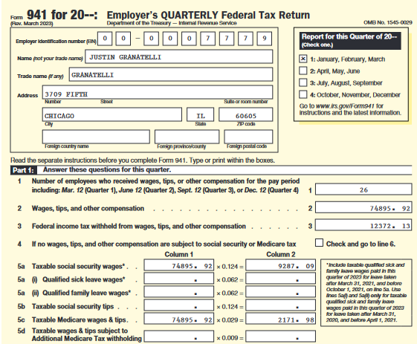
Preparing Form 941 (1 of 17)

Slide 36
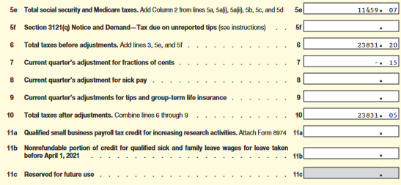
Preparing Form 941 (2 of 17)

Slide 37
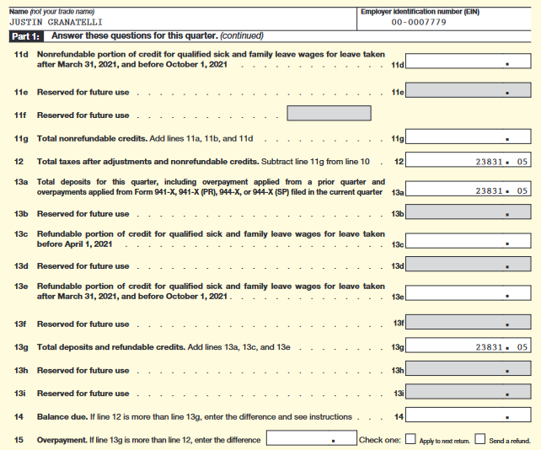
Preparing Form 941 (3 of 17)

Slide 38
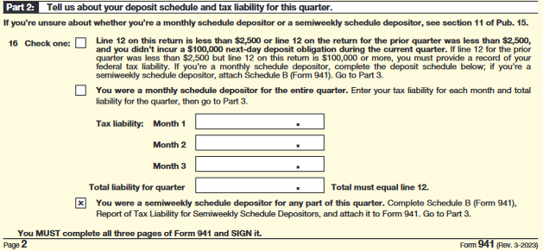
Preparing Form 941 (4 of 17)

Slide 39
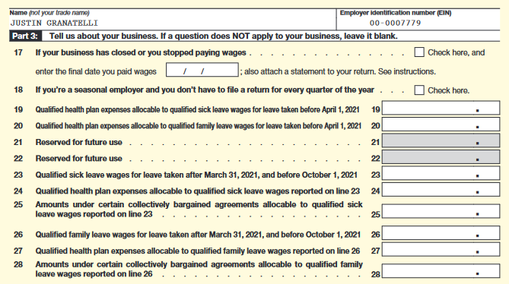
Preparing Form 941 (5 of 17)

Slide 40
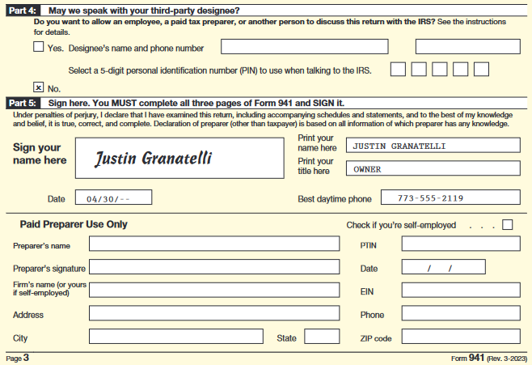
Preparing Form 941 (6 of 17)

Slide 41
Preparing Form 941 (7 of 17)
Part 1
  Most of the entries required on this part are self-explanatory. Other sources of information are shown in Figure 3.9 on page 3-26 and slides Preparing Form 941 (9 through 11 of 11). The tax adjustments and credits relate to:
    5f. on Form 4137, Social Security and Medicare Tax on Unreported Tip Income. Employer’s share of FICA taxes on tips reported
    7. Fractions of cents—employees’ share (one-half) of amounts on lines 5(a)–5(d) may differ slightly from amounts actually withheld (due to rounding).
    8. Sick pay—adjustment for employees’ share of FICA taxes that were withheld by third-party sick pay payer.
    9. Tips and group-term life insurance—uncollected FICA taxes on tips and group-term life insurance premiums.

Slide 42
Preparing Form 941 (8 of 17)
Part 1
    11a. Qualified small business payroll tax credit for increasing research activities
    11b. Nonrefundable portion of credit for qualified sick and family leave wages
    11d. Nonrefundable portion of credit for qualified sick and family leave wages for leave taken after March 31, 2021, and before October 1, 2021
    13c. Refundable portion of credit for qualified sick and family leave wages for leave taken before April 1, 2021

Slide 43
Preparing Form 941 (9 of 17)
Part 1
    13e. Refundable portion of credit for qualified sick and family leave wages for leave taken after March 31, 2021, and before October 1, 2021
Part 2
  16. Check the appropriate box. If the monthly schedule applies, enter a summary of your tax liability by month
  In addition, semiweekly and next-day depositors must complete Schedule B of Form 941, Report of Tax Liability for Semiweekly Schedule Depositors, instead of Form 941, line 16 (if the tax liability for the quarter was $2,500 or more). The employer’s tax liability is listed by each payday (see Figure 3.10 on page 3-27)

Slide 44
Preparing Form 941 (10 of 17)
Part 3
  17. to 28. Complete if either situation applies.
Part 4
  Complete if the employer wants to allow an employee, a paid tax preparer, or another person to discuss Form 941 with the IRS.

Slide 45
Preparing Form 941 (11 of 17)
Part 5
  The form must be signed by the employer or other person who is required to withhold and pay the tax. If the employer is:
    1. An individual, the return should be signed by that person.
    2. A corporation, the return should be signed by its president, vice president, or other principal officer authorized to sign the return. Corporate officers or duly authorized agents may use facsimile signatures under certain conditions.
    3. A partnership or other unincorporated organization, a responsible and duly authorized partner or officer having knowledge of the firm’s affairs should sign the return.

Slide 46
Preparing Form 941 (12 of 17)
Part 5
  The form must be signed by the employer or other person who is required to withhold and pay the tax. If the employer is:
    4. A trust or estate, the return should be signed by the fiduciary of the trust or estate.
    5. A political body, such as a state or territory, the return should be signed by the officer or employee having control of the wage payments or officer properly designated for that purpose.
    6. An agent, who pays the wages for the employer, may be authorized by the employer to sign the appropriate tax returns.

Slide 47
Preparing Form 941 (13 of 17)
Line Number | Source of Information
1 | Payroll Register
2 | General ledger accounts for wages and salaries; Forms 4070, or employees’ written statements reporting cash tips.
3 | General ledger accounts
4 | General ledger balances
5a | Payroll register; include any social security taxes (OASDI) paid for employees, sick pay, and taxable fringe benefits subject to OASDI. Do not include any tips. Do not report any employees’ wages that exceed $160,200, the taxable wage base for 2023.

Slide 48
Preparing Form 941 (14 of 17)
Line Number | Source of Information
5b | Forms 4070, or employees’ written statements to report cash tips. Enter all tips reported until tips and wages for each employee reach $160,200. Report this information even if you are unable to withhold the employee OASDI tax. Do not include allocated tips, which should be reported on Form 8027.
5c | Payroll register; Forms 4070, or employees’ written statements to report cash tips. Report amounts paid to certain federal, state, and local government employees who are subject only to the HI portion of the FICA tax.
5d | Payroll register; enter all wages, tips, sick pay, and taxable fringe benefits that are subject to additional Medicare tax withholding.

Slide 49
Preparing Form 941 (15 of 17)
Line Number | Source of Information
5f | Enter the tax due from Notice and Demand on line 5f. The IRS issues a Notice and Demand to advise an employer of the amount of tips received by employees who failed to report or underreported tips to the employer.
7 | To adjust for fractions of cents: If there is a difference between the total tax on line 6 and the total deducted from your employees’ wages or tips plus the employer’s tax on those wages or tips (general ledger accounts) because of fractions of cents added or dropped in collecting the tax, report the difference. Enter this difference in the space for “Fractions of Cents.” If a negative number is to be used, use a minus sign —.

Slide 50
Preparing Form 941 (16 of 17)
Line Number | Source of Information
8 | To adjust for the tax on third-party sick pay: Deduct the social security tax on third-party sick pay for which you are not responsible. Enter the amount of the adjustment in the space for “Sick Pay”
9 | To adjust for the tax on tips and group-term life insurance: Include the total uncollected employee social security tax for lines 5b and 5d
11a | Form 8974, line 12
11b | Worksheet 1, (not illustrated)
11d | Payroll Register

Slide 51
Preparing Form 941 (17 of 17)
Line Number | Source of Information
13a | General ledger accounts, previous Form 941; record the total deposits for the quarter, including any overpayment applied from previous quarter
13c and 13e | Worksheet 1 (not illustrated)
19 and 20 | Worksheet 1 (not illustrated)
23 | Payroll Register
24 | General Ledger
25 | Worksheet 2 (not illustrated)
26 | Payroll Register
27 and 28 | General Ledger

Slide 52
How to Report and Reconcile FIT and FICA
Make deposit with Form 941 if taxes for quarter are less than $2,500
  Use 941-V when making payment or can pay by credit card
Electronic filing options available for employers who meet requirements
  Complete an e-file application; then electronically submit 941 or
  Apply for a PIN on IRS website and file electronically through third-party transmitter or
  Can use reporting agent (file clients’ Forms 941 electronically)
Can correct errors on previously filed Form 941s by filing Form 941-X

Slide 53
Types of Penalties
Failure-to-comply penalties will be added to tax and interest charges; negligence can also result in fines and imprisonment
  Interest rate is set quarterly, based on short-term Treasury bill rate
Penalties imposed for:
  Not filing employment tax returns on time
  Not paying full taxes when due
  Not making timely deposits
  Not furnishing payee statements to employees and contractors on timely basis
  Not filing information returns with IRS on time
  Not supplying identification numbers

Slide 54
Discussion Activity 3
A cloth manufacturing company has failed to timely file the information returns with the government. The executives of the company are seeking your advice on the penalties that are applicable for failure to furnish information returns. Explain to the executives the fines and penalties for non-filing of information returns. Are these penalties restricted to non-filing or can any other non-performance also lead to penalties?
Notes:
Instructions:
Gather into small groups of 3 – 5.
Read through the slide information.
Collectively decide on your small group’s answer to the questions.
Share your findings with the larger group.

Slide 55
Discussion Activity Debrief 3
A cloth manufacturing company has failed to timely file the information returns with the government. The executives of the company are seeking your advice on the penalties that are applicable for failure to furnish information returns. Explain to the executives the fines and penalties for non-filing of information returns.
Answer:
Employers who fail to timely file their information returns with the government (any 1099 series or Forms W-2) are subject to fines for each failure.
These penalties also apply to failures to include all required information on the forms, to supply only correct information, to file magnetically if required, and to report correct taxpayer identification numbers.
The penalty is based on when the correct information is filed.
Notes:
Conduct a debriefing session with the class.

Slide 56
Self-Assessment
Which types of employment are exempt under the FICA law and what are the conditions of exclusion?
What amount of self-employment income is credited toward OASDI insurance benefits or HI coverage?
What are the major forms used for performing FICA tax returns and deposits?

Slide 57
Summary
Now that the lesson has ended, you should have learned how to:
Identify, for social security purposes, those persons covered under the law and those services that make up employment. (slides 03-09)
Identify the types of compensation that are defined as wages. (slides 10-14)
Apply the current tax rates and wage base for FICA and SECA purposes. (slides 15-27).
Describe the different requirements and procedures for depositing FICA taxes and income taxes withheld from employees’ wages. (slides 28-34)
Complete Form 941, Employer’s Quarterly Federal Tax Return. (slides 35-55)

