Slide 1


Entrepreneurship & Small Business V.2
Domain 1 – Entrepreneurial and Small Business Concepts

Slide 2
Domain 1 – Lesson 1
Entrepreneurship and Small Business Ownership

Slide 3
Legal Structure
Non-profit: No ownership, no US federal taxes
C-Corp: Best for international business even with being double-taxed
Proprietorship: Easy to create but comes with unlimited liability
S-Corp: Lower tax rate that prevents the company from being double-taxed
LLC: Ideal for a single owner seeking low risk
Partnership: Shared financial backing

Slide 4
Management: CEO
Highest ranked
Responsible for business’s success
Makes major decisions for the company
Oversees operations and resources
Develops the company’s vision, strategy, and mission
Reports to the Board of Directors

Slide 5

Management: CFO
In charge of the company’s finances
Manages and plans cash flow
Creates budgets
Forecasts whether the company will meet the set budget requirements or not
Negotiates all financial matters

Slide 6
Management: COO
Oversees the business’s day-to-day operations and administrative functions

Slide 7
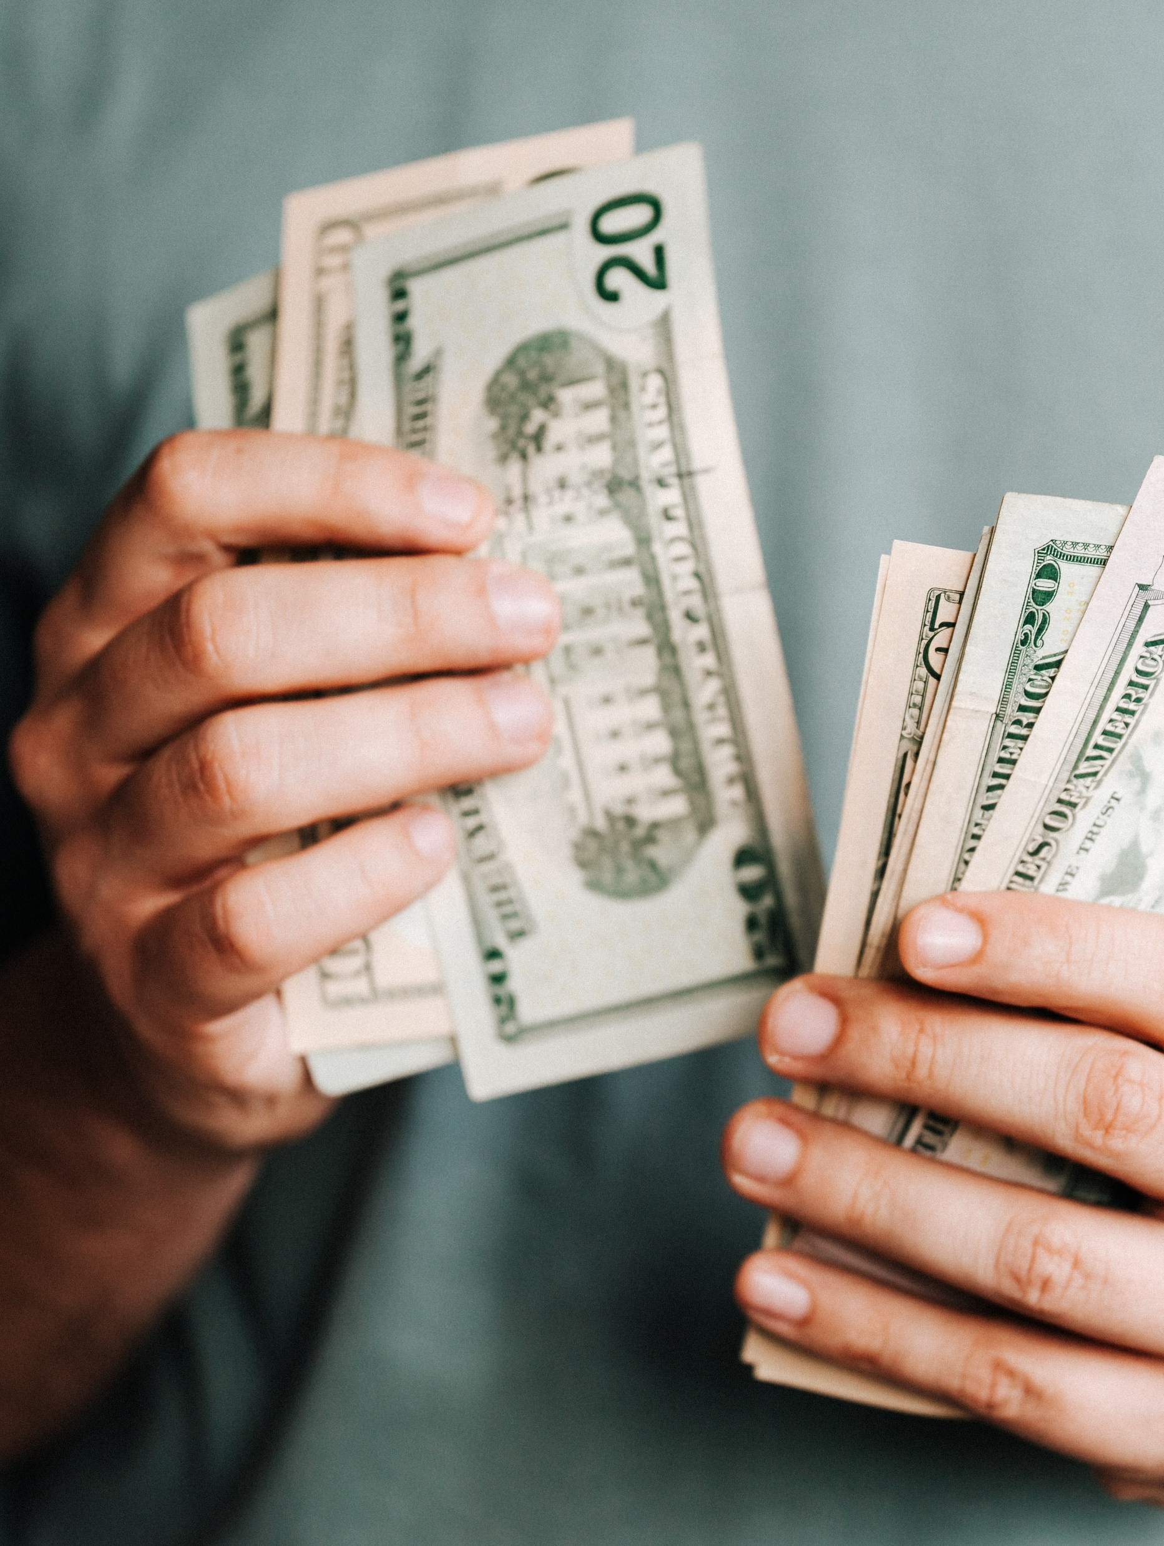
Compensation
Equity: Non-cash compensation
Hourly: Set rate of pay for hours worked
Commission: Usually found in sales roles
Salary: Set amount of pay in a given period

Slide 8
Employee Roles
Founder: Creates the company
CFO: Oversees company finances
Stockholder: Owns stock in the company
CEO: Reports to the board of directors
COO: Oversees daily operational and administrative functions
Stakeholder: Has a vested interest in the success of the company

Slide 9
Business Life Cycle
The first stage is existence, when a business begins.
Survival stage: income and customers begin to grow.
Success stage: economically healthy
Take-off stage: an owner decides whether to continue growing the business or to sell the business.
Resource maturity stage: the owner can separate financially and operationally from a business.
Pivot or persist is next as an owner decides if they will continue to grow the business into a large company or pivot to a new project.
Finally, an owner may choose to sell their company in the exit plan stage.

Slide 10

Design Thinking Process
Empathize: Identify needs of customer
Define: Identify & define problems
Ideate: Create solutions
Prototype:
and Test.

Slide 11
Domain 1 Lesson 2
Skills of a Successful Entrepreneur, Potential Business Opportunities, Business Plan Elements, and Intellectual Property Concepts

Slide 12
Characteristics of an Entrepreneur
Self-reliance: Trusting one’s self, goals, and progress
Forward thinking: Thinking about and planning for the future
Opportunity recognition: The way one approaches new ideas and ventures
Initiative: Turning one’s ideas into action or bringing new ideas to generate more or better business
Resiliency: Adapting to change, loss and disappointment
Grit: Tackling goals with courage and perseverance, even when it’s challenging
Risk tolerance: The amount of loss one is willing to take when making investment decisions

Slide 13
Characteristics of an Entrepreneur
Growth mindset: Believe that anything can be accomplished with enough hard work
Critical Thinking: Solving problems using a variety of possible solutions
Creativity &Innovation: Bringing new and unconventional ideas
Collaboration: Working with others towards a common goal
Problem solving: Coming up with solutions
Personal Agency: Working towards a goal without direction or push by others
Ethical Practices: Making decisions based on doing the right thing
Social Responsibilities: Preventing or removing corruption or unethical behavior from a business or community

Slide 14

Business Opportunity
An investment that lets a buyer start a business
Selling and leasing a product, service, or piece of equipment that allows the buyer to start a business
Initial buyer fee is at least $500
Seller is required to help the buyer find an ideal location for the business
Seller guarantees that the income is equal to or more than the buyer’s price when the product is resold
If the product cannot be resold, the original seller agrees to buy the product back
The buyer agrees to buy any products or services that the seller develops

Slide 15

Franchise
Buyers agree to buy and sell the products developed by the seller or owner of the franchise
Strict stipulations on where a franchise can be opened
Higher start-up costs
Offer ongoing support and training
Lower risk to start

Slide 16

Network Marketing
Network marketers recruit other marketers who work under them to create a distribution network
Make money off commissions
Distributors agree to sell products or services another company sells
Mary Kay, Tupperware & Otara

Slide 17
Licensing
Must pay a fee or royalty to use the brand or trademark of another company on your product
Using a Disney character on clothing you want to sell

Slide 18

Common Risks
Environmental
Political
Competition from similar businesses.
Entrepreneurs should work proactively to overcome these risks.

Slide 19
Viability
Market size: researches the demand for products or services - is there enough demand
Relationships: building relationships with experienced professionals - may help to find investors
Managing cash flow involves potential funding and uses of that funding
Management skillset: analyzes the skills of the employees
Passion: can help an entrepreneur make up for a lack of skills

Slide 20

Business Plan
It outlines goals and shows investors how their investments will help achieve them.
Includes an executive summary,
a marketing plan,
an organizational structure,
and a financial plan.

Slide 21

Pitch Deck
A pitch deck is typically presented to investors as a slideshow.
Brief overview of the business plan
Outlines the business,
what funding is needed,
and financial projections.

Slide 22

Lean Canvas
A one-page document
Covering problems, solutions, and key details of a business plan.

Slide 23
Lean Canvas
Problem: Discuss what problem the products or services solve
Vision and value proposition: A brief overview of a business company’s mission and the value provided to its customers
Team: Highlight key team members, skills, expertise and experience
Milestones: The traction the company has gained, such as crowdfunding
Business model: How a business works, how it makes money, and its marketing strategies

Slide 24

Intellectual Property
Copyright protects creative works such as art, literature, and music
Trademark protects brand names, logos, and business names.
Trade Secret protects a company’s practice, process, or formula from being shared with competitors.
Patent protects an invention from being copied.

Slide 25
Intellectual Property
Trademarked material is usually well recognized and may boost sales but requires permission to be used.
An entrepreneur can sign a licensing agreement and pay a licensing fee to use trademarked material.
To use a patent, the owner assigns ownership of the patent to another, allowing them to use and sell the invention. Royalty fees are then paid to the original patent owner.
To protect trade secrets, an employee will sign confidentiality or non-disclosure agreements.

