Slide 1
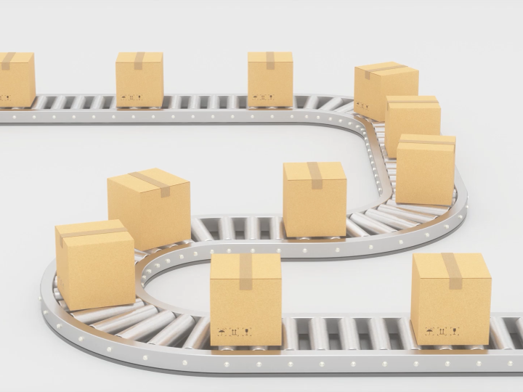

Entrepreneurship & Small Business V.2
Domain 3 – Production & Distribution

Slide 2
Domain 3 – Lesson 1
Value of a Minimum Viable Product and Supply Chain and Production Processes (Part 1)

Slide 3
Product/Market Fit
Product/market fit is reached when sales volume is high and continues to grow.
Companies go through different phases to reach product/market fit.
These phases are:
Idea stage
Develop a concept for a product or service
Prototype stage
A Minimum Viable Product (MVP) is created
Launch stage
Monetization stage
Growth stage
Sales gain momentum, growth begins
Traction stage
Develop a value hypothesis
Business start to earn revenue
Find product/market fit

Slide 4

Quality
Measured by how well the product or service successfully serves its user’s purpose
ISO: “The totality of features and characteristics of a product or service that bears on its ability to satisfy stated or implied needs”
3.1.2

Slide 5
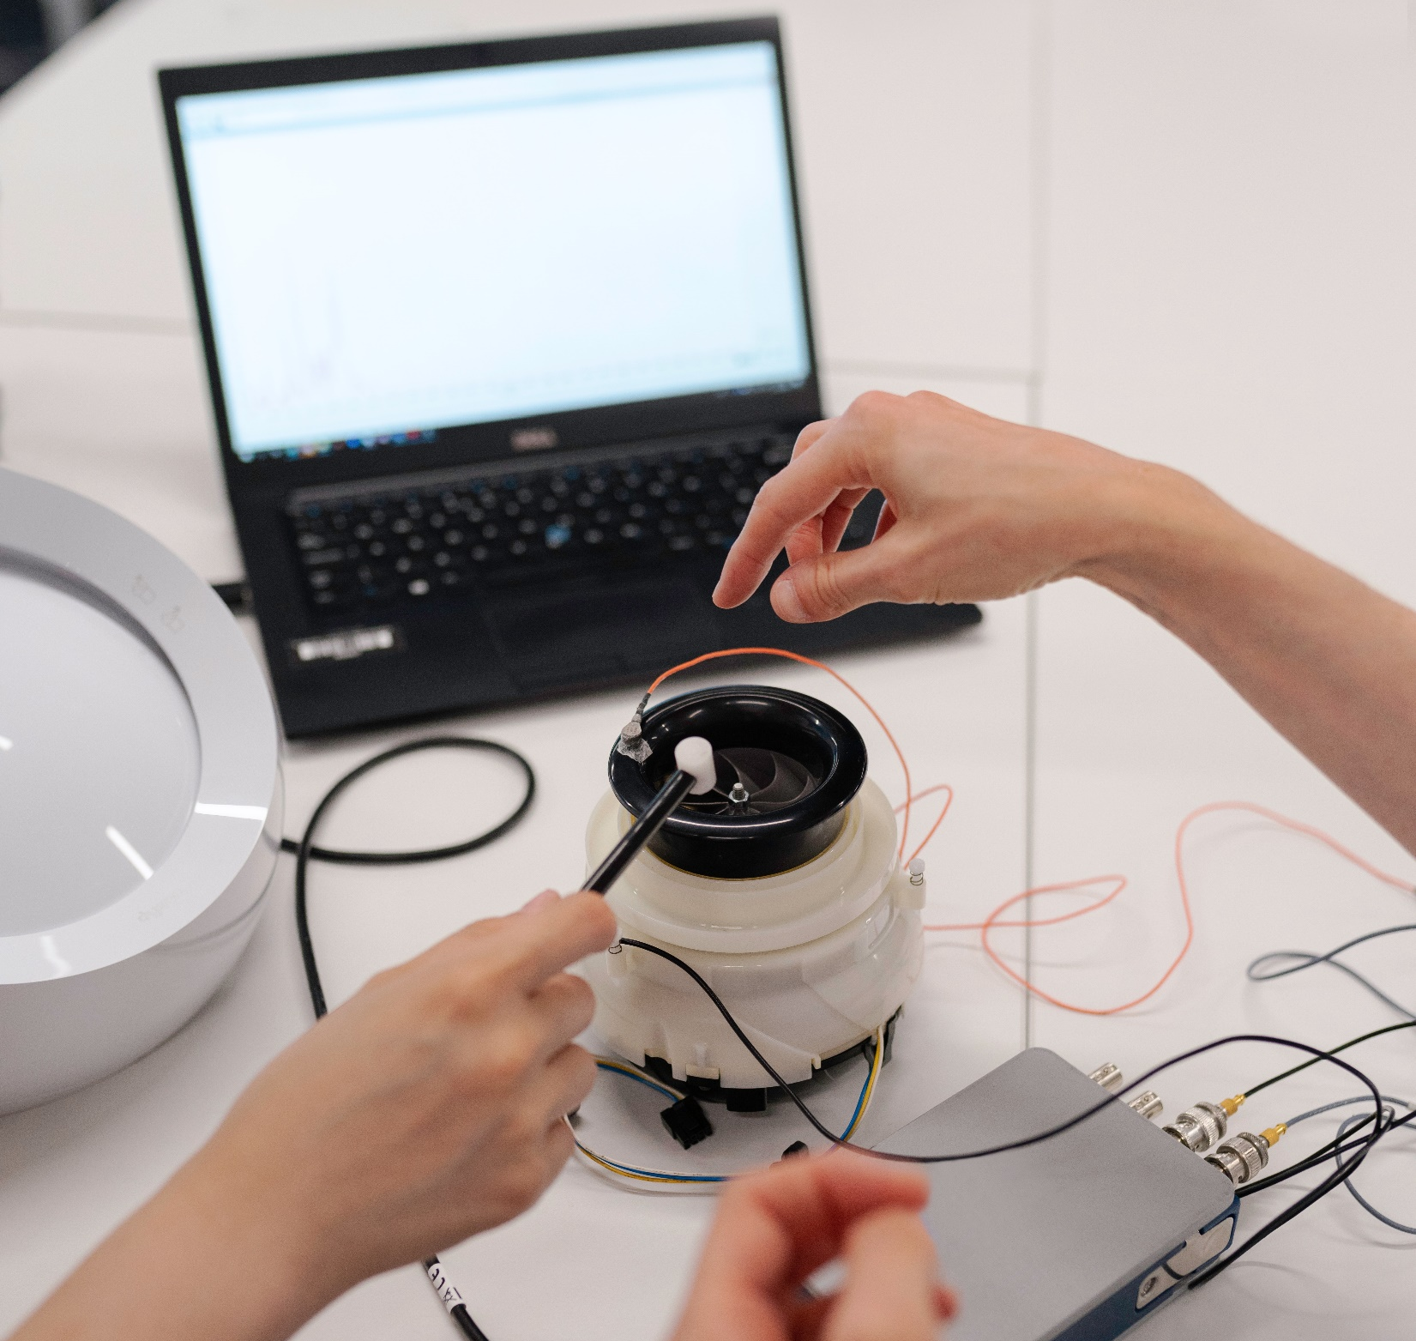
Minimum Value Proposition
A prototype used to test and functionality
To determine the user’s experience and ultimately improve the user’s experience
3.2.1

Slide 6
Researching a Product
Talk with others that have produced the same or a similar product
Gather information on how to make the product, identify the required materials, and determine how much the materials will cost
Finding a manufacturer that can make the product if needed

Slide 7
Researching a Service
Find out what customers' needs are
Survey customers in the area
Place phone calls
Talk with individuals interested in the service
Talk with customers that have received similar services from another company
Purchase equipment to perform the service if needed

Slide 8
Domain 3 – Lesson 2
Identify Distribution Channels Chain & Production Processes

Slide 9
Value Engineering
Substitutes high-quality components with low-cost components that still meet the product’s lifetime duration and basic purpose
Reduces production costs
Savings passed on to consumers

Slide 10
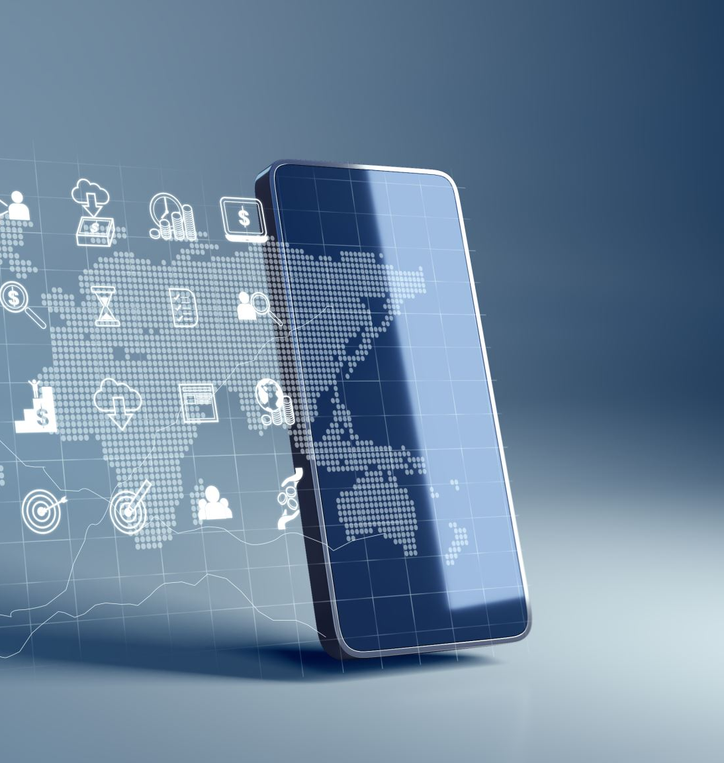
Digital Products
Software as a Service
  Delivered over the Internet
  Do NOT have control
  Options / features may not meet requirements
  They have cost and maintenance
  A subscription fee
Dropbox
Google Apps

Slide 11
Build
You control options & features
Time consuming
Expensive
Requires knowledge & experience
May require extra staff

Slide 12
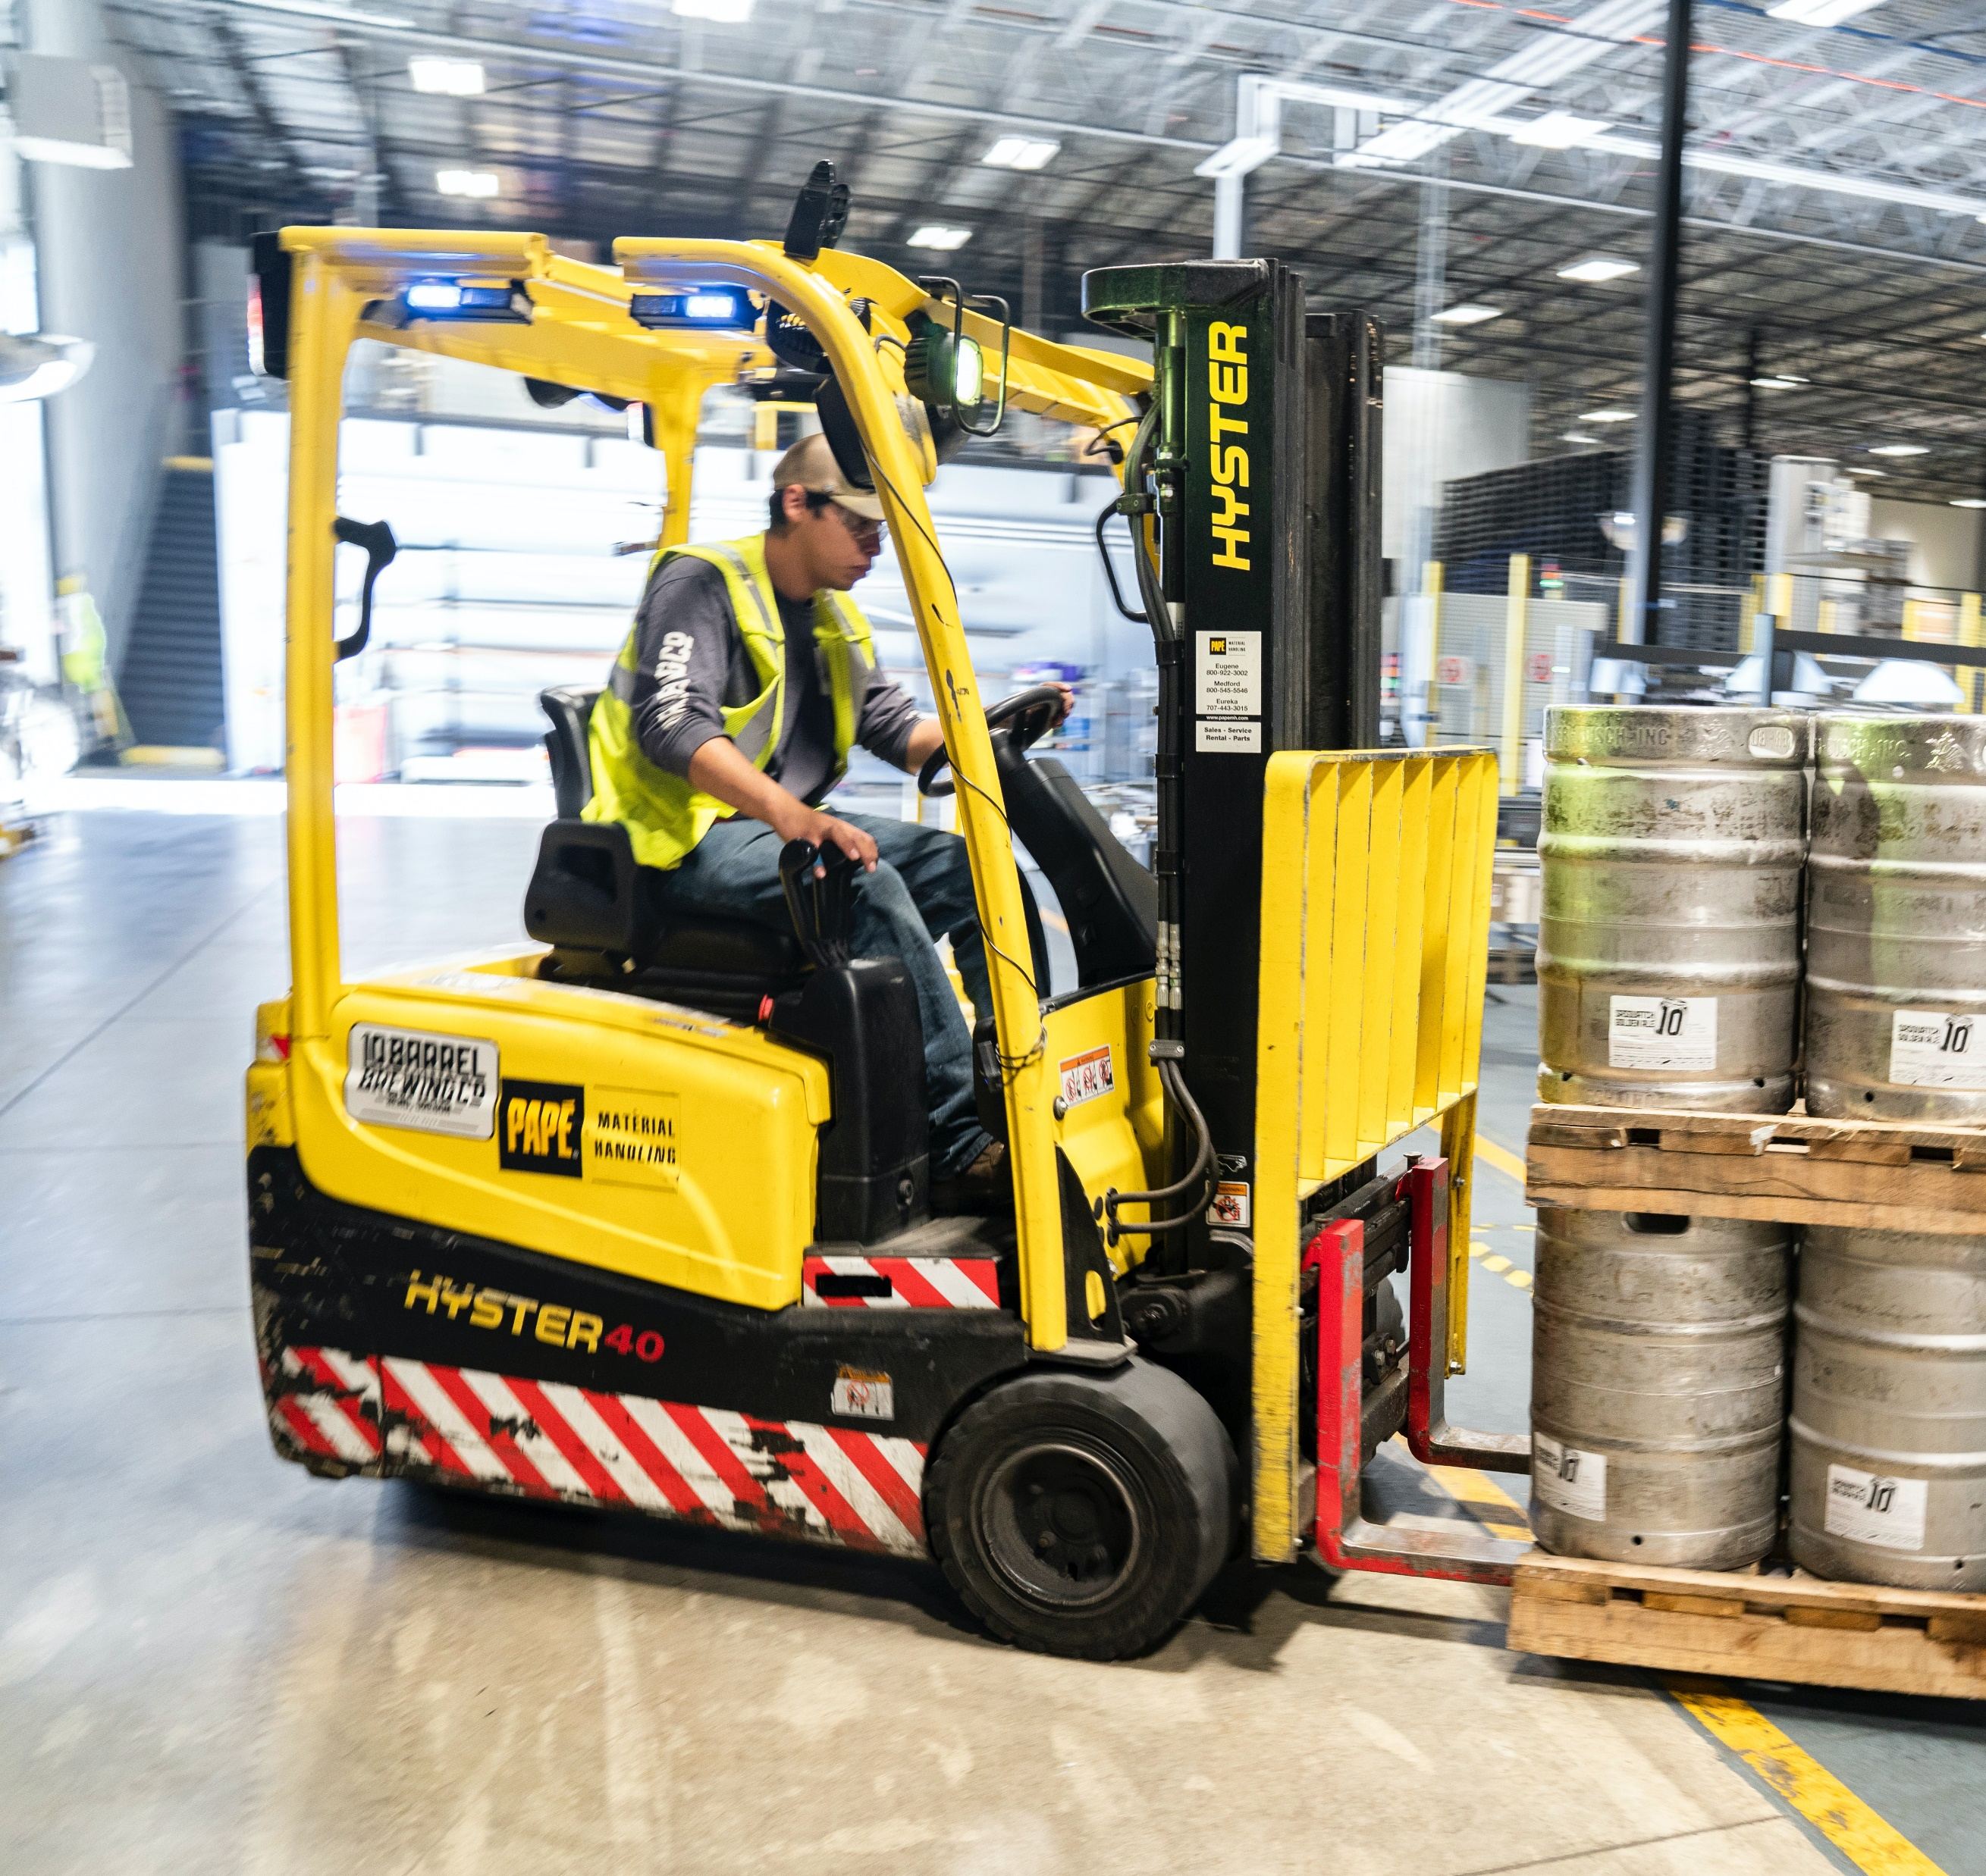
Leasing Equipment
Fewer up-front Costs
More in long run
Long-term interest & mark-up fees

Slide 13
Buy or Lease Office Space
Requires an upfront down payment
Eventually own property
Must bear maintenance & repair costs
Must pay property taxes

Slide 14
Quality Control - External
Helps ensure that you deliver a consistent product or service
Boost bottom line & increase customer satisfaction
Start by determining quality standards
External Quality Standards
Local health& Safety inspectors
Government regulatory agency
Industry leaders

Slide 15
Quality Control - Internal
Set quality standards
1
Establish testing methods
2
Random test samples
Log defects
Review results
3
Refine & improve process
4

Slide 16
Domain 3 – Lesson 3
Market Research

Slide 17
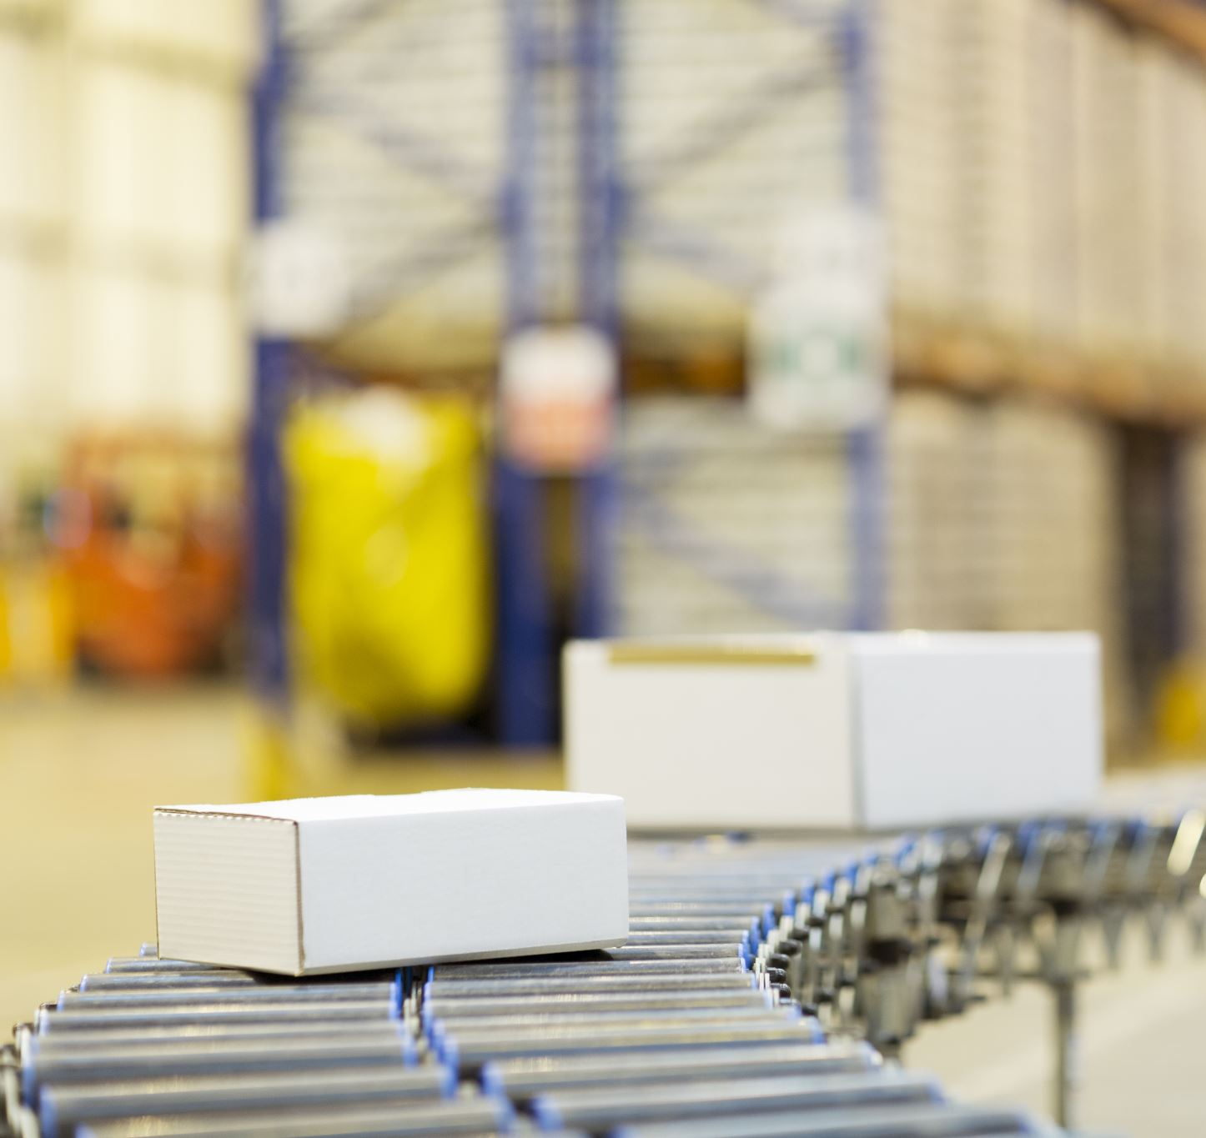
Distribution Channel
A method used to get a product from the manufacturer to the end user

Slide 18

Direct Distribution
Allows the consumer to make a purchase directly from manufacturer
Shortest & least complicated
No intermediaries
Customer Pay shipping
Lower priced goods no middleman markups
Door to door
  Manufacturer goes door to door
  Manufacturer hires someone to go door to door
  Organize delivery
E-commerce
  Post office
  Couriers

Slide 19
Indirect Distribution
Products are sold thru intermediaries like Wholesalers, agents, or retailers
More expensive
Time-consuming

Slide 20
Levels of Indirect Distribution
One-level channel
The price a consumer pays for a product is usually determined by the number of middlemen
Manufacturer
Customer
Two-level channel
Manufacturer
Wholesaler
Customer
Manufacturer
Wholesaler
Retailer
Customer
Two-level channel

Slide 21
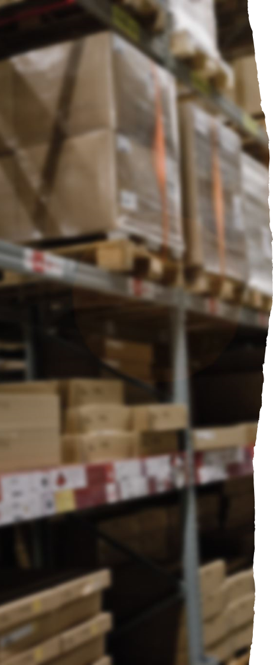
Direct Distribution and Fulfillment Services
Fulfillment center: receives, processes and fills customer order on behalf of company
  Strategically stores for quick pick-up – Amazon
Distribution center: receives and temporarily stores goods before fulfilling orders
  Usually, service retail stores
  Suppliers ship products to distribution center
  An online purchase and choose in-store pickup

