Slide 1
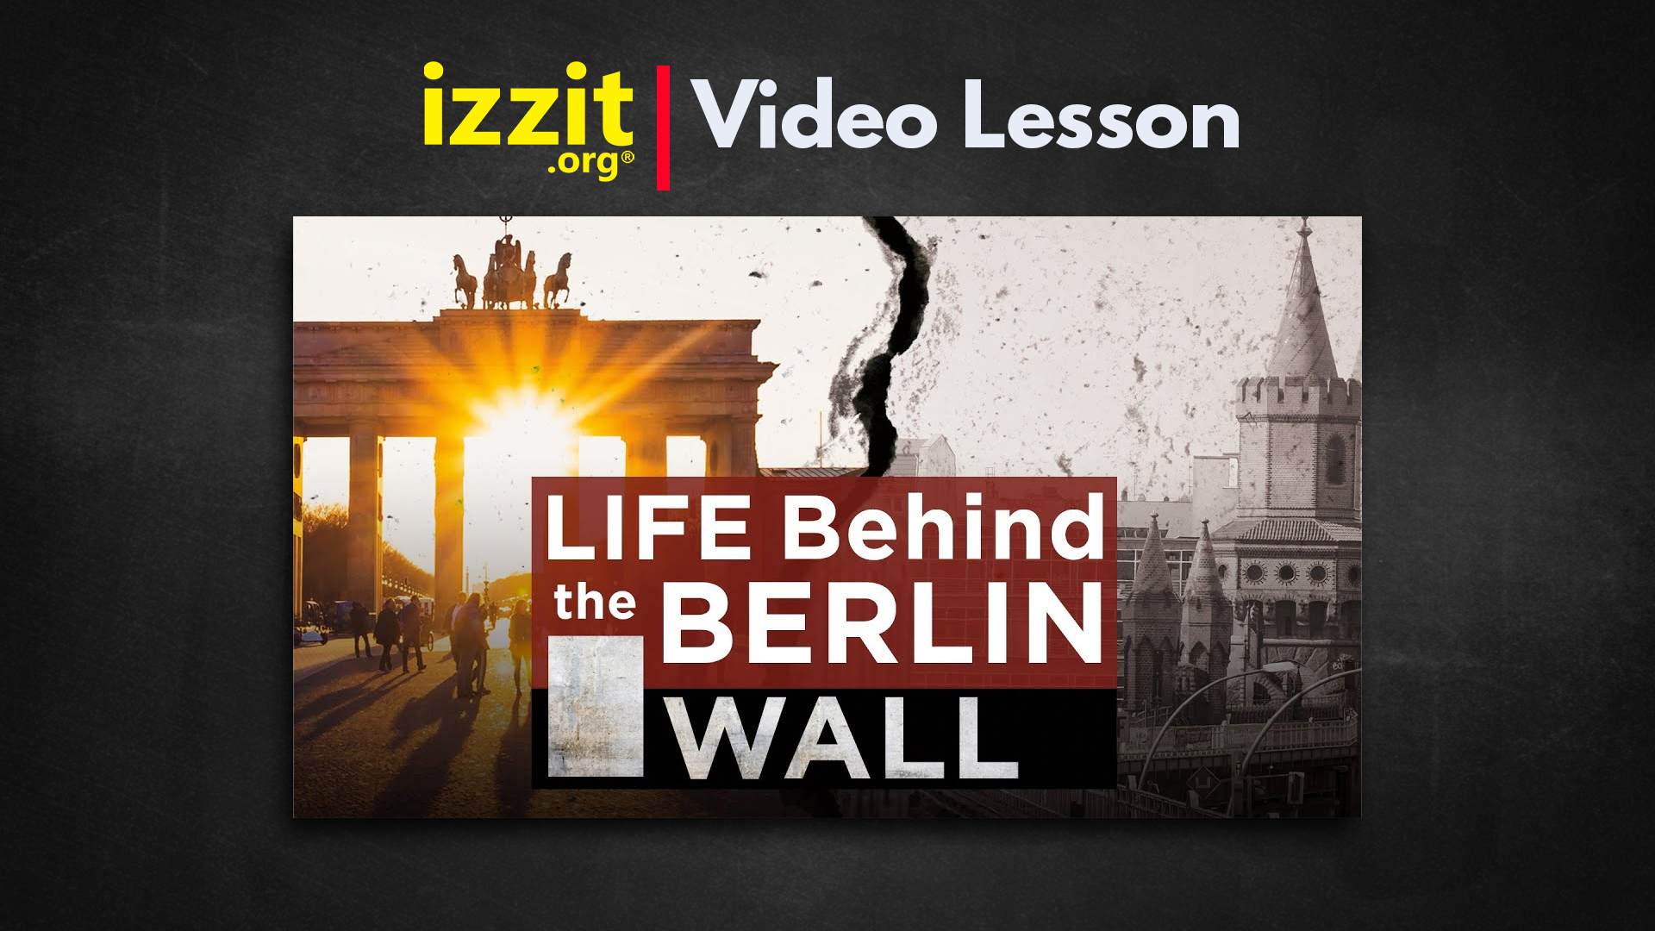

Slide 2

Life Behind the Berlin Wall
Video Preview Questions

Slide 3
Question #1
What was the Berlin Wall? What did it become a symbol for?

Slide 4
Question #2
Walls, fences, locks, and other barriers are typically built to hold or protect something inside from some outside threat. What are some reasons barriers might work and might not work?

Slide 5
Question #3
What’s the difference between a planned economy and a free market?

Slide 6
Question #4
In all the years the Berlin Wall stood, almost no one fled from West Berlin to East Berlin. Why not?

Slide 7
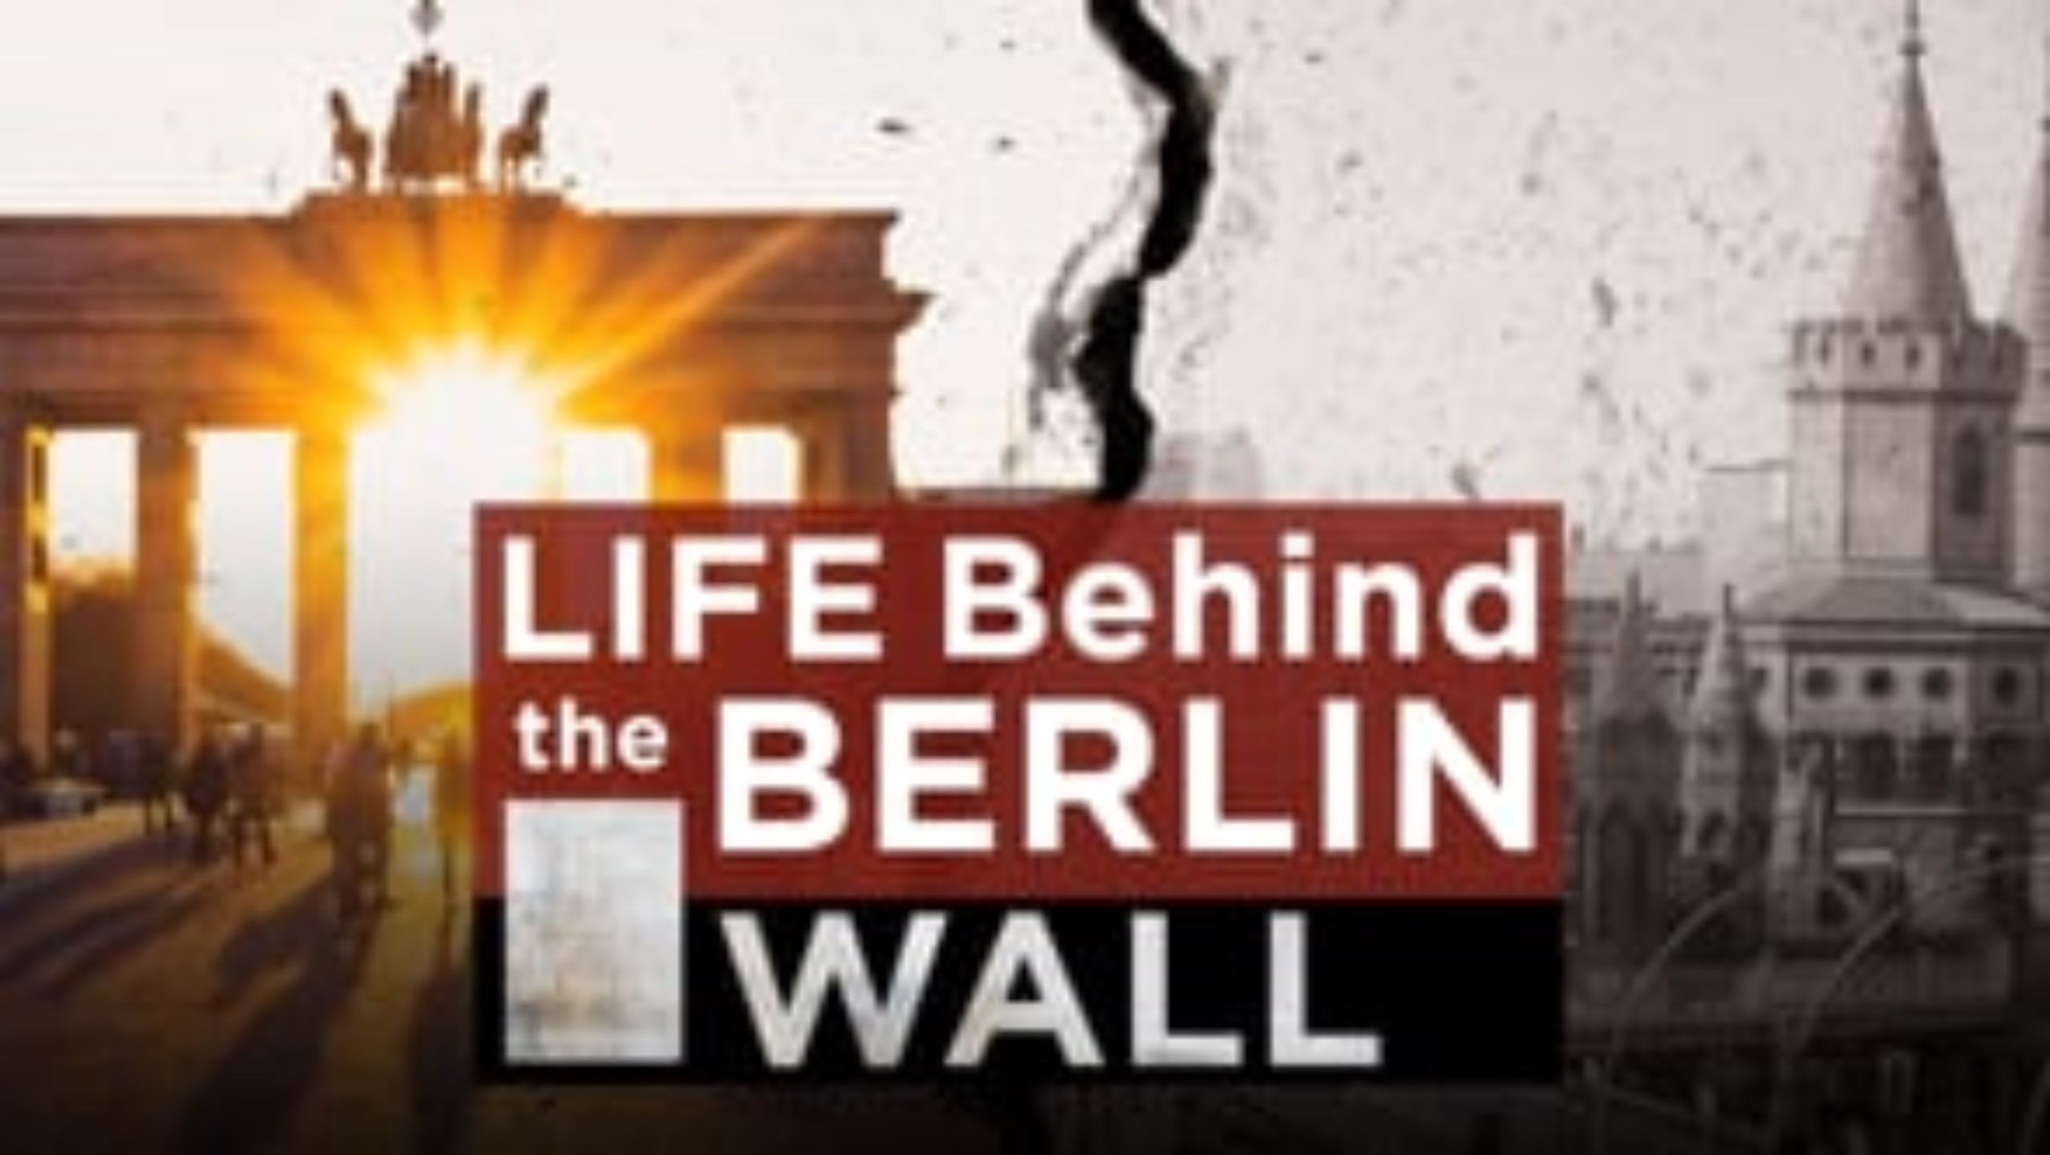
Notes:
If you are having issues playing the video, please refer to the How-to-Use Guide for additional viewing options.

Slide 8
Student Discussion #1
In the video, there were numerous mentions of how challenging it was to live in East Berlin and East Germany, as a whole.
Think about how hard it would have been to live with the struggles that those people faced. What secondary issues did they face?
For example, if you had to wait 12 years before you could buy a car, how many hours a day would you need to devote to get to and from work?
Notes:
Please see the How-to-Use guide for links to the full activity sheets.

Slide 9
Enduring Question
What would you be willing to risk for a better life?

Slide 10
Student Activity #2
When the Berlin Wall was standing, most of the side facing West Berlin was spray painted with images of hope, freedom, and encouragement for East Berliners.
Instructions: Using ideas and themes covered in the video, draw your version of a graffiti image representative of freedom and hope.
Examples of actual graffiti and paintings from the Berlin Wall are on the next slide.
Notes:
Please see the How-to-Use guide for links to the full activity sheets.

Slide 11
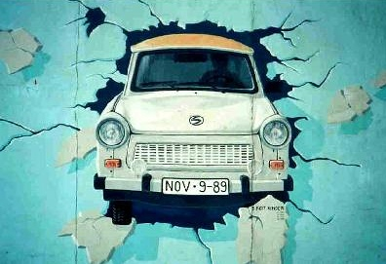
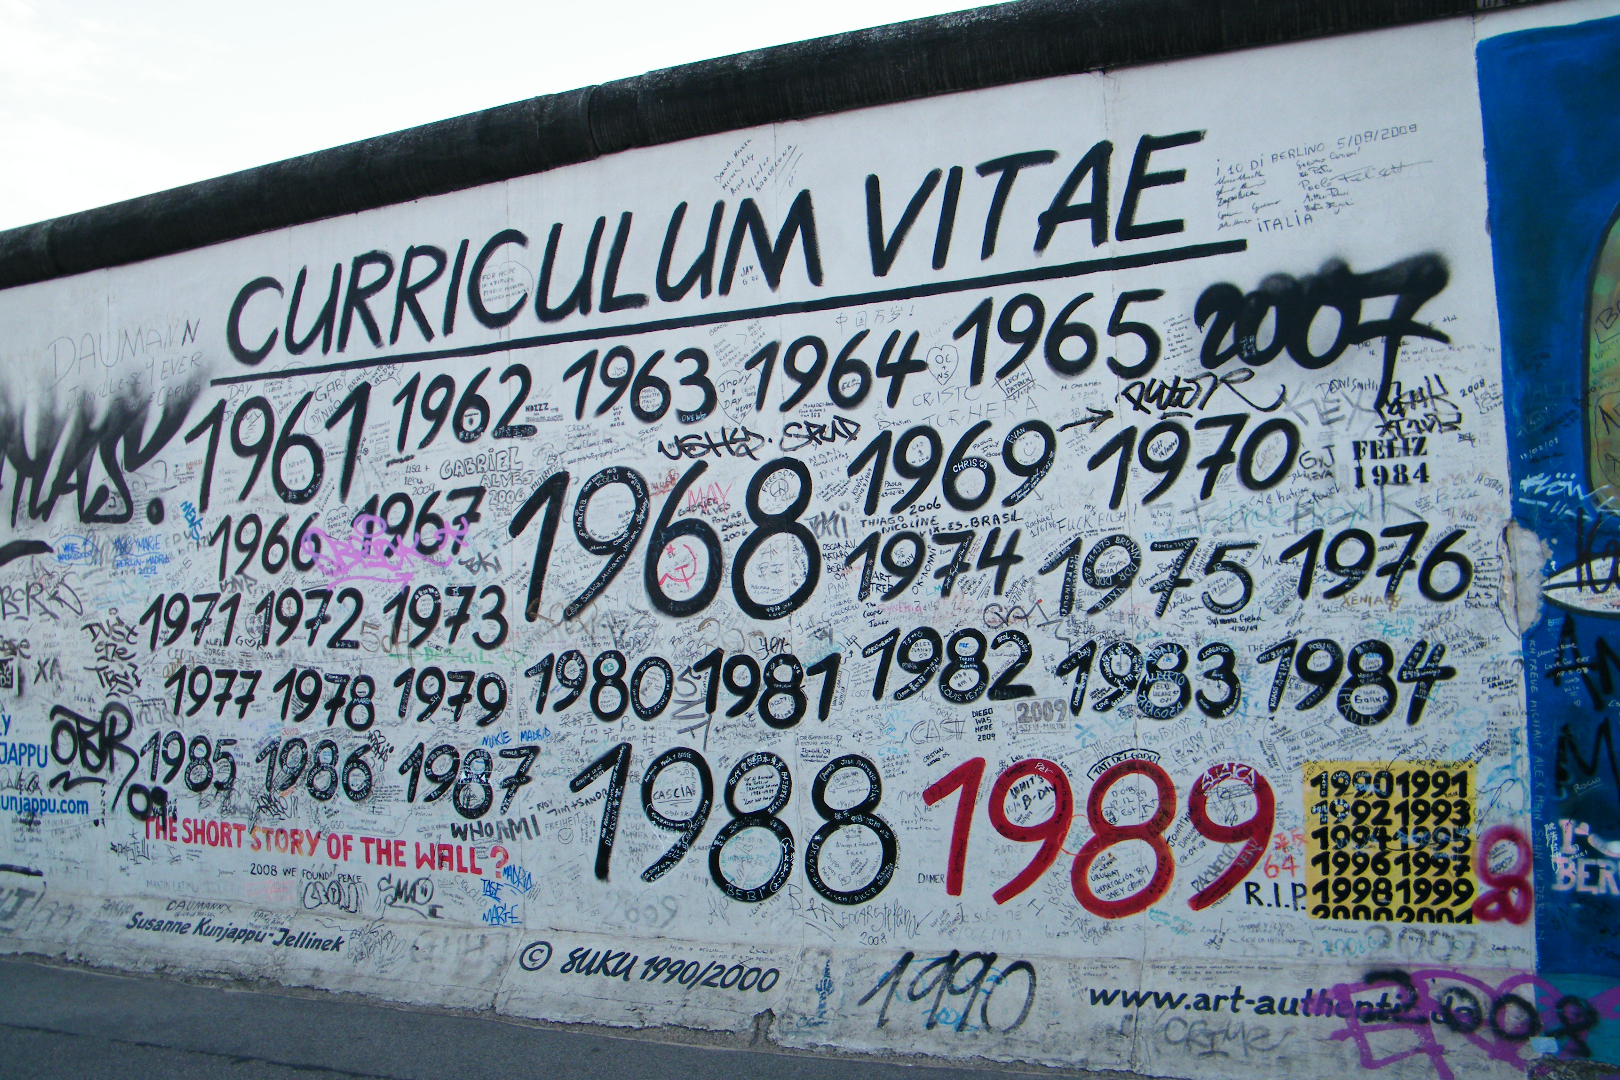
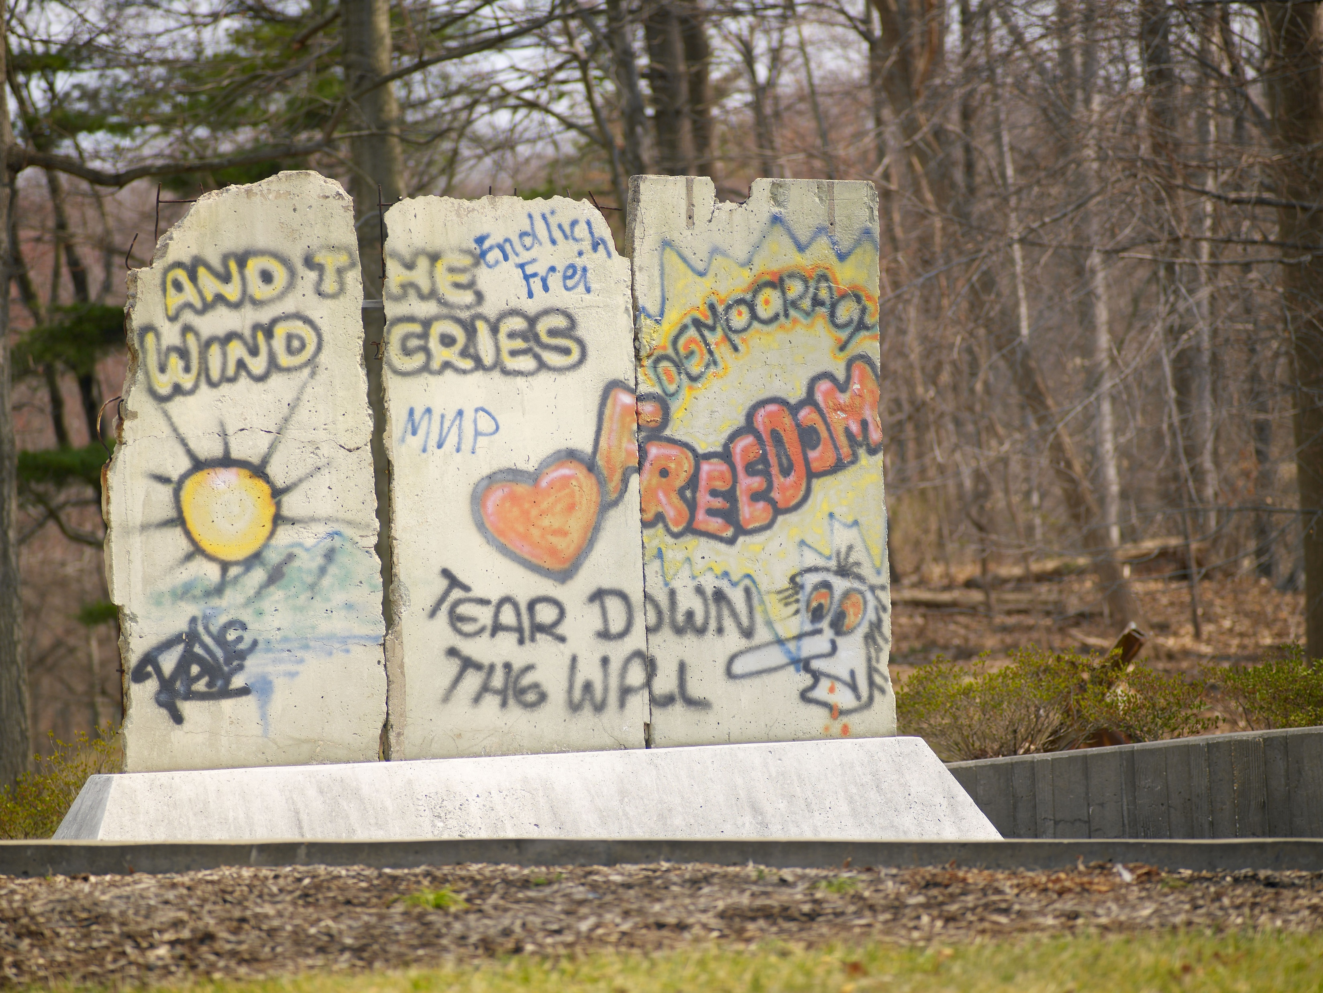
Student Activity #2
Japleenpasricha, CC BY-SA 4.0 <https://creativecommons.org/licenses/by-sa/4.0>, via Wikimedia Commons
Notes:
Please see the How-to-Use guide for links to the full activity sheets.

