Slide 1


Mastering the Modern Elevator Pitch: Communication for Career Success
Notes:
Created from: https://resources.biginterview.com/interviews-101/elevator-pitch-examples/

Slide 2

What is an Elevator Pitch?
A 30-60 second speech about yourself and your professional value
Used in job interviews, networking events, and professional gatherings
Goal: Start a conversation and make a memorable first impression
NOT a robotic, rehearsed sales speech

Slide 3

Opening Circle: Elevator Pitch Reflection
Think-Pair-Share: Discuss a time you've introduced yourself. What worked well? What felt uncomfortable?
What makes an introduction memorable?
Share one insight with a partner.

Slide 4
The Old vs. New Elevator Pitch
Old Approach: Rigid, sales-focused, generic
New Approach: Conversational, authentic, human-centered
Focus on creating genuine connection
Highlight your unique value and potential collaboration

Slide 5

Key Components of a Modern Elevator Pitch
Attention-grabbing hook
Brief explanation of what you do
Highlight specific value or achievements
Leave room for questions and dialogue
Show genuine interest in the other person

Slide 6
Personalization Strategy
Research the company or person beforehand
Identify potential pain points
Connect your skills to their specific needs
Demonstrate how you can solve problems

Slide 7

Storytelling in Your Pitch
Use real-world examples
Share a brief, engaging narrative
Demonstrate your passion and expertise
Make your introduction memorable

Slide 8
Avoiding Common Pitch Mistakes
Don't use complex, technical language
Avoid memorizing a rigid script
Don't focus solely on yourself
Skip corporate jargon
Be natural and conversational

Slide 9
Pitch Examples: Different Scenarios
Job interview pitch
Networking event pitch
Career transition pitch
Student/entry-level pitch
Freelance professional pitch

Slide 10
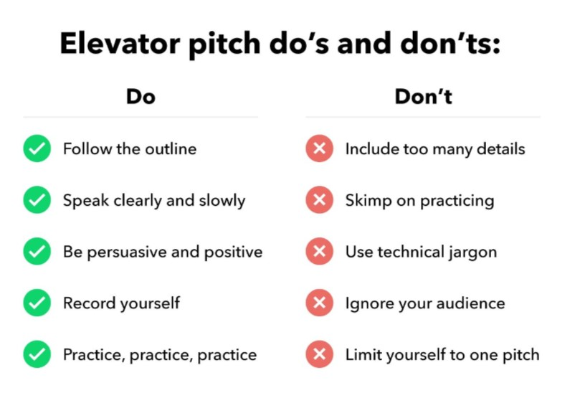
Pitch Structure Template
Start with an engaging hook
Briefly describe your professional role
Share a key achievement or unique skill
Explain potential value to the listener
End with an open-ended question

Slide 11
Practice Techniques
Record yourself
Practice with friends
Get constructive feedback
Adjust your tone and pace
Be authentic and confident

Slide 12
Pitch Adaptation Skills
Customize for different audiences
Read the room's energy
Be flexible in your approach
Show genuine interest
Listen more than you speak

Slide 13
Closing Circle: Pitch Reflection
What did you learn about effective communication?
How can you improve your professional introduction?
Share one key takeaway with the class
Set a personal goal for pitch improvement

Slide 14
Exit Ticket: Pitch Self-Assessment
Go to the link in Teams and answer the following questions:
      Rate your current elevator pitch skills (1-5)
      Identify one specific area for improvement
      Write a one-sentence professional introduction
      Reflect on how you'll practice your pitch

