Slide 1
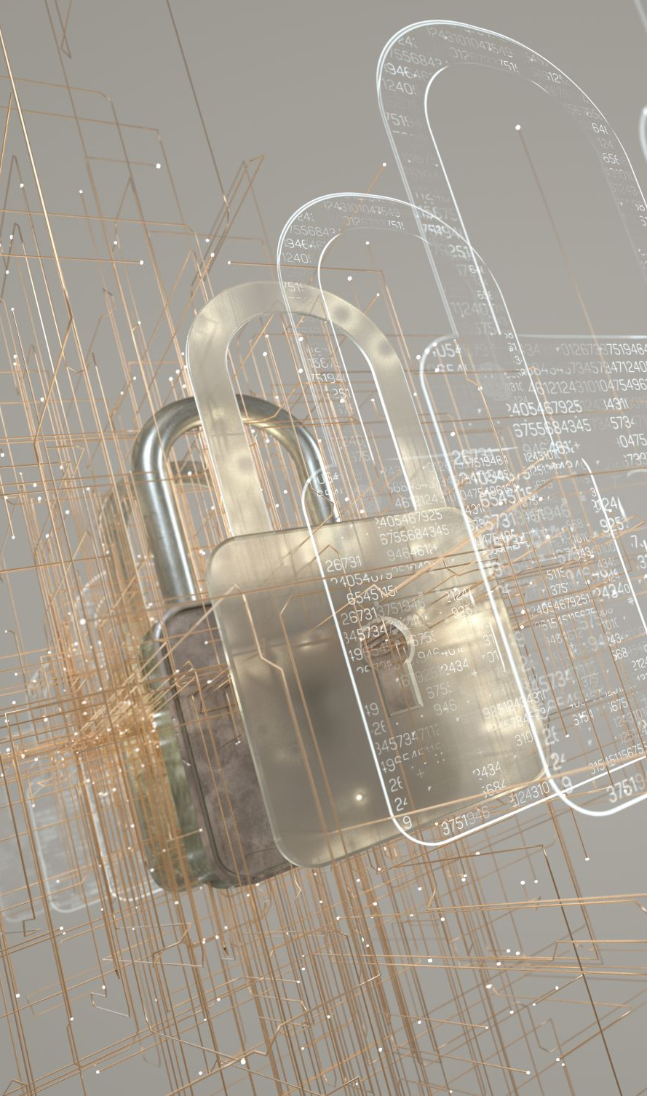
Business IT Security Overview
Key Concepts and Risks

Slide 2
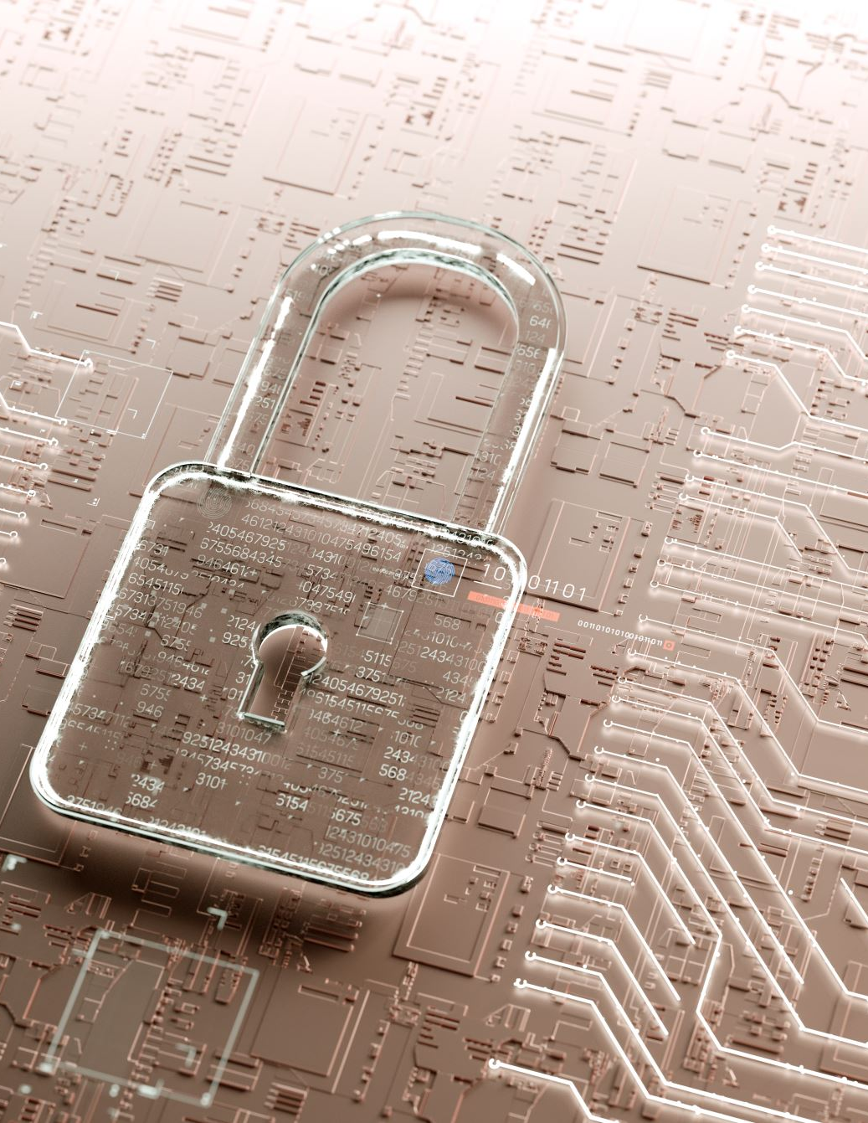
Data Security
Protection of digital information from unauthorized access, corruption, or theft.

Slide 3

Unauthorized Access
Gaining access to systems or data without permission.

Slide 4
Computer Theft
Stealing physical devices or digital information.

Slide 5

Worms
Self-replicating malware that spreads across networks.

Slide 6

Viruses
Malicious programs that attach to files and require user action to spread.

Slide 7
Trojan Horses
Malware disguised as legitimate software.

Slide 8
Preventing Problems
Use antivirus software, firewalls, updates, and employee training.

Slide 9
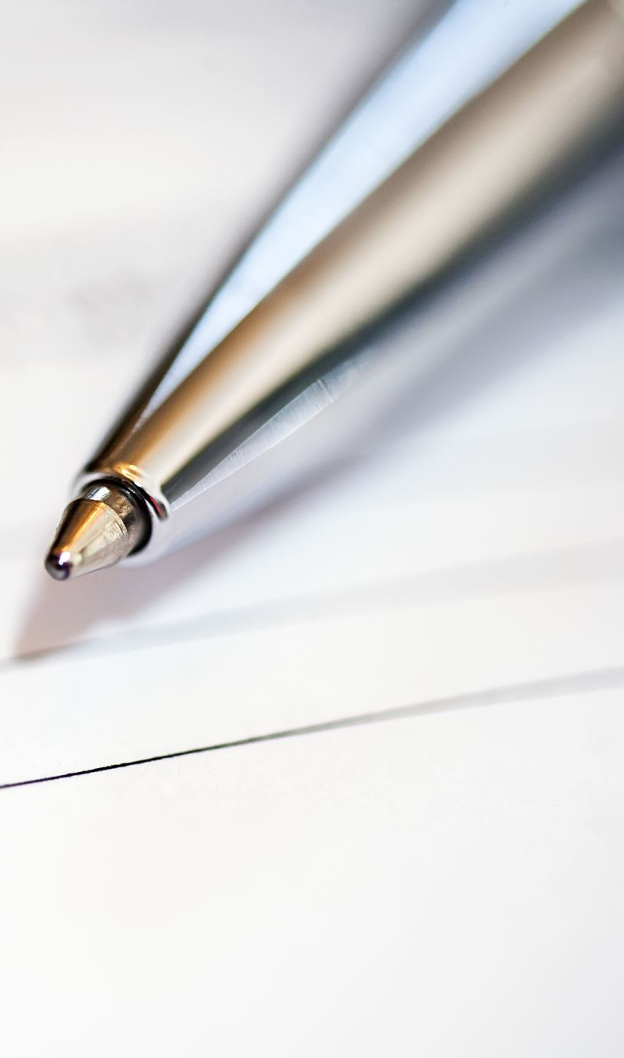
Security Policy
Formal rules defining how information and systems are protected.

Slide 10

Passwords
Strong, unique passwords help protect accounts and data.

Slide 11
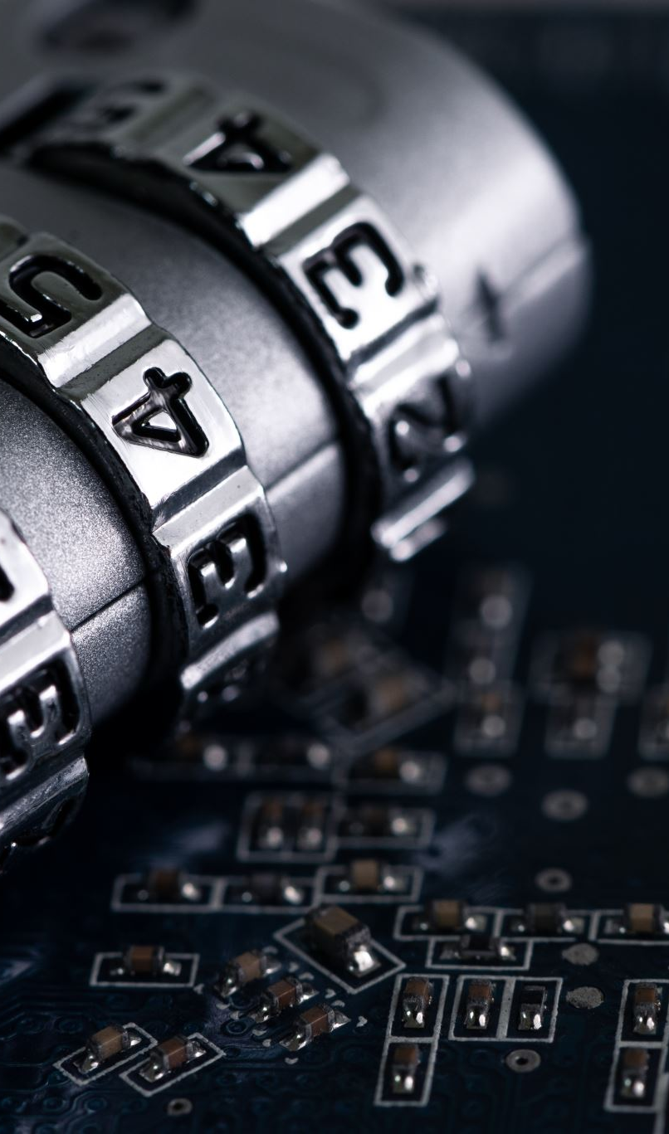
Procedures to Protect IT Assets
Access controls, backups, encryption, and physical security.

Slide 12

Financial Fraud
Illegal actions to gain financial benefits using deception.

Slide 13
Security Breaches
Incidents where protected data is accessed or exposed.

Slide 14

Keylogging Software
Programs that record keystrokes to steal information.

Slide 15
Spam
Unsolicited messages often used for scams or malware.

Slide 16
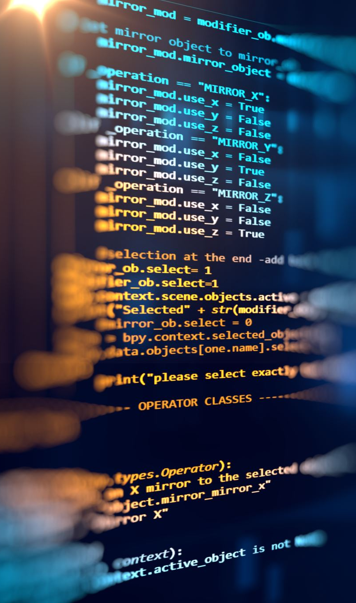
Software & Media Piracy
Illegal copying or distribution of software and media.

Slide 17

Data Mining
Analyzing large data sets to discover patterns and trends.

