Slide 1
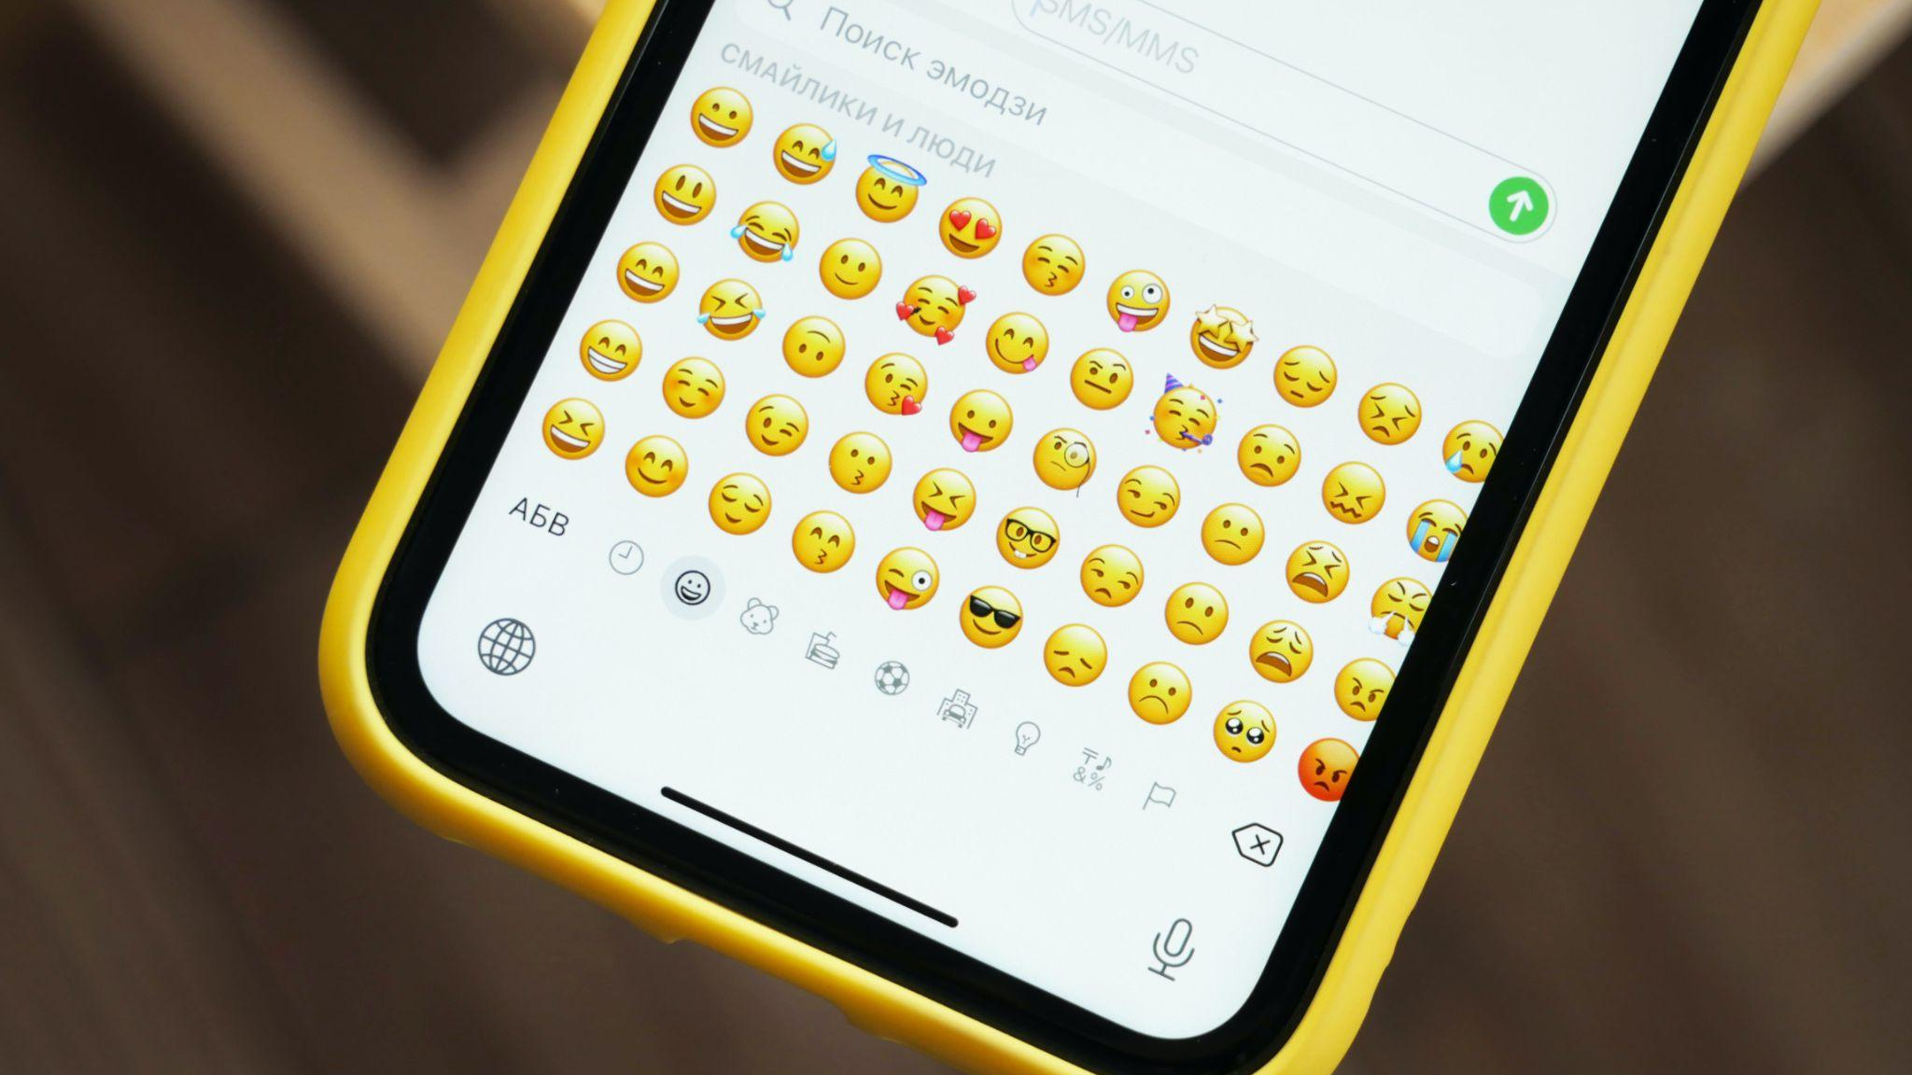



Target Lesson
Analyzing Connections
Emoji Evolution
“Untitled” by Denis Cherkashin is licensed under CC0.
Unless otherwise noted, this content is licensed under the CC BY-NC-SA 4.0 license by CommonLit.

Slide 2

LESSON OVERVIEW: TODAY’S AGENDA
Today you’ll read about the history of emoji and practice analyzing connections between events, people, and ideas.
Today’s Agenda:
Part 1 - Warm-Up: Writing
Part 2 - Video Introducing the Target Skill:
Analyzing Connections
Part 3 - Review the Target Skill
Part 4 - Reading and Answering Questions
Part 5 - Assessment

Slide 3
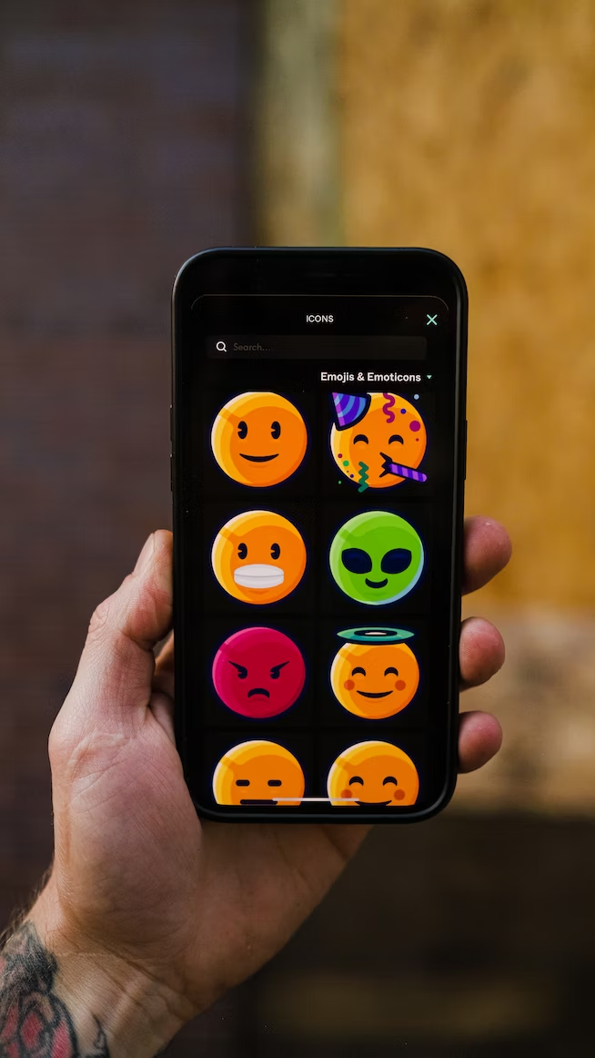
PART 1: WARM-UP: WRITING
Directions: Look at the picture and answer the questions.
Today you’re going to learn about how emoji have changed over the years.
What is your favorite emoji? Why is it your favorite? Explain your answer.
Take 3 minutes to write down your ideas.
Emoji are popular symbols to share how we feel or what we are thinking.
“Untitled” by Typerium App is licensed under CC0.

Slide 4
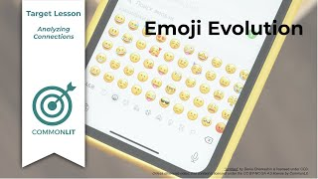
PART 2: VIDEO INTRODUCING THE TARGET SKILL
Directions: Watch the video and then answer the question.
What connections do authors usually make in a nonfiction article?

Slide 5
PART 3: REVIEW THE TARGET SKILL
As you read, you’ll analyze how key people, events, and ideas are connected to the history of emoji.
People
Events
Ideas
The history of emoji
connect

Slide 6
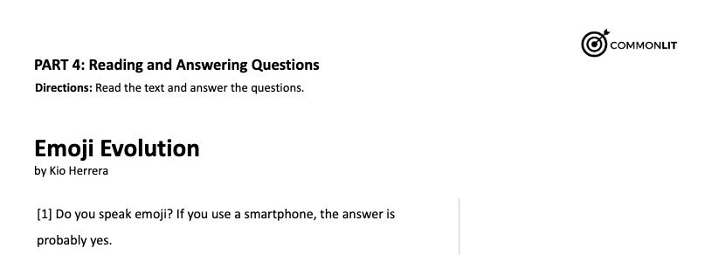
PART 4: READING AND ANSWERING QUESTIONS
Let’s start reading “Emoji Evolution”

